Slide 1
Spinal Nerves

Slide 2
13.5 Spinal Nerves
31 pairs of spinal nerves
All are mixed nerves named for point of issue from spinal cord
Supply all body parts except head and part of neck
8 pairs of cervical nerves (C₁–C₈)
12 pairs of thoracic nerves (T₁–T₁₂)
5 pairs of lumbar nerves (L₁–L₅)
5 pairs of sacral nerves (S₁–S₅)
1 pair of tiny coccygeal nerves (C₀)

Slide 3
13.5 Spinal Nerves
7 cervical vertebrae give rise to 8 pairs of cervical spinal nerves because:
Each of the first 7 pairs (C₁ to C₇) exits the vertebral canal superior to vertebra for which it is named
Last spinal nerve (C₈) exits canal inferior to C₇
So vertebra C₇ has a nerve that leaves above it and one that leaves below it
Each of the other spinal nerves exits inferior to vertebra for which it is named

Slide 4
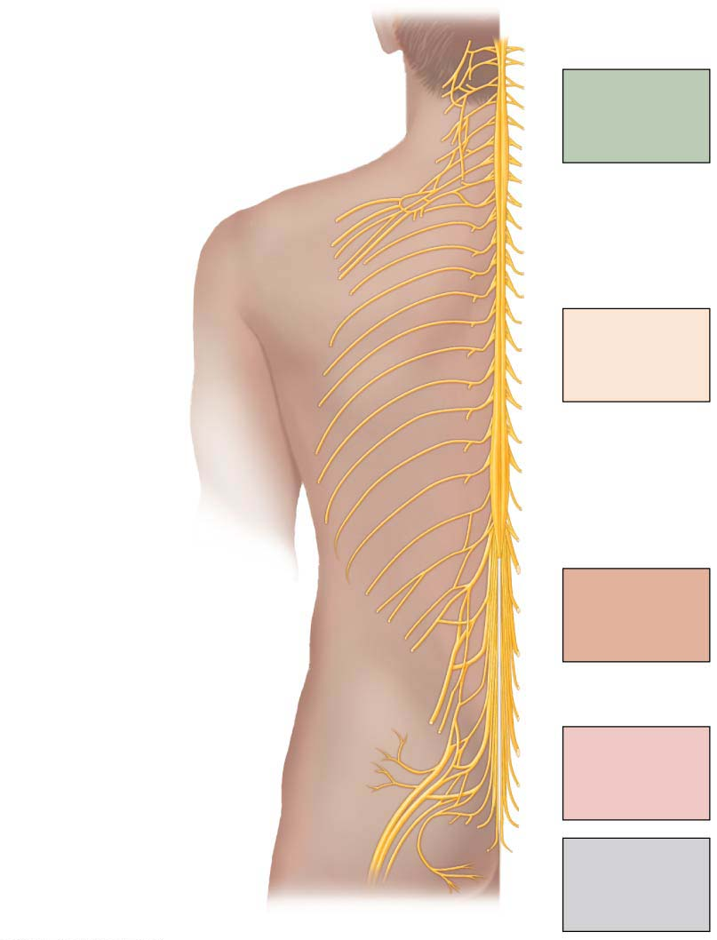
Figure 13.7 Spinal nerves.
Cervical plexus
Cervical
nerves
C₁ – C₈
Brachial plexus
Cervical
enlargement
Intercostal
nerves
Thoracic
nerves
T₁ – T₁₂
Lumbar
enlargement
Lumbar plexus
Lumbar
nerves
L₁ – L₅
Sacral plexus
Sacral
nerves
S₁ – S₅
Cauda equina
Coccygeal
nerve
Co₁

Slide 5
13.5 Spinal Nerves
Each spinal nerve is connected to spinal cord via two roots:
Ventral roots
Contain motor (efferent) fibers from ventral horn motor neurons that innervate skeletal muscles
Dorsal roots
Contain sensory (afferent) fibers from sensory neurons in dorsal root ganglia that conduct impulses from peripheral receptors
Both ventral and dorsal roots are branched medially as rootlets that then join laterally to form spinal nerve

Slide 6
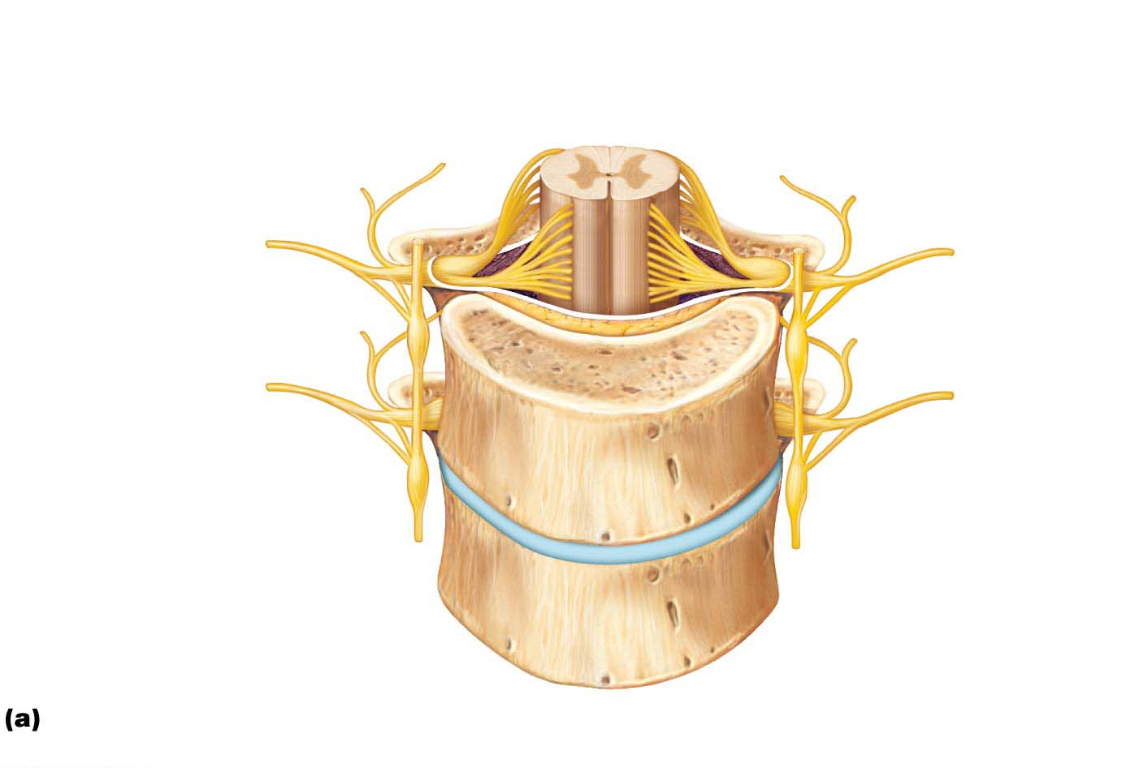
Figure 13.8a Formation of spinal nerves and rami distribution.
Gray matter
White matter
Ventral root
Dorsal and ventral
rootlets of spinal
nerve
Dorsal root
Dorsal root
ganglion
Dorsal ramus
of spinal nerve
Ventral ramus
of spinal nerve
Spinal nerve
Rami communicantes
Sympathetic trunk
ganglion
Anterior view showing spinal cord, associated nerves, and vertebrae. The dorsal
and ventral roots arise medially as rootlets and join laterally to form the spinal nerve.

Slide 7
13.5 Spinal Nerves
Spinal nerves emerge from vertebral column via their respective intervertebral foramina
Spinal roots become progressively longer superiorly to inferiorly down cord
Lumbar and sacral roots are very long and extend through lower vertebral canal as cauda equina

Slide 8
13.5 Spinal Nerves
Spinal nerves are quite short (~1–2 cm)
Almost immediately after exiting foramen, spinal nerves divide into three branches:
Dorsal ramus: smaller branch
Ventral ramus: larger branch
Meningeal branch: tiny branch that reenters vertebral canal to innervate meninges and blood vessels
Rami communicantes contain autonomic nerve fibers that join ventral rami in thoracic region

Slide 9
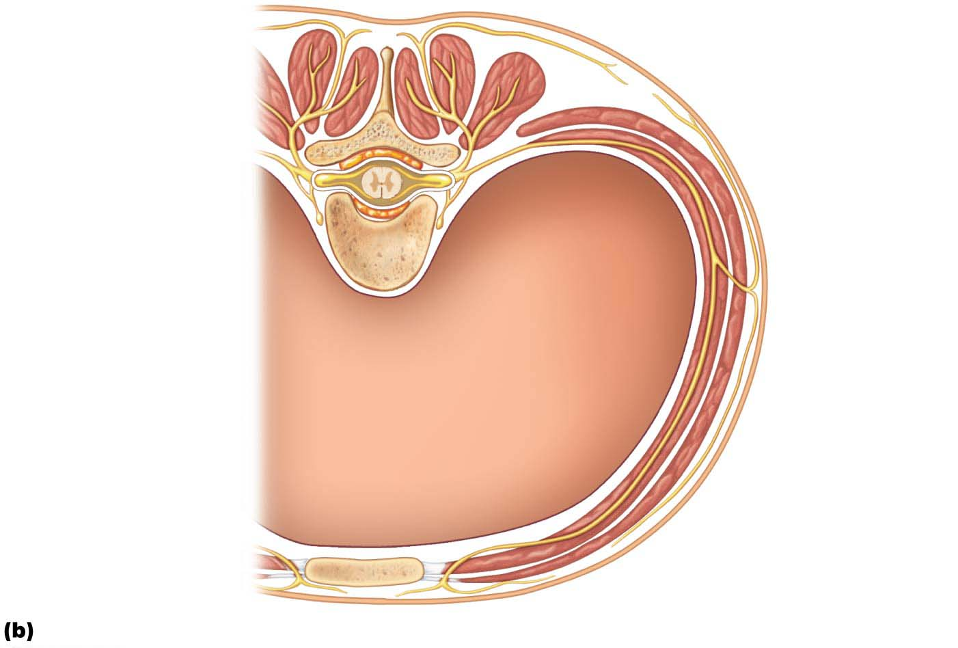
Figure 13.8b Formation of spinal nerves and rami distribution.
Dorsal ramus
Ventral ramus
Spinal nerve
Rami communicantes
Sympathetic trunk
ganglion
Intercostal nerve
Dorsal root ganglion
Dorsal root
Ventral root
Branches of intercostal nerve
Lateral cutaneous
Anterior
cutaneous
Sternum
Cross section of thorax showing the main roots and branches of a spinal nerve.

Slide 10
Innervation of Specific Body Regions
Spinal nerve rami and their main branches supply entire somatic region of body from neck down
Dorsal rami supply posterior body trunk
Ventral rami supply rest of trunk and limbs
Difference between roots and rami:
Roots lie medial to and form spinal nerves
Each root is purely sensory or motor
Rami lie distal to and are lateral branches of spinal nerves
Can carry both sensory and motor

Slide 11
Innervation of Specific Body Regions (cont.)
All ventral rami except T₂–T₁₂ form interlacing nerve networks called nerve plexuses
Found in cervical, brachial, lumbar, and sacral areas
Only ventral rami form plexuses
Within plexus, fibers crisscross so that:
Each branch contains fibers from several different spinal nerves

Slide 12
Innervation of Specific Body Regions (cont.)
Fibers from ventral ramus go to body periphery via several routes
Means each limb muscle is innervated by more than one spinal nerve, so damage to one does not cause paralysis

Slide 13
Innervation of Specific Body Regions (cont.)
Cervical plexus and the neck
First four ventral rami (C₁–C₄) form looping cervical plexus
Most branches of this form cutaneous nerves
Innervate skin of neck, ear, back of head, and shoulders
Other branches innervate neck muscles
Phrenic nerve
Major motor and sensory nerve of diaphragm, major muscles for breathing
Phrenic nerve receives fibers from C₃ to C₅

Slide 14
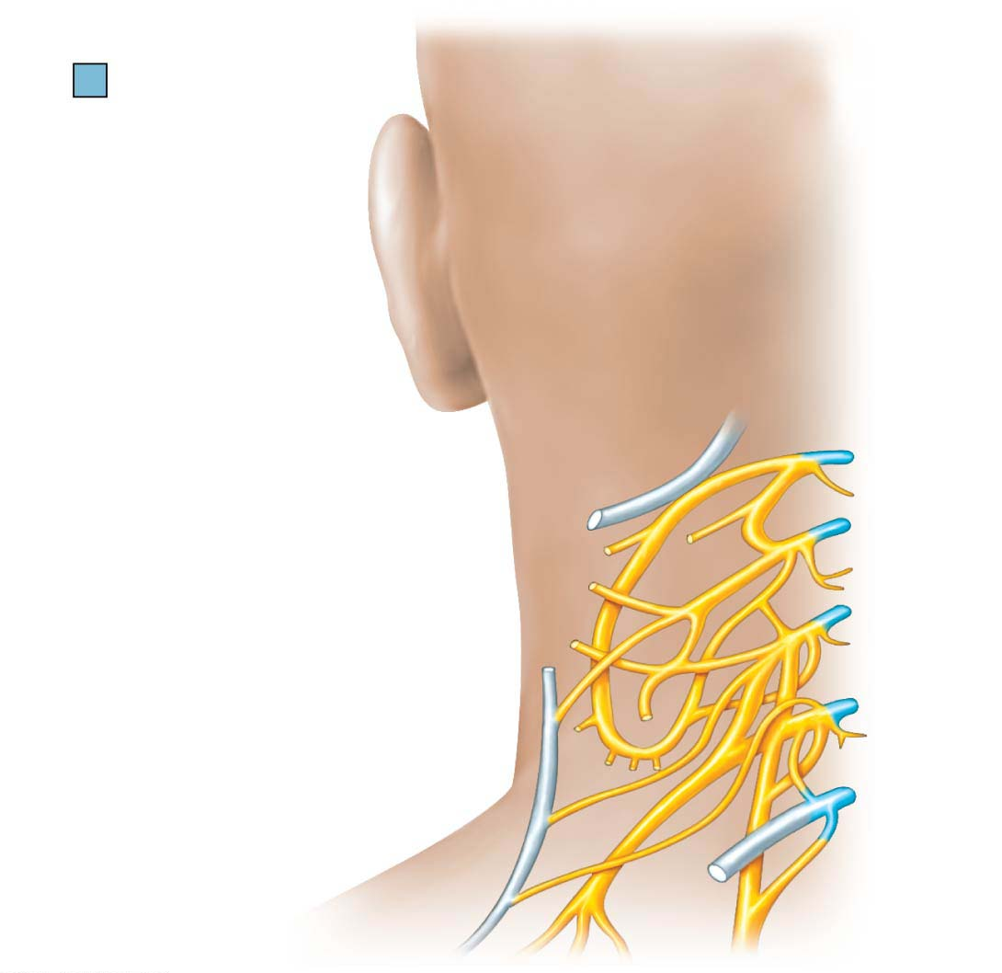
Figure 13.9 The cervical plexus.
Ventral rami
Segmental
branches
Hypoglossal
nerve (XII)
Lesser occipital
nerve
Ventral
rami:
C₁
Greater auricular
nerve
C₂
Transverse
cervical nerve
C₃
Ansa cervicalis
C₄
Accessory nerve (XI)
C₅
Phrenic nerve
Supraclavicular
nerves

Slide 15
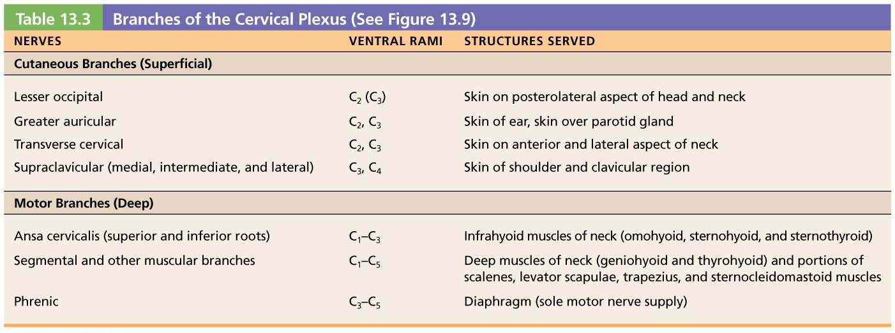
Table 13.3 Branches of the Cervical Plexus (See Figure 13.9)

Slide 16
Clinical – Homeostatic Imbalance 13.2
Irritation of the phrenic nerve causes spasms of the diaphragm, also called hiccups
If both phrenic nerves are severed, or if C₃–C₅ region of spinal cord is destroyed, diaphragm becomes paralyzed
Respiratory arrest occurs
Victim requires mechanical respirators to stay alive
Air is mechanically forced into the lungs—literally breathing for them

Slide 17
Innervation of Specific Body Regions (cont.)
Brachial plexus and upper limb
Formed by ventral rami of C₅–C₈ and T₁ (and often C₄ and/or T₂)
Gives rise to nerves that innervate upper limb
Four major branches of this plexus:
Roots—five ventral rami (C₅–T₁) unite to form…
Trunks—upper, middle, and lower, which unite to form…
Divisions—anterior and posterior, which unite to form …
Cords—lateral, medial, and posterior

Slide 18
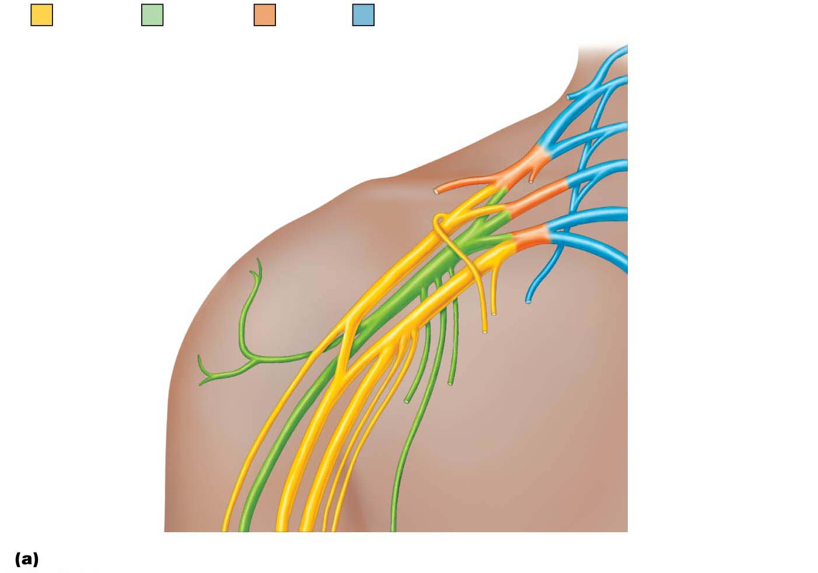
Figure 13.10a The brachial plexus.
Anterior
divisions
Posterior
divisions
Trunks
Roots
Roots (ventral rami):
C₄
Dorsal scapular
Nerve to
subclavius
C₅
C₆
Suprascapular
Upper
Posterior
divisions
C₇
Middle
Trunks
Lateral
C₈
Lower
Cords
Posterior
T₁
Long thoracic
Medial
Medial pectoral
Lateral pectoral
Axillary
Upper subscapular
Musculo-
cutaneous
Lower subscapular
Radial
Thoracodorsal
Median
Medial cutaneous
nerves of the arm
and forearm
Ulnar
Roots (rami C₅–T₁), trunks, divisions, and cords

Slide 19
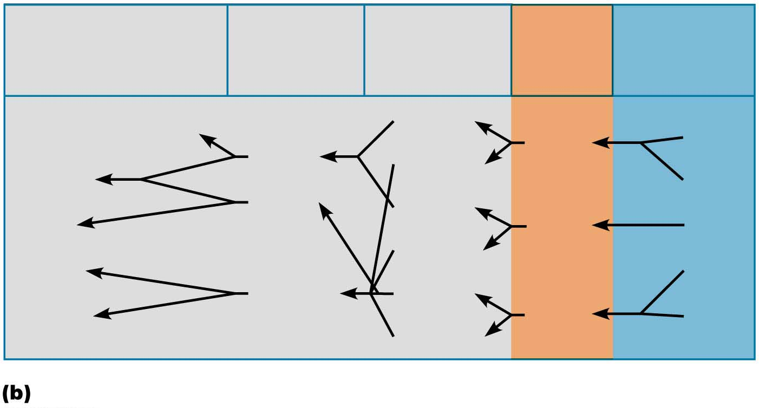
Figure 13.10b The brachial plexus.
Major terminal
branches
(peripheral nerves)
Roots
(ventral
rami)
Cords
Divisions
Trunks
Musculocutaneous
Anterior
Upper
C₅
Lateral
Posterior
Median
C₆
Medial
Anterior
Ulnar
Middle
C₇
Posterior
Radial
C₈
Posterior
Anterior
Axillary
Lower
T₁
Posterior
Flowchart summarizing relationships within the brachial plexus

Slide 20
Innervation of Specific Body Regions (cont.)
Cords of brachial plexus give rise to nerves of the upper limb, five of most important being:
Axillary: innervates deltoid, teres minor, and skin and joint capsule of shoulder
Musculocutaneous: innervates biceps brachii and brachialis, coracobrachialis, and skin of lateral forearm
Median: innervates skin, most flexors, forearm pronators, wrist and finger flexors, thumb opposition muscles

Slide 21
Innervation of Specific Body Regions (cont.)
Brachial plexus and upper limb (cont.)
Ulnar: supplies flexor carpi ulnaris, part of flexor digitorum profundus, most intrinsic hand muscles, skin of medial aspect of hand, wrist/finger flexion
Radial: innervates essentially all extensor muscles, supinators, and posterior skin of limb

Slide 22
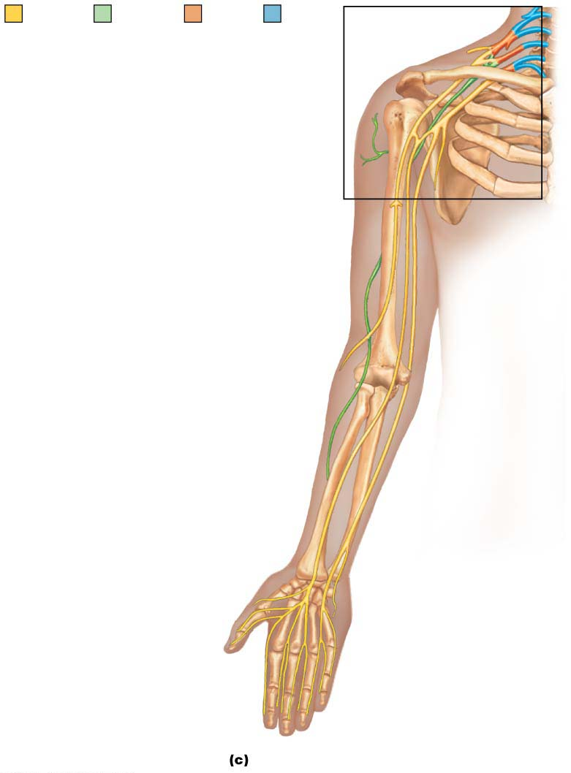
Figure 13.10c The brachial plexus.
Anterior
divisions
Posterior
divisions
Trunks
Roots
Axillary nerve
Humerus
Radial
nerve
Musculo-
cutaneous
nerve
Ulna
Radius
Ulnar nerve
Median
nerve
Radial nerve
(superficial
branch)
Dorsal branch
of ulnar nerve
Superficial branch
of ulnar nerve
Digital branch
of ulnar nerve
Muscular
branch
Digital
branch
Median
nerve
The major nerves of the upper limb

Slide 23
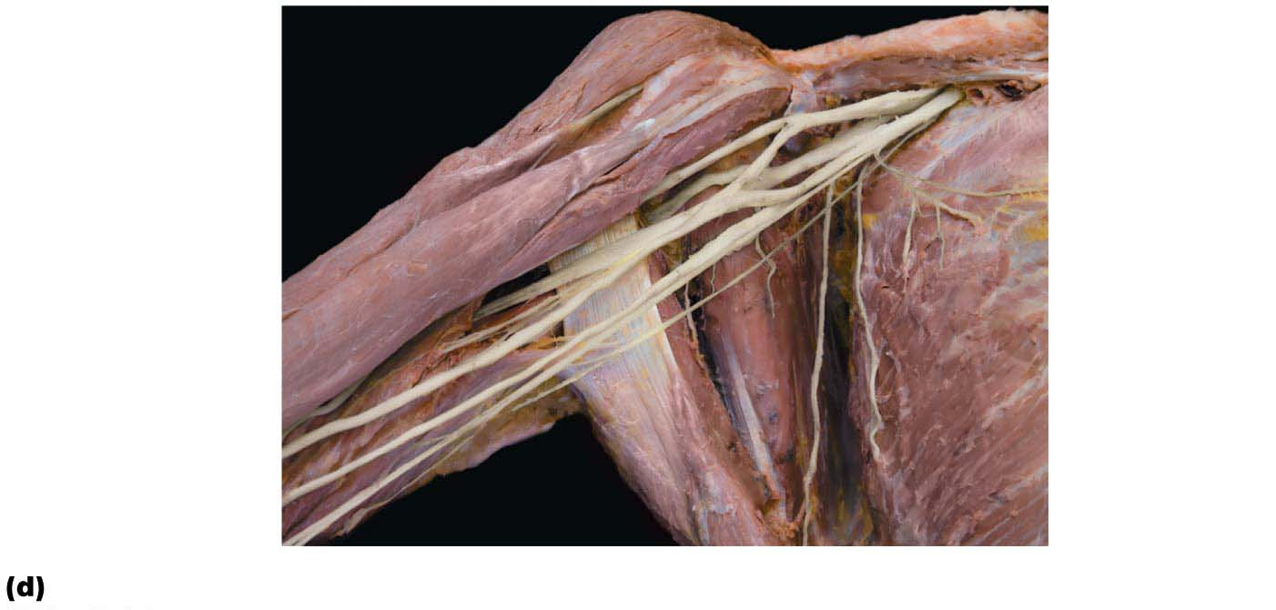
Figure 13.10d The brachial plexus.
Musculocutaneous
nerve
Lateral cord
Posterior cord
Axillary nerve
Medial cord
Radial nerve
Median nerve
Ulnar nerve
Cadaver photo

Slide 24
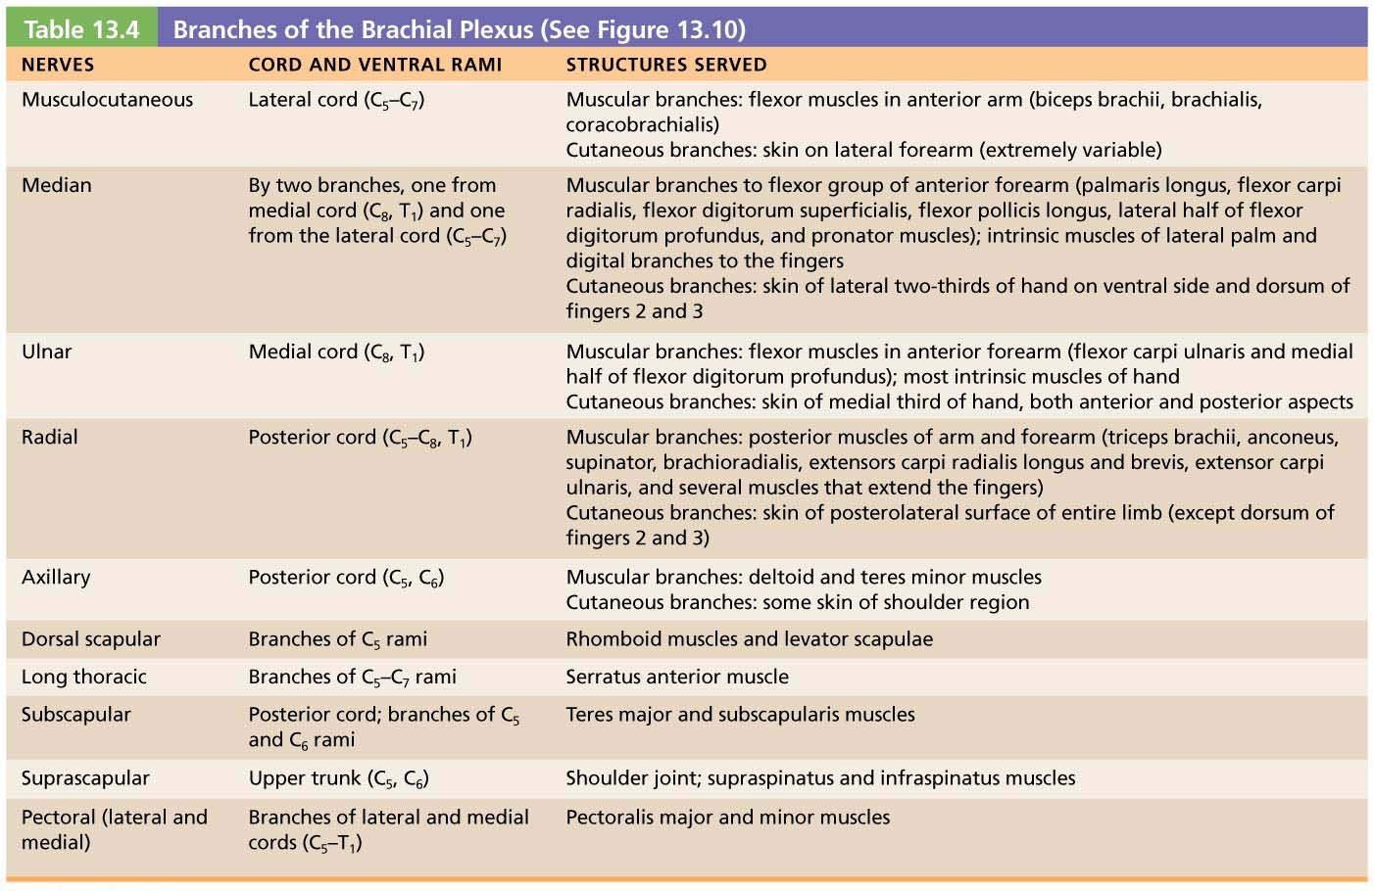
Table 13.4 Branches of the Brachial Plexus (See Figure 13.10)

Slide 25
Clinical – Homeostatic Imbalance 13.3
Injuries to brachial plexus are common
Severe injuries can weaken or paralyze entire upper limb
Injuries may occur if upper limb is pulled too hard, stretching plexus
Example: when football tackler yanks arm of running back
Blows to top of shoulder can force humerus inferiorly

Slide 26
Clinical – Homeostatic Imbalance 13.4
Injury to median nerve makes it difficult to use pincer grasp (opposed thumb and index finger) to pick up small objects
Seen in carpal tunnel syndrome, when median nerve is compressed
Also, frequent casualty of wrist-slashing suicide attempts

Slide 27
Clinical – Homeostatic Imbalance 13.5
Ulnar nerve is very vulnerable to injury
Severe or chronic damage to ulnar nerve can lead to sensory loss, paralysis, and muscle atrophy
Affected individuals have trouble making a fist and gripping objects
Little and ring fingers become hyperextended at the knuckles and flexed at distal interphalangeal joints
Causes hand to contort into a clawhand
Striking the “funny bone,” the spot where this nerve rests against medial epicondyle, can make the little finger tingle.

Slide 28
Clinical – Homeostatic Imbalance 13.6
Trauma to the radial nerve results in wrist drop, inability to extend the hand at the wrist
Improper use of a crutch can compress radial nerve and impair its blood supply
“Saturday night paralysis”: An intoxicated person falls asleep with an arm draped over the back of a chair or sofa edge, cutting off blood supply to radial nerve

Slide 29
Innervation of Specific Body Regions (cont.)
Lumbosacral plexus and lower limb
Lumbar and sacral plexuses have significant overlap
Fibers of lumbar plexus contribute to sacral plexus via lumbosacral trunk
Lumbosacral plexus serves mostly lower limb, but also sends some branches to abdomen, pelvis, and buttocks

Slide 30
Innervation of Specific Body Regions (cont.)
Lumbar plexus
Arises from L₁ to L₄
Innervates thigh, abdominal wall, and psoas muscle
Femoral nerve: innervates quadriceps and skin of anterior thigh and medial surface of leg
Obturator nerve: passes through obturator foramen to innervate adductor muscles

Slide 31
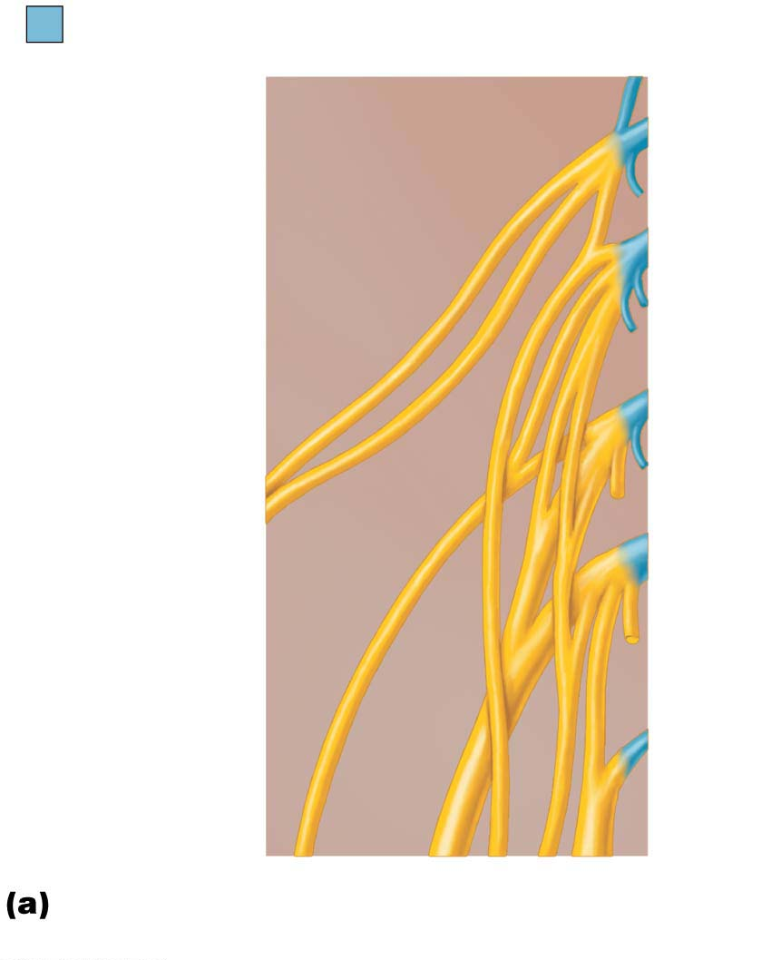
Figure 13.11a The lumbar plexus.
Ventral rami
Ventral
rami:
L₁
L₂
Iliohypogastric
Ilioinguinal
Genitofemoral
L₃
Lateral femoral
cutaneous
L₄
Obturator
Femoral
L₅
Lumbosacral
trunk
Ventral rami and major branches of
the lumbar plexus

Slide 32
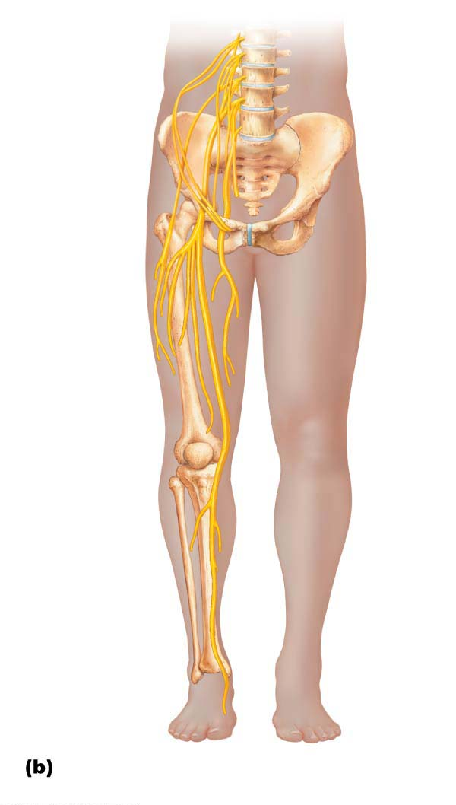
Figure 13.11b The lumbar plexus.
Iliohypogastric
Ilioinguinal
Femoral
Lateral
femoral
cutaneous
Obturator
Anterior
femoral
cutaneous
Saphenous
Distribution of the major nerves from
the lumbar plexus to the lower limb

Slide 33
Innervation of Specific Body Regions (cont.)
Sacral plexus
Arises from L₄ to S₄
Serves the buttock, lower limb, pelvic structures, and perineum
Sciatic nerve
Longest and thickest nerve of body
Innervates hamstring muscles, adductor magnus, and most muscles in leg and foot
Composed of two nerves: tibial and common fibular

Slide 34
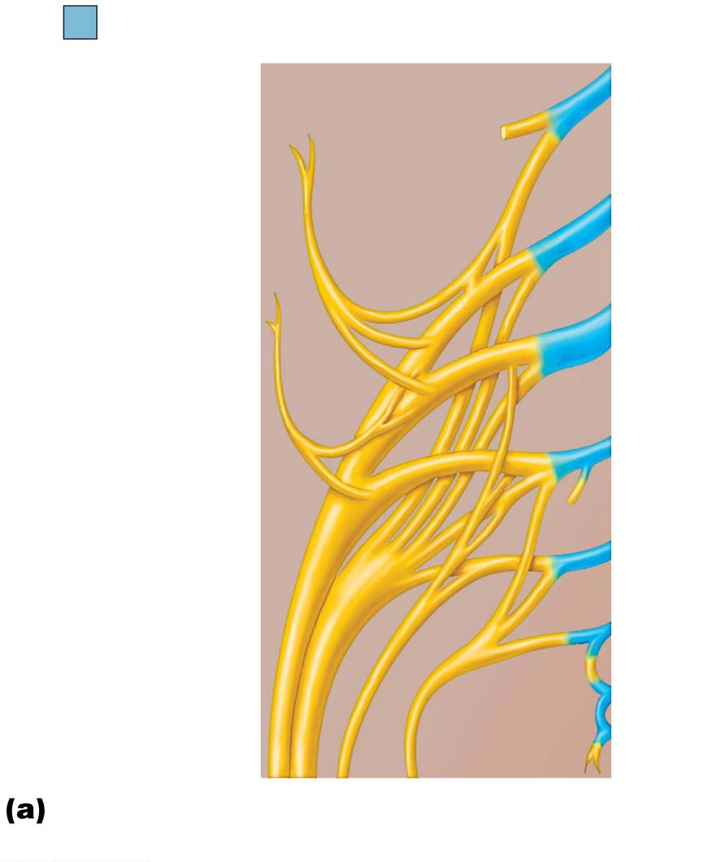
Figure 13.12a The sacral plexus.
Ventral rami
Ventral
rami:
L₄
Superior
gluteal
L₅
Lumbosacral
trunk
Inferior
gluteal
S₁
Common
fibular
S₂
Tibial
Posterior
femoral
cutaneous
S₃
S₄
Pudendal
S₅
Sciatic
Co₁
Ventral rami and major branches
of the sacral plexus

Slide 35
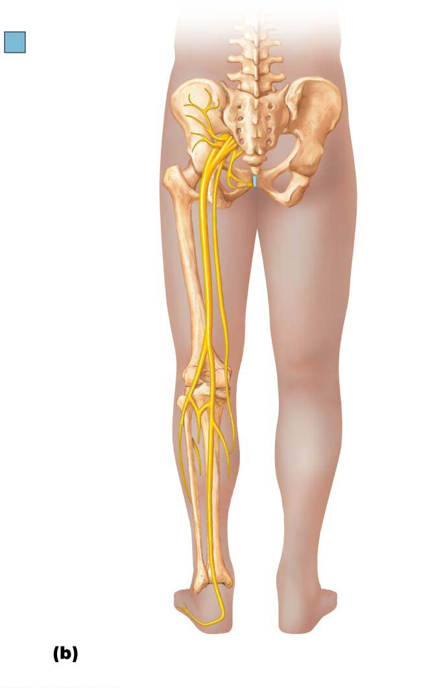
Figure 13.12b The sacral plexus.
Ventral rami
Superior
gluteal
Inferior
gluteal
Pudendal
Sciatic
Posterior
femoral
cutaneous
Common
fibular
Tibial
Sural (cut)
Deep
fibular
Superficial
fibular
Plantar
branches
Distribution of the major nerves from
the sacral plexus to the lower limb

Slide 36
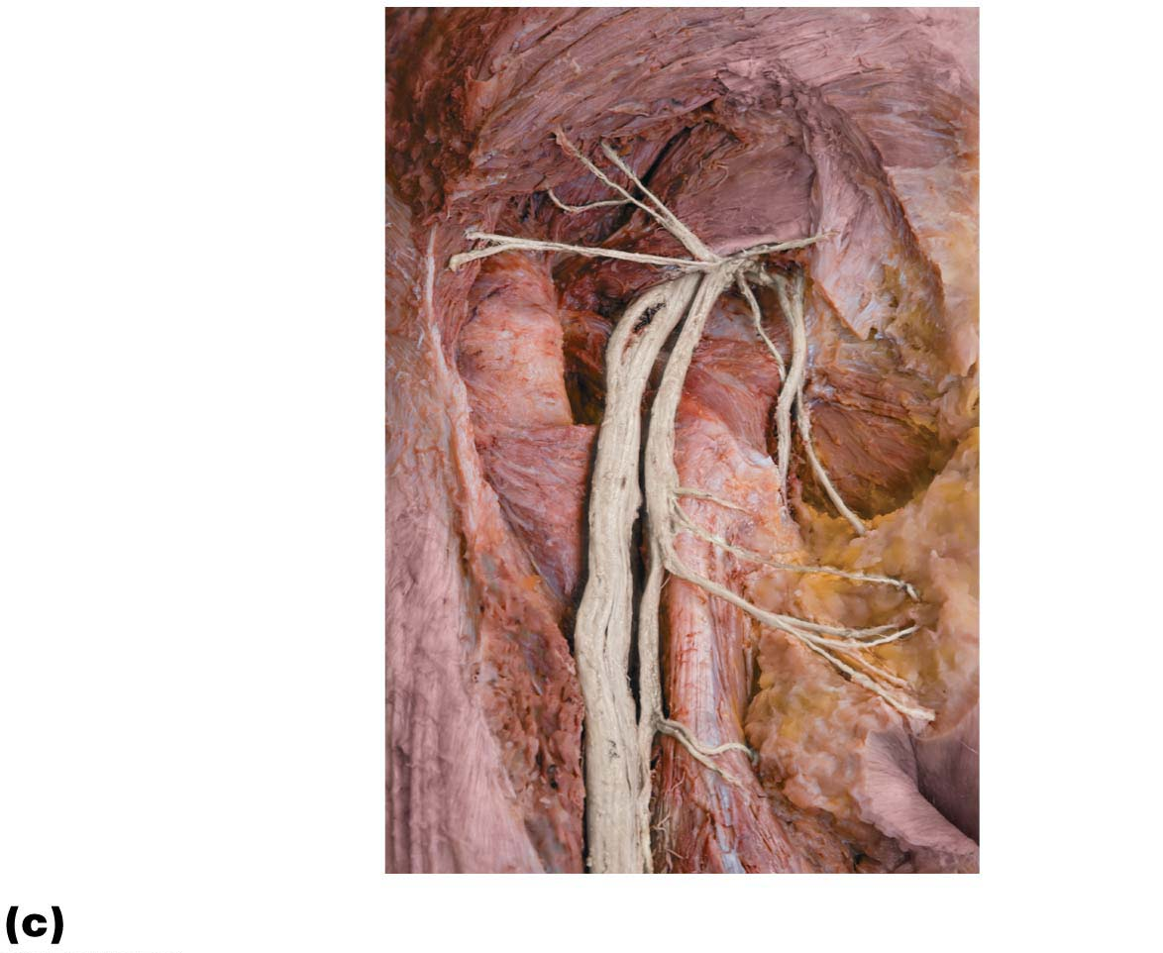
Figure 13.12c The sacral plexus.
Gluteus maximus
Piriformis
Inferior gluteal
nerve
Common fibular
nerve
Tibial nerve
Pudendal nerve
Posterior femoral
cutaneous nerve
Sciatic nerve
Dissection of the gluteal region, posterior view

Slide 37
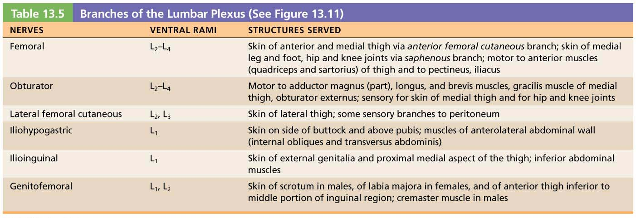
Table 13.5 Branches of the Lumbar Plexus (See Figure 13.11)

Slide 38
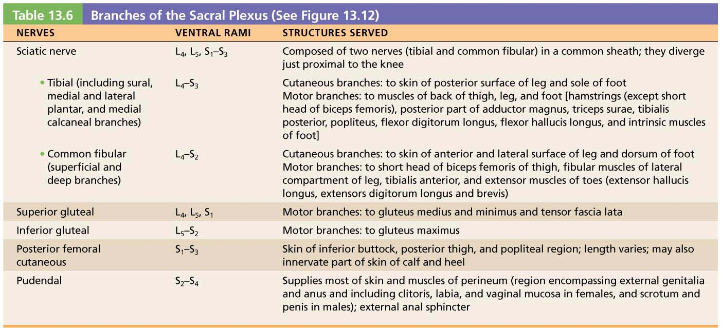
Table 13.6 Branches of the Sacral Plexus (See Figure 13.12)

Slide 39
Clinical – Homeostatic Imbalance 13.7
When spinal roots of lumbar plexus are compressed, gait problems occur
Other symptoms are pain or numbness of the anterior thigh
Femoral nerve serves prime movers that flex hip and extend knee
Damage can be caused by a herniated disc
If obturator nerve is impaired, person experiences pain in the medial thigh

Slide 40
Clinical – Homeostatic Imbalance 13.8
Sciatica, a common problem, is characterized by stabbing pain radiating over course of the sciatic nerve
Injury could be caused by a fall, disc herniation, or badly placed injection into the buttock
If the nerve is transected, leg is nearly useless and cannot be flexed because hamstrings are paralyzed

Slide 41
Clinical – Homeostatic Imbalance 13.8
Foot and ankle cannot move at all, so foot drops into plantar flexion, a condition called footdrop
Recovery from sciatic nerve injury is usually slow and incomplete
For lesions below knee, thigh muscles are spared
If tibial nerve is injured, paralyzed calf muscles cannot plantar flex foot, and a shuffling gait develops

Slide 42
Innervation of Specific Body Regions (cont.)
Anterolateral thorax and abdominal wall
Ventral rami of T₁₂–T₁₂ are intercostal nerves that supply muscles of ribs, anterolateral thorax, and abdominal wall
Give off cutaneous branches to skin along course
Two special thoracic nerves:
Tiny T₁
T₁₂, which is a subcostal nerve

Slide 43
Innervation of Specific Body Regions (cont.)
Back
Back is innervated by dorsal rami via several branches
Each branch innervates a strip of muscle and skin in line with where it emerges from spinal cord

Slide 44
Innervation of Specific Body Regions (cont.)
Innervation of skin: dermatomes
Dermatome: area of skin innervated by cutaneous branches of single spinal nerve
All spinal nerves except C₁ participate in dermatomes
Extent of spinal cord injuries ascertained by affected dermatomes
Most dermatomes overlap, so destruction of a single spinal nerve will not cause complete numbness

Slide 45
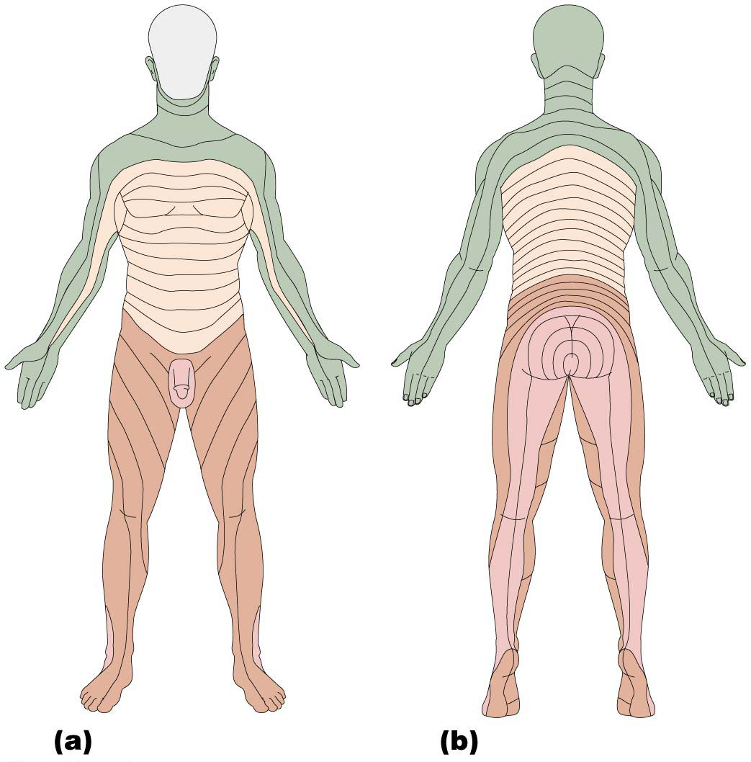
Figure 13.13 Map of dermatomes.
C2
C2
C3
C3
C4
C5
C6
C4
C7
C8
C5
T1
C5
T1
T2
T2
T3
T3
T4
T2
T4
T2
T5
T5
T6
T6
T7
T8
T7
T9
T8
C6
T10
C6
C5
T9
C5
T11
T10
C7
T12
C7
C6
T11
C6
C8
L2
S1
L1
C8
S2
L3
T12
L4
S3
L5
C6
L1
L1
C6
S4
C7
S2
C7
S5
C8
L2
S3
L2
C8
S1
S2
S2
S1
L3
L3
L1
L5
L2
L5
L4
L4
L5
L5
L3
L4
S1
S1
L4
L4
S1
L5
L5
Anterior view
Posterior view

Slide 46
Innervation of Specific Body Regions (cont.)
Innervation of joints
To remember which nerves serve which synovial joint, use:
Hilton’s law: Any nerve serving a muscle that produces movement at a joint also innervates that joint and skin over that joint

