Slide 1
Skeletal/ Muscular Systems

Slide 2
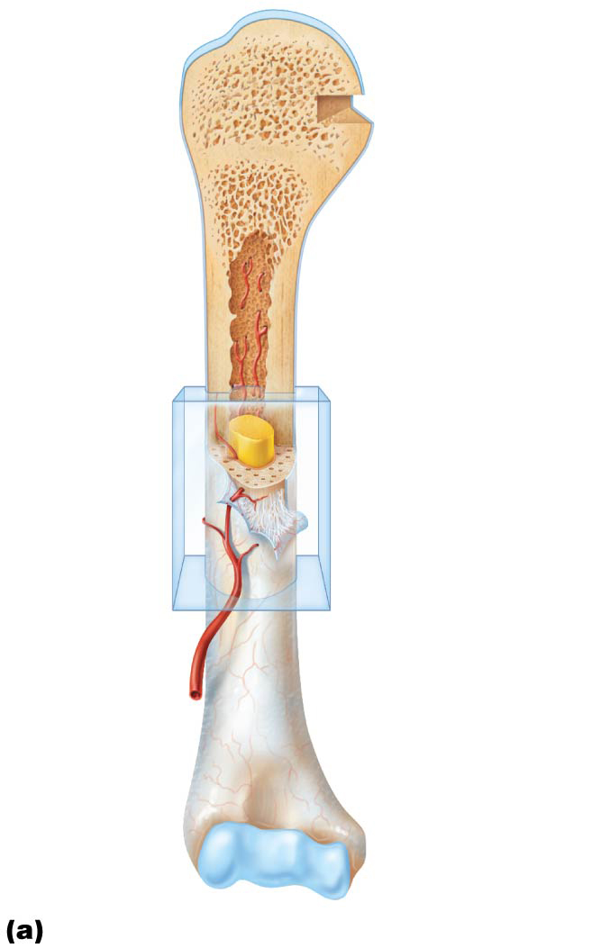
Articular
cartilage
Proximal
epiphysis
Spongy bone
Epiphyseal
line
Periosteum
Compact bone
Medullary
cavity (lined
by endosteum)
Diaphysis
Distal
epiphysis

Slide 3
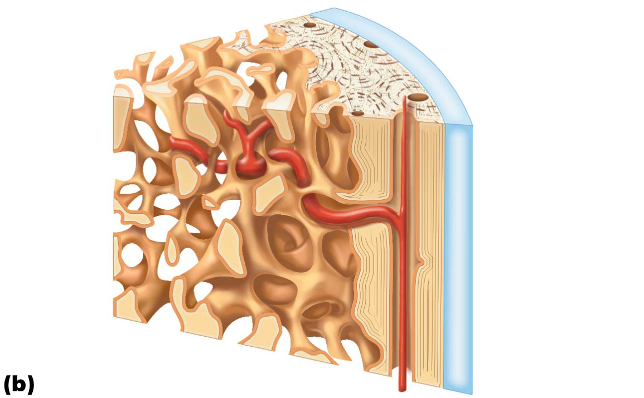
Articular
cartilage
Compact
bone
Spongy
bone
Endosteum

Slide 4
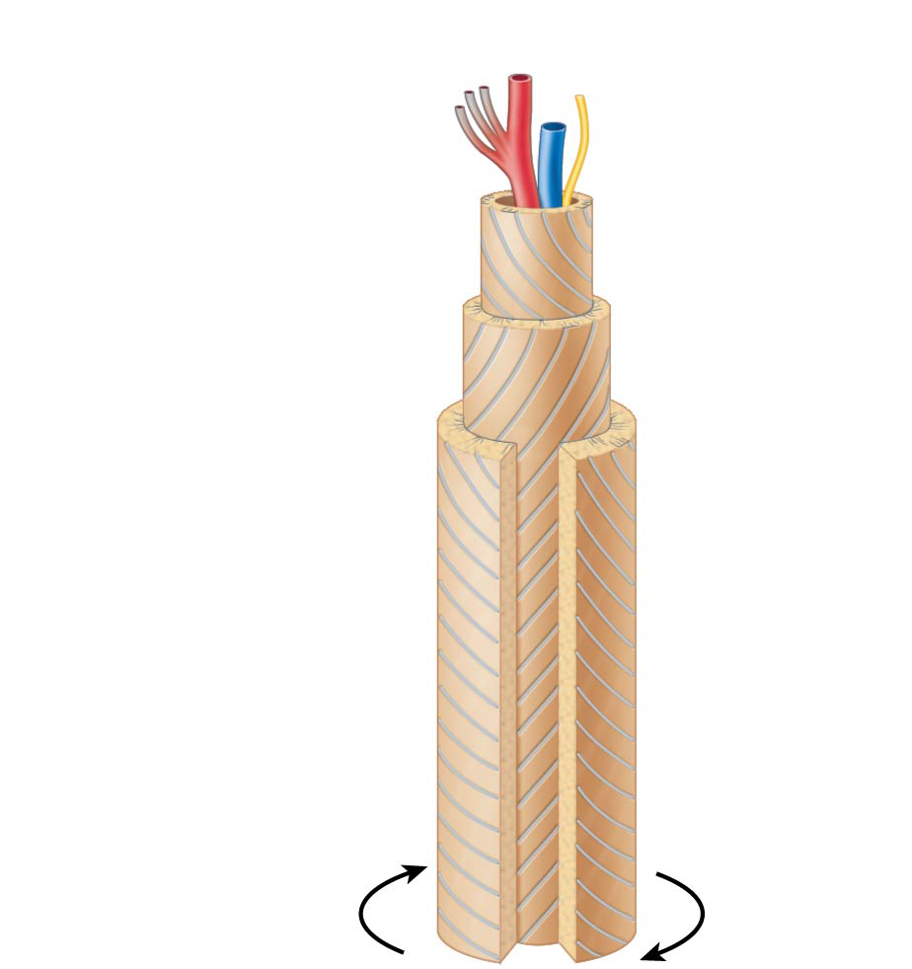
Osteon
Artery with
capillaries
Structures
in the
central
canal
Vein
Nerve fiber
Lamellae
Collagen
fibers
run in
different
directions
Twisting
force

Slide 5
6.3 Classification of Bones
Bones are also classified according to one of four shapes:
Long bones
Longer than they are wide
Limb bones
Short bones
Cube-shaped bones (in wrist and ankle)
Sesamoid bones form within tendons (example: patella)
Vary in size and number in different individuals

Slide 6
6.3 Classification of Bones
Flat bones
Thin, flat, slightly curved
Sternum, scapulae, ribs, most skull bones
Irregular bones
Complicated shapes
Vertebrae and hip bones

Slide 7
8.1 Classification of Joints
Joints, also called articulations: sites where two or more bones meet
Functions of joints: give skeleton mobility and hold skeleton together
Two classifications:
Structural: three types based on what material binds the joints and whether a cavity is present
Fibrous
Cartilaginous
Synovial

Slide 8
8.1 Classification of Joints
Functional classifications: three types based on movement joint allows
Synarthroses: immovable joints
Amphiarthroses: slightly movable joints
Diarthroses: freely movable joints

Slide 9
Synovial Joints
Plane, pivot, saddle, ball & socket, condylar….. Be able to match the correct synovial joint to an example given

Slide 10
6.5 Bone Development
Ossification (osteogenesis) is the process of bone tissue formation
Formation of bony skeleton begins in month 2 of development
Postnatal bone growth occurs until early adulthood
Bone remodeling and repair are lifelong

Slide 11
Formation of the Bony Skeleton
Up to about week 8, fibrous membranes and hyaline cartilage of fetal skeleton are replaced with bone tissue
Endochondral ossification
Bone forms by replacing hyaline cartilage
Bones are called cartilage (endochondral) bones
Form most of skeleton
Intramembranous ossification
Bone develops from fibrous membrane
Bones are called membrane bones

Slide 12
Endochondral Ossification
Endochondral ossification
Forms essentially all bones inferior to base of skull, except clavicles
Begins late in month 2 of development
Uses previously formed hyaline cartilage models
Requires breakdown of hyaline cartilage prior to ossification
Begins at primary ossification center in center of shaft
Blood vessels infiltrate perichondrium, converting it to periosteum
Mesenchymal cells specialize into osteoblasts

Slide 13
Endochondral Ossification (cont.)
Five main steps in the process of ossification:
Bone collar forms around diaphysis of cartilage model
Central cartilage in diaphysis calcifies, then develops cavities
Periosteal bud invades cavities, leading to formation of spongy bone
Bud is made up of blood vessels, nerves, red marrow, osteogenic cells, and osteoclasts
Diaphysis elongates, and medullary cavity forms
Secondary ossification centers appear in epiphyses
Epiphyses ossify
Hyaline cartilage remains only in epiphyseal plates and articular cartilages

Slide 14
Intramembranous Ossification
Intramembranous ossification: begins within fibrous connective tissue membranes formed by mesenchymal cells
Forms frontal, parietal, occipital, temporal, and clavicle bones
Four major steps are involved:
Ossification centers are formed when mesenchymal cells cluster and become osteoblasts
Osteoid is secreted, then calcified
Woven bone is formed when osteoid is laid down around blood vessels, resulting in trabeculae
Outer layer of woven bone forms periosteum
Lamellar bone replaces woven bone, and red marrow appears

Slide 15
Fracture Treatment and Repair
Repair involves four major stages:
Hematoma formation
Fibrocartilaginous callus formation
Bony callus formation
Bone remodeling

Slide 16
Fracture Treatment and Repair (cont.)
Hematoma formation
Torn blood vessels hemorrhage, forming mass of clotted blood called a hematoma
Site is swollen, painful, and inflamed

Slide 17
Fracture Treatment and Repair (cont.)
Fibrocartilaginous callus formation
Capillaries grow into hematoma
Phagocytic cells clear debris
Fibroblasts secrete collagen fibers to span break and connect broken ends
Fibroblasts, cartilage, and osteogenic cells begin reconstruction of bone
Create cartilage matrix of repair tissue
Osteoblasts form spongy bone within matrix
This mass of repair tissue is called fibrocartilaginous callus

Slide 18
Fracture Treatment and Repair (cont.)
Bony callus formation
Within one week, new trabeculae appear in fibrocartilaginous callus
Callus is converted to bony (hard) callus of spongy bone
Bony callus formation continues for about 2 months until firm union forms

Slide 19
Fracture Treatment and Repair (cont.)
Bone remodeling
Begins during bony callus formation and continues for several months
Excess material on diaphysis exterior and within medullary cavity is removed
Compact bone is laid down to reconstruct shaft walls
Final structure resembles original structure
Responds to same mechanical stressors

Slide 20
Skeletal System Terms
Compact bone, spongy bone, steoclast, osteoblast, osteocyte, lamellae, canaliculi, lacunae………

Slide 21
Bone from the description….
Be able to identify the correct bone from the description.
Ex. Bat-shaped bone in the floor of the cranium? Sphenoid
Name for the entire hip bone fused in an adult is? Os Coxa
There are 25 of these on the test

Slide 22
Bone markings….
Condyle, crest, facet,……. Be able to identify the correct bone marking from a description
There is a Quizlet on these

Slide 23
Muscular System

Slide 24
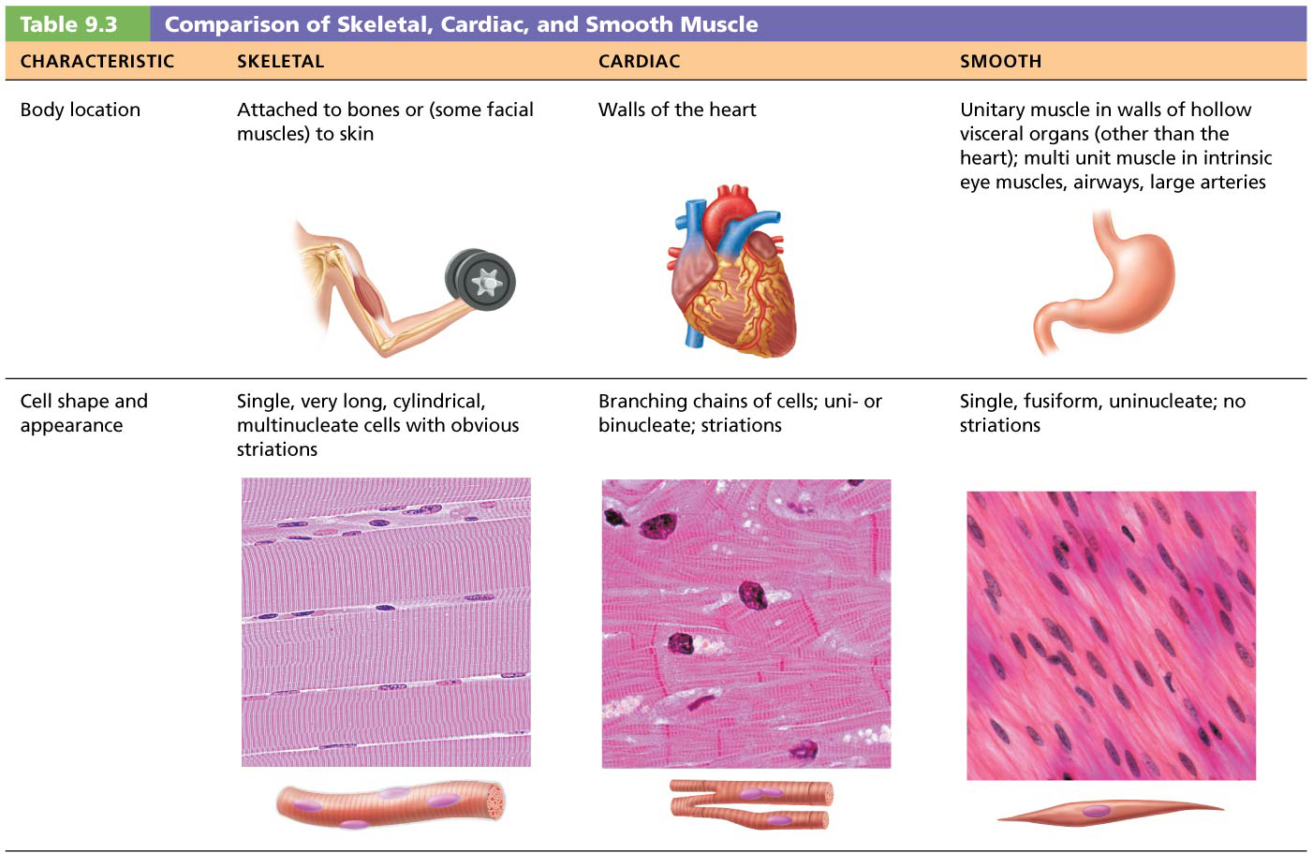

Slide 25
Connective Tissue Sheaths
Each skeletal muscle, as well as each muscle fiber, is covered in connective tissue
Support cells and reinforce whole muscle
Sheaths from external to internal:
Epimysium: dense irregular connective tissue surrounding entire muscle; may blend with fascia
Perimysium: fibrous connective tissue surrounding fascicles (groups of muscle fibers)
Endomysium: fine areolar connective tissue surrounding each muscle fiber

Slide 26
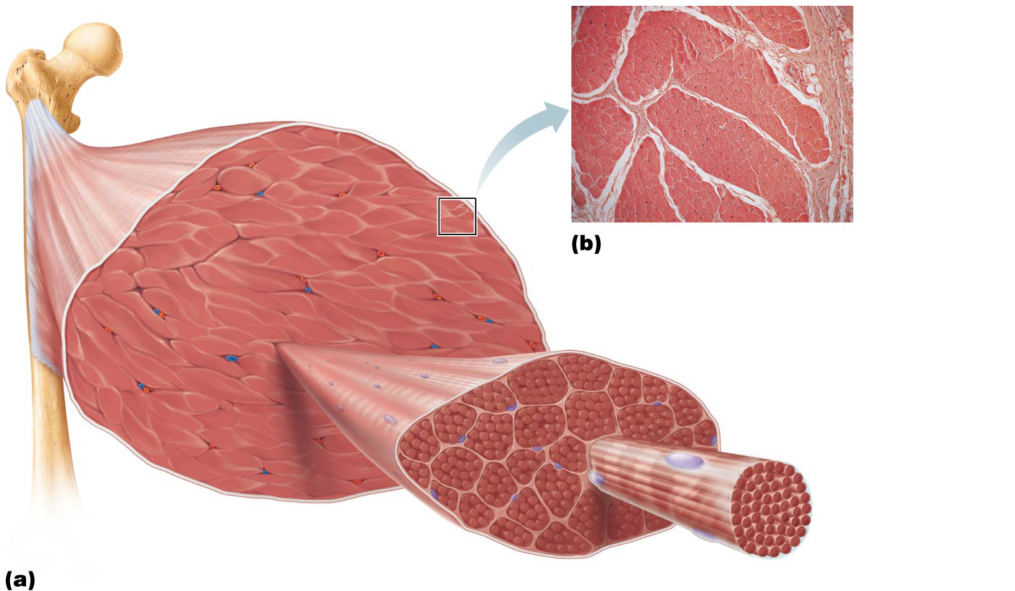
Bone
Epimysium
Epimysium
Perimysium
Tendon
Endomysium
Muscle fiber
in middle of
a fascicle
Blood vessel
Perimysium wrapping a fascicle
Endomysium
(between individual muscle fibers)
Muscle fiber
Fascicle
Perimysium

Slide 27
Sarcomere
Z disc
M line
Z disc
Thin (actin)
filament
Enlargement of
one sarcomere
(sectioned
lengthwise). Notice
the myosin heads
on the thick
filaments.
Elastic (titin)
filaments
Thick
(myosin)
filament
Cross-sectional
view of a
sarcomere cut
through in different
locations.
Myosin
filament
Actin
filament
I band
thin filaments
only
H zone
thick
filaments
only
M line
thick filaments
linked by
accessory
proteins
Outer edge
of A band
thick and thin
filaments overlap

Slide 28
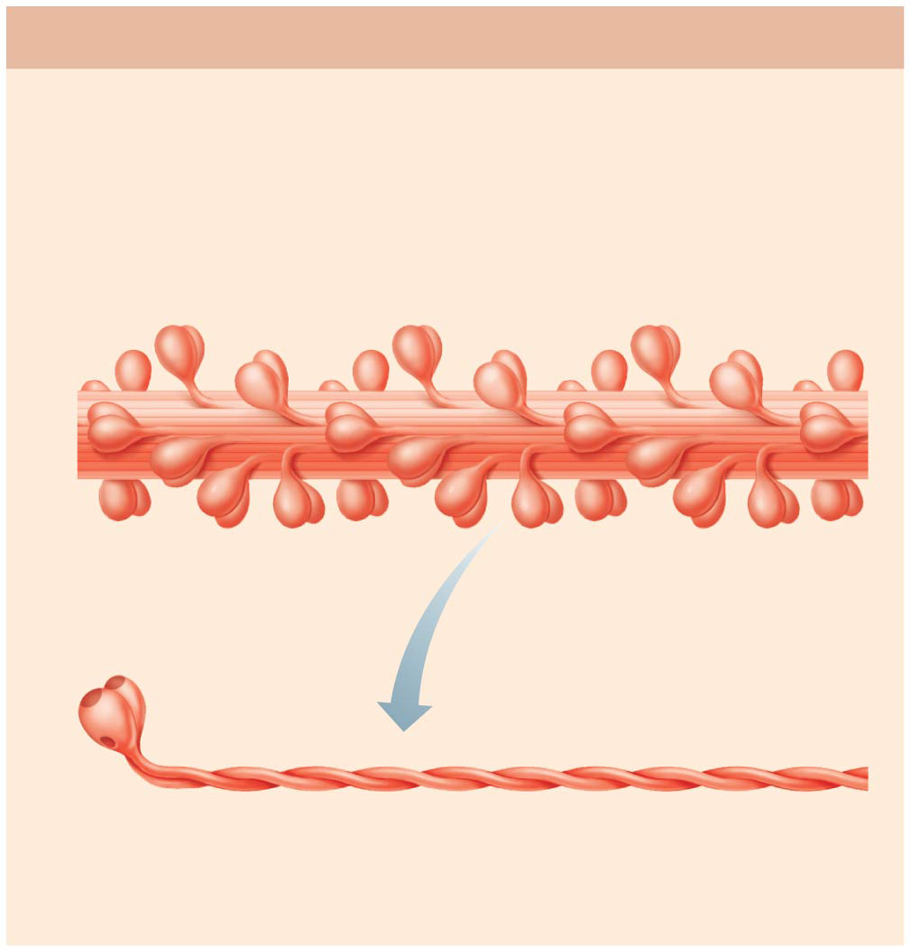
Thick filament
Each thick filament consists of many myosin molecules
whose heads protrude at opposite ends of the filament.
Portion of a thick filament
Myosin head
Actin-binding sites
Heads
Tail
ATP-
binding
site
Flexible hinge region
Myosin molecule

Slide 29
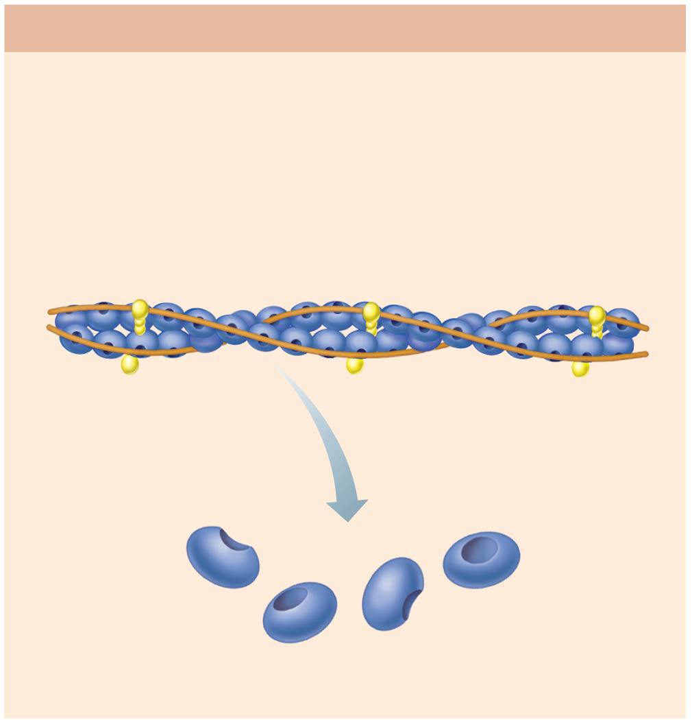
Thin filament
A thin filament consists of two strands of actin subunits
twisted into a helix plus two types of regulatory proteins
(troponin and tropomyosin).
Portion of a thin filament
Tropomyosin
Troponin
Actin
Active sites
for myosin
attachment
Actin subunits

Slide 30
Sliding Filament Model of Contraction
In the relaxed state, thin and thick filaments overlap only slightly at ends of A band
Sliding filament model of contraction states that during contraction, thin filaments slide past thick filaments, causing actin and myosin to overlap more
Neither thick nor thin filaments change length, just overlap more
When nervous system stimulates muscle fiber, myosin heads are allowed to bind to actin, forming cross bridges, which cause sliding (contraction) process to begin

Slide 31
Sliding Filament Model of Contraction (cont.)
Cross bridge attachments form and break several times, each time pulling thin filaments a little closer toward center of sarcomere in a ratcheting action
Causes shortening of muscle fiber
Z discs are pulled toward M line
I bands shorten
Z discs become closer
H zones disappear
A bands move closer to each other

Slide 32
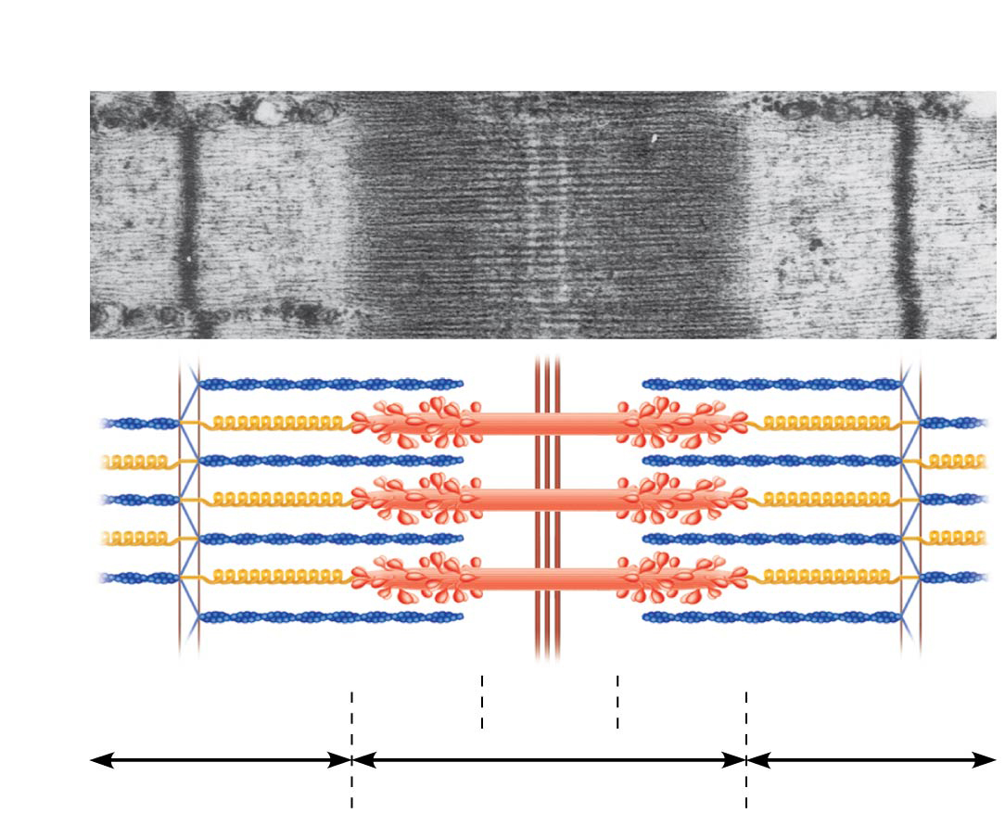
1
Fully relaxed sarcomere of a muscle fiber
Z
H
Z
l
A
l

Slide 33
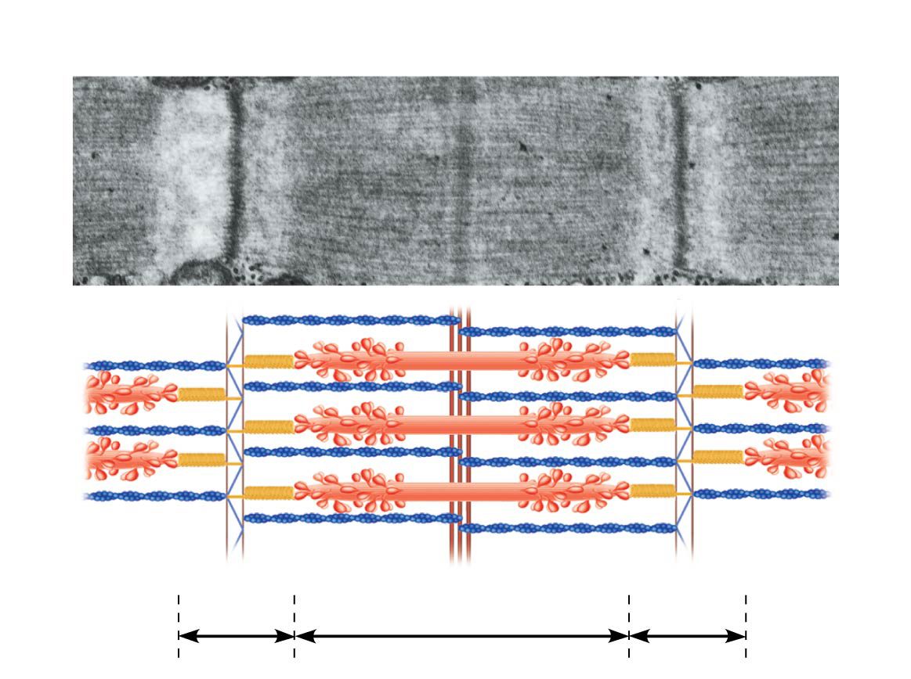
2
Fully contracted sarcomere of a muscle fiber
Z
Z
l
A
l

Slide 34
9.4 Muscle Fiber Contraction
Four steps must occur for skeletal muscle to contract:
Nerve stimulation
Action potential, an electrical current, must be generated in sarcolemma
Action potential must be propagated along sarcolemma
Intracellular Ca²⁺ levels must rise briefly
Steps 1 and 2 occur at neuromuscular junction
Steps 3 and 4 link electrical signals to contraction, so referred to as excitation-contraction coupling

Slide 35
Functions of Important Components in Contraction
ATP- immediate energy for muscular contraction; traps energy from respiration and releases it in small amounts.
Ca⁺⁺² moves through T-tubules (aka Z lines), causes cross-bridges to bond
Cross-Bridges- on myosin; attach and pull actin filaments in

Slide 36
Functions (cont’d)
T-Tubules- {transverse tubules; Z lines}; provide a path from 1 fiber to another
Sarcoplasmic reticulum- store chemicals for contraction (like ER in cell)

Slide 37
Functions (cont’d)
Acetylcholine (Ach)- secreted by nerve; INITIATES contraction
Acetylcholinesterase- secreted by nerve; NEUTRALIZES acetylcholine

Slide 38
Muscle Contraction
Stimulus travels over axon to neuromuscular junction (action potential)
Acetylcholine (Ach) released from synaptic vesicles & travels into muscle cells and binds
Sodium diffuses from SR, travels deep into muscle through t-tubules

Slide 39
Contraction (cont’d)
Calcium released from SR (sarcoplasmic reticulum)
Actin moves inward,
Cross-bridges form on myosin to hold actin filaments together
MUSCLE CONTRACTS

Slide 40
2
Fully contracted sarcomere of a muscle fiber
Z
Z
l
A
l

Slide 41
Relaxation
Acetylcholinesterase is released from nerve ending
Travels to muscle cells
Neutralizes acetylcholine
Cross bridges broken
Calcium ions go back into SR
Actin filaments move apart
MUSCLE RELAXES

Slide 42
1
Fully relaxed sarcomere of a muscle fiber
Z
H
Z
l
A
l

Slide 43
Muscle Contraction
1. All or None Law- if a threshold stimulus is received, the muscle contracts fully, or not at all (responds to its greatest capacity)
2. Threshold Stimuli- minimum stimuli to which a muscle responds (an increase in stimuli don’t cause increases in response)

Slide 44
Muscle Contraction
3. Summation- muscles can store sub-threshold stimuli until threshold is reached, then muscle responds

