Slide 1
Peripheral Nerves

Slide 2
13.3 Nerves and Associated Ganglia
Structure and Classification
Nerve: cordlike organ of PNS
Bundle of myelinated and nonmyelinated peripheral axons enclosed by connective tissue
Two types of nerves: spinal or cranial, depending on where they originate

Slide 3
Structure and Classification (cont.)
Connective tissue coverings include:
Endoneurium: loose connective tissue that encloses axons and their myelin sheaths (Schwann cells)
Perineurium: coarse connective tissue that bundles fibers into fascicles
Epineurium: tough fibrous sheath around all fascicles to form the nerve

Slide 4
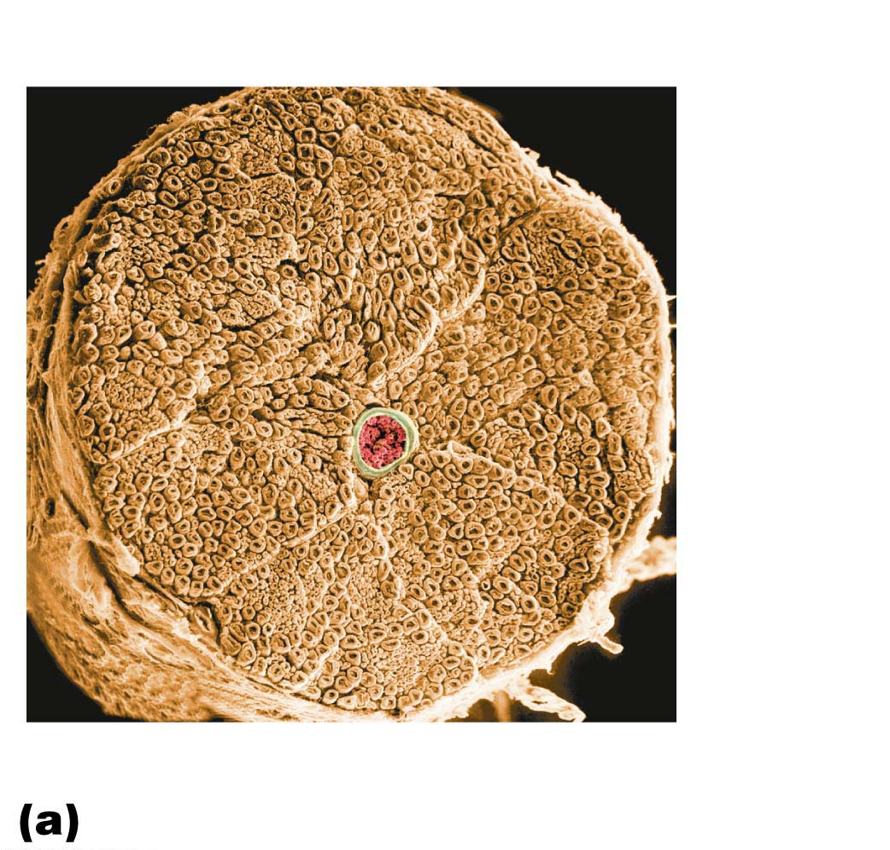
Figure 13.4a Structure of a nerve.
Endoneurium
Perineurium
Nerve
fibers
Blood
vessel
Fascicle
Epineurium

Slide 5
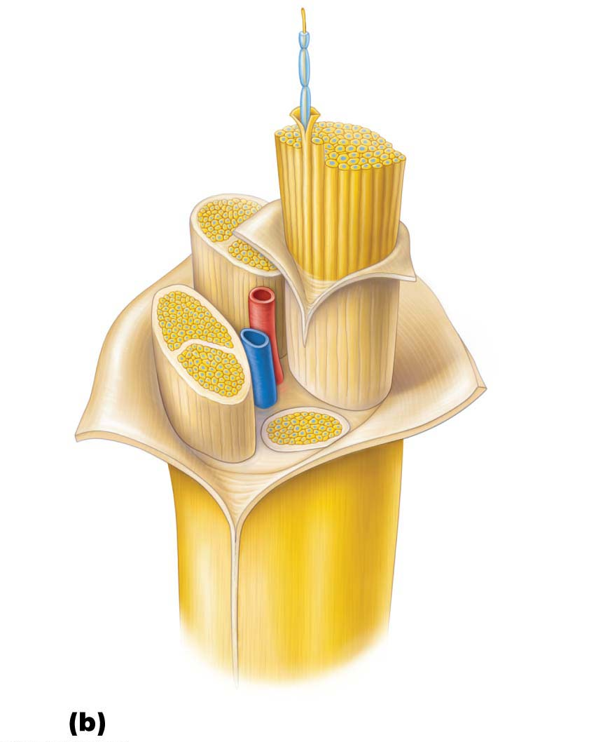
Figure 13.4b Structure of a nerve.
Axon
Endoneurium
Myelin sheath
Perineurium
Epineurium
Fascicle
Blood
vessels

Slide 6
Structure and Classification (cont.)
Most nerves are mixtures of afferent and efferent fibers and somatic and autonomic (visceral) fibers
Nerves are classified according to the direction they transmit impulses
Mixed nerves: contain both sensory and motor fibers
Impulses travel both to and from CNS
Sensory (afferent) nerves: impulses only toward CNS
Motor (efferent) nerves: impulses only away from CNS

Slide 7
Structure and Classification (cont.)
Pure sensory (afferent) or pure motor (efferent) nerves are rare; most nerves are mixed
Types of fibers in mixed nerves:
Somatic afferent (sensory from muscle to brain)
Somatic efferent (motor from brain to muscle)
Visceral afferent (sensory from organs to brain)
Visceral efferent (motor from brain to organs)

Slide 8
Structure and Classification (cont.)
Ganglia: contain neuron cell bodies associated with nerves in PNS
Ganglia associated with afferent nerve fibers contain cell bodies of sensory neurons
Dorsal root ganglia (sensory, somatic) (Chapter 12)
Ganglia associated with efferent nerve fibers contain autonomic motor neurons
Autonomic ganglia (motor, visceral) (Chapter 14)

Slide 9
Regeneration of Nerve Fibers
Mature neurons are amitotic, but if the soma (cell body) of the damaged nerve is intact, the peripheral axon may regenerate in PNS; does not occur in CNS

Slide 10
Regeneration of Nerve Fibers (cont.)
CNS axons
Most CNS fibers never regenerate
CNS oligodendrocytes bear growth-inhibiting proteins that prevent CNS fiber regeneration
Astrocytes at injury site form scar tissue
Treatment: neutralizing growth inhibitors, blocking receptors for inhibitory proteins, destroying scar tissue components

Slide 11
Regeneration of Nerve Fibers (cont.)
PNS axons
PNS axons can regenerate if damage is not severe
Axon fragments and myelin sheaths distal to injury degenerate (Wallerian degeneration); degeneration spreads down axon
Macrophages clean dead axon debris; Schwann cells are stimulated to divide
Axon filaments grow through regeneration tube
Axon regenerates, and new myelin sheath forms

