Slide 1
Cranial and Spinal Nerves

Slide 2
Cranial Nerves

Slide 3
There are 12pr of cranial nerves
The 1st 2 pr attach to the forebrain and the rest are associated w/the brain stem
Almost all (except the vagus) serve only head and neck structures
The vagus nerve extends into the abdomen

Slide 4
Named according to the structures they serve or their functions.
They are also numbered by Roman numerals rom the most rostral (closest to the front of the brain) to most caudal.

Slide 5
Most cranial nerves are mixed (sensory & motor fibers)
Sensory function only- (I and II)
Carry parasympathetic fibers that serve visceral muscles and glands- (III, VII, IX, & X)

Slide 6
Overview
I. Olfactory (S)- tiny sensory nerve filaments of smell running from nasal mucosa to synapse w/olfactory bulbs.
II. Optic (S)- is really a brain tract b/c it develops as an outgrowth of the brain
III. Oculomotor (M)- “eye mover”; supplies 4 4 of 6 extrinsic muscles that move the eyeball

Slide 7
Overview (cont’d)
IV. Trochlear (M)- “pulley”; innervates an extrinsic eye muscle that loops through a pulley-shaped ligament in the orbit.
V. Trigeminal (B)- “tri=3” branches; largest cranial nerve; supplies sensory fibers to face & motor fibers to chewing muscles.
VI. Abducens (M)- controls extrinsic eye muscle that abducts eyeball (moves laterally)

Slide 8
Overview (cont’d)
VII. Facial (B)- lg. nerve; innervates muscles of facial expression.
VIII. Vestibulocochlear (S)- formerly called “auditory nerve”; mostly sensory for hearing & balance.
IX. Glossopharyngeal (B)- “tongue & pharynx”; innervates both the tongue & pharynx

Slide 9
Overview (cont’d)
X. Vagus (B)- “wanderer” “vagabond”; only cranial nerve to extend beyond head & neck to thorax & abdomen.
XI. Accessory (M)- accessory to vagus; formerly called “spinal accessory nerve”
XII. Hypoglossal (M)- “under the tongue”; innervates tongue muscles.

Slide 10
Cranial Nerves

Slide 11
Cranial Nerves

Slide 12
Cranial Nerves

Slide 13
Cranial Nerves
Cranial Nerves

Slide 14
Cranial Nerves
Cranial Nerves

Slide 15
Cranial Nerves
Cranial Nerves

Slide 16
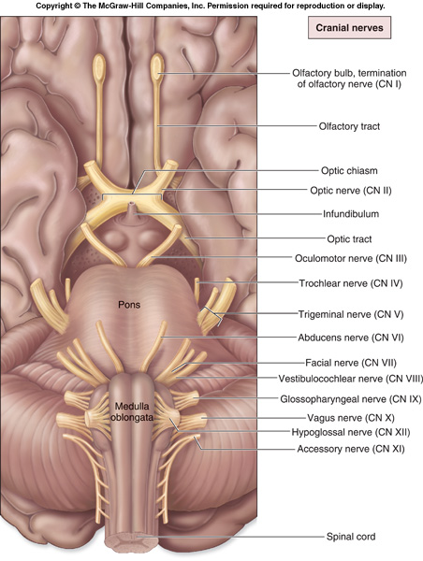
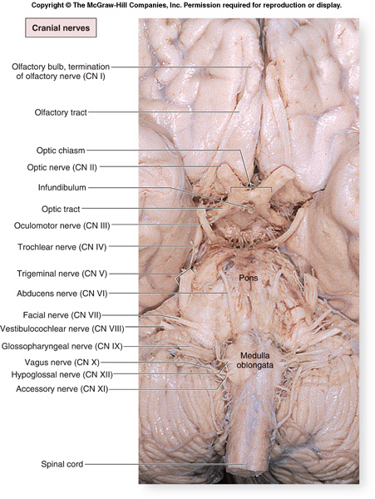
Cranial Nerves

Slide 17
Cranial Nerves
Indicated by Roman numerals I-XII from anterior to posterior
May have one or more of 3 functions
Sensory (special or general)
Somatic motor (skeletal muscles)
Parasympathetic (regulation of glands, smooth muscles, cardiac muscle)
Proprioception
Positional information of body parts
Fig. 15.24

Slide 18
Cranial Nerves
Olfactory (I)
Optic (II)
Oculomotor (III)
Trochlear (IV)
Trigeminal (V)
Abducens (VI)
Facial (VII)
Vestibulocochlear (VIII)
Also known as auditory
Glossopharyngeal (IX)
Vagus (X)
Accessory (XI)
Also known as spinal accessory
Hypoglossal (XII)

Slide 19
Mnemonic Aids for Cranial Nerves
On Old Olympus Towering Tops A Famous Vocal German Viewed Some Hops
Olfactory, Optic, Oculomotor, Trochlear, Trigeminal, Abducens, Facial, Vestibulocochlear, Glossopharyngeal, Vagus, Spinal Accessory (Accessory), Hypoglossal
Oh. Oh. Ooh...To Touch And Feel Very Green Vegetables...A H !!!
Oh, once one takes the anatomy final- very good vacations are heavenly!

Slide 20
Mnemonic Aids for Cranial Nerves
To remember at least part of the sequence of the first set of cranial nerves that begin with the letter O, try this –
You have I nose. You have II eyes.
I - Olfactory; II -- Optic

Slide 21
Mnemonic Aids for Cranial Nerves
OLd
OPie
OCcasionally
TRies
TRIGonometry
And
Feels
VEry
GLOomy
VAGUe
And
HYPOactive

Slide 22
Mnemonic Aids for Sensory and /or Motor Functions of Cranial Nerves
Some Say Marry Money, But My Brother Says Big Business Matters More
The first letter of each word signifies whether the particular cranial nerve is sensory only (S); motor (M); or both sensory and motor (B)

Slide 23
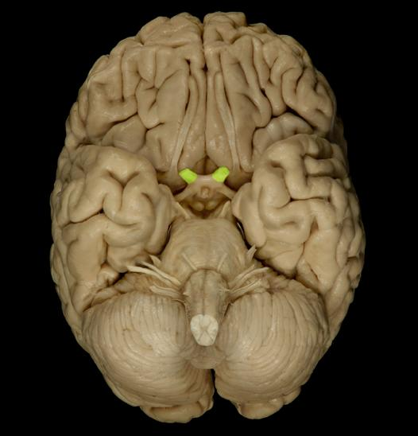
Cranial Nerves
Olfactory (I)
Sensory (smell)
Optic (II)
Sensory (sight)
Oculomotor (III)
Motor (4 of 6 eye muscles)
Parasympathetic (constriction of pupil, movement of lens)

Slide 24
Cranial Nerves
Trochlear (IV)
Motor (1 eye muscle)
Trigeminal (V)
Sensory (face, nasal cavity, cheeks, lips, skin of mandible)
Motor (muscles of mastication, anterior belly of digastric, mylohyoid)
Abducens (VI)
Motor (1 eye muscle)

Slide 25
Cranial Nerves
Facial (VII)
Sensory (taste)
Motor (facial muscles, posterior belly of digastric)
Parasympathetic (salivary glands, glands of nasal cavity)
Vestibulocochlear (VIII)
Sensory (hearing and balance)
Glossopharyngeal (IX)
Sensory (taste, back of mouth, tonsils, middle ear)
Motor (1 muscle of pharynx)
Parasympathetic (salivary gland, glands of tongue)

Slide 26
Cranial Nerves
Vagus (X)
Sensory (taste, back of mouth, larynx, thoracic and abdominal organs)
Motor (muscles of larynx, 1 muscle of tongue)
Parasympathetic (thoracic and abdominal organs)
Accessory (XI)
Motor (sternocleidomastoid, trapezius)
Hypoglossal (XII)
Motor (tongue and throat muscles)

Slide 27
Points to Remember
Cranial nerves are part of the peripheral nervous system.
Carry sensory or motor information or a combination and function in parasympathetic nervous system.
Cranial nerves I, II and VIII are purely sensory.
Cranial nerves III, IV, VI, XI and XII are motor (although also function for proprioception).

Slide 28
Spinal Nerves

Slide 29
Spinal nerves
There are 31 prs of spinal nerves
They supply all parts of the body except the head & some areas of the neck.
Spinal nerves are all classified as MIXED (contain both sensory and motor fibers)
They are named according to the portion of the spinal cord from which they LEAVE.

Slide 30
Spinal Nerves (cont’d)
4 areas:
1. cervical (8 pair) C1-C8
2. thoracic (12 pair) T1-T12
3. lumbar (5 pair) L1-L5
4. sacral (5 pair) S1-S5
Coccygeal nerves – very tiny (1pair) Terminal end of spinal cord

Slide 31
There are 8pr of cervical nerves but only 7 cervical vertebrae because the 1st 7pr exit the vertebral canal superior to the vertebrae for which they’re named.
C8 exits inferior to the 7th cervical vertebrae (betw. C7 & T1).
Below the cervical level, ea spinal nerve leaves the vertebral column inferior to the same numbered vertebra.

Slide 32
Terms
Ea spinal nerve connects to the spinal cord by a dorsal root & a ventral root.
Ventral roots contain motor (efferent) fibers & innervate the skeletal muscles
Dorsal roots contain sensory (afferent) fibers that conduct impulses from peripheral receptors to spinal cord.

Slide 33
Terms
Spinal nerves are short (1-2 cm) & divide into a dorsal, a ventral ramus, & a tiny meningeal branch that reenters vertebral canal to innervate meninges & bl.vessels inside
A rami (ramus) is a BRANCH of a nerve
Dorsal rami- supply posterior body trunk
Ventral rami- larger; supply rest of trunk & limbs

Slide 34
Roots- lie medial to & form the spinal nerves; each one is strictly sensory or motor.
Rami- lie distal to & are lateral branches of the spinal nerves; carry both sensory & motor fibers.
Except for T2-T12, all ventral rami branch & join ea other lateral to vertebral column forming interlacing nerve networks called nerve plexuses.
Plexuses occur in: cervical, brachial, lumbar, and sacral regions to serve the limbs.

Slide 35
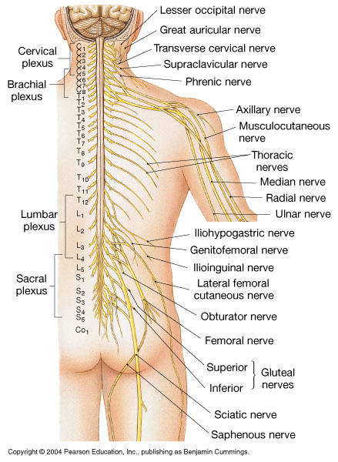
Peripheral Nerves and Nerve Plexus

Slide 36
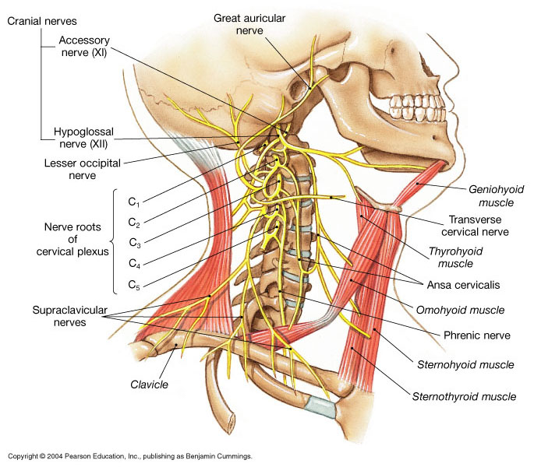
The Brachial Plexus

Slide 37
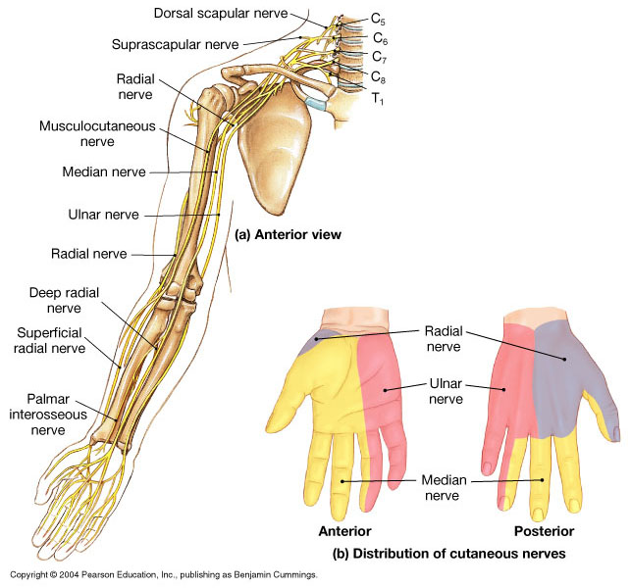
The Branchial Plexus

Slide 38
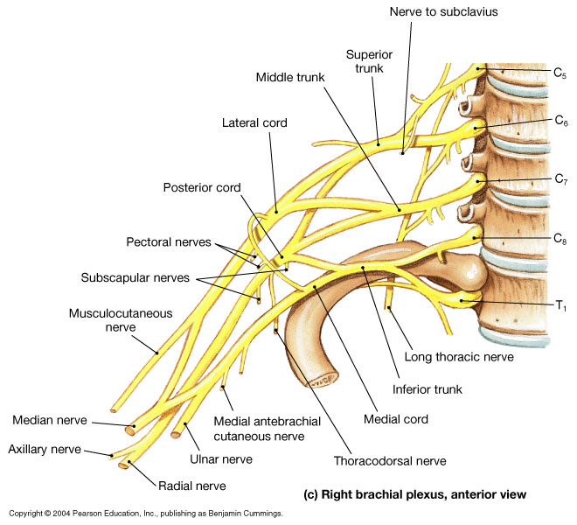
The Branchial Plexus

Slide 39
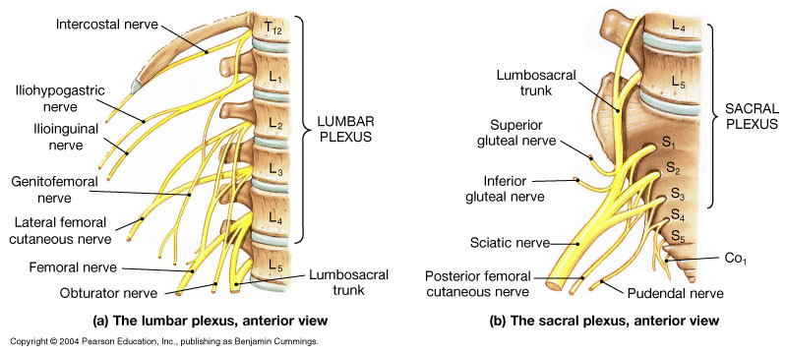
The Lumbar and Sacral Plexuses

Slide 40
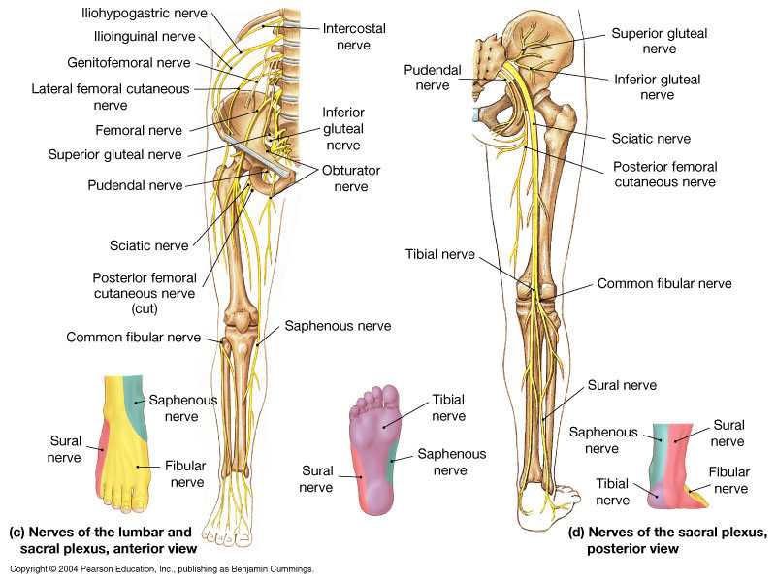
The Lumbar and Sacral Plexuses

Slide 41
Nerve Structure/ Composition
Structure of a nerve:
Epineurium- delicate loose connective tissue that surrounds ea axon.
Perineurium- coarser connective tissue that wraps bundles of axons into fascicles
Endoneurium- tough, fibrous sheath that encloses all the fascicles to form the nerve.

Slide 42
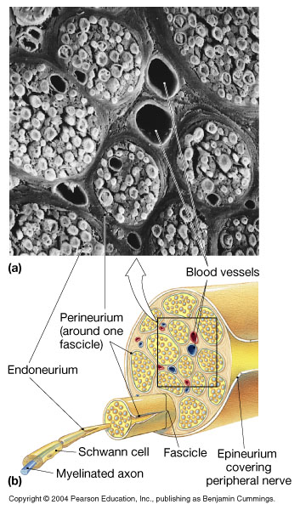
A Peripheral Nerve

Slide 43
Types of Nerves
In the PNS, nerves are classified according to the direction in which they transmit impulses:
Mixed nerves- both sensory & motor; transmit impulses to & from CNS
Sensory (afferent) nerves- carry impulses only towards CNS
Motor (efferent) nerves- carry impulses only away from CNS

Slide 44
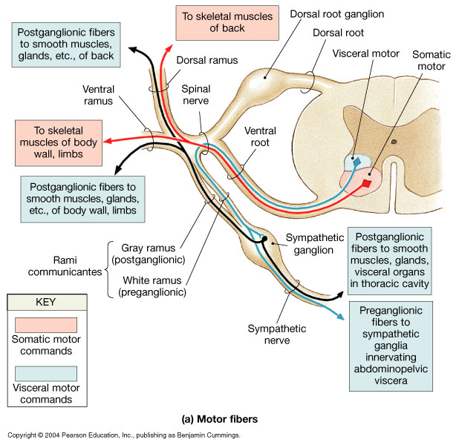
Peripheral Distribution of Spinal Nerves

Slide 45
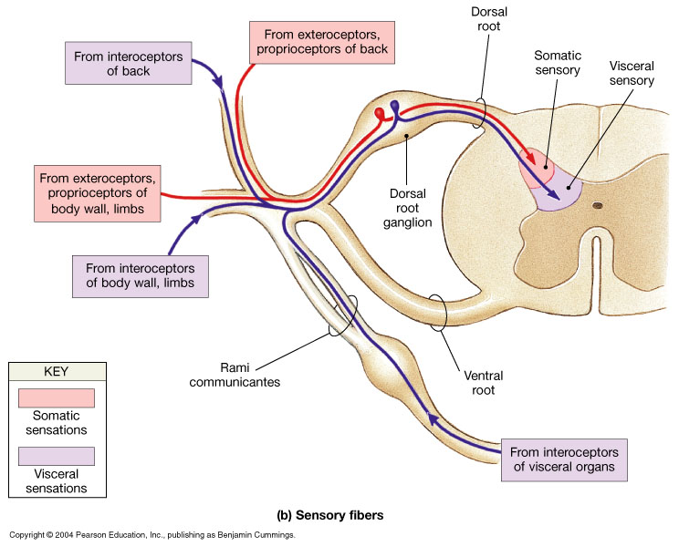
Peripheral Distribution of Spinal Nerves

Slide 46
Spinal nerves
White ramus (myelinated axons)
Gray ramus (unmyelinated axons that innervate glands and smooth muscle)
Dorsal ramus (sensory and motor innervation to the skin and muscles of the back)
Ventral ramus (supplying ventrolateral body surface, body wall and limbs)
Each pair of nerves monitors one dermatome

Slide 47
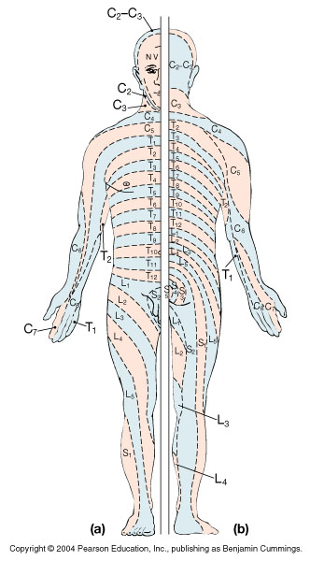
Dermatomes

Slide 48
Principles of Functional Organization
General organization
Sensory neurons
Deliver information to CNS
Motor neurons
Distribute commands to peripheral effectors
Interneurons
Interpret information and coordinate responses

