Slide 1
Chapter 01 Lecture Outline Dr. S. Montgomery
See separate PowerPoint slides for all figures and tables pre-inserted into PowerPoint without notes.
©2019 McGraw-Hill Education. All rights reserved. Authorized only for instructor use in the classroom. No reproduction or further distribution permitted without the prior written consent of McGraw-Hill Education.

Slide 2
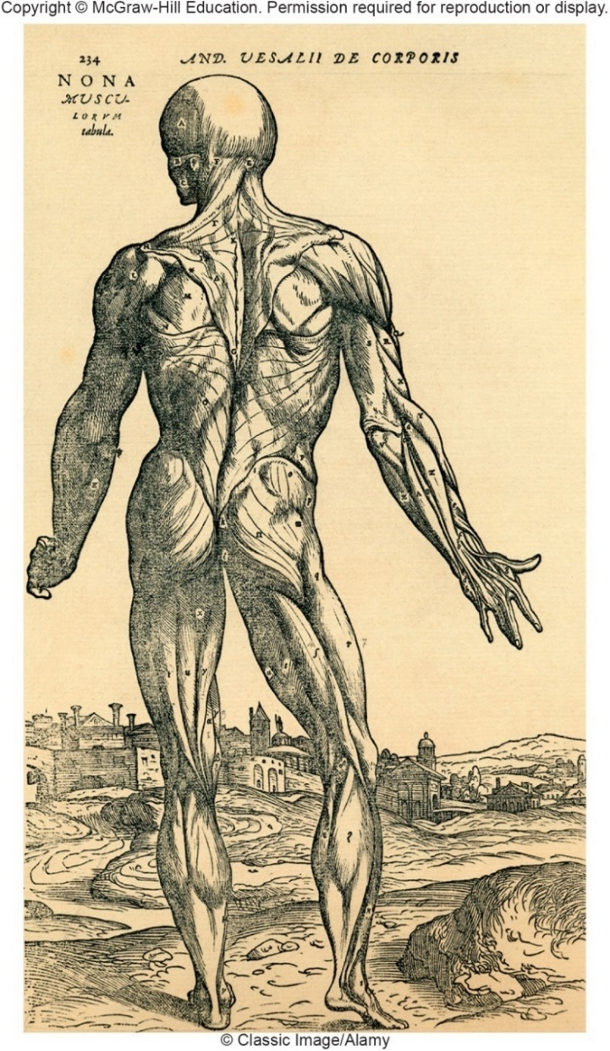
Figure 1.1 Origins of Medical Science
Early healers depended on superstition and magic.
Followed by observations of injuries, wound healing, and dead bodies.
This evolved into experimentation and creation of new terminology for anatomy & physiology.
Finally, study of corpses and cadaver dissection brought new knowledge of the human body.
© Classic Image/Alamy

Slide 3
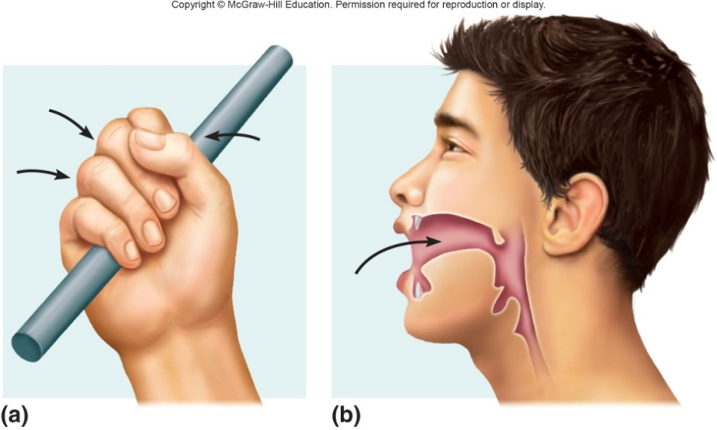
Figure 1.2 Anatomy & Physiology
Anatomy: The study of the structure/morphology of the human body and its parts; derived from Greek for “a cutting up”
Physiology: The study of the functions of the human body and its parts; derived from Greek for “relationship to nature”
The structure of organs and parts of the human body determines the function.

Slide 4
Levels of Organization
All materials, living or non-living, are composed of chemicals, which consist of atoms. This list is from simple to most complex.
Subatomic Particles: protons, neutrons, and electrons that make up cells
Atom: tiny particles that make up chemicals (hydrogen, carbon)
Molecule: particles consisting of atoms joined together (water, glucose)
Macromolecule: large particles consisting of molecules (D N A, protein)
Organelle: functional part of a cell (mitochondrion, lysosome)
Cell: basic unit of structure and functions (muscle, nerve, or blood cell)
Tissue: layer or mass of cells with specific function (adipose tissue)
Organ: group of different tissues with a function (heart, kidney, stomach)
Organ System: group of organs with common function (digestive system)
Organism: composed of organ systems interacting (human)

Slide 5
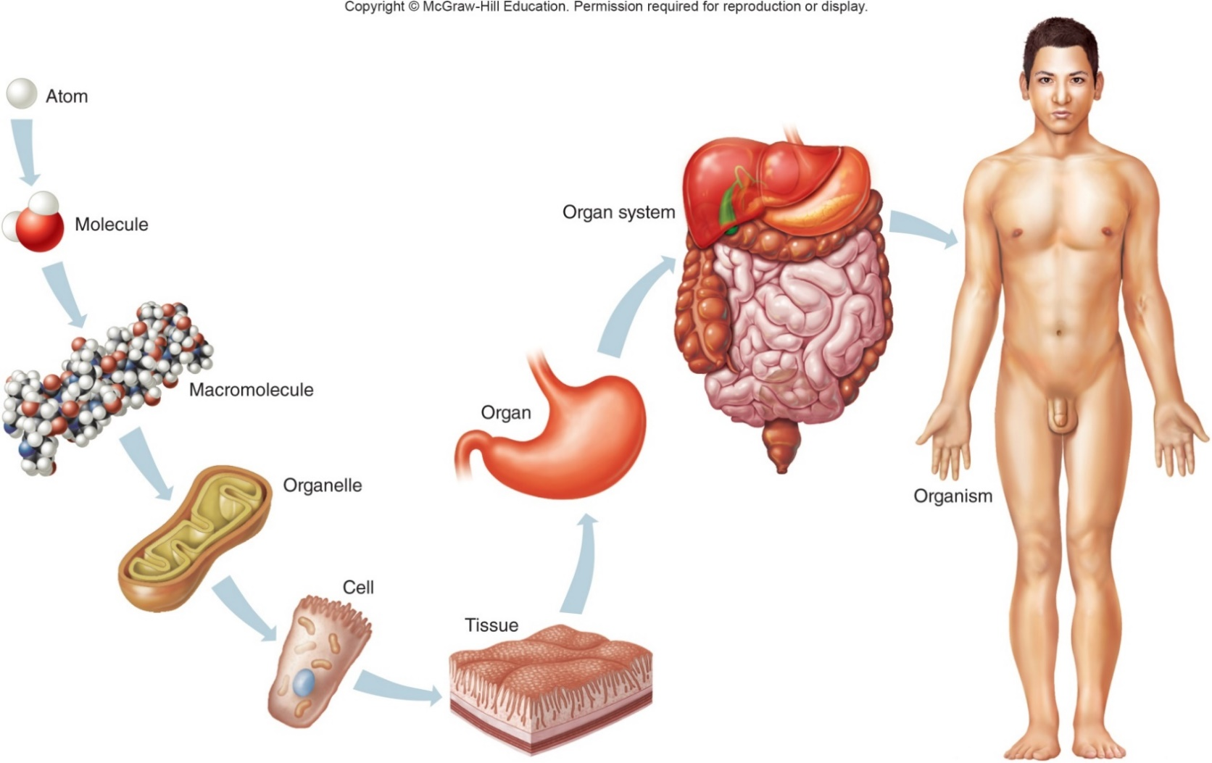
Figure 1.3 Levels of Organization

Slide 6
Table 1.2 Characteristics of Life
Process | Examples | Process | Examples
Movement | Change in position of the body or of a body part; motion of an internal organ | Digestion | Breakdown of food substances into simpler forms that can be absorbed and used
Responsiveness | Reaction to a change inside or outside the body | Absorption | Passage of substances through membranes and into body fluids
Growth | Increase in body size without change in shape | Circulation | Movement of substances in body fluids
Reproduction | Production of new organisms and new cells | Assimilation | Changing of absorbed substances into different chemical forms
Respiration | Obtaining oxygen, removing carbon dioxide, and releasing energy from foods (some forms of life do not use oxygen in respiration) | Excretion | Removal of wastes produced by metabolic reactions
The events inside the body which obtain, release, and utilize energy are the main part of metabolism (all of the chemical reactions in an organism that support life).

Slide 7
Survival Needs of Organisms Maintenance of Life
Life requires / depends on 5 environmental factors:
Water:
most abundant substance in body.
environment for metabolic processes.
required for transport of substances.
regulation of body temperature.
Food:
provides necessary nutrients.
supplies energy.
supplies raw materials for building living tissue.

Slide 8
Survival Needs of Organisms Maintenance of Life
Oxygen (gas):
one-fifth of air.
used to release energy from nutrients.
Heat:
heat is a form of energy in our environment.
helps maintain body temperature.
partly controls rate of metabolic reactions.
Pressure:
application of force on an object.
atmospheric pressure – important for breathing.
hydrostatic pressure – keeps blood flowing.

Slide 9
Homeostasis “steady state”
Homeostasis: Maintenance of a stable internal environment
Homeostatic Mechanisms: Self-regulating systems that monitor aspects of the internal environment and correct them as needed.
Communication: is necessary for homeostasis; occurs primarily through the Nervous and Endocrine Systems using electrical signals delivered by nerves or blood-borne hormones as information carriers.

Slide 10
Homeostasis “steady state”
Variable: the factor/event being regulated in the body
All homeostatic control mechanisms have 3 parts:
Receptor (sensor/ “receives”): area/structure that monitors conditions & sends info about the stimuli to the control center; Ex. Skin detects and provides information
Control Center: receives info, determines response; Ex. Brian, spinal cord.
Effector (“effects”): produces a response or changes a condition; Ex. muscle or gland

Slide 11
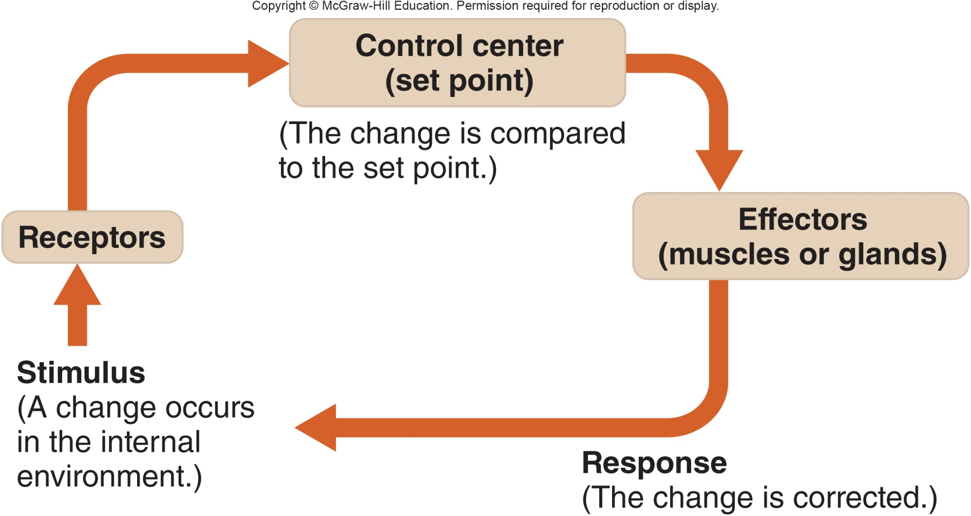
Figure 1.6 Homeostatic Mechanisms
AFFERENT Pathway- Receptor to Control Center
EFFERENT Pathway- Control Center to Effector

Slide 12
Feedback
The results of the response to a stimulus “feed back” to increase or decrease the stimulus
Positive Feedback- stimulus INCREASES
Not used for moment-to-moment well-being
Produces unstable body conditions & can cause death
Negative Feedback- stimulus DECREASES
Used in making adjustments for moment-to-moment well-being of body
Returns body to normal state
Goal is to prevent sudden, severe changes in the body

Slide 13
Example: Fever causes the body temp to increase when a pathogen is encountered.
This continued increase in temperature produces less than optimal conditions for the survival of the pathogen (positive feedback).
When numbers of pathogens decrease, the body’s temperature gradually falls to normal range.

Slide 14
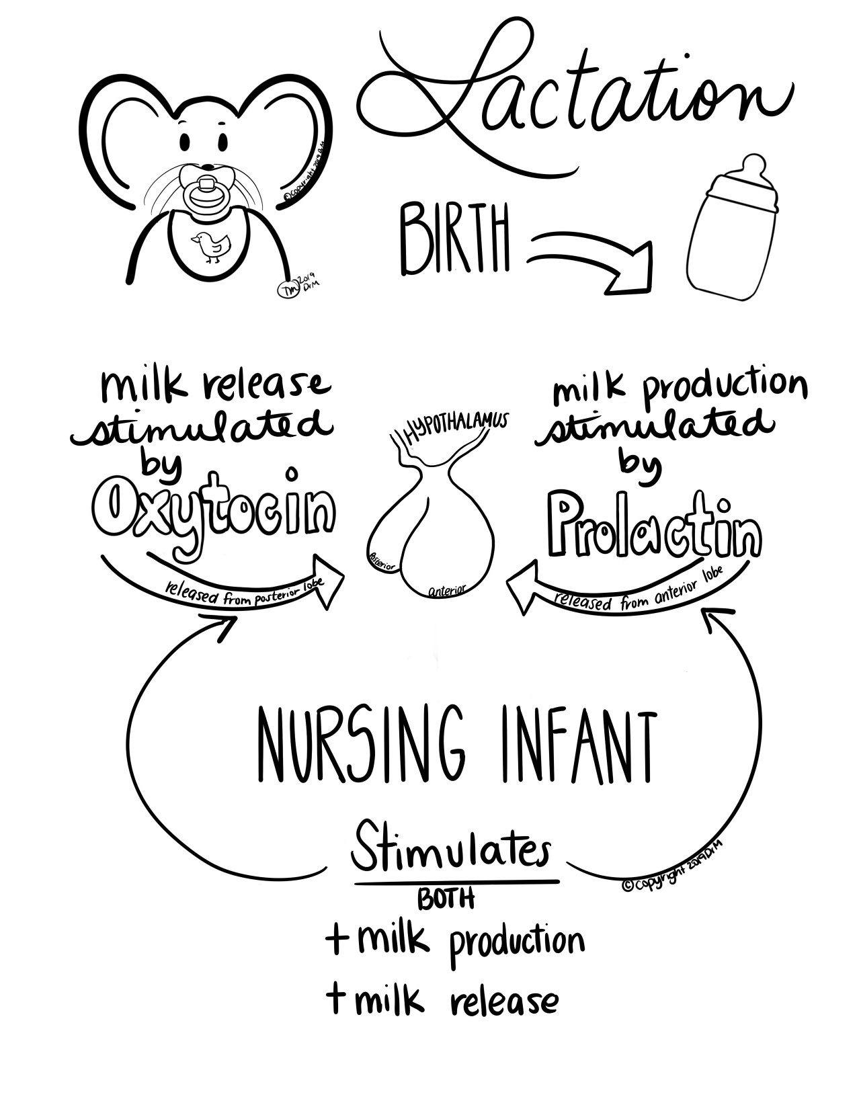
Additional Examples of Positive Feedback
Blood clotting – Blood clotting begins with a cut and continues until the wound is closed.
Childbirth- Labor begins & will continue until child is born
Lactation- After the birth, a nursing infant stimulates milk release due to release of oxytocin from posterior pituitary gland AND milk production by the release of prolactin from anterior pituitary gland.
Cancer- abnormal cells do not stop dividing & will form a tumor

Slide 15
Example: Thermostat in hypothalamus. When body temperature increases, body is triggered to sweat. Sweat evaporates and cools body until is returns to normal range. Sweating stops. Cold stimulus triggers shivering/ goosebumps. Muscular contractions generate heat. Body returns to normal range.

Slide 16
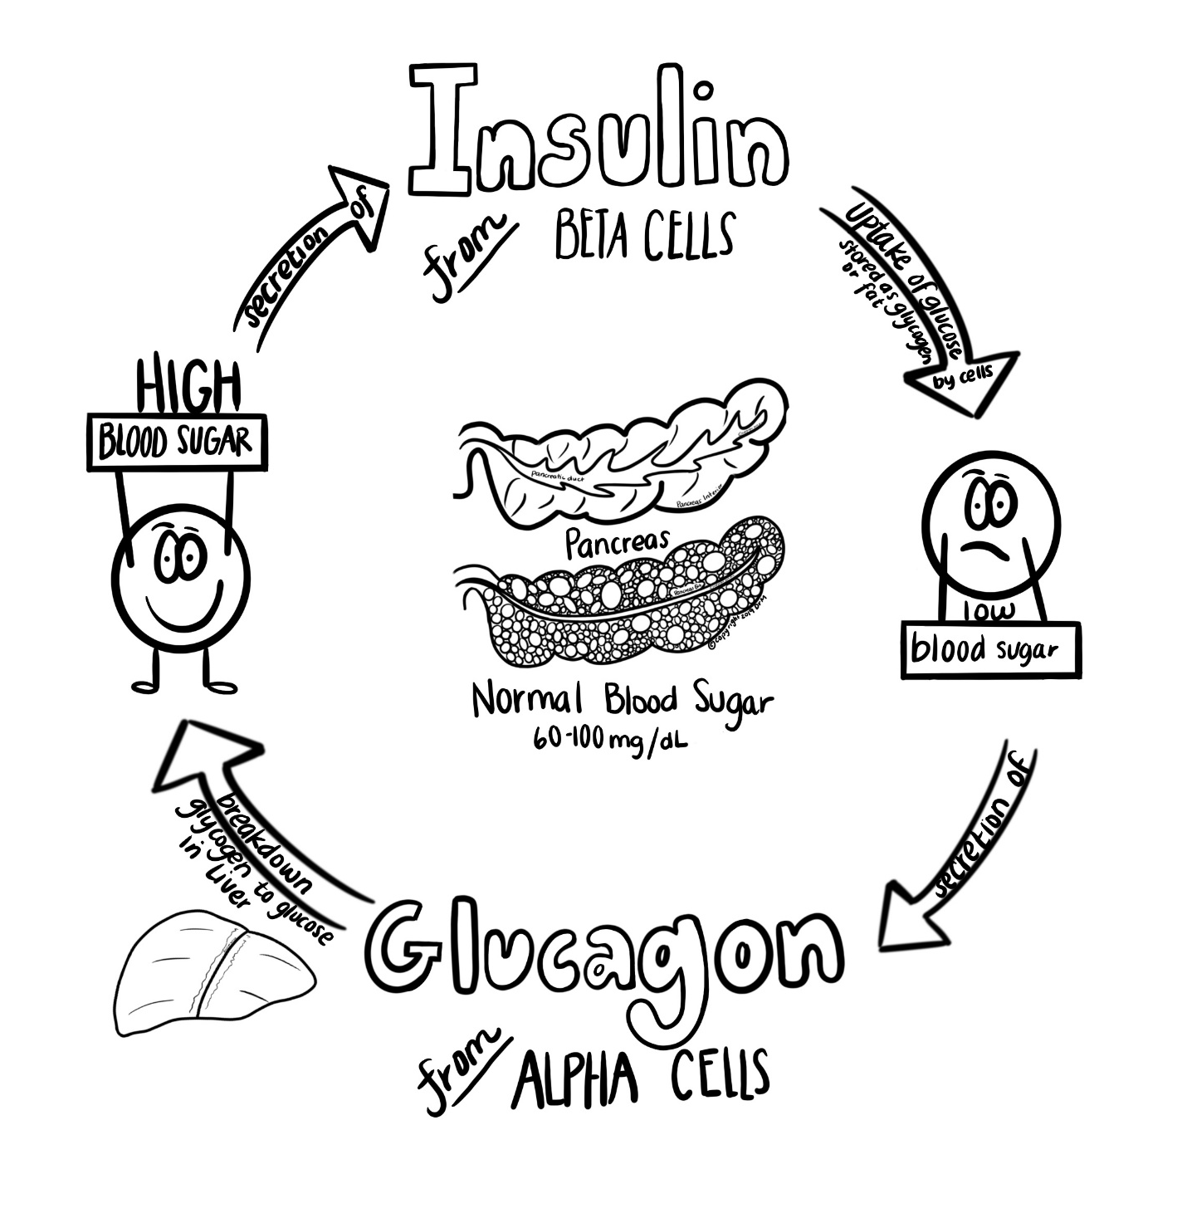
Additional Examples of Negative Feedback
Insulin/Glucagon Response (Blood Sugar):
Insulin- regulates HIGH blood sugar
Blood sugar increases
Pancreas secretes insulin
Insulin causes increased uptake of glucose by cells
Blood sugar returns to normal
Glycogen- regulates LOW blood sugar
Blood sugar decreases
Pancreas secretes Glucagon
Causes liver to secrete Glucose into blood
Blood sugar rises & returns to normal

Slide 17
Body Organization

Slide 18
Human body consists of 2 main portions:
Axial portion: head, neck, and trunk
Appendicular portion: upper and lower limbs
Main Cavities→ Dorsal (back side) and Ventral (belly side)
Dorsal cavities:
Cranial cavity: houses brain
Vertebral canal (spinal cavity): contains spinal cord
Ventral cavities:
Thoracic cavity: houses lungs and thoracic viscera
Abdominopelvic cavity: contains abdominal and pelvic viscera

Slide 19
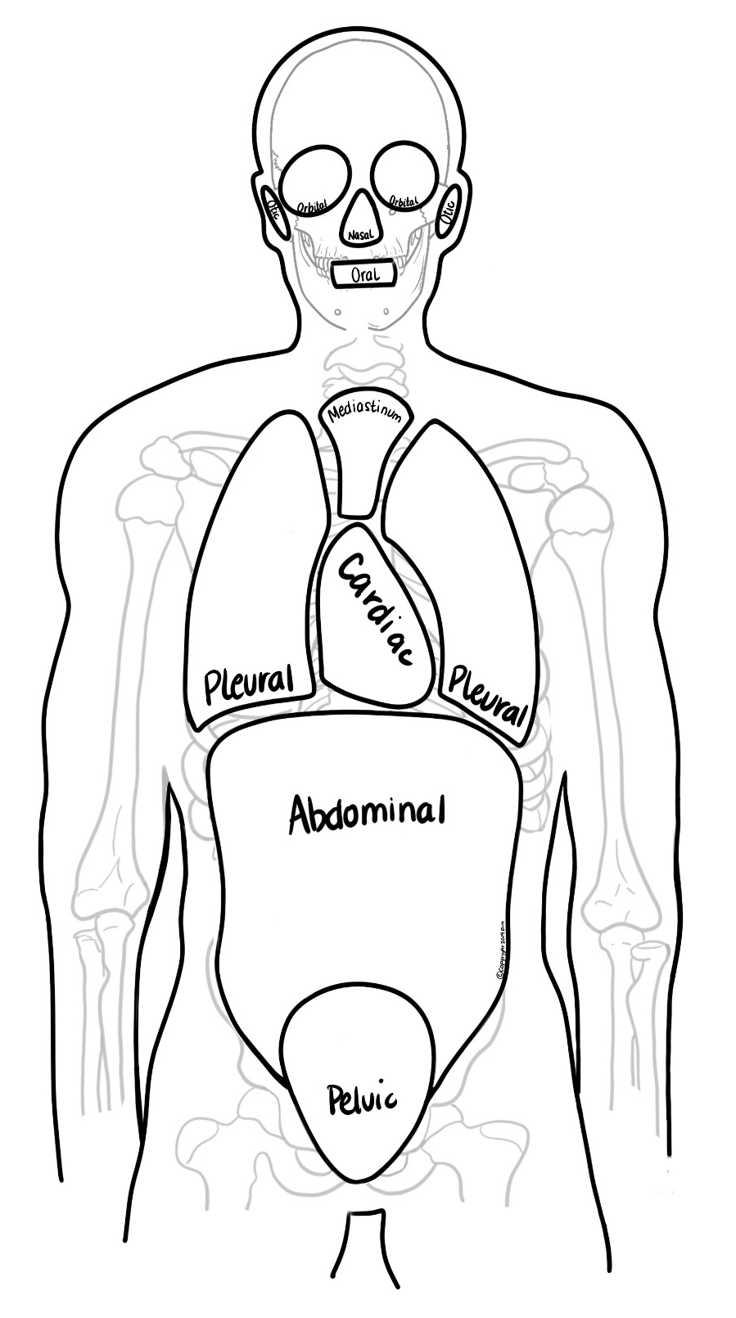
Ventral Body Cavities
Thoracic Cavity: surrounded by the ribs
Pleural Cavities (2)- contain lungs
Mediastinum: region between lungs in thoracic cavity, which contains esophagus, trachea, thymus gland
Pericardial Cavity: lies within Mediastinum & contains the heart
Diaphragm: muscle that separates the thoracic and abdominopelvic cavities
Abdominopelvic cavity contains 2 portions:
Abdominal cavity: extends from diaphragm to top of pelvis, and contains stomach, liver, spleen, kidneys small intestine, most of large intestine
Pelvic cavity: enclosed by pelvic bones, and contains end of large intestine, urinary bladder, internal reproductive organs

Slide 20
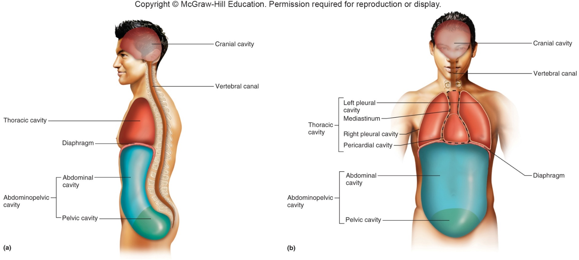
Figure 1.10 Major Body Cavities

Slide 21
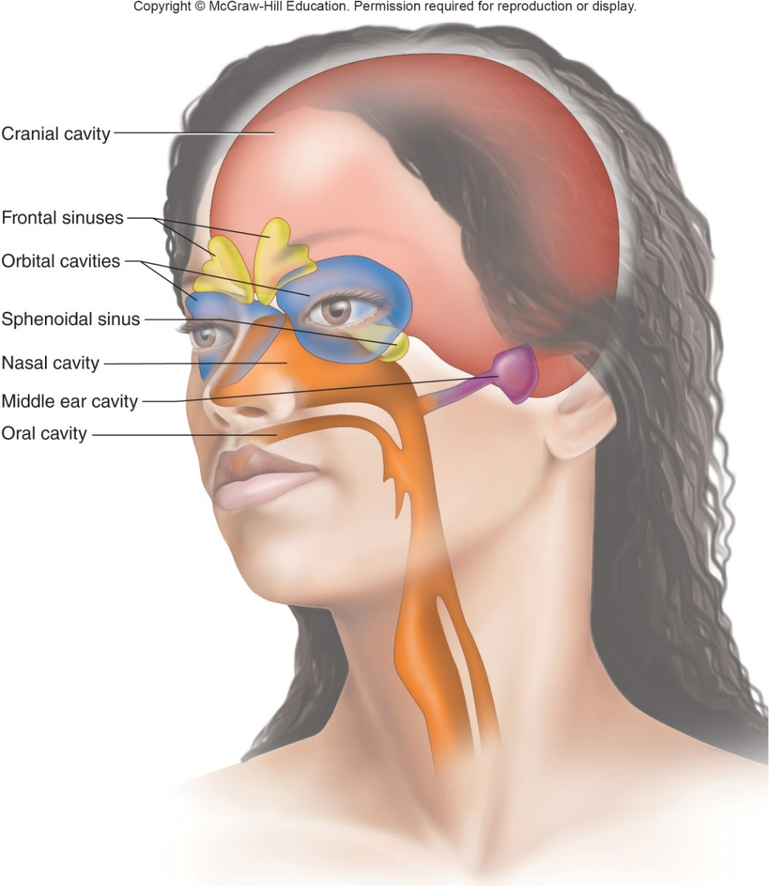
Figure 1.11 Small Cavities of the Head
Small cavities of the head:
Oral cavity- mouth
Nasal cavity- nose
Orbital cavities- eyes
Otic cavities- bones of middle ear

Slide 22
Body Membranes
Body cavities are lined with thins sheets of tissue called membranes which cover a structure or line a cavity.
Body’s membranes are classified into 2 broad categories:
Epithelial membranes- cutaneous (skin), mucous (mucosa), & serous (serosa); most are moist (except skin).
Synovial membranes- lack epithelium; provide smooth surface & cushioning through synovial fluid; found at joints
Dorsal body cavity is lined w/3 layers of protective membranes which cover brain & spinal cord: (called meninges)
Dura mater
Arachnoid mater
Pia mater

Slide 23
Ventral body cavity- contains cavities which are considered open (to the air) or closed (not exposed to air).
Open cavities- lined w/mucous membranes (mucosa)
Closed cavities- lined w/double-layered serous membranes (serosa) & separated by serous fluid which allows for lubrication & movement of organs.
Visceral- inner membrane; clings to ORGANS (“viscera”=organ)
Parietal- outer membrane; clings to WALL OF CAVITY
*These are named according to their location
Pleura= in pleural cavity
Pericardium= in pericardial cavity
Peritoneum= in abdominopelvic cavity

Slide 24
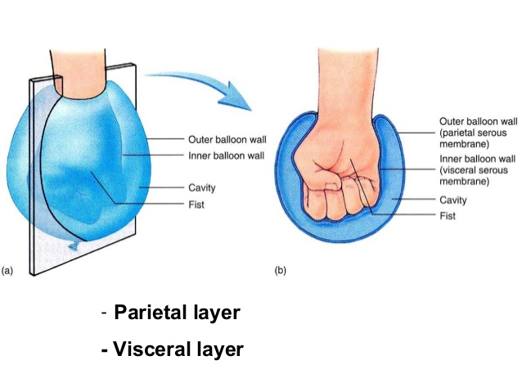
Examples
Parietal pleural membrane- clings to wall of pleural cavity containing lungs
Visceral peritoneum membrane- clings to an organ in the abdominopelvic cavity (ex. the small intestine)
Parietal pericardium- clings to the wall of the pericardial cavity
Visceral pericardium- clings to the surface of the heart itself

Slide 25
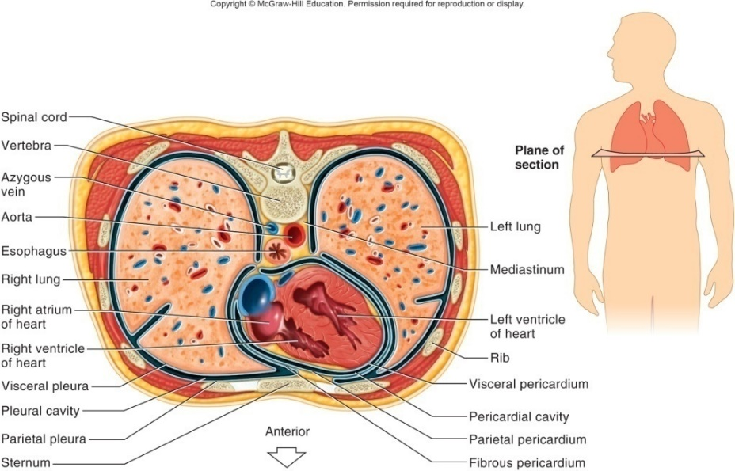
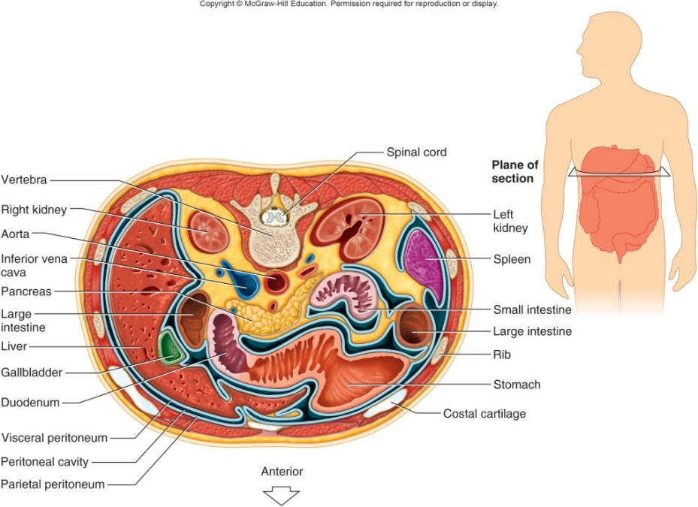
Figures 1.12 and 1.13 Serous Membranes
Serous membranes of the thoracic cavity
Serous membranes of the abdominal cavity

Slide 26
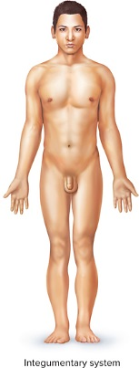
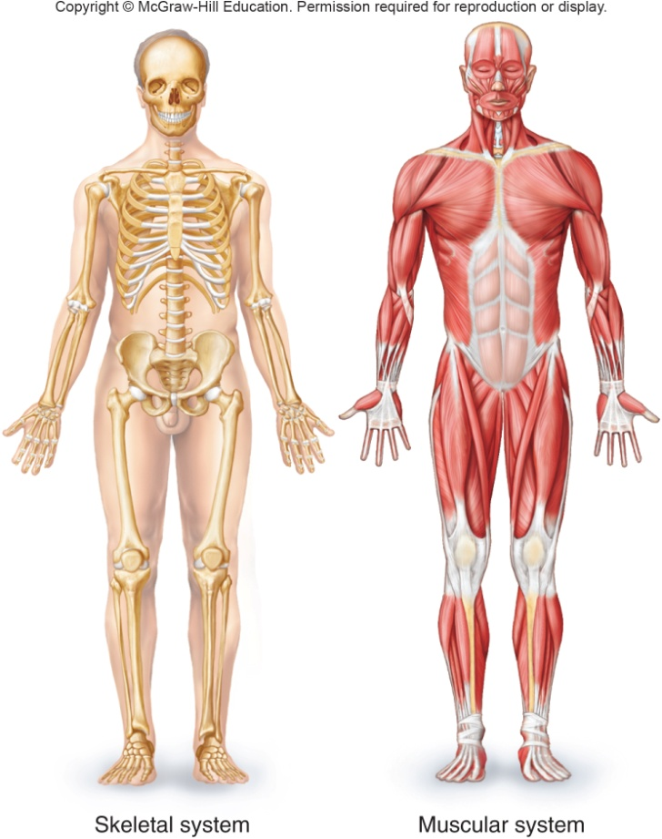
Figures 1.14 and 1.15 Organ Systems
Integumentary System:
Protection, body temperature regulation, sensory reception, production of Vitamin D
Skeletal System:
Framework, protection, attachment sites, storage of inorganic salts, production of blood cells, support and movement
Muscular System:
Movement, main source of body heat, maintenance of posture.

Slide 27
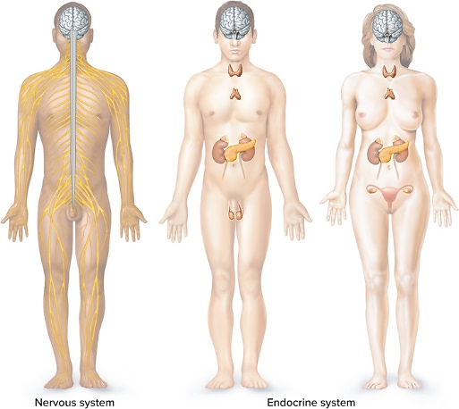
Figure 1.16 Organ Systems
Nervous and Endocrine Systems:
Integration and coordination of organ function through nerve impulses or hormones

Slide 28
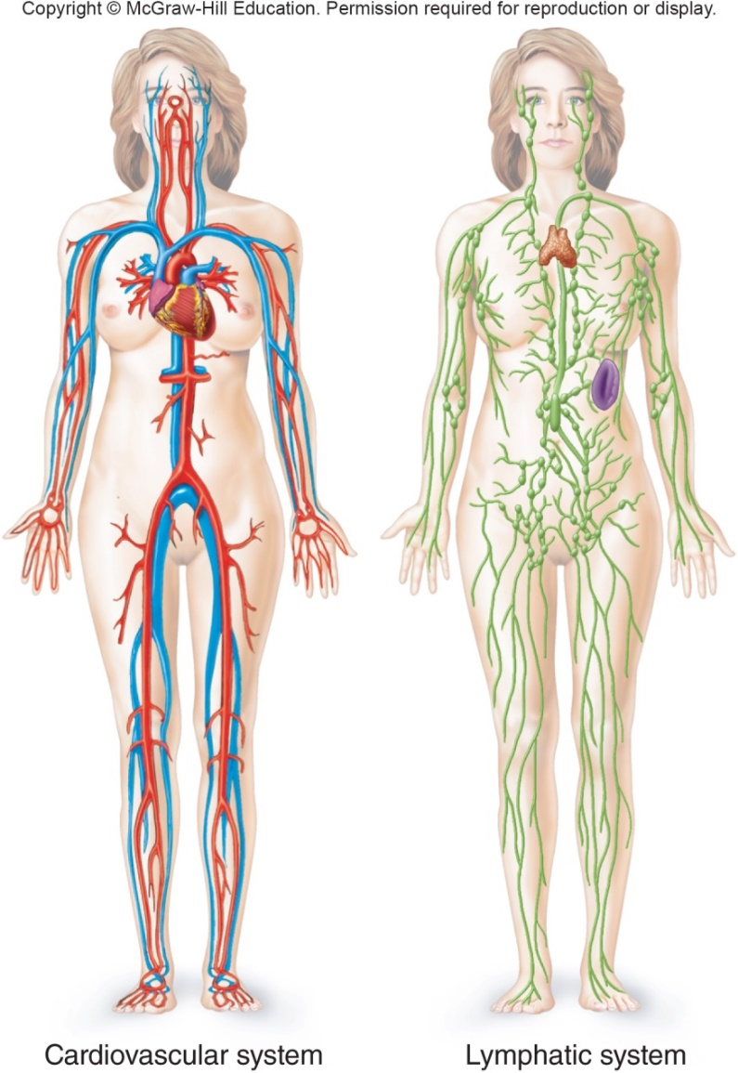
Figure 1.17 Organ Systems
Cardiovascular System:
Transportation of gases, nutrients, blood cells and wastes
Lymphatic System:
Transportation of fluids, lymphocyte production, body defense

Slide 29
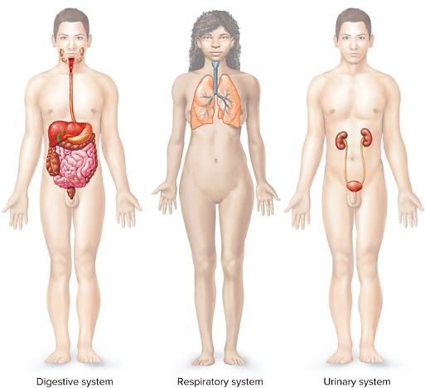
Figure 1.18 Organ Systems
Digestive System:
Receives food, breaks down food, excretes waste
Respiratory System:
Exchange of gases
Urinary System:
Removes blood wastes, regulates electrolyte & water balance, blood pressure

Slide 30
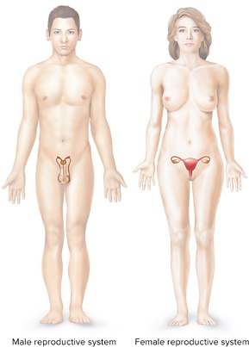
Figure 1.19 Organ Systems
Reproductive System:
Male and female systems produce and transport sex cells. Female also provides fetal development and childbirth.

Slide 31
Table 1.4 Organ Systems
Organ System | Major Organs | Major Functions
Integumentary | Skin, hair, nails, sweat glands, sebaceous glands | Protect tissues, regulate body temperature, support sensory receptors
Skeletal | Bones, ligaments, cartilages | Provide framework, protect soft tissues, provide attachments for muscles, produce blood cells, store inorganic salts
Muscular | Muscles | Cause movements, maintain posture, produce body heat
Nervous | Brain, spinal cord, nerves, sense organs | Detect changes, receive and interpret sensory information, stimulate muscles and glands
Endocrine | Glands that secrete hormones (pituitary gland, thyroid gland, parathyroid glands, adrenal glands, pancreas, ovaries, testes, pineal gland, and thymus) | Control metabolic activities of body structures
Cardiovascular | Heart, arteries, capillaries, veins | Move blood through blood vessels and transport substances throughout body
Lymphatic | Lymphatic vessels, lymph nodes, thymus, spleen | Return tissue fluid to the blood, carry certain absorbed food molecules, defend the body against infection
Digestive | Mouth, tongue, teeth, salivary glands, pharynx, esophagus, stomach, liver, gallbladder, pancreas, small and large intestines | Receive, break down, and absorb food; eliminate unabsorbed material
Respiratory | Nasal cavity, pharynx, larynx, trachea, bronchi, lungs | Intake and output of air, exchange of gases between air and blood
Urinary | Kidneys, ureters, urinary bladder, urethra | Remove wastes from blood, maintain water and electrolyte balance, store and eliminate urine
Reproductive | Male: scrotum, testes, epididymides, ductus deferentia, seminal vesicles, prostate gland, bulbourethral glands, urethra, penis Female: ovaries, uterine tubes, uterus, vagina, clitoris, vulva | Produce and maintain sperm cells, transfer sperm cells into female reproductive tract Produce and maintain egg cells, receive sperm cells, support development of an embryo, and function in birth process

Slide 32
Figure 1.20 Anatomical Terminology
Anatomical Position:
Standing erect, facing forward, upper limbs at the sides, palms facing forward
Anatomical terms of relative position are based on a person standing in anatomical position.

Slide 33
Terms of Relative Position
Superior (above) / Inferior (below)
Anterior or ventral (toward the front) / Posterior or dorsal (toward the back)
Medial (toward the midline) / Intermediate (in the middle) / Lateral (away from midline)
Proximal (close to point of attachment to trunk) / Distal (farther from point of attachment to trunk)
Supine (face/anterior surface facing up) / Prone (face/anterior surface facing down)
Superficial (close to body surface) / Deep (more internal)

Slide 35
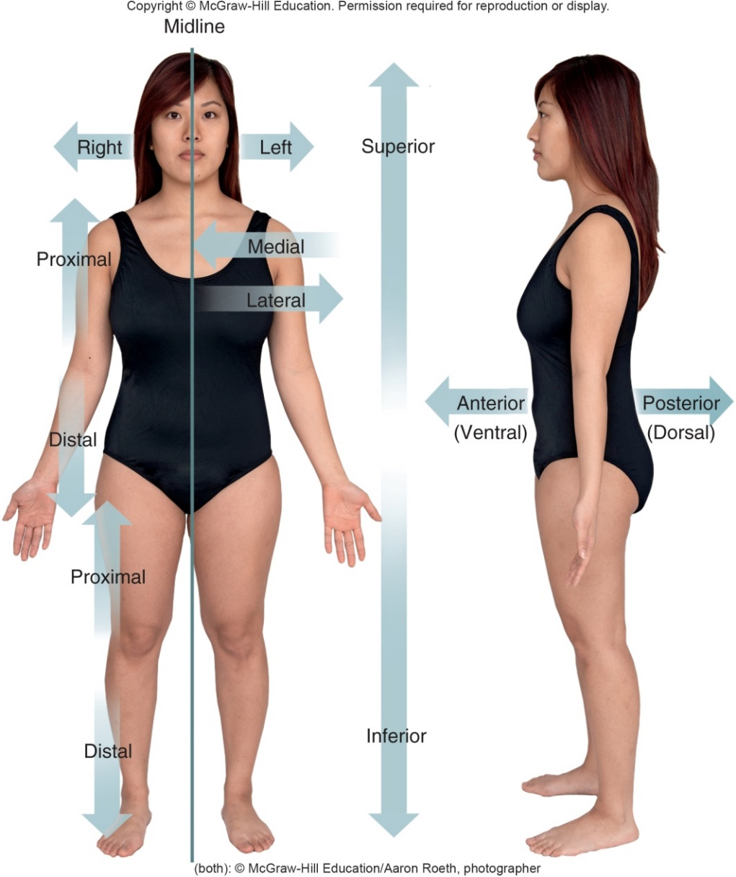
Figure 1.21 Terms of Relative Position
(both): © McGraw-Hill Education/Aaron Roeth, photographer

Slide 36
Body Sections or Planes
Sagittal section: longitudinal cut that divides body into left and right portions
Mid-sagittal/Median section: divides body into equal left and right portions
Parasagittal section: sagittal section lateral to midline; divides body into unequal left and right portions
Transverse or Horizontal section: divides body into superior and inferior portions
Coronal or Frontal section: longitudinal cut that divides body into anterior and posterior portions

Slide 38
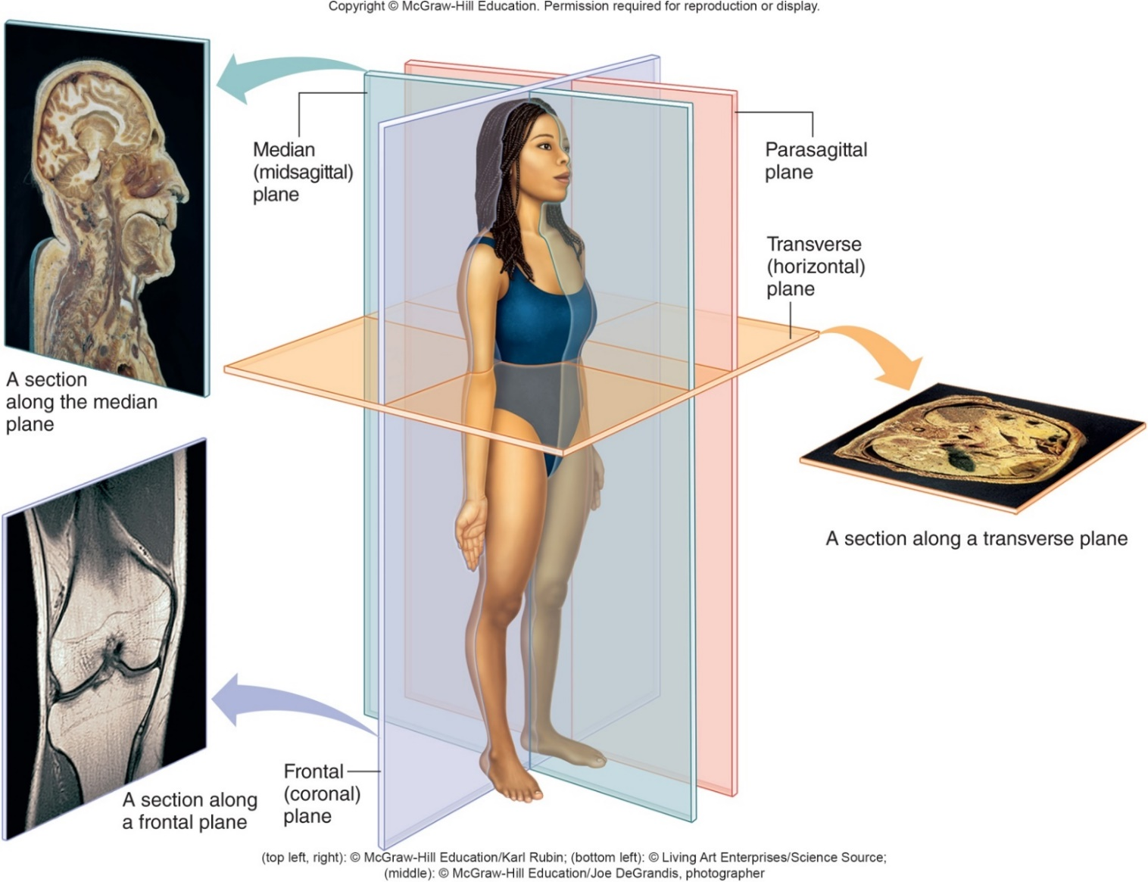
Figure 1.22 Body Sections
(top left, right): © McGraw-Hill Education/Karl Rubin;
(bottom left): © Living Art Enterprises/Science Source;
(middle): © McGraw-Hill Education/Joe DeGrandis, photographer

Slide 39
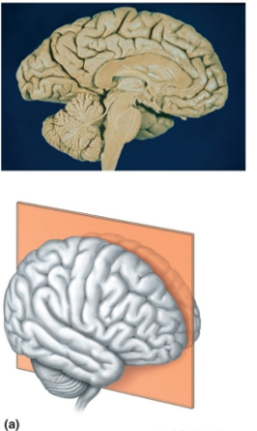
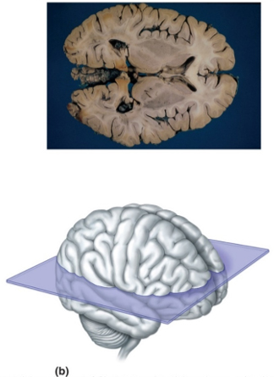
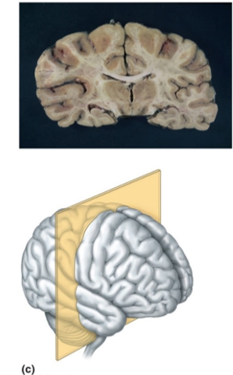
Figure 1.23 Body Sections: The Brain
Sagittal Section
Transverse Section
Frontal section
(a): © Patrick J. Lynch/Science Source;
(b): © Biophoto Associates/Science Source;
(c): © A. Glauberman/Science Source

Slide 40
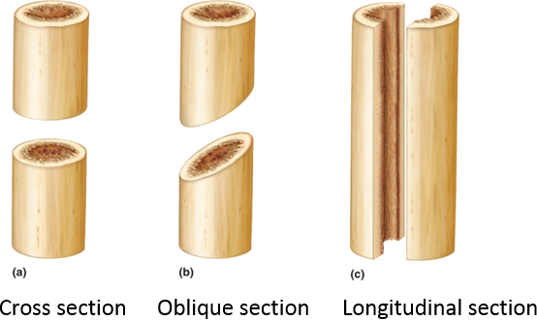
Figure 1.24 Body Sections in Cylindrical Organs
These sections are found in organs such as blood vessels, the ureter, the trachea, or the intestines.

Slide 41
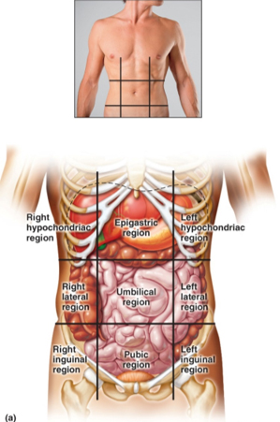
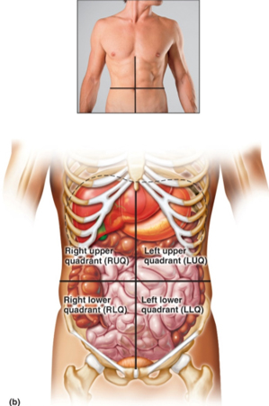
Figure 1.25 Body Regions and Quadrants
Abdominal Regions
Abdominal Quadrants
(a-b): © I love images/Male Body/Alamy RF

Slide 42
