Slide 1
Joint Types, Movements, & Disorders
Chapter 8

Slide 2
8.1 Classification of Joints
Joints, also called articulations: sites where two or more bones meet
Functions of joints: give skeleton mobility and hold skeleton together
Two classifications:
Structural: three types based on what material binds the joints and whether a cavity is present
Fibrous
Cartilaginous
Synovial

Slide 3
8.1 Classification of Joints
Functional classifications: three types based on movement joint allows
Synarthroses: immovable joints
Amphiarthroses: slightly movable joints
Diarthroses: freely movable joints
Structural classifications are more clear cut, so these will be used here

Slide 4
8.2 Fibrous Joints
Bones joined by dense fibrous connective tissue
No joint cavity
Most are immovable
Depends on length of connective tissue fibers
Three types of fibrous joints
Sutures
Syndesmoses
Gomphoses

Slide 5
Sutures
Rigid, interlocking joints of skull
Allow for growth during youth
Contain short connective tissue fibers that allow for expansion
In middle age, sutures ossify and fuse
Immovable joints join skull into one unit that protects brain
Closed, immovable sutures referred to as synostoses

Slide 6
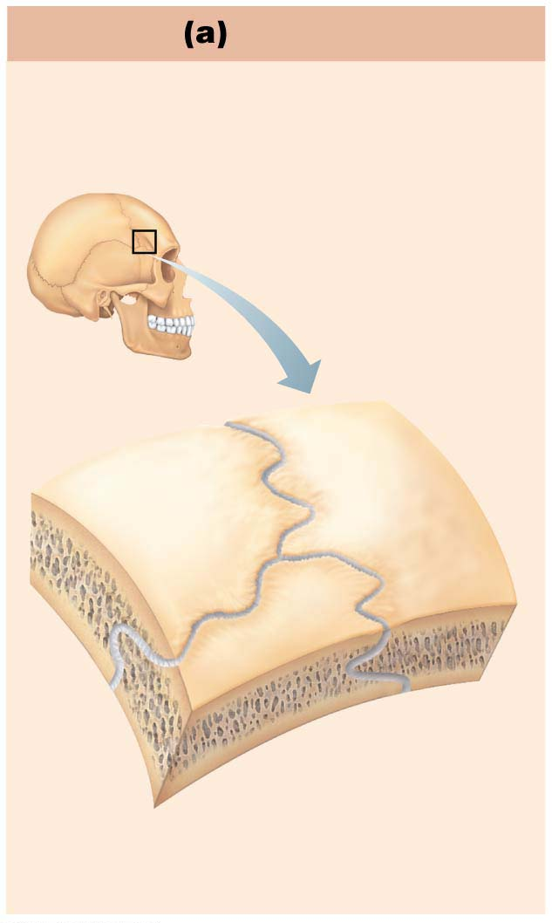
Figure 8.1a Fibrous joints.
Suture
Joint held together with very short,
interconnecting fibers, and bone
edges interlock. Found only in
the skull.
Suture
line
Fibrous
connective
tissue

Slide 7
Syndesmoses
Bones connected by ligaments, bands of fibrous tissue
Fiber length varies, so movement varies
Short fibers offer little to no movement
Example: inferior tibiofibular joint
Longer fibers offer a larger amount of movement
Example: interosseous membrane connecting radius and ulna

Slide 8
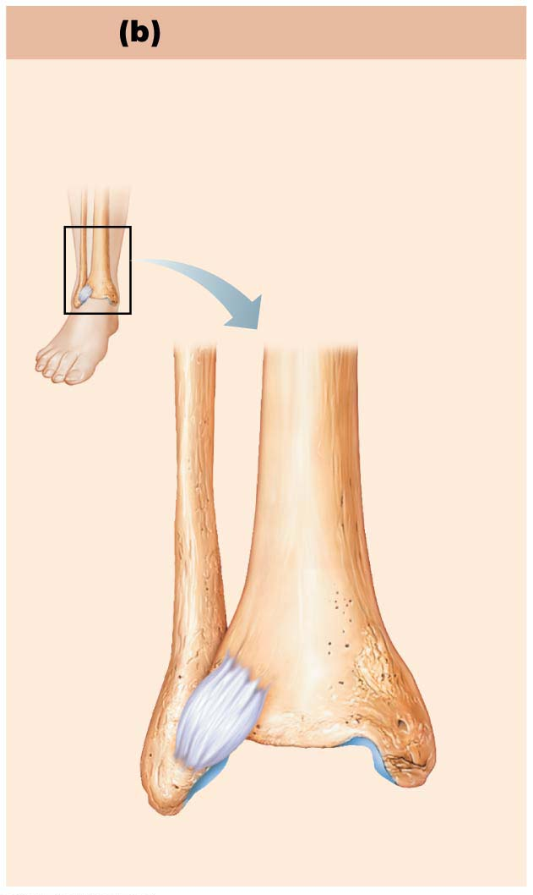
Figure 8.1b Fibrous joints.
Syndesmosis
Joint held together by a ligament.
Fibrous tissue can vary in length,
but is longer than in sutures.
Fibula
Tibia
Ligament

Slide 9
Gomphoses
Peg-in-socket joints
Only examples are the teeth in alveolar sockets
Fibrous connection is the periodontal ligament
Holds tooth in socket

Slide 10
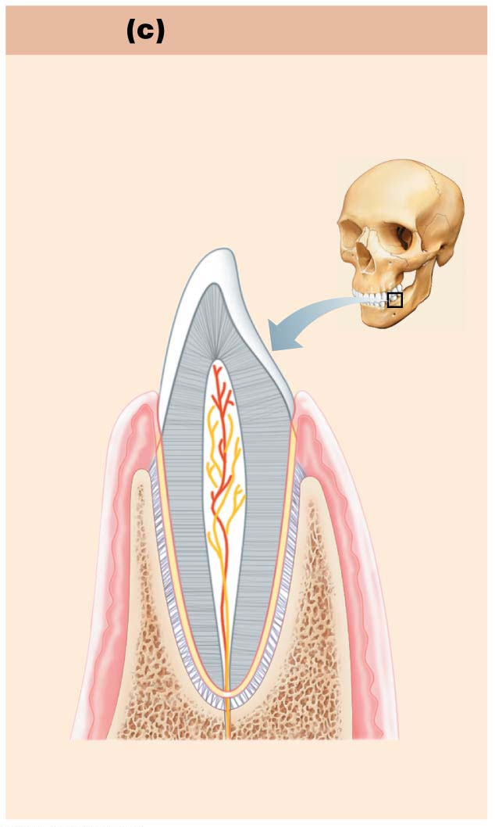
Figure 8.1c Fibrous joints.
Gomphosis
“Peg in socket” fibrous joint.
Periodontal ligament holds tooth
in socket.
Socket of
alveolar
process
Root of
tooth
Periodontal
ligament

Slide 11
8.3 Cartilaginous Joints
Bones united by cartilage
Like fibrous joints, have no joint cavity
Not highly movable
Two types
Synchondroses
Symphyses

Slide 12
Synchondroses
Bar or plate of hyaline cartilage unites bones
Almost all are synarthrotic (immovable)
Examples
Temporary epiphyseal plate joints
Become synostoses after plate closure
Cartilage of 1st rib with manubrium of sternum

Slide 13
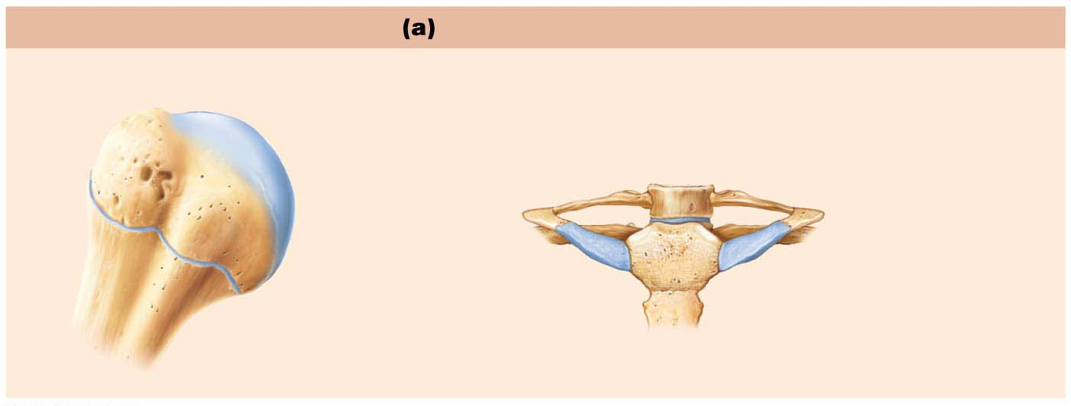
Figure 8.2a Cartilaginous joints.
Synchondroses
Bones united by hyaline cartilage
Sternum
(manubrium)
Epiphyseal
plate (temporary
hyaline cartilage
joint)
Joint between
first rib and
sternum
(immovable)

Slide 14
Symphyses
Fibrocartilage unites bone in symphysis joint
Hyaline cartilage also present as articular cartilage on bony surfaces
Symphyses are strong, amphiarthrotic (slightly movable) joints
Examples
Intervertebral joints
Pubic symphysis

Slide 15
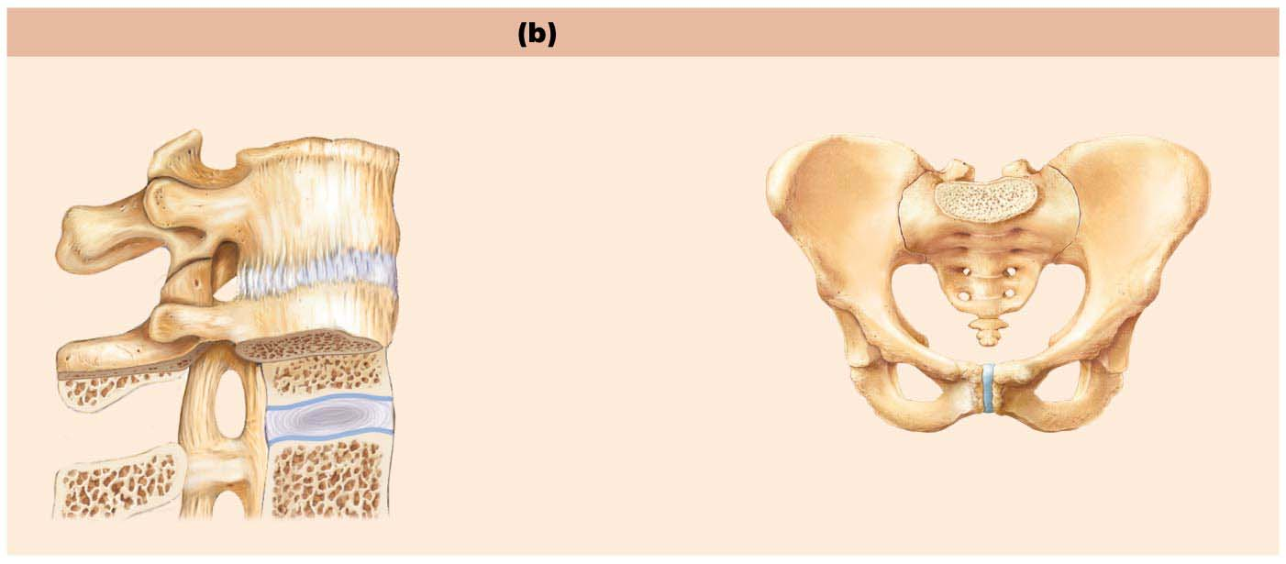
Figure 8.2b Cartilaginous joints.
Symphyses
Bones united by fibrocartilage
Body of vertebra
Fibrocartilaginous
intervertebral disc
(sandwiched between
hyaline cartilage)
Pubic symphysis

Slide 16
8.4 Synovial Joints
Bones separated by fluid-filled joint cavity
All are diarthrotic (freely movable)
Include almost all limb joints
Characteristics of synovial joints
Have six general features
Have bursae and tendon sheaths associated with them
Stability is influenced by three factors
Allow several types of movements
Classified into six different types

Slide 17
General Structure
Synovial joints have six general features:
Articular cartilage: consists of hyaline cartilage covering ends of bones
Prevents crushing of bone ends
Joint (synovial) cavity: small, fluid-filled potential space that is unique to synovial joints
Articular (joint) capsule: two layers thick
External fibrous layer: dense irregular connective tissue
Inner synovial membrane: loose connective tissue that makes synovial fluid

Slide 18
General Structure (cont.)
Synovial fluid: viscous, slippery filtrate of plasma and hyaluronic acid
Lubricates and nourishes articular cartilage
Contains phagocytic cells to remove microbes and debris
Different types of reinforcing ligaments
Capsular: thickened part of fibrous layer
Extracapsular: outside the capsule
Intracapsular: deep to capsule; covered by synovial membrane

Slide 19
General Structure (cont.)
Nerves and blood vessels
Nerves detect pain; monitor joint position and stretch
Capillary beds supply filtrate for synovial fluid

Slide 20
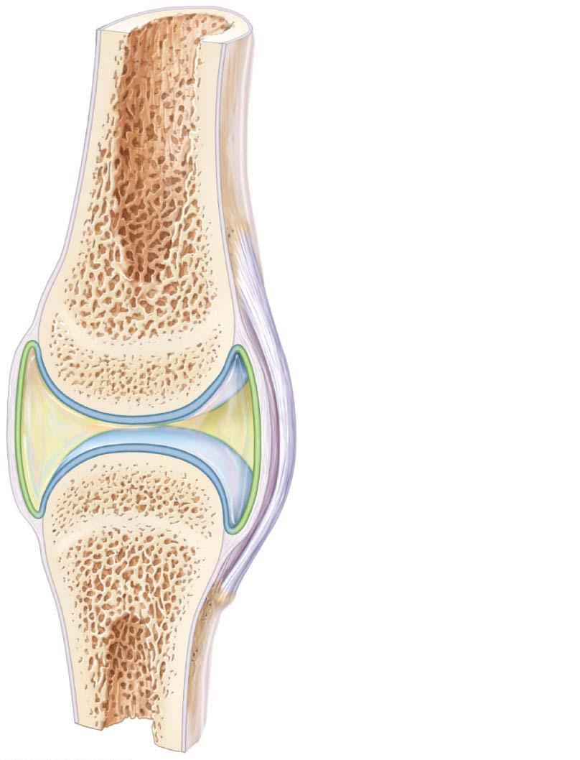
Figure 8.3 General structure of a synovial joint.
Ligament
Joint cavity
(contains
synovial fluid)
Articular (hyaline)
cartilage
Fibrous
layer
Synovial
membrane
(secretes
synovial
fluid)
Articular
capsule
Periosteum

Slide 21
General Structure (cont.)
Other features of some synovial joints:
Fatty pads
For cushioning between fibrous layer of capsule and synovial membrane or bone
Articular discs (menisci)
Fibrocartilage separates articular surfaces to improve “fit” of bone ends, stabilize joint, and reduce wear and tear

Slide 22
Bursae and Tendon Sheaths
Bags of synovial fluid that act as lubricating “ball bearing”
Not strictly part of synovial joints, but closely associated
Bursae: reduce friction where ligaments, muscles, skin, tendons, or bones rub together
Tendon sheaths: elongated bursae wrapped completely around tendons subjected to friction

Slide 23
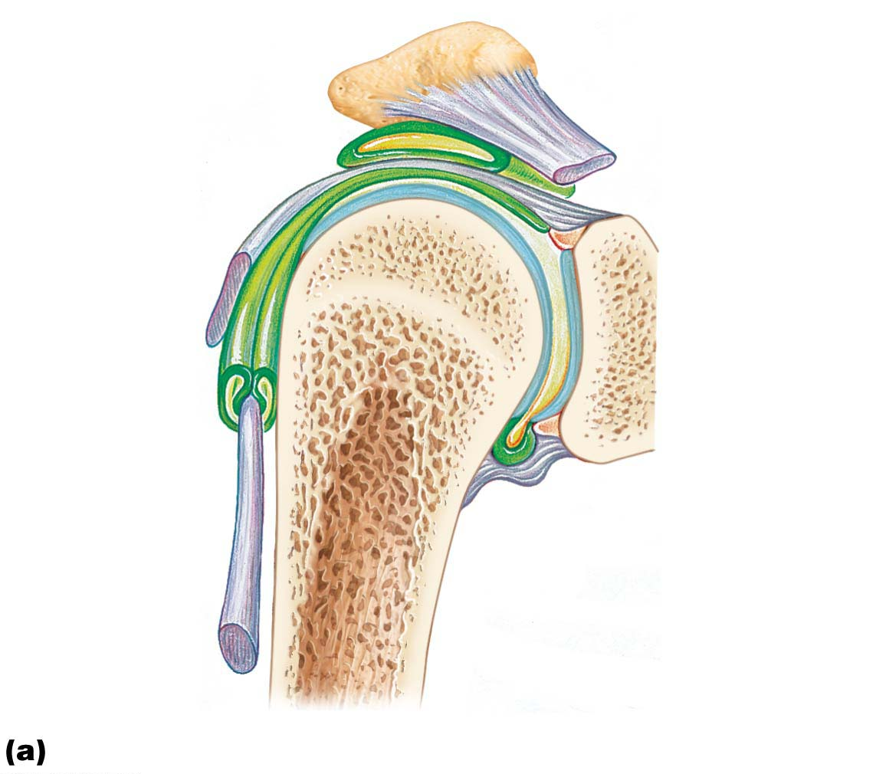
Figure 8.4a Bursae and tendon sheaths.
Acromion
of scapula
Subacromial
bursa
Joint cavity
containing
synovial fluid
Fibrous layer of
articular capsule
Articular
cartilage
Tendon
sheath
Synovial
membrane
Tendon of
long head
of biceps
brachii muscle
Fibrous
layer
Humerus
Frontal section through the right shoulder joint

Slide 24
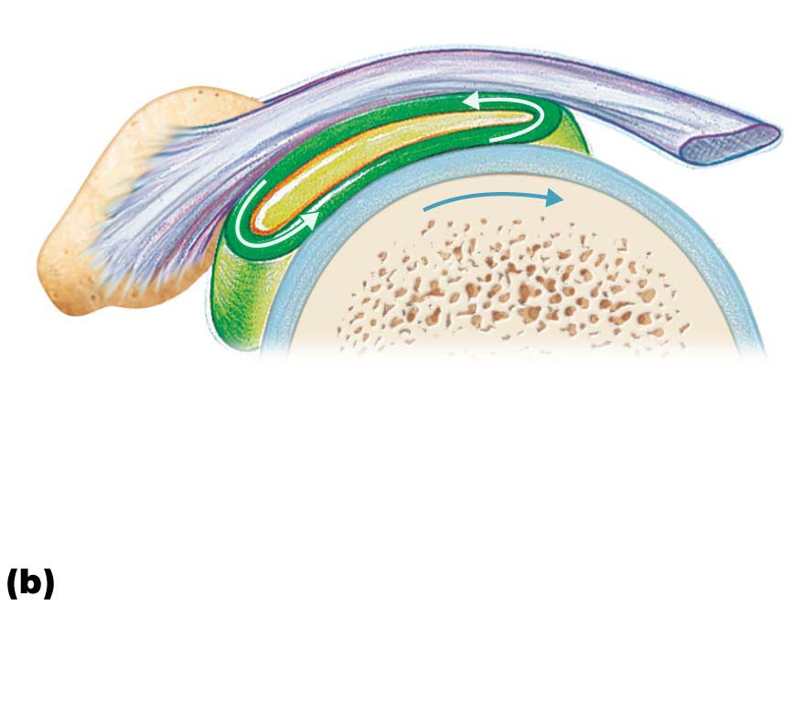
Figure 8.4b Bursae and tendon sheaths.
Bursa rolls
and lessens
friction.
Humerus head
rolls medially
as arm abducts.
Humerus moving
Enlargement of (a), showing how
a bursa eliminates friction where
a ligament (or other structure) would
rub against a bone

Slide 25
Factors Influencing Stability of Synovial Joints
Three factors determine stability of joints to prevent dislocations:
Shape of articular surface (minor role)
Shallow surfaces less stable than ball-and-socket
Ligament number and location (limited role)
The more ligaments, the stronger the joint
Muscle tone keeps tendons taut as they cross joints (most important)
Extremely important in reinforcing shoulder and knee joints and arches of the foot

Slide 26
Table 8.2-1 Structural and Functional Characteristics of Body Joints

Slide 27
Table 8.2-2 Structural and Functional Characteristics of Body Joints (continued)

Slide 28
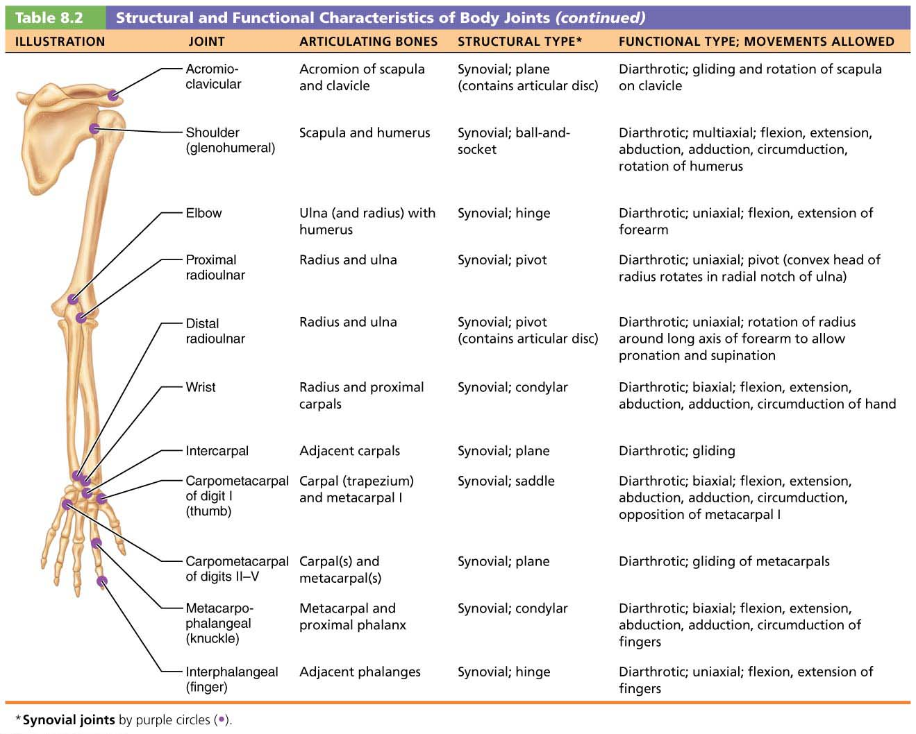
Table 8.2-3 Structural and Functional Characteristics of Body Joints (continued)

Slide 29
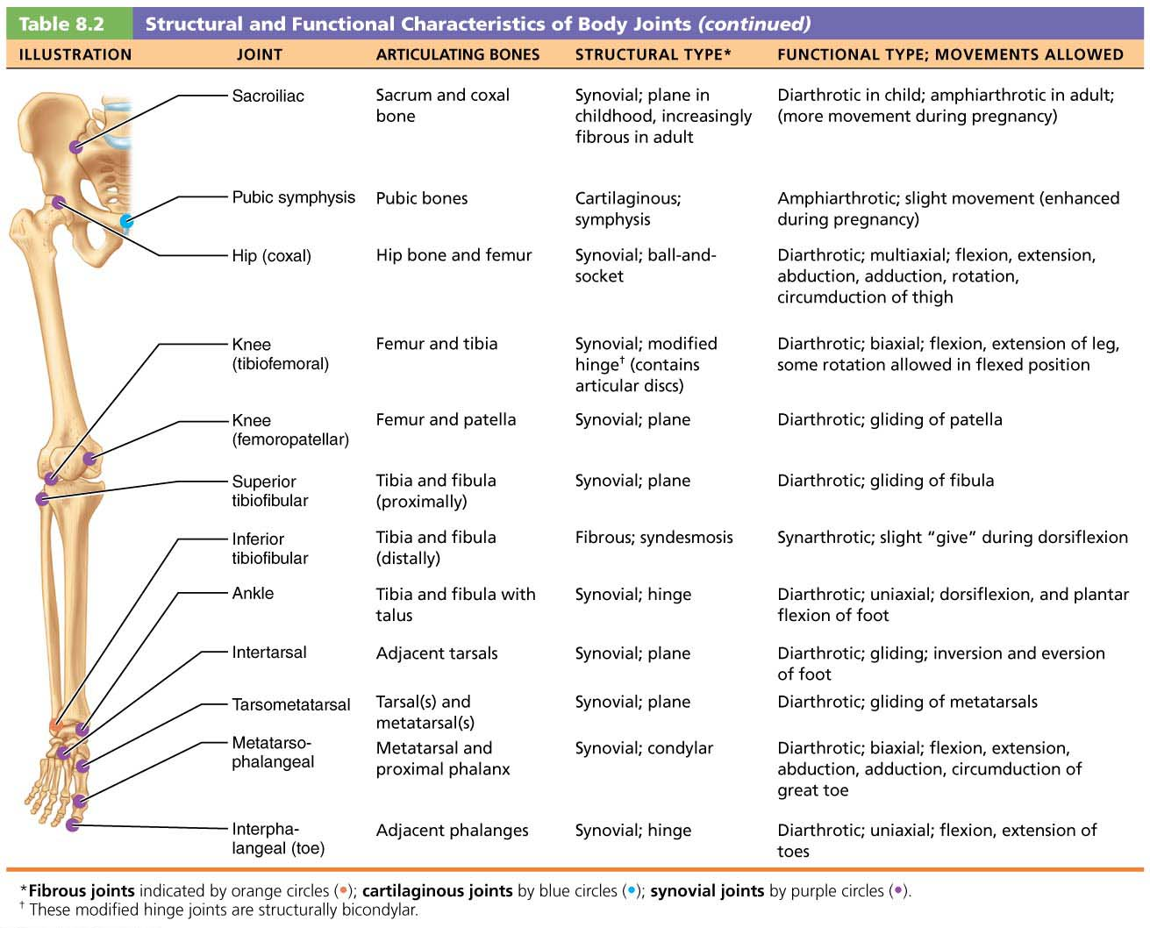
Table 8.2-3 Structural and Functional Characteristics of Body Joints (continued)

Slide 30
Movements Allowed by Synovial Joints
All muscles attach to bone or connective tissue at no fewer than two points
Origin: attachment to immovable bone
Insertion: attachment to movable bone
Muscle contraction causes insertion to move toward origin
Movements occur along transverse, frontal, or sagittal planes

Slide 31
Movements Allowed by Synovial Joints (cont.)
Range of motion allowed by synovial joints
Nonaxial: slipping movements only
Uniaxial: movement in one plane
Biaxial: movement in two planes
Multiaxial: movement in or around all three planes
Three general types of movements
Gliding
Angular movements
Rotation

Slide 32
Movements Allowed by Synovial Joints (cont.)
Gliding movements
One flat bone surface glides or slips over another similar surface
Examples
Intercarpal joints
Intertarsal joints
Between articular processes of vertebrae

Slide 33
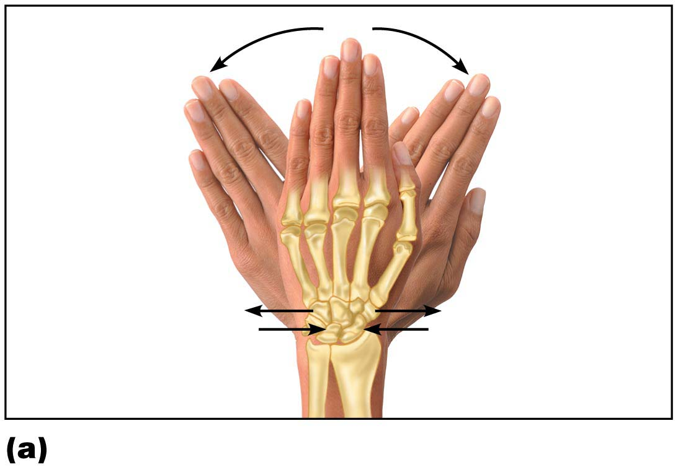
Figure 8.5a Movements allowed by synovial joints.
Gliding
Gliding movements at the wrist

Slide 34
Movements Allowed by Synovial Joints (cont.)
Angular movements
Increase or decrease angle between two bones
Movement along sagittal plane
Angular movements include:
Flexion: decreases the angle of the joint
Extension: increases the angle of the joint
Hyperextension: movement beyond the anatomical position

Slide 35
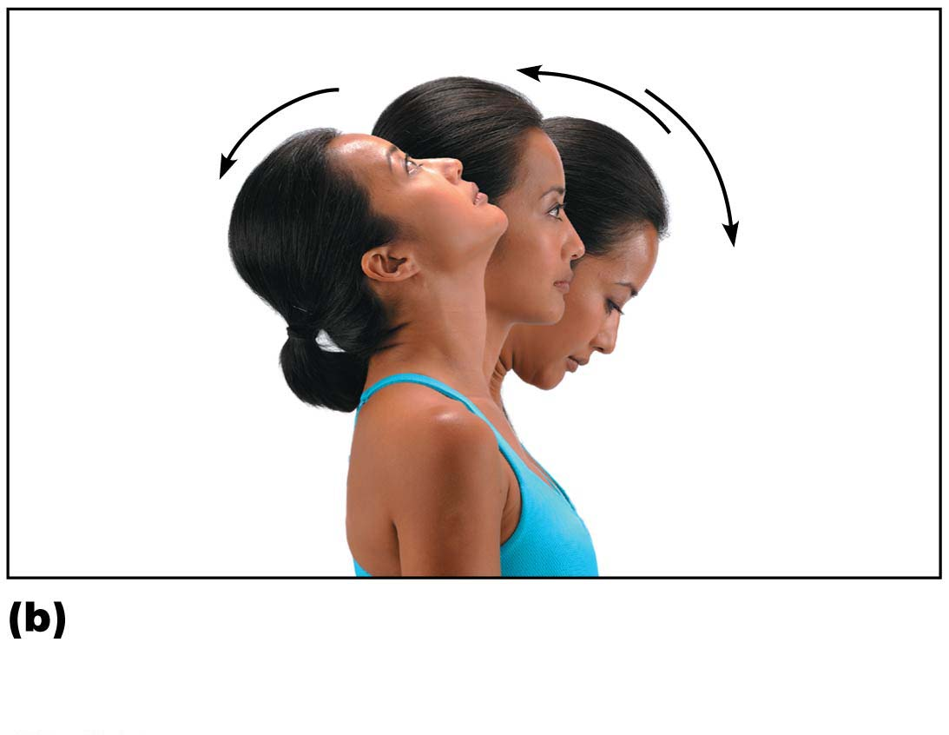
Figure 8.5b Movements allowed by synovial joints.
Extension
Hyperextension
Flexion
Angular movements: flexion,
extension, and hyperextension
of the neck

Slide 36
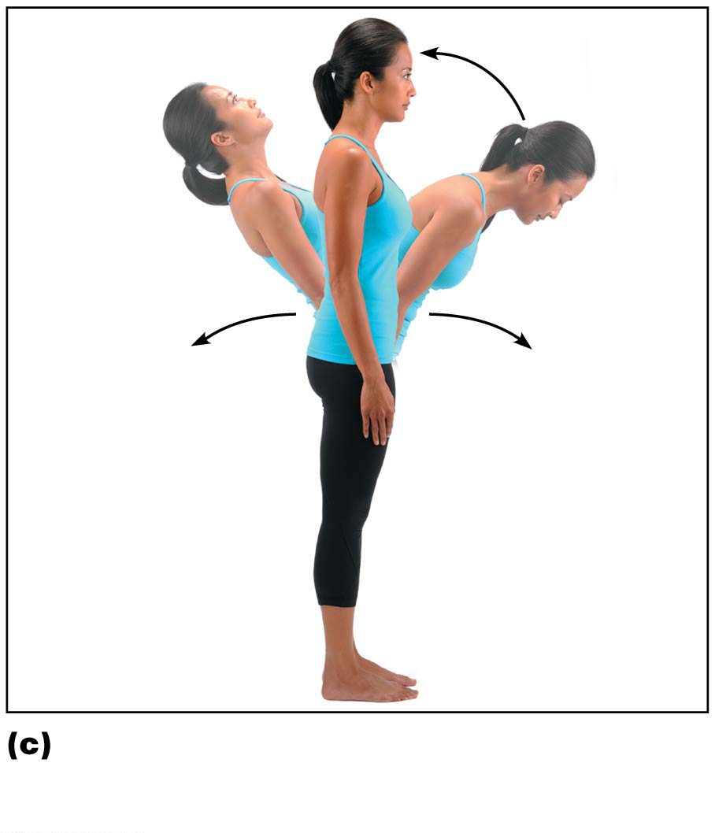
Figure 8.5c Movements allowed by synovial joints.
Extension
Hyperextension
Flexion
Angular movements: flexion,
extension, and hyperextension of
the vertebral column

Slide 37
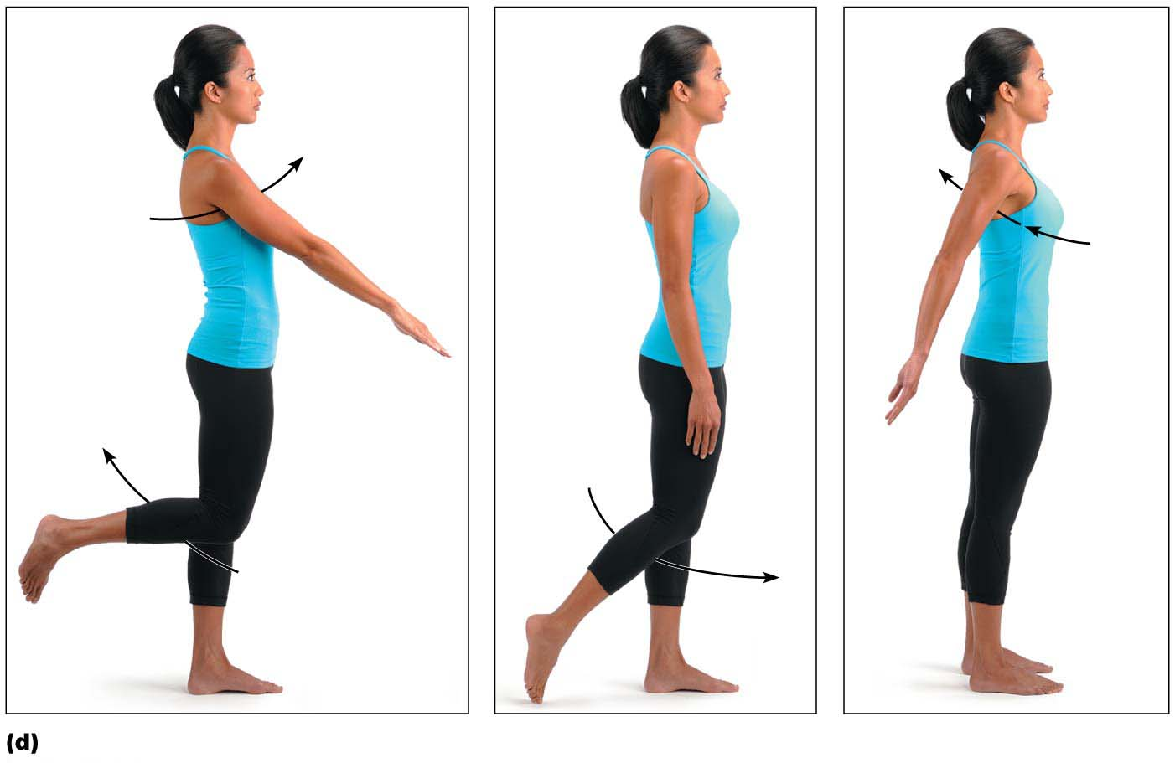
Figure 8.5d Movements allowed by synovial joints.
Flexion
Hyper-
extension
Extension
Flexion
Extension
Angular movements: flexion, extension, and hyperextension at the shoulder and knee

Slide 38
Movements Allowed by Synovial Joints (cont.)
Angular movements (cont.)
Abduction: movement along frontal plane, away from the midline
Adduction: movement along frontal plane, toward the midline
Circumduction
Involves flexion, abduction, extension, and adduction of limb
Limb describes cone in space

Slide 39
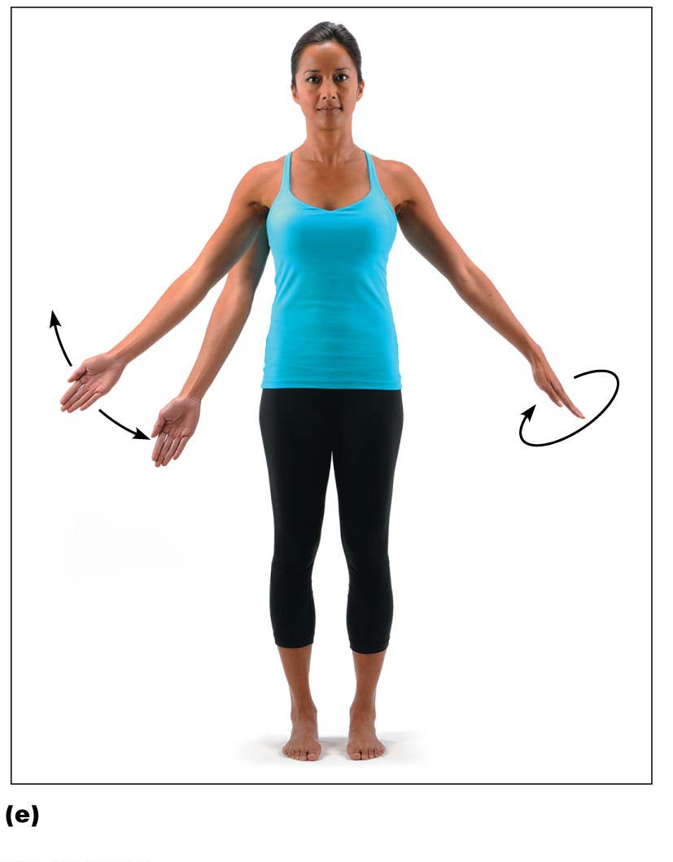
Figure 8.5e Movements allowed by synovial joints.
Abduction
Adduction
Circumduction
Angular movements: abduction, adduction, and
circumduction of the upper limb at the shoulder

Slide 40
Movements Allowed by Synovial Joints (cont.)
Rotation: turning of bone around its own long axis, toward midline or away from it
Medial: rotation toward midline
Lateral: rotation away from midline
Examples
Rotation between C₁ and C₂ vertebrae
Rotation of humerus and femur

Slide 41
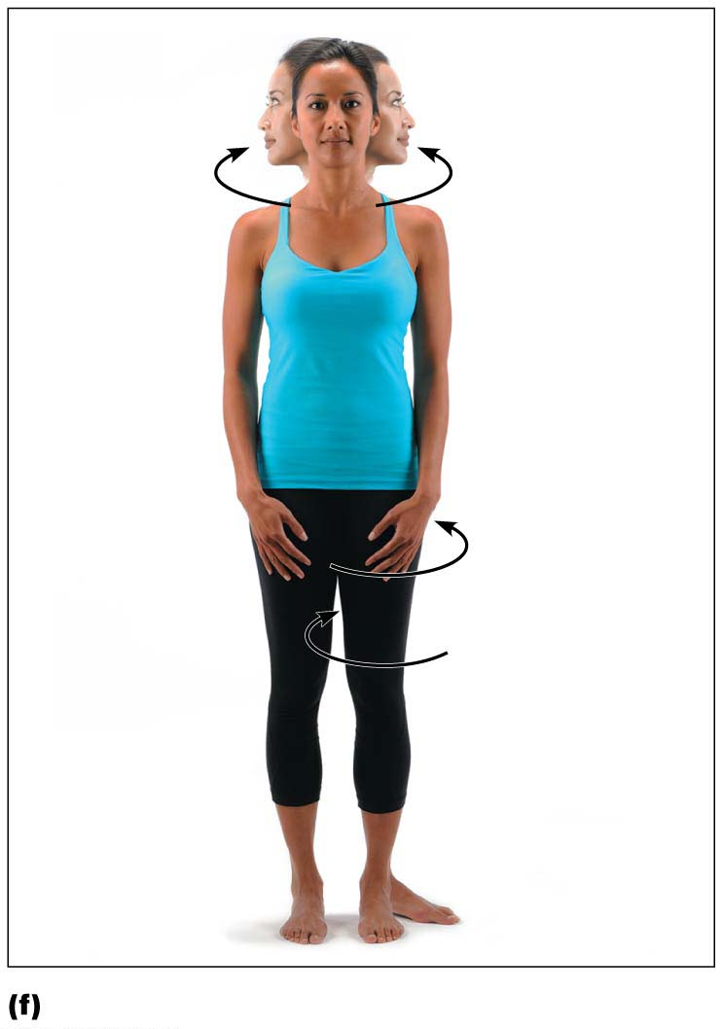
Figure 8.5f Movements allowed by synovial joints.
Rotation
Lateral
rotation
Medial
rotation
Rotation of the head, neck, and lower limb

Slide 42
Movements Allowed by Synovial Joints (cont.)
Special movements
Supination and pronation: rotation of radius and ulna
Supination: palms face anteriorly
Radius and ulna are parallel
Pronation: palms face posteriorly
Radius rotates over ulna
Dorsiflexion and plantar flexion of foot
Dorsiflexion: bending foot toward shin
Plantar flexion: pointing toes

Slide 43
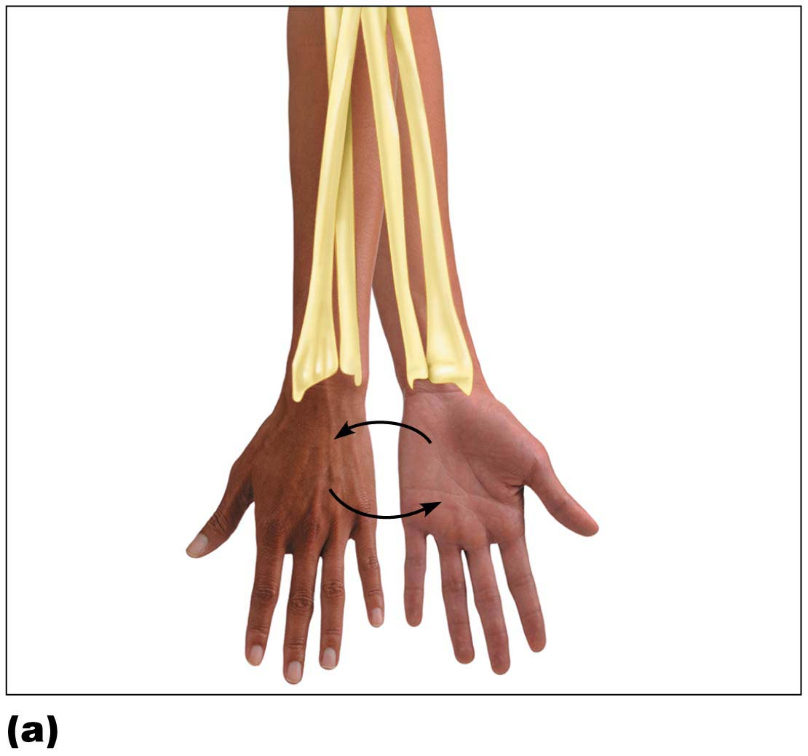
Figure 8.6a Special body movements.
Pronation
(radius rotates
over ulna)
Supination
(radius and ulna
are parallel)
P
S
Pronation (P) and supination (S)

Slide 44
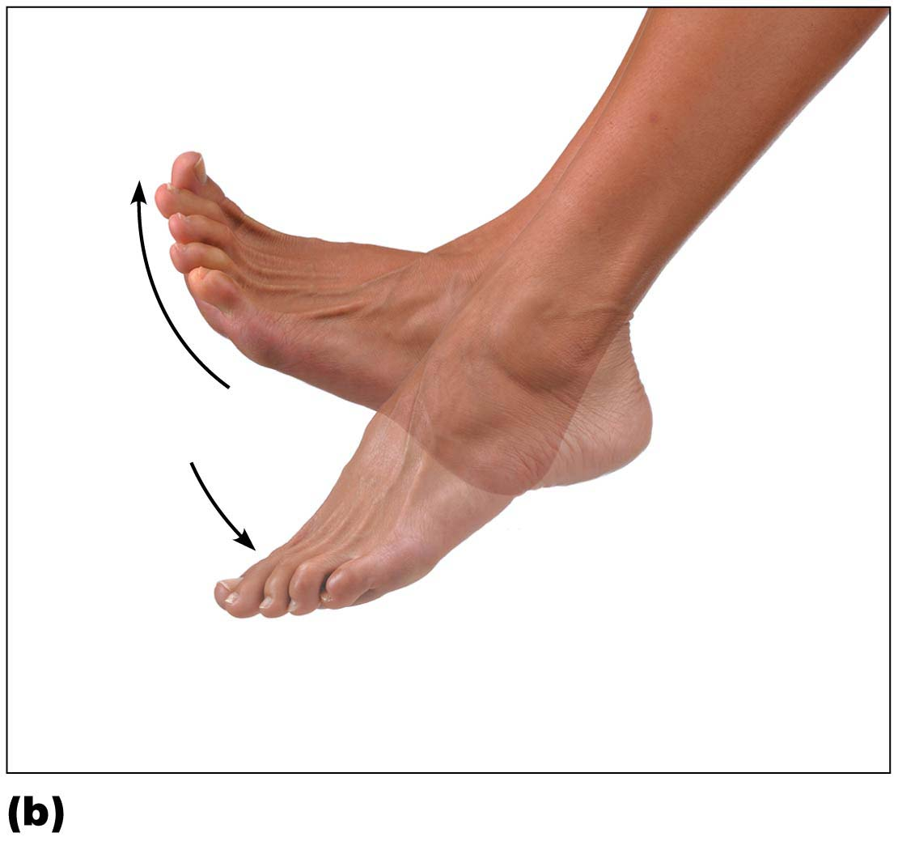
Figure 8.6b Special body movements.
Dorsiflexion
Plantar flexion
Dorsiflexion and plantar flexion

Slide 45
Movements Allowed by Synovial Joints (cont.)
Special movements (cont.)
Inversion and eversion of foot
Inversion: sole of foot faces medially
Eversion: sole of foot faces laterally
Protraction and retraction: movement in lateral plane
Protraction: mandible juts out
Retraction: mandible is pulled toward neck

Slide 46
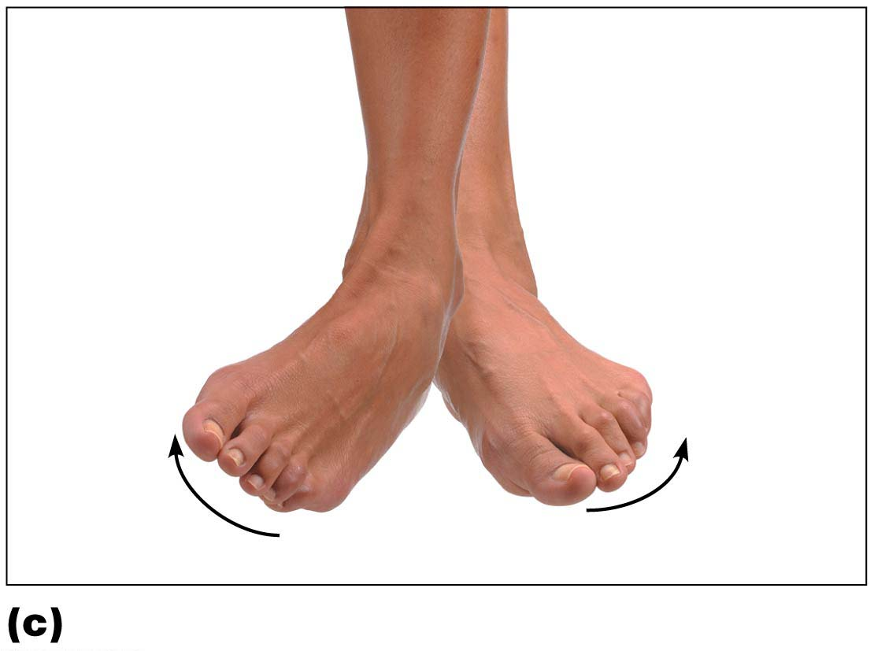
Figure 8.6c Special body movements.
Inversion
Eversion
Inversion and eversion

Slide 47
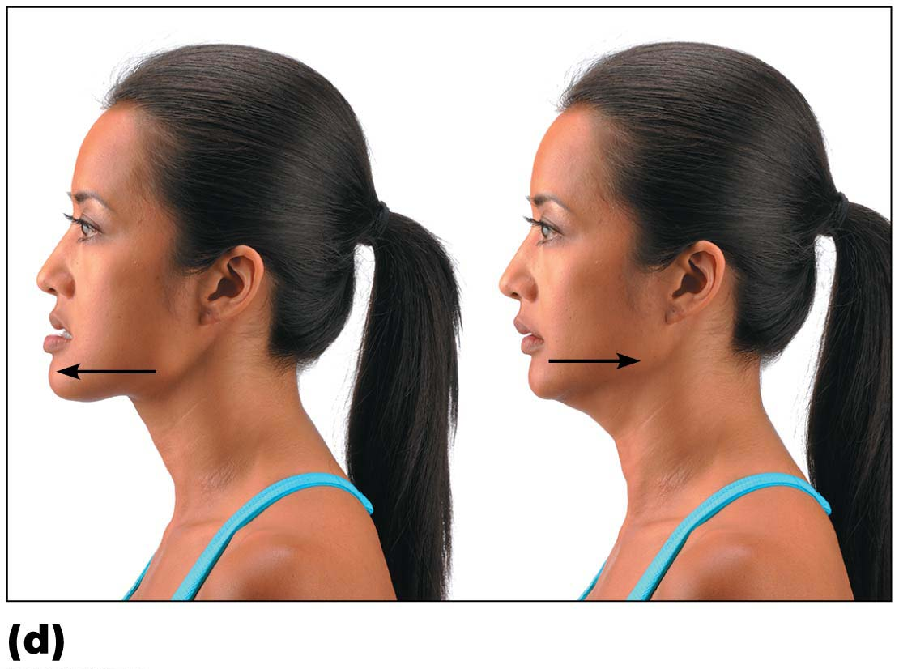
Figure 8.6d Special body movements.
Protraction
of mandible
Retraction
of mandible
Protraction and retraction

Slide 48
Movements Allowed by Synovial Joints (cont.)
Special movements (cont.)
Elevation and depression of mandible
Elevation: lifting body part superiorly
Example: shrugging shoulders
Depression: lowering body part
Example: opening jaw
Opposition: movement of thumb
Example: touching thumb to tips of other fingers on same hand or any grasping movement

Slide 49
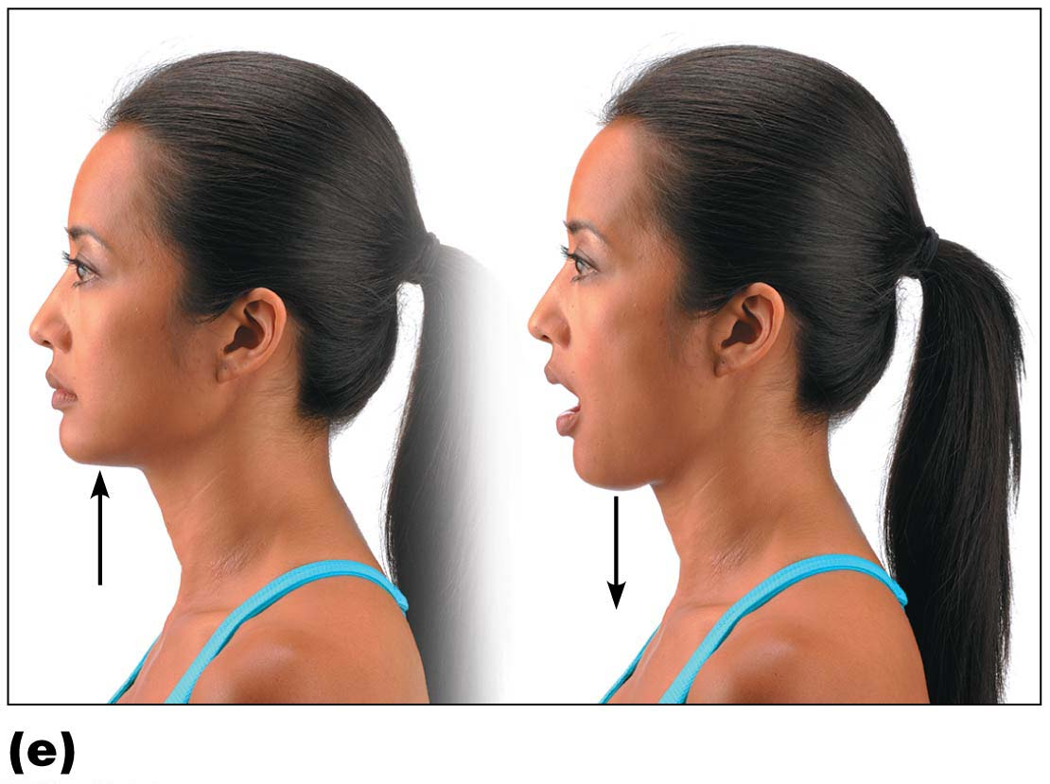
Figure 8.6e Special body movements.
Elevation
of mandible
Depression
of mandible
Elevation and depression

Slide 50
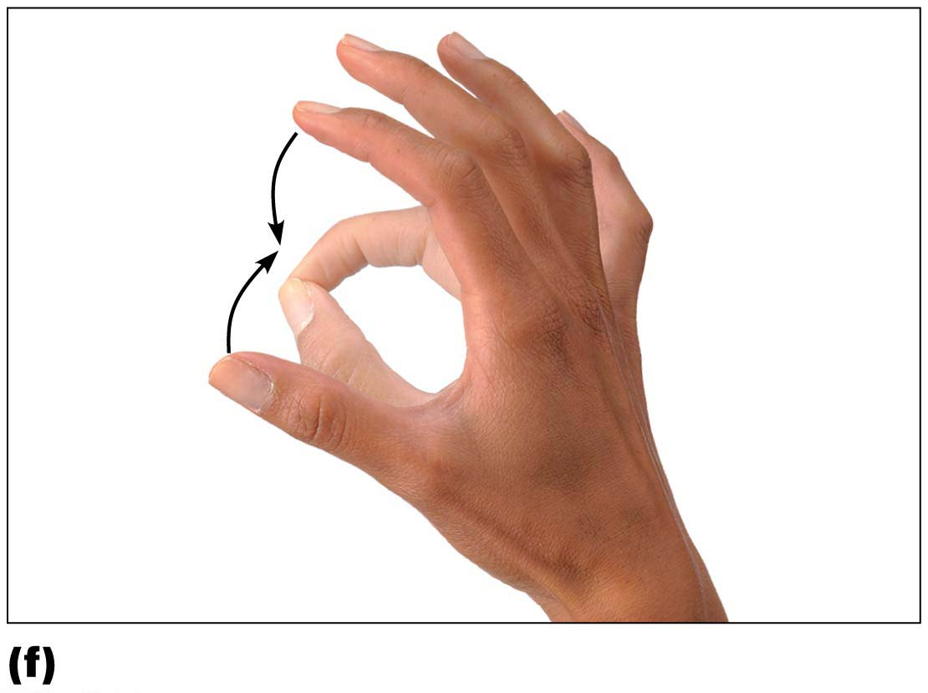
Figure 8.6f Special body movements.
Opposition
Opposition

Slide 51
Types of Synovial Joints
There are six different types of synovial joints
Categories are based on shape of articular surface, as well as movement joint is capable of
Plane
Hinge
Pivot
Condylar
Saddle
Ball-and-socket

Slide 52
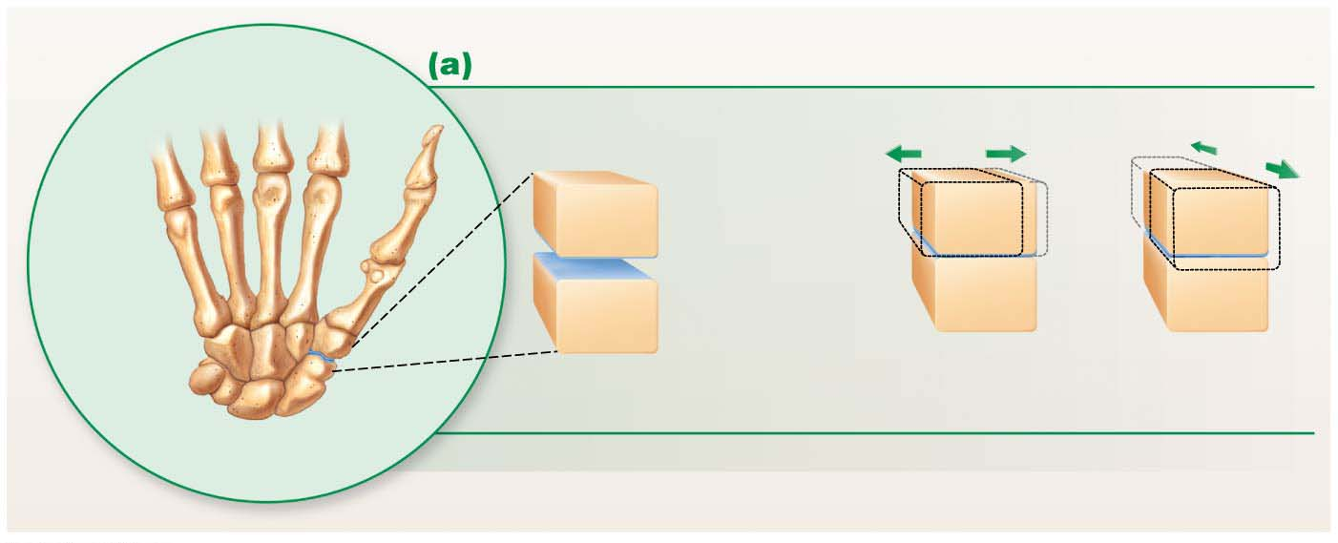
Focus Figure 8.1a Six types of synovial joint shapes determine the movements that can occur at a joint.
Plane joint
Nonaxial movement
Meta-
carpals
Flat
articular
surfaces
Carpals
Gliding
Examples: Intercarpal joints, intertarsal joints, joints between
vertebral articular surfaces

Slide 53
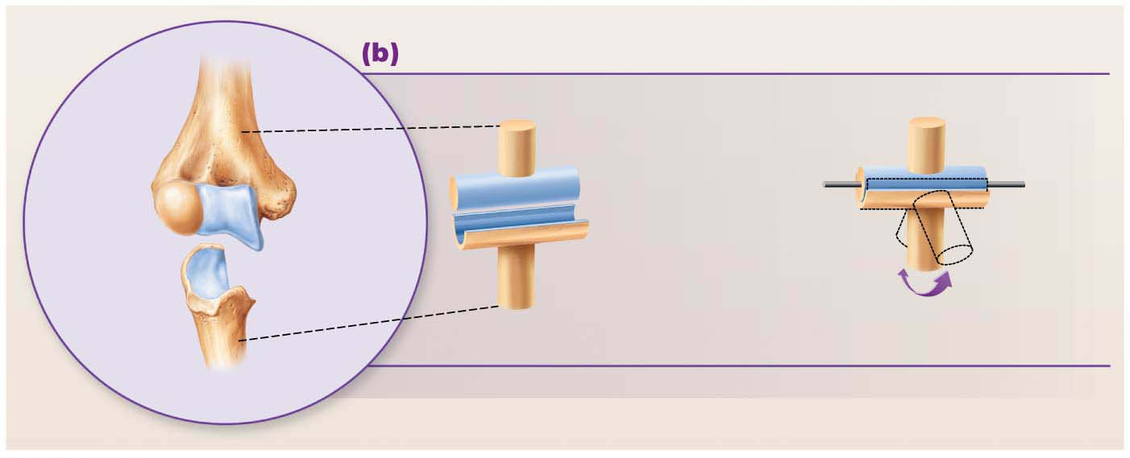
Focus Figure 8.1b Six types of synovial joint shapes determine the movements that can occur at a joint.
Hinge joint
Uniaxial movement
Humerus
Medial/lateral
axis
Cylinder
Trough
Ulna
Flexion and extension
Examples: Elbow joints, interphalangeal joints

Slide 54
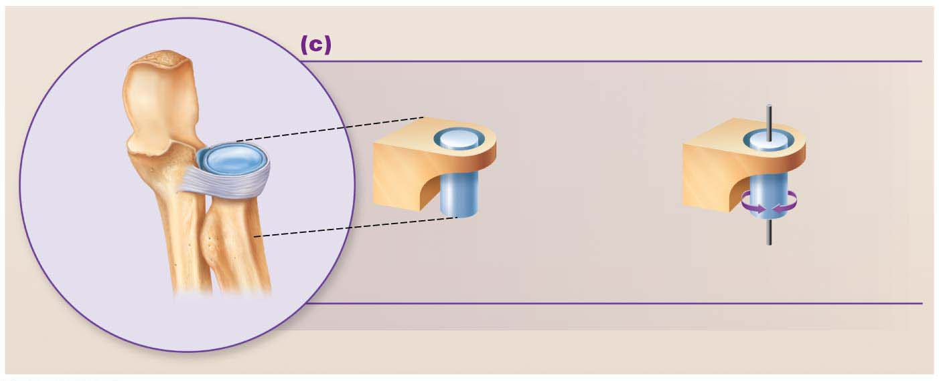
Focus Figure 8.1c Six types of synovial joint shapes determine the movements that can occur at a joint.
Pivot joint
Uniaxial movement
Sleeve
(bone and
ligament)
Vertical axis
Ulna
Axle (rounded
bone)
Radius
Rotation
Examples: Proximal radioulnar joints, atlantoaxial joint

Slide 55
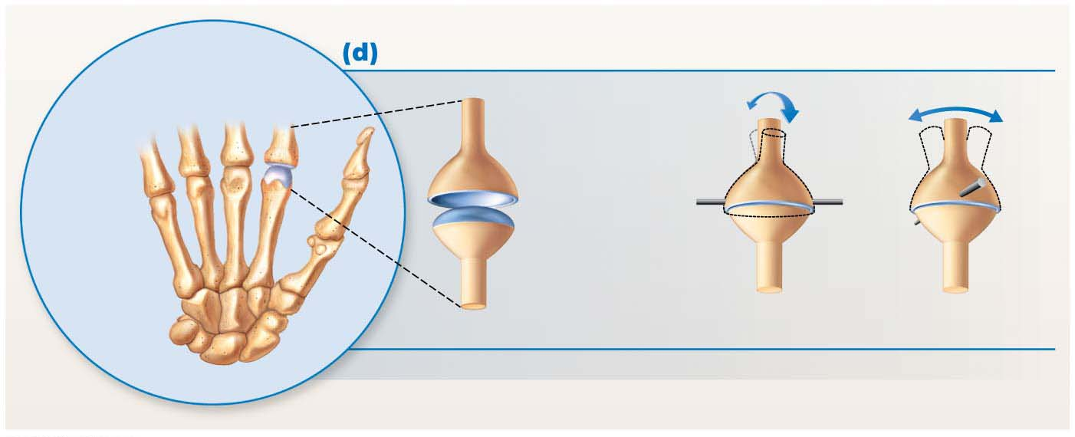
Focus Figure 8.1d Six types of synovial joint shapes determine the movements that can occur at a joint.
Condylar joint
Biaxial movement
Phalanges
Medial/
lateral
axis
Anterior/
posterior
axis
Oval
articular
surfaces
Meta-
carpals
Flexion
and extension
Adduction
and abduction
Examples: Metacarpophalangeal (knuckle) joints, wrist joints

Slide 56
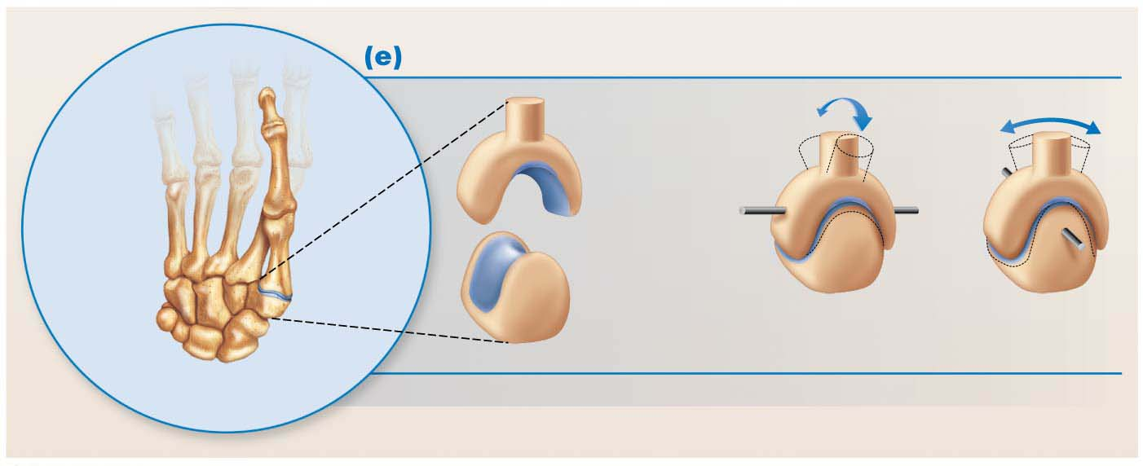
Focus Figure 8.1e Six types of synovial joint shapes determine the movements that can occur at a joint.
Saddle joint
Biaxial movement
Anterior/
posterior
axis
Medial/
lateral
axis
Articular
surfaces
are both
concave
and convex
Metacarpal
I
Adduction
and abduction
Flexion and
extension
Trapezium
Example: Carpometacarpal joints of the thumbs

Slide 57
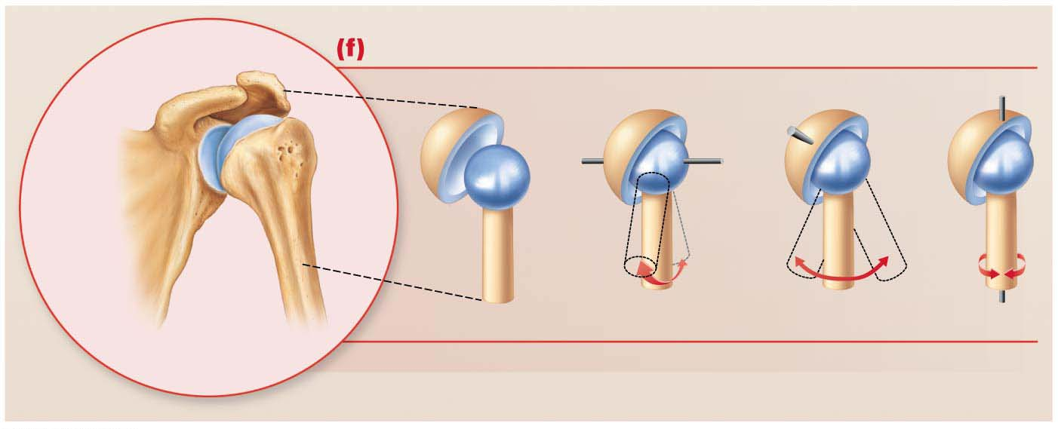
Focus Figure 8.1f Six types of synovial joint shapes determine the movements that can occur at a joint.
Ball-and-socket joint
Multiaxial movement
Cup
(socket)
Medial/lateral
axis
Anterior/posterior
axis
Vertical
axis
Scapula
Spherical
head
(ball)
Humerus
Flexion
and extension
Adduction and
abduction
Rotation
Examples: Shoulder joints and hip joints

Slide 58
Joint Disorders

Slide 59
Temporomandibular Joint (TMJ)
Jaw joint is a modified hinge joint
Mandibular condyle articulates with temporal bone
Posterior temporal bone forms mandibular fossa, while anterior portion forms articular tubercle
Articular capsule thickens into strong lateral ligament

Slide 60
Temporomandibular Joint (TMJ) (cont.)
Two types of movement
Hinge: depression and elevation of mandible
Gliding: side-to-side (lateral excursion) grinding of teeth
Most easily dislocated joint in the body

Slide 61
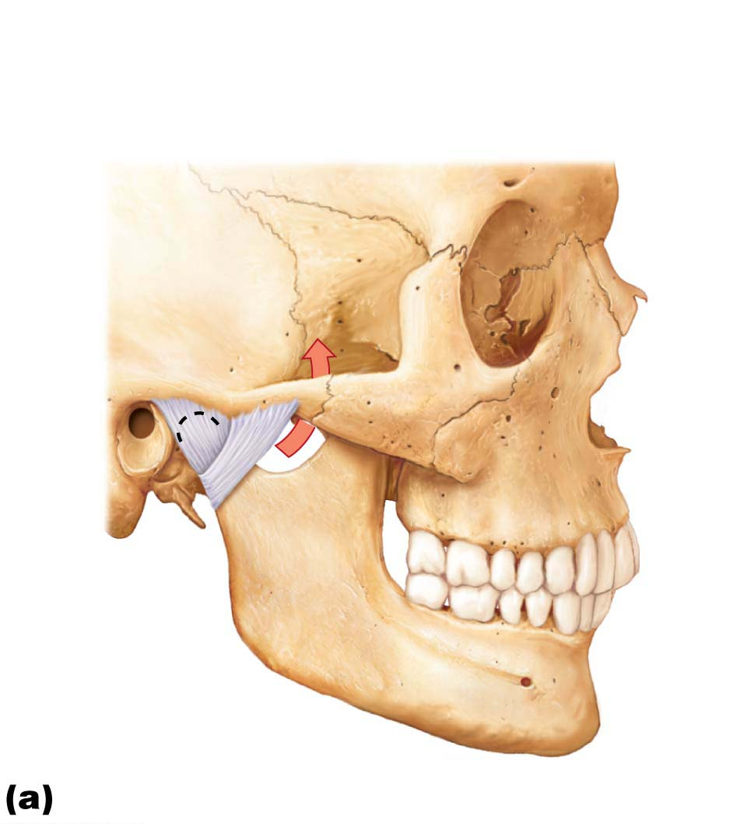
Figure 8.12a The temporomandibular (jaw) joint.
Mandibular fossa
Articular tubercle
Zygomatic process
Infratemporal fossa
External
acoustic
meatus
Articular
capsule
Lateral
ligament
Ramus of
mandible
Location of the joint in the skull

Slide 62
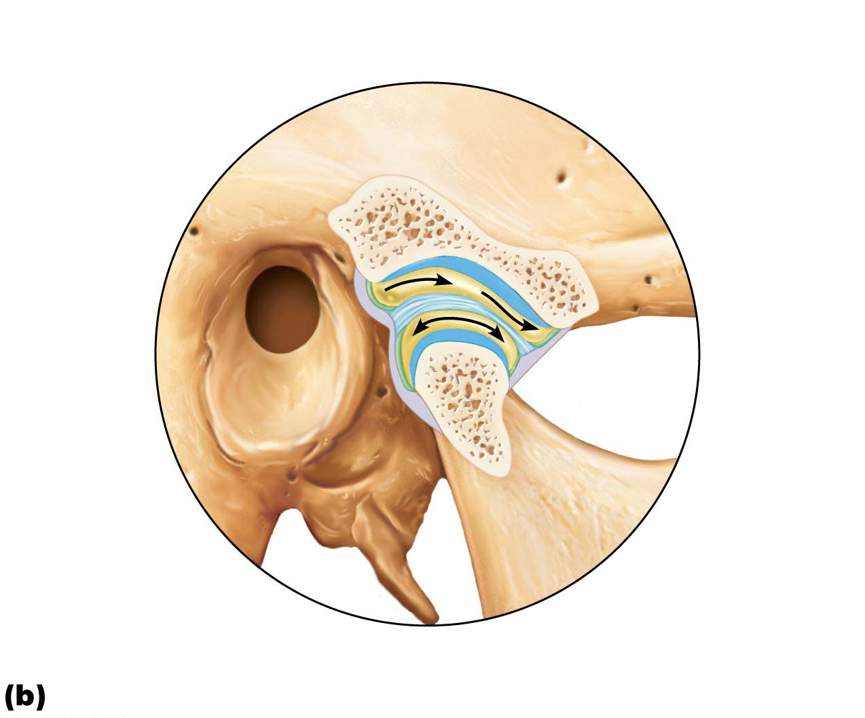
Figure 8.12b The temporomandibular (jaw) joint.
Articular disc
Mandibular
fossa
Articular tubercle
Superior joint
cavity
Articular
capsule
Synovial
membranes
Condylar
process of
mandible
Ramus of
mandible
Inferior joint
cavity
Enlargement of a sagittal section through the joint

Slide 63
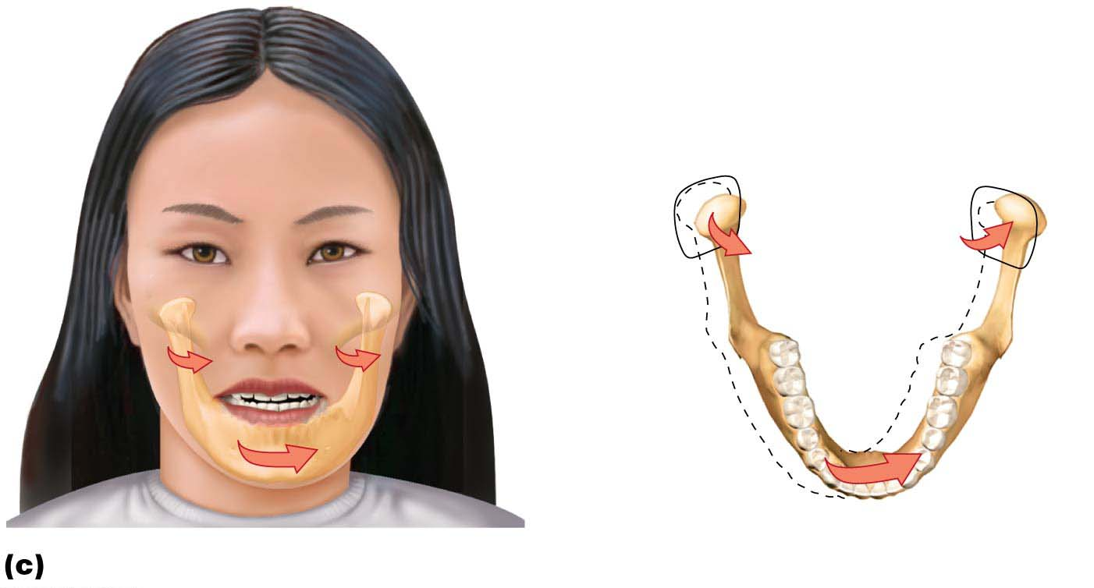
Figure 8.12c The temporomandibular (jaw) joint.
Superior view
Outline of
the mandibular
fossa
Lateral excursion: lateral (side-to-side) movements of the mandible

Slide 64
Clinical – Homeostatic Imbalance 8.2
Dislocation of TMJ is most common because of shallow socket of joint
Almost always dislocates anteriorly, causing mouth to remain open
To realign, physician must push mandible back into place

Slide 65
Clinical – Homeostatic Imbalance 8.2
Symptoms: ear and face pain, tender muscles, popping sounds when opening mouth, joint stiffness
Usually caused by grinding teeth, but can also be due to jaw trauma or poor occlusion of teeth
Treatment for grinding teeth includes bite plate
Relaxing jaw muscles helps

Slide 66
8.6 Disorders of Joints
Common Joint Injuries
Cartilage tears
Due to compression and shear stress
Fragments may cause joint to lock or bind
Cartilage rarely repairs itself
Repaired with arthroscopic surgery
Partial menisci removal renders joint less stable but mobile; complete removal leads to osteoarthritis
Meniscal transplant possible in younger patients
Perhaps meniscus grown from own stem cells in future

Slide 67
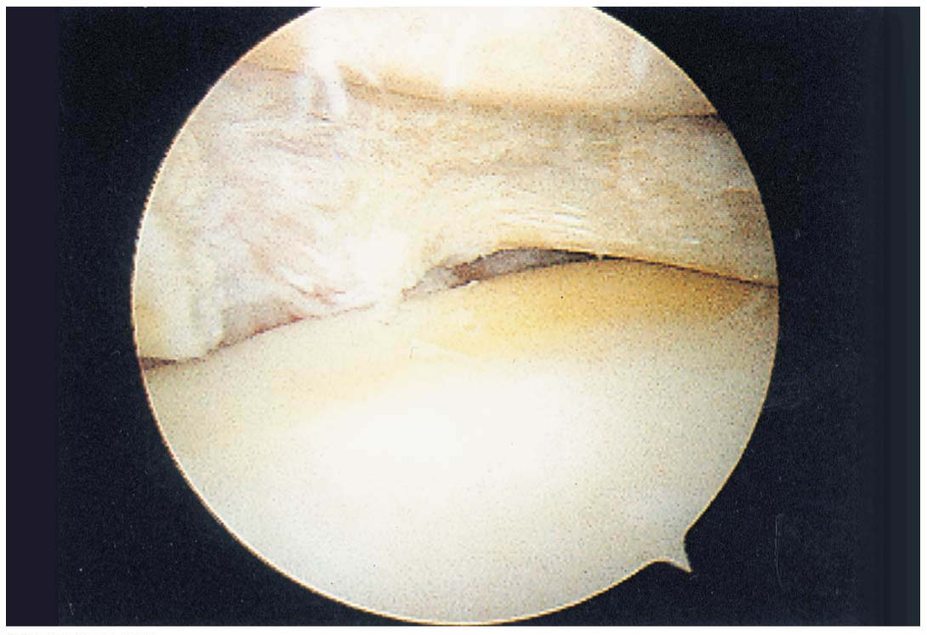
Figure 8.13 Arthroscopic photograph of a torn medial meniscus.
Femur
Meniscus
Tear in
meniscus
Tibia

Slide 68
Common Joint Injuries (cont.)
Sprains
Reinforcing ligaments are stretched or torn
Common sites are ankle, knee, and lumbar region of back
Partial tears repair very slowly because of poor vascularization
Three options if torn completely
Ends of ligaments can be sewn together
Replaced with grafts
Just allow time and immobilization for healing

Slide 69
Common Joint Injuries (cont.)
Dislocations (luxations)
Bones forced out of alignment
Accompanied by sprains, inflammation, and difficulty moving joint
Caused by serious falls or contact sports
Must be reduced to treat
Subluxation: partial dislocation of a joint

Slide 70
Inflammatory and Degenerative Conditions
Bursitis
Inflammation of bursa, usually caused by blow or friction
Treated with rest and ice and, if severe, anti-inflammatory drugs
Tendonitis
Inflammation of tendon sheaths, typically caused by overuse
Symptoms and treatment similar to those of bursitis

Slide 71
Inflammatory and Degenerative Conditions (cont.)
Arthritis
>100 different types of inflammatory or degenerative diseases that damage joints
Most widespread crippling disease in the U.S.
Symptoms: pain, stiffness, and swelling of joint
Acute forms: caused by bacteria, treated with antibiotics
Chronic forms: osteoarthritis, rheumatoid arthritis, and gouty arthritis

Slide 72
Inflammatory and Degenerative Conditions (cont.)
Osteoarthritis (OA)
Most common type of arthritis
Irreversible, degenerative (“wear-and-tear”) arthritis
May reflect excessive release of enzymes that break down articular cartilage
Cartilage is broken down faster than it is replaced
Bone spurs (osteophytes) may form from thickened ends of bones
By age 85, half of Americans develop OA, more women than men

Slide 73
Inflammatory and Degenerative Conditions (cont.)
Osteoarthritis (OA) (cont.)
OA is usually part of normal aging process
Joints may be stiff and make crunching noise referred to as crepitus, especially upon rising
Treatment: moderate activity, mild pain relievers, capsaicin creams
Glucosamine, chondroitin sulfate, and nutritional supplements not effective

Slide 74
Inflammatory and Degenerative Conditions (cont.)
Rheumatoid arthritis (RA)
Chronic, inflammatory, autoimmune disease of unknown cause
Immune system attacks own cells
Usually arises between ages 40 and 50, but may occur at any age; affects three times as many women as men
Signs and symptoms include joint pain and swelling (usually bilateral), anemia, osteoporosis, muscle weakness, and cardiovascular problems

Slide 75
Inflammatory and Degenerative Conditions (cont.)
Rheumatoid arthritis (RA) (cont.)
RA begins with inflammation of synovial membrane (synovitis) of affected joint
Inflammatory blood cells migrate to joint, release inflammatory chemicals that destroy tissues
Synovial fluid accumulates, causing joint swelling
Inflamed synovial membrane thickens into abnormal pannus tissue that clings to articular cartilage
Pannus erodes cartilage, scar tissue forms and connects articulating bone ends (ankylosis)

Slide 76
Inflammatory and Degenerative Conditions (cont.)
Rheumatoid arthritis (RA) (cont.)
Treatment includes steroidal and nonsteroidal anti-inflammatory drugs to decrease pain and inflammation
Disruption of destruction of joints by immune system
Immune suppressants slow autoimmune reaction
Some agents target tumor necrosis factor to block action of inflammatory chemicals
Can replace joint with prosthesis

Slide 77
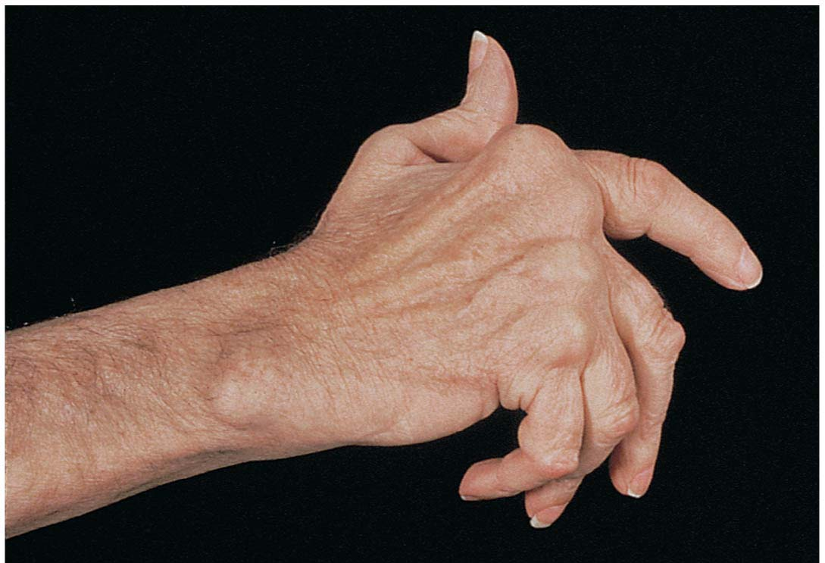
Figure 8.14 A hand deformed by rheumatoid arthritis.

Slide 78
Inflammatory and Degenerative Conditions (cont.)
Gouty arthritis
Deposition of uric acid crystals in joints and soft tissues, followed by inflammation
More common in men
Typically affects joint at base of great toe
In untreated gouty arthritis, bone ends fuse and immobilize joint
Treatment: drugs, plenty of water, avoidance of alcohol and foods high in purines, such as liver, kidneys, and sardines

Slide 79
Inflammatory and Degenerative Conditions (cont.)
Lyme disease
Caused by bacteria transmitted by tick bites
Symptoms: skin rash, flu-like symptoms, and foggy thinking
May lead to joint pain and arthritis
Treatment
Long course of antibiotics

