Slide 1
Ch 6 Skeletal System: Cartilage, Bone Classification, Gross Anatomy, and Microscopic Anatomy

Slide 2
6.1 Skeletal Cartilages
The human skeleton initially consists of just cartilage, which is replaced by bone, except in areas requiring flexibility

Slide 3
Basic Structure, Types, and Locations
Skeletal cartilage: made of highly resilient, molded cartilage tissue that consists primarily of water
Contains no blood vessels or nerves
Perichondrium: layer of dense connective tissue surrounding cartilage like a girdle
Helps cartilage resist outward expansion
Contains blood vessels for nutrient delivery to cartilage
Cartilage is made up of chondrocytes, cells encased in small cavities (lacunae) within jelly-like extracellular matrix

Slide 4
Basic Structure, Types, and Locations (cont.)
Three types of cartilage:
Hyaline cartilage
Provides support, flexibility, and resilience
Most abundant type; contains collagen fibers only
Articular (joints), costal (ribs), respiratory (larynx), nasal cartilage (nose tip)
Elastic cartilage
Similar to hyaline cartilage, but contains elastic fibers
External ear and epiglottis
Fibrocartilage
Thick collagen fibers: has great tensile strength
Menisci of knee; vertebral discs

Slide 5
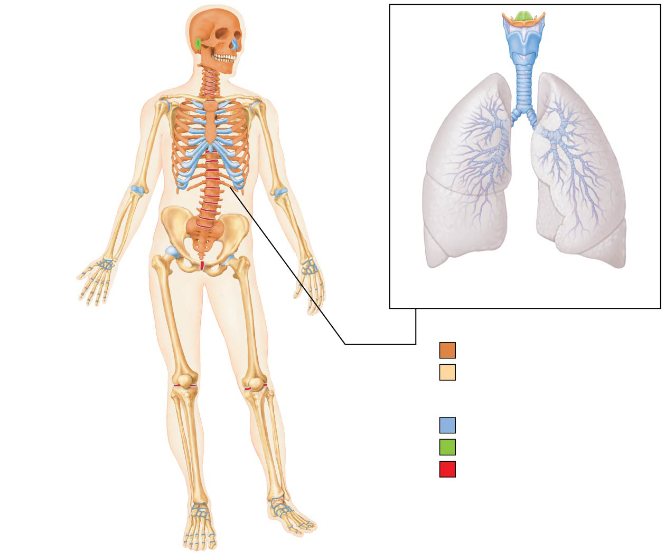
Figure 6.1 The bones and cartilages of the human skeleton.
Epiglottis
Cartilage in
external ear
Cartilages in
nose
Thyroid
cartilage
Larynx
Articular
cartilage
of a joint
Cricoid
cartilage
Trachea
Lung
Costal
cartilage
Cartilage in
intervertebral
disc
Respiratory
tube cartilages
in neck and thorax
Pubic symphysis
Bones of skeleton
Axial skeleton
Meniscus (padlike
cartilage in
knee joint)
Appendicular skeleton
Cartilages
Articular cartilage
of a joint
Hyaline cartilages
Elastic cartilages
Fibrocartilages

Slide 6
Growth of Cartilage
Cartilage grows in two ways:
Appositional growth
Cartilage-forming cells in perichondrium secrete matrix against external face of existing cartilage
New matrix laid down on surface of cartilage
Interstitial growth
Chondrocytes within lacunae divide and secrete new matrix, expanding cartilage from within
New matrix made within cartilage

Slide 7
Growth of Cartilage (cont.)
Calcification of cartilage occurs during normal bone growth in youth, but can also occur in old age
Hardened cartilage is not the same as bone

Slide 8
6.2 Functions of Bones
There are seven important functions of bones:
Support
For body and soft organs
Protection
Protect brain, spinal cord, and vital organs
Movement
Levers for muscle action
Mineral and growth factor storage
Calcium and phosphorus, and growth factors reservoir

Slide 9
6.2 Functions of Bones
Blood cell formation
Hematopoiesis occurs in red marrow cavities of certain bones
Triglyceride (fat) storage
Fat, used for an energy source, is stored in bone cavities
Hormone production
Osteocalcin secreted by bones helps to regulate insulin secretion, glucose levels, and metabolism

Slide 10
6.3 Classification of Bones
206 named bones in human skeleton
Divided into two groups based on location
Axial skeleton
Long axis of body
Skull, vertebral column, rib cage
Appendicular skeleton
Bones of upper and lower limbs
Girdles attaching limbs to axial skeleton

Slide 11
Figure 6.1 The bones and cartilages of the human skeleton.
Epiglottis
Cartilage in
external ear
Cartilages in
nose
Thyroid
cartilage
Larynx
Articular
cartilage
of a joint
Cricoid
cartilage
Trachea
Lung
Costal
cartilage
Cartilage in
intervertebral
disc
Respiratory
tube cartilages
in neck and thorax
Pubic symphysis
Bones of skeleton
Axial skeleton
Meniscus (padlike
cartilage in
knee joint)
Appendicular skeleton
Cartilages
Articular cartilage
of a joint
Hyaline cartilages
Elastic cartilages
Fibrocartilages

Slide 12
6.3 Classification of Bones
Bones are also classified according to one of four shapes:
Long bones
Longer than they are wide
Limb bones
Short bones
Cube-shaped bones (in wrist and ankle)
Sesamoid bones form within tendons (example: patella)
Vary in size and number in different individuals

Slide 13
6.3 Classification of Bones
Flat bones
Thin, flat, slightly curved
Sternum, scapulae, ribs, most skull bones
Irregular bones
Complicated shapes
Vertebrae and hip bones

Slide 14
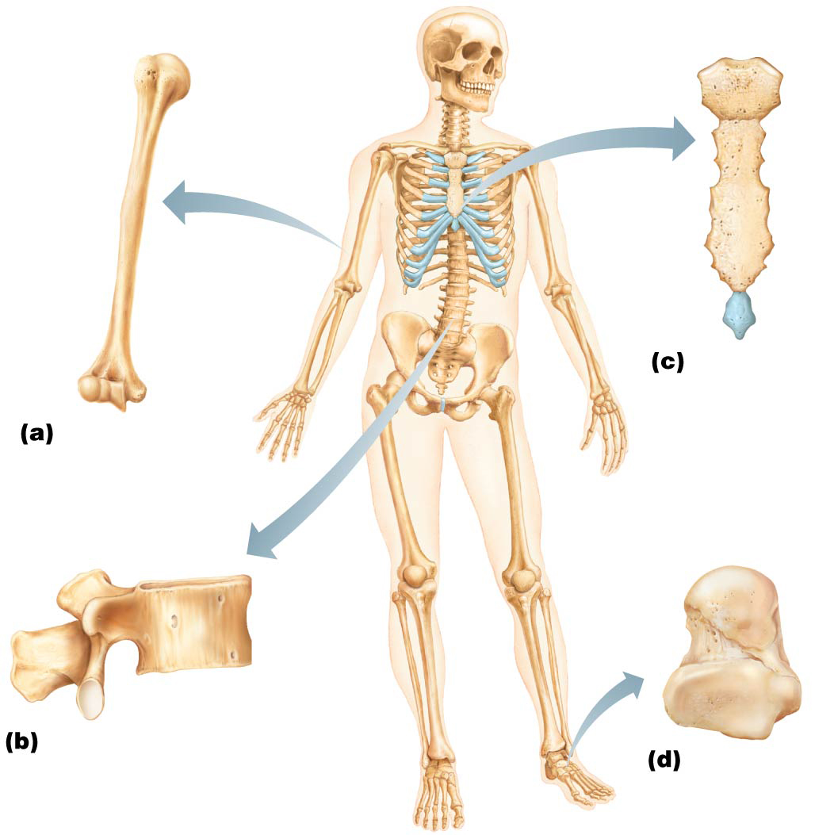
Figure 6.2 Classification of bones on the basis of shape.
Flat bone
(sternum)
Long bone
(humerus)
Irregular bone (vertebra),
right lateral view
Short bone
(talus)

Slide 15
6.4 Bone Structure
Bones are organs because they contain different types of tissues
Bone (osseous) tissue predominates, but a bone also has nervous tissue, cartilage, fibrous connective tissue, muscle cells, and epithelial cells in its blood vessels
Three levels of structure
Gross
Microscopic
Chemical

Slide 16
Gross Anatomy
Compact and spongy bone
Compact bone: dense outer layer on every bone that appears smooth and solid
Spongy bone: made up of a honeycomb of small, needle-like or flat pieces of bone called trabeculae
Open spaces between trabeculae are filled with red or yellow bone marrow

Slide 17
Gross Anatomy (cont.)
Structure of short, irregular, and flat bones
Consist of thin plates of spongy bone (diploe) covered by compact bone
Compact bone sandwiched between connective tissue membranes
Periosteum covers outside of compact bone, and endosteum covers inside portion of compact bone
Bone marrow is scattered throughout spongy bone; no defined marrow cavity
Hyaline cartilage covers area of bone that is part of a movable joint

Slide 18
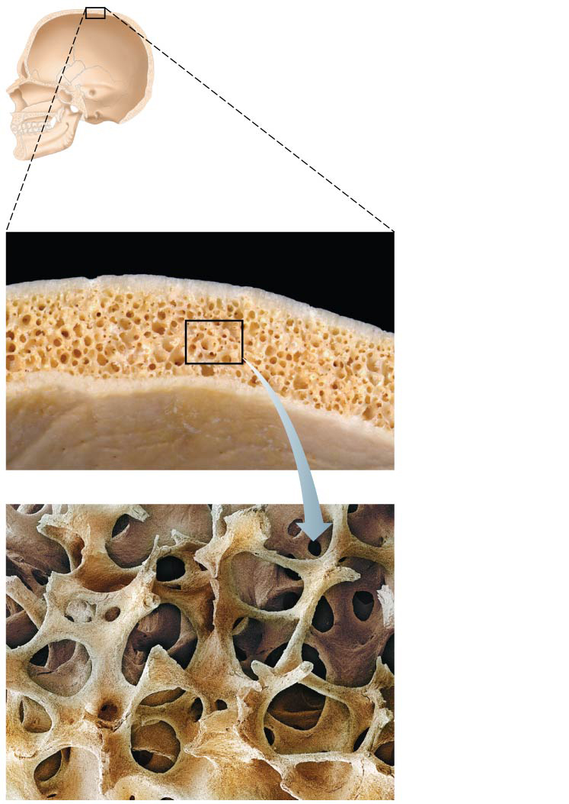
Figure 6.3 Flat bones consist of a layer of spongy bone sandwiched between two thin layers of compact bone.
Spongy bone
(diploë)
Compact
bone
Trabeculae of
spongy bone

Slide 19
Gross Anatomy (cont.)
Structure of typical long bone
All long bones have a shaft (diaphysis), bone ends (epiphyses), and membranes
Diaphysis: tubular shaft that forms long axis of bone
Consists of compact bone surrounding central medullary cavity that is filled with yellow marrow in adults
Epiphyses: ends of long bones that consist of compact bone externally and spongy bone internally
Articular cartilage covers articular (joint) surfaces
Between diaphysis and epiphysis is epiphyseal line
Remnant of childhood epiphyseal plate where bone growth occurs

Slide 20
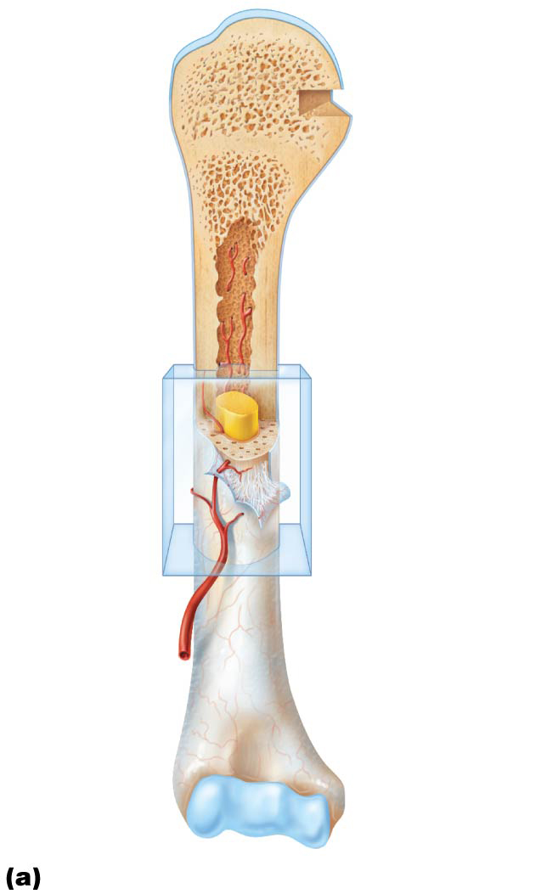
Figure 6.4a The structure of a long bone (humerus of arm).
Articular
cartilage
Proximal
epiphysis
Spongy bone
Epiphyseal
line
Periosteum
Compact bone
Medullary
cavity (lined
by endosteum)
Diaphysis
Distal
epiphysis

Slide 21
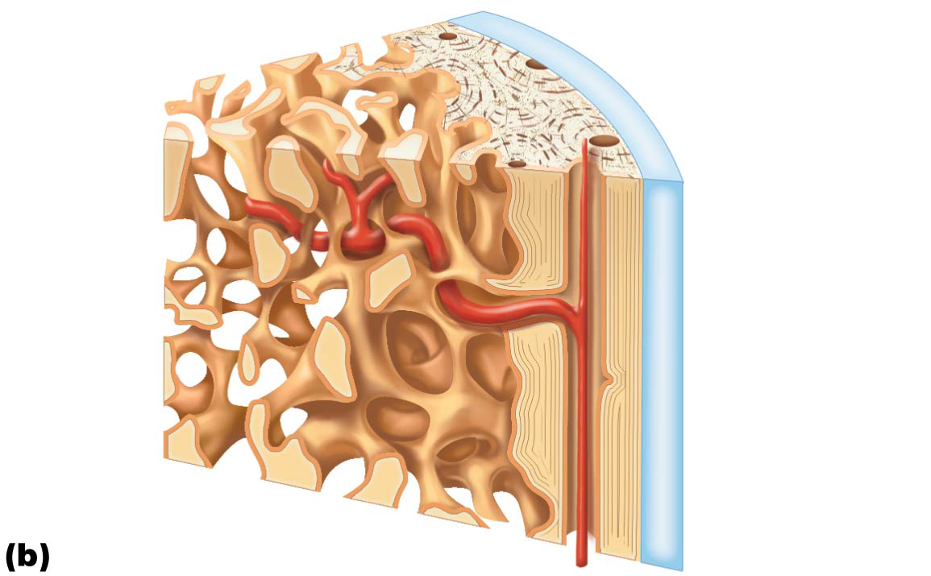
Figure 6.4b The structure of a long bone (humerus of arm).
Articular
cartilage
Compact
bone
Spongy
bone
Endosteum

Slide 22
Gross Anatomy (cont.)
Membranes: two types (periosteum and endosteum)
Periosteum: white, double-layered membrane that covers external surfaces except joints
Fibrous layer: outer layer consisting of dense irregular connective tissue consisting of Sharpey’s fibers that secure to bone matrix
Osteogenic layer: inner layer abutting bone and contains primitive osteogenic stem cells that gives rise to most all bone cells
Contains many nerve fibers and blood vessels that continue on to the shaft through nutrient foramen openings
Anchoring points for tendons and ligaments

Slide 23
Gross Anatomy (cont.)
Membranes (cont.)
Endosteum
Delicate connective tissue membrane covering internal bone surface
Covers trabeculae of spongy bone
Lines canals that pass through compact bone
Like periosteum, contains osteogenic cells that can differentiate into other bone cells

Slide 24
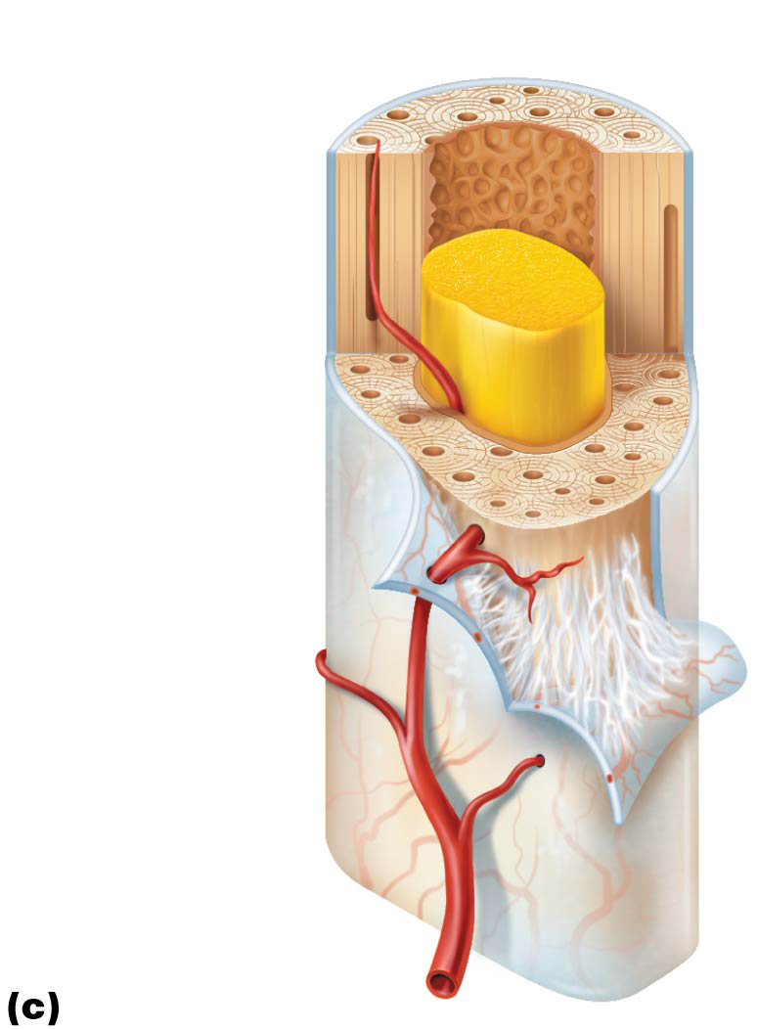
Figure 6.4c The structure of a long bone (humerus of arm).
Endosteum
Yellow
bone marrow
Compact bone
Periosteum
Perforating
(Sharpey’s)
fibers
Nutrient
artery

Slide 25
Gross Anatomy (cont.)
Hematopoietic tissue in bones
Red marrow is found within trabecular cavities of spongy bone and diploë of flat bones, such as sternum
In newborns, medullary cavities and all spongy bone contain red marrow
In adults, red marrow is located in heads of femur and humerus, but most active areas of hematopoiesis are flat bone diploë and some irregular bones (such as the hip bone)
Yellow marrow can convert to red, if person becomes anemic

Slide 26
Gross Anatomy (cont.)
Bone markings
Sites of muscle, ligament, and tendon attachment on external surfaces
Areas involved in joint formation or conduits for blood vessels and nerves

Slide 27
Gross Anatomy (cont.)
Bone markings (cont.)
Three types of markings:
Projection: outward bulge of bone
May be due to increased stress from muscle pull or is a modification for joints
Depression: bowl- or groove-like cut-out that can serve as passageways for vessels and nerves, or plays a role in joints
Opening: hole or canal in bone that serves as passageways for blood vessels and nerves

Slide 28
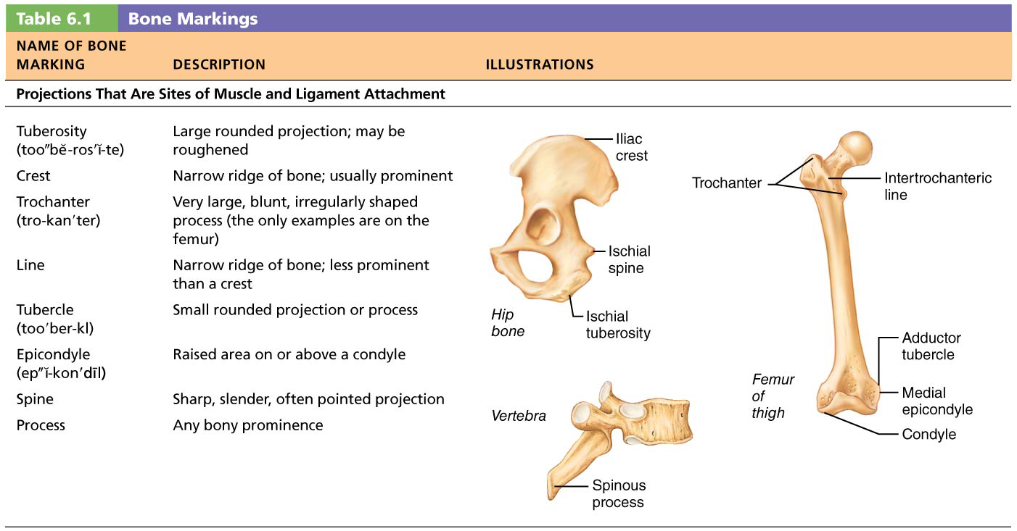
Table 6.1-1 Bone Markings

Slide 29
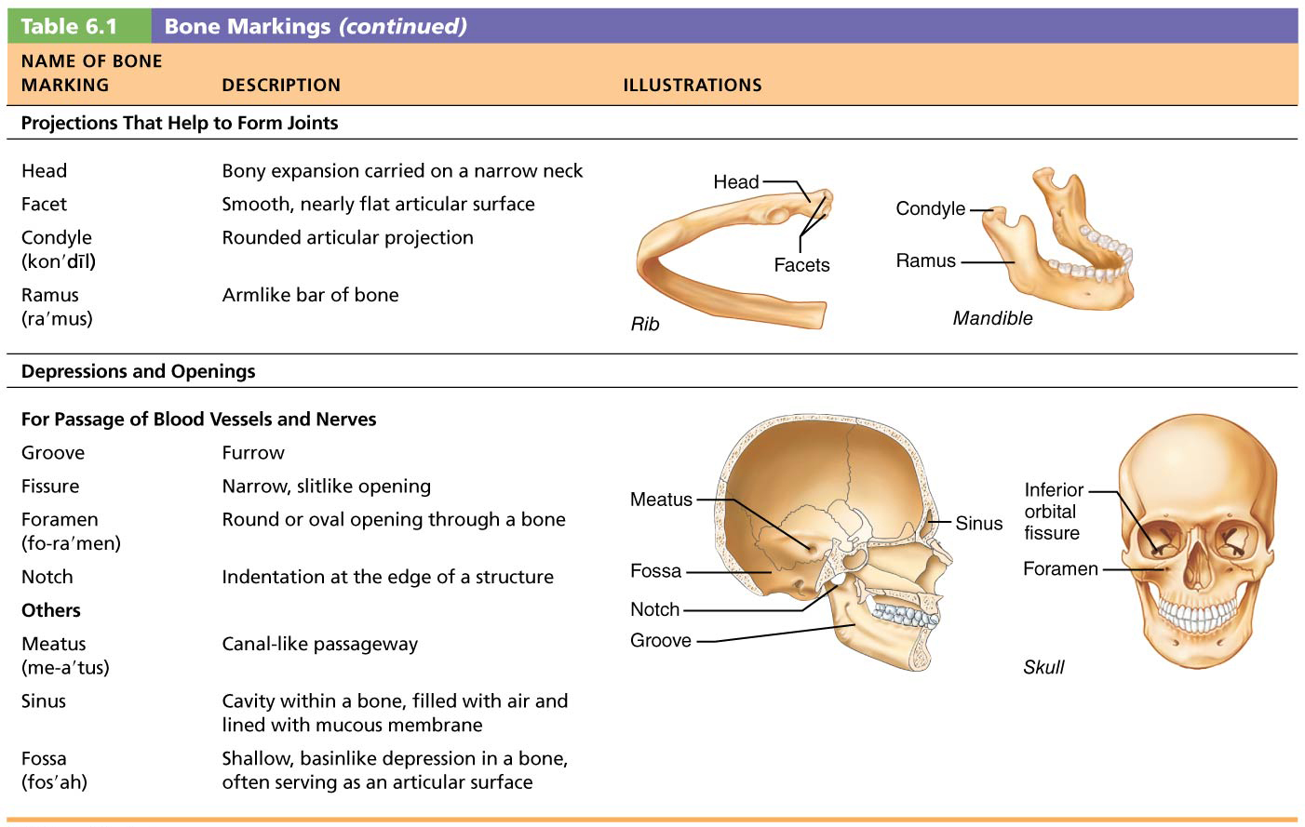
Table 6.1-2 Bone Markings (continued)

Slide 30
Microscopic Anatomy of Bone
Cells of bone tissue
Five major cell types, each of which is a specialized form of the same basic cell type
Osteogenic cells
Osteoblasts
Osteocytes
Bone-lining cells
Osteoclasts

Slide 31
Microscopic Anatomy of Bone (cont.)
Osteogenic cells
Also called osteoprogenitor cells
Mitotically active stem cells in periosteum and endosteum
When stimulated, they differentiate into osteoblasts or bone-lining cells
Some remain as osteogenic stem cells

Slide 32
Microscopic Anatomy of Bone (cont.)
Osteoblasts
Bone-forming cells that secrete unmineralized bone matrix called osteoid
Osteoid is made up of collagen and calcium-binding proteins
Collagen makes up 90% of bone protein
Osteoblasts are actively mitotic

Slide 33
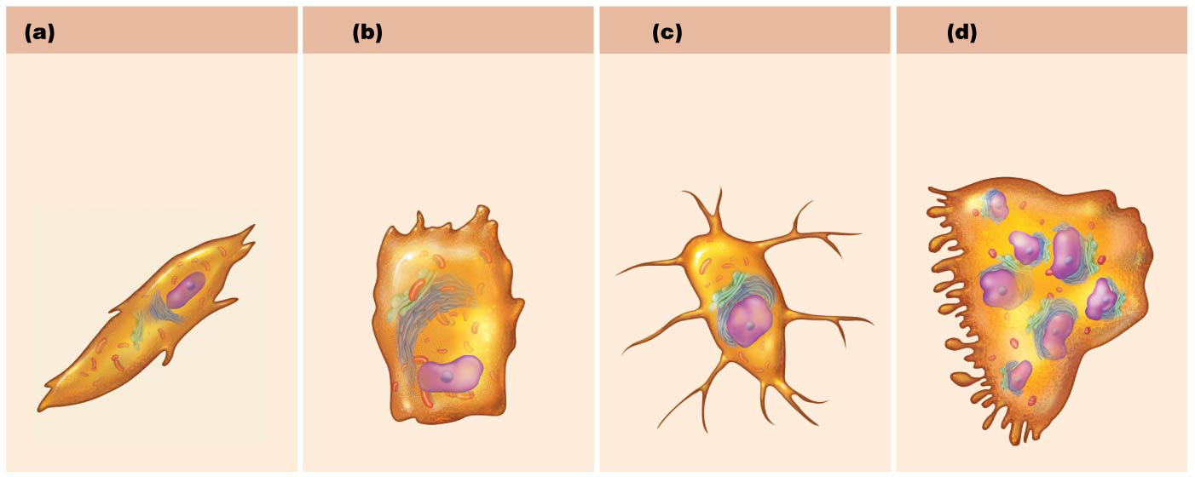
Figure 6.5ab Comparison of different types of bone cells.
Osteogenic cell
Osteoblast
Stem cell
Matrix-synthesizing
cell responsible for
bone growth

Slide 34
Microscopic Anatomy of Bone (cont.)
Osteocytes
Mature bone cells in lacunae that no longer divide
Maintain bone matrix and act as stress or strain sensors
Respond to mechanical stimuli such as increased force on bone or weightlessness
Communicate information to osteoblasts and osteoclasts (cells that destroy bone) so bone remodeling can occur

Slide 35
Microscopic Anatomy of Bone (cont.)
Bone-lining cells
Flat cells on bone surfaces believed to also help maintain matrix (along with osteocytes)
On external bone surface, lining cells are called periosteal cells
On internal surfaces, they are called endosteal cells

Slide 36
Microscopic Anatomy of Bone (cont.)
Osteoclasts
Derived from same hematopoietic stem cells that become macrophages
Giant, multinucleate cells function in bone resorption (breakdown of bone)
When active, cells are located in depressions called resorption bays
Cells have ruffled borders that serve to increase surface area for enzyme degradation of bone
Also helps seal off area from surrounding matrix

Slide 37
Figure 6.5cd Comparison of different types of bone cells.
Osteocyte
Osteoclast
Mature bone cell that
monitors and maintains
the mineralized
bone matrix
Bone-resorbing cell

Slide 38
Microscopic Anatomy of Bone (cont.)
Compact bone
Also called lamellar bone
Consists of:
Osteon (Haversian system)
Canals and canaliculi
Interstitial and circumferential lamellae

Slide 39
Microscopic Anatomy of Bone (cont.)
Osteon (Haversian system)
An osteon is the structural unit of compact bone
Consists of an elongated cylinder that runs parallel to long axis of bone
Acts as tiny weight-bearing pillars
An osteon cylinder consists of several rings of bone matrix called lamellae
Lamellae contain collagen fibers that run in different directions in adjacent rings
Withstands stress and resist twisting
Bone salts are found between collagen fibers

Slide 40
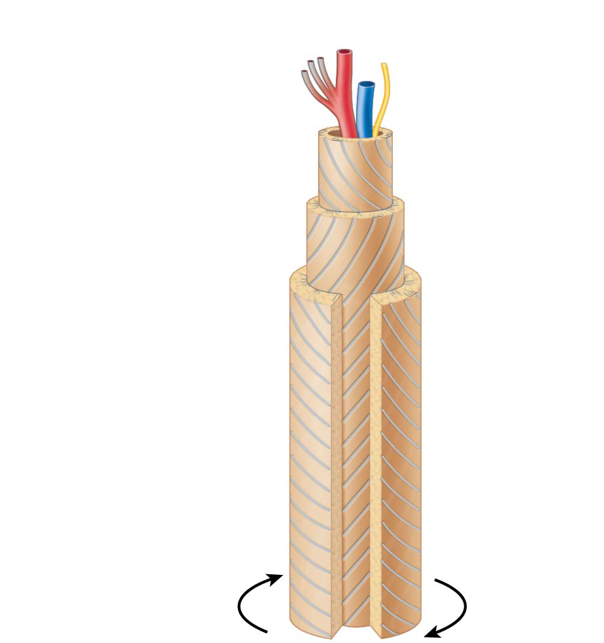
Figure 6.6 A single osteon.
Artery with
capillaries
Structures
in the
central
canal
Vein
Nerve fiber
Lamellae
Collagen
fibers
run in
different
directions
Twisting
force

Slide 41
Microscopic Anatomy of Bone (cont.)
Canals and canaliculi
Central (Haversian) canal runs through core of osteon
Contains blood vessels and nerve fibers
Perforating (Volkmann’s) canals: canals lined with endosteum that occur at right angles to central canal
Connect blood vessels and nerves of periosteum, medullary cavity, and central canal

Slide 42
Microscopic Anatomy of Bone (cont.)
Canals and canaliculi (cont.)
Lacunae: small cavities that contain osteocytes
Canaliculi: hairlike canals that connect lacunae to each other and to central canal
Osteoblasts that secrete bone matrix maintain contact with each other and osteocytes via cell projections with gap junctions
When matrix hardens and cells are trapped the canaliculi form
Allow communication between all osteocytes of osteon and permit nutrients and wastes to be relayed from one cell to another

Slide 43
Microscopic Anatomy of Bone (cont.)
Interstitial and circumferential lamellae
Interstitial lamellae
Lamellae that are not part of osteon
Some fill gaps between forming osteons; others are remnants of osteons cut by bone remodeling
Circumferential lamellae
Just deep to periosteum, but superficial to endosteum, these layers of lamellae extend around entire surface of diaphysis
Help long bone to resist twisting

Slide 44
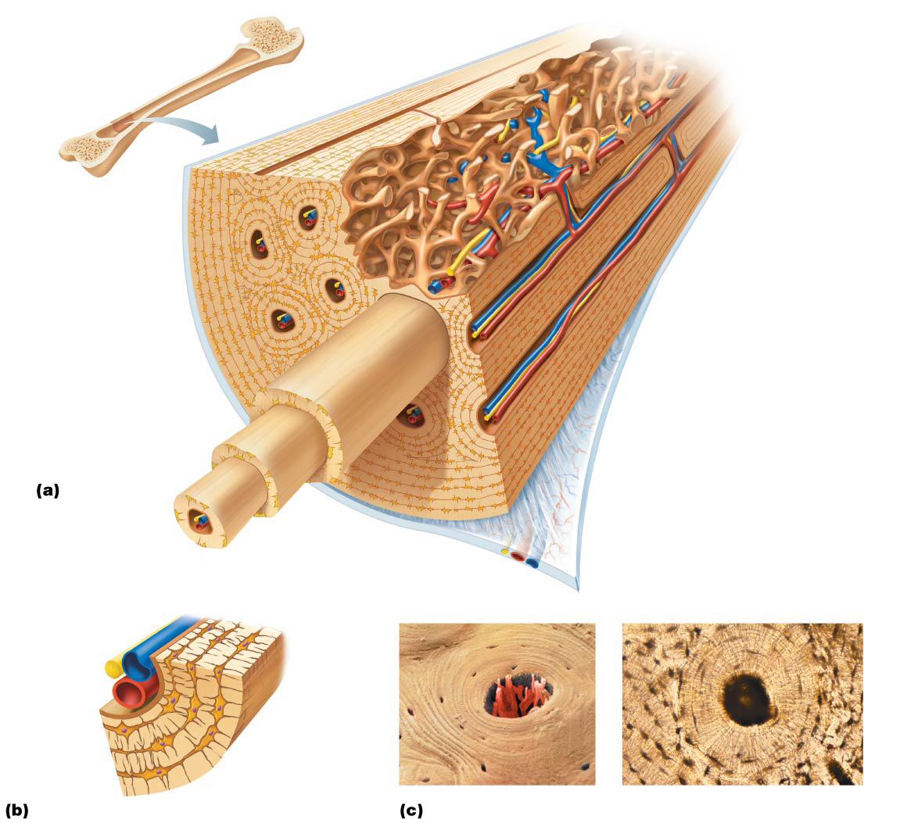
Figure 6.7 Microscopic anatomy of compact bone.
Compact
bone
Spongy bone
Central
(Haversian) canal
Perforating
(Volkmann’s) canal
Endosteum lining bony canals
and covering trabeculae
Osteon
(Haversian system)
Circumferential
lamellae
Perforating (Sharpey’s) fibers
Lamellae
Periosteal blood vessel
Periosteum
Nerve
Vein
Lamellae
Artery
Canaliculi
Central
canal
Osteocyte
in a lacuna
Lacunae
Interstitial lamella
Lacuna (with osteocyte)

Slide 45
Microscopic Anatomy of Bone (cont.)
Spongy bone
Appears poorly organized but is actually organized along lines of stress to help bone resist any stress
Trabeculae, like cables on a suspension bridge, confer strength to bone
No osteons are present, but trabeculae do contain irregularly arranged lamellae and osteocytes interconnected by canaliculi
Capillaries in endosteum supply nutrients

Slide 46
Figure 6.3 Flat bones consist of a layer of spongy bone sandwiched between two thin layers of compact bone.
Spongy bone
(diploë)
Compact
bone
Trabeculae of
spongy bone

Slide 47
Chemical Composition of Bone
Bone is made up of both organic and inorganic components
Organic components
Includes osteogenic cells, osteoblasts, osteocytes, bone-lining cells, osteoclasts, and osteoid
Osteoid, which makes up one-third of organic bone matrix, is secreted by osteoblasts
Consists of ground substance and collagen fibers, which contribute to high tensile strength and flexibility of bone

Slide 48
Chemical Composition of Bone (cont.)
Organic components (cont.)
Resilience of bone is due to sacrificial bonds in or between collagen molecules that stretch and break to dissipate energy and prevent fractures
If no additional trauma, bonds re-form
Inorganic components
Hydroxyapatites (mineral salts)
Makeup 65% of bone by mass
Consist mainly of tiny calcium phosphate crystals in and around collagen fibers
Responsible for hardness and resistance to compression

Slide 49
Chemical Composition of Bone (cont.)
Inorganic components (cont.)
Bone is half as strong as steel in resisting compression and as strong as steel in resisting tension
Lasts long after death because of mineral composition
Can reveal information about ancient people

