Slide 1
Ch 5 Integumentary System

Slide 2
Skin
The largest organ in the body
Functions:
1. protection- keratin & melanin
2. regulate temp- sweat; large blood supply
3. sense organ- Meissner’s (touch); Pacinian (pressure); Krause’s end bulbs (low frequency & cold); and free nerve endings (pain)
4. metabolic functions
5. blood reservoir
6. excretion

Slide 3
In 1 square inch….
You will find:
More than 1000 nerve endings
Yards of capillaries
100 oil (sebaceous) glands
150 pressure sensors (Pacinian- deep; Meissner’s- surface)
75 heat sensors
10 cold sensors (Krause’s end bulbs)
Millions of cells

Slide 4
Integumentary System
Integumentary system consists of:
Skin
Hair
Nails
Sweat glands
Sebaceous (oil) glands

Slide 5
Skin

Slide 6
5.1 Structure of skin
Skin consists of two distinct regions:
1. Epidermis: superficial region
Consists of epithelial tissue and is avascular
2. Dermis: underlies epidermis
Mostly fibrous connective tissue, vascular
Hypodermis (superficial fascia)
Subcutaneous layer deep to skin
Not part of skin but shares some functions
Mostly adipose tissue that absorbs shock and insulates
Anchors skin to underlying structures: mostly muscles

Slide 7
Structure
Epidermis- Avascular
Thin (keratinized stratified squamous); cells close together; form 5 distinct layers
A. Horny Layer - Outer--- stratum corneum- contains keratin
B. Clear Layer– stratum lucidum; very thin boundary
C. Granular Layer– stratum granulosum- cells contain lipids & create water barrier
D. Prickly Layer– stratum spinosum; spiny cells
E. Basal Layer– stratum basale or stratum germinativum- repair and reproduction “germinates” ; produces melanin (pigment)
4 distinct cell types
A. Keratinocytes C. Dendritic (Langerhans) Cells
B. Melanocytes D. Tactile (Merkel) Cells

Slide 8
Structure (cont’d)
Dermal- epidermal junction
“glue” between outer surface (stratum germinativum) and dermis
Where blisters occur

Slide 9
Structure (cont’d)
Dermis- Vascularized
Thick (connective tissue); semifluid matrix; cells scattered with collagen or elastin in between
2 layers:
Papillary Layer (Top)– dermal papillae (projections serve as “glue”); form at birth; responsible for FINGERPRINTS
Reticular Layer (Deep)– 80% of dermis; contain collagen & elastin; nerves, muscles; glands

Slide 10
Sensors
Meissner’s corpuscle- on surface of skin in dermal papillae; light touch
Pacinian corpuscle- deep in dermis or in hypodermis; pressure
Free nerve endings- detect pain; in epidermis
Krause’s end bulbs- low frequency & cold; in dermis

Slide 11
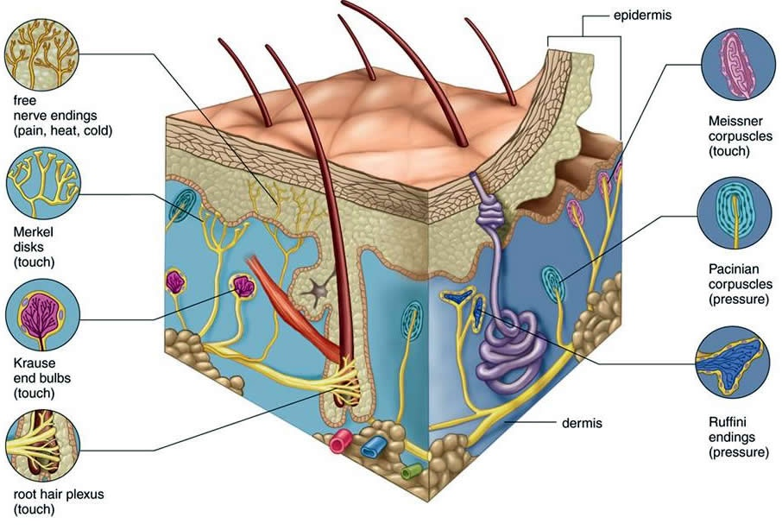
Sensors
Meissner’s corpuscle- on surface of skin; light touch
Pacinian corpuscle- deep in skin; pressure
Free nerve endings- detect pain
Krause’s end bulbs- low frequency & cold

Slide 12
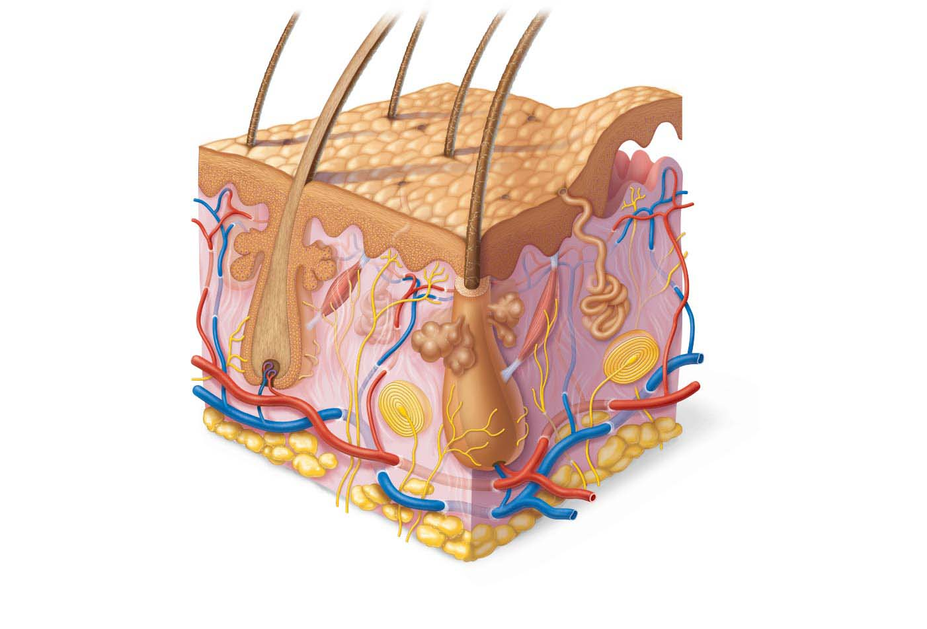
Figure 5.1 Skin structure.
Hair shaft
Dermal papillae
Epidermis
Subpapillary
plexus
Papillary
layer
Sweat pore
Dermis
Appendages of skin
Reticular
layer
• Eccrine sweat gland
• Arrector pili muscle
• Sebaceous (oil) gland
• Hair follicle
• Hair root
Hypodermis
(subcutaneous
tissue; not part
of skin)
Cutaneous plexus
Nervous structures
• Sensory nerve fiber
with free nerve endings
Adipose tissue
• Lamellar corpuscle
• Hair follicle receptor
(root hair plexus)

Slide 13
5.2 Epidermis
Cells of the Epidermis
Epidermis consists mostly of keratinized stratified squamous epithelium
Four cell types found in epidermis:
Keratinocytes
Produce fibrous keratin (protein that gives skin its protective properties)
Major cells of epidermis
Tightly connected by desmosomes
Millions slough off every day

Slide 14
Cells of the Epidermis (cont.)
Melanocytes
Spider-shaped cells located in deepest epidermis
Produce pigment melanin, which is packaged into melanosomes
Melanosomes are transferred to keratinocytes, where they protect nucleus from UV damage
Dendritic (Langerhans) cells
Star-shaped macrophages that patrol deep epidermis
Are key activators of immune system
Tactile (Merkel) cells
Sensory receptors that sense touch

Slide 15
Layers of the Epidermis
Variation in epidermal thickness determines if skin is thick or thin
Epidermis is made up of four or five distinct layers
Thick skin contains five layers (strata) and is found in high-abrasion areas (palms, fingers, soles)
Thin skin contains only four strata; found covering rest of body

Slide 16
Layers of the Epidermis
Five layers of skin
Stratum basale
Stratum spinosum
Stratum granulosum
Stratum lucidum (only in thick skin)
Stratum corneum

Slide 17
Layers of the Epidermis (cont.)
Stratum basale (basal layer)
Deepest of all epidermal layers (base layer)
Layer that is firmly attached to dermis
Consists of a single row of stem cells that actively divide (mitotic), producing two daughter cells each time
One daughter cell journeys from basal layer to surface, taking 25–45 days to reach surface
Cell dies as it moves toward surface
Other daughter cell remains in stratum basale as stem cell
Layer also known as stratum germinativum because of active mitosis
10–25% of layer also composed of melanocytes

Slide 18
Layers of the Epidermis (cont.)
Stratum spinosum (prickly layer)
Several cell layers thick
Cells contain weblike system of intermediate prekeratin filaments attached to desmosomes
Allows them to resist tension and pulling
Keratinocytes in this layer appear spikey, so they are called prickle cells
Scattered among keratinocytes are abundant melanosomes and dendritic cells

Slide 19
Layers of the Epidermis (cont.)
Stratum granulosum (granular layer)
Four to six cells thick, but cells are flattened, so layer is thin
Cell appearance changes
Cells flatten, nuclei and organelles disintegrate
Keratinization begins
Cells accumulate keratohyaline granules that help form keratin fibers in upper layers
Cells also accumulate lamellar granules, a water-resistant glycolipid that slows water loss
Cells above this layer die
Too far from dermal capillaries to survive

Slide 20
Layers of the Epidermis (cont.)
Stratum lucidum (clear layer)
Found only in thick skin
Consists of thin, translucent band of two to three rows of clear, flat, dead keratinocytes
Lies superficial to the stratum granulosum

Slide 21
Layers of the Epidermis (cont.)
Stratum corneum (horny layer)
20–30 rows of flat, anucleated, keratinized dead cells
Accounts for three-quarters of epidermal thickness
Though dead, cells still function to:
Protect deeper cells from the environment
Prevent water loss
Protect from abrasion and penetration
Act as a barrier against biological, chemical, and physical assaults

Slide 22
Layers of the Epidermis (cont.)
Cells change by going through apoptosis (controlled cell death)
Dead cells slough off as dandruff and dander
Humans can shed ~50,000 cells every minute

Slide 23
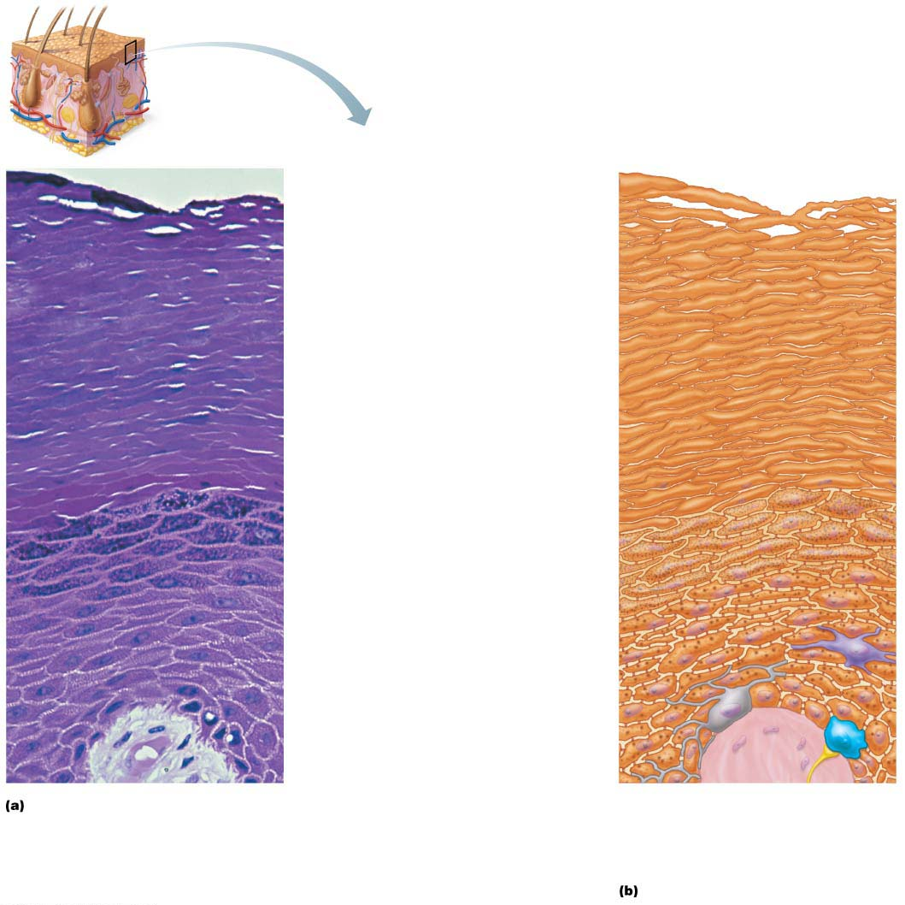
Figure 5.2 Epidermal cells and layers of the epidermis.
Keratinocytes
Stratum corneum
Most superficial layer; 20–30 layers of dead
cells, essentially flat membranous sacs
filled with keratin. Glycolipids in
extracellular space.
Stratum granulosum
Typically one to five layers of flattened
cells, organelles deteriorating; cytoplasm
full of lamellar granules (release lipids) and
keratohyaline granules.
Stratum spinosum
Several layers of keratinocytes unified by
desmosomes. Cells contain thick bundles
of intermediate filaments made of
pre-keratin.
Stratum basale
Deepest epidermal layer; one row of actively
mitotic stem cells; some newly formed cells
become part of the more superficial layers.
See occasional melanocytes and dendritic
cells.
Dermis
Dermis
Melanin
granule
Sensory
nerve
ending
Tactile
(Merkel)
cell
Desmosomes
Melanocyte
Dendritic cell

Slide 24
5.3 Dermis
Strong, flexible connective tissue
Cells include fibroblasts, macrophages, and occasionally mast cells and white blood cells
Fibers in matrix bind body together
Makes up the “hide” that is used to make leather
Contains nerves, blood vessels, and lymphatic vessels
Contains epidermal hair follicles, oil glands, and sweat glands
Two layers
Papillary
Reticular

Slide 25
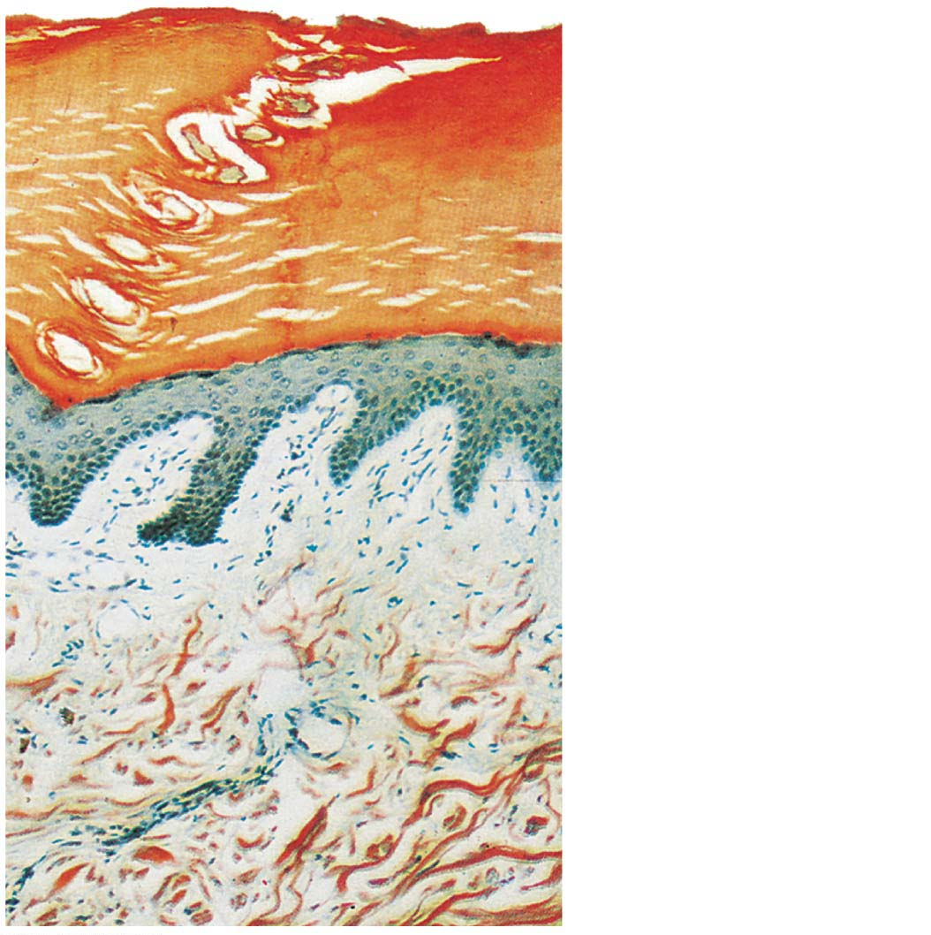
Figure 5.3 Light micrograph of the dermis.
Epidermis
Papillary
layer
Dermis
Reticular
layer

Slide 26
Papillary Layer
Superficial layer of areolar connective tissue consisting of loose, interlacing collagen and elastic fibers and blood vessels
Loose fibers allow phagocytes to patrol for microorganisms
Dermal papillae: superficial region of dermis that sends fingerlike projections up into epidermis
Projections contains capillary loops, free nerve endings, and touch receptors (tactile corpuscles, also called Meissner’s corpuscles)

Slide 27
Papillary Layer (cont.)
In thick skin, dermal papillae lie on top of dermal ridges, which give rise to epidermal ridges
Collectively ridges are called friction ridges
Enhance gripping ability
Contribute to sense of touch
Sweat pores in ridges leave unique fingerprint pattern

Slide 28
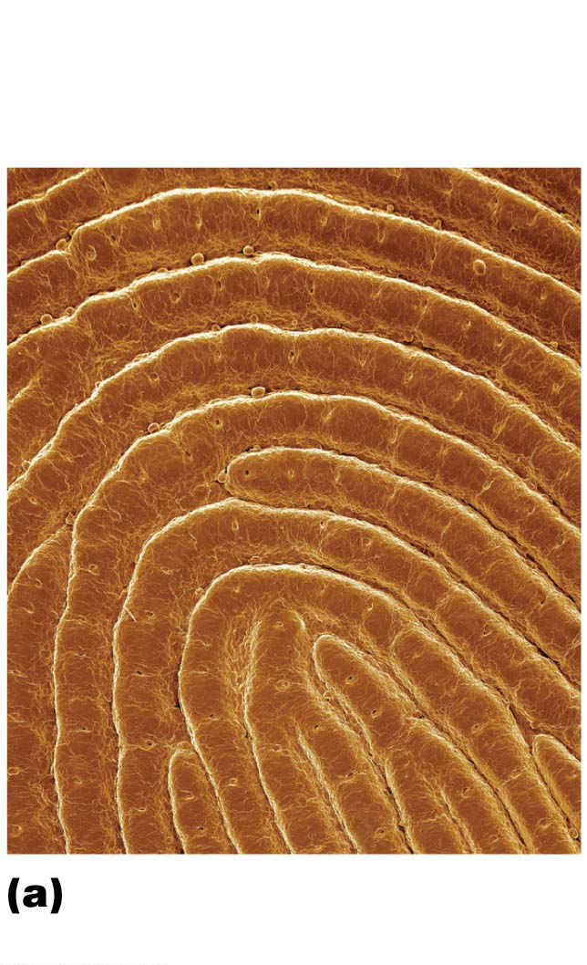
Figure 5.4a Dermal modifications result in characteristic skin markings.
Openings of
sweat gland
ducts
Friction
ridges
Friction ridges of
fingertip (SEM 12⋅)

Slide 29
Reticular Layer
Makes up ~80% of dermal thickness
Consists of coarse, dense fibrous connective tissue
Many elastic fibers provide stretch-recoil properties
Collagen fibers provide strength and resiliency
Bind water, keeping skin hydrated
Cutaneous plexus: network of blood vessels between reticular layer and hypodermis
Extracellular matrix contains pockets of adipose cells

Slide 30
Reticular Layer (cont.)
Cleavage (tension) lines in reticular layer are caused by many collagen fibers running parallel to skin surface
Externally invisible
Important to surgeons because incisions parallel to cleavage lines heal more readily

Slide 31
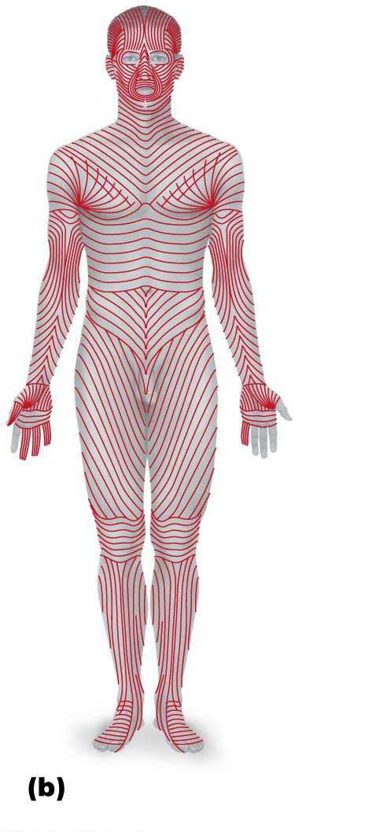
Figure 5.4b Dermal modifications result in characteristic skin markings.
Cleavage lines in the
reticular dermis

Slide 32
Reticular Layer (cont.)
Flexure lines of reticular layer are dermal folds at or near joints
Dermis is tightly secured to deeper structures
Skin’s inability to slide easily for joint movement causes deep creases
Visible on hands, wrists, fingers, soles, toes

Slide 33
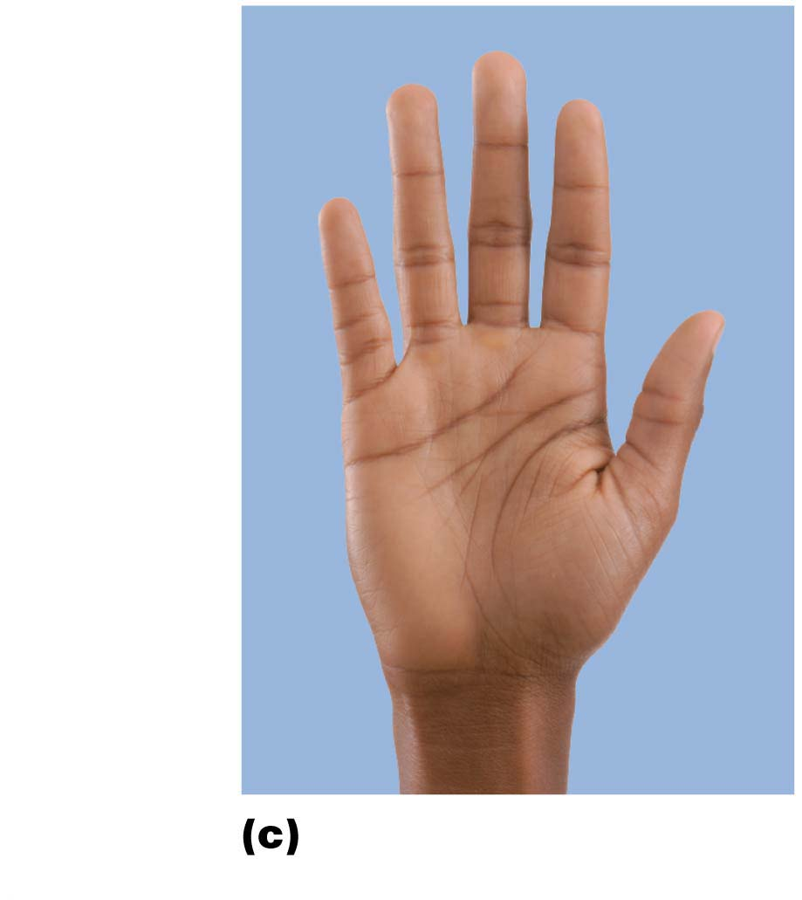
Figure 5.4c Dermal modifications result in characteristic skin markings.
Flexure
lines
on digit
Flexure
lines
on the
palm
Flexure lines of the
hand

Slide 34
Clinical – Homeostatic Imbalance 5.1
Extreme stretching of skin can cause dermal tears, leaving silvery white scars called striae
Also known as “stretch marks”
Acute, short-term traumas to skin can cause blisters, fluid-filled pockets that separate epidermal and dermal layers

Slide 35
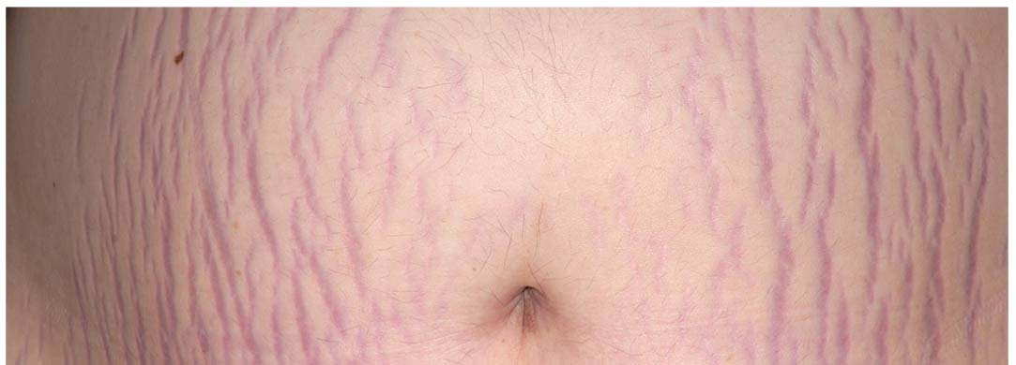
Figure 5.5 Stretch marks (striae).

Slide 36
5.4 Skin Color
Three pigments contribute to skin color
Melanin
Only pigment made in skin; made by melanocytes
Packaged into melanosomes that are sent to keratinocytes to shield DNA from sunlight
Sun exposure stimulates melanin production
Two forms: reddish yellow to brownish black
All humans have same number of keratinocytes, so color differences are due to amount and form of melanin
Freckles and pigmented moles are local accumulations of melanin

Slide 37
5.4 Skin Color
Carotene
Yellow to orange pigment
Most obvious in palms and soles
Accumulates in stratum corneum and hypodermis
Can be converted to vitamin A for vision and epidermal health
Hemoglobin
Pinkish hue of fair skin is due to lower levels of melanin
Skin of Caucasians is more transparent, so color of hemoglobin shows through

Slide 38
Clinical – Homeostatic Imbalance 5.2
Excessive sun exposure damages skin
Elastic fibers clump, causing skin to become leathery
Can depress immune system and cause alterations in DNA that may lead to skin cancer
UV light destroys folic acid
Necessary for DNA synthesis, so insufficient folic acid is especially dangerous for developing embryos
Photosensitivity is increased reaction to sun
Some drugs (e.g., antibiotics, antihistamines) and perfumes cause photosensitivity, leading to skin rashes

Slide 39
Clinical – Homeostatic Imbalance 5.3
Alterations in skin color can indicate disease
Cyanosis
Blue skin color: low oxygenation of hemoglobin
Erythema (redness)
Fever, hypertension, inflammation, allergy
Pallor (blanching or pale color)
Anemia, low blood pressure, fear, anger
Jaundice (yellow cast)
Liver disorders

Slide 40
Clinical – Homeostatic Imbalance 5.3
Alterations in skin color can indicate disease (cont.)
Bronzing
Inadequate steroid hormones (example: Addison’s disease)
Bruises (black-and-blue marks)
Clotted blood beneath skin

Slide 41
Hair

Slide 42
Appendages of the Skin
Hair
Hair follicle- deep in skin; develop in fetus
Hair papillae- around base of follicle; cluster of cells that begin hair growth
Root- in follicle under skin
Shaft- visible strand
Dermal blood vessel- around hair papillae
Arrector pili- small muscle attached to each hair; causes “chill bumps”

Slide 43
5.5 Hair
Consists of dead keratinized cells
None located on palms, soles, lips, nipples, and portions of external genitalia
Functions:
Warn of insects on skin
Hair on head guards against physical trauma
Protect from heat loss
Shield skin from sunlight

Slide 44
Structure of a Hair
Hairs (also called pili): flexible strands of dead, keratinized cells
Produced by hair follicles
Contains hard keratin, not like soft keratin found in skin
Hard keratin is tougher and more durable, and cells do not flake off
Regions:
Shaft: area that extends above scalp, where keratinization is complete
Root: area within scalp, where keratinization is still going on

Slide 45
Structure of a Hair (cont.)
Three parts of hair shaft:
Medulla: central core of large cells and air spaces
Cortex: several layers of flattened cells surrounding medulla
Cuticle: outer layer consisting of overlapping layers of single cells

Slide 46
Structure of a Hair (cont.)
Hair pigments are made by melanocytes in hair follicles
Combinations of different melanins (yellow, rust, brown, black) create all the hair colors
Red hair has additional pheomelanin pigment
Gray/white hair results when melanin production decreases and air bubbles replace melanin in shaft

Slide 47
Figure 5.6ab Skin appendages: Structure of a hair and hair follicle.
Follicle wall
• Peripheral
connective tissue
(fibrous) sheath
• Glassy membrane
• Epithelial root sheath
• External root sheath
• Internal root sheath
Hair
• Cuticle
• Cortex
• Medulla
Photomicrograph of a cross
section of a hair and hair
follicle (100⋅)
Diagram of a cross section of a hair within its follicle

Slide 48
Structure of a Hair Follicle
Extends from epidermal surface to dermis
Hair bulb: expanded area at deep end of follicle
Hair follicle receptor (or root hair plexus): sensory nerve endings that wrap around bulb
Hair is considered a sensory touch receptor
Wall of follicle composed of:
Peripheral connective tissue sheath
Derived from dermis
Also called fibrous sheath
Glassy membrane: thickened basal lamina
Epithelial root sheath
Derived from epidermis

Slide 49
Structure of a Hair Follicle (cont.)
Hair matrix: actively dividing area of bulb that produces hair cells
As matrix makes new cells, it pushes older ones upward
Arrector pili: small band of smooth muscle attached to follicle
Responsible for “goose bumps”
Hair papilla
Dermal tissue containing a knot of capillaries that supplies nutrients to growing hair

Slide 50
Figure 5.6cd Skin appendages: Structure of a hair and hair follicle.
Follicle wall
• Peripheral
connective tissue
(fibrous) sheath
• Glassy membrane
• Epithelial root sheath
• External root sheath
• Internal root sheath
Hair root
• Cuticle
• Cortex
• Medulla
Hair matrix
Hair papilla
Melanocyte
Subcutaneous
adipose tissue
Diagram of a longitudinal view of the expanded hair
bulb of the follicle, which encloses the matrix
Photomicrograph of longitudinal view
of the hair bulb in the follicle (150⋅)

Slide 51
Types and Growth of Hair
Vellus hair: pale, fine body hair of children and adult females
Terminal hair: coarse, long hair
Found on scalp and eyebrows
At puberty
Appear in axillary and pubic regions of both sexes
Also on face and neck of males
Nutrition and hormones affect hair growth
Follicles cycle between active and regressive phases
Average 2.25 mm growth per week
Lose 90 scalp hairs daily

Slide 52
Clinical – Homeostatic Imbalance 5.4
In women, ovaries and adrenal glands produce small amounts of androgens (male sex hormones), but tumors on these organs can cause abnormally large amounts of androgens
Can result in excessive hairiness, called hirsutism, as well as other signs of masculinization
Treatment is surgical removal of tumors

Slide 53
Hair Thinning and Baldness
Alopecia: hair thinning in both sexes after age 40
True (frank) baldness
Genetically determined and sex-influenced condition
Male pattern baldness caused by follicular response to DHT (dihydrotestosterone)

Slide 54
Clinical û Homeostatic Imbalance 5.5
Hair thinning can be induced by several factors:
Acutely high fever
Surgery
Severe emotional trauma
Certain drugs (such as antidepressants, blood thinners, steroids, and chemotherapeutic drugs)
Protein-deficient diets
Alopecia areata: immune system attacks follicles
Some hair loss is reversible, but others (such as from burns or radiation) are permanent

Slide 55
Appendages (cont’d)
Nails
Epidermal cells filled with keratin
Glands
Sweat (sudoriferous); most numerous
Classified as:
1. eccrine- widespread, small produce sweat
2. apocrine- armpits; larger secrete thicker substance
Oil (sebaceous)
Secrete oil for hair and skin

Slide 56
Nails

Slide 57
5.6 Nails
Scale-like modifications of epidermis that contain hard keratin
Act as a protective cover for distal, dorsal surface of fingers and toes
Consist of free edge, nail plate, and root
Nail bed is epidermis underneath keratinized nail plate
Nail matrix: thickened portion of bed responsible for nail growth

Slide 58
5.6 Nails
Nail folds: skin folds that overlap border of nail
Eponychium: nail fold that projects onto surface of nail body
Also called cuticle
Hyponychium: area under free edge of plate that accumulates dirt
Nails normally appear pink because of underlying capillaries
Lunule: thickened nail matrix, appears white
Abnormal color or shape can be an indicator of disease

Slide 59
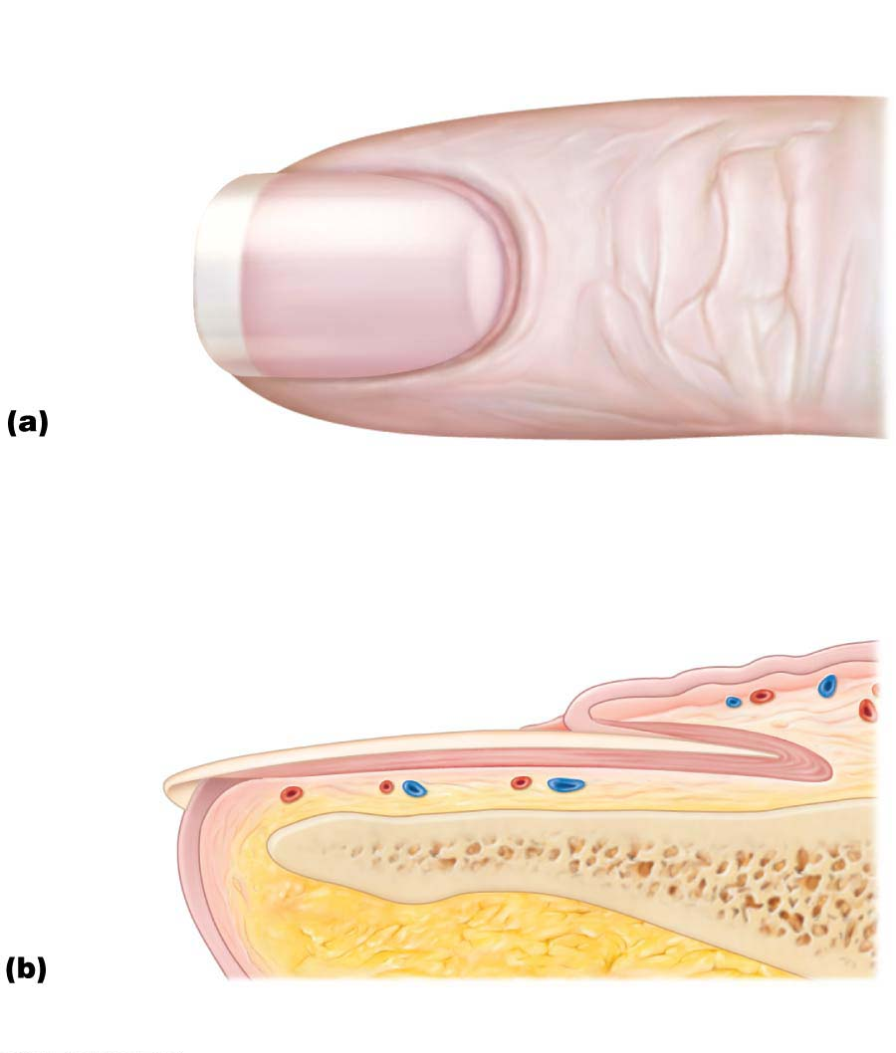
Figure 5.7 Skin appendages: Structure of a nail.
Lunule
Lateral
nail fold
Free edge
of nail
Body
of nail
Eponychium
(cuticle)
Root of nail
Proximal
nail fold
Nail
matrix
Hyponychium
Nail bed
Phalanx (bone of fingertip)

Slide 60
Glands

Slide 61
5.7 Sweat Glands
Also called sudoriferous glands
All skin surfaces except nipples and parts of external genitalia contain sweat glands
About 3 million per person
Two main types
Eccrine (merocrine) sweat glands
Apocrine sweat glands
Contain myoepithelial cells
Contract upon nervous system stimulation to force sweat into ducts

Slide 62
Eccrine (Merocrine) Sweat Glands
Most numerous type
Abundant on palms, soles, and forehead
Ducts connect to pores
Function in thermoregulation
Regulated by sympathetic nervous system
Their secretion is sweat
99% water, salts, vitamin C, antibodies, dermcidin (microbe-killing peptide), metabolic wastes

Slide 63
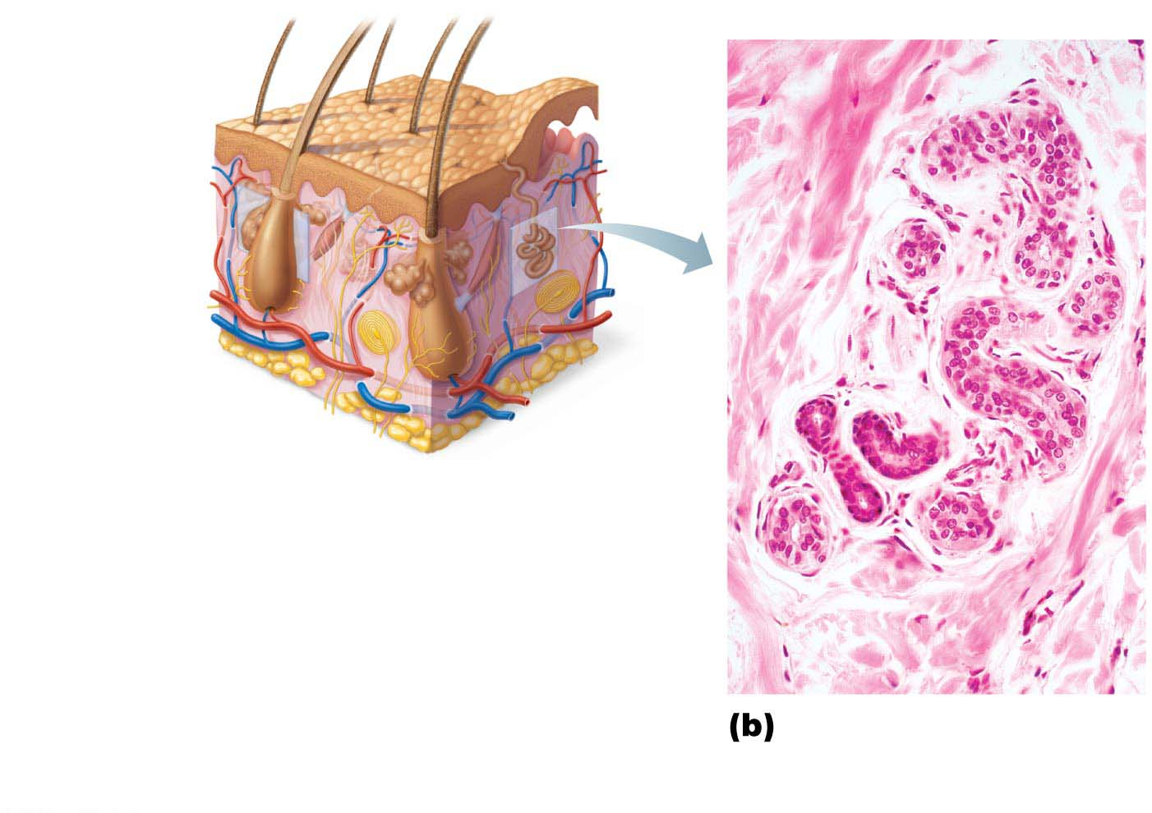
Figure 5.8b Skin appendages: Cutaneous glands.
Sebaceous
gland
Sweat
pore
Eccrine
gland
Duct
Dermal connective
tissue
Secretory cells
Photomicrograph of
a sectioned eccrine
gland (140⋅)

Slide 64
Apocrine Sweat Glands
Confined to axillary and anogenital areas
Secrete viscous milky or yellowish sweat that contains fatty substances and proteins
Bacteria break down sweat, leading to body odor
Larger than eccrine sweat glands with ducts emptying into hair follicles
Begin functioning at puberty
Function unknown but may act as sexual scent gland

Slide 65
Apocrine Sweat Glands (cont.)
Modified apocrine glands
Ceruminous glands: lining of external ear canal; secrete cerumen (earwax)
Mammary glands: secrete milk

Slide 66
Sebaceous (Oil) Glands
Widely distributed, except for thick skin of palms and soles
Most develop from hair follicles and secrete into hair follicles
Relatively inactive until puberty
Stimulated by hormones, especially androgens
Secrete sebum
Oily holocrine secretion
Bactericidal (bacteria-killing) properties
Softens hair and skin

Slide 67
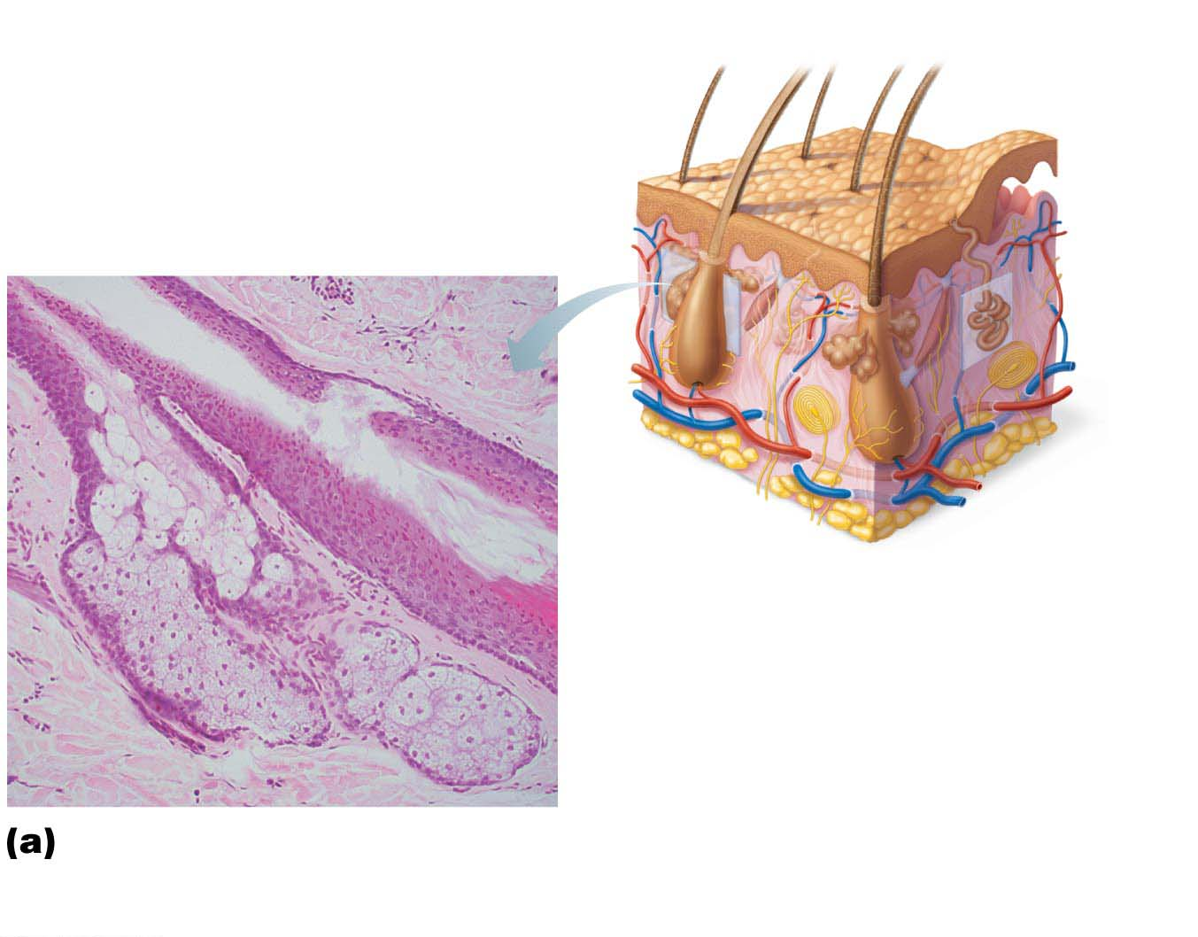
Figure 5.8a Skin appendages: Cutaneous glands.
Dermal
connective
tissue
Sebaceous
gland
Sweat
pore
Sebaceous
gland duct
Hair in
hair follicle
Eccrine
gland
Secretory cells
Photomicrograph of a
sectioned sebaceous
gland (90⋅)

Slide 68
Clinical – Homeostatic Imbalance 5.6
Whiteheads are blocked sebaceous glands
If secretion oxidizes, whitehead becomes a blackhead
Acne is usually an infectious inflammation of the sebaceous glands, resulting in pimples (pustules)
Overactive sebaceous glands in infants can lead to seborrhea, known as “cradle cap”
Begins as pink, raised lesions on scalp that turn yellow/brown and flake off

Slide 69
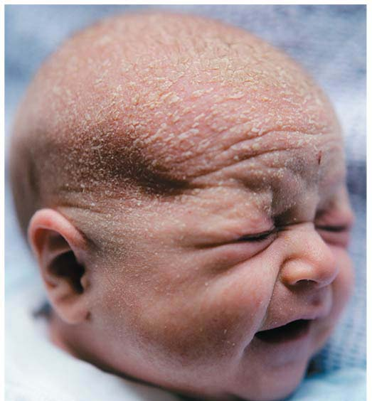
Figure 5.9 Cradle cap (seborrhea) in a newborn.

Slide 70
Functions of Skin

Slide 71
5.8 Functions of Skin
Skin is first and foremost a barrier
Its main functions include:
Protection
Body temperature regulation
Cutaneous sensations
Metabolic functions
Blood reservoir
Excretion of wastes

Slide 72
Protection
Skin is exposed to microorganisms, abrasions, temperature extremes, and harmful chemicals
Constitutes three barriers:
Chemical barrier
Physical barrier
Biological barrier

Slide 73
Protection (cont.)
Chemical barrier
Skin secretes many chemicals, such as:
Sweat, which contains antimicrobial proteins
Sebum and defensins, which kill bacteria
Cells also secrete antimicrobial defensin
Acid mantle: low pH of skin retards bacterial multiplication
Melanin provides a chemical barrier against UV radiation damage

Slide 74
Protection (cont.)
Physical barrier
Flat, dead, keratinized cells of stratum corneum, surrounded by glycolipids, block most water and water-soluble substances
Some chemicals have limited penetration of skin
Lipid-soluble substances
Plant oleoresins (e.g., poison ivy)
Organic solvents (acetone, paint thinner)
Salts of heavy metals (lead, mercury)
Some drugs (nitroglycerin)
Drug agents (enhancers that help carry other drugs across skin)

Slide 75
Protection (cont.)
Biological barriers
Epidermis contains phagocytic cells
Dendritic cells of epidermis engulf foreign antigens (invaders) and present to white blood cells, activating the immune response
Dermis contains macrophages
Macrophages also activate immune system by presenting foreign antigens to white blood cells
DNA can absorb harmful UV radiation, converting it to harmless heat

Slide 76
Body Temperature Regulation
Under normal, resting body temperature, sweat glands produce about 500 ml/day of unnoticeable sweat
Called insensible perspiration
If body temperature rises, dilation of dermal vessels can increase sweat gland activity to produce 12 L (3 gallons) of noticeable sweat
Called sensible perspiration; designed to cool body
Cold external environment
Dermal blood vessels constrict
Skin temperature drops to slow passive heat loss

Slide 77
Cutaneous Sensations
Cutaneous sensory receptors are part of the nervous system
Exteroreceptors respond to stimuli outside body, such as temperature and touch
Free nerve endings sense painful stimuli

Slide 78
Figure 5.1 Skin structure.
Hair shaft
Dermal papillae
Epidermis
Subpapillary
plexus
Papillary
layer
Sweat pore
Dermis
Appendages of skin
Reticular
layer
• Eccrine sweat gland
• Arrector pili muscle
• Sebaceous (oil) gland
• Hair follicle
• Hair root
Hypodermis
(subcutaneous
tissue; not part
of skin)
Cutaneous plexus
Nervous structures
• Sensory nerve fiber
with free nerve endings
Adipose tissue
• Lamellar corpuscle
• Hair follicle receptor
(root hair plexus)

Slide 79
Metabolic Functions
Skin can synthesize vitamin D needed for calcium absorption in intestine
Chemicals from keratinocytes can disarm some carcinogens
Keratinocytes can activate some hormones
Example: convert cortisone into hydrocortisone
Skin makes collagenase, which aids in natural turnover of collagen to prevent wrinkles

Slide 80
Blood Reservoir
Skin can hold up to 5% of the body’s total blood volume
Skin vessels can be constricted to shunt blood to other organs, such as an exercising muscle

Slide 81
Excretion
Skin can secrete limited amounts of nitrogenous wastes, such as ammonia, urea, and uric acid
Sweating can cause salt and water loss

Slide 82
Skin Cancer

Slide 83
5.9 Skin Cancer and Burns
Skin can develop over 1000 different conditions and ailments
Many internal diseases reveal themselves on skin
Most common disorders are infections
Less common, but more damaging, are:
Skin cancer
Burns

Slide 84
Skin Cancer
Most skin tumors are benign (not cancerous) and do not spread (metastasize)
Risk factors
Overexposure to UV radiation
Frequent irritation of skin
Some skin lotions contain enzymes that can repair damaged DNA
Three major types of skin cancer
Basal cell carcinoma
Squamous cell carcinoma
Melanoma

Slide 85
Skin Cancer (cont.)
Basal cell carcinoma
Least malignant and most common
Stratum basale cells proliferate and slowly invade dermis and hypodermis
Cured by surgical excision in 99% of cases

Slide 86
Figure 5.10a Photographs of skin cancers.
Basal cell carcinoma

Slide 87
Skin Cancer (cont.)
Squamous cell carcinoma
Second most common type; can metastasize
Involves keratinocytes of stratum spinosum
Usually is a scaly reddened papule on scalp, ears, lower lip, or hands
Good prognosis if treated by radiation therapy or removed surgically

Slide 88
Figure 5.10b Photographs of skin cancers.
Squamous cell
carcinoma

Slide 89
Skin Cancer (cont.)
Melanoma
Cancer of melanocytes; is most dangerous type because it is highly metastatic and resistant to chemotherapy
Treated by wide surgical excision accompanied by immunotherapy
Key to survival is early detection: ABCD rule
A: asymmetry; the two sides of the pigmented area do not match
B: border irregularity; exhibits indentations
C: color; contains several colors (black, brown, tan, sometimes red or blue)
D: diameter; larger than 6 mm (size of pencil eraser)

Slide 90
Figure 5.10c Photographs of skin cancers.
Melanoma

Slide 91
Burns

Slide 92
Burns
Tissue damage caused by heat, electricity, radiation, or certain chemicals
Damage caused by denaturation of proteins, which destroys cells
Immediate threat is dehydration and electrolyte imbalance
Leads to renal shutdown and circulatory shock
To evaluate burns, the Rule of Nines is used
Body is broken into 11 sections, with each section representing 9% of body surface (except genitals, which account for 1%)
Used to estimate volume of fluid loss

Slide 93
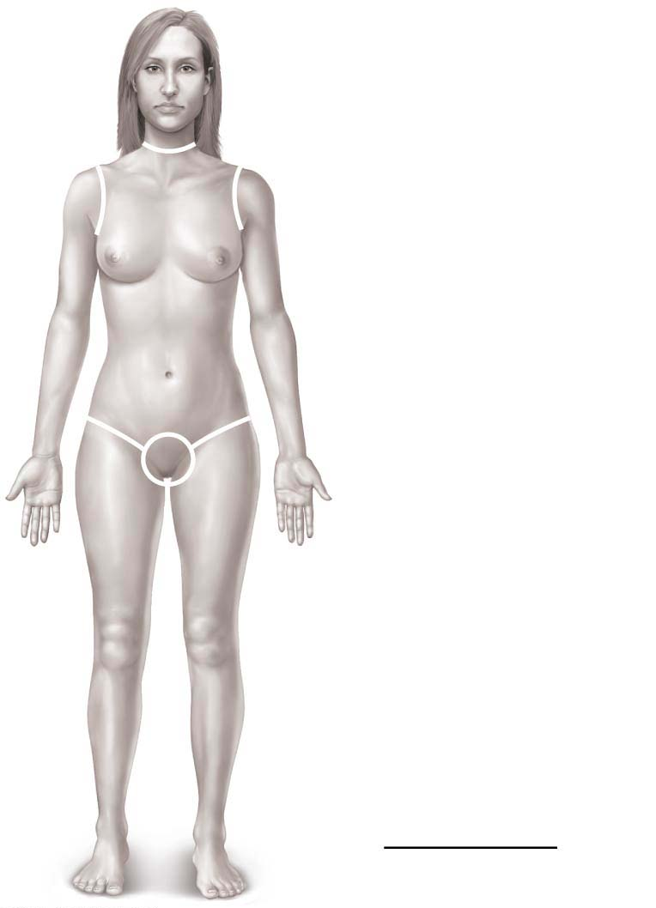
Figure 5.11 Estimating the extent and severity of burns using the rule of nines.
Totals
4¹⁄₂%
Anterior and posterior
head and neck, 9%
Anterior and posterior
upper limbs, 18%
4¹⁄₂%
4¹⁄₂%
Anterior and posterior
trunk, 36%
Anterior
trunk, 18%
9%
9%
Perineum, 1%
Anterior and posterior
lower limbs, 36%
100%

Slide 94
Burns (cont.)
Burns can be classified by severity
First-degree
Epidermal damage only
Localized redness, edema (swelling), and pain
Second-degree
Epidermal and upper dermal damage
Blisters appear
First- and second-degree burns are referred to as partial-thickness burns because only the epidermis and upper dermis are involved

Slide 95
Burns (cont.)
Burns can be classified by severity (cont.)
Third-degree
Entire thickness of skin involved (referred to as full-thickness burns)
Skin color turns gray-white, cherry red, or blackened
No edema is seen and area is not painful because nerve endings are destroyed
Skin grafting usually necessary

Slide 96
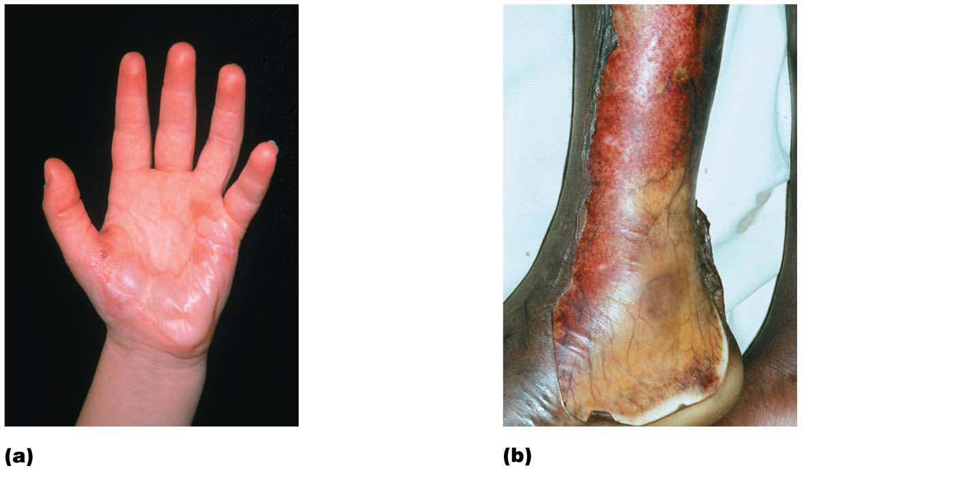
Figure 5.12 Partial-thickness and full-thickness burns.
1st-degree
burn
3rd-degree
burn
2nd-degree
burn
Skin bearing partial-thickness
burn (1st- and 2nd-degree burns)
Skin bearing full-thickness
burn (3rd-degree burn)

Slide 97
Burns (cont.)
Burns are considered critical if:
>25% of body has second-degree burns
>10% of body has third-degree burns
Face, hands, or feet bear third-degree burns
Treatment includes:
Debridement (removal) of burned skin
Antibiotics
Temporary covering
Skin grafts

Slide 98
Developmental Aspects of the Integumentary System
Fetal: by end of 4th month, skin of fetus is developed
Lanugo coat: delicate hairs in 5th and 6th month
Vernix caseosa: sebaceous gland secretion that protects skin of fetus while in watery amniotic fluid

Slide 99
Developmental Aspects of the Integumentary System
Infancy to adulthood: skin thickens and accumulates more subcutaneous fat; sweat and sebaceous gland activity increases, leading to acne
Optimal appearance during 20s and 30s
After age 30, effects of cumulative environmental assaults start to show
Scaling and dermatitis become more common

Slide 100
Developmental Aspects of the Integumentary System
Aging skin
Epidermal replacement slows; skin becomes thin, dry, and itchy (decreased sebaceous gland activity)
Subcutaneous fat and elasticity decrease, leading to cold intolerance and wrinkles
Increased risk of cancer due to decreased numbers of melanocytes and dendritic cells
Hair thinning
Ways to delay aging:
UV protection, good nutrition, lots of fluids, good hygiene

