Slide 1
Tissues
Groups of cells with similar structure and a common function

Slide 2
Tissue Types
There are 4 tissue types:
1. Epithelial-- covering
2. Connective-- support
3. Muscle-- movement
4. Nervous-- control

Slide 3
Tissues
Most organs contain all 4 tissue types.
Their arrangement determines an organ’s structure and capabilities.

Slide 4
Epithelial Tissue

Slide 5
Epithelial Tissue
Epithelial tissue (epithelium) is a sheet of cells that covers body surfaces or cavities
Two main forms:
Covering and lining epithelia
On external and internal surfaces (example: skin)
Glandular epithelia
Secretory tissue in glands (example: salivary glands)
Main functions: protection, absorption, filtration, excretion, secretion, and sensory reception

Slide 6
Special Characteristics of Epithelial Tissues
Epithelial tissue has five distinguishing characteristics:
Polarity
Specialized contacts
Supported by connective tissues
Avascular, but innervated
Regeneration

Slide 7
Epithelial Tissue
1. Polarity- All cells in epithelial are attached to a basement membrane and have a free surface (apical).
Basement membrane is supported by connective tissue

Slide 8
Special Characteristics
Polarity
Cells have polarity (top and bottom)
Apical surface, upper free side, is exposed to surface or cavity
Most apical surfaces are smooth, but some have specialized fingerlike projections called microvilli
Basal surface, lower attached side, faces inwards toward body
Attaches to basal lamina, an adhesive sheet that holds basal surface of epithelial cells to underlying cells
Both surfaces differ in structure and function

Slide 9
Epithelial Tissue
2. Specialized contacts- Epithelial tissue is made of closely packed cells with very little extracellular material (matrix) between cells.

Slide 10
Special Characteristics
Specialized contacts
Epithelial tissues need to fit closely together
Many form continuous sheets
Specialized contact points bind adjacent epithelial cells together
Lateral contacts include:
Tight junctions
Desmosomes

Slide 11
Epithelial Tissue
3. Support- All epithelial sheets are supported by connective tissue

Slide 12
Special Characteristics
Connective tissue support
All epithelial sheets are supported by connective tissue
Reticular lamina
Deep to basal lamina
Consists of network of collagen fibers
Basement membrane
Made up of basal and reticular lamina
Reinforces epithelial sheet
Resists stretching and tearing
Defines epithelial boundary

Slide 13
Clinical – Homeostatic Imbalance 4.1
Cancerous epithelial cells are not contained by the basement membrane boundary
They penetrate the boundary and invade underlying tissues, resulting in spread of cancer

Slide 14
Epithelial Tissue
4. Avascular but innervated- Epithelial tissue has no blood vessels (avascular) so gets nourishment from substances that diffuse.
While epithelial tissue doesn’t have blood supply, it does have nerves (innervated).

Slide 15
Special Characteristics
Avascular, but innervated
No blood vessels are found in epithelial tissue
Must be nourished by diffusion from underlying connective tissues
Epithelia are supplied by nerve fibers, however

Slide 16
Epithelial Tissue
5. Regeneration- Epithelial tissue has highly regenerative capacity, so can repair itself easily.

Slide 17
Special Characteristics
Regeneration
Epithelial cells have high regenerative capacities
Stimulated by loss of apical-basal polarity and broken lateral contacts
Some cells are exposed to friction, some to hostile substances, resulting in damage
Must be replaced
Requires adequate nutrients and cell division

Slide 18
Classification of Epithelia

Slide 19
Classification of Epithelia
All epithelial tissues have two names
First name indicates number of cell layers:
simple= 1 layer
stratified= 2+ layers
Examples:
Simple epithelia are a single layer thick
Stratified epithelia are two or more layers thick and involved in protection (example: skin)

Slide 20
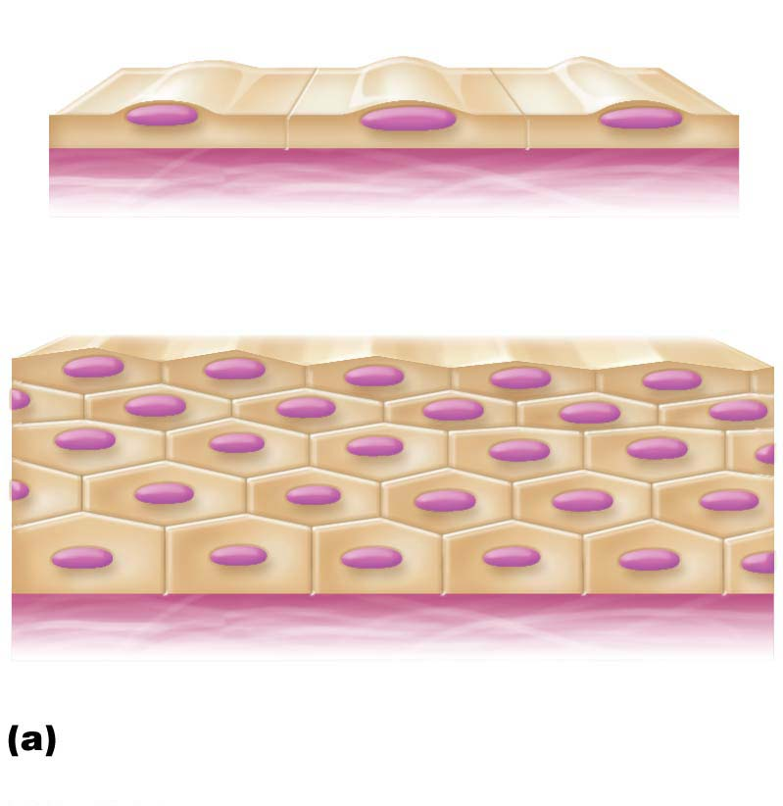
Figure 4.2a Classification of epithelia.
Apical surface
Basal surface
Simple
Apical surface
Basal surface
Stratified
Classification based on number of
cell layers.

Slide 21
Classification of Epithelia
2nd part tells the shape of the cells:
type looks like nucleus is
squamous flat; scale-like disc-shaped
cuboidal boxlike spherical
columnar tall; column-shaped elongated
**shape of nucleus conforms to shape of cell
**In stratified epithelia, shape can vary in each layer, so cell is named according to the shape in apical layer

Slide 22
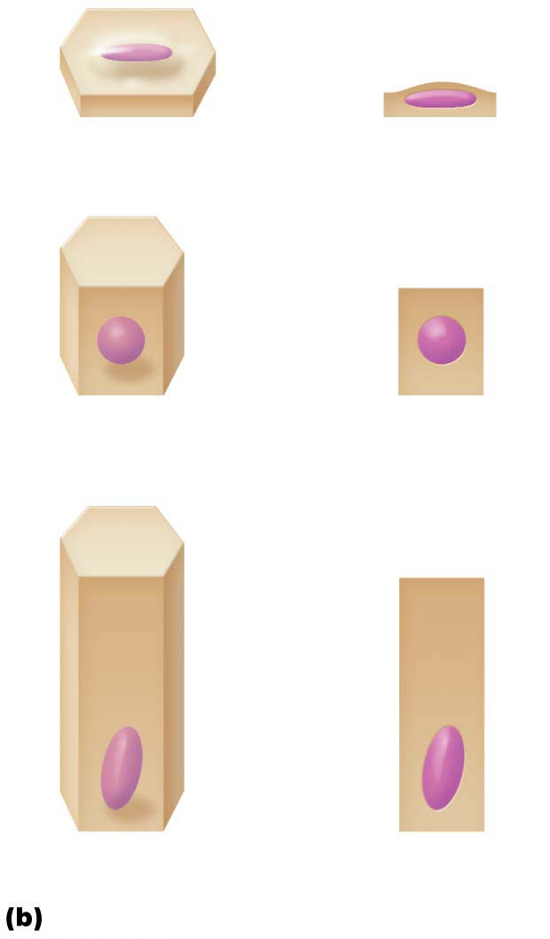
Figure 4.2b Classification of epithelia.
Squamous
Cuboidal
Columnar
Classification based on cell shape.

Slide 23
Simple Epithelia

Slide 24
Simple Squamous
Single layer
thin & flat
job= diffusion
found lining blood vessels and heart

Slide 25
Simple epithelia
Involved in absorption, secretion, or filtration processes
Simple squamous epithelium
Cells are flattened laterally, and cytoplasm is sparse
Function where rapid diffusion is priority
Example: kidney, lungs
Two special simple squamous epithelia are based on locations
Endothelium: lining of lymphatic vessels, blood vessels, and heart
Mesothelium: serous membranes in the ventral body cavity

Slide 26
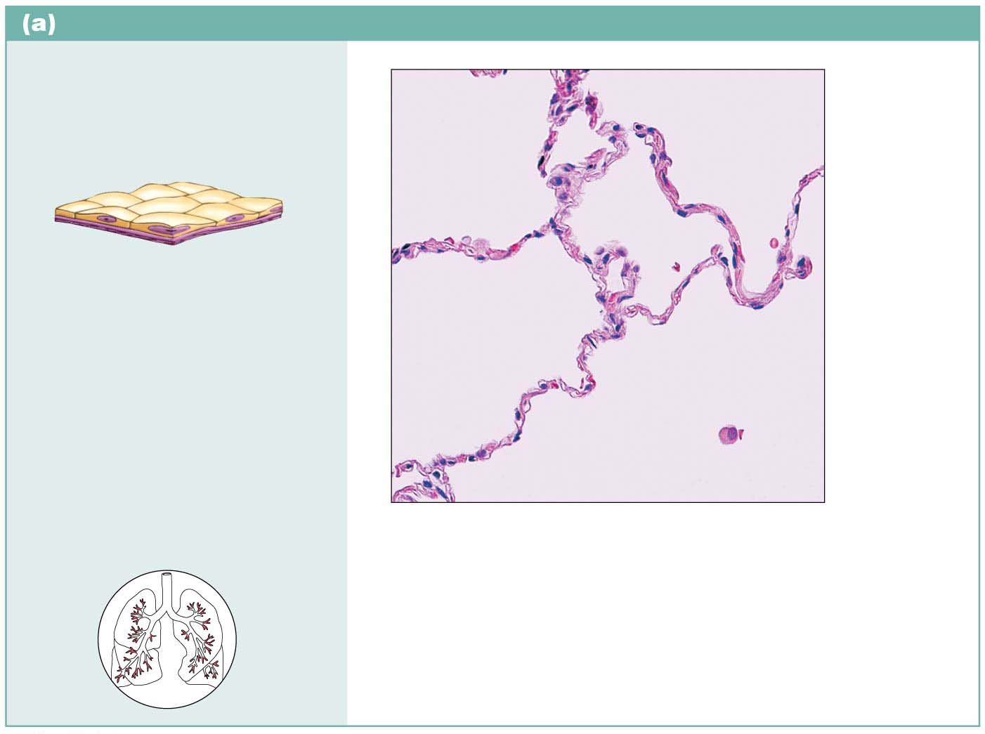
Simple squamous epithelium
Description: Single layer of
flattened cells with disc-shaped
central nuclei and sparse
cytoplasm; the simplest of the
epithelia.
Air sacs of
lung tissue
Nuclei of
squamous
epithelial
cells
Function: Allows materials to
pass by diffusion and filtration
in sites where protection is not
important; secretes lubricating
substances in serosae.
Location: Kidney glomeruli;
air sacs of lungs; lining of heart,
blood vessels, and lymphatic
vessels; lining of ventral body
cavity (serosae).
Photomicrograph: Simple squamous
epithelium forming part of the alveolar
(air sac) walls (140⋅).

Slide 27
Simple Cuboidal

Slide 28
Simple cuboidal epithelium
Single layer of cells
Involved in secretion and absorption
Forms walls of smallest ducts of glands, lining ovary, and many kidney tubules

Slide 29
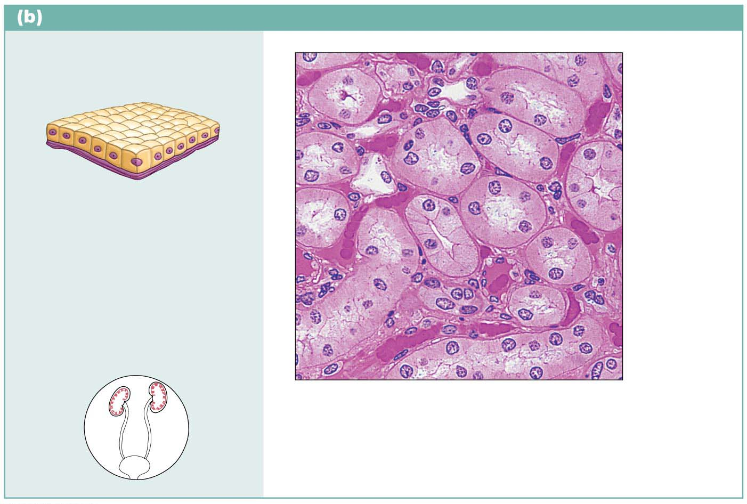
Simple cuboidal epithelium
Description: Single layer
of cubelike cells with large,
spherical central nuclei.
Simple
cuboidal
epithelial
cells
Nucleus
Function: Secretion and
absorption.
Basement
membrane
Location: Kidney tubules;
ducts and secretory portions
of small glands; ovary surface.
Connective
tissue
Photomicrograph: Simple cuboidal
epithelium in kidney tubules (430⋅).

Slide 30
Simple Columnar
Single layer
tall w/ oval nuclei
may contain goblet cells (mucus)
job= absorb, secrete, produce mucus
found lining digestive tract

Slide 31
Classification of Epithelia (cont.)
Simple columnar epithelium
Single layer of tall, closely packed cells
Some cells have microvilli, and some have cilia
Some layers contain mucus-secreting goblet cells
Involved in absorption and secretion of mucus, enzymes, and other substances
Ciliated cells move mucus
Found in digestive tract, gallbladder, ducts of some glands, bronchi, and uterine tubes

Slide 32
Ciliated Columnar
Single layer
tall
with cilia
job= absorb & secrete
found lining respiratory tract and oviduct

Slide 33
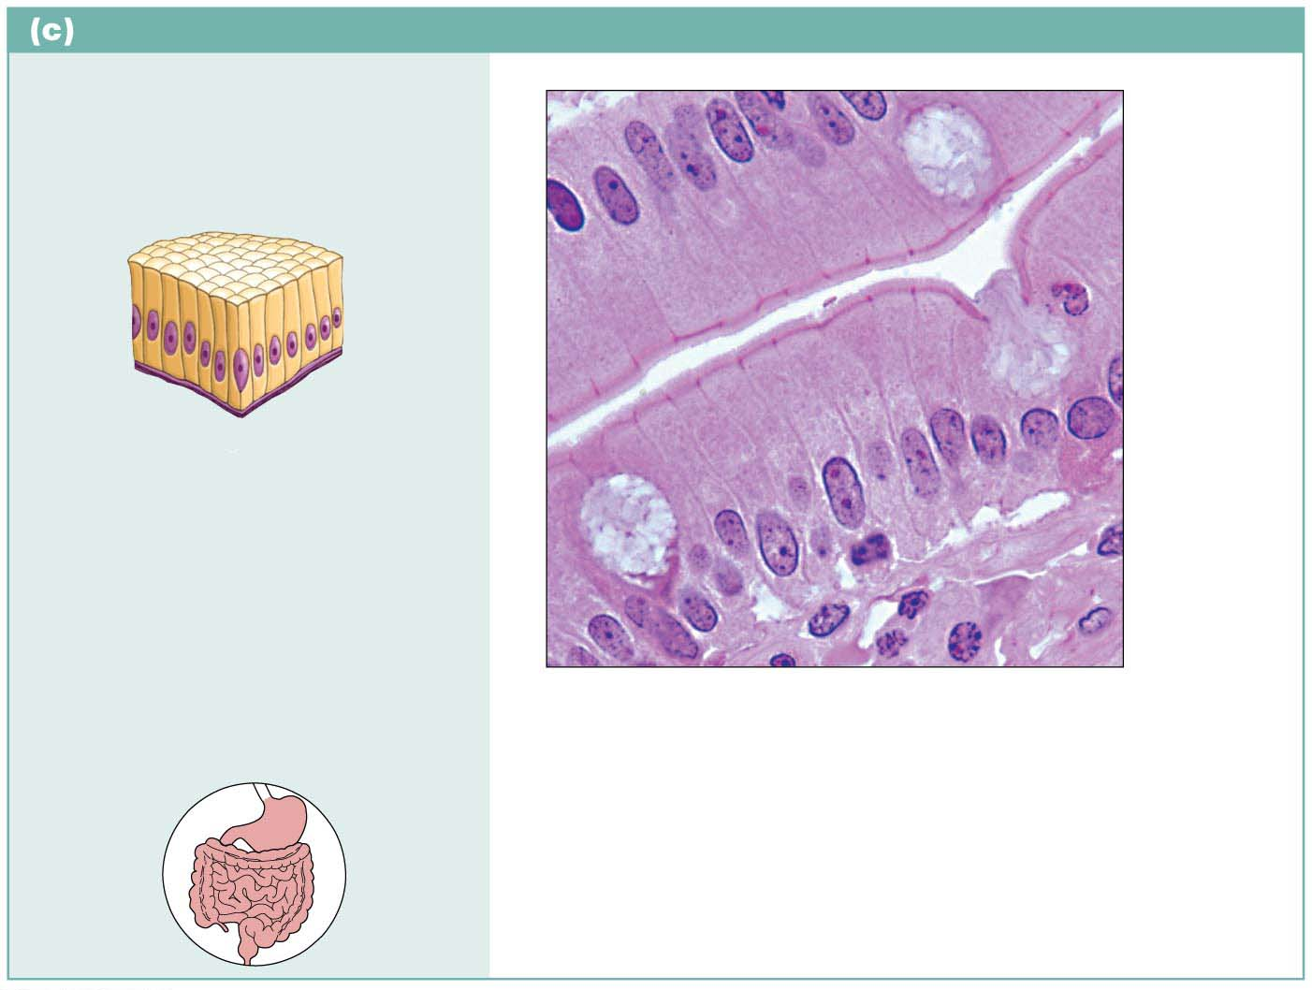
Simple columnar epithelium
Description: Single layer of tall
cells with round to oval nuclei; many
cells bear microvilli, some bear cilia;
layer may contain mucus-secreting
unicellular glands (goblet cells).
Microvilli
Simple
columnar
epithelial
cell
Function: Absorption; secretion
of mucus, enzymes, and other
substances; ciliated type propels
mucus (or reproductive cells) by
ciliary action.
Mucus of
goblet cell
Location: Nonciliated type lines
most of the digestive tract (stomach
to rectum), gallbladder, and excretory
ducts of some glands; ciliated variety
lines small bronchi, uterine tubes,
and some regions of the uterus.
Photomicrograph: Simple columnar
epithelium of the small intestine mucosa
(640⋅).

Slide 34
Pseudostratified
Cells irregular heights
Appear to be stratified
job= secrete, absorb, protect
found lining respiratory tract and male reproductive tract

Slide 35
Pseudostratified columnar epithelium
Cells vary in height and appear to be multi-layered and stratified, but tissue is in fact single-layered simple epithelium
“Pseudo” means false
Many cells are ciliated
Involved in secretion, particularly of mucus, and also in movement of mucus via ciliary sweeping action
Located mostly in upper respiratory tract, ducts of large glands, and tubules in testes

Slide 36
Pseudostratified columnar epithelium
Description: Single layer of cells
of differing heights, some not
reaching the free surface; nuclei
seen at different levels; may
contain mucus-secreting cells and
bear cilia.
Goblet cell
(contains
mucus)
Cilia
Pseudo-
stratified
epithelial
layer
Function: Secrete substances,
particularly mucus; propulsion
of mucus by ciliary action.
Location: Nonciliated type in
males’ sperm-carrying ducts and
ducts of large glands; ciliated
variety lines the trachea, most of
the upper respiratory tract.
Basement
membrane
Photomicrograph: Pseudostratified ciliated
columnar epithelium lining the human trachea
(780⋅).
Trachea

Slide 37
Stratified Epithelia

Slide 38
Stratified epithelial tissues
Involve two or more layers of cells
New cells regenerate from below
Basal cells divide and migrate toward surface
More durable than simple epithelia because protection is the major role
Stratified squamous epithelium
Most widespread of stratified epithelia
Free surface is squamous, with deeper cuboidal or columnar layers
Located in areas of high wear and tear (example: skin)
Keratinized cells found in skin; non-keratinized cells are found in moist linings

Slide 39
Stratified Squamous
3 layers
flattened
thick
can contain keratin
job= protection
found in skin & lining esophagus and mouth

Slide 40
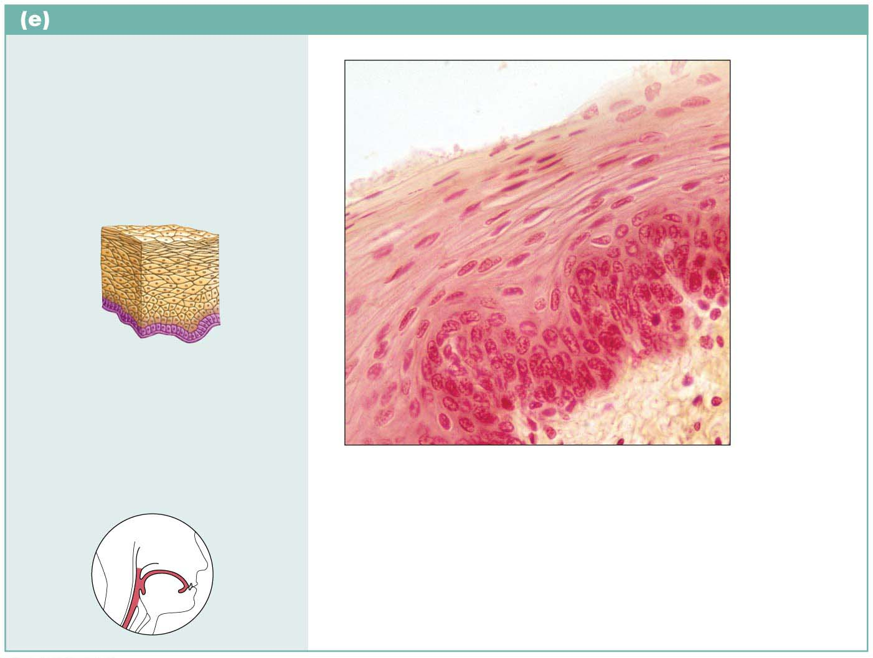
Stratified squamous epithelium
Description: Thick membrane
composed of several cell layers;
basal cells are cuboidal or columnar
and metabolically active; surface
cells are flattened (squamous); in the
keratinized type, the surface cells are
full of keratin and dead; basal cells
are active in mitosis and produce the
cells of the more superficial layers.
Stratified
squamous
epithelium
Nuclei
Basement
membrane
Function: Protects underlying
tissues in areas subjected to
abrasion.
Connective
tissue
Location: Nonkeratinized type forms
the moist linings of the esophagus,
mouth, and vagina; keratinized variety
forms the epidermis of the skin, a dry
membrane.
Photomicrograph: Stratified squamous
epithelium lining the esophagus (285⋅).

Slide 41
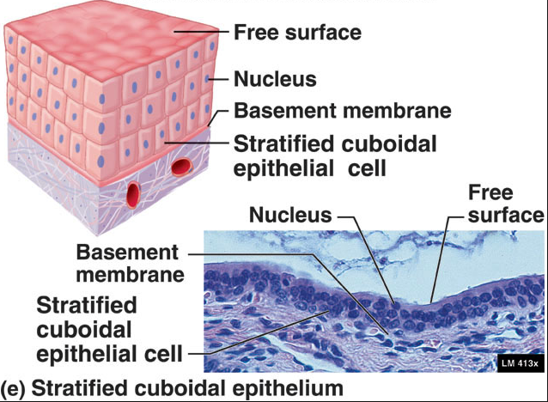
Stratified Cuboidal
Stratified cuboidal epithelium
Quite rare
Found in some sweat and mammary glands
Typically only two cell layers thick

Slide 42
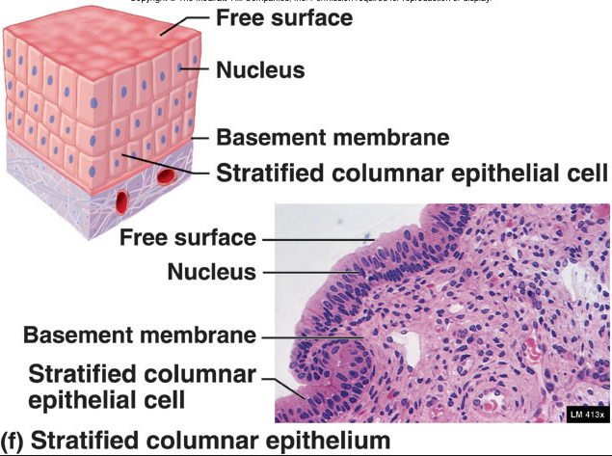
Stratified Columnar
RARE- basal are cuboidal, upper are columnar
job= protect & secrete
found lining male reproductive tract

Slide 43
Stratified epithelial tissues (cont.)
Stratified columnar epithelium
Also very limited distribution in body
Small amounts found in pharynx, in male urethra, and lining some glandular ducts
Usually occurs at transition areas between two other types of epithelia
Only apical layer is columnar

Slide 44
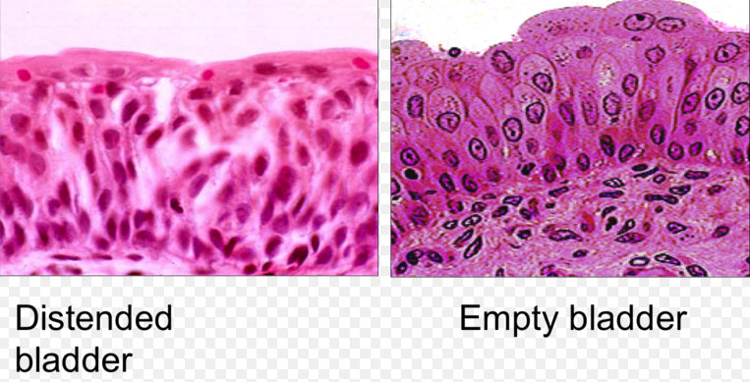
Transitional
Surface cells are large and rounded
job= stretches
found lining urinary organs

Slide 45
Transitional epithelium
Forms lining of hollow urinary organs
Found in bladder, ureters, and urethra
Basal layer cells are cuboidal or columnar
Ability of cells to change shape when stretched allows for increased flow of urine and, in the case of bladder, more storage space

Slide 46
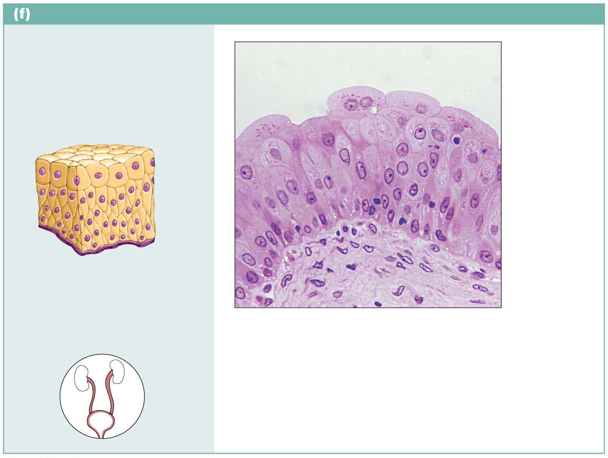
Transitional epithelium
Description: Resembles both
stratified squamous and
stratified cuboidal; basal cells
cuboidal or columnar; surface
cells dome shaped or
squamouslike, depending on
degree of organ stretch.
Transitional
epithelium
Function: Stretches readily,
permits stored urine to distend
urinary organ.
Basement
membrane
Location: Lines the ureters,
bladder, and part of the urethra.
Connective
tissue
Photomicrograph: Transitional epithelium
lining the bladder, relaxed state (360⋅); note
the bulbous, or rounded, appearance of the
cells at the surface; these cells flatten and
elongate when the bladder fills with urine.

Slide 47
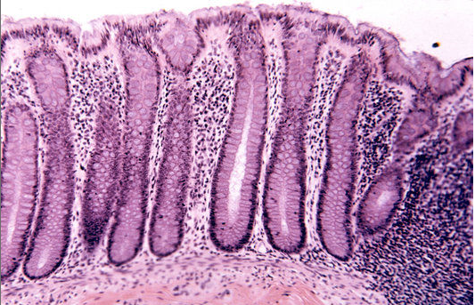
Glandular Epithelia

Slide 48
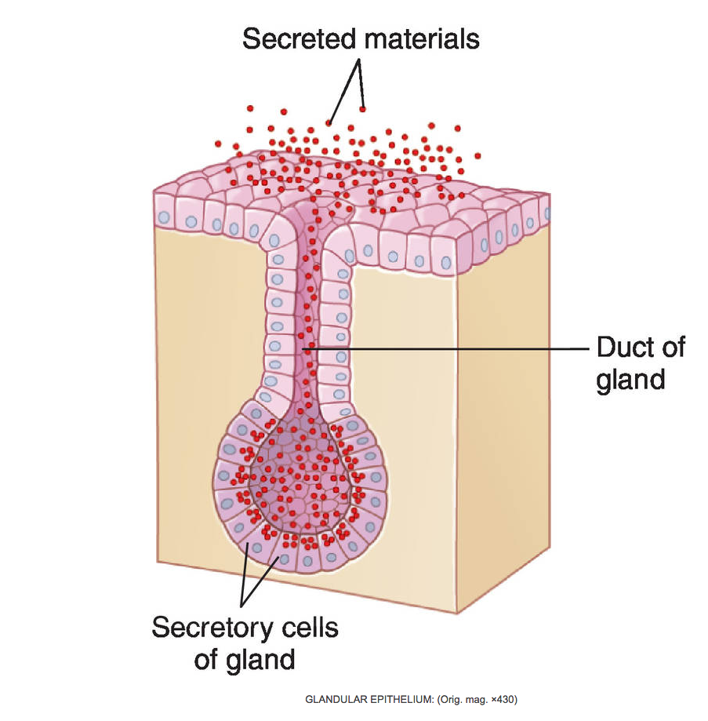
Glandular
Single or layered
job= secretes to surface of body (exocrine; has duct) or to bloodstream (endocrine; has no duct)
found all over body

Slide 49
Glandular Epithelia
Gland
One or more cells that makes and secretes an aqueous fluid called a secretion
Classified by:
Site of product release:
Endocrine: internally secreting (example: hormones)
Exocrine: externally secreting (example: sweat)
Relative number of cells forming the gland
Unicellular (example: goblet cells) or multicellular (example: salivary)

Slide 50
Endocrine Glands
Endocrine glands
Ductless glands
Secretions are not released into a duct; are released into surrounding interstitial fluid, which is picked up by circulatory system
Secrete (by exocytosis) hormones, messenger chemicals that travel through lymph or blood to their specific target organs
Target organs respond in some characteristic way

Slide 51
Exocrine Glands
Exocrine glands
Secretions are released onto body surfaces, such as skin, or into body cavities
More numerous than endocrine glands
Secrete products into ducts
Examples include mucous, sweat, oil, and salivary glands
Can be:
Unicellular
Multicellular

Slide 52
Exocrine Glands (cont.)
Unicellular exocrine glands
The only important unicellular glands are mucous cells and goblet cells
Found in epithelial linings of intestinal and respiratory tracts
All produce mucin, a sugar-protein that can dissolve in water to form mucus, a slimy protective, lubricating coating

Slide 53
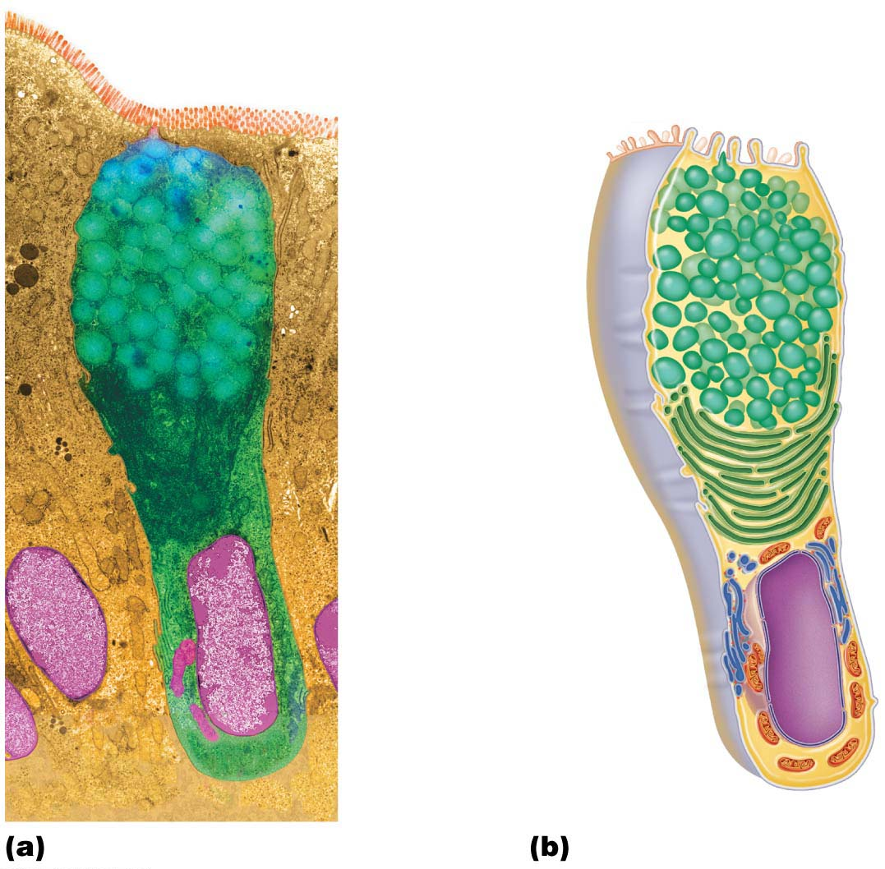
Microvilli
Secretory
vesicles
containing
mucin
Golgi
apparatus
Rough ER
Nucleus

Slide 54
Exocrine Glands (cont.)
Multicellular exocrine glands
Multicellular exocrine glands are composed of a duct and a secretory unit
Usually surrounded by supportive connective tissue that supplies blood and nerve fibers to gland
Connective tissue can form capsule around gland, and also extend into gland, dividing it into lobes
Classified by:
Structure
Mode of secretion

Slide 55
Exocrine Glands (cont.)
Multicellular exocrine glands (cont.)
Structure
Simple exocrine glands have unbranched ducts, but compound glands have branched ducts
In a tubular gland, secretory cells form a duct, whereas in alveolar glands, secretory cells form sacs
Tubuloalveolar glands have both types

Slide 56
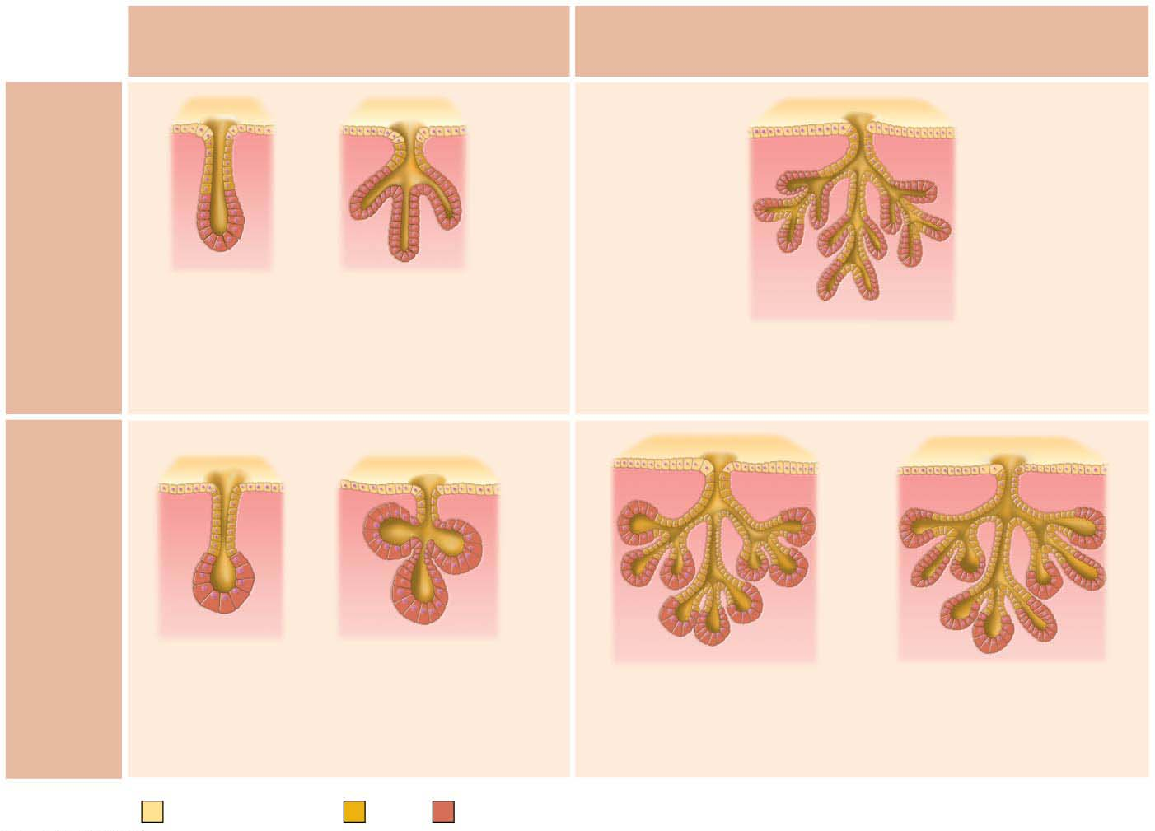
Simple duct structure
Compound duct structure
(duct does not branch)
(duct branches)
Tubular
secretory
structure
Simple tubular
Simple branched
tubular
Example
Compound tubular
Intestinal glands
Example
Stomach (gastric)
glands
Example
Duodenal glands of small intestine
Alveolar
secretory
structure
Simple alveolar
Simple branched
alveolar
Example
Compound alveolar
Compound
tubuloalveolar
No important
example in humans
Example
Example
Sebaceous (oil) glands
Mammary glands
Example
Salivary glands
Surface epithelium
Duct
Secretory epithelium

Slide 57
Glandular Epithelia (cont.)
Multicellular exocrine glands (cont.)
Mode of secretion
Merocrine: most secrete products by exocytosis as secretions are produced (sweat, pancreas)
Holocrine: accumulate products within, then rupture (sebaceous oil glands)
Apocrine: accumulate products within, but only apex ruptures; whether this type exists in humans is controversial (maybe mammary cells?)

Slide 58
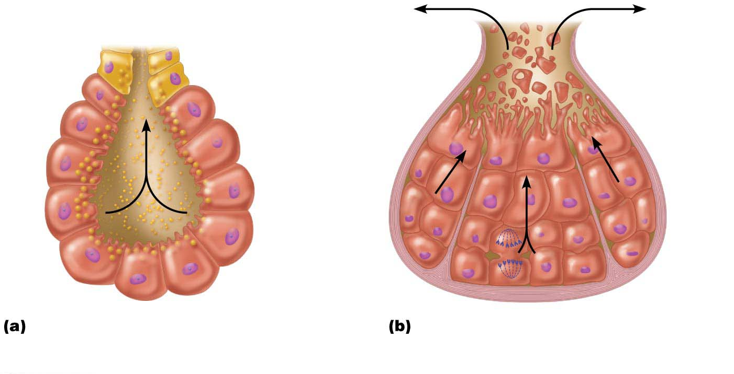
Figure 4.6 Chief modes of secretion in human exocrine glands.
Secretory
cell fragments
Secretory
vesicles
Merocrine glands secrete their
products by exocytosis.
In holocrine glands, the entire
secretory cell ruptures, releasing
secretions and dead cell fragments.

