Slide 1
Connective Tissue
Connective tissue is the most abundant and widely distributed of primary tissues
Major functions: binding and support, protecting, insulating, storing reserve fuel, and transporting substances (blood)

Slide 2
Characteristics
1. Found everywhere in body
2. Made of living cells surrounded by a matrix--
differ in the type of cells, fibers, and amounts
3. Most abundant type of tissue

Slide 3
Classes
There are 4 classes of connective tissue:
1. Connective
2. Cartilage
3. Bone
4. Blood

Slide 4
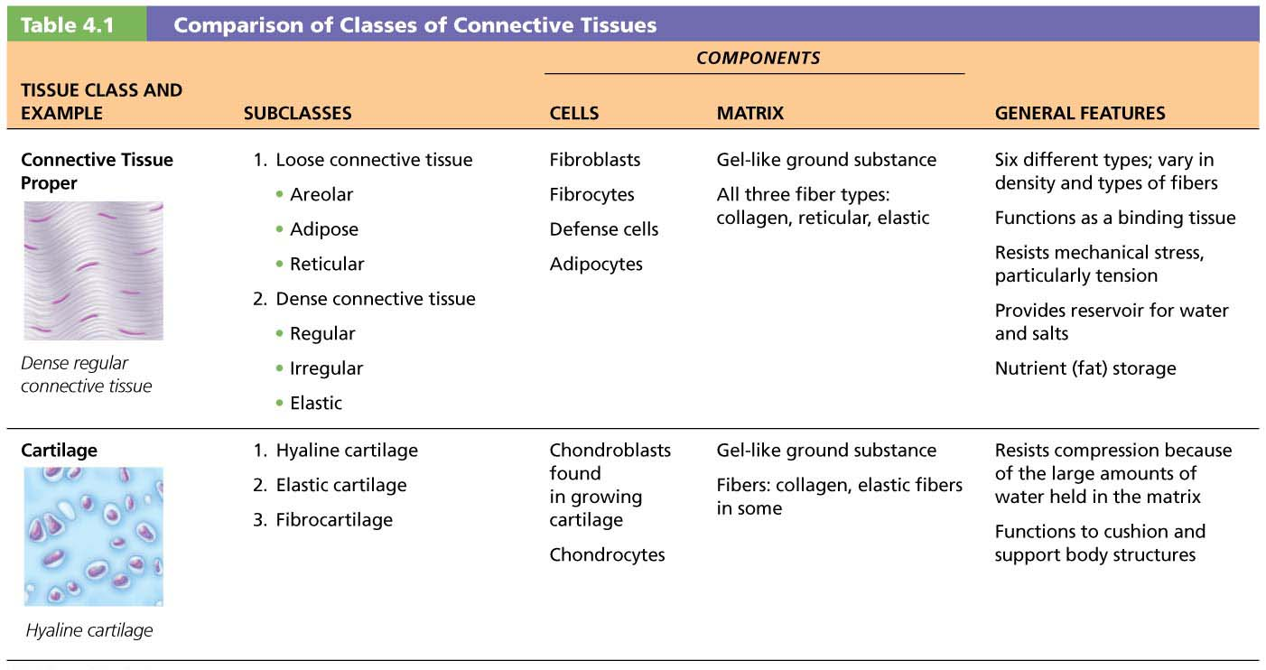
Table 4.1-1 Comparison of Classes of Connective Tissues

Slide 5
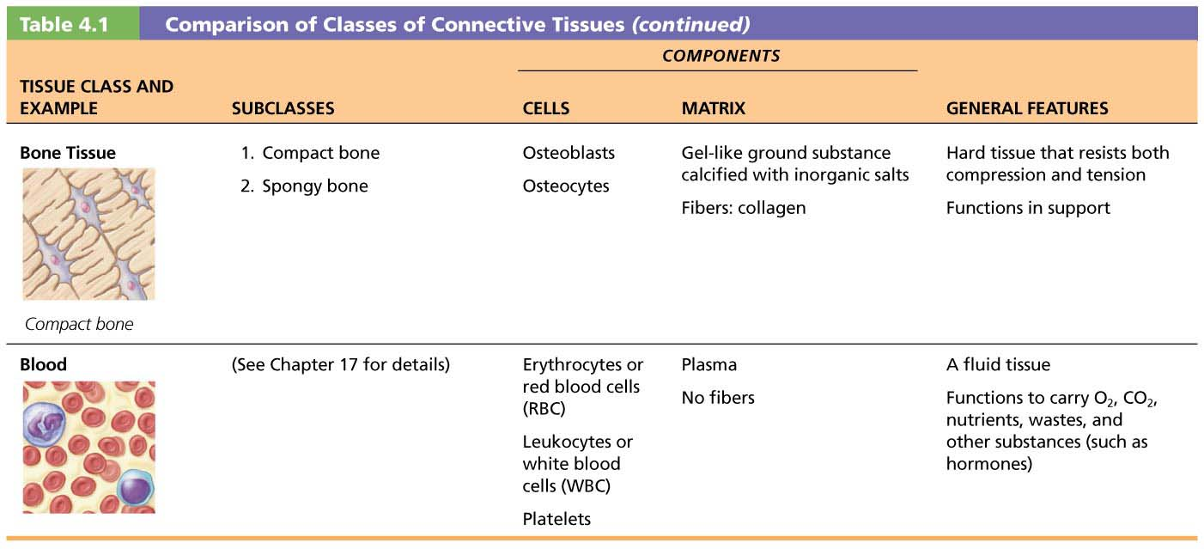
Table 4.1-2 Comparison of Classes of Connective Tissues (continued)

Slide 6
Common Characteristics of Connective Tissue
3 characteristics make connective tissues different from other primary tissues:
All have common embryonic origin: all arise from mesenchyme tissue as their tissue of origin
Have varying degrees of vascularity (cartilage is avascular, bone is highly vascularized)
Cells are suspended/embedded in extracellular matrix (ECM) (protein-sugar mesh)
Matrix supports cells so they can bear weight, withstand tension, endure abuse

Slide 7
Structural Elements of Connective Tissue
All connective tissues have three main elements
Ground substance
Fibers
Cells
The first two elements (ground substance and fibers) together make up the extracellular matrix
Composition and arrangement of these three elements vary considerably in different types of connective tissues

Slide 8
Structural Elements of Connective Tissue (cont.)
Ground substance
Unstructured gel-like material that fills space between cells
Medium through which solutes diffuse between blood capillaries and cells
Components
Interstitial fluid
Cell adhesion proteins (“glue” for attachment)
Proteoglycans (sugar proteins), made up of protein core + large polysaccharides
Example: chrondroitin sulfate and hyaluronic acid
Water also is trapped in varying amounts, affecting viscosity of ground substance

Slide 9
Structural Elements of Connective Tissue (cont.)
Connective tissue fibers
Three types of fibers provide support
Collagen (white, thick)
Strongest and most abundant type
Tough; provides high tensile strength
Elastic fibers (yellow, thin, single, branched)
Networks of long, thin, elastin fibers that allow for stretch and recoil
Reticular (black, short, fine)
Short, fine, highly branched collagenous fibers (different chemistry and form from collagen fibers)
Branching forms networks that offer more “give”

Slide 10
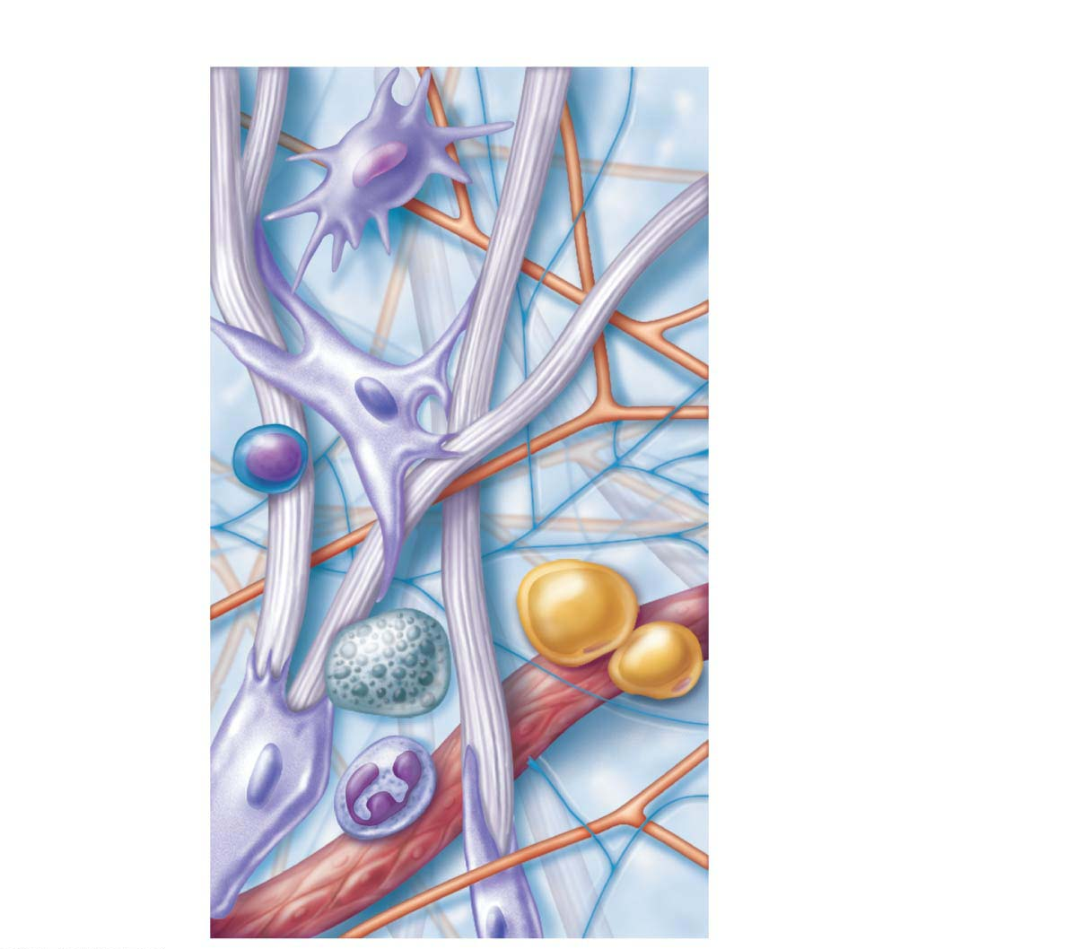
Figure 4.7 Areolar connective tissue: A prototype (model) connective tissue.
Cell types
Extracellular
matrix
Ground substance
Fibers
Macrophage
• Collagen fiber
• Elastic fiber
• Reticular fiber
Fibroblast
Lymphocyte
Fat cell
Capillary
Mast cell
Neutrophil

Slide 11
Cells of Connective Tissue
Cells- named (suffix) according to function:
-blast- build
-cyte- maintain (mature)
-clast- break
* also named (prefix) according to their classification (type/ location)
fibro- connective
chondro- cartilage
osteo- bone
hemato- blood

Slide 12
Cells of Connective Tissue (cont.)
Cells
“Blast” cells
Immature form of cell that actively secretes ground substance and ECM fibers
Fibroblasts found in connective tissue proper
Chondroblasts found in cartilage
Osteoblasts found in bone
Hematopoietic stem cells in bone marrow
“Cyte” cells
Mature, less active form of “blast” cell that now becomes part of and helps maintain health of matrix

Slide 13
Cells of Connective Tissue (cont.)
Other cell types in connective tissues
Fat cells (adipocytes)
Store nutrients
White blood cells
Neutrophils, eosinophils, lymphocytes
Tissue response to injury
Mast cells (secrete histamine)
Initiate local inflammatory response against foreign microorganisms they detect
Macrophages
Phagocytic cells that “eat” dead cells, microorganisms; function in immune system
Plasma cells
Produce antibodies

Slide 14
Types of Connective Tissues
There are four main classes of connective tissue:
1. Connective tissue proper
2. Cartilage
3. Bone
4. Blood

Slide 15
Connective Tissue Proper
Connective tissue proper
Consists of all connective tissues except bone, cartilage, and blood
Two subclasses
1) CT proper: loose connective tissues
Areolar
Adipose
Reticular
2) CT proper: dense connective tissues
Dense regular
Dense irregular
Elastic

Slide 16
Loose Connective (Areola)
Scattered cells w/both collagen & elastin in gel matrix
location- fills spaces; surrounds & supports bl.vess., organs, & nerves
“tissue fluid”

Slide 17
Connective Tissue Proper (cont.)
1. CT proper: loose connective tissues
a) Areolar connective tissue
Most widely distributed CT
Supports and binds other tissues
Universal packing material between other tissues
Contains fibroblasts that secrete loose arrangement of mostly collagen fibers
Loose fibers allow for increased ground substance, which can act as water reservoir by holding more interstitial fluid
Macrophages and fat cells are contained in spaces

Slide 18
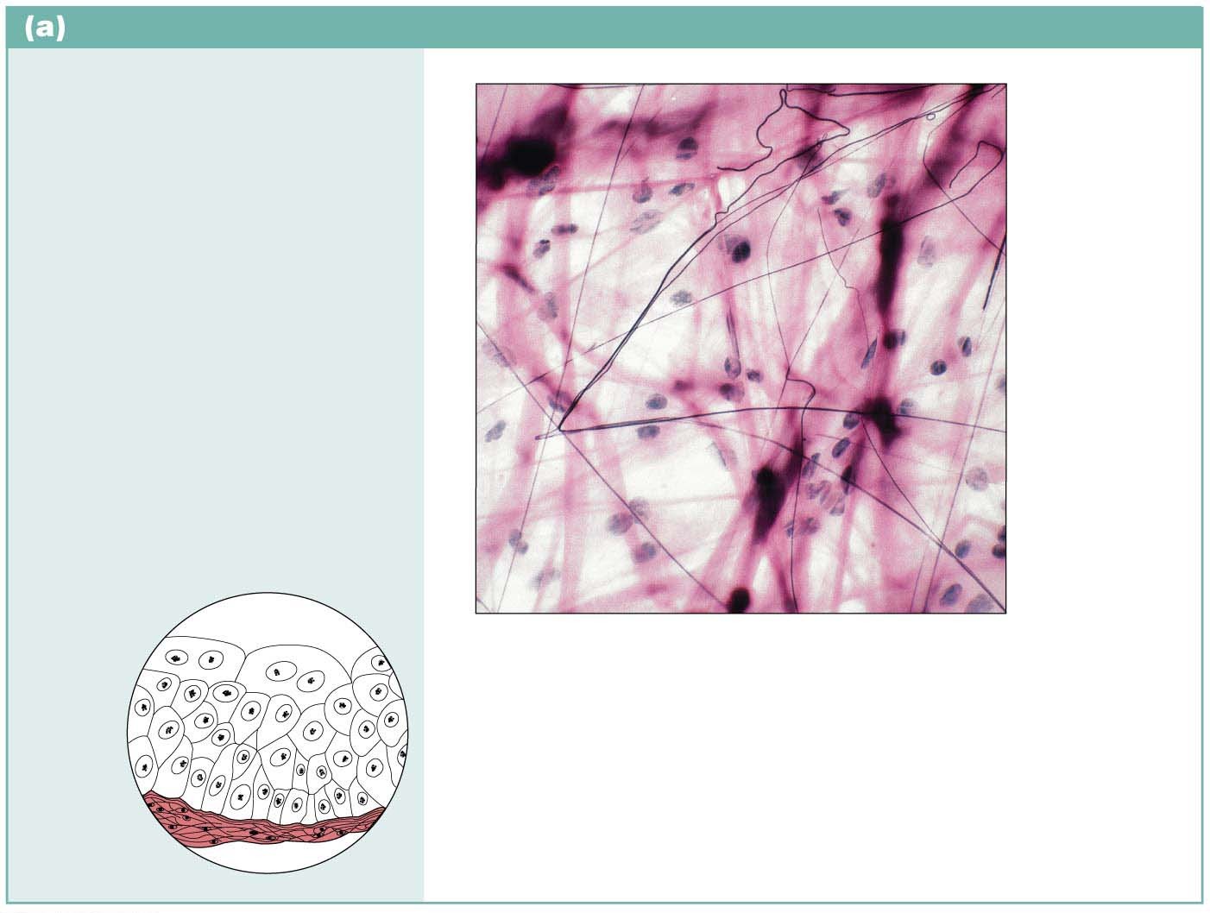
.
Connective tissue proper: loose connective tissue, areolar
Description: Gel-like matrix with
all three fiber types; cells:
fibroblasts, macrophages, mast
cells, and some white blood cells.
Elastic
fibers
Function: Wraps and cushions
organs; its macrophages
phagocytize bacteria; plays
important role in inflammation;
holds and conveys tissue fluid.
Ground
substance
Fibroblast
nuclei
Location: Widely distributed
under epithelia of body, e.g.,
forms lamina propria of mucous
membranes; packages organs;
surrounds capillaries.
Collagen
fibers
Epithelium
Photomicrograph: Areolar connective tissue,
a soft packaging tissue of the body (340⋅).
Lamina
propria

Slide 19
Adipose (Fat)
Little matrix; cells w/ lg fat droplet in vacuole; richly vascularized
loc-behind eyes, palms, soles, abdomen, hips

Slide 20
Connective Tissue Proper (cont.)
1. CT proper: loose connective tissues (cont.)
b) Adipose tissue
White fat
Similar to areolar tissue but greater nutrient storage
Cells are called adipocytes
Scanty matrix
Richly vascularized
Functions in shock absorption, insulation, and energy storage
Brown fat
Use lipid fuels to heat bloodstream rather than to produce ATP, as does white fat

Slide 21
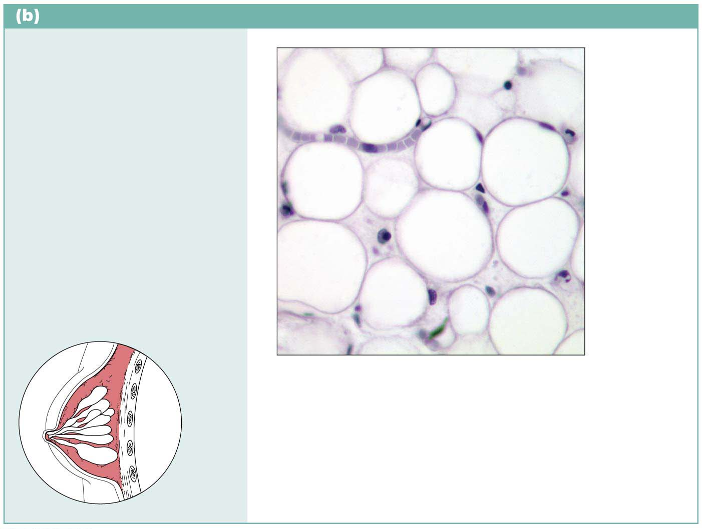
Connective tissue proper: loose connective tissue, adipose
Description: Matrix as in
areolar, but very sparse; closely
packed adipocytes, or fat cells,
have nucleus pushed to the
side by large fat droplet.
Nucleus of
adipose
(fat) cell
Function: Provides reserve
food fuel; insulates against
heat loss; supports and
protects organs.
Fat droplet
Location: Under skin in
subcutaneous tissue; around
kidneys and eyeballs; within
abdomen; in breasts.
Adipose
tissue
Photomicrograph: Adipose tissue from the
subcutaneous layer under the skin (350⋅).
Mammary
glands

Slide 22
Reticular
Delicate matrix of reticular fibers (blk) & fibroblasts (ret. Cells)
loc- soft internal structure of lymph nodes, bone marrow, spleen

Slide 23
Connective Tissue Proper (cont.)
1. CT proper: loose connective tissues (cont.)
c) Reticular connective tissue
Resembles areolar tissue, but fibers are thinner reticular fibers
Fibroblast cells are called reticular cells
Secrete reticular fibers made up of thin collagen
Reticular fibers form a mesh-like stroma that acts as a support for blood cells in lymph nodes, spleen, and bone marrow

Slide 24
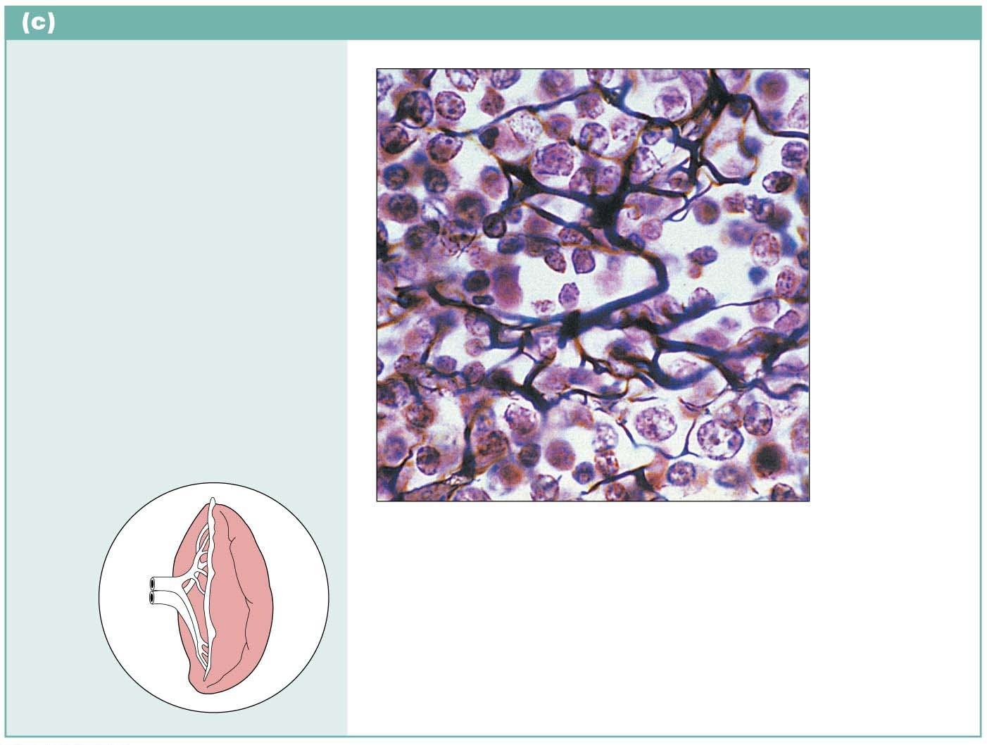
Connective tissue proper: loose connective tissue, reticular
Description: Loose network
of reticular fibers in a gel-like
ground substance; reticular
cells lie on the network.
Function: Fibers form a soft
internal skeleton (stroma) that
supports other cell types
including white blood cells,
mast cells, and macrophages.
White
blood cell
(lymphocyte)
Reticular
fibers
Location: Lymphoid organs
(lymph nodes, bone marrow,
and spleen).
Photomicrograph: Dark-staining network
of reticular connective tissue fibers forming
the internal skeleton of the spleen (350⋅).
Spleen

Slide 25
Connective Tissue Proper (cont.)
2. CT proper: dense connective tissues
Three varieties of dense connective tissue
a). Dense regular
b). Dense irregular
c). Elastic

Slide 26
Dense Regular (White Fibrous)
Cells w/densely packed parallel bundles of collagen (wt) fibers; poorly vascularized
loc- tendon (musc to bone)/ ligament (bone to bone)

Slide 27
Connective Tissue Proper (cont.)
2. CT proper: dense connective tissues (cont.)
a) Dense regular connective tissue
Very high tensile strength; can withstand high tension and stretching
Closely packed bundles of thick collagen fibers run parallel to direction of pull; very symmetric arrangement of bundles
Fibers appear as white structures
Great resistance to pulling
Fibers slightly wavy, so stretch a little
Fibroblasts manufacture collagen fibers and ground substance
Very few cells and ground substance, mostly fibers
Poorly vascularized
Example: tendons and ligaments

Slide 28
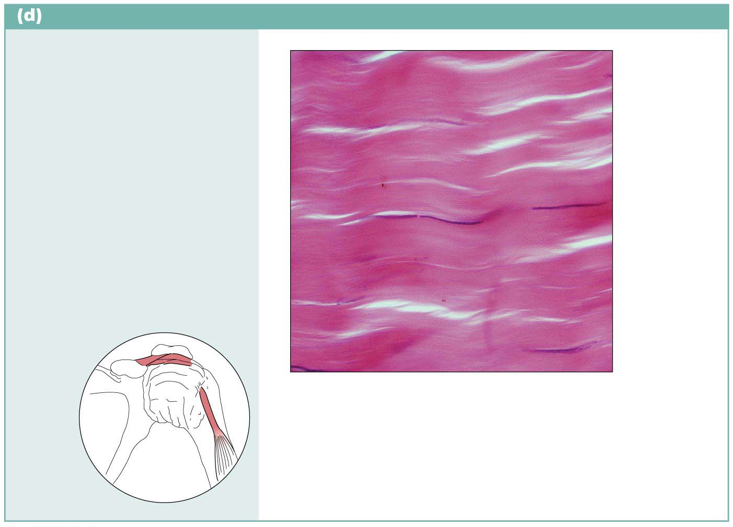
Connective tissue proper: dense connective tissue, dense regular
Description: Primarily parallel
collagen fibers; a few elastic
fibers; major cell type is the
fibroblast.
Collagen
fibers
Function: Attaches muscles to
bones or to muscles; attaches
bones to bones; withstands
great tensile stress when
pulling force is applied in one
direction.
Nuclei of
fibroblasts
Location: Tendons, most
ligaments, aponeuroses.
Shoulder
joint
Photomicrograph: Dense regular connective
tissue from a tendon (430⋅).
Ligament
Tendon

Slide 29
Dense Irregular
Cells W/ irreg collagen fibers; can withstand tension in many directions
loc- dermis of skin; capsules of organs

Slide 30
Connective Tissue Proper (cont.)
2. CT proper: dense connective tissues (cont.)
b) Dense irregular connective tissue
Same elements as dense regular, but bundles of collagen are thicker and irregularly arranged
Forms sheets rather than bundles
Resists tension from many directions
Found in:
Dermis
Fibrous joint capsules
Fibrous coverings of some organs

Slide 31
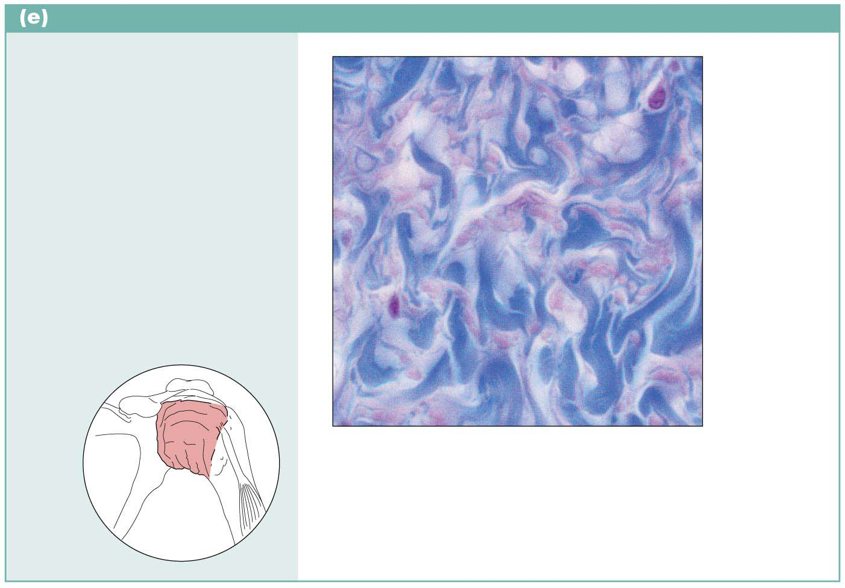
Connective tissue proper: dense connective tissue, dense irregular
Description: Primarily
irregularly arranged collagen
fibers; some elastic fibers;
fibroblast is the major cell type.
Nuclei of
fibroblasts
Function: Withstands tension
exerted in many directions;
provides structural strength.
Location: Fibrous capsules of
organs and of joints; dermis of
the skin; submucosa of
digestive tract.
Collagen
fibers
Shoulder
joint
Photomicrograph: Dense irregular connective
tissue from the fibrous capsule of a joint (430⋅).
Fibrous
joint
capsule

Slide 32
Connective Tissue Proper(cont.)
2. CT proper: dense connective tissues (cont.)
c) Elastic connective tissue
Some ligaments are very elastic
Example: ligaments connecting adjacent vertebrae must be very elastic
Also found in walls of many large arteries
Arteries need to stretch when blood enters and recoil to push blood out

Slide 33
Connective tissue proper: dense connective tissue, elastic
Description: Dense regular
connective tissue containing a
high proportion of elastic fibers.
Function: Allows tissue to
recoil after stretching; maintains
pulsatile flow of blood through
arteries; aids passive recoil of
lungs following inspiration.
Elastic
fibers
Location: Walls of large
arteries; within certain ligaments
associated with the vertebral
column; within the walls of the
bronchial tubes.
Photomicrograph: Elastic connective tissue
in the wall of the aorta (250⋅).
Aorta
Heart

Slide 34
Cartilage
Stands up to both tension (pull) and compression (push)
avascular- no blood supply; nourished by diffusion
lack nerve fibers
cells called chondrocytes are embedded in a firm gel.

Slide 35
Cartilage
Cells are found in lacunae (spaces)
There are 3 types of cells
Cells are in groups of 2, 4, or 6
Cells are distinguished by the type of fiber they contain

Slide 36
Cartilage
Cartilage
Matrix secreted from chondroblasts (during growth) and chondrocytes (adults)
Chondrocytes found in cavities called lacunae
80% water, with packed collagen fibers and sugar proteins (chondroitin and hyaluronic acid)
Tough yet flexible material that lacks nerve fibers
Avascular: receives nutrients from membrane surrounding it (perichondrium)
Periochondrium gives rise to chondroblasts and chondrocytes

Slide 37
Cartilage
3 Types of Cartilage:
Hyaline--clear matrix with little collagen
Fibrocartilage- lots of collagen in a matrix
Elastic-- contains elastin

Slide 38
Hyaline Cartilage
Clear matrix
hyalin= “glass”
most abundant type
“gristle”
Appears as shiny bluish glass
loc- ends of bones @joints; ribs to sternum; nose, trachea, larynx (respiratory passages)

Slide 39
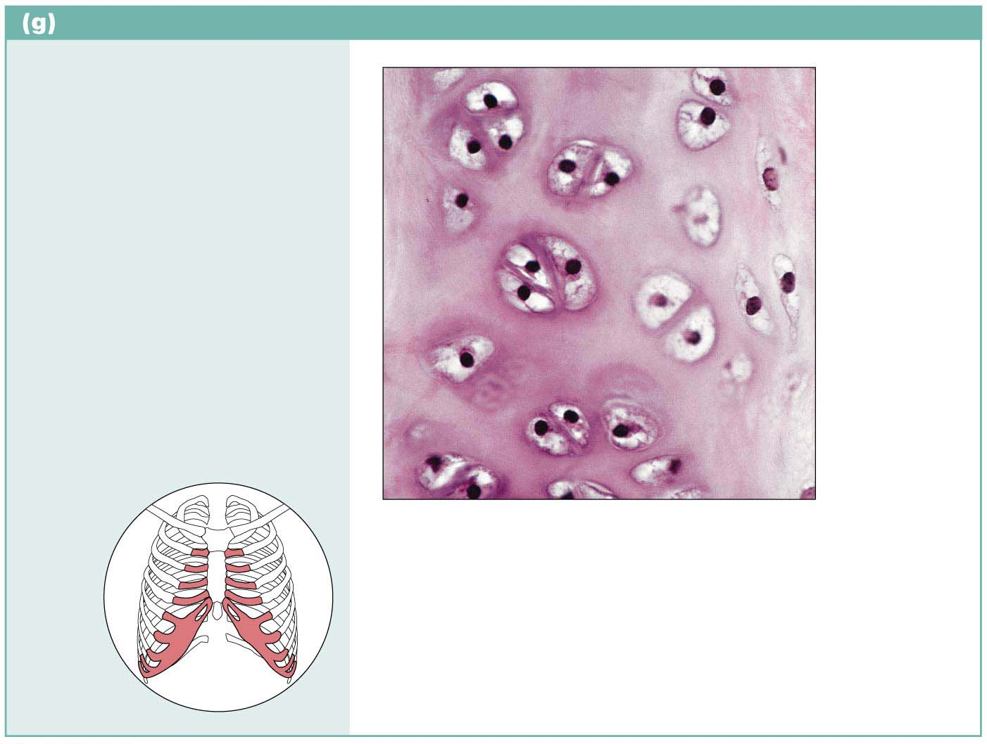
Cartilage: hyaline
Description: Amorphous but
firm matrix; collagen fibers form
an imperceptible network;
chondroblasts produce the
matrix and when mature
(chondrocytes) lie in lacunae.
Chondrocyte
in lacuna
Function: Supports and
reinforces; serves as resilient
cushion; resists compressive
stress.
Matrix
Location: Forms most of the
embryonic skeleton; covers the
ends of long bones in joint
cavities; forms costal cartilages
of the ribs; cartilages of the
nose, trachea, and larynx.
Photomicrograph: Hyaline cartilage from
a costal cartilage of a rib (470⋅).
Costal
cartilages

Slide 40
Elastic Cartilage
Single elastic fibers in matrix
Similar to hyaline but with more elastic fibers
loc-Found in ears and epiglottis

Slide 41
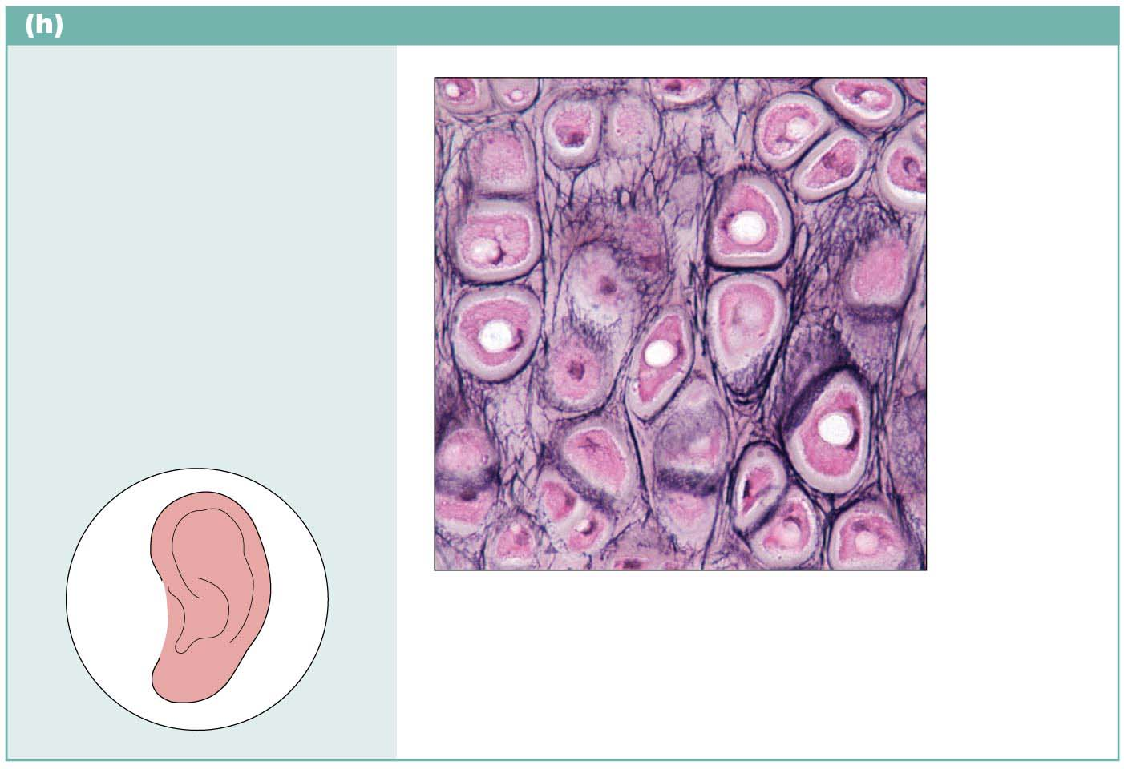
Cartilage: elastic
Description: Similar to hyaline
cartilage, but more elastic
fibers in matrix.
Chondrocyte
in lacuna
Function: Maintains the shape
of a structure while allowing
great flexibility.
Matrix
Location: Supports the
external ear (pinna); epiglottis.
Photomicrograph: Elastic cartilage from the
human ear pinna; forms the flexible skeleton
of the ear (800⋅).

Slide 42
Fibrocartilage
Chondrocytes (cells) w/collagen in matrix
Properties between hyaline and dense regular tissue
Loc- strong, so found in areas such as intervertebral discs and knee

Slide 43
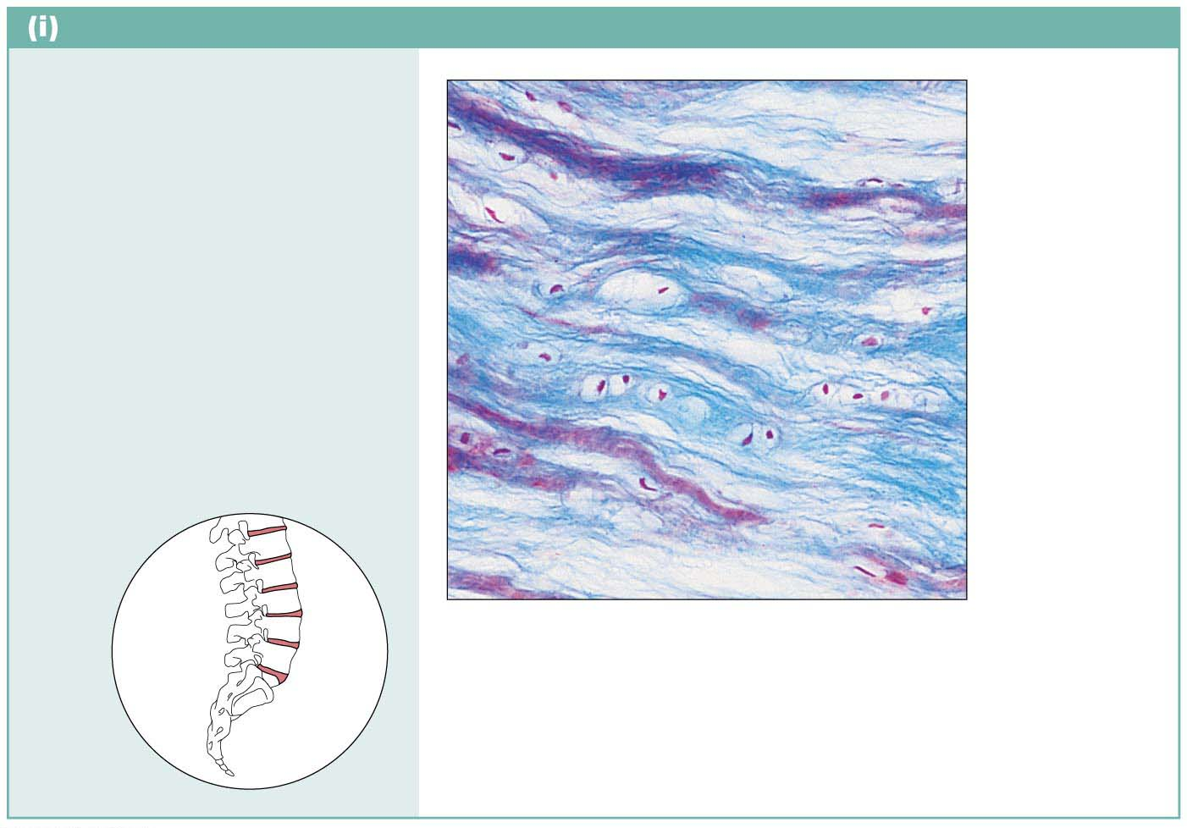
Cartilage: fibrocartilage
Description: Matrix similar to
but less firm than that in hyaline
cartilage; thick collagen fibers
predominate.
Function: Tensile strength
allows it to absorb compressive
shock.
Chondrocytes
in lacunae
Location: Intervertebral discs;
pubic symphysis; discs of knee
joint.
Collagen
fiber
Intervertebral
discs
Photomicrograph: Fibrocartilage of an
intervertebral disc (125⋅). Special staining
produced the blue color seen.

Slide 44
Osseous (Bone)
Cells in nonliving calcified matrix; Strongest conn tissue; 2 types (compact/ spongy);fat storage; manuf blood cells
loc- skeleton

Slide 45
Bone
2 types of bone:
1. Compact- shaft of bone- Haversian system parallel
2. Spongy- ends of bone- no Haversian syst
Haversian system- mature osteocyte (bone cell) around a blood vessel

Slide 46
Bone
Bone
Also called osseous tissue
Supports and protects body structures
Stores fat and synthesizes blood cells in cavities
Has more collagen compared to cartilage
Has inorganic calcium salts
Osteocytes maintain the matrix; mature bone cell
Reside in cavities in matrix called lacunae
Osteon- bone cell unit
osteoblast- builds bone; produces the matrix
osteoclast- breaks down bone
Richly vascularized

Slide 47
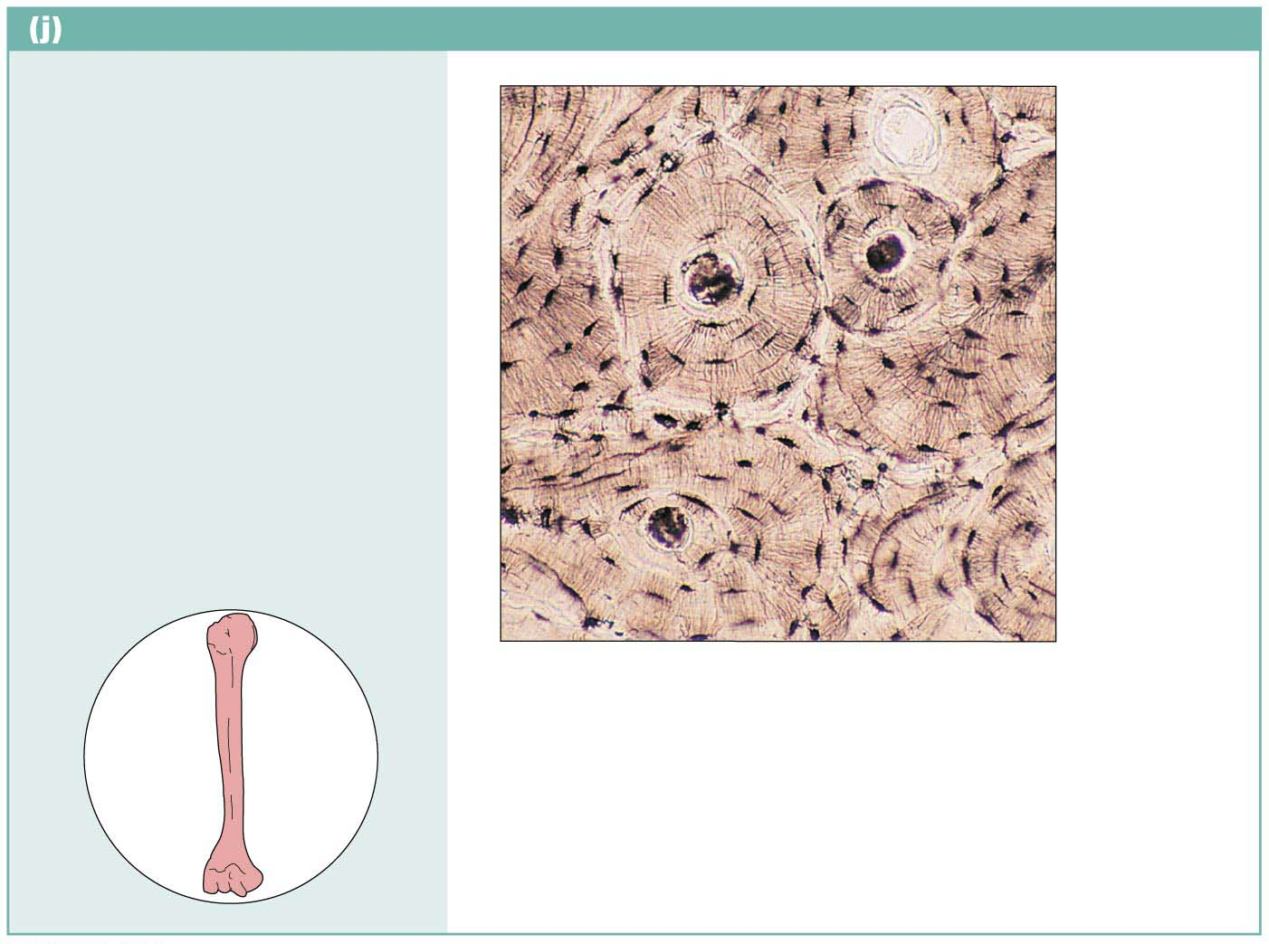
Others: bone (osseous tissue)
Description: Hard, calcified
matrix containing many
collagen fibers; osteocytes
lie in lacunae. Very well
vascularized.
Central
canal
Lacunae
Function: Supports and
protects (by enclosing);
provides levers for the muscles
to act on; stores calcium and
other minerals and fat; marrow
inside bones is the site for
blood cell formation
(hematopoiesis).
Lamella
Location: Bones
Photomicrograph: Cross-sectional view of
bone (125⋅).

Slide 48
Vascular (Blood)
Liquid matrix contained w/in vessels; contains different types of cells
loc- whole body

Slide 49
Blood
Blood
Most atypical connective tissue because it is fluid
Consists of cells surrounded by matrix (plasma)
Red blood cells are most common cell type
Also contains white blood cells and platelets
Fibers are soluble proteins that precipitate during blood clotting
Functions in transport and in carrying nutrients, wastes, gases, and other substances

Slide 50
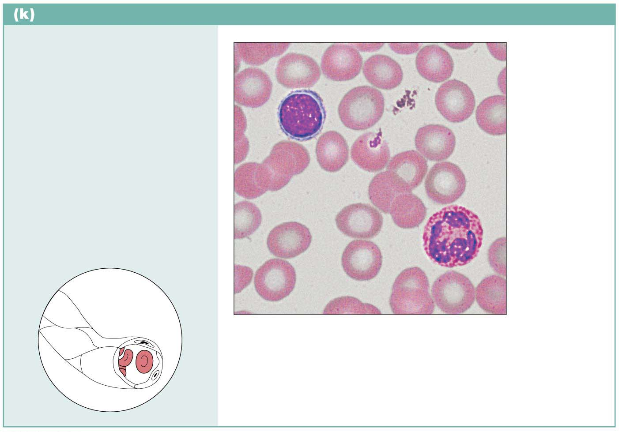
Connective tissue: blood
Description: Red and white
blood cells in a fluid matrix
(plasma).
Red blood
cells
(erythrocytes)
Function: Transport
respiratory gases, nutrients,
wastes, and other substances.
White blood
cells:
• Lymphocyte
• Neutrophil
Location: Contained within
blood vessels.
Plasma
Photomicrograph: Smear of human blood (1670⋅);
shows two white blood cells surrounded by red
blood cells.

