Slide 1
Ch 15 Special Senses Part 2
Smell, Taste, and Hearing

Slide 2
The Chemical Senses: Smell and Taste
Smell (olfaction) and taste (gustation): complementary senses that let us know whether a substance should be savored or avoided
Chemoreceptors are used by these systems
Chemicals must be dissolved in aqueous solution to be picked up by chemoreceptors
Smell receptors are excited by chemicals dissolved in nasal fluids
Taste receptors respond to chemicals dissolved in saliva

Slide 3
15.5 Sense of Smell
Location and Structure of Olfactory Receptors
Olfactory epithelium: organ of smell
Located in in roof of nasal cavity
Covers superior nasal conchae
Contains olfactory sensory neurons
Bipolar neurons with radiating olfactory cilia
Supporting cells surround and cushion olfactory receptor cells
Olfactory stem cells lie at base of epithelium

Slide 4
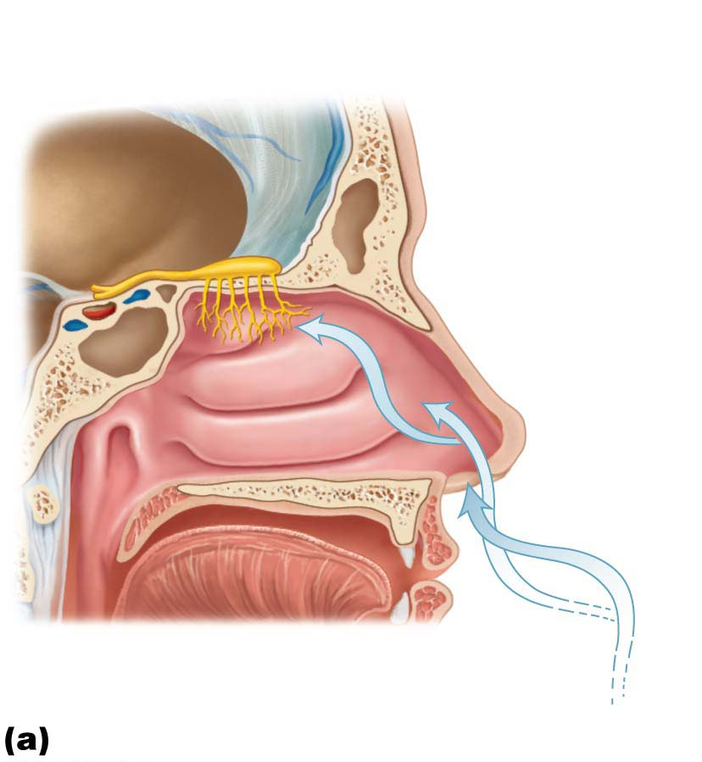
Figure 15.20a Olfactory receptors.
Olfactory
epithelium
Olfactory tract
Olfactory bulb
Nasal
conchae
Route of
inhaled air

Slide 5
Location and Structure of Olfactory Receptors
Olfactory neurons are unusual bipolar neurons
Thin apical dendrites terminate in knob
Long, largely nonmotile cilia, olfactory cilia, radiate from knob
Covered by mucus (solvent for odorants)
Bundles of nonmyelinated axons of olfactory receptor cells gather in fascicles that make up filaments of olfactory nerve (cranial nerve I)
Olfactory neurons, unlike other neurons, have stem cells that give rise to new neurons every 30–60 days

Slide 6
Specificity of Olfactory Receptors
Smells may contain 100s of different odorants
Humans have ~400 “smell” genes active in nose
Each encodes a unique receptor protein
Protein responds to one or more odors
Each odor binds to several different receptors
Each receptor has one type of receptor protein
Pain and temperature receptors are also in nasal cavities
Respond to irritants, such as ammonia, or can “smell” hot or cold (chili peppers, menthol)

Slide 7
Physiology of Smell
In order to smell substance, it must be volatile
Must be in gaseous state
Odorant must also be able to dissolve in olfactory epithelium fluid
Activation of olfactory sensory neurons
Dissolved odorants bind to receptor proteins in olfactory cilium membranes
Open cation channels, generating receptor potential
At threshold, AP is conducted to first relay station in olfactory bulb

Slide 8
Taste

Slide 9
15.6 Sense of Taste
Location and Structure of Taste Buds
Taste buds: sensory organs for taste
Most of 10,000 taste buds are located on tongue in papillae, peglike projections of tongue mucosa
Fungiform papillae: tops of these mushroom-shaped structures house most taste buds; scattered across tongue
Foliate papillae: on side walls of tongue
Vallate papillae: largest taste buds with 8–12 forming “V” at back of tongue
Few on soft palate, cheeks, pharynx, epiglottis

Slide 10
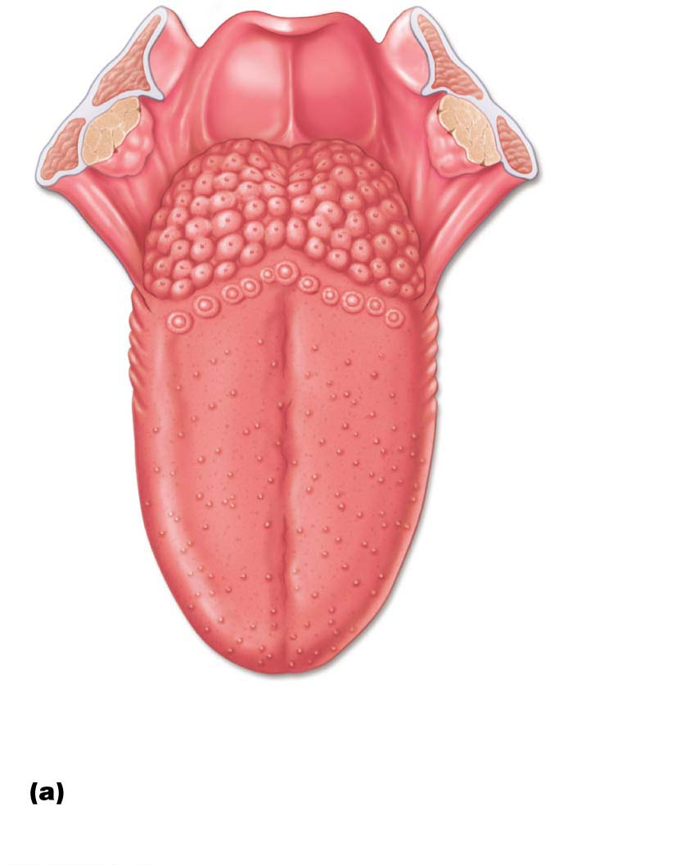
Figure 15.22a Location and structure of taste buds on the tongue.
Epiglottis
Palatine
tonsil
Lingual
tonsil
Foliate
papillae
Fungiform
papillae
Taste buds are associated
with fungiform, foliate,
and vallate papillae.

Slide 11
Location and Structure of Taste Buds (cont.)
Each taste bud consists of 50–100 flask-shaped epithelial cells of two types:
Gustatory epithelial cells: taste receptor cells have microvilli called gustatory hairs that project into taste pores, bathed in saliva
Sensory dendrites coiled around gustatory epithelial cells send taste signals to brain
Three types of gustatory epithelial cells
One releases serotonin; others lack synaptic vesicles, but one releases ATP as neurotransmitter
Basal epithelial cells: dynamic stem cells that divide every 7–10 days

Slide 12
Basic Taste Sensations
There are five basic taste sensations
Sweet—sugars, saccharin, alcohol, some amino acids, some lead salts
Sour—hydrogen ions in solution
Salty—metal ions (inorganic salts); sodium chloride tastes saltiest
Bitter—alkaloids such as quinine and nicotine, caffeine, and nonalkaloids such as aspirin
Umami—amino acids glutamate and aspartate; example: beef (meat) or cheese taste, and monosodium glutamate

Slide 13
Basic Taste Sensations (cont.)
Possible sixth taste
Growing evidence humans can taste long-chain fatty acids from lipids
Perhaps explain liking of fatty foods
Taste likes/dislikes have homeostatic value
Guide intake of beneficial and potentially harmful substances
Dislike for sourness and bitterness is a protective way of warning us if something is spoiled or poisonous

Slide 14
Physiology of Taste
To be able to taste a chemical, it must:
Be dissolved in saliva
Diffuse into taste pore
Contact gustatory hairs

Slide 15
Gustatory Pathway
Two main cranial nerve pairs carry taste impulses from tongue to brain:
Facial nerve (VII) carries impulses from anterior two-thirds of tongue
Glossopharyngeal (X) carries impulses from posterior one-third and pharynx
Vagus nerve transmits from epiglottis and lower pharynx

Slide 16
Gustatory Pathway (cont.)
Important roles of taste involve:
Triggering reflexes involved in digestion, such as:
Increased secretion of saliva into mouth
Increased secretion of gastric juice into stomach
May initiate protective reactions, such as:
Gagging
Reflexive vomiting

Slide 17
Influence of Other Sensations on Taste
Taste is 80% smell
If nose is blocked, foods taste bland
Mouth also contains thermoreceptors, mechanoreceptors, and nociceptors
Temperature and texture enhance or detract from taste
Spicy hot foods can excite pain receptors in mouth, which some people experience as pleasure
Example: hot chili peppers

Slide 18
The Ear

Slide 19
Part 3 – The Ear: Hearing and Balance
15.7 Structure of the Ear
The ear has three major areas:
External (outer) ear: hearing only
Middle ear (tympanic cavity): hearing only
Internal (inner) ear: hearing and equilibrium
Receptors for hearing and balance respond to separate stimuli and are activated independently

Slide 20
External Ear

Slide 21
External Ear
The external (outer) ear consists of two parts:
Auricle (pinna): shell-shaped structure surrounding ear canal that functions to funnel sound waves into auditory canal
Helix: cartilaginous rim
Lobule: fleshy earlobe
External acoustic meatus (auditory canal)
Short, curved tube lined with skin bearing hairs, sebaceous glands, and ceruminous (earwax) glands
Transmits sound waves to eardrum

Slide 22
External Ear (cont.)
Tympanic membrane (eardrum)
Boundary between external and middle ears
Thin, translucent connective tissue membrane
Vibrates in response to sound
Transfers sound energy to bones of middle ear

Slide 23
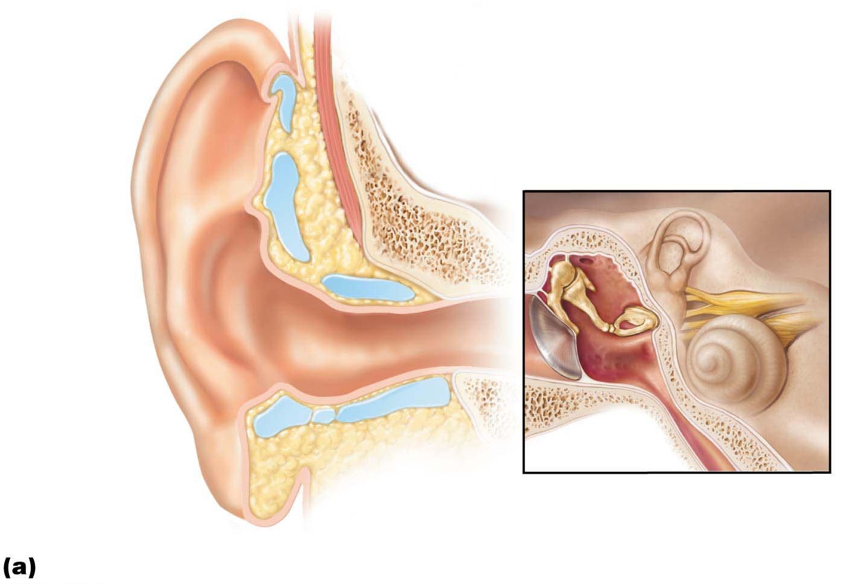
Figure 15.24a Structure of the ear.
External
ear
Middle
ear
Internal ear
(labyrinth)
Auricle
(pinna)
Helix
Lobule
External
acoustic
meatus
Tympanic
membrane
Pharyngotympanic
(auditory) tube
The three regions of the ear

Slide 24
Middle Ear (Tympanic Cavity)

Slide 25
Middle Ear (Tympanic Cavity)
A small, air-filled, mucosa-lined cavity in temporal bone
Flanked laterally by eardrum and medially by bony wall containing oval and round membranous windows
Epitympanic recess: superior portion of middle ear (roof of cavity)
Mastoid antrum: canal for communication with mastoid air cells in mastoid process

Slide 26
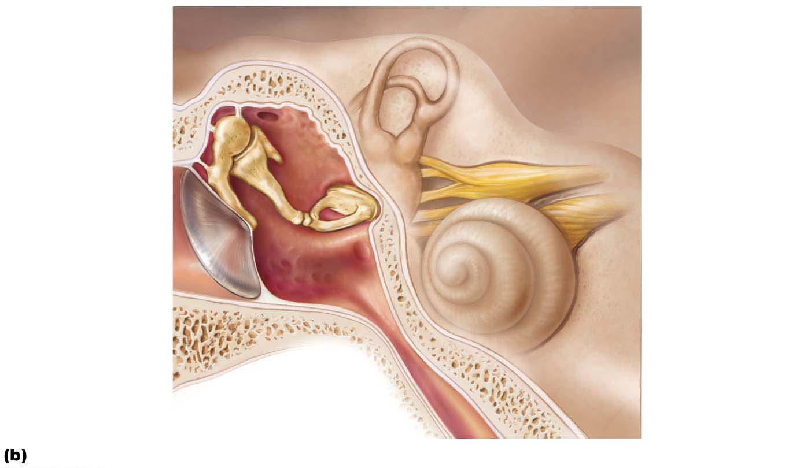
Figure 15.24b Structure of the ear.
Oval window
(deep to stapes)
Entrance to mastoid
antrum in the
epitympanic recess
Semicircular
canals
Malleus
(hammer)
Vestibule
Auditory
ossicles
Incus
(anvil)
Vestibular
nerve
Stapes
(stirrup)
Cochlear
nerve
Tympanic
membrane
Cochlea
Round window
Pharyngotympanic
(auditory) tube
Middle and internal ear

Slide 27
Middle Ear (Tympanic Cavity) (cont.)
Pharyngotympanic (auditory) tube: connects middle ear to nasopharynx
Formerly called eustachian tube
Usually flattened tube, but can be opened by yawning or swallowing to equalize pressure in middle ear cavity with external air pressure
Tympanic membrane cannot vibrate efficiently if pressures on both sides are not equal
Sounds are distorted

Slide 28
Middle Ear (Tympanic Cavity) (cont.)
Auditory ossicles: three small bones in tympanic cavity, named for their shape:
Malleus: the “hammer” is secured to eardrum
Incus: the “anvil”
Stapes: the “stirrup” base fits into oval window
Synovial joints allow malleus to articulate with incus, which articulates with stapes
Suspended by ligaments; transmit vibratory motion of eardrum to oval window
Tensor tympani and stapedius muscles contract reflexively in response to loud sounds to prevent damage to hearing receptors

Slide 29
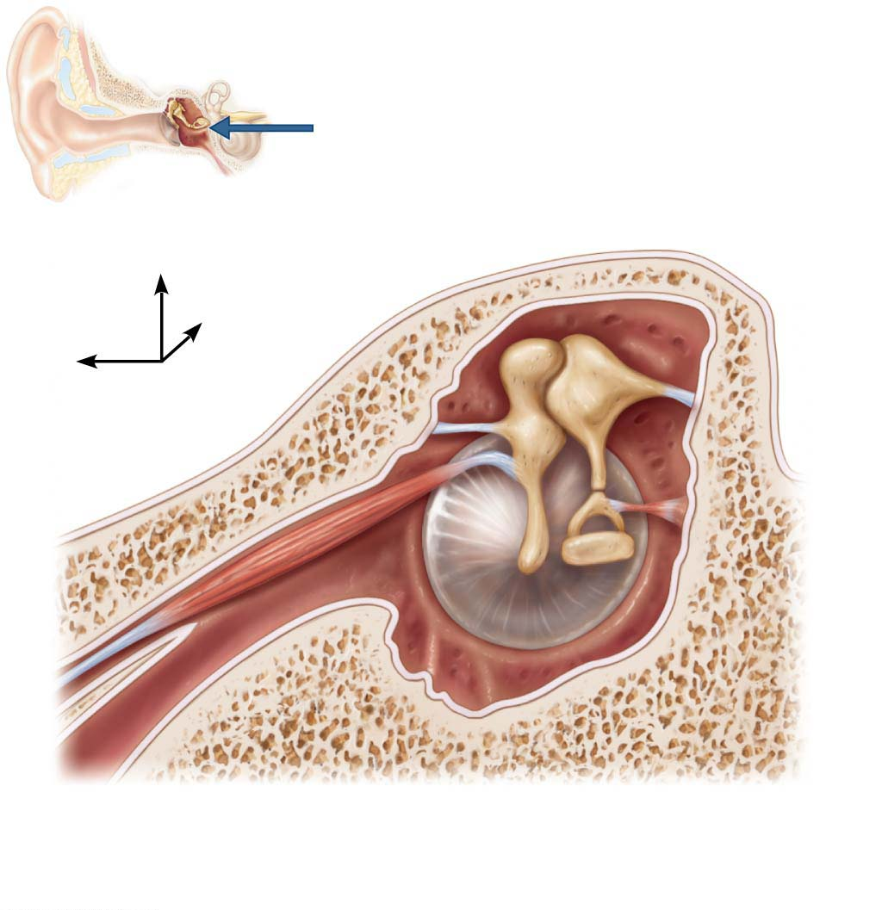
Figure 15.25 The three auditory ossicles and associated skeletal muscles.
View
Epitympanic
recess
Malleus
Incus
Superior
Lateral
Anterior
Pharyngotym-
panic tube
Tensor
tympani
muscle
Tympanic
membrane
(medial view)
Stapes
Stapedius
muscle

Slide 30
Clinical – Homeostatic Imbalance 15.14
Otitis media
Middle ear inflammation
Commonly seen in children with sore throat
Especially those with shorter, more horizontal pharyngotympanic tubes
Most frequent cause of hearing loss in children
Acute infectious forms cause eardrum to bulge outward and become inflamed
Most cases respond to antibiotics

Slide 31
Inner Ear

Slide 32
Internal Ear
Also referred to as the labyrinth (maze)
Located in temporal bone behind eye socket
Two major divisions:
Bony labyrinth: system of tortuous channels and cavities that worm through the bone
Divided into three regions: vestibule, semicircular canals, and cochlea
Filled with perilymph fluid; similar to CSF
Membranous labyrinth; series of membranous sacs and ducts contained in bony labyrinth; filled with potassium-rich endolymph

Slide 33
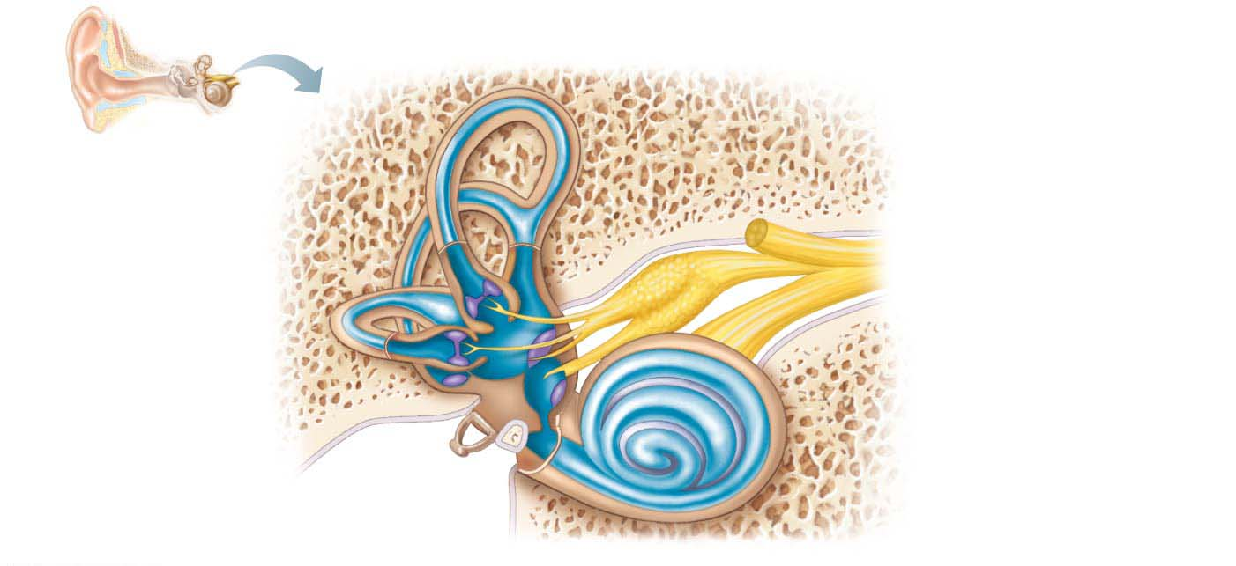
Figure 15.26 Membranous labyrinth of the internal ear.
Temporal
bone
Semicircular ducts in
semicircular canals
Facial nerve
• Anterior
• Posterior
• Lateral
Vestibular nerve
Superior vestibular ganglion
Inferior vestibular ganglion
Cristae ampullares
in the membranous
ampullae
Cochlear nerve
Maculae
Utricle in vestibule
Spiral organ
Saccule in vestibule
Cochlear duct
in cochlea
Stapes in
oval window
Round window

Slide 34
Internal Ear (cont.)
Vestibule
Central egg-shaped cavity of bony labyrinth
Contains two membranous sacs
Saccule is continuous with cochlear duct
Utricle is continuous with semicircular canals
Sacs house equilibrium receptor regions (maculae) that respond to gravity and changes in position of head

Slide 35
Internal Ear (cont.)
Semicircular canals
Three canals oriented in three planes of space: anterior, lateral, and posterior
Anterior and posterior are at right angles to each other, whereas the lateral canal is horizontal
Membranous semicircular ducts line each canal and communicate with utricle
Ampulla: enlarged area of ducts of each canal that houses equilibrium receptor region called the crista ampullaris
Receptors respond to angular (rotational) movements of the head

Slide 36
Internal Ear (cont.)
Cochlea
A small spiral, conical, bony chamber, size of a split pea
Extends from vestibule
Coils around bony pillar (modiolus)
Contains cochlear duct, which houses spiral organ (organ of Corti) and ends at cochlear apex

Slide 37
Internal Ear (cont.)
Cochlea (cont.)
Spiral organ contains cochlear hair cells functionally arranged in one row of inner hair cells and three rows of outer hair cells
Hair cells are sandwiched between tectorial and basilar membranes
The cochlear branch of nerve VIII runs from spiral organ to brain

Slide 38
Table 15.2 Summary of the Internal Ear

Slide 39
Hearing

Slide 40
Hearing
15.8 Sound Detection
Hearing is the reception of an air sound wave that is converted to a fluid wave that ultimately stimulates mechanosensitive cochlear hair cells that send impulses to the brain for interpretation
Properties of Sound
Sound is a pressure disturbance (alternating areas of high and low pressure) produced by a vibrating object and propagated by molecules of the medium (air)

Slide 41
Properties of Sound (cont.)
Sound can be described by two physical properties: frequency and amplitude
Frequency
Number of waves that pass given point in a given time
Pure tone has repeating crests and troughs
Wavelength
Distance between two consecutive crests
Shorter wavelength = higher frequency of sound
Wavelength is consistent for a particular sound

Slide 42
Properties of Sound (cont.)
Frequency (cont.)
Frequency range of human hearing is 20–20,000 hertz (Hz = waves per second), but most sensitive between 1500 and 4000 Hz
Pitch: perception of different frequencies
Higher the frequency, higher the pitch
Quality: characteristic of sounds
Most sounds are mixtures of different frequencies
Tone: one frequency (ex: tuning fork)
Sound quality provides richness and complexity of sounds (music)

Slide 43
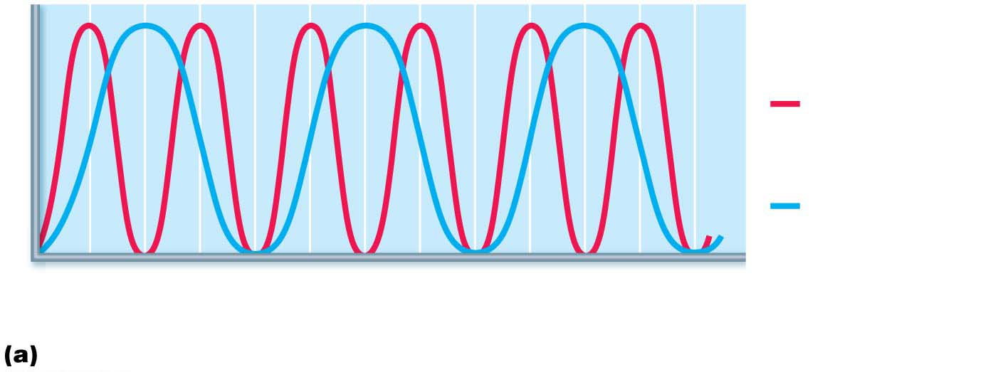
Figure 15.29a Frequency and amplitude of sound waves.
High frequency
(short wavelength)
= high pitch
Pressure
Low frequency
(long wavelength)
= low pitch
0.01
0.02
0.03
Time (s)
Frequency is perceived as pitch.

Slide 44
Properties of Sound (cont.)
Amplitude
Height of crests
Amplitude perceived as loudness: subjective interpretation of sound intensity
Measured in decibels (dB)
Normal range is 0–120 decibels (dB)
Normal conversation is around 50 dB
Threshold of pain is 120 dB
Severe hearing loss can occur with prolonged exposure above 90 dB
Amplified rock music is 120 dB or more

Slide 45
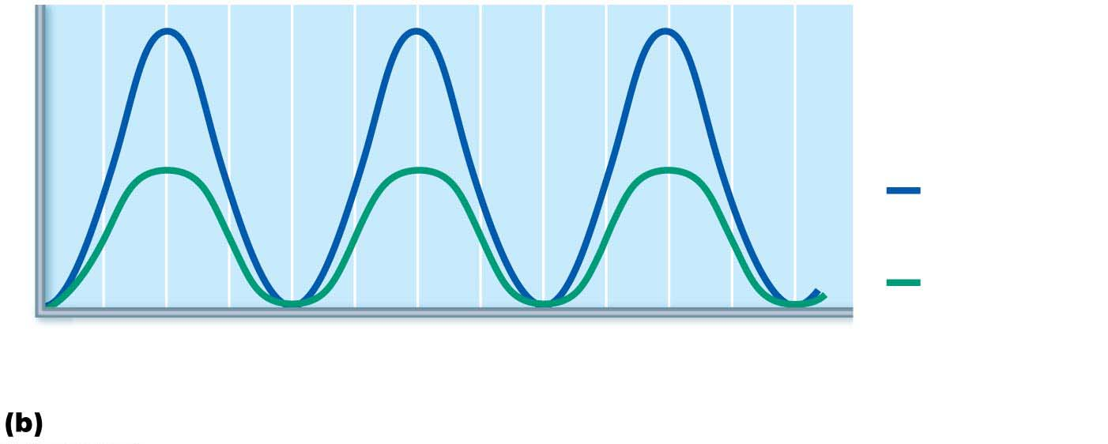
Figure 15.29b Frequency and amplitude of sound waves.
Pressure
High amplitude
= loud
Low amplitude
= soft
0.01
0.02
0.03
Time (s)
Amplitude (size or intensity) is perceived as loudness.

Slide 46
The Maculae
Maculae: sensory receptor organs that monitor static equilibrium
One organ located in each saccule wall and one in each utricle wall
Monitor the position of head in space
Play a key role in control of posture
Respond to linear acceleration forces, but not rotation

Slide 47
Figure 15.26 Membranous labyrinth of the internal ear.
Temporal
bone
Semicircular ducts in
semicircular canals
Facial nerve
• Anterior
• Posterior
• Lateral
Vestibular nerve
Superior vestibular ganglion
Inferior vestibular ganglion
Cristae ampullares
in the membranous
ampullae
Cochlear nerve
Maculae
Utricle in vestibule
Spiral organ
Saccule in vestibule
Cochlear duct
in cochlea
Stapes in
oval window
Round window

Slide 48
The Cristae Ampullares
Receptor for rotational acceleration is crista ampullaris (crista)
Small elevation in ampulla of each semicircular canal
Cristae are excited by acceleration and deceleration of head
Major stimuli are rotational (angular) movements, such as twirling of the body
Semicircular canals are located in all three planes of space, so cristae can pick up on all rotational movements of head

Slide 49
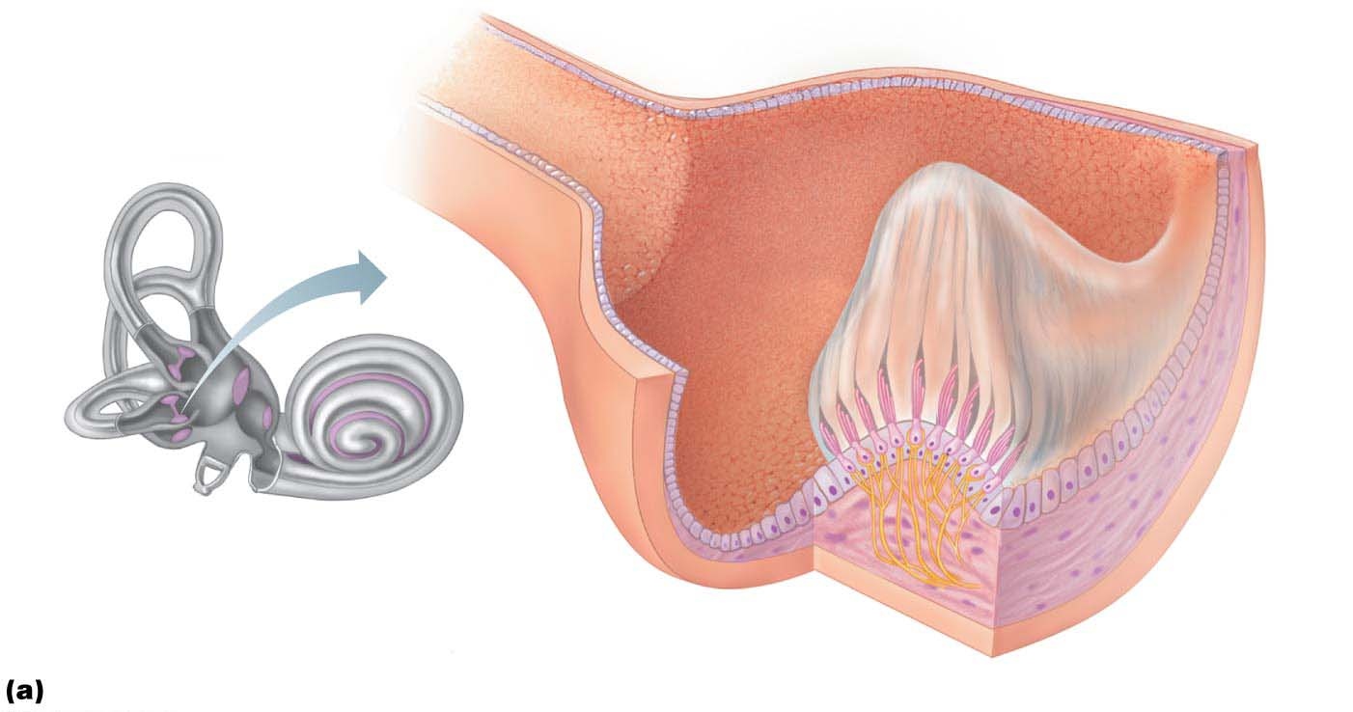
Figure 15.35a Location, structure, and function of a crista ampullaris in the internal ear.
Ampullary cupula
Crista
ampullaris
Endolymph
Hair bundle
(kinocilium
plus stereocilia)
Crista
ampullaris
Hair cell
Membranous
labyrinth
Fibers of vestibular nerve
Supporting
cell
Anatomy of a crista ampullaris in a semicircular canal

Slide 50
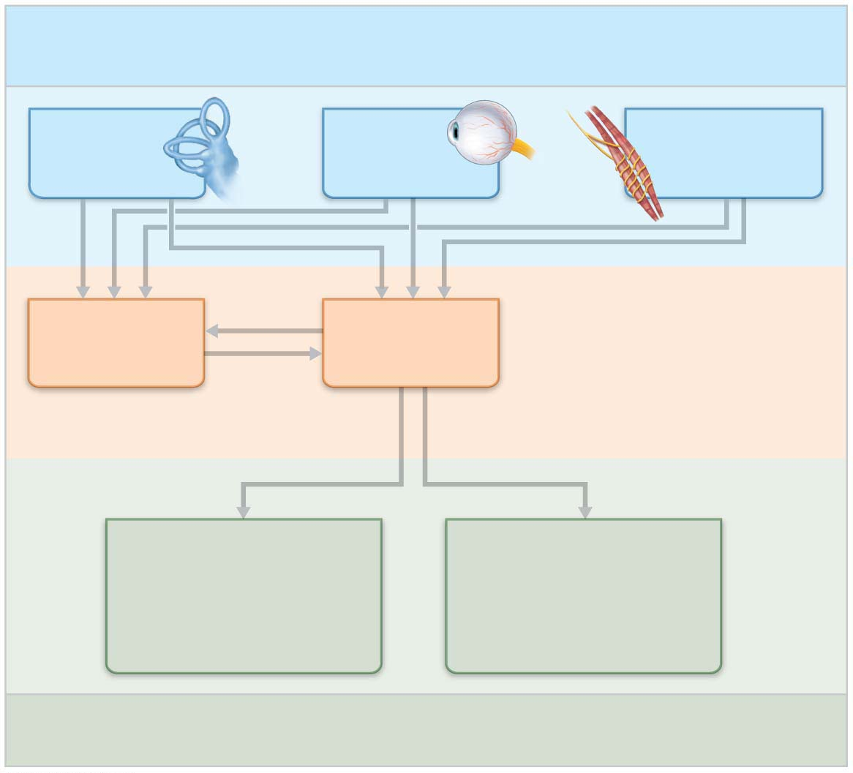
Figure 15.36 Neural pathways of the balance and orientation system.
Input: Information about the body’s position in space
comes from three main sources and is fed into two
major processing areas in the central nervous system.
Vestibular
receptors
Visual
receptors
Somatic receptors
(skin, muscle
and joints)
Vestibular
nuclei
(brain stem)
Cerebellum
Central nervous
system processing
Oculomotor control (cranial nerve nuclei
III, IV, VI)
(eye movements)
Spinal motor control
(cranial nerve XI nuclei
and vestibulospinal tracts)
(neck, limb, and trunk
movements)
Output: Responses by the central nervous system provide fast reflexive control of the muscles serving the eyes, neck, limbs, and trunk.

Slide 51
Clinical – Homeostatic Imbalance 15.15
Equilibrium problems are usually unpleasant and can cause nausea, dizziness, and loss of balance
Nystagmus in the absence of rotational stimuli may be present

Slide 52
Clinical – Homeostatic Imbalance 15.15
Motion sickness: sensory inputs are mismatched
Visual input differs from equilibrium input
Conflicting information causes motion sickness
Warning signs are excess salivation, pallor, rapid deep breathing, profuse sweating
Treatment with antimotion drugs that depress vestibular input, such as meclizine and scopolamine

Slide 53
15.11 Homeostatic Imbalances of Hearing
Deafness
Conduction deafness
Blocked sound conduction to fluids of internal ear
Causes include impacted earwax, perforated eardrum, otitis media, otosclerosis of the ossicles
Sensorineural deafness
Damage to neural structures at any point from cochlear hair cells to auditory cortical cells
Typically from gradual hair cell loss

Slide 54
Deafness (cont.)
Sensorineural deafness research is under way to prod supporting cells to differentiate into hair cells
Cochlear implants that convert sound energy into electrical signals are effective for congenital or age/noise cochlear damage
Inserted into drilled recess in temporal bone
So effective that deaf children can learn to speak

Slide 55
Tinnitus
Ringing, buzzing, or clicking sound in ears in absence of auditory stimuli
Due to cochlear nerve degeneration, inflammation of middle or internal ears, side effects of aspirin

Slide 56
Ménière’s Syndrome
Labyrinth disorder that affects cochlea and semicircular canals
Causes vertigo, nausea, and vomiting
Treatment: anti–motion sickness drugs in mild cases or surgical removal of labyrinth in severe cases

Slide 57
Developmental Aspects of the Special Senses
Taste and Smell
All special senses are functional at birth
Chemical senses: few problems occur until fourth decade, when these senses begin to decline
Odor and taste detection is poor after 65

Slide 58
Developmental Aspects of the Special Senses
Vision
Optic vesicles protrude from diencephalon during week 4 of development
Vesicles indent to form optic cups
Stalks form optic nerves
Later, lens forms from ectoderm
Vision is not fully functional at birth; babies are hyperopic because eyes are shortened
See only gray tones
Eye movements are uncoordinated
Tearless for about 2 weeks

Slide 59
Developmental Aspects of the Special Senses
Vision (cont.)
By 5 months of age, infants can follow objects, but acuity is still poor
Depth perception and color vision develop by age 3
Adult eye size reached around 8–9 years of age
Around year 40, lenses start to lose elasticity, resulting in presbyopia

Slide 60
Developmental Aspects of the Special Senses
Vision (cont.)
With age, lens loses clarity, dilator muscles are less efficient; visual acuity is drastically decreased by age 70
Lacrimal glands less active, so eyes are dry, more prone to infection

Slide 61
Developmental Aspects of the Special Senses
Hearing and Balance
Ear development begins in 3-week embryo
Inner ears develop from thickening of ectoderm called otic placodes, which invaginate into otic pit and otic vesicle
Otic vesicle becomes membranous labyrinth, and surrounding mesenchyme becomes bony labyrinth

Slide 62
Developmental Aspects of the Special Senses
Hearing and Balance (cont.)
Middle ear structures develop from endodermal pharyngeal pouches, ossicles from neural crest cells, and pharyngeal cleft (branchial groove) develops into outer ear structures
Newborns can hear, but early responses are reflexive in nature
By month 4, infants can turn head toward voices of family members

Slide 63
Developmental Aspects of the Special Senses
Hearing and Balance (cont.)
Language skills tied to ability to hear well
Few ear problems until 60s, when deterioration of spiral organ becomes noticeable
Hair cell numbers decline with age
Presbycusis: loss of high-pitch perception occurs first
Type of sensorineural deafness

