Slide 1
Ch 15 Special Senses
Part 1 -The Eye and Vision

Slide 2
Special Senses
The sense of touch is one of the general senses, mediated by general receptors (covered in Chapter 13)
Special senses of body include:
Vision
Taste
Smell
Hearing
Equilibrium

Slide 3
Special Senses (cont.)
All use special sensory receptors, which are distinct receptor cells localized in head region
Not like modified nerves of general receptors

Slide 4
Part 1 The Eye and Vision
70% of body’s sensory receptors are in eye
Half of cerebral cortex is involved in visual processing

Slide 5
15.1 The Eye
Small sphere; only one-sixth of surface visible
Most of eye enclosed and protected by fat cushion and bony orbit
Consists of accessory structures and the eyeball

Slide 6
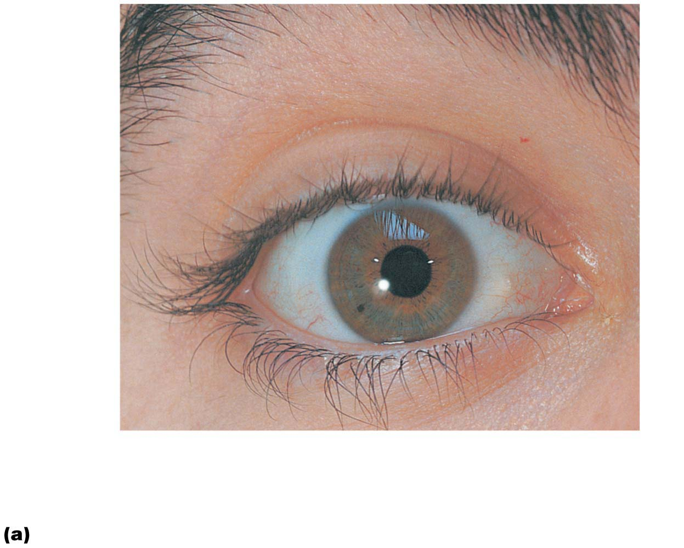
Figure 15.1a The eye and accessory structures.
Eyebrow
Eyelid
Eyelashes
Site where
conjunctiva
merges with
cornea
Palpebral
fissure
Lateral
commissure
Iris
Eyelid
Pupil
Sclera
(covered by
conjunctiva)
Lacrimal
caruncle
Medial
commissure
Surface anatomy of the right eye

Slide 7
Accessory Structures of the Eye
Accessory structures protect the eye and aid eye function
Structures include:
Eyebrows
Eyelids
Conjunctiva
Lacrimal apparatus
Extrinsic eye muscles

Slide 8
Accessory Structures of the Eye (cont.)
Eyebrows
Overlie supraorbital margins
Function
Shade eye from sunlight
Prevent perspiration from reaching eye

Slide 9
Accessory Structures of the Eye (cont.)
Eyelids
Also called palpebrae; thin, skin-covered folds that protect eye anteriorly
Separated at palpebral fissure (slit)
Meet in corners at medial and lateral commissures
Lacrimal caruncle located at medial commissure contains oil and sweat glands
Tarsal plates: supporting connective tissue for folds, as well as anchor orbicularis oculi and levator palpebrae superioris muscles

Slide 10
Accessory Structures of the Eye (cont.)
Eyelids (cont.)
Eyelids blink reflexively every 3–7 seconds
Offers protection from foreign objects and spreads secretions to moisten eye
Eyelashes have follicles that are innervated
Nerve endings initiate reflex blinking
Lubricating glands associated with eyelids
Tarsal (Meibomian) glands
Modified sebaceous glands produce oily secretion that lubricates lid and eye
Ciliary glands between hair follicles are
Modified sweat glands

Slide 11
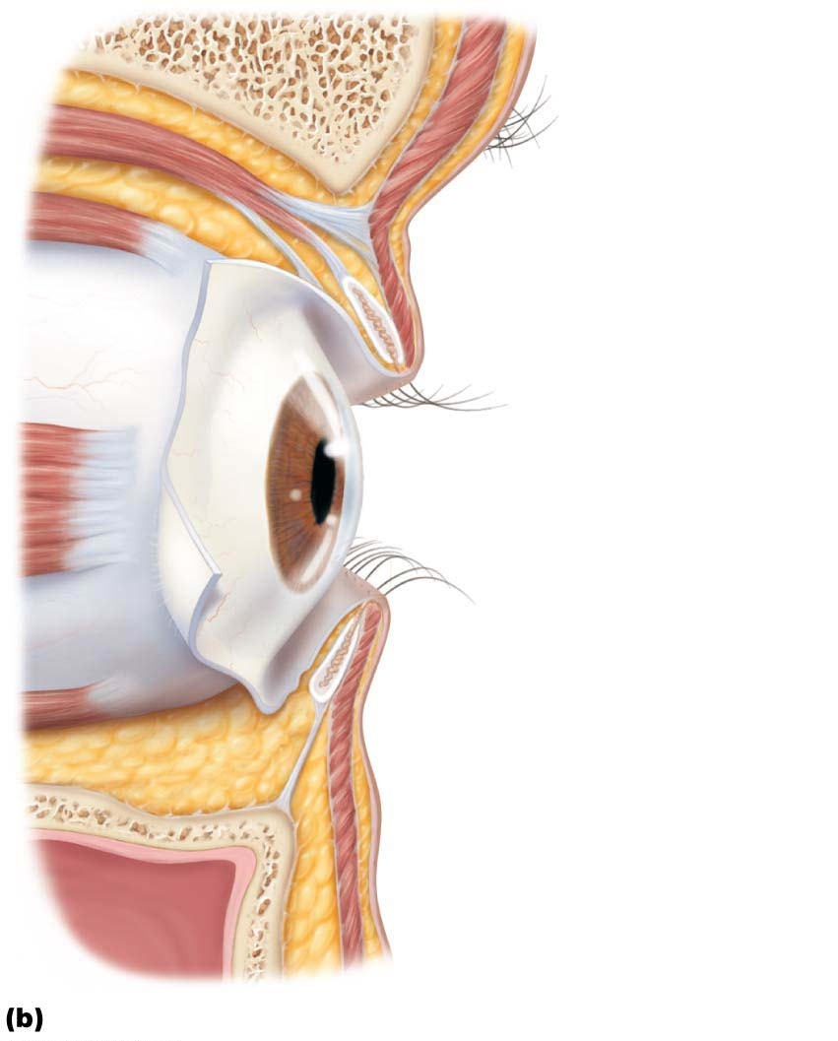
Figure 15.1b The eye and accessory structures.
Levator palpebrae
superioris muscle
Orbicularis
oculi muscle
Eyebrow
Tarsal plate
Palpebral
conjunctiva
Tarsal glands
Cornea
Palpebral
fissure
Eyelashes
Bulbar
conjunctiva
Conjunctival
sac
Orbicularis
oculi muscle
Lateral view; some structures shown in sagittal section

Slide 12
Accessory Structures of the Eye (cont.)
Conjunctiva
Transparent mucous membrane that produces a lubricating mucous secretion
Palpebral conjunctiva: membrane that lines underside of eyelids
Bulbar conjunctiva: membrane that covers white of eyes (not cornea)
Small blood vessels found in this membrane; seen easily in “bloodshot” eyes
Conjunctival sac: space between palpebral and bulbar conjunctiva
Area where contact lens rests

Slide 13
Accessory Structures of the Eye (cont.)
Lacrimal apparatus
Consists of lacrimal gland and ducts that drain into nasal cavity
Lacrimal gland is located in orbit above lateral end of eye and secretes lacrimal secretion (tears), a dilute saline solution containing mucus, antibodies, and antibacterial lysozyme
Blinking spreads tears toward medial commissure, where they enter paired lacrimal canaliculi via lacrimal puncta

Slide 14
Accessory Structures of the Eye (cont.)
Lacrimal apparatus (cont.)
Tears then drain into lacrimal sac and nasolacrimal duct, which empties into nasal cavity

Slide 15
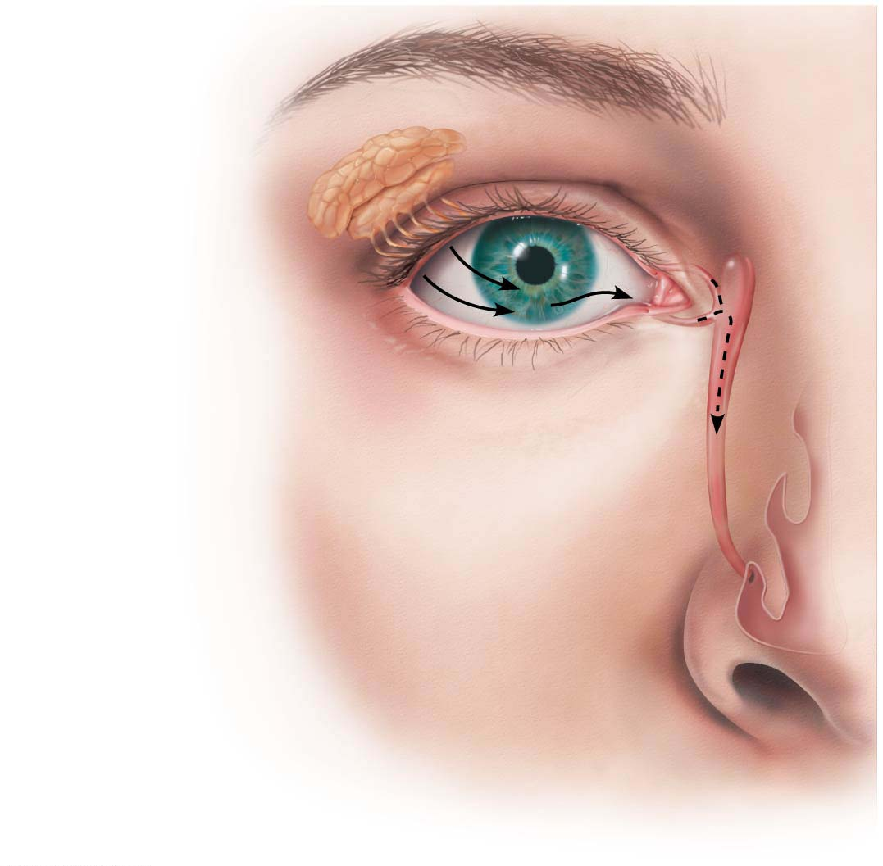
Figure 15.2 The lacrimal apparatus.
Lacrimal sac
Lacrimal gland
Excretory ducts
of lacrimal gland
Lacrimal punctum
Lacrimal canaliculus
Nasolacrimal duct
Inferior meatus
of nasal cavity
Nostril

Slide 16
Accessory Structures of the Eye (cont.)
Extrinsic eye muscles
Six straplike extrinsic eye muscles
Originate from bony orbit and insert on eyeball
Enable eye to follow moving objects, maintain shape of eyeball, and hold it in orbit
Four rectus muscles originate from common tendinous ring; names indicate movements
Superior, inferior, lateral, and medial rectus
Two oblique muscles move eye in vertical plane and rotate eyeball
Superior and inferior oblique muscles

Slide 17
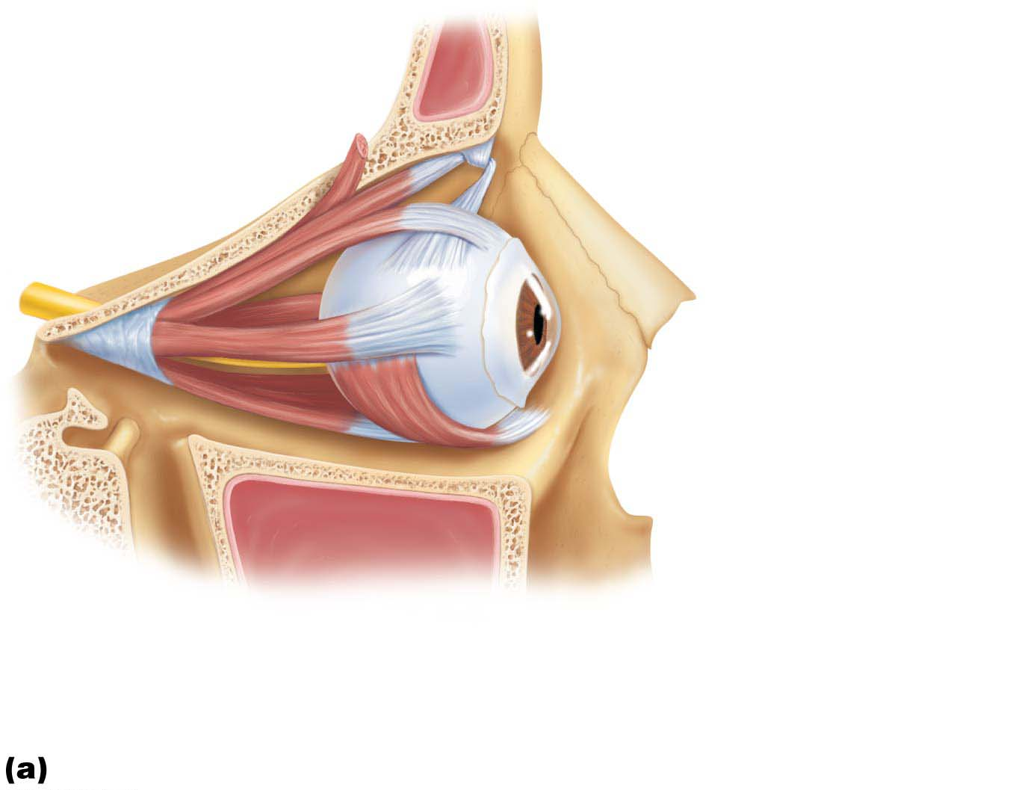
Figure 15.3a Extrinsic eye muscles.
Superior oblique
tendon
Superior oblique
muscle
Superior rectus
muscle
Lateral rectus
muscle
Inferior rectus
muscle
Inferior oblique
muscle
Lateral view of the right eye

Slide 18
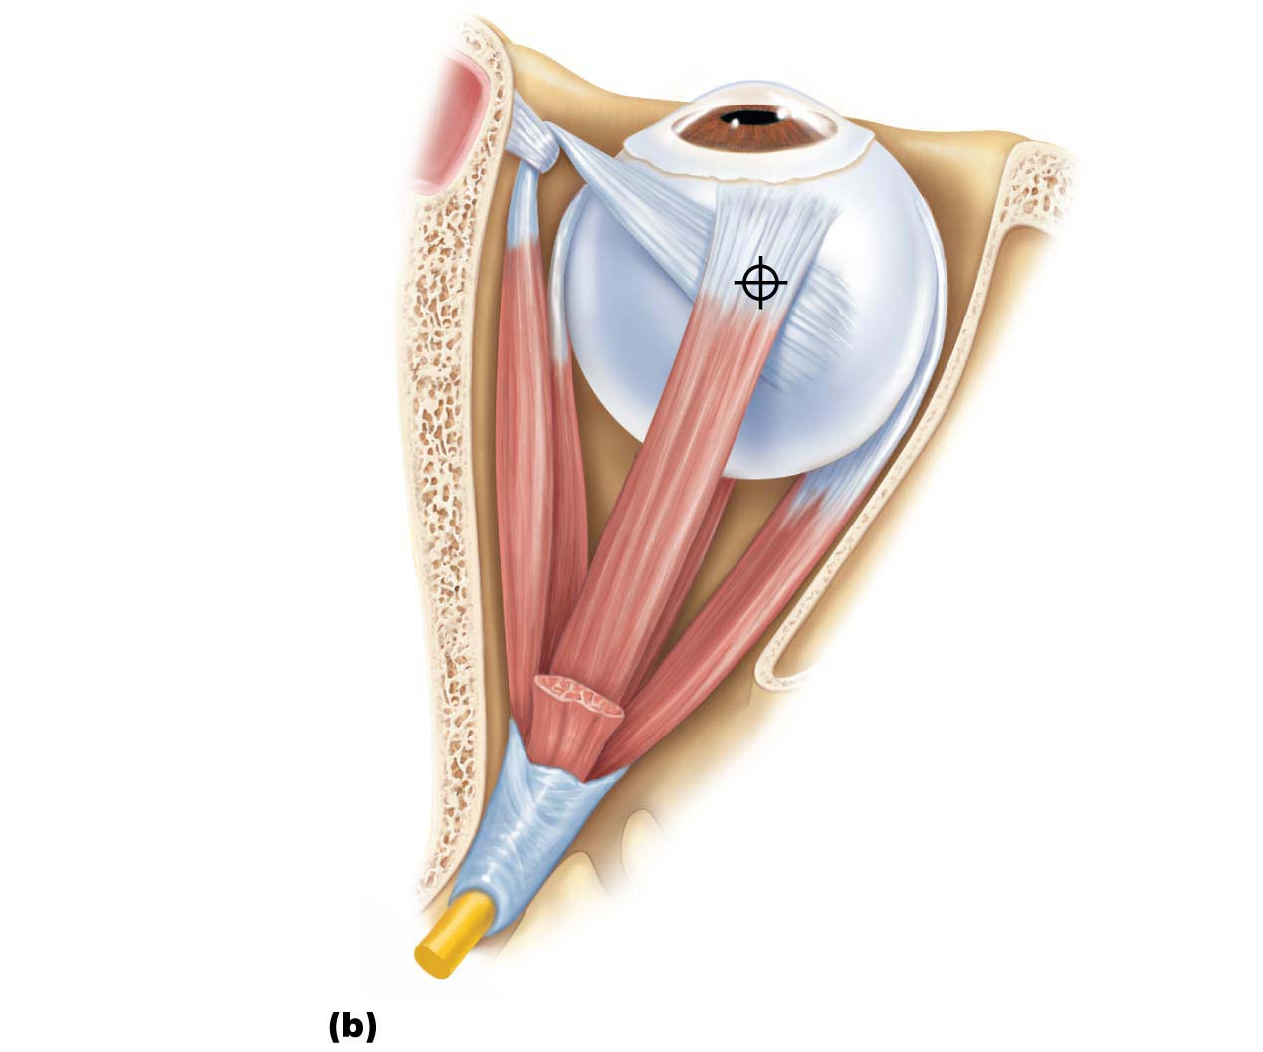
Figure 15.3b Extrinsic eye muscles.
Trochlea
Superior oblique
tendon
Axis of
rotation
of eye
Superior oblique
muscle
Superior rectus
muscle
Inferior
rectus muscle
Medial
rectus muscle
Lateral
rectus muscle
Common
tendinous ring
Superior view of the right eye

Slide 19
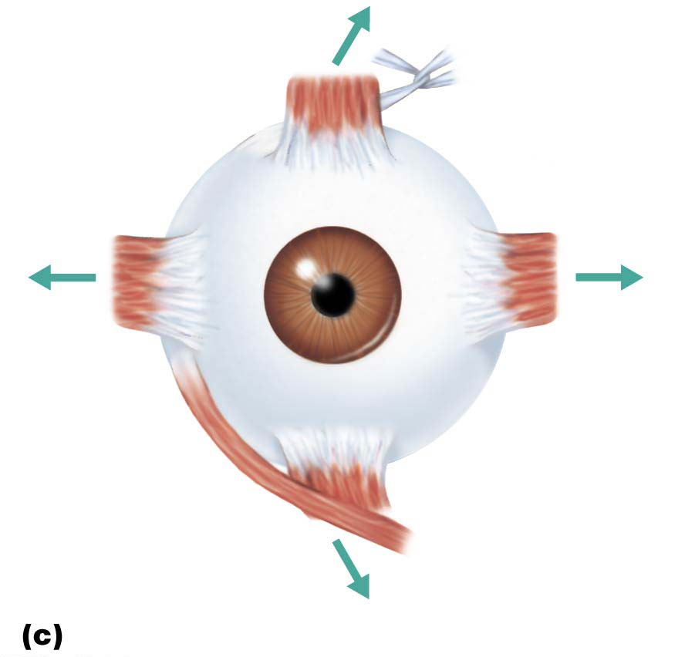
Figure 15.3c Extrinsic eye muscles.
Trochlea
Superior
rectus
Superior
oblique
Lateral
rectus
Medial
rectus
Inferior
oblique
Inferior
rectus
Anterior view of the right eye

Slide 20
Figure 15.3d Extrinsic eye muscles.
Muscle
Action
Controlling cranial nerve
Lateral rectus
Medial rectus
Superior rectus
Inferior rectus
Inferior oblique
Superior oblique
Moves eye laterally
Moves eye medially
Elevates eye and turns it medially
Depresses eye and turns it medially
Elevates eye and turns it laterally
Depresses eye and turns it laterally
VI (abducens)
III (oculomotor)
III (oculomotor)
III (oculomotor)
III (oculomotor)
IV (trochlear)
Summary of muscle actions and innervating cranial nerves

Slide 21
Clinical – Homeostatic Imbalance 15.2
Inflammation of any of the smaller sebaceous glands is called a sty
Conjunctivitis: inflammation of the conjunctiva resulting in reddened, irritated eyes
Pinkeye: conjunctival infection caused by bacteria or viruses
Highly contagious

Slide 22
Clinical – Homeostatic Imbalance 15.3
Nasal cavity mucosa is continuous with mucosa of lacrimal duct system, so a cold or nasal inflammation often causes lacrimal mucosa to swell
Swelling constricts the ducts and prevents tears from draining, causing “watery” eyes

Slide 23
Clinical – Homeostatic Imbalance 15.4
Diplopia (double vision): occurs when movements of external muscles of two eyes are not perfectly coordinated
Person cannot properly focus images of same area of the visual field from each eye, so sees two images instead of one
Can result from paralysis, extrinsic muscle weakness, or neurological disorders

Slide 24
Clinical – Homeostatic Imbalance 15.4
Strabismus (“cross-eye”): congenital weakness of external eye muscles
Eye rotates medially or laterally
Eyes may alternate focusing on objects, or only controllable eye is used
Brain begins to disregard inputs from deviant eye, which can become functionally blind if not treated early

Slide 25
Eye Structure

Slide 26
Structure of the Eyeball
Wall of eyeball contains three layers
Fibrous layer
Vascular layer
Inner layer
Internal cavity filled with fluids called humors
Lens separates internal cavity into anterior and posterior segments

Slide 27
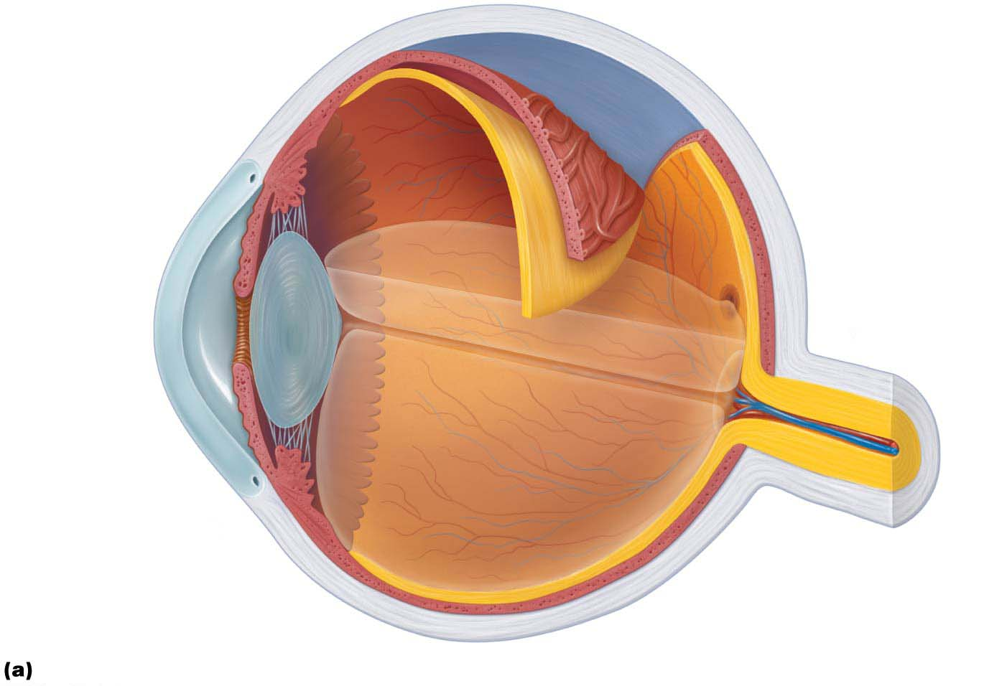
Figure 15.4a Internal structure of the eye (sagittal section).
Ora serrata
Ciliary body
Sclera
Ciliary zonule
(suspensory
ligament)
Choroid
Retina
Cornea
Macula lutea
Iris
Fovea centralis
Pupil
Optic nerve
Anterior
segment
(contains
aqueous humor)
Lens
Scleral venous sinus
Central artery and
vein of the retina
Posterior segment
(contains vitreous humor)
Optic disc
(blind spot)
Diagrammatic view. The vitreous humor is illustrated only in the bottom part of the eyeball.

Slide 28
Structure of the Eyeball (cont.)
Fibrous layer
Outermost layer; dense avascular connective tissue
Two regions: sclera and cornea
Sclera
Opaque posterior region
Protects and shapes eyeball
Anchors extrinsic eye muscles
Posteriorly, where optic nerve exits, sclera is continuous with dura mater of brain

Slide 29
Structure of the Eyeball (cont.)
Cornea
Transparent anterior one-sixth of fibrous layer
Forms clear window that lets light enter and bends light as it enters eye
Epithelium covers both surfaces
Outer surface protects from abrasions
Inner layer, corneal endothelium, contains sodium pumps that help maintain clarity of cornea
Numerous pain receptors contribute to blinking and tearing reflexes

Slide 30
Structure of the Eyeball (cont.)
Vascular layer
Middle pigmented layer of eye, also called uvea
Three regions: choroid, ciliary body, and iris
Choroid region
Posterior portion of uvea
Supplies blood to all layers of eyeball
Brown pigment absorbs light to prevent scattering of light, which would cause visual confusion

Slide 31
Structure of the Eyeball (cont.)
Ciliary body
Anteriorly, choroid becomes ciliary body
Thickened ring of tissue surrounding lens
Consists of smooth muscle bundles, ciliary muscles, that control shape of lens
Capillaries of ciliary processes secrete fluid for anterior segment of eyeball
Ciliary zonule (suspensory ligament) extends from ciliary processes to lens
Holds lens in position

Slide 32
Structure of the Eyeball (cont.)
Iris
Colored part of eye that lies between cornea and lens, continuous with ciliary body
Pupil: central opening that regulates amount of light entering eye
Close vision and bright light cause sphincter pupillae (circular muscles) to contract and pupils to constrict; parasympathetic control
Distant vision and dim light cause dilator pupillae (radial muscles) to contract and pupils to dilate; sympathetic control
Changes in emotional state—pupils dilate when subject matter is appealing or requires problem-solving skills

Slide 33
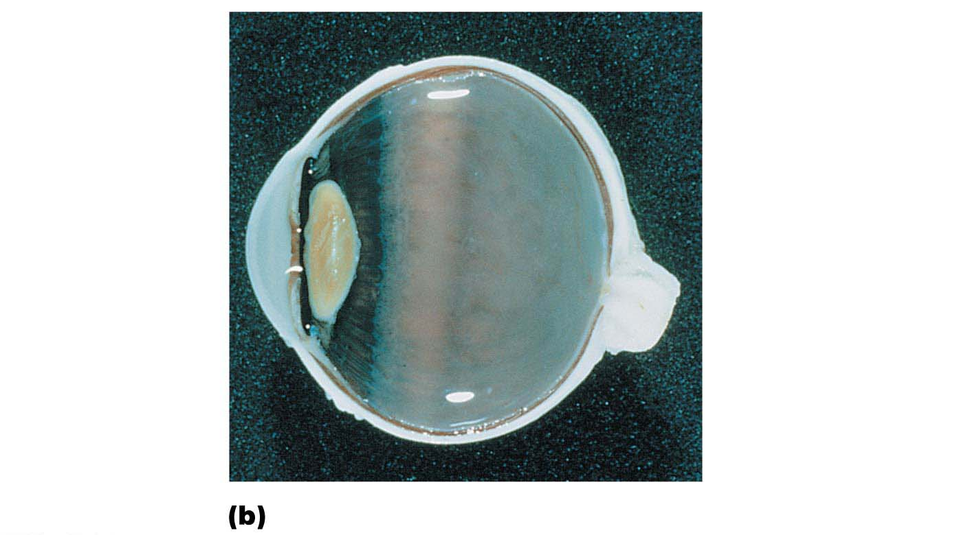
Figure 15.4b Internal structure of the eye (sagittal section).
Ciliary body
Vitreous humor
in posterior
segment
Ciliary
processes
Iris
Retina
Margin
of pupil
Choroid
Anterior
segment
Sclera
Fovea centralis
Lens
Cornea
Optic nerve
Ciliary zonule
(suspensory
ligament)
Optic disc
Photograph of the human eye.

Slide 34
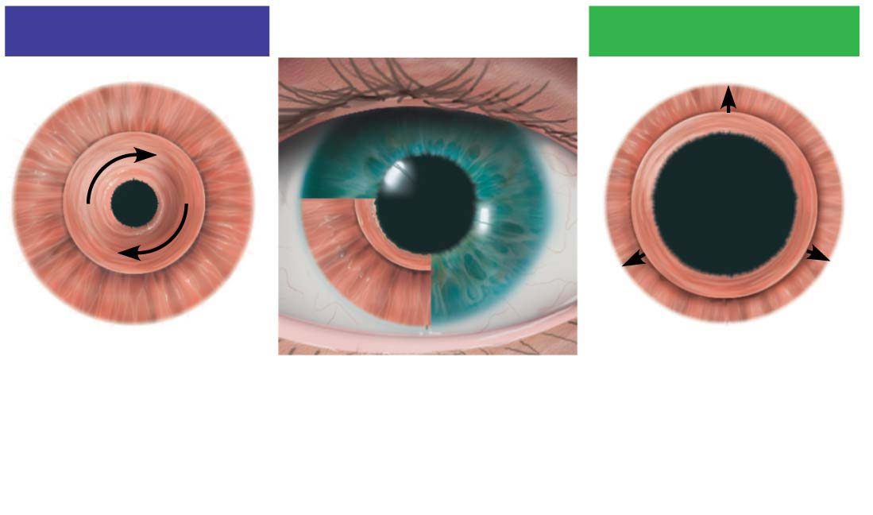
Figure 15.5 Pupil constriction and dilation.
Parasympathetic +
Sympathetic +
Sphincter pupillae
muscle contracts:
Pupil constricts
(size decreases).
Iris (two muscles)
• Sphincter pupillae
• Dilator pupillae
Dilator pupillae
muscle contracts:
Pupil dilates
(size increases).

Slide 35
Structure of the Eyeball (cont.)
Inner layer (retina)
Retina originates as an outpocketing of brain
Contains:
Millions of photoreceptor cells that transduce light energy
Neurons
Glial cells
Delicate two-layered membrane
Outer pigmented layer
Inner neural layer

Slide 36
Structure of the Eyeball (cont.)
Inner layer (retina) (cont.)
Pigmented layer of the retina
Single-cell-thick lining next to choroid
Extends anteriorly, covering ciliary body and iris
Functions:
Absorbs light and prevents its scattering
Phagocytizes photoreceptor cell fragments
Stores vitamin A

Slide 37
Structure of the Eyeball (cont.)
Inner layer (retina) (cont.)
Neural layer of the retina
Transparent layer that runs anteriorly to margin of ciliary body
Anterior end has serrated edges called ora serrata
Composed of three main types of neurons
Photoreceptors, bipolar cells, ganglion cells
Signals spread from photoreceptors to bipolar cells to ganglion cells
Ganglion cell axons exit eye as optic nerve

Slide 38
Structure of the Eyeball (cont.)
Inner layer (retina) (cont.)
Neural layer of the retina (cont.)
Optic disc
Site where optic nerve leaves eye
Lacks photoreceptors, so referred to as blind spot
Retina has quarter-billion photoreceptors that are one of two types:
Rods
Cones

Slide 39
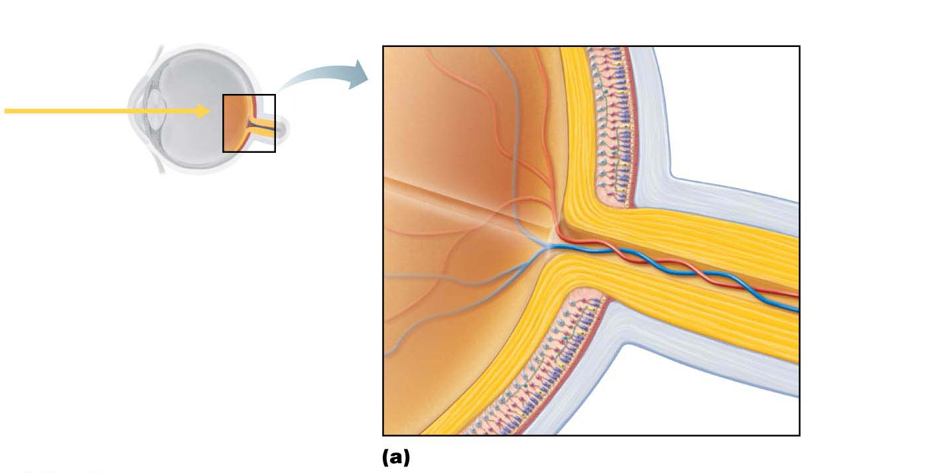
Figure 15.6a Microscopic anatomy of the retina.
Neural layer of retina
Pigmented
layer of
retina
Pathway
of light
Choroid
Optic disc
Sclera
Central artery
and vein of retina
Optic
nerve
Posterior aspect of the eyeball

Slide 40
Structure of the Eyeball (cont.)
Inner layer (retina) (cont.)
Rods
Dim light, peripheral vision receptors
More numerous and more sensitive to light than cones
No color vision or sharp images
Numbers greatest at periphery

Slide 41
Structure of the Eyeball (cont.)
Inner layer (retina) (cont.)
Cones
Vision receptors for bright light
High-resolution color vision
Macula lutea area at posterior pole lateral to blind spot
Contains mostly cones
Fovea centralis: tiny pit in center of macula lutea that contains all cones, so is region with best visual acuity
Eye movement allows us to focus in on object so that fovea can pick it up

Slide 42
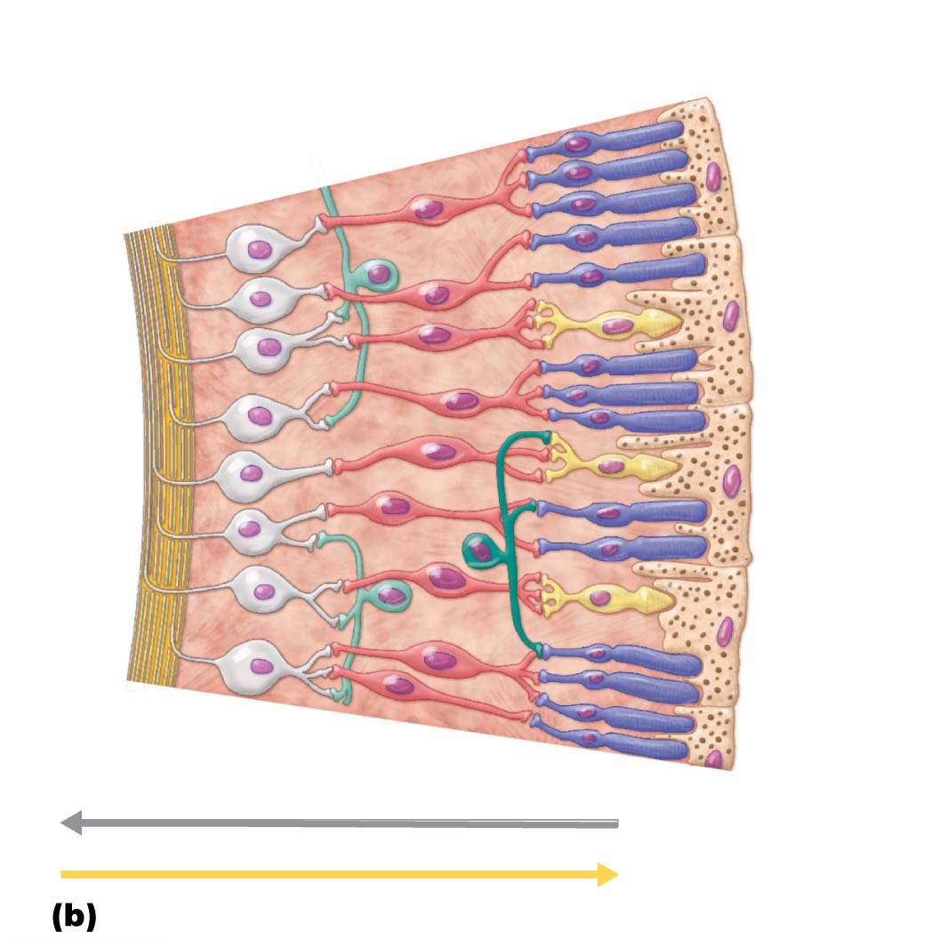
Figure 15.6b Microscopic anatomy of the retina.
Ganglion
cells
Bipolar
cells
Photoreceptors
• Rod
Axons
of
ganglion
cells
• Cone
Horizontal
cell
Amacrine cell
Pathway of signal output
Pigmented
layer of retina
Pathway of light
Cells of the neural layer of the retina

Slide 43
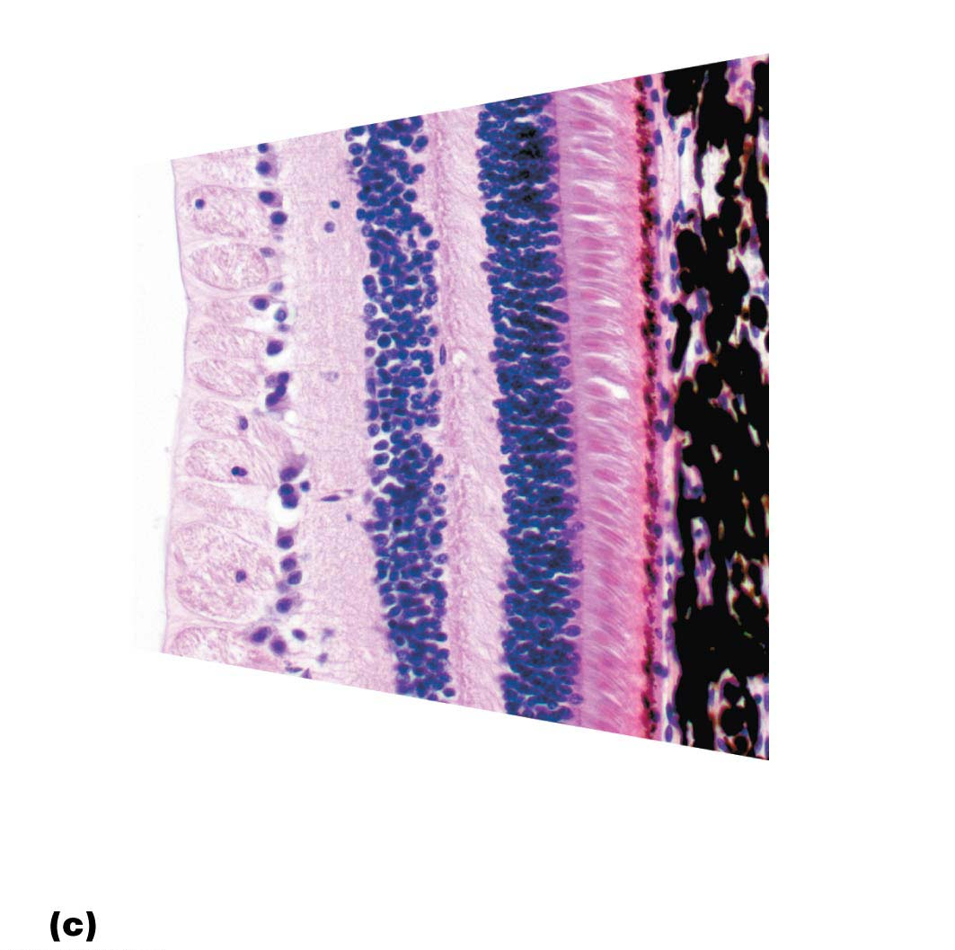
Figure 15.6c Microscopic anatomy of the retina.
Outer segments
of rods and cones
Choroid
Nuclei of
ganglion
cells
Axons of
ganglion cells
Nuclei
of bipolar
cells
Nuclei of
rods and
cones
Pigmented
layer of retina
Photomicrograph of retina

Slide 44
Structure of the Eyeball (cont.)
Inner layer (retina) (cont.)
Two sources of blood supply to retina
Choroid supplies outer third (photoreceptors)
Central artery and vein of retina supply inner two-thirds
Enter/exit eye in center of optic nerve
Vessels are visible in living person

Slide 45
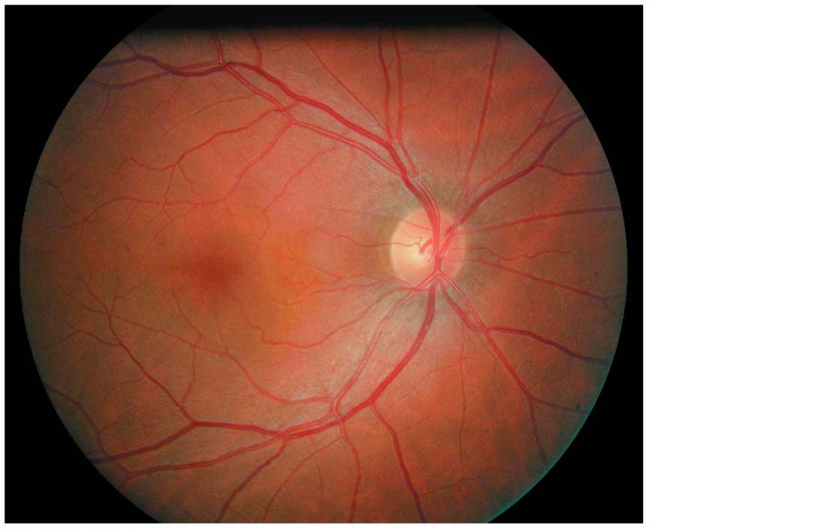
Figure 15.7 Part of the posterior wall (fundus) of the right eye as seen with an ophthalmoscope.
Central
artery
and vein
emerging
from the
optic disc
Optic disc
Macula
lutea
Retina
Lateral
Medial

Slide 46
Clinical – Homeostatic Imbalance 15.5
Retinal detachment: condition where pigmented and neural layers separate (detach), allowing jellylike vitreous humor to seep between them
Can lead to permanent blindness
Usually happens when retina is torn during traumatic blow to head or sudden stopping of head during movement (example: bungee jumping)

Slide 47
Clinical – Homeostatic Imbalance 15.5
Symptom described by victims as “curtain being drawn across the eye” and/or sootlike spots or light flashes
Treatment: reattachment of retina with laser surgery

Slide 48
Internal Structure of the Eye

Slide 49
Structure of the Eyeball (cont.)
Internal chambers and fluids
The lens and ciliary zonule separate eye into two segments
Posterior segment
Anterior segment

Slide 50
Structure of the Eyeball (cont.)
Internal chambers and fluids (cont.)
Posterior segment
Contains vitreous humor, a fluid that:
Transmits light
Supports posterior surface of lens
Holds neural layer of retina firmly against pigmented layer
Contributes to intraocular pressure
Vitreous humor forms in embryo and lasts whole lifetime

Slide 51
Structure of the Eyeball (cont.)
Internal chambers and fluids (cont.)
Anterior segment
Iris divides anterior segment into two chambers:
Anterior chamber—between cornea and iris
Posterior chamber—between iris and lens
Entire segment contains aqueous humor, a plasma like fluid continuously formed (unlike vitreous humor) by capillaries of ciliary processes
Drains via scleral venous sinus (canal of Schlemm) at sclera-cornea junction
Supplies nutrients and oxygen mainly to lens and cornea but also to retina, and removes wastes

Slide 52
Clinical – Homeostatic Imbalance 15.6
Glaucoma: condition in which drainage of aqueous humor is blocked, causing fluid to back up and increase pressure within eye
Pressures may increase to dangerous levels and compress retina and optic nerve, leading to blindness
Symptoms: few early signs, but late signs include seeing halos around lights and blurred vision

Slide 53
Clinical – Homeostatic Imbalance 15.6
Detection: intraocular pressure determined by directing puff of air at cornea and measuring amount of corneal deformation
Test should be done yearly after age 40
Treatment: eye drops that increase rate of aqueous humor drainage or decrease its production; laser therapy or surgery

Slide 54
Structure of the Eyeball (cont.)
Lens
Biconvex, transparent, flexible, and avascular
Changes shape to precisely focus light on retina
Two regions:
Lens epithelium: anterior region of cuboidal cells that differentiate into lens fiber cells
Lens fibers: form bulk of lens and are filled with transparent protein crystallin
Lens fibers are continually added, so lens becomes more dense, convex, and less elastic with age

Slide 55
Clinical – Homeostatic Imbalance 15.7
Clouding of lens
Consequence of aging, diabetes mellitus, heavy smoking, frequent exposure to intense sunlight
Some congenital
Crystallin proteins clump
Vitamin C increases cataract formation
Lens can be replaced surgically with artificial lens

Slide 56
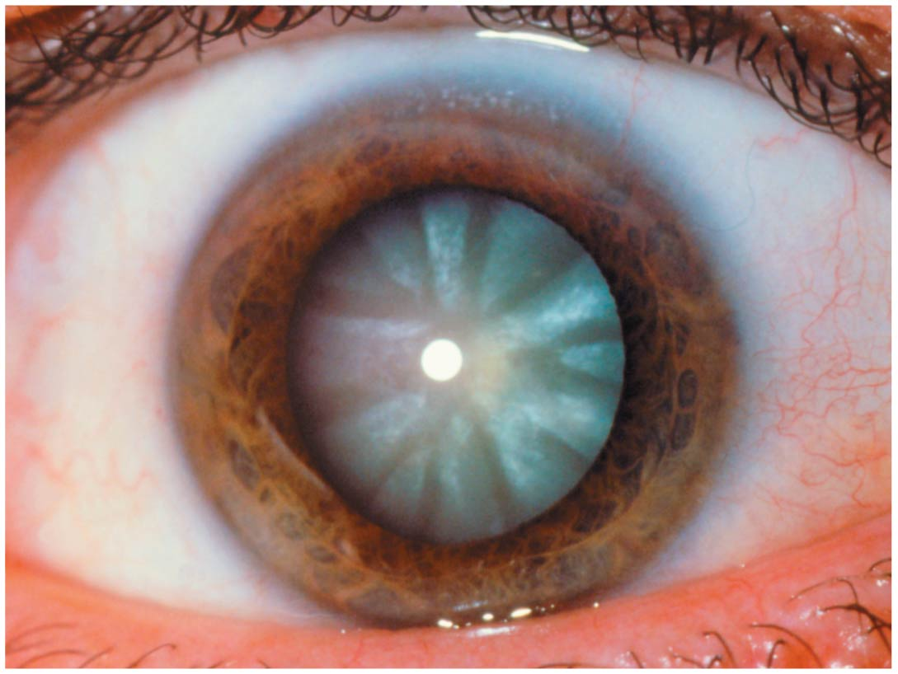
Figure 15.9 Photograph of a cataract.

Slide 57
Light and Optics

Slide 58
15.2 Focusing and Light
Overview: Light and Optics
Wavelength and color
Electromagnetic radiation: all energy waves, from long radio waves to short X rays; visible light occupies a small portion in the middle of the spectrum
Light has wavelengths between 400 and 700 nm
Eyes respond only to visible light

Slide 59
Overview: Light and Optics
Wavelength and color (cont.)
Light: packets of energy (photons or quanta) that travel in wavelike fashion at high speeds
When visible light passes through spectrum, it is broken up into bands of colors (rainbow)
Red wavelengths are longest and have lowest energy, and violet are shortest and have most energy
Color that eye perceives is a reflection of that wavelength
Grass is green because it absorbs all colors except green
White reflects all colors, and black absorbs all colors

Slide 60
Overview: Light and Optics (cont.)
Refraction and lenses
Refraction: bending of light rays
Due to change in speed of light when it passes from one transparent medium to another and path of light is at an oblique angle
Example: from liquid to air
Lenses of eyes can also refract light because they are curved on both sides
Convex: thicker in center than at edges
Concave: thicker at edges than in center

Slide 61
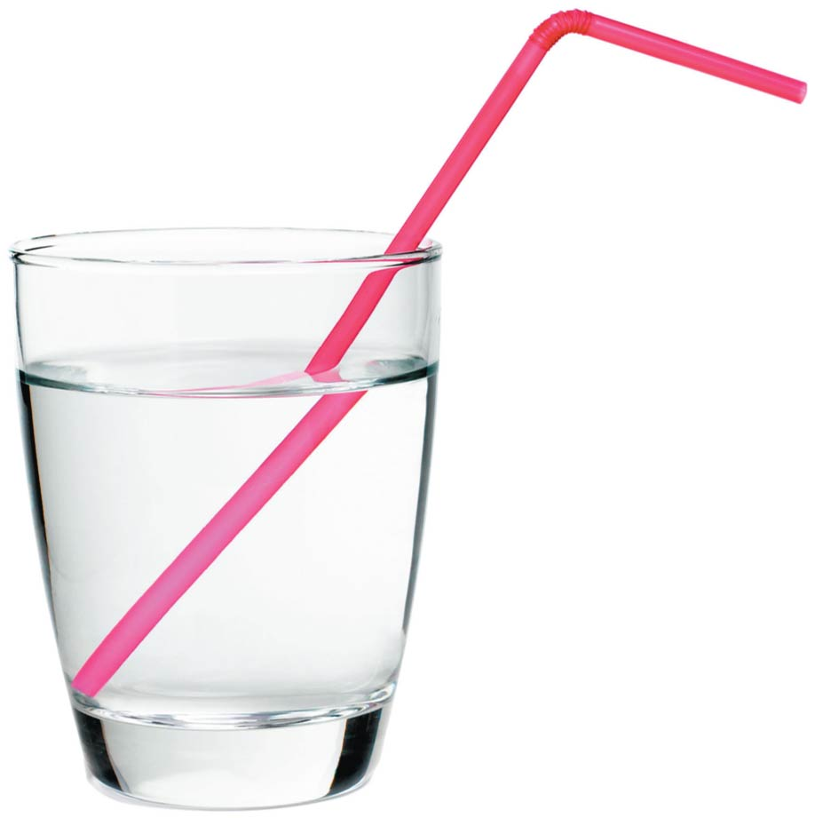
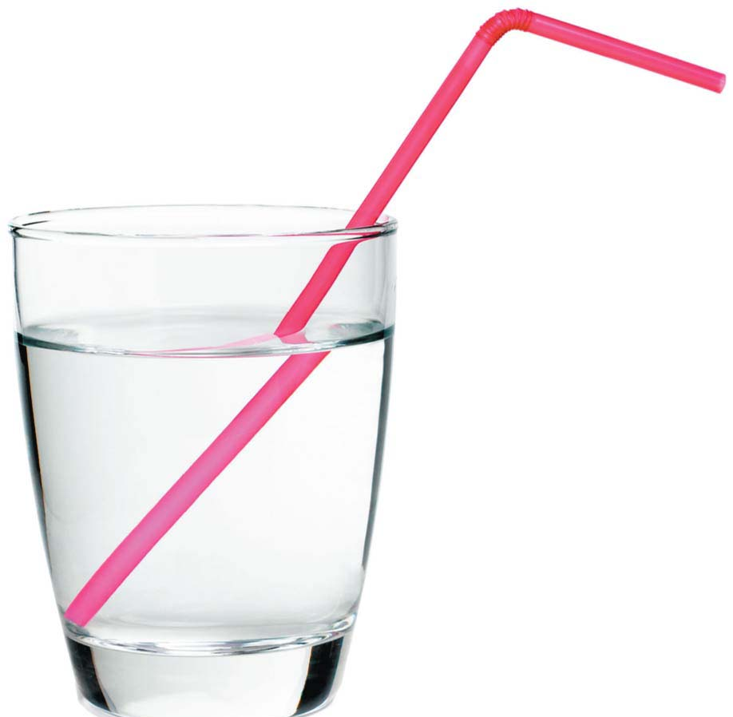
Figure 15.11 Refraction.

Slide 62
Overview: Light and Optics (cont.)
Refraction and lenses (cont.)
Convex lenses bend light passing through it, so that rays converge at focal point
Image formed at focal point is upside-down and reversed from left to right
Concave lenses disperse light, preventing light from being focused

Slide 63
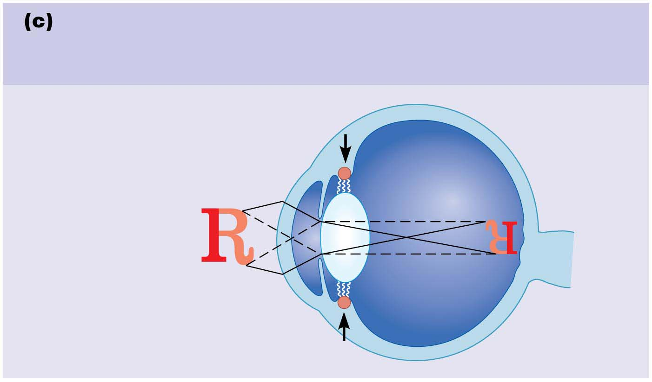
Figure 15.13c Focusing for distant and close vision.
The lens bulges for close vision.
Parasympathetic input contracts the ciliary muscle. This
loosens the ciliary zonule and allows the lens to bulge.
Contracted ciliary muscle
Loosened ciliary zonule
Bulging lens
Divergent rays
from close object
Image

Slide 64
Clinical – Homeostatic Imbalance 15.8
Problems associated with refraction related to eyeball shape:
Myopia (nearsightedness)
Eyeball is too long, so focal point is in front of retina
Corrected with a concave lens
Hyperopia (farsightedness)
Eyeball is too short, so focal point is behind retina
Corrected with a convex lens
Astigmatism
Unequal curvatures in different parts of cornea or lens
Corrected with cylindrically ground lenses or laser procedures

Slide 65
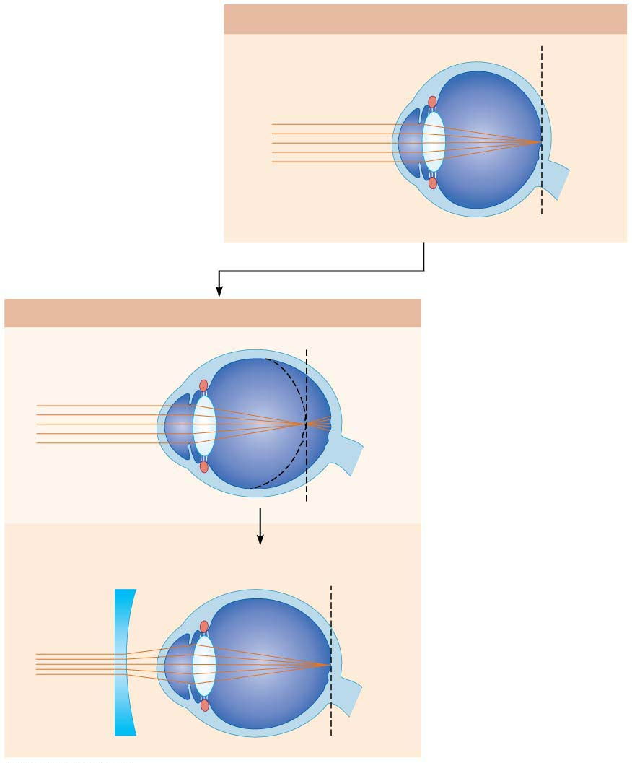
Figure 15.14-1 Problems of refraction.
Emmetropic eye (normal)
Focal point is on retina.
Focal
plane
Myopic eye (nearsighted: eyeball too long)
Uncorrected
Focal point is in front
of retina.
Eyeball
too long
Corrected
Concave lens moves focal
point further back.

Slide 66
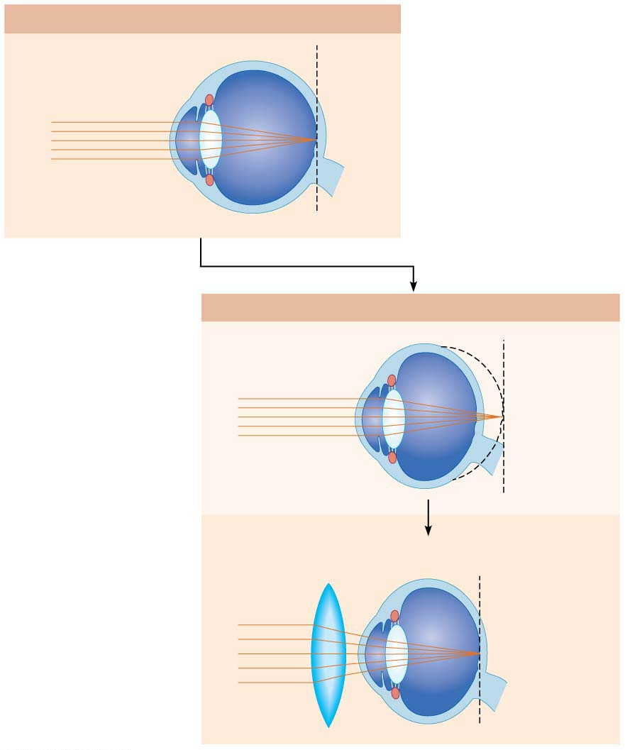
Figure 15.14-2 Problems of refraction.
Emmetropic eye (normal)
Focal point is on retina.
Focal
plane
Hyperopic eye (farsighted: eyeball too short)
Uncorrected
Focal point is behind
retina.
Eyeball
too short
Corrected
Convex lens moves focal
point forward.

Slide 67
Comparing Rod and Cone Vision
Rods are very sensitive to light, making them best suited for night vision and peripheral vision
Contain a single pigment, so vision is perceived in gray tones only
Pathways converge, causing fuzzy, indistinct images
As many as 100 rods may converge into one ganglion

Slide 68
Comparing Rod and Cone Vision (cont.)
Cones have low sensitivity, so require bright light for activation
React more quickly than rods
Have one of three pigments, which allow for vividly colored sight
Nonconverging pathways result in detailed, high-resolution vision
Some cones have their own ganglion cell, so brain can put together accurate, high-acuity resolution images

Slide 69
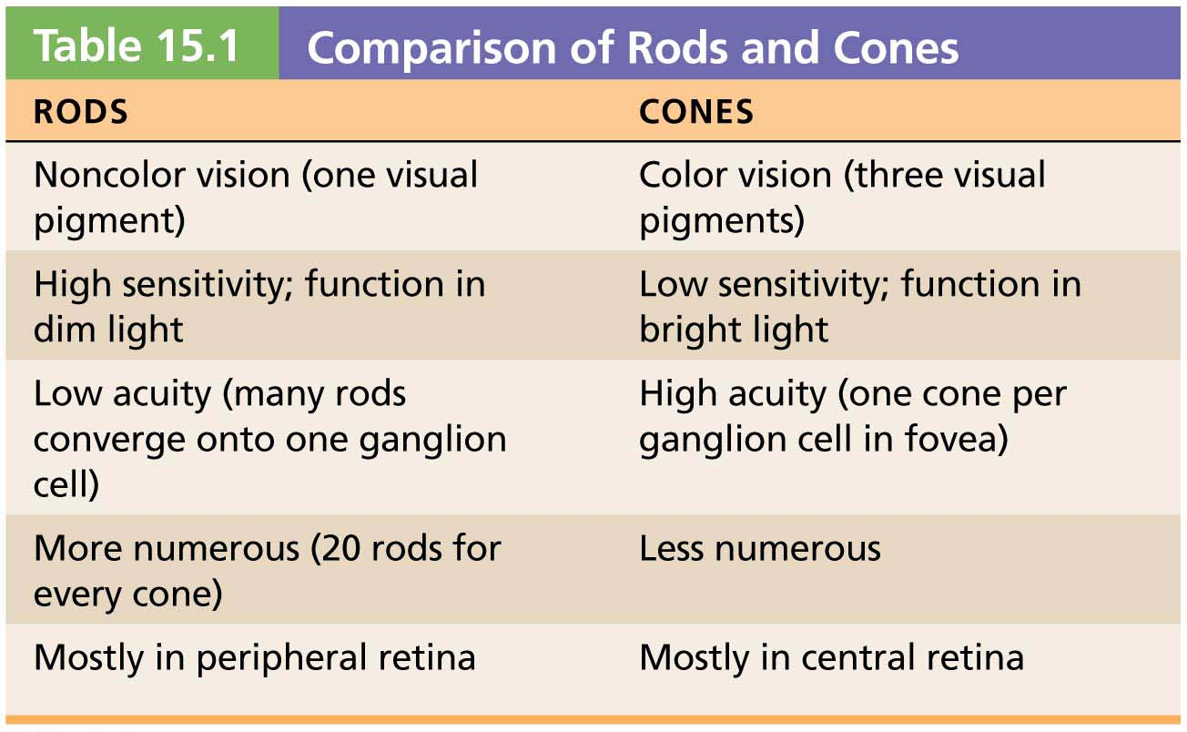
Table 15.1 Comparison of Rods and Cones

Slide 70
Clinical – Homeostatic Imbalance 15.9
Color blindness: lack of one or more cone pigments
Inherited as an X-linked condition, so more common in males
As many as 8–10% of males have some form
The most common type is red-green, in which either red cones or green cones are absent
Depending on which cone is missing, red can appear green, or vice versa
Rely on different shades to get cues of color

Slide 71
Light and Dark Adaptation (cont.)
Dark adaptation
When moving from bright light into darkness, we see blackness because:
Cones stop functioning in low-intensity light
Bright light bleached rod pigments, so they are still turned off
Pupils dilate
Rhodopsin accumulates in dark, so retinal sensitivity starts to increase
Transducin returns to outer segments
Sensitivity increases within 20–30 minutes

Slide 72
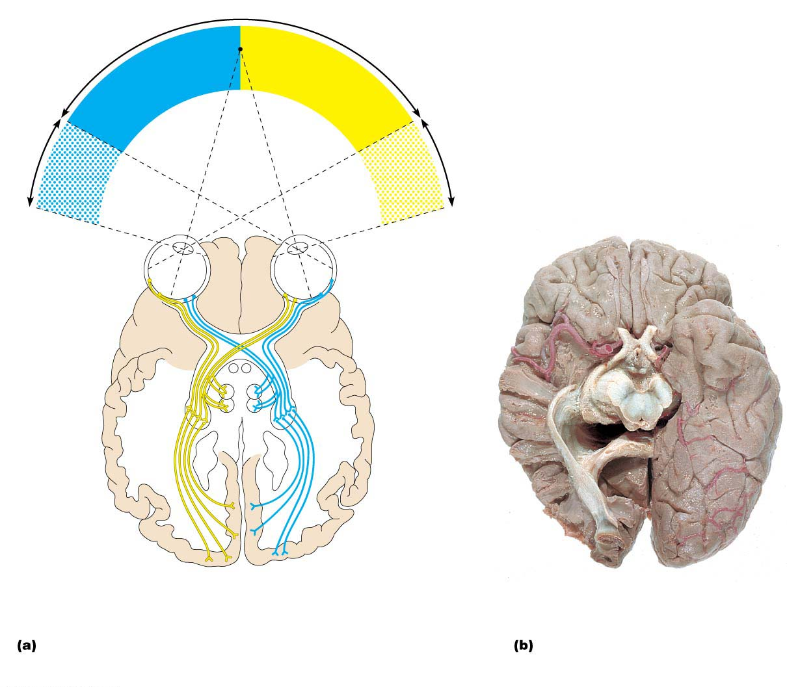
Figure 15.19 Visual pathway to the brain and visual fields, inferior view.
Both
eyes
Fixation point
eye
Left
only
only
Right
eye
Right eye
Left eye
Supra-
chiasmatic
nucleus
Optic nerve
Optic chiasma
Pretectal
nucleus
Optic tract
Lateral
geniculate
nucleus
Superior
colliculus
(sectioned)
Uncrossed
(ipsilateral) fiber
Lateral
geniculate
nucleus of
thalamus
Crossed
(contralateral) fiber
Superior
colliculus
Optic
radiation
Primary visual
cortex
(occipital lobe)
Corpus
callosum
The visual fields of the two eyes overlap considerably.
Note that fibers from the lateral portion of each retinal field
do not cross at the optic chiasma.
Photograph of human brain, with
the right side dissected to reveal
internal structures.

Slide 73
Depth Perception
Both eyes view same image from slightly different angles
Visual cortex fuses these slightly different images, resulting in a three-dimensional image, which leads to depth perception
Requires input from both eyes

Slide 74
Clinical – Homeostatic Imbalance 15.11
Loss of an eye or destruction of one optic nerve eliminates true depth perception entirely
Peripheral vision on damaged side is also affected
If neural destruction occurs beyond optic chiasma, then part or all of opposite half of the visual field is lost
Example: stroke can affect left visual cortex, which leads to blindness in right half of visual field

