Slide 1
The Nervous System
Chapter 11

Slide 2
Why This Matters
Understanding neurotransmitter function will help you be aware of how drugs affect a patient’s nervous system

Slide 3
11.1 Functions of Nervous System
Nervous system is master controlling and communicating system of body
Cells communicate via electrical and chemical signals
Rapid and specific
Usually cause almost immediate responses

Slide 4
11.1 Functions of Nervous System
Nervous system has three overlapping functions
Sensory input
Information gathered by sensory receptors about internal and external changes
Integration
Processing and interpretation of sensory input
Motor output
Activation of effector organs (muscles and glands) produces a response

Slide 5
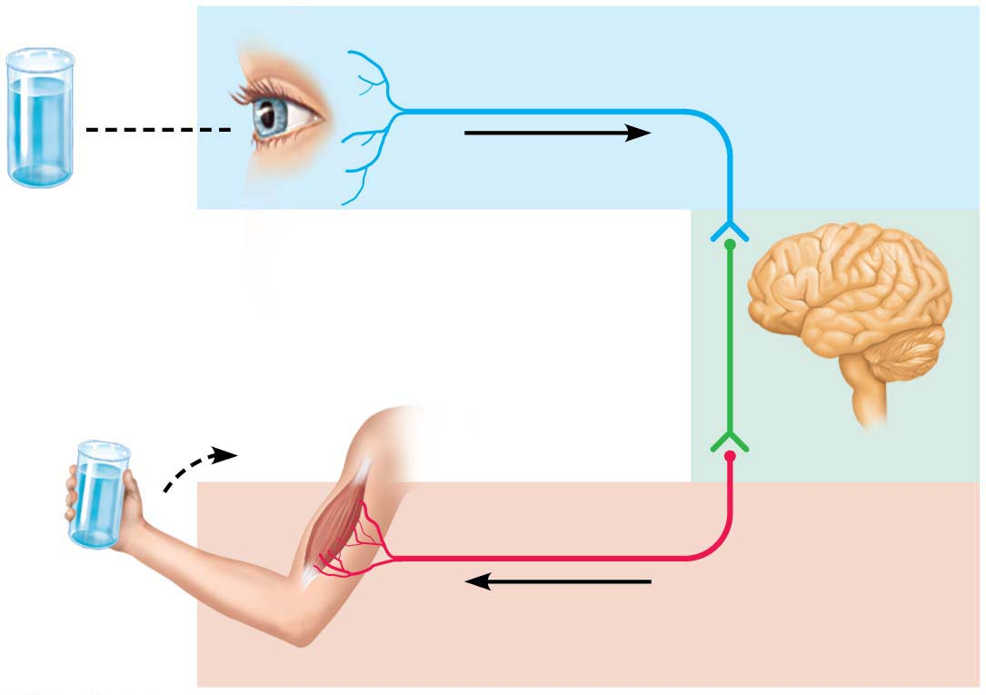
Figure 11.1 The nervous system’s functions.
Sensory input
Integration
Motor output

Slide 6
Divisions of the Nervous System
The nervous system is divided into 2 parts
1. Central Nervous System (CNS)- brain and spinal cord
2. Peripheral Nervous System (PNS)- nerves from brain and spinal cord
PNS further divided into 2 divisions:
a. Afferent- (sensory)- body to CNS
b. Efferent (motor)- CNS to muscles / glands
The efferent division (CNS to organs)
a. Somatic (“body”)- CNS to skeletal muscle
b. Autonomic Nervous System (ANS)- CNS to smooth muscle, cardiac muscle
1). Sympathetic- prepares for “fight or flight”
2). Parasympathetic- prepares for body at rest.

Slide 7
11.1 Functions of Nervous System
Nervous system is divided into two principal parts:
Central nervous system (CNS)
Brain and spinal cord of dorsal body cavity
Integration and control center
Interprets sensory input and dictates motor output
Peripheral nervous system (PNS)
The portion of nervous system outside CNS
Consists mainly of nerves that extend from brain and spinal cord
Spinal nerves to and from spinal cord
Cranial nerves to and from brain

Slide 8
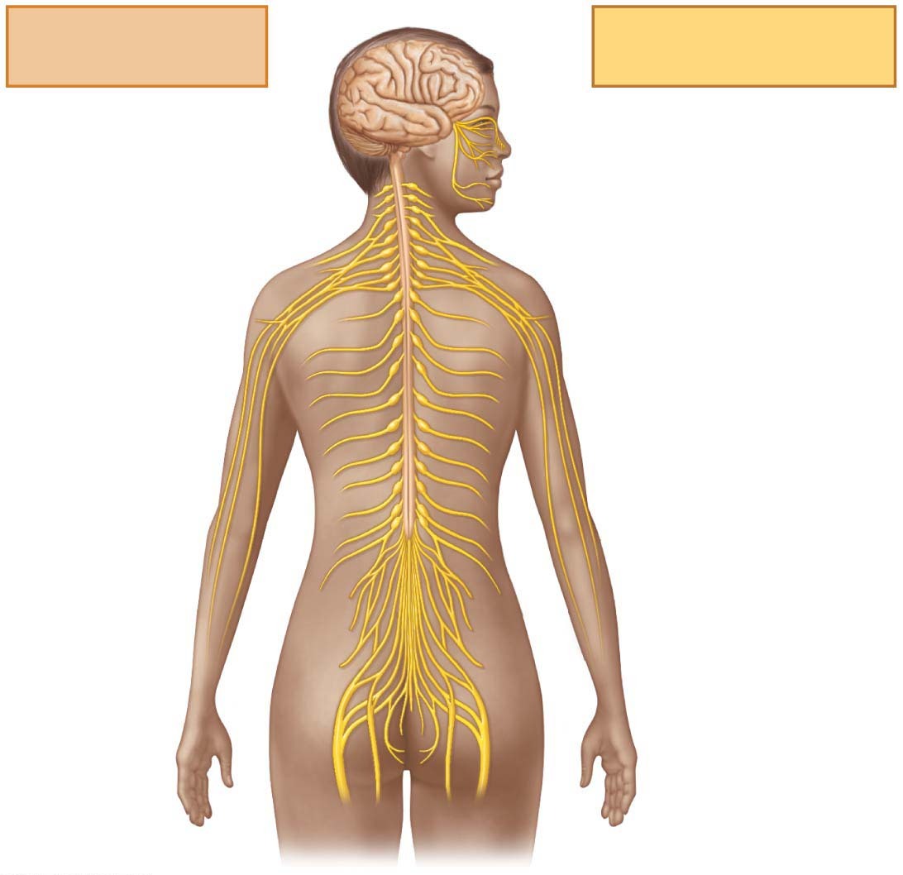
Figure 11.2 The nervous system.
Central nervous
system (CNS)
Peripheral nervous
system (PNS)
Brain
Cranial nerves
Spinal cord
Spinal nerves
Ganglia

Slide 9
11.1 Functions of Nervous System
Peripheral nervous system (PNS) has two functional divisions
Sensory (afferent) division
Somatic sensory fibers: convey impulses from skin, skeletal muscles, and joints to CNS
Visceral sensory fibers: convey impulses from visceral organs to CNS
Motor (efferent) division
Transmits impulses from CNS to effector organs
Muscles and glands
Two divisions
Somatic nervous system
Autonomic nervous system

Slide 10
11.1 Functions of Nervous System
Somatic nervous system
Somatic motor nerve fibers conduct impulses from CNS to skeletal muscle
Voluntary nervous system
Conscious control of skeletal muscles

Slide 11
11.1 Functions of Nervous System
Autonomic nervous system
Consists of visceral motor nerve fibers
Regulates smooth muscle, cardiac muscle, and glands
Involuntary nervous system
Two functional subdivisions
Sympathetic
Parasympathetic
Work in opposition to each other

Slide 12
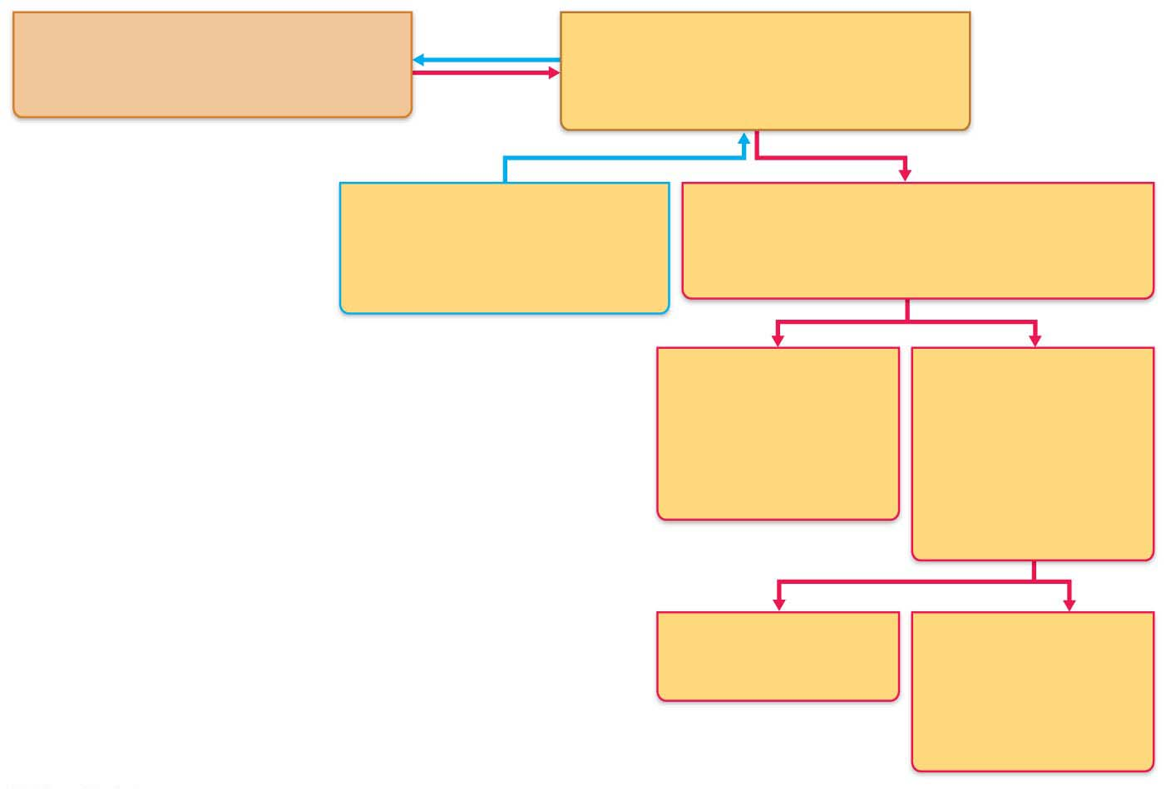
Figure 11.3 Organization of the nervous system.
Central nervous system (CNS)
Peripheral nervous system (PNS)
Brain and spinal cord
Cranial nerves and spinal nerves
Integrative and control centers
Communication lines between the CNS
and the rest of the body
Sensory (afferent) division
Motor (efferent) division
Somatic and visceral sensory
nerve fibers
Motor nerve fibers
Conducts impulses from
receptors to the CNS
Conducts impulses from the CNS
to effectors (muscles and glands)
Somatic nervous
system
Autonomic nervous
system (ANS)
Somatic motor
(voluntary)
Visceral motor
(involuntary)
Conducts impulses
from the CNS to
skeletal muscles
Conducts impulses
from the CNS to
cardiac muscle,
smooth muscle,
and glands
Sympathetic division
Parasympathetic
division
Mobilizes body systems
during activity
Conserves energy
Promotes house-
keeping functions
during rest
Structure
Function

Slide 13
Nervous Tissue
Composed of 2 types of cells:
conducting= neurons
nonconducting= neuroglial, supporting cells

Slide 14
11.2 Neuroglia
Nervous tissue histology
Nervous tissue consists of two principal cell types
Neuroglia (glial cells): small cells that surround and wrap delicate neurons
Neurons (nerve cells): excitable cells that transmit electrical signals

Slide 15
Neuroglia of the CNS
Four main neuroglia support CNS neurons
Astrocytes
Microglial cells
Ependymal cells
Oligodendrocytes

Slide 16
Nonconducting Cells
Nonconducting cells in nervous tissue are called neuroglial cells
They support and protect nervous system tissue

Slide 17
Types of nonconducting cells in the CNS- Astrocytes
Astrocyte- connect neurons to capillaries
Most abundant, versatile, and highly branched of glial cells
Cling to neurons, synaptic endings, and capillaries

Slide 18
Neuroglia of the CNS (cont.)
Astrocytes (cont.)
Functions include:
Support and brace neurons
Play role in exchanges between capillaries and neurons
Guide migration of young neurons
Control chemical environment around neurons
Respond to nerve impulses and neurotransmitters
Influence neuronal functioning
Participate in information processing in brain

Slide 19
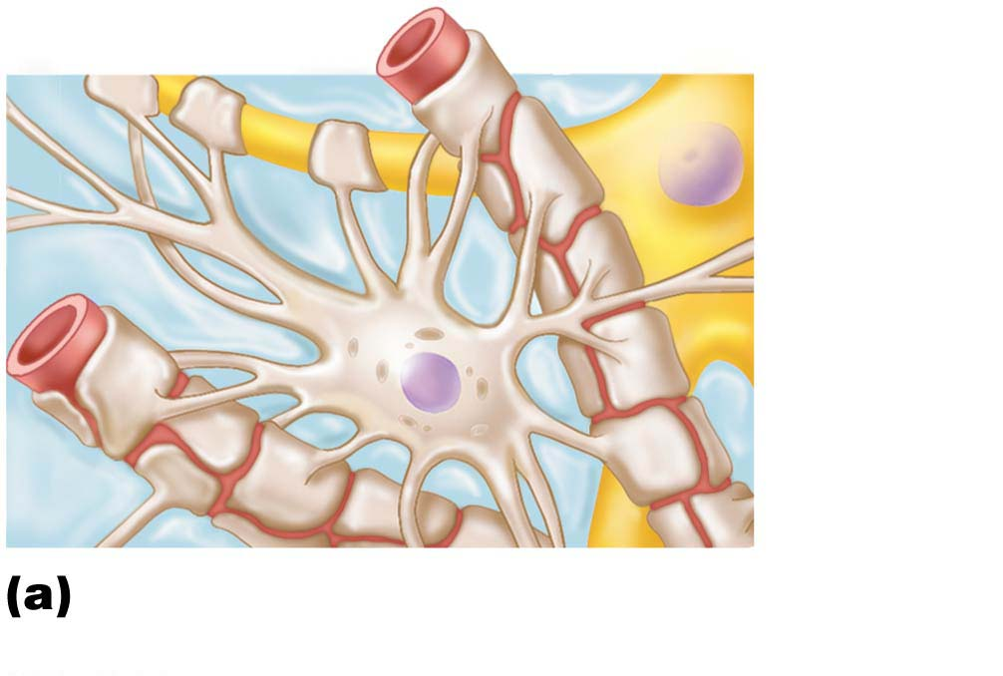
Figure 11.4a Neuroglia.
Capillary
Neuron
Astrocyte
Astrocytes are the most
abundant CNS neuroglia.

Slide 20
Types of nonconducting cells in the CNS- Microglial
Microglial– phagocytes
Small, ovoid cells with thorny processes that touch and monitor neurons
Migrate toward injured neurons
Can transform to phagocytize microorganisms and neuronal debris

Slide 21
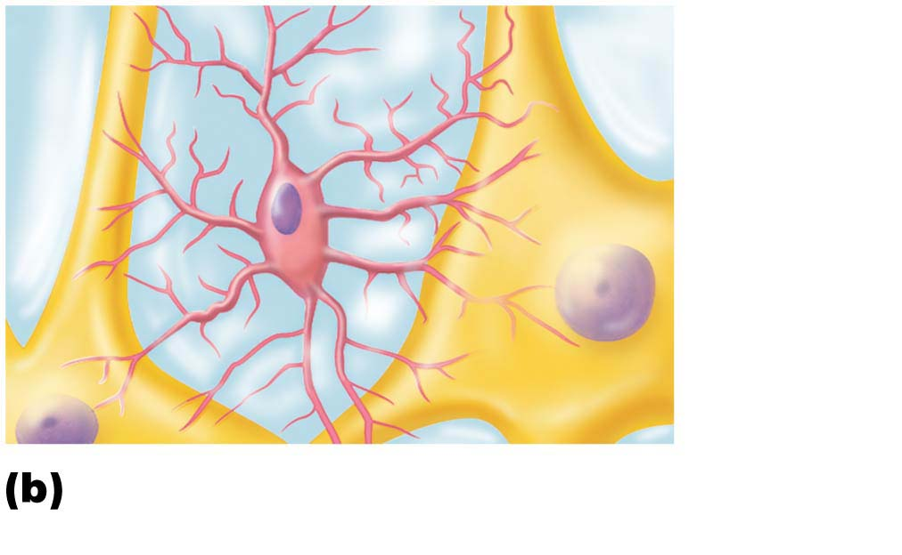
Figure 11.4b Neuroglia.
Neuron
Microglial
cell
Microglial cells are defensive
cells in the CNS.

Slide 22
Types of nonconducting cells in the CNS- Ependymal
Ependymal- circulates cerebrospinal fluid (CSF); lines brain and spinal cord.

Slide 23
Neuroglia of the CNS (cont.)
Ependymal cells
Range in shape from squamous to columnar
May be ciliated
Cilia beat to circulate CSF
Line the central cavities of the brain and spinal column
Form permeable barrier between cerebrospinal fluid (CSF) in cavities and tissue fluid bathing CNS cells

Slide 24
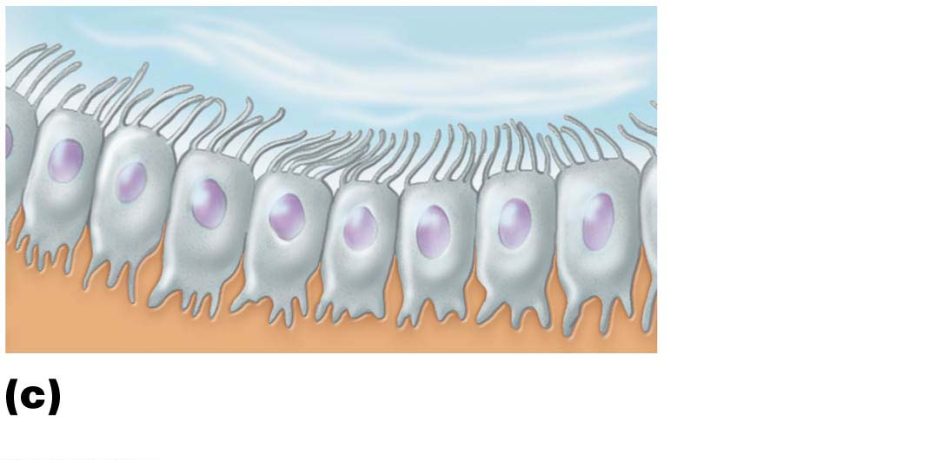
Figure 11.4c Neuroglia.
Fluid-filled cavity
Cilia
Ependymal
cells
Brain or
spinal cord
tissue
Ependymal cells line cerebrospinal
fluid–filled cavities.

Slide 25
Types of nonconducting cells in the CNS- Oligodendrocytes
Oligodendrocyte- make myelin in CNS
Branched cells
Processes wrap CNS nerve fibers, forming insulating myelin sheaths in thicker nerve fibers

Slide 26
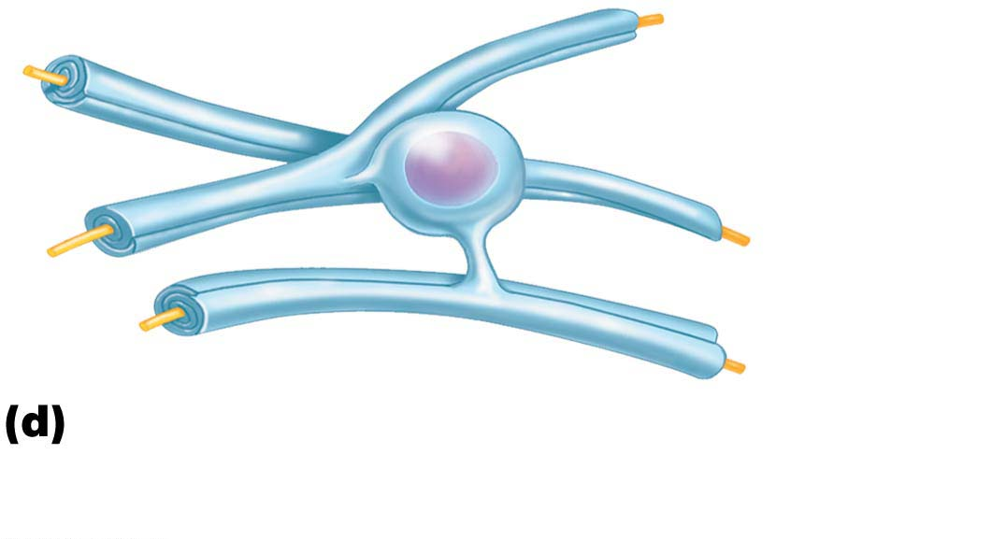
Figure 11.4d Neuroglia.
Myelin sheath
Process of
oligodendrocyte
Nerve
fibers
Oligodendrocytes have processes
that form myelin sheaths around CNS
nerve fibers.

Slide 27
Neuroglia of PNS
Two major neuroglia seen in PNS
Satellite cells
Surround neuron cell bodies in PNS
Function similar to astrocytes of CNS
Schwann cells (neurolemmocytes)
Surround all peripheral nerve fibers and form myelin sheaths in thicker nerve fibers
Similar function as oligodendrocytes
Vital to regeneration of damaged peripheral nerve fibers

Slide 28
Types of nonconducting cells in the PNS- Schwann Cells
Schwann cells- make myelin in PNS

Slide 29
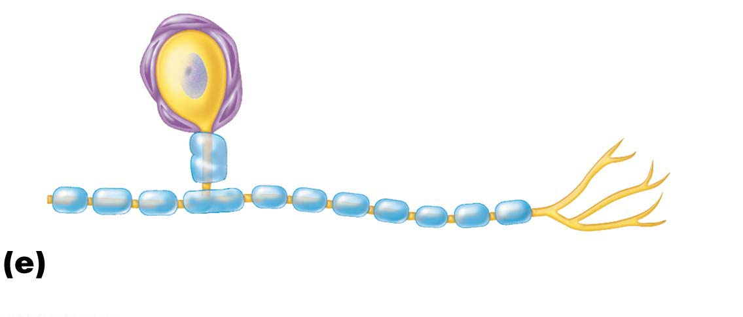
Figure 11.4e Neuroglia.
Cell body of neuron
Satellite
cells
Schwann cells
(forming myelin sheath)
Nerve fiber
Satellite cells and Schwann cells (which
form myelin) surround neurons in the PNS.

Slide 30
Conducting Cells
Neurons are the conducting cells of the nervous system

Slide 31
11.3 Neurons
Neurons (nerve cells) are structural units of nervous system
Large, highly specialized cells that conduct impulses
Special characteristics
Extreme longevity (lasts a person’s lifetime)
Amitotic, with few exceptions
High metabolic rate: requires continuous supply of oxygen and glucose
All have cell body and one or more processes

Slide 32
Neuron Cell Body
Also called the perikaryon or soma
Biosynthetic center of neuron
Synthesizes proteins, membranes, chemicals
Rough ER (chromatophilic substance, or Nissl bodies)
Contains spherical nucleus with nucleolus
Some contain pigments
In most, plasma membrane is part of receptive region that receives input info from other neurons

Slide 33
Neuron Cell Body (cont.)
Most neuron cell bodies are located in CNS
Nuclei: clusters of neuron cell bodies in CNS
Ganglia: clusters of neuron cell bodies in PNS

Slide 34
Neuron Processes
Armlike processes that extend from cell body
CNS contains both neuron cell bodies and their processes
PNS contains chiefly neuron processes
Tracts
Bundles of neuron processes in CNS
Nerves
Bundles of neuron processes in PNS
Two types of processes
Dendrites
Axon

Slide 35
Neurons
Neurons consist of 3 major parts:
1. Axon- conducts impulse
2. Dendrite- receives impulse
3. Cell body- contains nucleus “control center”

Slide 36
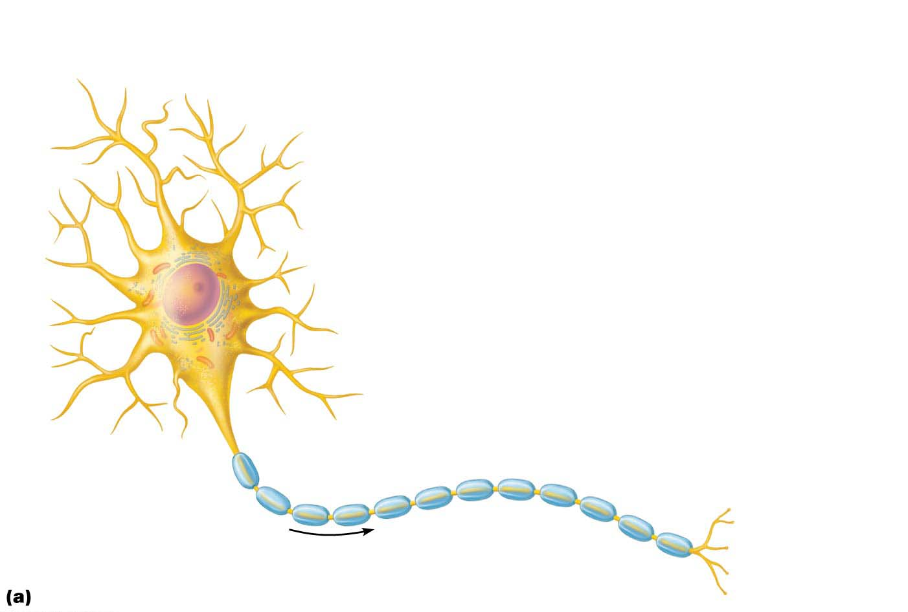
Figure 11.5a Structure of a motor neuron.
Dendrites
(receptive
regions)
Cell body
(biosynthetic center
and receptive region)
Nucleus
Axon
(impulse-generating
and conducting
region)
Nucleolus
Myelin sheath gap
(node of Ranvier)
Chromatophilic
substance (rough
endoplasmic
reticulum)
Axon terminals
(secretory
region)
Axon
hillock
Schwann
cell
Impulse
direction
Terminal
branches

Slide 37
Neuron Processes (cont.)
Dendrites
Motor neurons can contain 100s of these short, tapering, diffusely branched processes
Contain same organelles as in cell body
Receptive (input) region of neuron
Convey incoming messages toward cell body as graded potentials (short distance signals)
In many brain areas, finer dendrites are highly specialized to collect information
Contain dendritic spines, appendages with bulbous or spiky ends

Slide 38
Structures found in nerve cells
Cell Body=
1. Nucleus
2. Nucleolus
3. Mitochondria
4. Golgi body
5. Nissl bodies
Processes=
1. Axon
2. dendrite

Slide 39
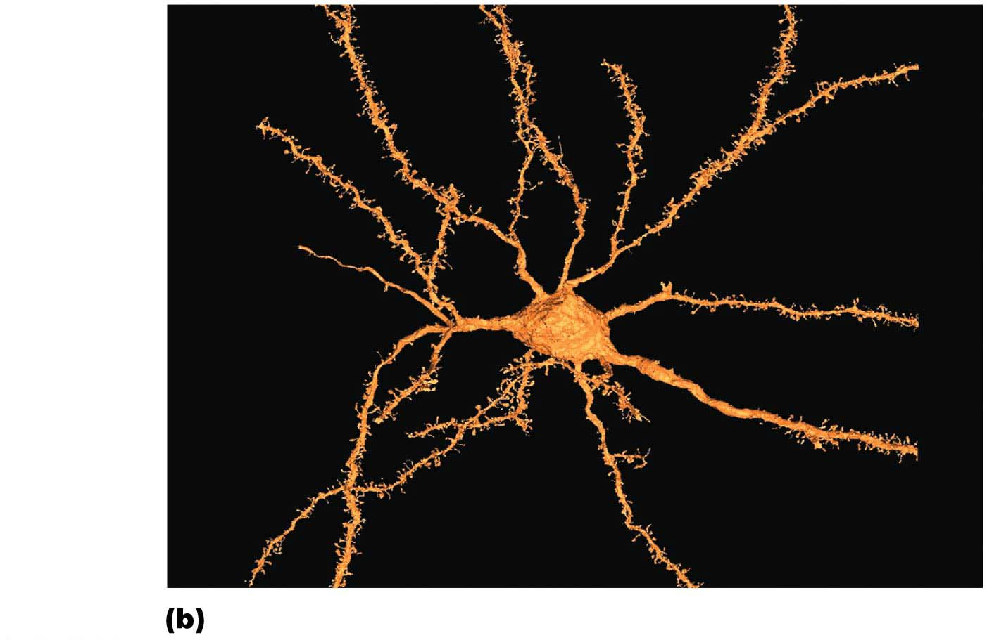
Figure 11.5b Structure of a motor neuron.
Neuron
cell body
Dendritic
spine

Slide 40
Path of an impulse
The path of an impulse through the neuron is always in this direction: DENDRITE--> CELL BODY --> AXON

Slide 41
Neuron Processes (cont.)
The axon: structure
Each neuron has one axon that starts at cone-shaped area called axon hillock
In some neurons, axons are short or absent; in others, axon comprises almost entire length of cell
Some axons can be over 1 meter long
Long axons are called nerve fibers
Axons have occasional branches called axon collaterals
Axons branch profusely at their end (terminus)
Can number as many as 10,000 terminal branches
Distal endings are called axon terminals or terminal boutons

Slide 42
Neuron Processes (cont.)
The axon: functional characteristics
Axon is the conducting region of neuron
Generates nerve impulses and transmits them along axolemma (neuron cell membrane) to axon terminal
Terminal: region that secretes neurotransmitters, which are released into extracellular space
Can excite or inhibit neurons it contacts
Carries on many conversations with different neurons at same time
Axons rely on cell bodies to renew proteins and membranes
Quickly decay if cut or damaged

Slide 43
Neuron Processes (cont.)
The axon: functional characteristics (cont.)
Axons have efficient internal transport mechanisms
Molecules and organelles are moved along axons by motor proteins and cytoskeletal elements
Movement occurs in both directions
Anterograde: away from cell body
Examples: mitochondria, cytoskeletal elements, membrane components, enzymes
Retrograde: toward cell body
Examples: organelles to be degraded, signal molecules, viruses, and bacterial toxins

Slide 44
Clinical – Homeostatic Imbalance 11.1
Certain viruses and bacterial toxins damage neural tissues by using retrograde axonal transport
Example: polio, rabies, and herpes simplex viruses, and tetanus toxin
Research is under way to investigate using retrograde transport to treat genetic diseases
Viruses containing “corrected” genes or microRNA to suppress defective genes can enter cell through retrograde transport

Slide 45
Neuron Processes (cont.)
Myelin sheath
Composed of myelin, a whitish, protein-lipid substance
Function of myelin
Protect and electrically insulate axon
Increase speed of nerve impulse transmission
Myelinated fibers: segmented sheath surrounds most long or large-diameter axons
Nonmyelinated fibers: do not contain sheath
Conduct impulses more slowly

Slide 46
Neuron Processes (cont.)
Myelination in the PNS
Formed by Schwann cells
Wraps around axon in jelly roll fashion
One cell forms one segment of myelin sheath
Outer collar of perinuclear cytoplasm (formerly called neurilemma): peripheral bulge containing nucleus and most of cytoplasm
Plasma membranes have less protein
No channels or carriers, so good electrical insulators
Interlocking proteins bind adjacent myelin membranes

Slide 47
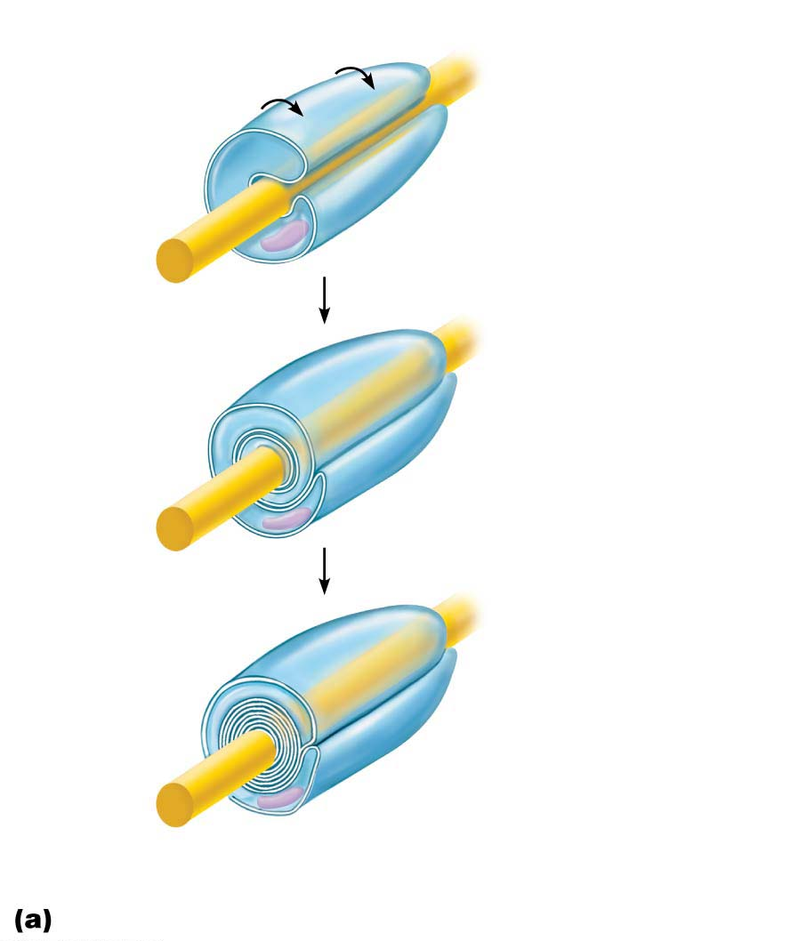
Figure 11.6a PNS nerve fiber myelination.
Schwann
cell plasma
membrane
Schwann cell
cytoplasm
1
A Schwann cell
envelops an axon.
Axon
Schwann cell
nucleus
2
The Schwann cell
then rotates around
the axon, wrapping
its plasma membrane loosely around it in successive layers.
3
The Schwann cell cytoplasm is forced
from between the membranes. The tight membrane wrappings surrounding the axon form the myelin sheath.
Myelin
sheath
Schwann cell
cytoplasm
Myelination of a nerve fiber (axon)

Slide 48
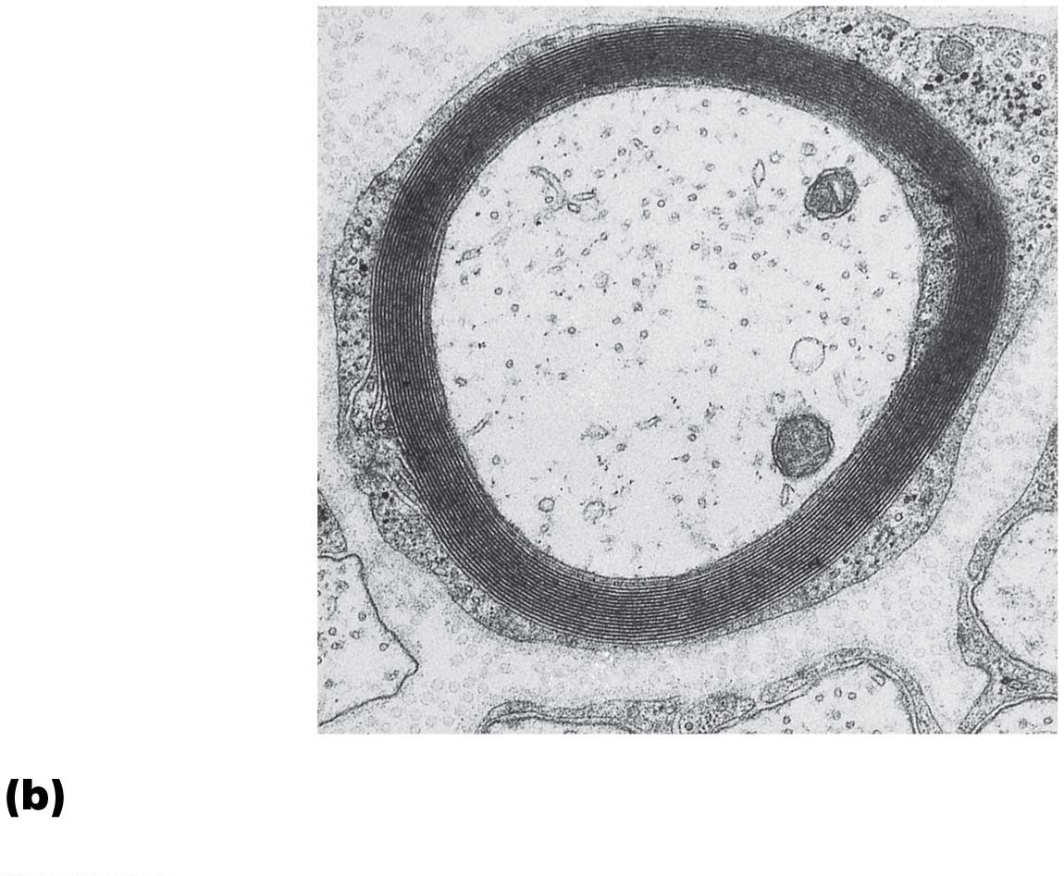
Figure 11.6b PNS nerve fiber myelination.
Myelin sheath
Outer collar
of perinuclear
cytoplasm
(of Schwann
cell)
Axon
Cross-sectional view of a myelinated axon
(electron micrograph 24,000⋅)

Slide 49
Neuron Processes (cont.)
Myelination in the PNS (cont.)
Myelin sheath gaps
Gaps between adjacent Schwann cells
Sites where axon collaterals can emerge
Formerly called nodes of Ranvier
Nonmyelinated fibers
Thin fibers not wrapped in myelin; surrounded by Schwann cells but no coiling; one cell may surround 15 different fibers

Slide 50
Figure 11.5a Structure of a motor neuron.
Dendrites
(receptive
regions)
Cell body
(biosynthetic center
and receptive region)
Nucleus
Axon
(impulse-generating
and conducting
region)
Nucleolus
Myelin sheath gap
(node of Ranvier)
Chromatophilic
substance (rough
endoplasmic
reticulum)
Axon terminals
(secretory
region)
Axon
hillock
Schwann
cell
Impulse
direction
Terminal
branches

Slide 51
Neuron Processes (cont.)
Myelin sheaths in the CNS
Formed by processes of oligodendrocytes, not whole cells
Each cell can wrap up to 60 axons at once
Myelin sheath gap is present
No outer collar of perinuclear cytoplasm
Thinnest fibers are unmyelinated, but covered by long extensions of adjacent neuroglia

Slide 52
Neuron Processes (cont.)
Myelin sheaths in the CNS (cont.)
White matter: regions of brain and spinal cord with dense collections of myelinated fibers
Usually fiber tracts
Gray matter: mostly neuron cell bodies and nonmyelinated fibers

Slide 53
Figure 11.4d Neuroglia.
Myelin sheath
Process of
oligodendrocyte
Nerve
fibers
Oligodendrocytes have processes
that form myelin sheaths around CNS
nerve fibers.

Slide 54
Classification of neurons
Neurons are classified on the basis of their structure
1. Multipolar
2. Bipolar
3. Unipolar

Slide 55
Classification of Neurons
Structural classification
Three types grouped by number of processes
Multipolar: three or more processes (1 axon, others dendrites)
Most common and major neuron type in CNS
Bipolar: two processes (one axon, 1one dendrite)
Rare (ex: retina and olfactory mucosa)
Unipolar: one T-like process (two axons)
Also called pseudounipolar
Peripheral (distal) process: associated with sensory receptor
Proximal (central) process: enters CNS

Slide 56
Multipolar
1. Multipolar= most common type; many dendrites

Slide 57
Bipolar
2. Bipolar= one axon and one dendrite; RARE; found only in eye and ear

Slide 58
Unipolar
3. Unipolar= one process; very short; found in sensory neurons in PNS

Slide 59
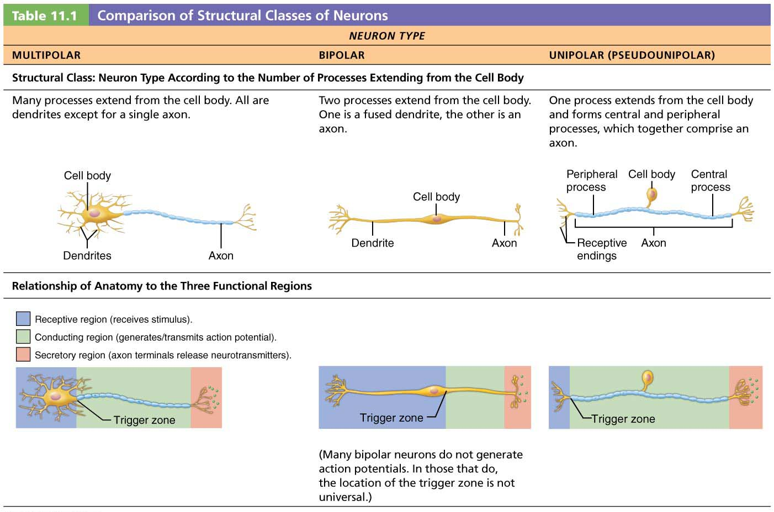
Table 11.1-1 Comparison of Structural Classes of Neurons

Slide 60
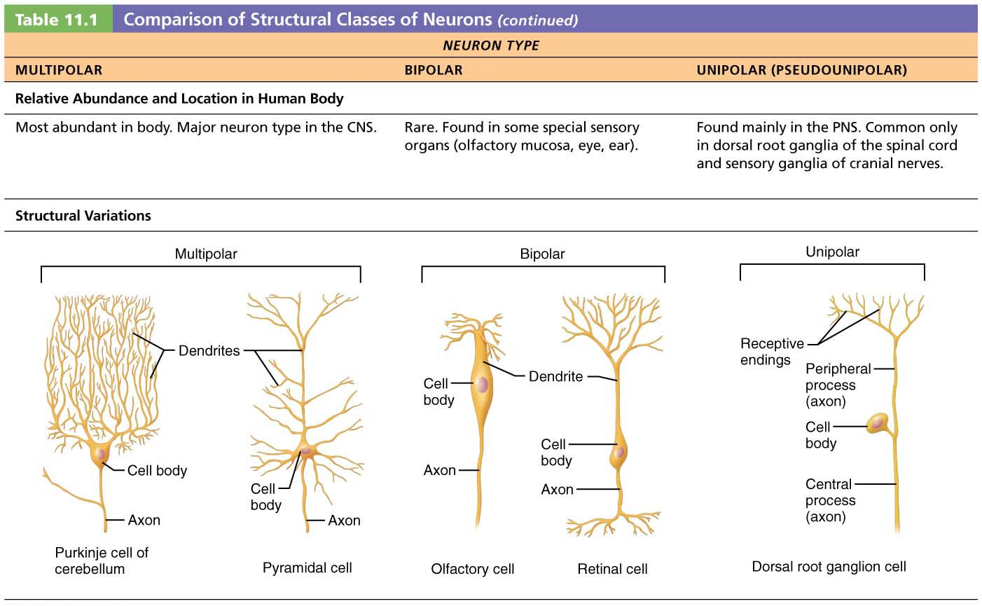
Table 11.1-2 Comparison of Structural Classes of Neurons (continued)

Slide 61
Classification of neurons
Neurons are also classified based on the function that each performs
1. Sensory or afferent= sense organ to CNS
2. Motor or efferent= CNS to muscle or gland
3. Association or interneuron= connect motor to sensory neurons

Slide 62
Classification of Neurons (cont.)
Functional classification of neurons
Three types of neurons grouped by direction in which nerve impulse travels relative to CNS
Sensory
Transmit impulses from sensory receptors toward CNS
Almost all are unipolar
Cell bodies are located in ganglia in PNS
Motor
Carry impulses from CNS to effectors
Multipolar
Most cell bodies are located in CNS (except some autonomic neurons)

Slide 63
Motor (Efferent) Neurons
Motor neurons begin in the CNS (brain or spinal cord) and terminate at an effector which is a muscle or gland

Slide 64
Sensory (Afferent) Neurons
Sensory neurons originate at a muscle or gland and terminate in the CNS (brain or spinal cord)

Slide 65
Classification of Neurons (cont.)
Functional classification of neurons (cont.)
Three types (cont.)
Interneurons
Also called association neurons
Lie between motor and sensory neurons
Shuttle signals through CNS pathways
Most are entirely within CNS
99% of body’s neurons are interneurons

Slide 66
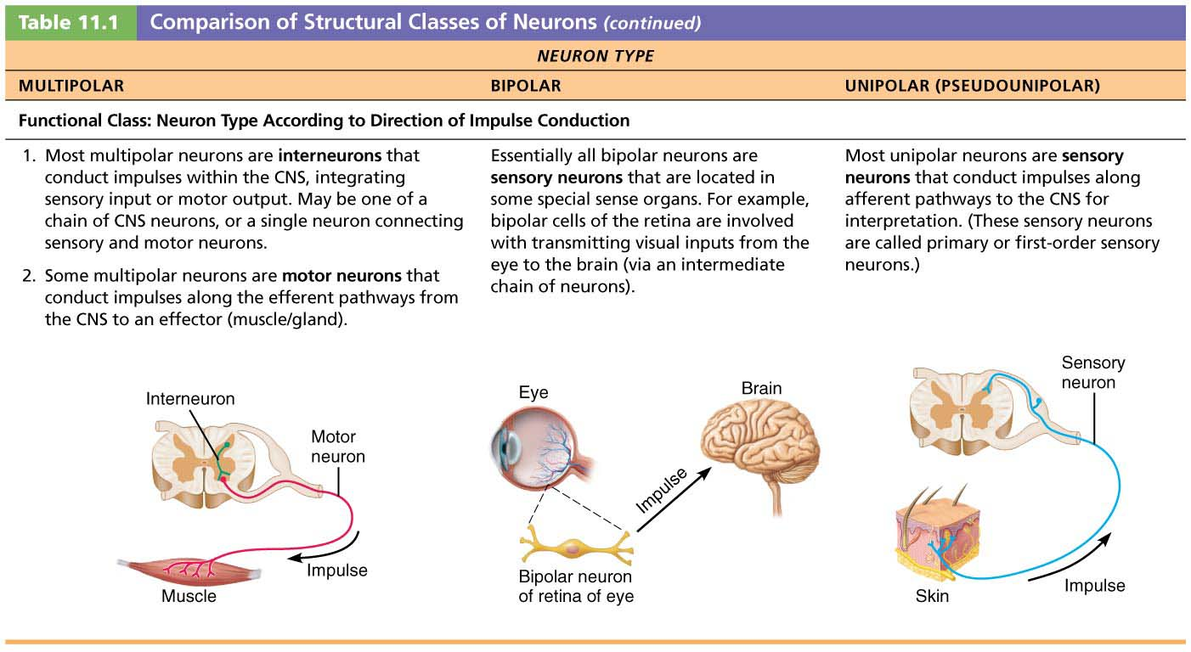
Table 11.1-3 Comparison of Structural Classes of Neurons (continued)

