Slide 2
11.4 Membrane Potentials
Like all cells, neurons have a resting membrane potential
Unlike most other cells, neurons can rapidly change resting membrane potential
Neurons are highly excitable

Slide 3
Basic Principles of Electricity
Opposite charges are attracted to each other
Energy is required to keep opposite charges separated across a membrane
Energy is liberated when the charges move toward one another
When opposite charges are separated, the system has potential energy

Slide 4
Basic Principles of Electricity (cont.)
Definitions
Voltage: a measure of potential energy generated by separated charge
Measured between two points in volts (V) or millivolts (mV)
Called potential difference or potential
Charge difference across plasma membrane results in potential
Greater charge difference between points = higher voltage

Slide 5
Basic Principles of Electricity (cont.)
Definitions (cont.)
Current: flow of electrical charge (ions) between two points
Can be used to do work
Flow is dependent on voltage and resistance
Resistance: hindrance to charge flow
Insulator: substance with high electrical resistance
Conductor: substance with low electrical resistance

Slide 6
Basic Principles of Electricity (cont.)
Definitions (cont.)
Ohm’s law: gives relationship of voltage, current, resistance
Current (I) = voltage (V)/resistance (R)
Current is directly proportional to voltage
Greater the voltage (potential difference), greater the current
No net current flow between points with same potential
Current is inversely proportional to resistance
The greater the resistance, the smaller the current

Slide 7
Basic Principles of Electricity (cont.)
Role of membrane ion channels
Large proteins serve as selective membrane ion channels
K⁺ ion channel allows only K⁺ to pass through
Two main types of ion channels
Leakage (nongated) channels, which are always open
Gated channels, in which part of the protein changes shape to open/close the channel
Three main gated channels: chemically gated, voltage-gated, or mechanically gated

Slide 8
Basic Principles of Electricity (cont.)
Chemically gated (ligand-gated) channels
Open only with binding of a specific chemical (example: neurotransmitter)
Voltage-gated channels
Open and close in response to changes in membrane potential
Mechanically gated channels
Open and close in response to physical deformation of receptors, as in sensory receptors

Slide 9
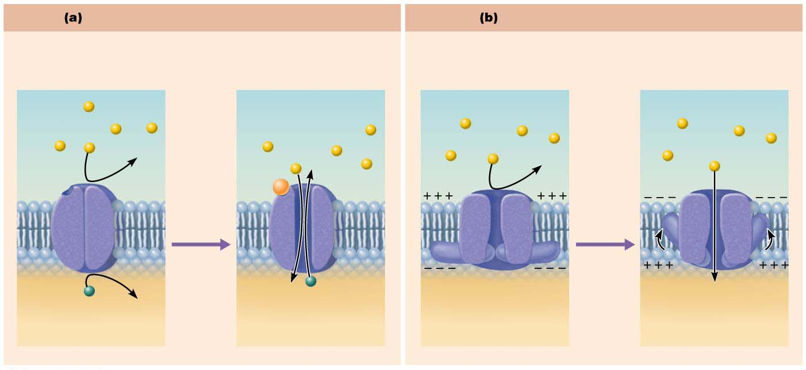
Figure 11.7 Operation of gated channels.
Chemically gated ion channels
Voltage-gated ion channels
Open in response to binding of the
appropriate neurotransmitter
Open in response to changes
in membrane potential
Neurotransmitter
chemical attached
to receptor
Receptor
Na⁺
Na⁺
Na⁺
Na⁺
Chemical
binds
Membrane
voltage
changes
K⁺
K⁺
Closed
Open
Closed
Open

Slide 10
Basic Principles of Electricity (cont.)
When gated channels are open, ions diffuse quickly:
Along chemical concentration gradients from higher concentration to lower concentration
Along electrical gradients toward opposite electrical charge

Slide 11
Basic Principles of Electricity (cont.)
Electrochemical gradient: electrical and chemical gradients combined
Ion flow creates an electrical current, and voltage changes across membrane
Expressed by rearranged Ohm’s law equation:
V = IR

Slide 12
Generating the Resting Membrane Potential
A voltmeter can measure potential (charge) difference across membrane of resting cell
Resting membrane potential of a resting neuron is approximately –70 mV
The cytoplasmic side of membrane is negatively charged relative to the outside
The actual voltage difference varies from –40 mV to –90 mV
The membrane is said to be polarized

Slide 13
Generating the Resting Membrane Potential (cont.)
Potential generated by:
Differences in ionic composition of ICF and ECF
Differences in plasma membrane permeability

Slide 14
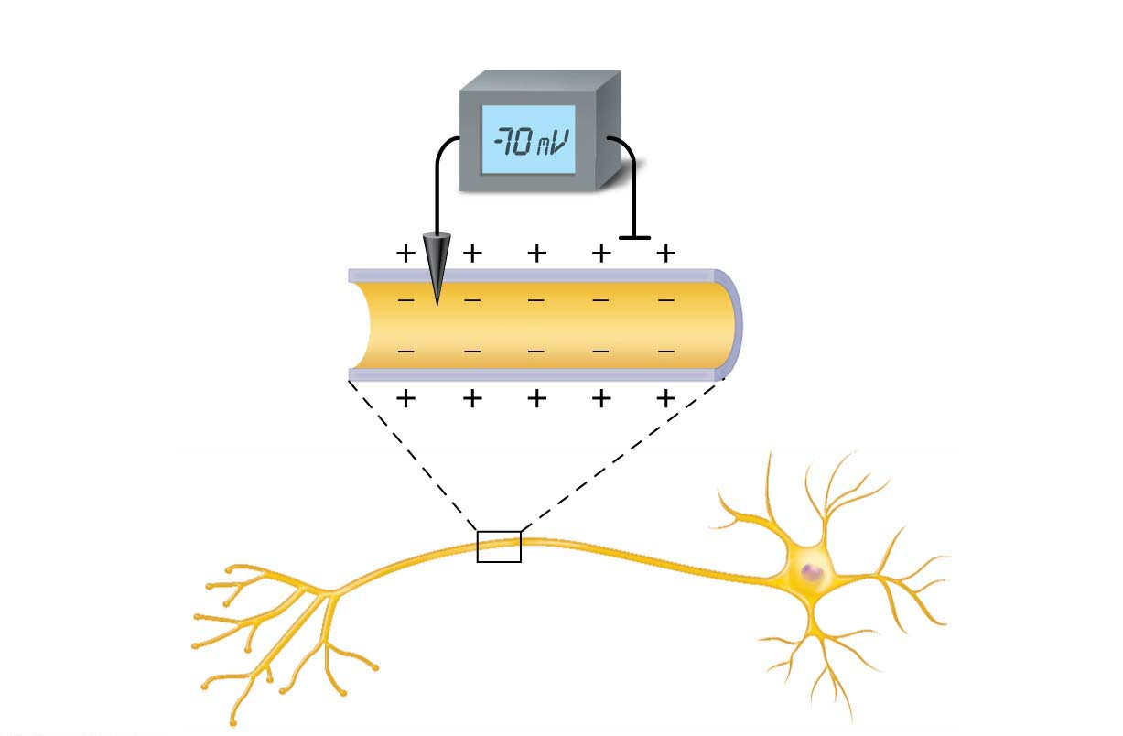
Figure 11.8 Measuring membrane potential in neurons.
Voltmeter
Plasma
membrane
Ground electrode
outside cell
Microelectrode
inside cell
Axon
Neuron

Slide 15
Generating the Resting Membrane Potential (cont.)
Differences in ionic composition
ECF has higher concentration of Na⁺ than ICF
Balanced chiefly by chloride ions (Cl⁻)
ICF has higher concentration of K⁺ than ECF
Balanced by negatively charged proteins
K⁺ plays most important role in membrane potential

Slide 16
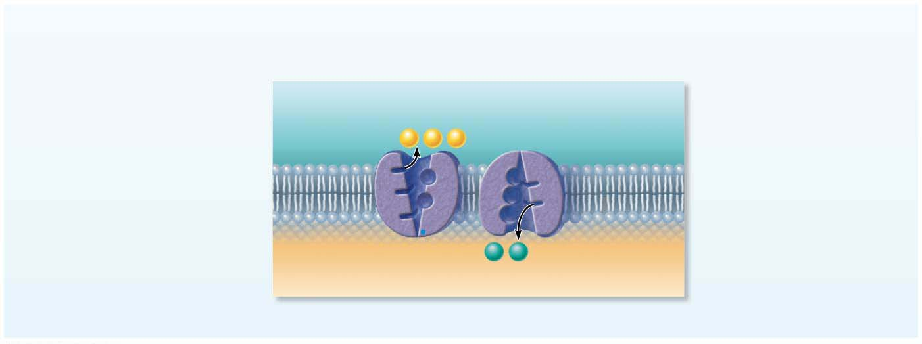
Focus Figure 11.1-1 Generating a resting membrane potential depends on (1) differences in K⁺ and Na⁺ concentrations inside and outside cells, and (2) differences in permeability of the plasma membrane to these ions.
The concentrations of Na⁺ and K⁺ on each side
of the membrane are different.
The Na⁺ concentration
is higher outside the
cell.
Outside cell
K⁺
(5 mM)
Na⁺
(140 mM)
Na⁺
Na⁺
Na⁺
The K⁺ concentration is
higher inside the cell.
K⁺
(140 mM)
K⁺
K⁺
Na⁺
(15 mM)
Na⁺-K⁺ pumps maintain
the concentration
gradients of Na⁺ and K⁺
across the membrane.
Inside cell

Slide 17
Generating the Resting Membrane Potential (cont.)
Differences in plasma membrane permeability
Impermeable to large anionic proteins
Slightly permeable to Na⁺ (through leakage channels)
Sodium diffuses into cell down concentration gradient
25 times more permeable to K⁺ than sodium (more leakage channels)
Potassium diffuses out of cell down concentration gradient
Quite permeable to Cl–

Slide 18
Generating the Resting Membrane Potential (cont.)
Differences in plasma membrane permeability (cont.)
More potassium diffuses out than sodium diffuses in
As a result, the inside of the cell is more negative
Establishes resting membrane potential
Sodium-potassium pump (Na⁺/K⁺ ATPase) stabilizes resting membrane potential
Maintains concentration gradients for Na⁺ and K⁺
Three Na⁺ are pumped out of cell while two K⁺ are pumped back in

Slide 19
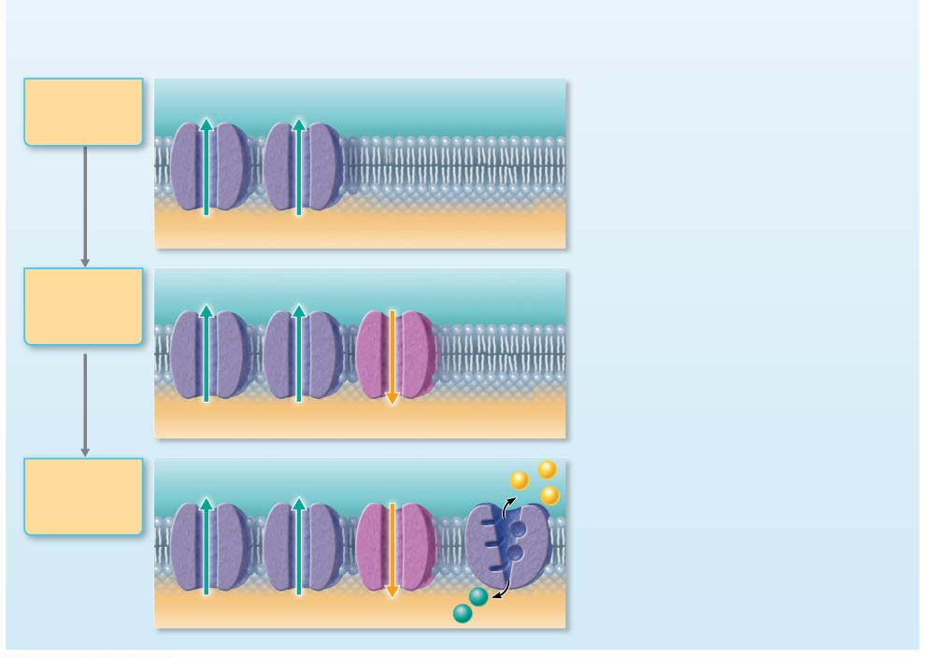
Focus Figure 11.1 Generating a resting membrane potential depends on (1) differences in K⁺ and Na⁺ concentrations inside and outside cells, and (2) differences in permeability of the plasma membrane to these ions.
The permeabilities of Na⁺ and K⁺ across the
membrane are different. In the next three panels, we will
build the resting membrane potential step by step.
Suppose a
cell has only
K⁺ channels...
K⁺ leakage channels
K⁺ loss through abundant leakage channels
establishes a negative membrane potential.
K⁺
K⁺
• The membrane is highly permeable to K⁺, so K⁺
flows down its concentration gradient.
• As positive K⁺ leaks out, a negative voltage
(electrical gradient) develops on the membrane
interior. This electrical gradient pulls K⁺ back in.
• At −90 mV, the concentration and electrical
gradients for K⁺ are balanced.
K⁺
K⁺
Cell interior
−90 mV
Now, let’s add
some Na⁺
channels to
our cell...
K⁺
K⁺
Na⁺
Na⁺ entry through a few leakage channels
reduces the negative membrane potential
slightly.
• Adding Na⁺ channels creates a small Na⁺
permeability that brings the membrane potential
to −70 mV.
K⁺
K⁺
Na⁺
Cell interior
−70 mV
Finally, let’s
add a pump to
compensate for
leaking ions.
K⁺
K⁺
Na⁺
Na⁺-K⁺ pump
Na⁺
Na⁺
Na⁺-K⁺ pumps maintain the concentration
gradients, resulting in the resting membrane
potential.
Na⁺
• A cell at rest is like a leaky boat: K⁺ leaks out
and Na⁺ leaks in through open channels.
• The “bailing pump” for this boat is the
Na⁺-K⁺ pump, which transports Na⁺ out
and K⁺ in.
K⁺
K⁺
Na⁺
K⁺
K⁺
Cell interior
−70 mV

Slide 20
Changing the Resting Membrane Potential
Membrane potential changes when:
Concentrations of ions across membrane change
Membrane permeability to ions changes
Changes produce two types of signals
Graded potentials
Incoming signals operating over short distances
Action potentials
Long-distance signals of axons
Changes in membrane potential are used as signals to receive, integrate, and send information

Slide 21
Changing the Resting Membrane Potential (cont.)
Terms describing membrane potential changes relative to resting membrane potential
Depolarization: decrease in membrane potential (moves toward zero and above)
Inside of membrane becomes less negative than resting membrane potential
Probability of producing impulse increases
Hyperpolarization: increase in membrane potential (away from zero)
Inside of membrane becomes more negative than resting membrane potential
Probability of producing impulse decreases

Slide 22
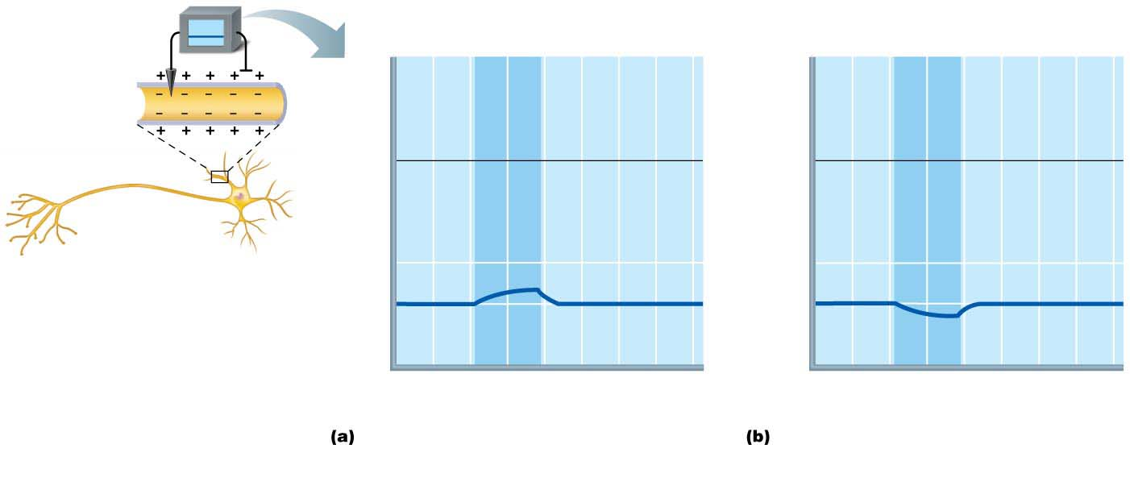
Figure 11.9 Depolarization and hyperpolarization of the membrane.
Depolarizing stimulus
Hyperpolarizing stimulus
+50
+50
Inside
positive
0
0
Inside
negative
Membrane potential (voltage, mV)
Membrane potential (voltage, mV)
−50
Depolarization
Resting
potential
−50
−70
Resting
potential
−70
Hyper-
polarization
−100
4
6
7
−100
0
1
2
3
5
0
1
2
3
4
5
6
7
Time (ms)
Time (ms)
Depolarization: The membrane
potential moves toward 0 mV, the inside
becoming less negative (more positive).
Hyperpolarization: The membrane
potential increases, the inside becoming
more negative.

Slide 23
11.5 Graded Potentials
Short-lived, localized changes in membrane potential
The stronger the stimulus, the more voltage changes and the farther current flows
Triggered by stimulus that opens gated ion channels
Results in depolarization or sometimes hyperpolarization
Named according to location and function
Receptor potential (generator potential): graded potentials in receptors of sensory neurons
Postsynaptic potential: neuron graded potential

Slide 24
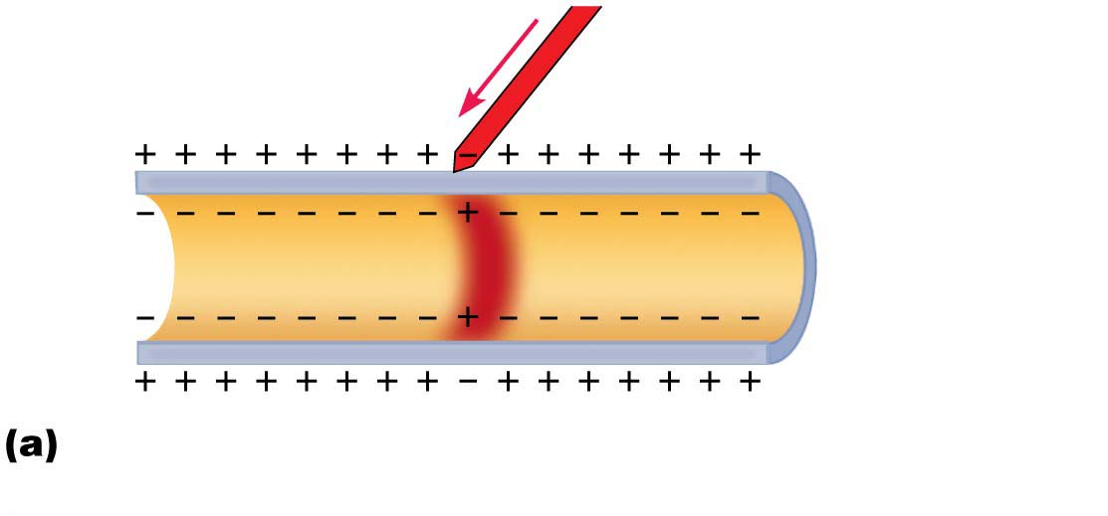
Figure 11.10a The spread and decay of a graded potential.
Depolarized
region
Stimulus
Plasma
membrane
Depolarization: A small patch of the
membrane (red area) depolarizes.

Slide 25
Graded Potentials (cont.)
Once gated ion channel opens, depolarization spreads from one area of membrane to next

Slide 26
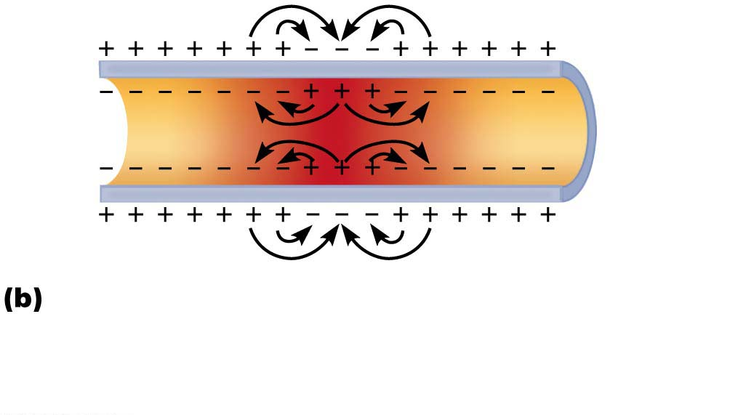
Figure 11.10b The spread and decay of a graded potential.
Depolarization spreads: Opposite charges attract
each other. This creates local currents (black arrows)
that depolarize adjacent membrane areas, spreading
the wave of depolarization.

Slide 27
Graded Potentials (cont.)
Current flows but dissipates quickly and decays
Graded potentials are signals only over short distances

Slide 28
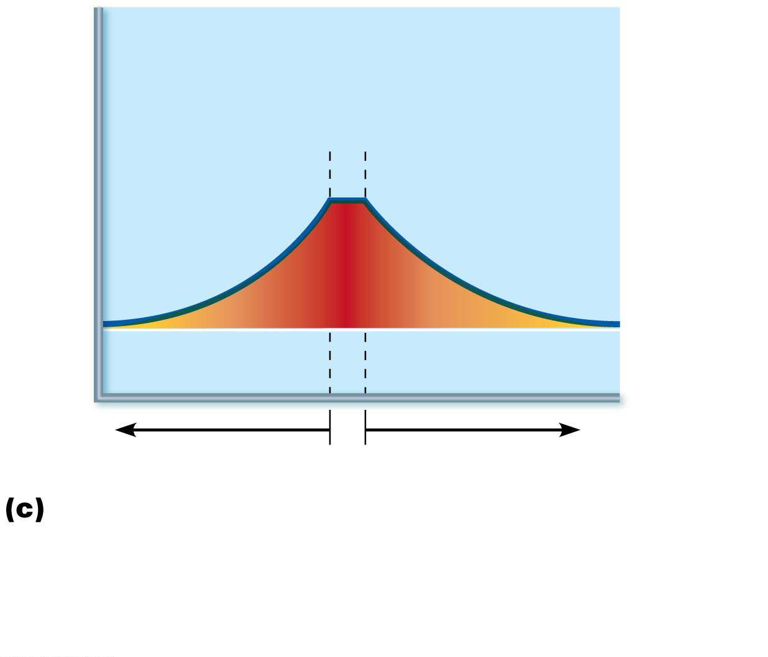
Figure 11.10c The spread and decay of a graded potential.
Active area
(site of initial
depolarization)
Membrane potential (mV)
+70
Resting potential
Distance (a few mm)
Membrane potential decays with distance:
Because current is lost through the “leaky” plasma
membrane, the voltage declines with distance from the
stimulus (the voltage is decremental). Consequently,
graded potentials are short-distance signals.

Slide 29
11.6 Action Potentials
Principal way neurons send signals
Means of long-distance neural communication
Occur only in muscle cells and axons of neurons
Brief reversal of membrane potential with a change in voltage of ~100 mV
Action potentials (APs) do not decay over distance as graded potentials do
In neurons, also referred to as a nerve impulse
Involves opening of specific voltage-gated channels

Slide 30
Generating an Action Potential
Four main steps
Resting state: All gated Na⁺ and K⁺ channels are closed
Only leakage channels for Na⁺ and K⁺ are open
Maintains the resting membrane potential
Each Na⁺ channel has two voltage-sensitive gates
Activation gates: closed at rest; open with depolarization, allowing Na⁺ to enter cell
Inactivation gates: open at rest; block channel once it is open to prevent more Na⁺ from entering cell

Slide 31
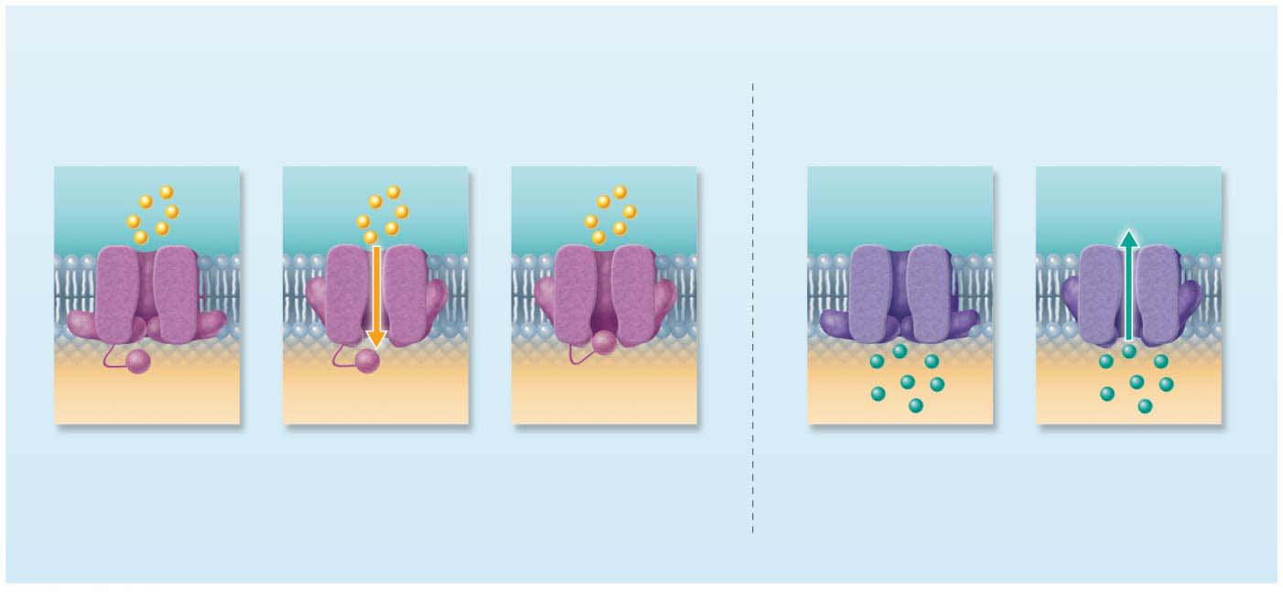
Focus Figure 11.2-2 The action potential (AP) is a brief change in membrane potential in a patch of membrane that is depolarized by local currents.
The key players
Voltage-gated Na⁺ channels have two gates and
alternate between three different states.
Voltage-gated K⁺ channels
have one gate and two states.
Outside
cell
Outside
cell
Na⁺
Na⁺
Na⁺
Inside
cell
Activation
gate
Inactivation
gate
Inside
cell
K⁺
K⁺
Closed at the
resting state, so no
Na⁺ enters the cell
through them
Opened by
depolarization,
allowing Na⁺ to
enter the cell
Inactivated—
channels
automatically blocked
by inactivation gates
soon after they open
Closed at the
resting state, so no
K⁺ exits the cell
through them
Opened by
depolarization, after a
delay, allowing K⁺ to
exit the cell

Slide 32
Generating an Action Potential (cont.)
Each K⁺ channel has one voltage-sensitive gate
Closed at rest
Opens slowly with depolarization

Slide 33
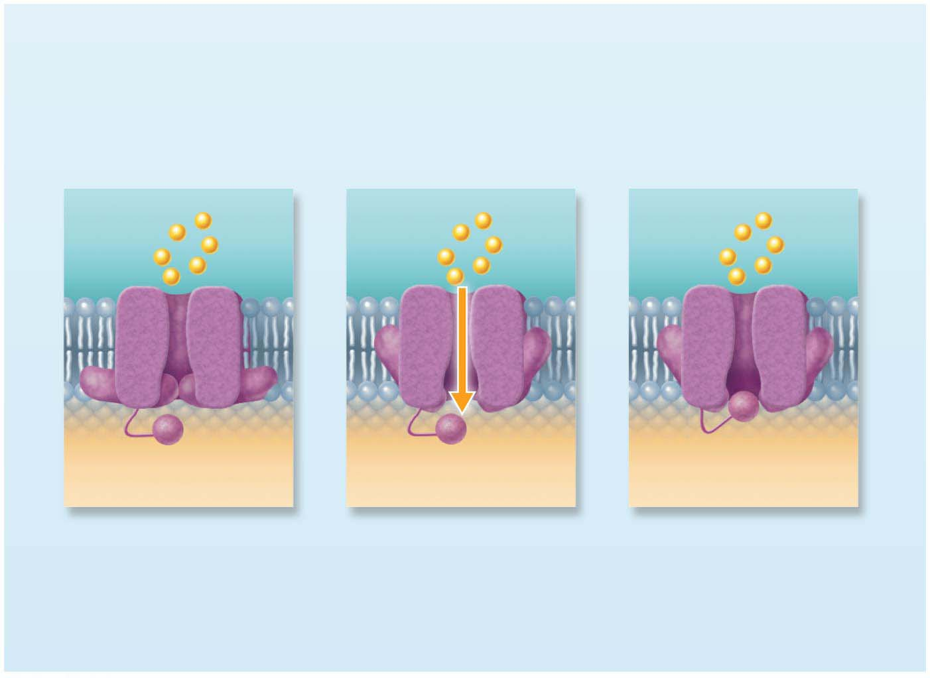
Focus Figure 11.2-2-1 The action potential (AP) is a brief change in membrane potential in a patch of membrane that is depolarized by local currents.
The key players
Voltage-gated Na⁺ channels have two gates and
alternate between three different states.
Outside
cell
Na⁺
Na⁺
Na⁺
Activation
gate
Inactivation
gate
Inside
cell
Closed at the
resting state, so no
Na⁺ enters the cell
through them
Opened by
depolarization,
allowing Na⁺ to
enter the cell
Inactivated—
channels
automatically blocked
by inactivation gates
soon after they open

Slide 34
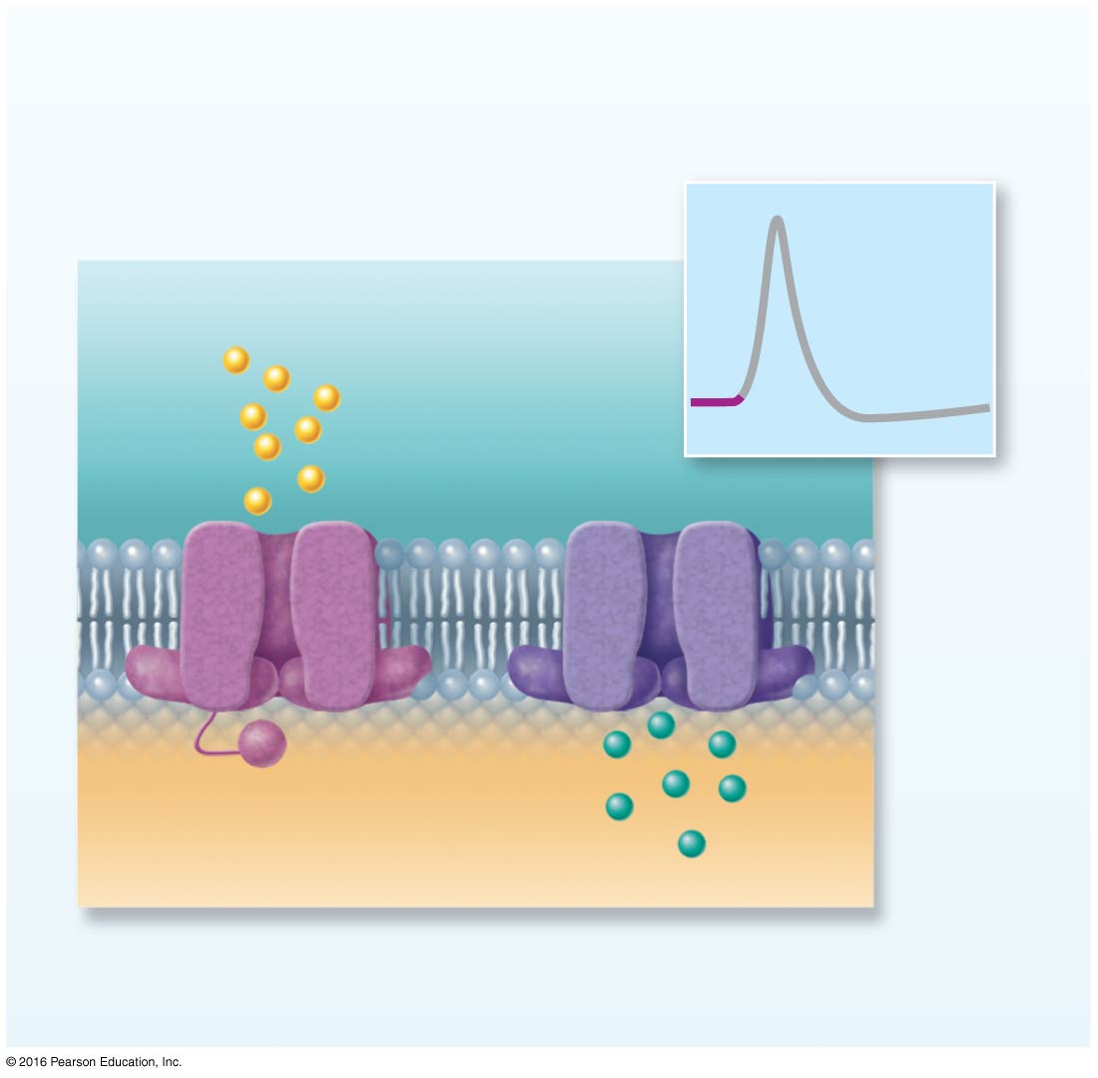
Focus Figure 11.2-3-1 The action potential (AP) is a brief change in membrane potential in a patch of membrane that is depolarized by local currents.
The events
Each step corresponds to
one part of the AP graph.
Na⁺
1
Sodium
channel
Potassium
channel
Activation
gates
Inactivation
gate
K⁺
1
Resting state: All gated Na⁺ and K⁺
channels are closed.

Slide 35
Generating an Action Potential (cont.)
Depolarization: Na⁺ channels open
Depolarizing local currents open voltage-gated Na⁺ channels, and Na⁺ rushes into cell
Na⁺ activation and inactivation gates open
Na⁺ influx causes more depolarization, which opens more Na⁺ channels
As a result, ICF becomes less negative
At threshold (–55 to –50 mV), positive feedback causes opening of all Na⁺ channels
Results in large action potential spike
Membrane polarity jumps to +30 mV

Slide 36
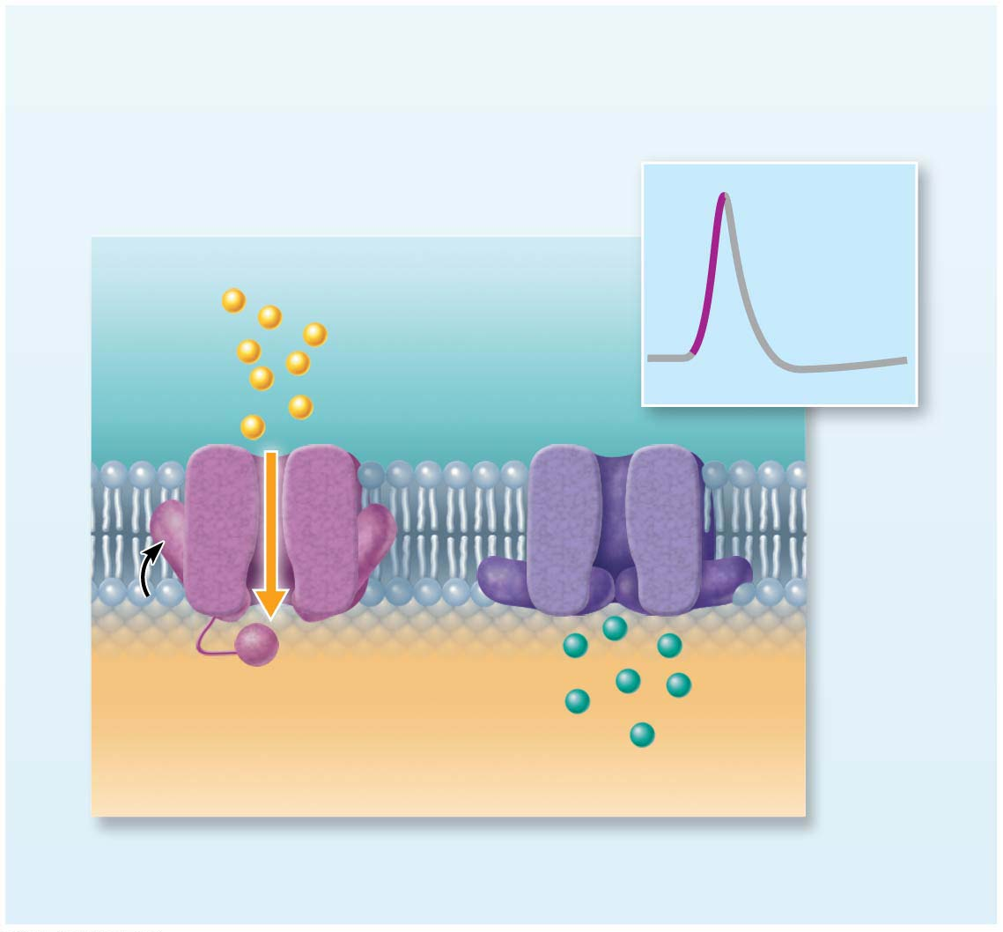
Focus Figure 11.2-3-2 The action potential (AP) is a brief change in membrane potential in a patch of membrane that is depolarized by local currents.
The events
Each step corresponds to
one part of the AP graph.
2
Na⁺
K⁺
2
Depolarization: Na⁺ channels open, allowing
Na⁺ entry.

Slide 37
Generating an Action Potential (cont.)
Repolarization: Na⁺ channels are inactivating, and K⁺ channels open
Na⁺ channel inactivation gates close
Membrane permeability to Na⁺ declines to resting state
AP spike stops rising
Voltage-gated K⁺ channels open
K⁺ exits cell down its electrochemical gradient
Repolarization: membrane returns to resting membrane potential

Slide 38
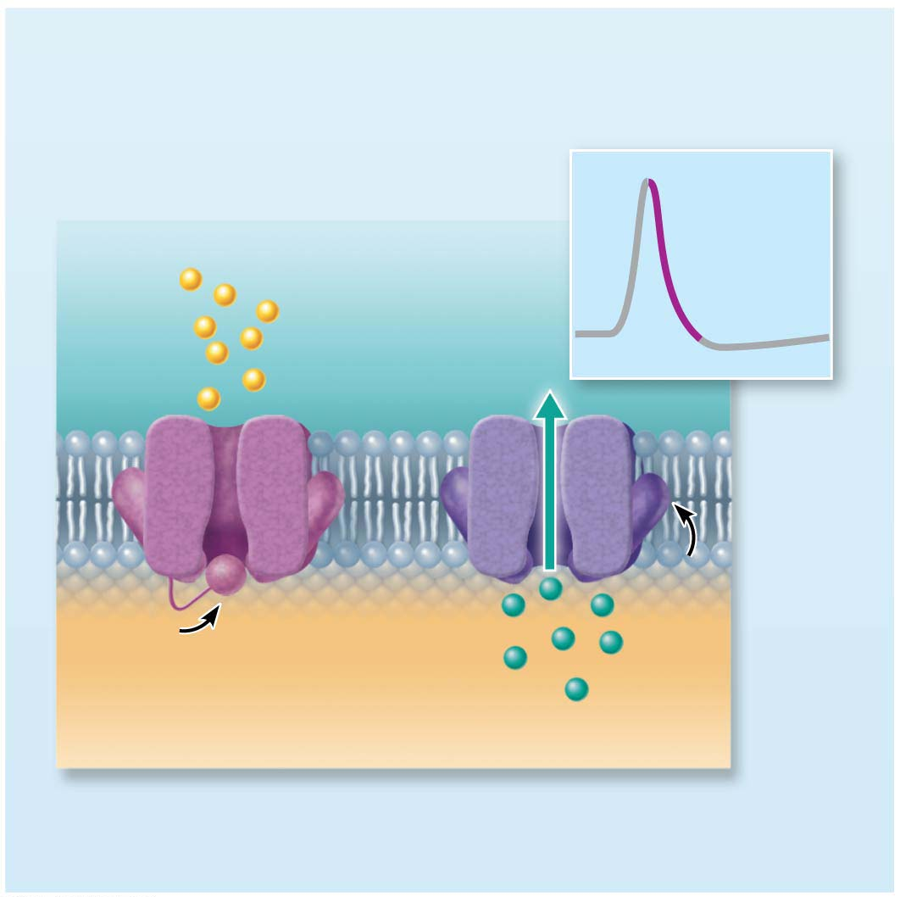
Focus Figure 11.2-3-3 The action potential (AP) is a brief change in membrane potential in a patch of membrane that is depolarized by local currents.
The events
Each step corresponds to
one part of the AP graph.
3
Na⁺
K⁺
3
Repolarization: Na⁺ channels are inactivating.
K⁺ channels open, allowing K⁺ to exit.

Slide 39
Generating an Action Potential (cont.)
Hyperpolarization: Some K⁺ channels remain open, and Na⁺ channels reset
Some K⁺ channels remain open, allowing excessive K⁺ efflux
Inside of membrane becomes more negative than in resting state
This causes hyperpolarization of the membrane (slight dip below resting voltage)
Na⁺ channels also begin to reset

Slide 40
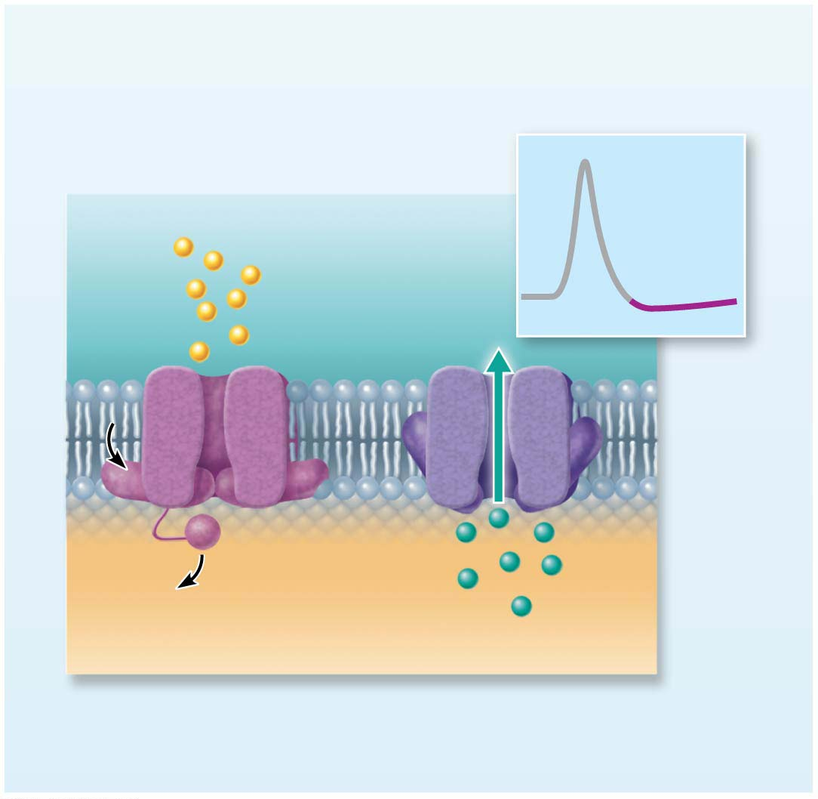
Focus Figure 11.2-3-4 The action potential (AP) is a brief change in membrane potential in a patch of membrane that is depolarized by local currents.
The events
Each step corresponds to
one part of the AP graph.
4
Na⁺
K⁺
4
Hyperpolarization: Some K⁺ channels
remain open, and Na⁺ channels reset.

Slide 41
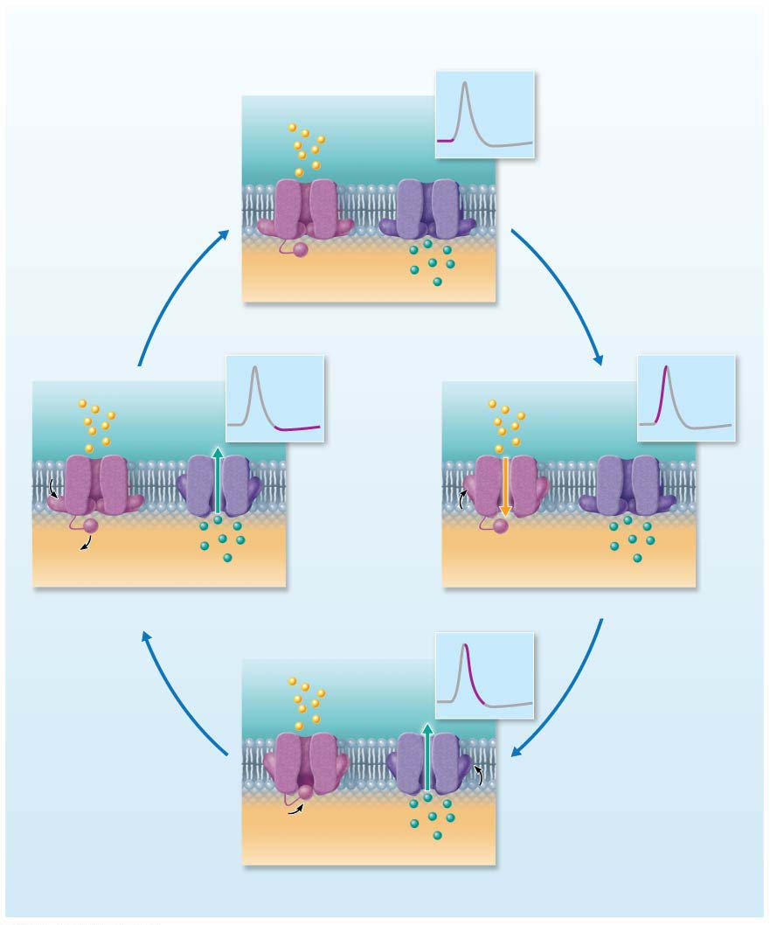
Focus Figure 11.2-3 The action potential (AP) is a brief change in membrane potential in a patch of membrane that is depolarized by local currents.
The events
Each step corresponds to
one part of the AP graph.
Sodium
channel
Na⁺
Potassium
channel
1
Inactivation
gate
Activation
gates
K⁺
1
Resting state: All gated Na⁺ and K⁺
channels are closed.
2
Na⁺
4
Na⁺
K⁺
K⁺
4
Hyperpolarization: Some K⁺ channels
2
Depolarization: Na⁺ channels open, allowing
remain open, and Na⁺ channels reset.
Na⁺ entry.
3
Na⁺
K⁺
3
Repolarization: Na⁺ channels are inactivating.
K⁺ channels open, allowing K⁺ to exit.

Slide 42
Generating an Action Potential (cont.)
Repolarization resets electrical conditions, not ionic conditions
After repolarization, Na⁺/K⁺ pumps (thousands of them in an axon) restore ionic conditions

Slide 43
Focus Figure 11.1-1 Generating a resting membrane potential depends on (1) differences in K⁺ and Na⁺ concentrations inside and outside cells, and (2) differences in permeability of the plasma membrane to these ions.
The concentrations of Na⁺ and K⁺ on each side
of the membrane are different.
The Na⁺ concentration
is higher outside the
cell.
Outside cell
K⁺
(5 mM)
Na⁺
(140 mM)
Na⁺
Na⁺
Na⁺
The K⁺ concentration is
higher inside the cell.
K⁺
(140 mM)
K⁺
K⁺
Na⁺
(15 mM)
Na⁺-K⁺ pumps maintain
the concentration
gradients of Na⁺ and K⁺
across the membrane.
Inside cell

Slide 44
Threshold and the All-or-None Phenomenon
Not all depolarization events produce APs
For an axon to “fire,” depolarization must reach threshold voltage to trigger AP
At threshold:
Membrane is depolarized by 15 to 20 mV
Na⁺ permeability increases
Na⁺ influx exceeds K⁺ efflux
The positive feedback cycle begins
All-or-None: An AP either happens completely, or does not happen at all

Slide 45
Propagation of an Action Potential
Propagation allows AP to be transmitted from origin down entire axon length toward terminals
Na⁺ influx through voltage gates in one membrane area cause local currents that cause opening of Na⁺ voltage gates in adjacent membrane areas
Leads to depolarization of that area, which in turn causes depolarization in next area

Slide 46
Propagation of an Action Potential (cont.)
Once initiated, an AP is self-propagating
In nonmyelinated axons, each successive segment of membrane depolarizes, then repolarizes
Propagation in myelinated axons differs
Since Na⁺ channels closer to the AP origin are still inactivated, no new AP is generated there
AP occurs only in a forward direction

Slide 47
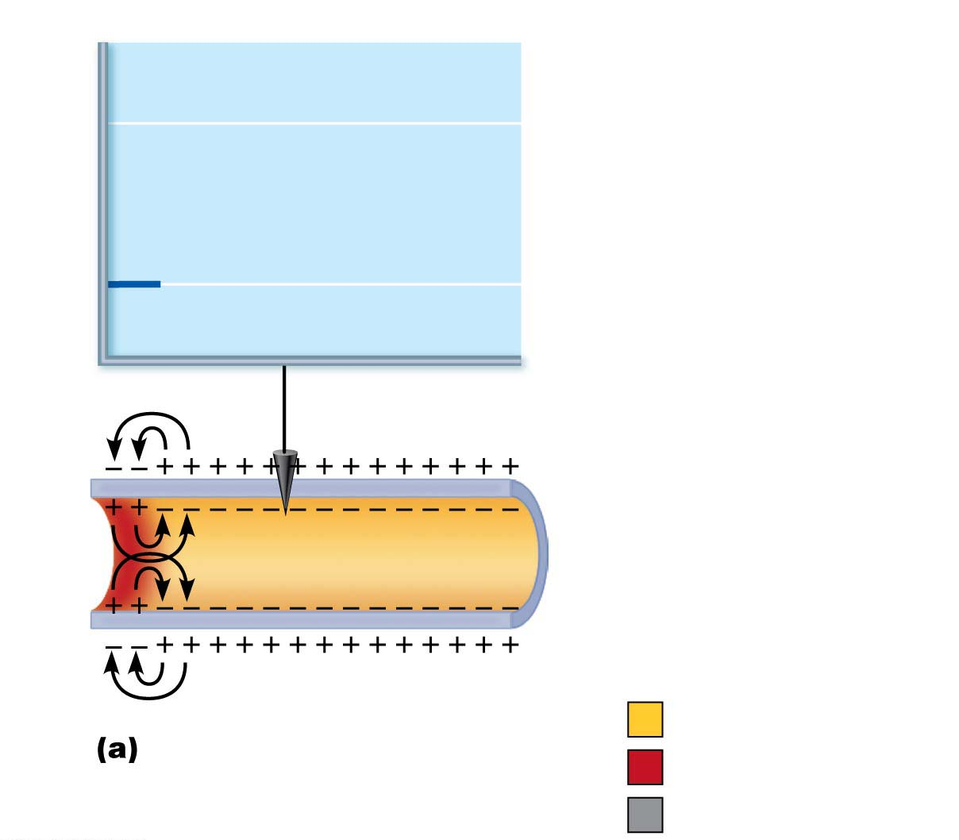
Figure 11.11a Propagation of an action potential (AP).
+30
Voltage
at 0 ms
Membrane potential (mV)
−70
Recording
electrode
Resting potential
Time = 0 ms. Action
potential has not yet reached
the recording electrode.
Peak of action potential
Hyperpolarization

Slide 48
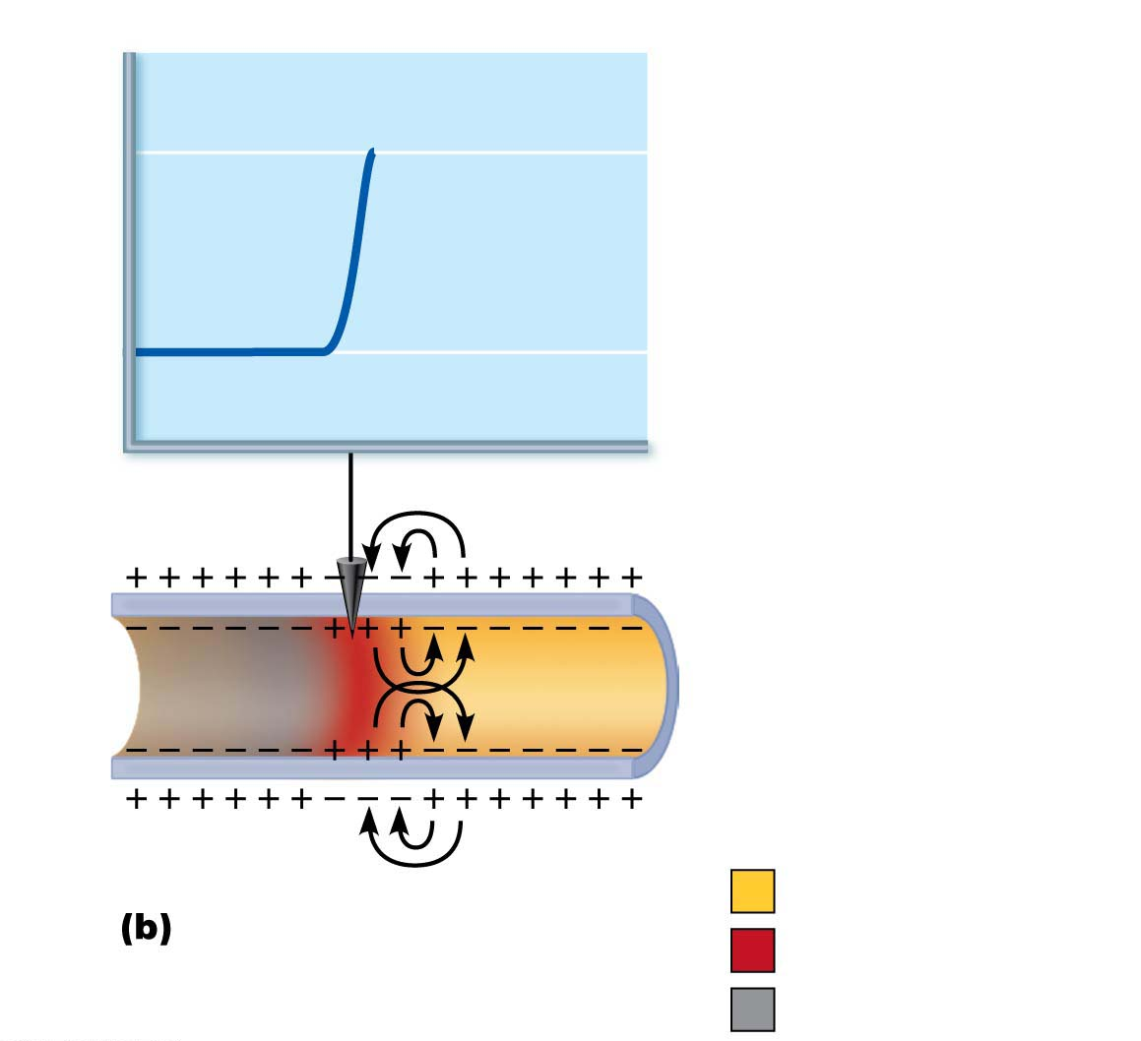
Figure 11.11b Propagation of an action potential (AP).
Voltage
at 2 ms
+30
Membrane potential (mV)
−70
Resting potential
Time = 2 ms. Action
potential peak reaches the
recording electrode.
Peak of action potential
Hyperpolarization

Slide 49
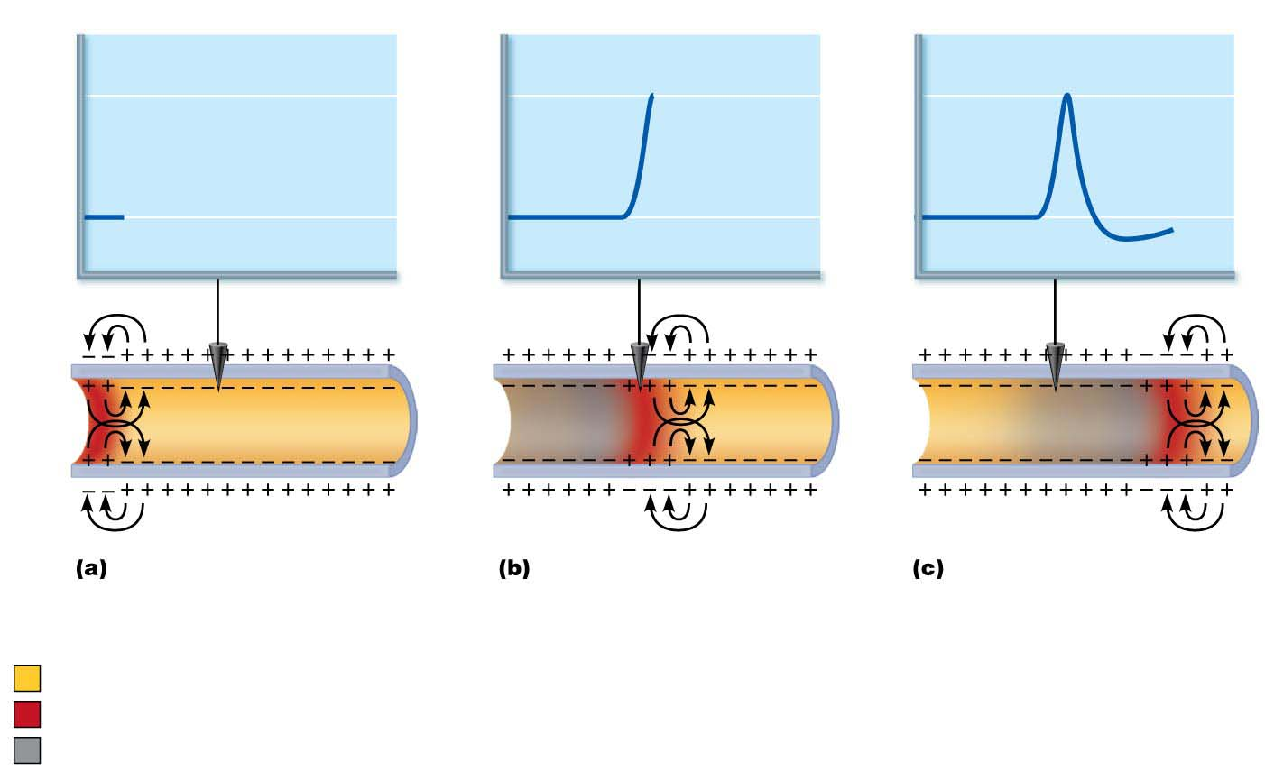
Figure 11.11 Propagation of an action potential (AP).
Voltage
at 2 ms
+30
Voltage
at 0 ms
Membrane potential (mV)
Voltage
at 4 ms
−70
Recording
electrode
Time = 0 ms. Action
potential has not yet reached
the recording electrode.
Time = 2 ms. Action
potential peak reaches the
recording electrode.
Time = 4 ms. Action
potential peak has
passed the recording
electrode. Membrane at
the recording electrode
is still hyperpolarized.
Resting potential
Peak of action potential
Hyperpolarization

Slide 50
Coding for Stimulus Intensity
All action potentials are alike and are independent of stimulus intensity
CNS tells difference between a weak stimulus and a strong one by frequency of impulses
Frequency is number of impulses (APs) received per second
Higher frequencies mean stronger stimulus

Slide 51
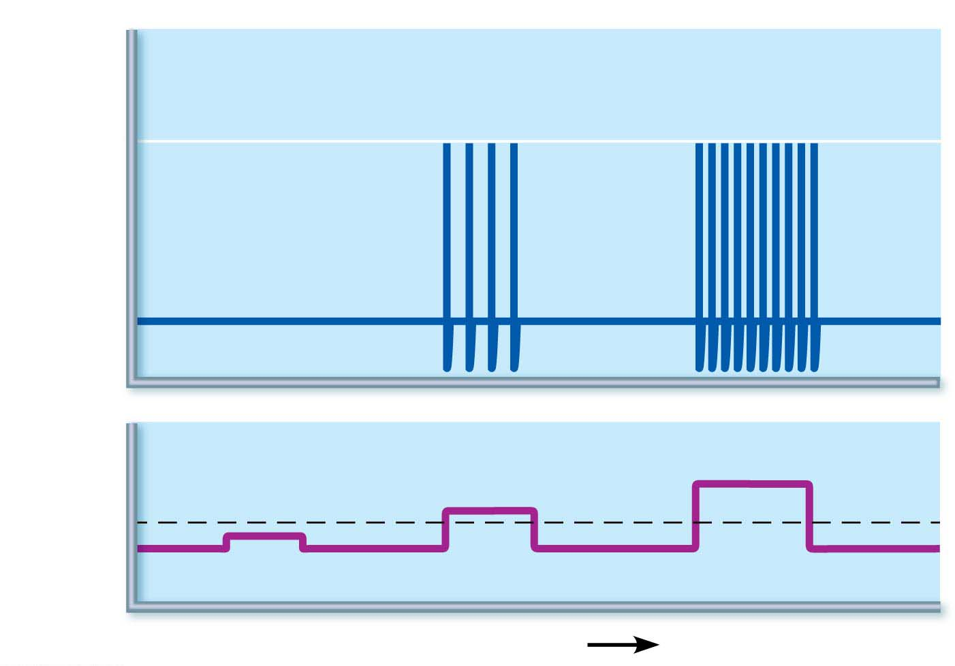
Figure 11.12 Relationship between stimulus strength and action potential frequency.
Action
potentials
+30
Membrane potential (mV)
−70
Stimulus
Threshold
Stimulus
voltage
0
Time (ms)

Slide 52
Refractory Periods
Refractory period: time in which neuron cannot trigger another AP
Voltage-gated Na⁺ channels are open, so neuron cannot respond to another stimulus
Two types
Absolute refractory period
Time from opening of Na⁺ channels until resetting of the channels
Ensures that each AP is an all-or-none event
Enforces one-way transmission of nerve impulses

Slide 53
Refractory Periods (cont.)
Relative refractory period
Follows absolute refractory period
Most Na⁺ channels have returned to their resting state
Some K⁺ channels still open
Repolarization is occurring
Threshold for AP generation is elevated
Only exceptionally strong stimulus could stimulate an AP

Slide 54
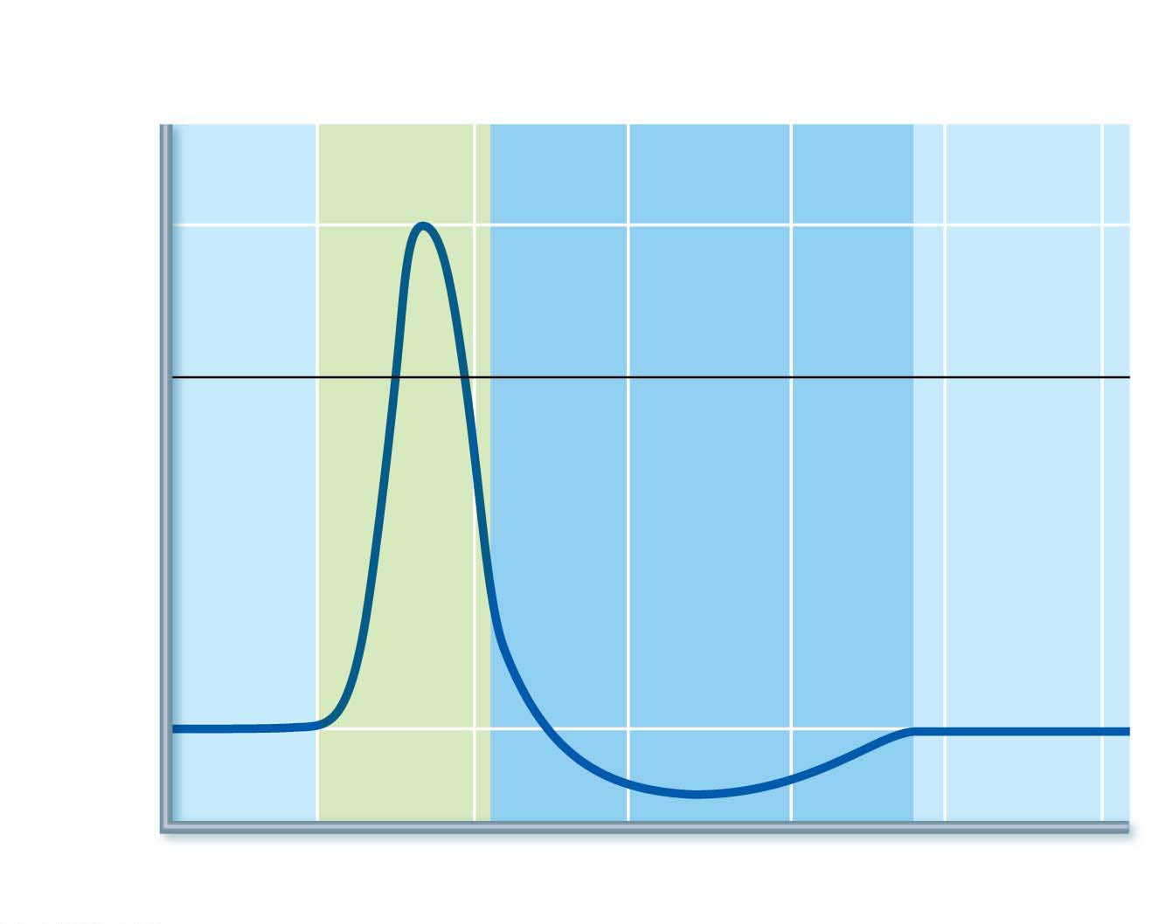
Figure 11.13 Absolute and relative refractory periods in an AP.
Absolute refractory
period
Relative refractory
period
Depolarization
(Na⁺ enters)
+30
0
Membrane potential (mV)
Repolarization
(K⁺ leaves)
Hyperpolarization
−70
Stimulus
0
1
2
3
4
5
Time (ms)

Slide 55
Conduction Velocity
APs occur only in axons, not other cell areas
AP conduction velocities in axons vary widely
Rate of AP propagation depends on two factors:
Axon diameter
Larger-diameter fibers have less resistance to local current flow, so have faster impulse conduction
Degree of myelination
Two types of conduction depending on presence or absence of myelin
Continuous conduction
Saltatory conduction

Slide 56
Conduction Velocity (cont.)
Continuous conduction: slow conduction that occurs in nonmyelinated axons
Saltatory conduction: occurs only in myelinated axons and is about 30 times faster
Myelin sheaths insulate and prevent leakage of charge
Voltage-gated Na⁺ channels are located at myelin sheath gaps
APs generated only at gaps
Electrical signal appears to jump rapidly from gap to gap

Slide 57
Figure 11.14a Action potential propagation in nonmyelinated and myelinated axons.
Stimulus
Size of voltage
In bare plasma membranes, voltage decays.
Without voltage-gated channels, as on a dendrite,
voltage decays because current leaks across the
membrane.

Slide 58
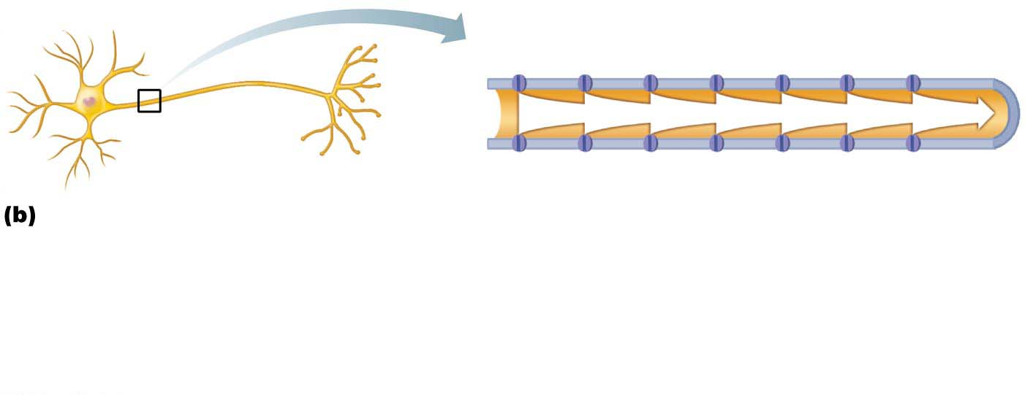
Figure 11.14b Action potential propagation in nonmyelinated and myelinated axons.
Stimulus
Voltage-gated
ion channel
In nonmyelinated axons, conduction is slow
(continuous conduction). Voltage-gated Na⁺ and K ⁺
channels regenerate the action potential at each point
along the axon, so voltage does not decay. Conduction
is slow because it takes time for ions and for gates of
channel proteins to move, and this must occur before
voltage can be regenerated.

Slide 59
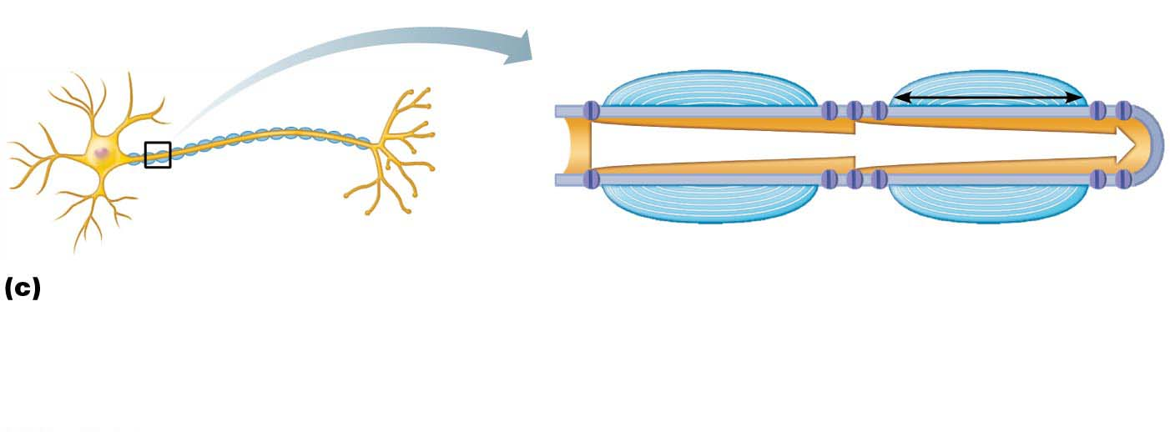
Figure 11.14c Action potential propagation in nonmyelinated and myelinated axons.
Stimulus
Myelin
sheath
Myelin
sheath gap
Myelin
sheath
1 mm
In myelinated axons, conduction is fast
(saltatory conduction). Myelin keeps current in
axons (voltage doesn’t decay much). APs are
generated only in the myelin sheath gaps and
appear to jump rapidly from gap to gap.

Slide 60
Clinical – Homeostatic Imbalance 11.2
Multiple sclerosis (MS) is an autoimmune disease that affects primarily young adults
Myelin sheaths in CNS are destroyed when immune system attacks myelin
Turns myelin into hardened lesions called scleroses
Impulse conduction slows and eventually ceases
Demyelinated axons increase Na⁺ channels, causing cycles of relapse and remission

Slide 61
Clinical – Homeostatic Imbalance 11.2
Symptoms: visual disturbances, weakness, loss of muscular control, speech disturbances, incontinence
Treatment: drugs that modify immune system activity
May not be able to prevent, but maintaining high blood levels of vitamin D may reduce risk of development

Slide 62
Conduction Velocity (cont.)
Nerve fibers are classified according to diameter, degree of myelination, and speed of conduction
Fall into three groups:
Group A fibers
Largest diameter
Myelinated somatic sensory and motor fibers of skin, skeletal muscles, and joints
Transmit at 150 m/s (~300 mph)

Slide 63
Conduction Velocity (cont.)
Group B fibers
Intermediate diameter
Lightly myelinated fibers
Transmit at 15 m/s (~30 mph)
Group C fibers
Smallest diameter
Unmyelinated
Transmit at 1 m/s (~2 mph)
B and C groups include ANS visceral motor and sensory fibers that serve visceral organs

Slide 64
Clinical – Homeostatic Imbalance 11.3
Impaired AP impulse propagation can be caused by a number of chemical and physical factors.
Local anesthetics act by blocking voltage-gated Na⁺ channels.
Cold temperatures or continuous pressure interrupt blood circulation and delivery of oxygen to neurons
Cold fingers get numb, or foot “goes to sleep”

