Slide 1
Chapter 05 Lecture Outline Dr. S. Montgomery
See separate PowerPoint slides for all figures and tables pre-inserted into PowerPoint without notes.
©2019 McGraw-Hill Education. All rights reserved. Authorized only for instructor use in the classroom. No reproduction or further distribution permitted without the prior written consent of McGraw-Hill Education.

Slide 2
Cells are Organized into Tissues
In complex organisms, cells are organized into tissues
Tissues: Groups of similar cells with a common function
The study of tissues is called histology.
There are 4 major types of tissues in the body:
Epithelial tissue
Connective tissue
Muscle tissue
Nervous tissue

Slide 3
Table 5.2 - 4 Major Tissue Types
Type | Function | Location | Distinguishing Characteristics
Epithelial | Protection, secretion, absorption, excretion | Cover body surface, cover and line internal organs, compose glands | Lack blood vessels, cells readily divide, cells are tightly packed
Connective | Bind, support, protect, fill spaces, store fat, produce blood cells | Widely distributed throughout the body | Mostly have good blood supply, cells are farther apart than epithelial cells, with extracellular matrix in between
Muscle | Movement | Attached to bones, in the walls of hollow internal organs, heart | Able to contract in response to specific stimuli
Nervous | Conduct impulses for coordination, regulation, integration, and sensory reception | Brain, spinal cord, nerves | Cells communicate with each other and other body parts

Slide 4
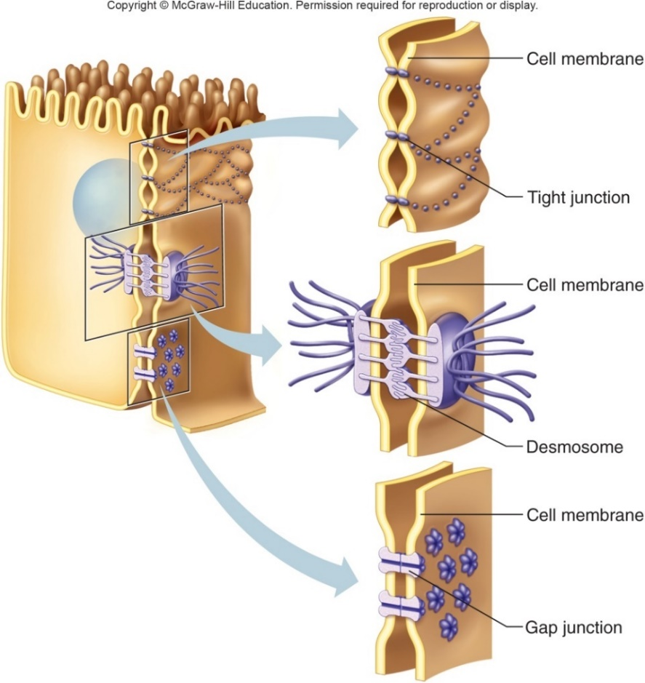
Figure 5.1 Intercellular Junctions
Tight junctions:
Membranes of adjacent cells merge and fuse.
Located among cells that form linings, sheet-like layers.
Blood-brain barrier.
Desmosomes:
Form “spot welds” between cells.
Structural reinforcement.
Located among outer skin cells.
Gap junctions:
Tubular channels between cells.
Molecules can move between cells.
Located in cardiac muscle cells.

Slide 5
Table 5.1 Types of Intercellular Junctions
Type | Characteristics | Example
Tight junctions | Close space between cells by fusing cell membranes | Cells that line the small intestine
Desmosomes | Bind cells by forming “spot welds” between cell membranes | Cells of the outer skin layer
Gap junction | Form tubular channels between cells that allow exchange of substances | Muscle cells of the heart and digestive tract

Slide 6
Epithelial Tissue
Named according to shape and number of cell layers thick

Slide 8
Epithelial Tissue
General Characteristics:
Covers organs and body surface.
Lines cavities and hollow organs.
Makes up glands.
Have a free surface on outside, and basement membrane on inside.
This tissue lacks blood vessels (avascular) and nutrients diffuse to epithelial tissue from underlying connective tissue.
Cells readily divide; injuries heal rapidly.
Cells are tightly packed.
Classified according to cell shape and number of cell layers.
Shapes: squamous (flat), cuboidal (cube-shaped), columnar (tall).
Layers: simple (one layer of cells), stratified (2 or more layer of cells), or pseudostratified (appears layered, but is not).

Slide 9
Simple Epithelium
Simple= “1 cell layer thick”

Slide 10
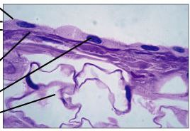
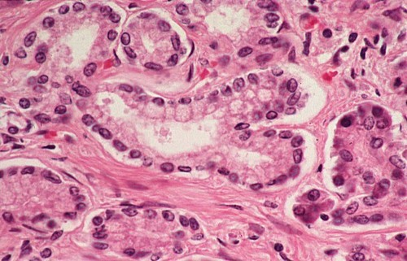
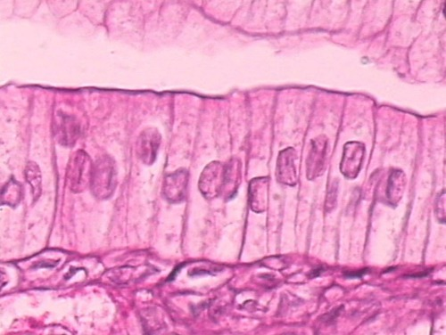

Slide 11
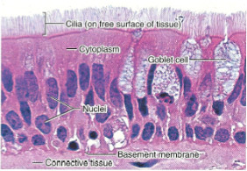

Slide 12
Stratified Epithelium
Stratified= more than “1 cell layer thick”

Slide 13
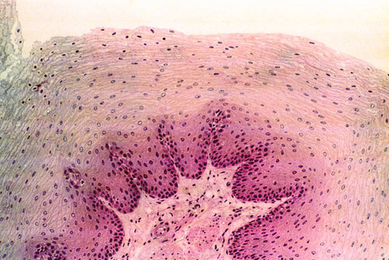
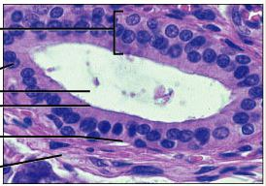

Slide 14
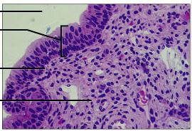
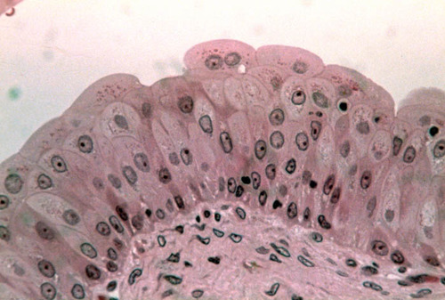

Slide 15
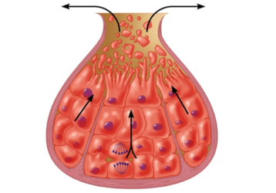
Glandular Epithelium
Glandular Epithelium: Composed of cells that produce and secrete substances into ducts or body fluids
There are 2 types of glands:
Endocrine glands secrete into tissue fluid or blood.
Exocrine glands secrete into ducts that open onto surface.
2 structural types of exocrine glands:
Unicellular: Composed of one cell, such as a goblet cell (secretes mucus).
Multicellular:
Composed of many cells.
Sweat glands, salivary glands, etc.
Simple or compound.

Slide 16
Table 5.5 Epithelial Tissues
Type | Description | Function | Location
Simple squamous epithelium | Single layer, flattened cells | Filtration, diffusion, osmosis, covers surface | Air sacs of lungs, walls of capillaries, linings of blood and lymph vessels, part of the membranes lining body cavities and covering viscera
Simple cuboidal epithelium | Single layer, cube-shaped cells | Protection, secretion, absorption | Surface of ovaries, linings of kidney tubules, and linings of ducts of certain glands
Simple columnar epithelium | Single layer, elongated cells | Protection, secretion, absorption | Linings of uterus, stomach, and intestines
Pseudostratified columnar epithelium | Single layer, elongated cells | Protection, secretion, movement of mucus and substances | Linings of respiratory passages
Stratified squamous epithelium | Many layers, top cells flattened | Protection | Superficial layer of skin and linings of oral cavity, vagina, and anal canal
Stratified cuboidal epithelium | 2 or 3 layers, cube-shaped cells | Protection | Linings of ducts of mammary glands, sweat glands, salivary glands, and pancreas
Stratified columnar epithelium | Top layer of elongated cells, lower layers of cube-shaped cells | Protection, secretion | Part of the male urethra and lining of larger ducts of excretory glands
Transitional epithelium | Many layers of cube-shaped and elongated cells | Stretchability, protection | Inner lining of urinary bladder and linings of ureters and part of urethra
Glandular epithelium | Unicellular or multicellular | Secretion | Salivary glands, sweat glands, endocrine glands

Slide 17
Connective Tissue
Most Diverse Group. Classified according to type of cells and fibers present

Slide 18
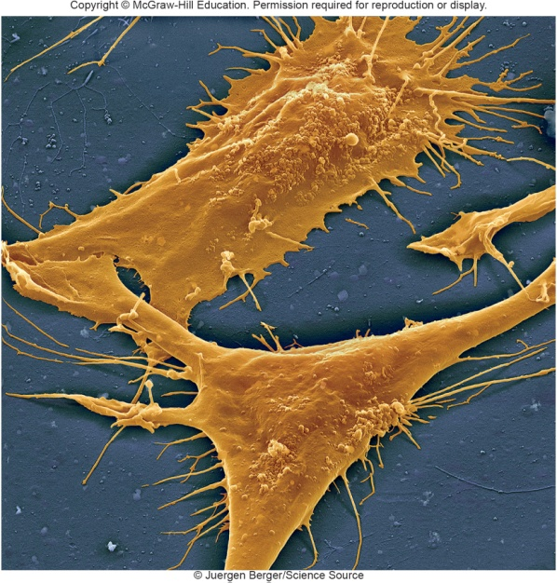
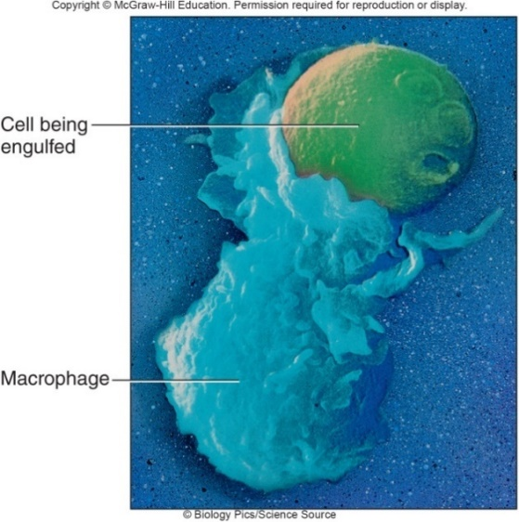
Major Cell Types of Connective Tissue
Fibroblasts:
Most common fixed cell.
Large star-shaped cell.
Secrete fibers into extracellular matrix.
Macrophages (Histiocytes):
Usually attached to fibers, but can detach and wander
Conduct phagocytosis.
Defend against infection.
Top: © Juergen Berger/Science Source, Bottom: © Biology Pics/Science Source

Slide 19
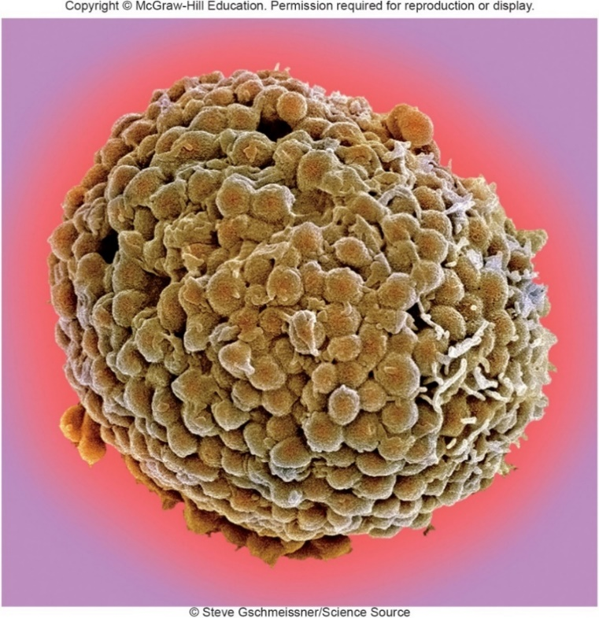
Major Cell Types of Connective Tissue
Mast Cells:
Large cells.
Release heparin to prevent blood clotting.
Release histamine, which.
causes inflammatory response.
© Steve Gschmeissner/Science Source

Slide 20
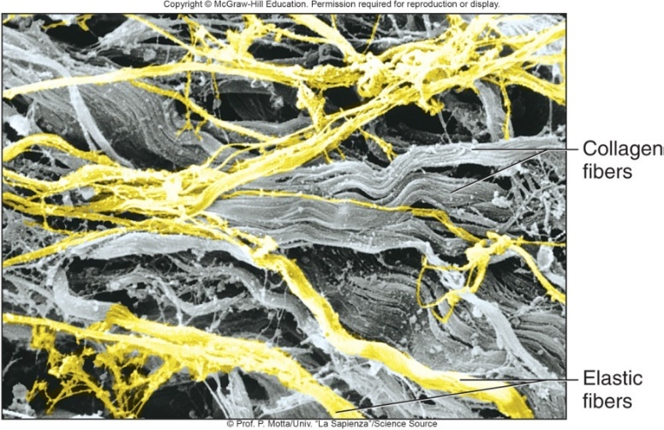
Connective Tissue Fibers
Fibroblasts produce 3 types of fibers in connective tissue:
1. Collagen Fibers:
Thick threads of collagen, the body’s main structural protein.
Great tensile strength and flexible, slightly elastic.
Found in ligaments and tendons.
2. Elastic (Yellow) Fibers:
Composed of elastin protein; branching.
Can stretch and return to original shape.
Not as strong as collagen fibers.
Found in vocal cords, respiratory air passages.
3. Reticular Fibers:
Thin, branching fibers of collagen.
Form delicate, supporting networks.
Found in spleen, liver.
© Prof. P. Motta/Univ. “La Sapienza”/Science Source

Slide 21
Table 5.6 Components of Connective Tissue
Component | Characteristics | Function
Cellular | Blank | Blank
Fibroblasts | Widely distributed, large, star-shaped cells | Secrete proteins that become fibers
Macrophages | Motile cells sometimes attached to fibers | Clear foreign particles from tissues by phagocytosis
Mast cells | Large cells, usually located near blood vessels | Release substances that may help prevent blood clotting (heparin) and promote inflammation (histamine)
Extracellular Matrix | Blank | Blank
Collagen fibers (white fibers) | Thick, threadlike fibers of collagen with great tensile strength | Hold structures together
Elastic fibers (yellow fibers) | Bundles of microfibrils embedded in elastin | Provide elastic quality to parts that stretch
Reticular fibers | Thin fibers of collagen | Form delicate supportive networks within tissues
Ground substance | Nonfibrous protein and other molecules, and varying amounts of fluid | Fills in spaces around cells and fibers

Slide 23
Connective Tissues
General characteristics:
Most abundant tissue type Cells are farther apart than epithelial cells; contain matrix between cells
Many functions:
Bind structures together.
Provide support and protection.
Serve as frameworks.
Fill spaces.
Store fat.
Produce blood cells.
Protect against infections.
Help repair tissue damage.
Extrcellular matrix consists of protein fibers and ground substance; consistency varies from fluid to semisolid to solid
Most have good blood supply, and are well-nourished, but vascularity varies among tissue types
Most cells can divide

Slide 24
Categories of Connective Tissue
Connective tissues can be classified in 2 major categories:
1. Connective Tissue Proper:
Loose connective tissues:
Areolar.
Adipose.
Reticular.
Dense connective tissues:
Dense Regular.
Dense Irregular.
Elastic.
2. Specialized connective tissues:
Cartilage
Bone
Blood

Slide 25
Loose Connective Tissue

Slide 26
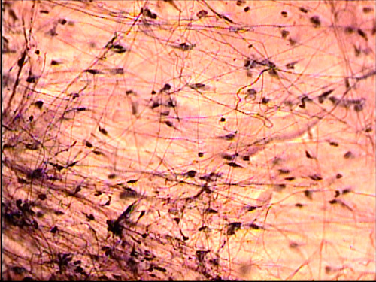
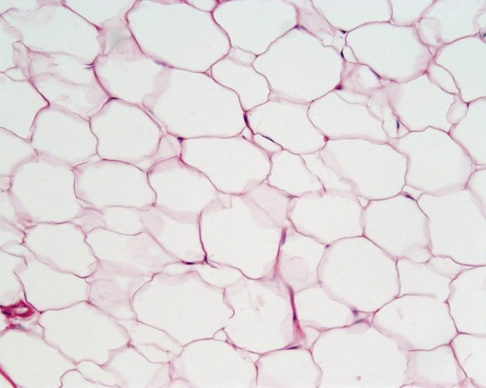
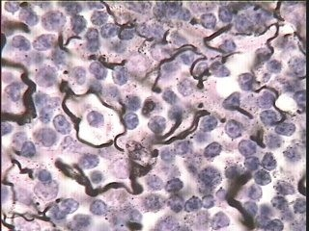

Slide 27
Dense Connective Tissue

Slide 28
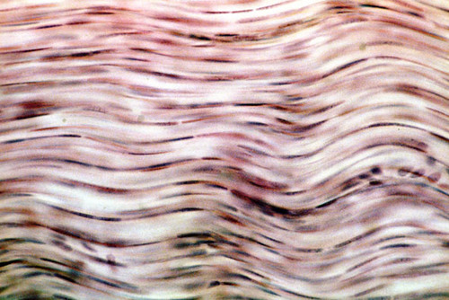
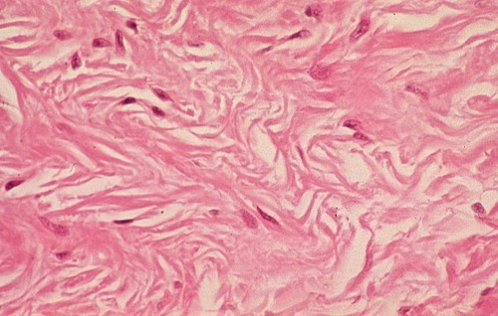
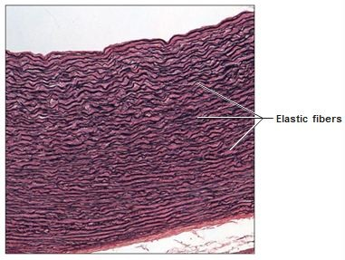

Slide 29
Specialized Connective Tissue
Cartilage, Blood, Bone

Slide 30
Connective Tissue Types 1
Cartilage:
A rigid, specialized connective tissue.
Support, framework, attachments.
Protection of underlying tissue.
Models for developing bone.
Matrix contains collagen in gel-like ground substance.
Chondrocytes (cartilage cells) in lacunae (chambers), surrounded by matrix.
Lacks blood supply; heals slowly.
Covered by perichondrium (connective tissue), which provides some nutrients to the cartilage.
3 types of cartilage: Hyaline, Elastic, and Fibrocartilage.

Slide 31
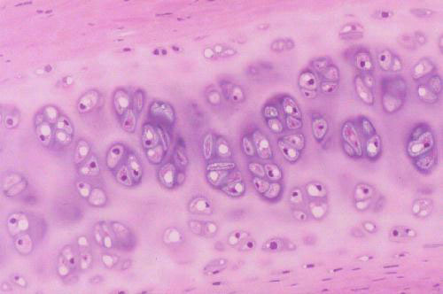
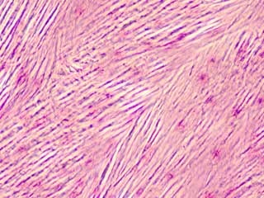
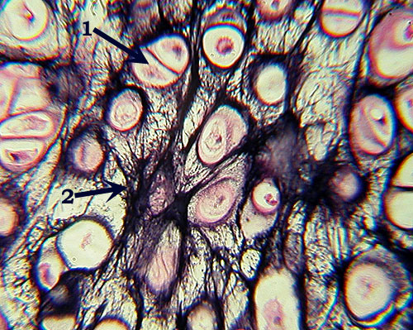

Slide 32
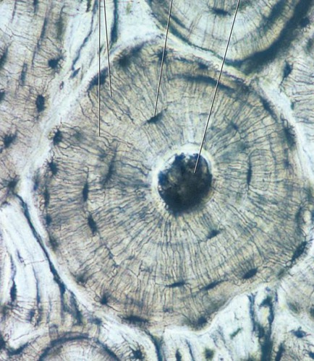
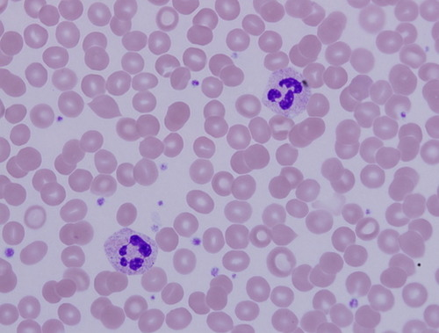

Slide 33
Connective Tissue Types 2
Bone (Osseous Tissue):
Most rigid connective tissue.
Solid matrix, composed of mineral (C a) salts & collagen.
Supports structures.
Protects vital structures.
Produces blood cells.
Stores & releases C a, P.
Attachment sites for muscles.
Forms skeleton.
Contain osteocytes (bone cells) in lacunae.
2 types: compact and spongy.
Blood:
Cells suspended in fluid matrix called plasma.
Red blood cells transport gases.
White blood cells defend again infection.
Platelets help in blood clotting.
Transports substances around body.

Slide 34
Table 5.7 Connective Tissues
Type | Description | Function | Location
Areolar connective tissue | Cells in fluid-gel matrix | Binds organs | Beneath the skin, between muscles, beneath epithelial tissues
Adipose tissue | Cells in fluid-gel matrix | Protects, insulates, stores fat | Beneath the skin, around the kidneys, behind the eyeballs, on the surface of the heart
Reticular connective tissue | Cells in fluid-gel matrix | Supports | Walls of liver and spleen
Dense regular connective tissue | Cells in fluid-gel matrix | Binds body parts | Tendons, ligaments
Dense irregular connective tissue | Cells in fluid-gel matrix | Sustains tissue tension | In the deep layer of skin
Elastic connective tissue | Cells in fluid-gel matrix | Provides elastic quality | Connecting parts of the spinal column, in walls of arteries and airways
Hyaline cartilage | Cells in solid-gel matrix | Supports, protects, provides framework | Ends of bones, nose, and rings in walls of respiratory passages
Elastic cartilage | Cells in solid-gel matrix | Supports, protects, provides flexible framework | Framework of external ear and part of larynx
Fibrocartilage | Cells in solid-gel matrix | Supports, protects, absorbs shock | Between bony parts of spinal column, parts of pelvic girdle, and knee
Bone | Cells in solid matrix | Supports, protects, provides framework | Bones of skeleton, middle ear
Blood | Cells and platelets in fluid matrix | Transports gases, defends against disease, clotting | Throughout the body in a closed system of blood vessels and heart chambers

Slide 35
Muscle Tissue

Slide 37
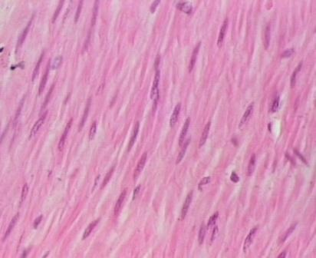
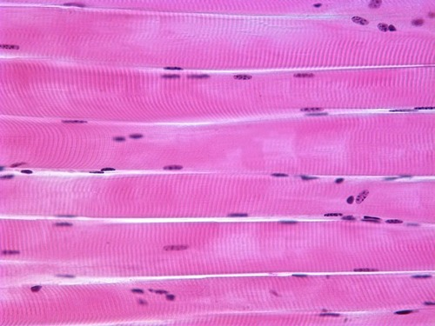
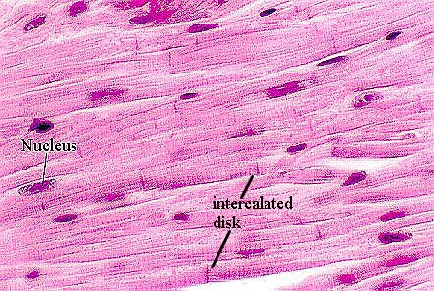

Slide 39
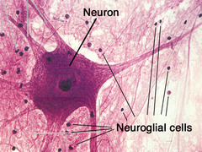

Slide 40
Table 5.8 Muscle and Nervous Tissues
Type | Description | Function | Location
Skeletal muscle tissue | Long, thread-like cells, striated, many nuclei | Voluntary movements of skeletal parts | Muscles usually attached to bones
Smooth muscle tissue | Shorter cells, single, central nucleus | Involuntary movements of internal organs | Walls of hollow internal organs
Cardiac muscle tissue | Branched cells, striated, single nucleus | Heart movements | Heart muscle
Nervous tissue | Cells with cytoplasmic extensions | Sensory reception, release of neurotransmitter, and conduction of electrical impulses | Brain, spinal cord, and peripheral nerves

