Slide 1
Ch 4 Muscular & Nervous Tissue Tissue Repair

Slide 2
4.4 Muscle Tissue
Highly vascularized
Responsible for most types of movement
Muscle cells possess myofilaments made up of actin and myosin proteins that bring about contraction
Three types of muscle tissues:
Skeletal muscle
Cardiac muscle
Smooth muscle

Slide 3
Skeletal Muscle
Cells have bands (striations)
nuclei lie outside cells
voluntary
loc-- attached to bones

Slide 4
Skeletal Muscle
Skeletal muscle tissue
Attached to and causes movement of bones
Also called voluntary muscle
Skeletal muscles can be consciously controlled
Cells are called muscle fibers
Contain multiple nuclei
Appear striated or banded

Slide 5
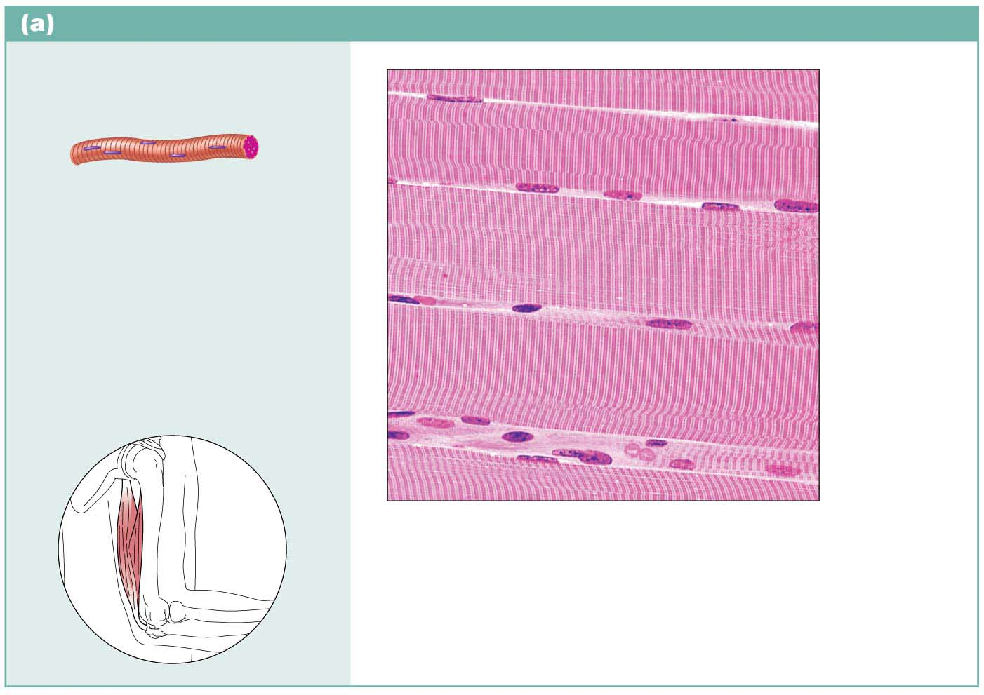
Figure 4.9a Muscle tissues.
Skeletal muscle
Description: Long, cylindrical,
multinucleate cells; obvious
striations.
Part of
muscle
fiber (cell)
Function: Voluntary movement;
locomotion; manipulation of the
environment; facial expression;
voluntary control.
Nuclei
Location: In skeletal muscles
attached to bones or
occasionally to skin.
Striations
Photomicrograph: Skeletal muscle (440⋅).
Notice the obvious banding pattern and the
fact that these large cells are multinucleate.

Slide 6
Cardiac Muscle
Cells greatly branched
contract without a stimulus
faint striations
involuntary
loc-- heart

Slide 7
Cardiac Muscle
Cardiac muscle tissue
Found only in walls of heart
Involuntary muscle
Like skeletal muscle, contains striations; but cells have only one nucleus
Cells can have many branches that join branches of other cardiac cells
Intercalated discs are special joints where cardiac cells are joined

Slide 8
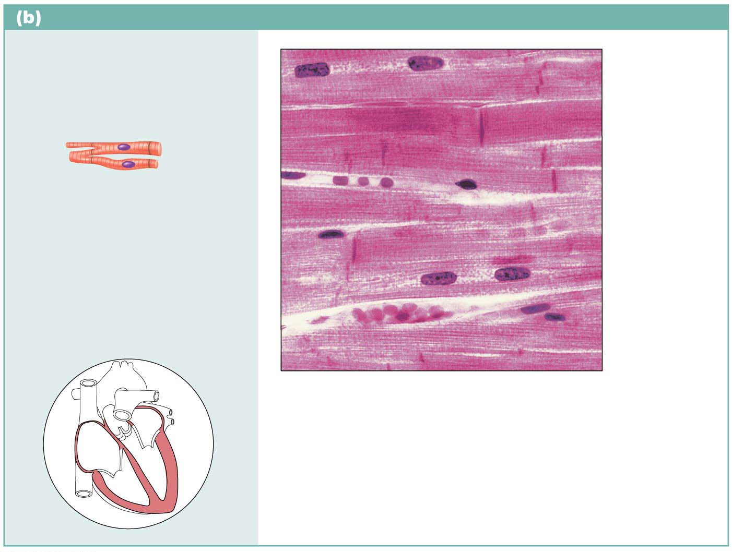
Cardiac muscle
Description: Branching,
striated, generally uninucleate
cells that interdigitate at
specialized junctions
(intercalated discs).
Intercalated
discs
Function: As it contracts,
it propels blood into the
circulation; involuntary control.
Striations
Nucleus
Location: The walls of the
heart.
Photomicrograph: Cardiac muscle (475⋅);
notice the striations, branching of cells, and
the intercalated discs.

Slide 9
Smooth Muscle
Cells long and tapered
single nucleus per cell
not striated
involuntary
loc-- inner wall of organs

Slide 10
Smooth Muscle
Smooth muscle tissue
Found mainly in walls of hollow organs (other than heart)
Involuntary muscle
Has no visible striations
Spindle-shaped cells with one nucleus

Slide 11
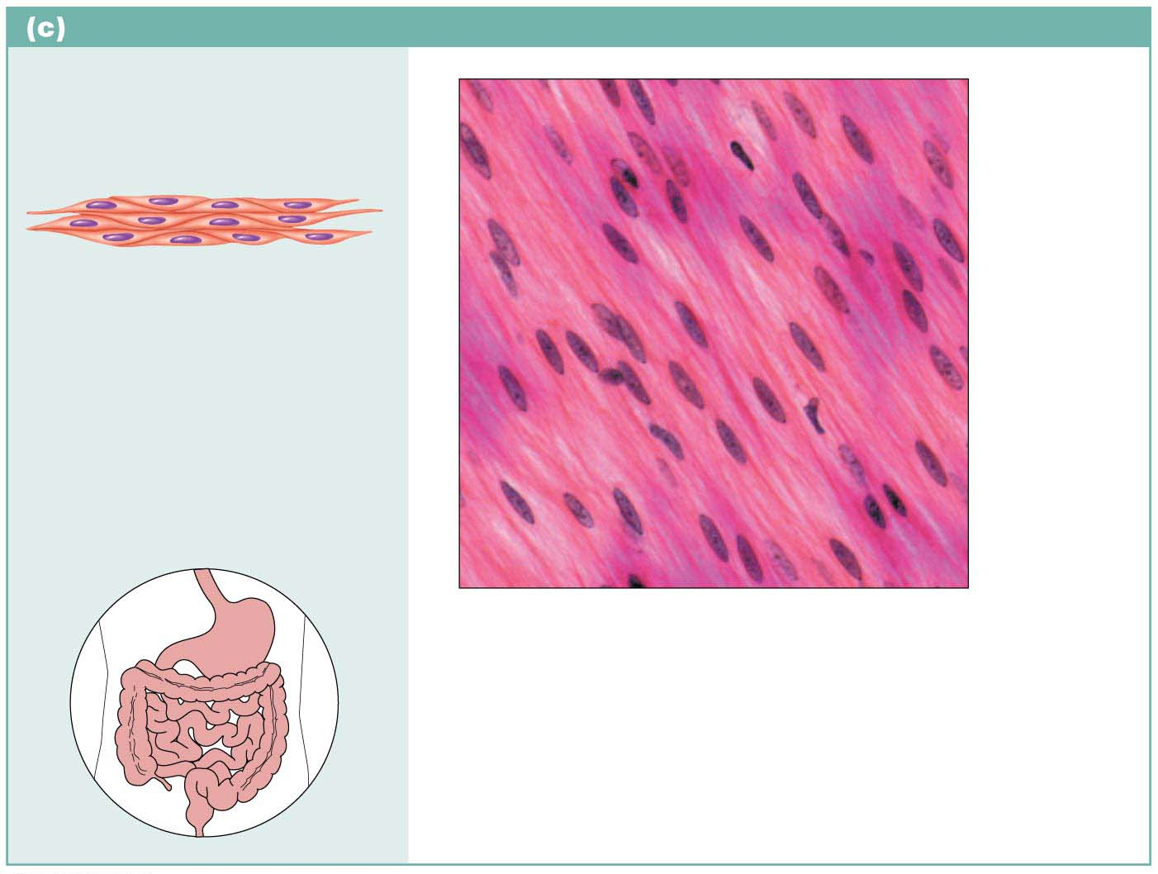
Smooth muscle
Description: Spindle-shaped
(elongated) cells with central
nuclei; no striations; cells
arranged closely to form sheets.
Nuclei
Function: Propels substances
or objects (foodstuffs, urine,
a baby) along internal
passageways; involuntary
control.
Location: Mostly in the walls
of hollow organs.
Smooth
muscle
cell
Photomicrograph: Sheet of smooth muscle
from the digestive tract (500⋅).

Slide 12
Nervous Tissue
Branching cells
long cytoplasmic extensions
2 kinds of cells:
1. Neuron- conducts impulse
2. Neuroglial- protects & supports neurons
loc--brain, spinal cord, nerves

Slide 13
4.5 Nervous Tissue
Main component of nervous system (brain, spinal cord, nerves)
Regulates and controls body functions
Made up of two specialized cells:
Neurons: specialized nerve cells that generate and conduct nerve impulses
Supporting cells that support, insulate, and protect neurons

Slide 14
The Neuron
Dendrite: short processes around cell body; receive impulses
Cell body: contains organelles
Axon: conducts impulses

Slide 15
Figure 4.10 Nervous tissue.
Nervous tissue
Description: Neurons are
branching cells; cell processes
that may be quite long extend
from the nucleus-containing
cell body; also contributing to
nervous tissue are nonexcitable
supporting cells.
Neuron processes
Cell body
Nuclei of
supporting
cells
Axon
Dendrites
Cell body
of a neuron
Function: Neurons transmit
electrical signals from sensory
receptors and to effectors
(muscles and glands); supporting
cells support and protect neurons.
Location: Brain, spinal
cord, and nerves.
Neuron
processes
Photomicrograph: Neurons (350⋅)

Slide 16
Tissue Repair

Slide 17
External defenses
1. Intact skin and mucosa
2. Ciliary action of the cells in the respiratory tract.
3. Strong acid in the stomach

Slide 18
4.7 Tissue Repair
When the body’s barriers are compromised, the inflammatory and immune responses are activated
Repair starts very quickly
Repair is the function of the inflammatory process

Slide 19
Inflammation
4 cardinal signs of inflammation:
1. Redness
2. Heat
3. Swelling
4. Pain

Slide 20
Tissue Repair
Initiated by growth factors (wound hormones) released by injured cells;
requires
a. Cells to divide
b. Cells to migrate
occurs by:
a. Regeneration- replace with same kind of tissue
b. Fibrosis- replace with fibrous conn (scar)

Slide 21
Repair
Depends on:
a. Type of tissue damaged
b. Severity of injury

Slide 22
Responses to injury
1. Inflammatory response- nonspecific and quick
works by getting rid of agent, preventing injury, and restoring the tissue.
2. Immune response- specific, slow
works by id foreign material and attacking it
“inflammatory response” triggered by injured tissues
“inflam” means- to set on fire

Slide 23
Steps in Tissue Repair
I. Tissue trauma= inflammation sets stage
a. Injured cells release inflammation chemical.
B. Chemical causes bl. Vess. To dilate and become permeable
c. Wbc and plasma fluid leak into injured area
d. Clot is constructed
e. Excess fluid and debris removed by lymph or macrophages

Slide 24
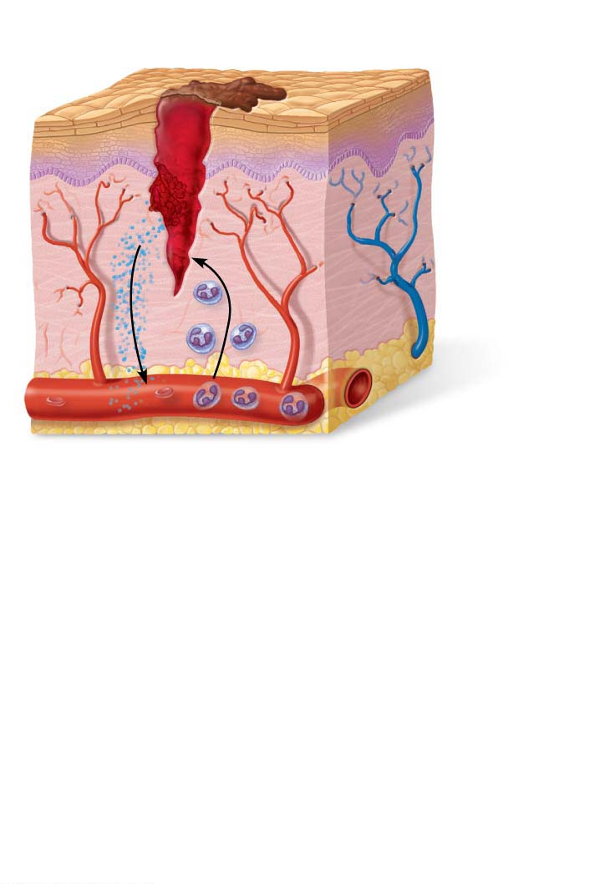
Scab
Blood clot in
incised wound
Epidermis
Vein
Inflammatory
chemicals
Migrating
white
blood cell
Artery
1
Inflammation sets the stage:
Severed blood vessels bleed.
Inflammatory chemicals are released by
injured tissue cells, mast cells, and others.
Local blood vessels become more permeable, allowing white blood cells, fluid, clotting proteins, and other plasma proteins to seep into the injured area.
Clotting occurs; surface exposed to air dries and forms a scab.

Slide 25
Steps
II. Organization- restores blood supply
a. Blood clot replaced by granulation tissue (delicate pink w/ many fibroblasts that prod new collagen fibers)
b. Macrophages digest original clot and deposit collagen fibers.

Slide 26
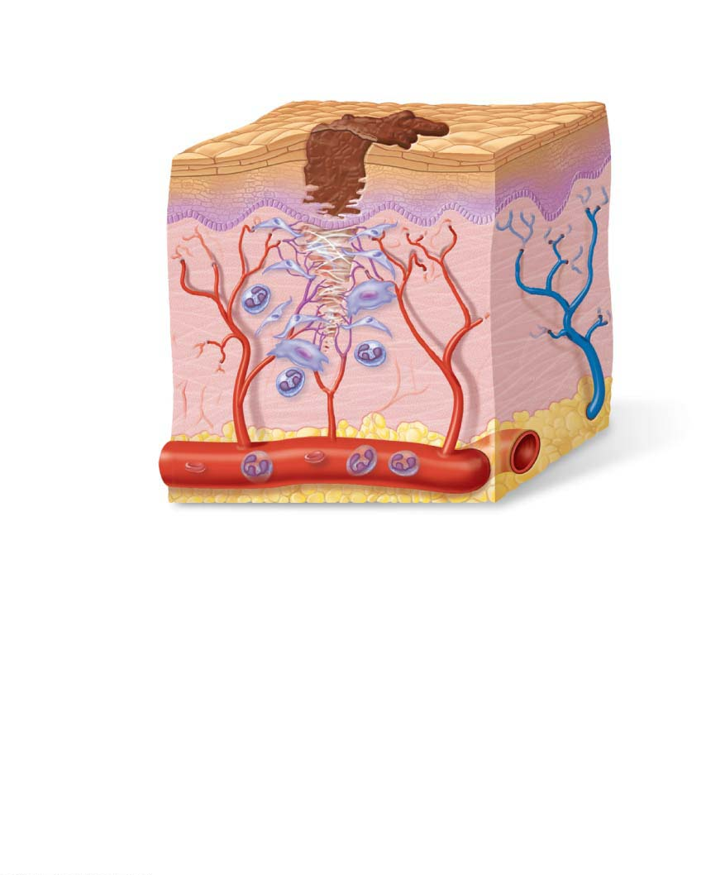
Regenerating
epithelium
Area of
granulation
tissue
ingrowth
Fibroblast
Macrophage
Budding
capillary
2
Organization restores the blood supply:
The clot is replaced by granulation tissue, which restores the vascular supply.
Fibroblasts produce collagen fibers that bridge the gap.
Macrophages phagocytize dead and dying cells and other debris.
Surface epithelial cells multiply and migrate over the granulation tissue.

Slide 27
Steps
III. Regeneration & fibrosis effect- permanent repair
a. Surface epithelial regenerates under scab
b. Scar tissue forms under surface
c. Scab detaches
** wound- uses this process (I-III)
*pure infection- heals by regeneration only (no clots or scarring)

Slide 28
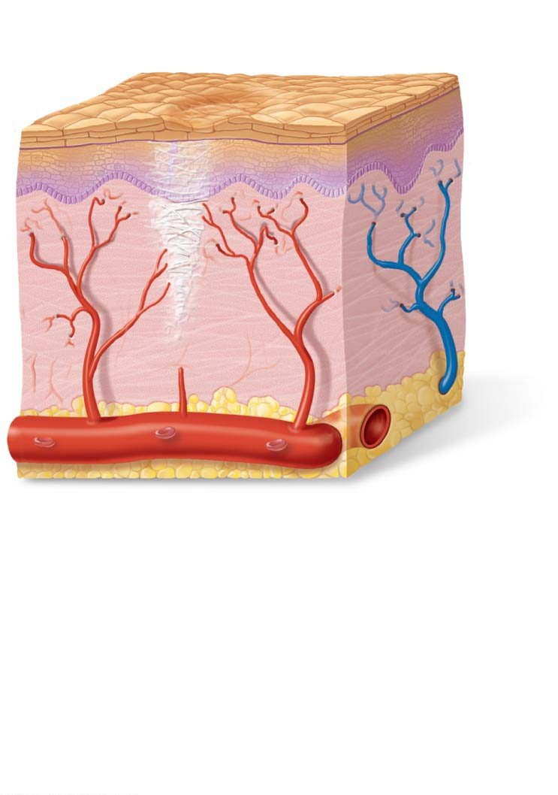
Regenerated epithelium
Fibrosed area
3
Regeneration and fibrosis effect
permanent repair:
The fibrosed area matures and contracts; the epithelium thickens.
A fully regenerated epithelium with an underlying area of scar tissue results.

Slide 29
Regenerative Capacity of Different Tissues
Tissues that regenerate extremely well include:
Epithelial tissues, bone, areolar connective tissue, dense irregular connective tissue, blood-forming tissue
Tissue with moderate regenerating capacity:
Smooth muscle and dense regular connective tissue

Slide 30
Regenerative Capacity of Different Tissues (cont.)
Tissues with virtually no functional regenerative capacity:
Cardiac muscle and nervous tissue of brain and spinal cord
New research shows cell division does occur, and efforts are underway to coax them to regenerate better

Slide 31
Clinical – Homeostatic Imbalance 4.3
Scar tissue that forms in organs, particularly the heart, can severely impair the function of that organ
May cause the organ to lose volume capacity
May block substances from moving through organ
May interfere with ability of muscles to contract or may impair nerve transmissions

Slide 32
Clinical – Homeostatic Imbalance 4.3
Scar adhesions may cause organs to adhere to neighboring structures, preventing normal functions
Scarring can potentially cause progressive failure of the organ, particularly the heart

