Slide 1
CHEMISTRY
The Chemical Basis of the Body

Slide 2
MATTER
Anything that has mass and occupies space
Three states: solid - liquid - gas
Made up of chemical building blocks called ELEMENTS

Slide 3
Elements
Composed of the same atoms.
Cannot be broken down into simpler substances by ordinary chemical means.
109 Elements (92 occurring naturally).
26 Elements found in the human body.
C, H, O, N - 96% of the human body.
S and P make up 99% of the body.

Slide 4
Atoms
The smallest unit of matter that can enter into chemical reactions.
Composed of two basic components:
Nucleus
Outer energy levels or clouds

Slide 5
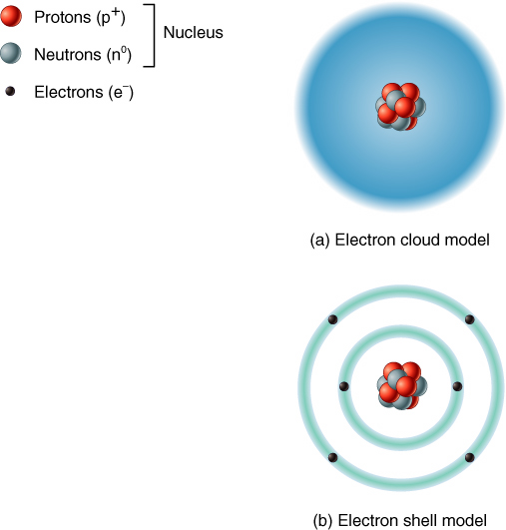
Structure of an Atom

Slide 6
Nucleus
Protons (+ charge)
# of protons is element’s atomic number
Neutrons (uncharged)
# of protons plus # of neutrons form the element’s atomic weight

Slide 7
Electrons
Negatively charged particles that orbit around the nucleus.
# of electrons always equals the # of protons in an atom.

Slide 8
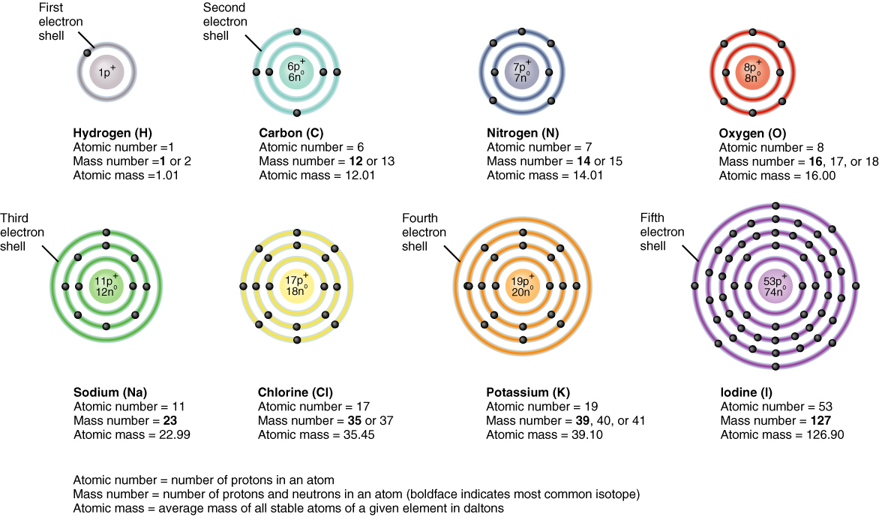
Atoms

Slide 9
Ions (Electrolytes)
Most atoms have too many or too few electrons in their outermost energy level which is not complete.
Valance is the number of extra or deficient electrons in outermost orbital.
Anions - extra electrons in outermost orbital which creates a net negative charge.
Cation - deficient electrons in outermost orbital which creates a net positive charge.
Electrolytes - ions in solution

Slide 10
Major Elements in the Body
The four major elements in the body are:
C – carbon
H – hydrogen
O – oxygen
N - nitrogen

Slide 11
Molecules
The combination of two or more elements in a chemical reaction.
May be atoms of the same element
H₂, O₂, N₂, etc.
May be atoms of different elements
NaCl, HCl etc.

Slide 12
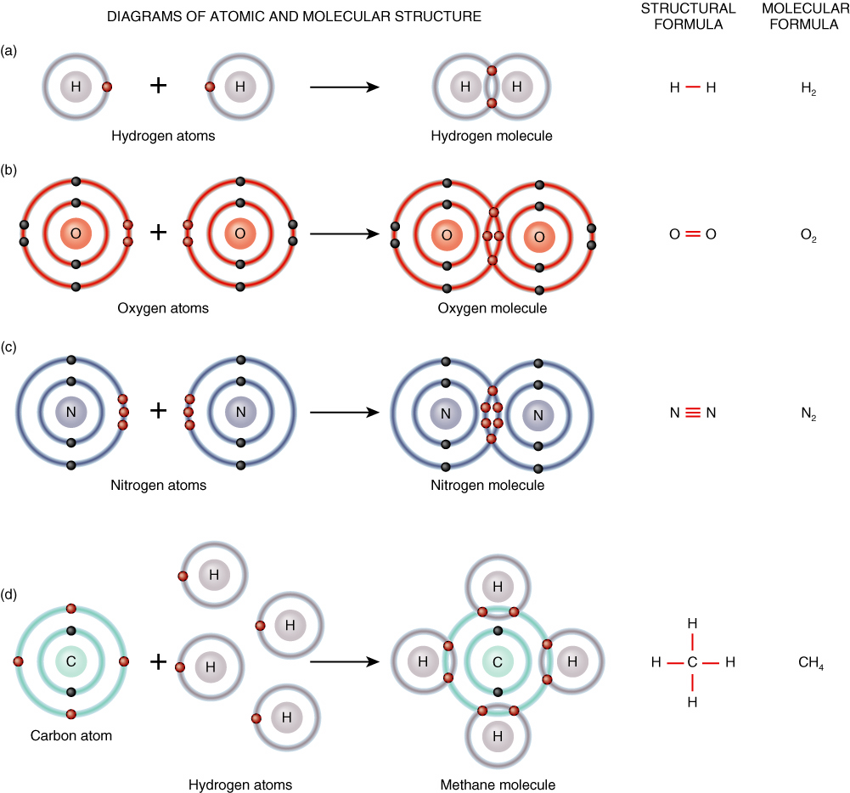
Molecule Examples

Slide 13
Compounds
A substance that can be broken down into two or more elements by chemical means.
Molecules of a compound always contain atoms of two or more different elements.
***All compounds are molecules but not all molecules are compounds***

Slide 14
Anions and Cations
Anions
An anion is formed when an atom gains an electron or electrons from another atom creating an overall negative charge. Example: Cl⁻

Slide 15
Cations
Cations
Cations are formed when an atom loses an electron or electrons to another atom creating an overall positive charge.
Example: Na⁺

Slide 16
Chemical Bonding
Chemical bonds are formed between atoms when electrons in the outermost orbital are gained, lost, or shared

Slide 17
Types of Chemical Bonds
Ionic Bonding
Covalent Bonding
Hydrogen Bonding

Slide 18
Ionic Bonding
Bonding when one atom gains an electron and another atom loses an electron.
Transfer electrons from one atom to another.
Bonds together two oppositely charged ions.
Strongest type of chemical bonding.

Slide 19
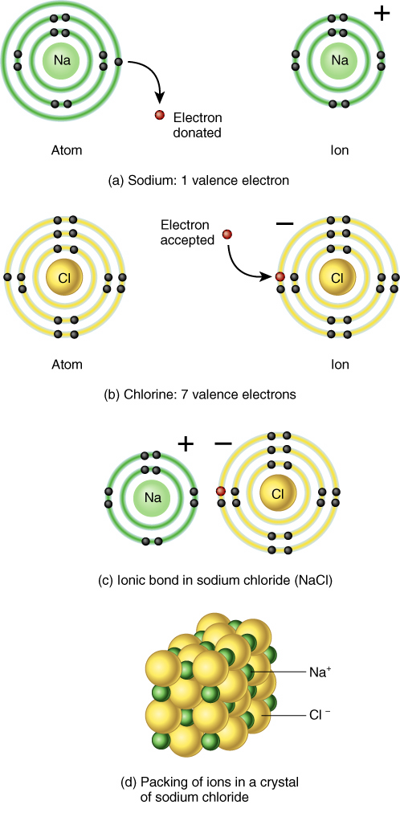
Ionic Bond Example

Slide 20
Covalent Bonding
Sharing of electron pairs by more than one atom
single covalent bond: share one pair of electrons
double covalent bond: share two pairs of electrons
triple covalent bonds: share three pairs of electrons

Slide 21
Hydrogen Bonds
A hydrogen atom covalently bonded to another atom.
Very weak bond.
Often serves as a bridge between molecules.
Many large molecules can contain hundreds of these bonds.

Slide 22
pH Scale
A scale used to describe the degree of acidity or alkalinity (basicity) of a solution.
Expressed on a logrhythmic base 10 scale that runs from 0 - 14 with 7 being a neutral pH:
> 7 is a basic or alkaline solution
< 7 is a acidic solution
Actually represents the number of H+ ions or OH- ions in solution.

Slide 23
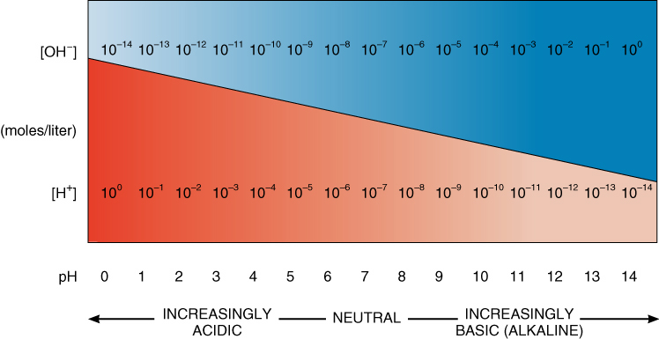
pH Scale

Slide 24
Acids
A substance that dissociates into one or more hydrogen ions (H+) and one or more negative ions (anions)
Acids are proton donors.
Closer to 0= more acidic

Slide 25
Bases
A substance that dissociates into one or more hydroxyl ions (OH-) and one or more positively charged ions (cations)
Bases are proton acceptors
Closer to 14= more basic (alkaline)

Slide 26
Salts
A substance, that when dissolved in water, dissociates into both anions and cations neither of which is H+ or OH-

Slide 27
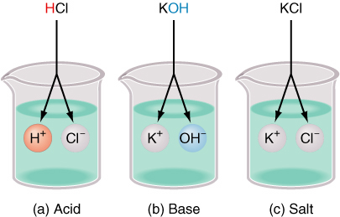
Acids – Bases - Salts

Slide 28
Neutral pH and pH of Blood
Neutral pH is considered to be 7.0 on the pH scale. This is distilled water which has equal concentrations of H⁺ and OH⁻.
The pH of blood is slightly basic (alkaline) ranging from 7.35 to 7.45.

Slide 29
Water
Universal solvent
Participates in or is essential in many chemical reactions
Absorbs and releases heat very slowly
Important transport medium
Functions as a lubricant in various regions of the body

Slide 30
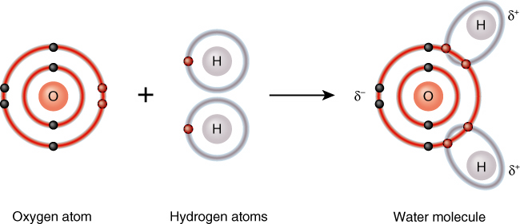
Water Molecule

Slide 31
Classification of Chemical Compounds
Inorganic Compounds
Small ionically bonded molecules
Generally lack a carbon atom
Vital to normal physiological functioning
Organic Compounds
Contains one or more carbon atoms
Contains hydrogen atoms
Almost exclusively held together by covalent bonds

Slide 32
Inorganic Compounds
Water
Acids
Bases
Salts

Slide 33
Organic Compounds
Carbohydrates (sugars & starches)
Lipids (fats)
Proteins
Nucleic Acids (DNA & RNA)

Slide 34
Carbohydrates
Includes sugars and starches.
Account for about 2% of body mass.
Contain C, H, and O molecules in a general formula of (C H₂ O)n.
Functions of carbohydrates:
structural units of DNA and RNA
energy source (4.5 kcal/gm)
only energy source for brain and nerve cells

Slide 35
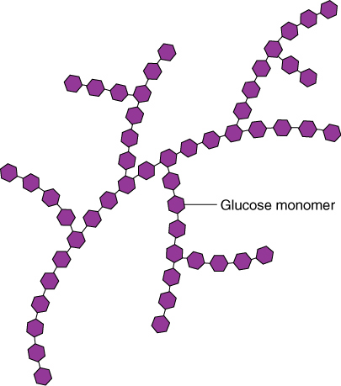
Glucose Molecule Storage form of Carbohydrates

Slide 36
Lipids (FATS)
Most are insoluble in water.
Most highly concentrated source of energy (9.2 kcal/gm).
Less efficient as a body fuel than carbs.
Made up of C, H, and O in structural units called fatty acids and glycerols (triglycerides).
Types of fats determined by the types of hydrogen bonds in the molecule
saturated fat
unsaturated fat (mono or poly)

Slide 37
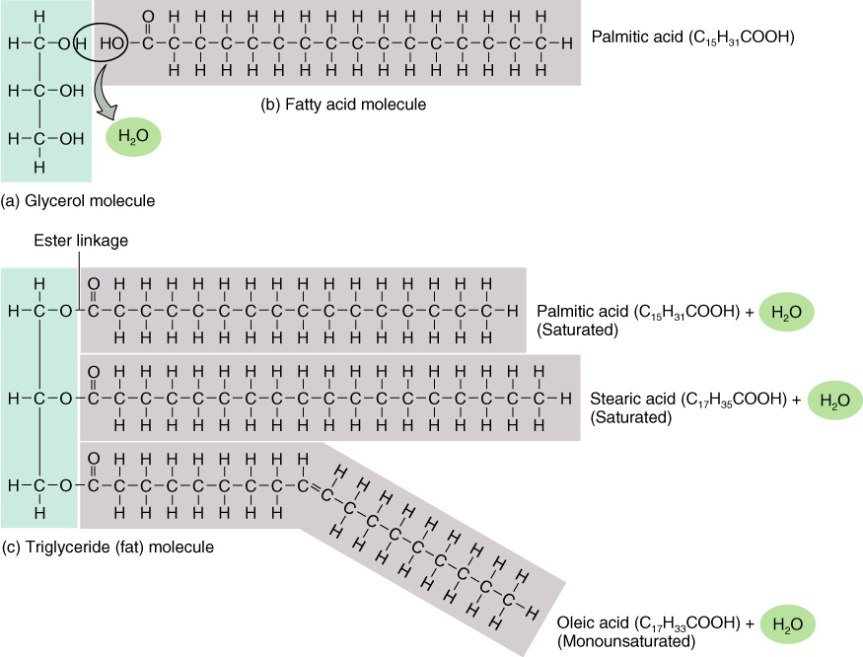
Fat Molecules

Slide 38
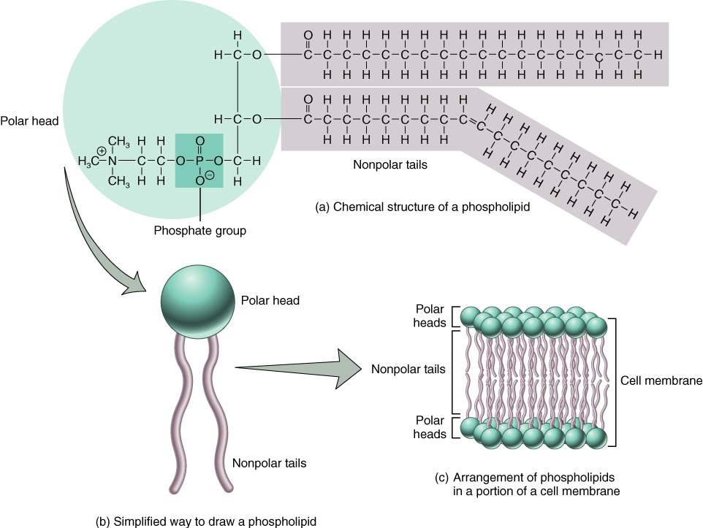
Phospholipid Molecule

Slide 39
Proteins
All contain C, H, O, and N (many also contain S and P).
Composed of molecules called amino acids (20).
Type of protein is determined by the number and sequence of amino acids.
Amino acids are joined together at the N atoms in a chemical bond called a peptide bond

Slide 40
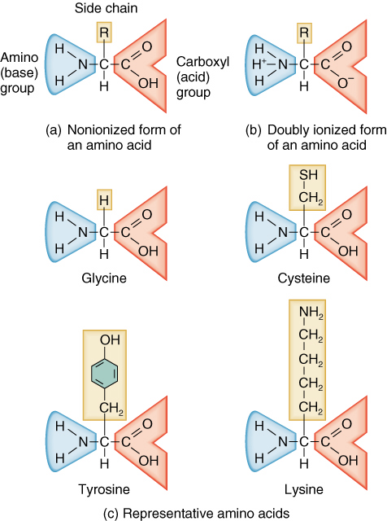
Amino Acids

Slide 41
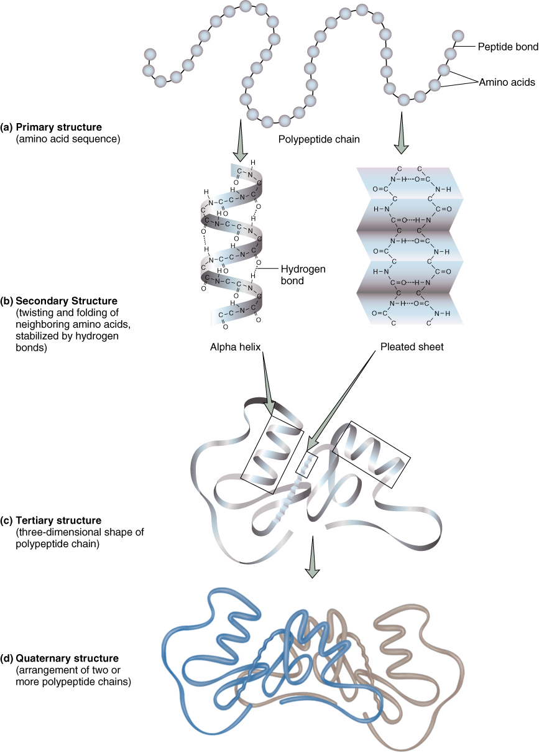
Protein Structure

Slide 42
Types and Functions of Proteins
Structural Proteins
Form the structural framework of various body parts (muscle, skin, hair, nails, etc.)
Regulatory Proteins
Function as hormones to control a variety of physiological processes (insulin)
Contractile Proteins
Serve as the contractile elements in muscle tissue (actin and myosin)

Slide 43
Types and Functions of Proteins
Immunological Proteins
Serve as anti-bodies to protect the body (gamma globulin)
Transport Proteins
Transports vital substances throughout the body (hemoglobin)
Enzymatic Proteins
Alter the rate or activation energy of chemical reactions (amylase, lipase, lactase)

Slide 44
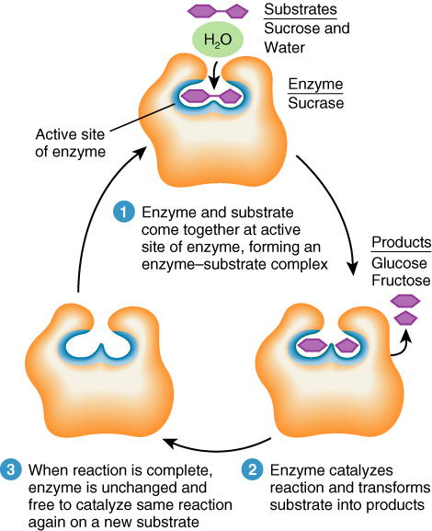
Enzyme Function

Slide 45
Nucleic Acids DNA and RNA
Building blocks of life
All contain C, H, O, N, and P
Made up of structural units called nucleotides
DNA contains the genetic code
DNA and RNA assist with protein synthesis

Slide 46
DNA Deoxyribonucleic Acid
Nucleotides are molecules composed of C, H, O, and a nitrogen base of:
thymine - adenine
guanine - cytosine
Contains a pentose sugar called deoxyribose
Contains a phosphate group

Slide 47
Structure of DNA
A two stranded molecule that twists around each other (double helix).
looks like a twisted ladder
Sides or uprights of the ladder are made of alternating phosphates and the deoxyribose section of the molecule.
The rungs of the ladder contain the paired nitrogen bases.
thymine (T) - adenine (A)
guanine (G) - cytosine (C)

Slide 48
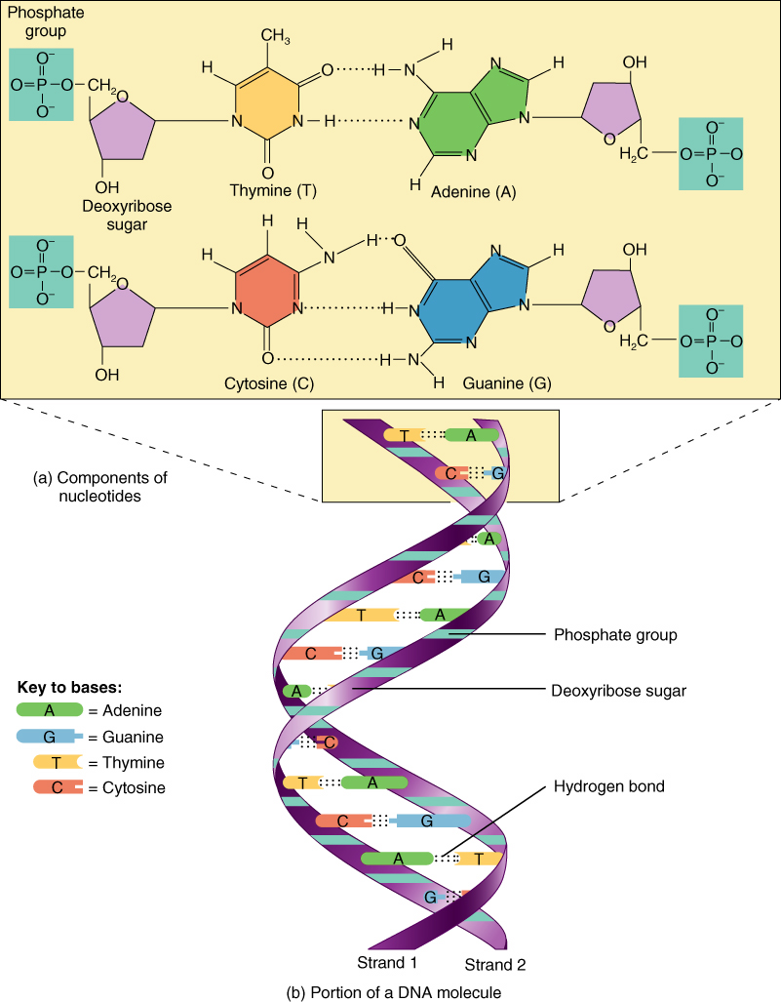
Structure of DNA

Slide 49
RNA Ribonucleic Acid
Molecule is a single strand of nucleotides.
The sugar portion of the molecule is a pentose sugar, ribose.
Nitrogen base thymine in DNA is replaced by uracil in RNA.

Slide 50
Adenosine Triphosphate (ATP)
High energy compound that supplies energy for most chemical reactions.
Found in all living systems.
Formed during a process called cellular respiration which takes place in the cytoplasm and the mitochondria of cells.

Slide 51
Structure of ATP
Adenine unit composed of an adenine molecule and a five carbon sugar (ribose).
Three phosphate groups attached to the end of the molecule.
Tremendous amount of energy is released when the terminal phosphate is removed.

Slide 52
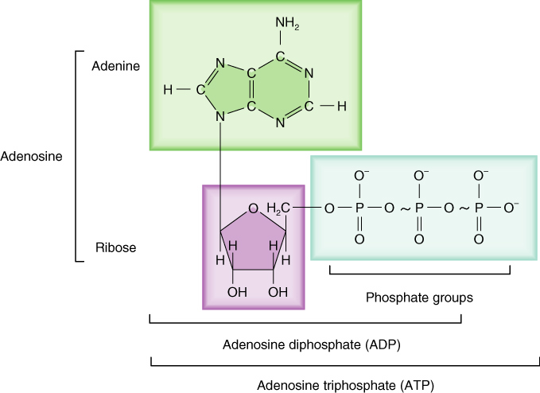
Structure of ATP

Slide 53
ATP <----> ADP + P + ENERGY

