Slide 1
Ch1 The HUMAN BODY: An Orientation
General Concepts of
ANATOMY
and
PHYSIOLOGY

Slide 2
Background
Study of human body began because people were curious about illness and injury.
They learned through observations
Used potions, herbs, magic, but not dissections.
Believed in “bad blood” and “bad air”
In ancient times, it was believed that most natural processes were controlled by spirits and supernatural forces that humans could not understand.

Slide 3
Background
In the 18th century, the stage was set for the development of modern science as
People began to look more closely
began to ask questions
techniques were developed
dissection popular; “grave robbers”

Slide 4
ANATOMY
Anatomy-
Greek for “to cut apart”
study of the structure of body parts and their relationships to each other.
The scientific study of structures and the relationship of structures to each other.
FORM
Other terms include shape, structure, and appearance.

Slide 5
PHYSIOLOGY
The scientific study of the functioning of specific body parts and systems.
FUNCTION

Slide 6
Overview
“structure determines function”
what a structure can do depends on its form/ shape

Slide 7
Levels of Organization
Chemical Level
Cellular Level
Tissue Level
Organ Level
System Level
Organism Level

Slide 8
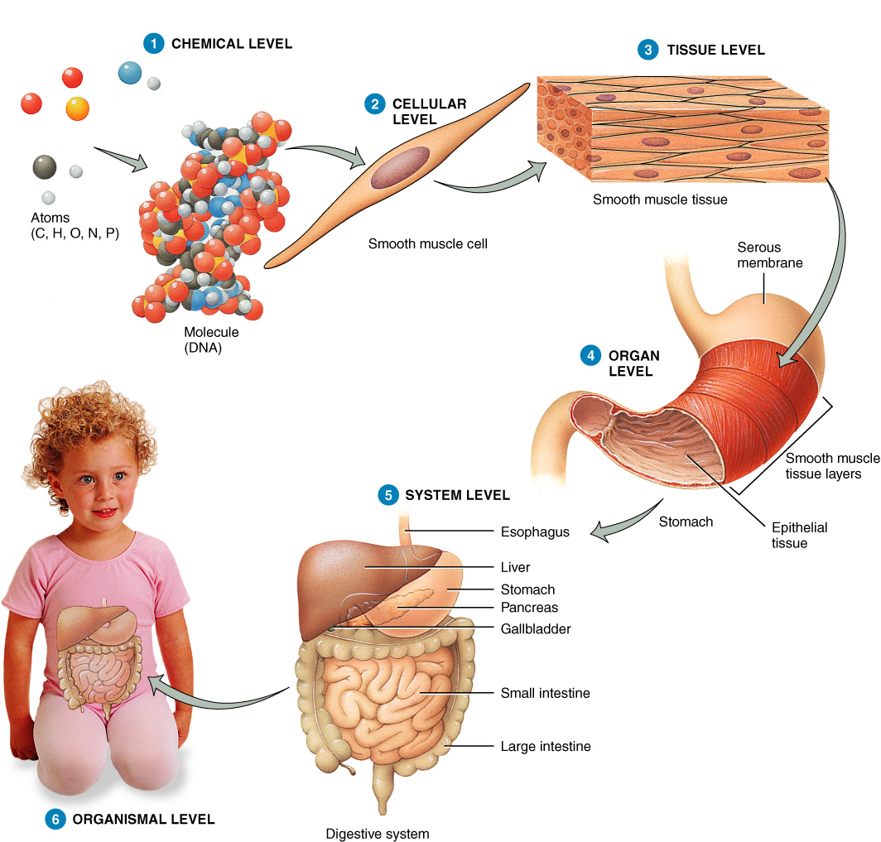
Levels of Organization

Slide 9
Levels of Structural Organization
Chemical Level
1. Atoms- smallest unit of a substance
2. Molecules- 2 or more atoms bonded
3. Organelles- basic component of cells

Slide 10
Chemical Level
All chemical substances essential for maintaining life – atoms-compounds-molecules.
Major Elements
C - carbon
H - hydrogen
O - oxygen
N - nitrogen

Slide 11
Cellular Level
Cellular Level
4. Cell- smallest unit of living things
The cell is the basic unit of structure and function.
Each cell has a unique structure and function.
Muscle cells
Nerve cells
Blood cells
Cartilage cells

Slide 12
Tissue Level
Cellular Level
5. Tissue- cells with common function
Collection of similar cells grouped together to perform a specific function.
Usually derived from a common embryonic origin.
Four Major Tissue Types
Epithelial Tissue
Connective Tissue
Nervous Tissue
Muscular Tissue

Slide 13
Tissues
4 types & functions:
a. epithelial- covers surfaces and lines cavities
b. muscle- movement
c. Connective- supports and protects organs
d. Nervous- communication with electrical impulses

Slide 14
Organ Level
Structures composed of two or more different tissues.
Have specific functions.
Usually have recognizable shapes
Heart
Brain
Kidney
Liver

Slide 15
Organ Level
6. Organ- made of at least 2 tissue types (usually 4) with the same function.
7. Organ system- organs working together.

Slide 16
Organ System Level
An association of organs that have a common function.
Digestive System
Cardiovascular System
Nervous System
Lymphatic System

Slide 17
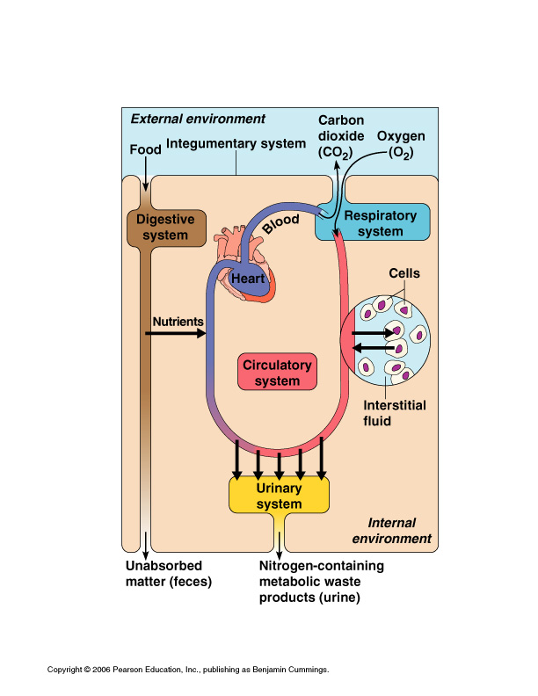

Slide 18
Organism Level
8. All structural levels (body systems) functioning with one another as a living individual.

Slide 19
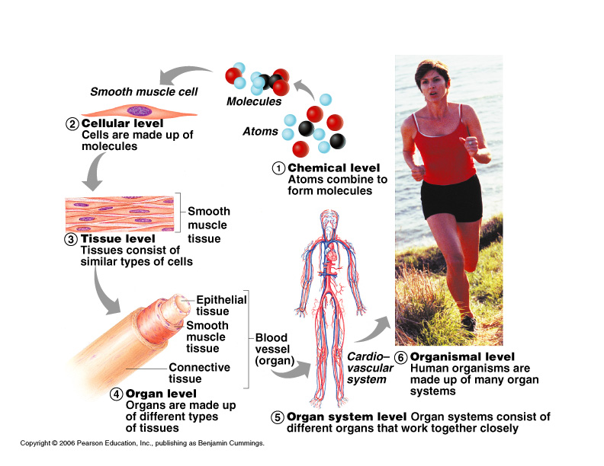

Slide 20
Life and Survival

Slide 21
What is Life?
Characteristics of living things:
1. Reactions- occur in all living organisms
2. Responsiveness (irritability)- respond to outside conditions.
3. Movement- locomotion from within
4. Growth- increase in size because new material produced too fast.
5. Differentiation- development of cells into a specialized state.
6. Reproduction- occurs at cellular (mitosis) or organismal level
7. Digestion- food is physically and chemically changed into simple substances
8. Excretion- removal of wastes

Slide 22
What is Life?
All of these characteristics depend on physical and chemical changes that occur within body parts.
These changes are called metabolism.
~Metabolic reactions are classified as either a. anabolic (build new substances) or b. catabolic (break substances down)

Slide 23
Metabolism
The sum total of all chemical processes that occur in the body.

Slide 24
Anabolism
Using energy to synthesize or manufacture new tissue or molecules.

Slide 25
Catabolism
The breakdown of tissues or chemical structures to produce or generate energy.

Slide 26
Metabolism
Metabolism results in vital signs.
A. Temperature
B. Breathing
C. Blood Pressure
D. Pulse

Slide 27
What is death?
The absence of vital signs.
There will be no:
spontaneous muscular movements
response to stimuli (even painful)
reflexes
brain waves (flat encephalogram)

Slide 28
What is death?
Biological death= no pulse, no heartbeat
Clinical death= no brain waves

Slide 29
Survival Needs
Quality and Quantity are both important.
1. Nutrients- chemical substances from food used for energy and cell building
2. Oxygen- chemical reactions to release energy from food require oxygen
3. Water- most abundant chemical subst.; (60-80% body weight); fluid base for chemical reactions.
4. Heat- too low= slow reactions; too high= proteins don’t function (death)
5. Pressure- force exerted on body surface; for breathing and gas exchange

Slide 30
Homeostasis
The ability of the body to maintain a constant internal environment within prescribed physiological limits.

Slide 31
Homeostasis
“Steady State”
Communication is essential for homeostasis.
Occurs chiefly between the nervous and endocrine systems that use electrical signals delivered by nerves or bloodborne hormones as information carriers.

Slide 32
Parameters Maintained in Homeostasis
gas concentrations
temperature
pressure
pH (acidity)
nutrients
water

Slide 33
STRESS
Any factor which disrupts homeostasis.
Any stimulus which creates an imbalance in the body’s internal environment
Anything that causes stress - Stressor
Physical
Emotional
Metabolic
Environmental

Slide 34
External Stressors
Heat
Cold
Noise
Light
Exercise

Slide 35
Internal Stressors
Pain
Tumors
High blood pressure
Chemical imbalances
Unpleasant thoughts

Slide 36
Feedback Mechanisms
Any circular situation in which information about something is monitored and sent to a control center

Slide 37
Components of a Feedback Mechanism
Control Center
An area that receives information about a monitored condition and determines an appropriate response.
Receptor (sensor) “receives”
An area or structure that monitors a controlled condition; sends info to control center
Effector “effects”
Structure that produces a response or changes a controlled condition. Usually a muscle or gland.
The factor/ event being regulated is the variable.

Slide 38
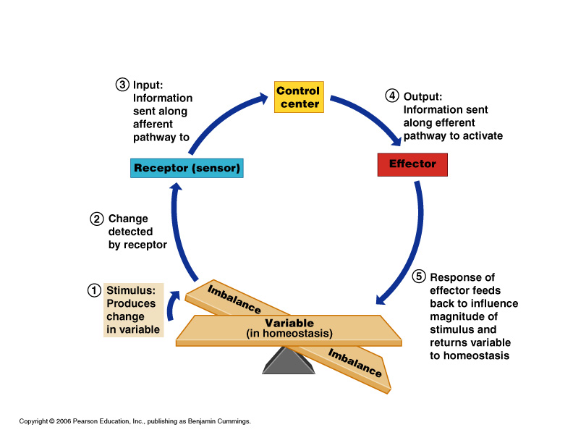

Slide 39
Pathways
1. Afferent: information from receptor to control center.
2. Efferent: response from control center to effector (usually muscle or gland)

Slide 40
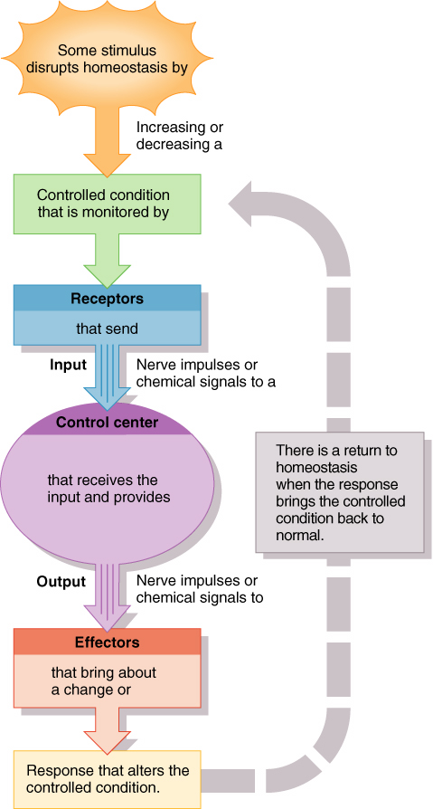
Feedback Mechanisms

Slide 41
Homeostasis
Results of response “feed back” to increase or decrease the stimulus.
Increase = positive feedback
Decrease= negative feedback

Slide 42
Types of Feedback Mechanisms
Positive Feedback Mechanisms (Stimulatory)
The response is intensified by the input.
Example: Breastfeeding by an infant, childbirth, and blood clotting.

Slide 43
Positive Feedback- Stimulatory
Positive feedback- increases stimulus
The response is intensified by the input.
Amplifies original stimulus “cascades”
not used for moment-to-moment well-being
produces unstable body conditions, even death
Examples: bad- cancer;
good- blood clotting, breastfeeding by an infant, childbirth, and blood clotting.

Slide 44
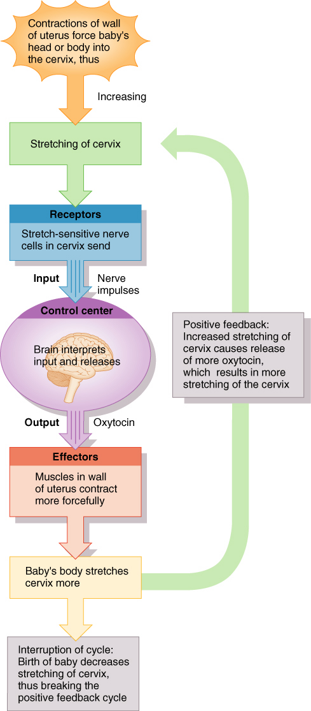
Positive Feedback System

Slide 45
Negative Feedback- Inhibitory
The most common feedback mechanism.
decreases stimulus~the response counteracts the input
returns body to normal state
goal- to prevent sudden, severe changes within the body
. Examples: Thermostat- located in hypothalamus
Withdrawal reflex- in response to pain by nervous system
Also:
blood pressure
blood sugar regulation
cardiac output

Slide 46
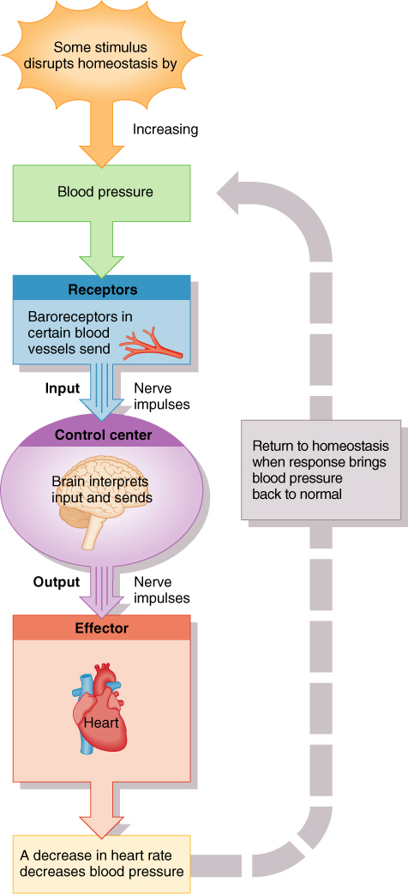
Negative Feedback System

Slide 47
Examples
C. Insulin response- regulates hi blood sugar
increased blood sugar
pancreas secretes insulin
insulin causes increased glucose uptake and storage by cells
blood sugar returns to normal

Slide 48
Examples
C. Glucagon response- regulates low blood sugar
low blood sugar
glucagon secreted by pancreas
causes liver to secrete glucose into blood
blood sugar rises and returns to normal

Slide 49
Organ System Overview

Slide 50
Skeletal System
Function: supports body
site of skel. musc. attachment
protection
forms blood cells
stores minerals
Organs: bones, cartilage, ligament, joints

Slide 51
Muscular System
Function: movement
maintain posture
produce heat
Organs: muscles (smooth, cardiac, skeletal)

Slide 52
Nervous System
Function: rapid response to stimuli
Organs: brain, spinal cord, nerves, sensory receptors (eye, ear, tongue)

Slide 53
Integumentary System
Functions: covers body
Protection
Makes vit. D
Contains receptors (pain, pressure), and glands (sweat, oil)
Organ: skin

Slide 54
Endocrine System
Function: secrete hormones that regulate processes
Organs: glands

Slide 55
Endocrine Glands
Pituitary- water retention, milk prod, stimulate reproductive cell formation
posterior- 2 hormones (ex. ADH )
anterior- 6 hormones (ex. Growth)
Thyroid- metabolism (T3 & T4 hormones)
Parathyroid - increase blood Ca (PTH hormone)
Adrenal- incr. Blood glucose (epinepherine & norepinephrine)
Thymus- programs T-lymphocytes (thymosin)
Pancreas- blood glucose (insulin & glucagon)
Pineal-biological rhythms, sleep/wake (melatonin)
Ovary- female sex char (estrogen & progesterone)
Testes- male sex char (androgen)

Slide 56
Cardiovascular System
Function: carry O2, nutrients, hormones to & from tissues for exchange
wbc- protection
heart- blood pump
Organs: heart & blood vessels

Slide 57
Lymphatic System
Function: return fluid leaked from blood back to blood vessels
complement to CV system
nodes- cleanse blood, house immune cells
Organs: lymphatic vessels, lymph nodes, lymphoid organs (spleen, tonsils)

Slide 58
Respiratory System
Function: supply O2
remove CO2
Organs: nasal passages, pharynx, larynx, trachea, bronchi, lungs

Slide 59
Digestive System
Function: break down food (mouth -> sm int)
reclaim water (lg.int)
Organs: oral cavity (mouth), esophagus, stomach, sm. int, lg. int, rectum, liver (bile), pancreas (enzymes)

Slide 60
Urinary (Excretory) System
Function: remove wastes (nitrogen) from blood
maintain salt & electrolyte balance
regulate acid/base balance of blood
Organs: kidney, ureter, bladder, urethra

Slide 61
Reproductive System (Male)
Function: produce offspring
prod sperm (testes)
Organs: scrotum, penis, accessory glands, duct system

Slide 62
Reproductive System (Female)
Function: produce offspring
prod egg (ova) (ovary)
Organs: ovary, uterine tubes, uterus, vagina

Slide 63
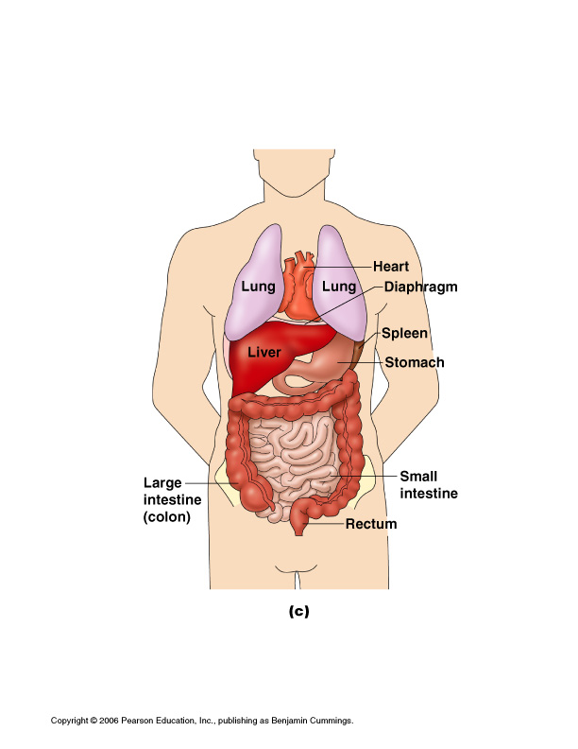
Organ Locations and Functions

Slide 64
Labels for torso diagram in notes
Left Side:
1. larynx
2. trachea
3. R lung
4. diaphragm
5. liver
6. gallbladder
7. cystic duct
8. duodenum
9. ascending colon
10. appendix
11. mesentery
Right Side:
12. thyroid gland
13. thymus gland
14. L lung
15. heart
16. stomach
17. spleen
18. pancreas
19. transverse colon
20. descending colon
21. small intestine
22. sigmoid colon
23. urinary bladder

Slide 65
Organs and Functions
Larynx- speech
Trachea- air passage
Lung- O2/CO2 exch
Diaphragm- muscle for breathing
Liver- detox blood
Gallbladder- store bile
Cystic duct- tube for bile from gallbladder to duodenum
Duodenum- 1st part of sm int where bile & pancreatic fluid released
Colon (lg intestine)- absorbs, transports waste, reclaim water
Sm intestine- absorbs nutrients
Appendix- sm pouch of ascending colon (cecum)
Mesentery- membrane that holds organs in
Thyroid- secretes hormones for metabolism
Thymus gland- prod lymphocytes
Heart- pumps & circulates blood
Stomach- chemical & physical digestion
Spleen- filters blood
Pancreas- regulates blood sugar
Urinary bladder- stores urine

Slide 66
BODY CAVITIES
Spaces within the body that contain the internal organs.

Slide 67
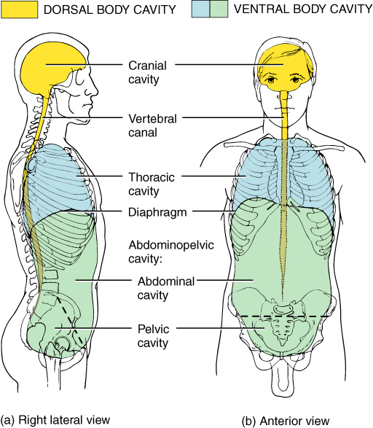
Body Cavities

Slide 68
Dorsal Body Cavity
Cranial Cavity
Contains the brain
Spinal (Vertebral) Cavity
Bony cavity formed by the vertebrae of the spine that contains and protects the spinal cord.

Slide 69
Ventral Body Cavity
Facial Cavity
Orbital (eye)
Nasal (nose)
Oral (mouth)
Otic (ear)
Thoracic Cavity
Pleural cavities (2) (lungs)
Mediastinum
Pericardial cavity (heart)
Abdominopelvic Cavity
Abdominal cavity
Pelvic cavity

Slide 70
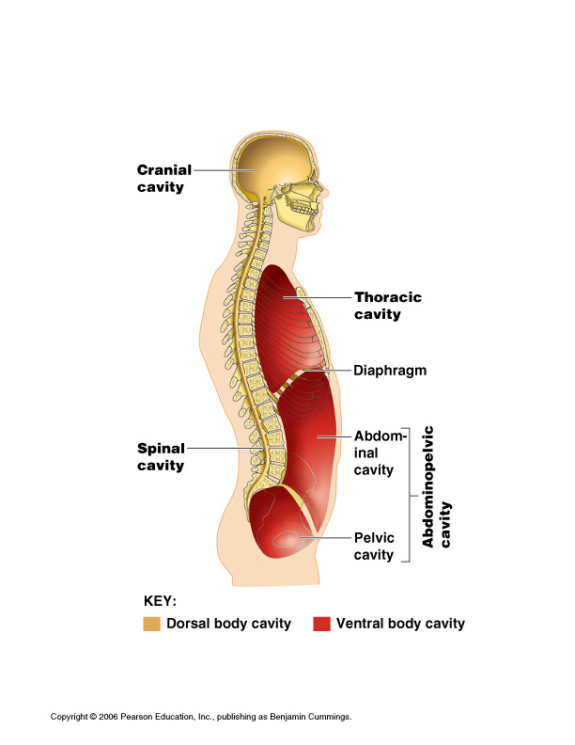
Body Cavities
←Add FACIAL
Orbital (eye)
Otic (ear)
Nasal (nose)
Oral (mouth)
←Thoracic
Pleural (lungs)
Pericardial (heart)
True body cavities are CLOSED cavities. Cavities with 1 end open to the outside are OPEN cavities.

Slide 71
Body Membranes
Mucous- lines body open & closed cavities; thick; lubricant
Serous- lines closed cavities only; thin & watery

Slide 72
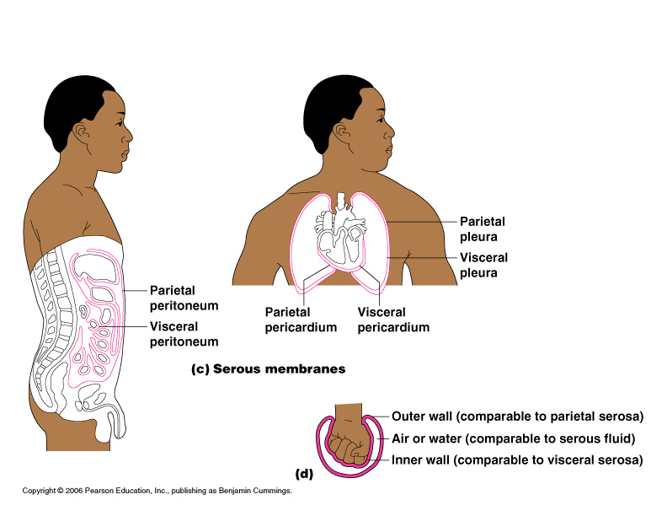
Serous Membranes- Named according to LOCATION
2 types:
Parietal- lines WALL of cavity
Visceral- covers ORGANS in cavity
Location names:
Peritoneum- abdominal
Pleural- lungs
Pericardium- heart

Slide 73
The Language of Anatomy
Special terminology is used to prevent misunderstanding
Exact terms are used for:
Position
Direction
Regions
Structures

Slide 74
Planes
Fixed lines of reference along which the body or organ is often divided to facilitate viewing.

Slide 75
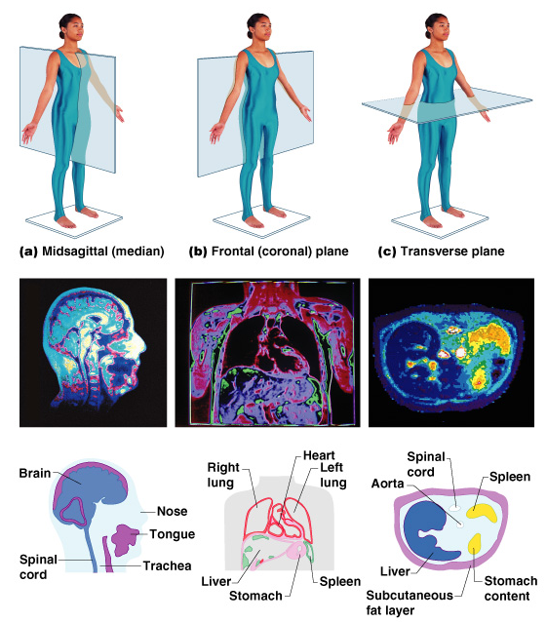
Body Planes
Figure 1.6

Slide 76
Sagittal Plane
A vertical plane which divides the body or structure into right and left sections.

Slide 77
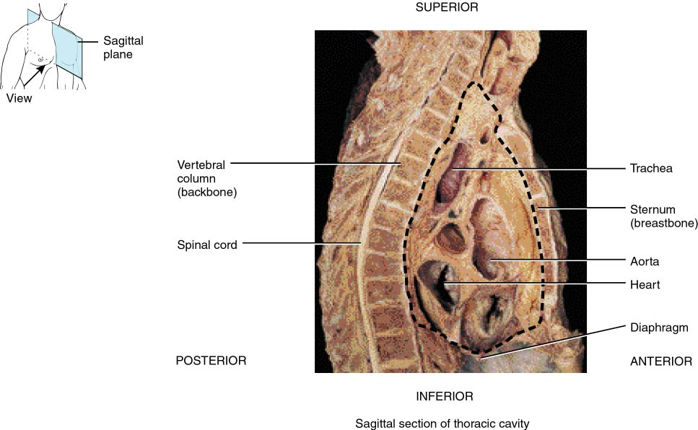
Sagittal Section of Thorax

Slide 78
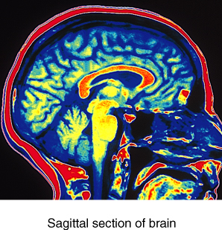
MRI of Brain

Slide 79
Mid-Sagittal Plane
A vertical plane which divides a body or structure into equal right and left halves.

Slide 80
Frontal (Coronal) Plane
A vertical plane which divides a body or structure into anterior and posterior sections

Slide 81
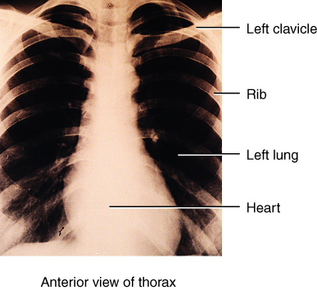
X-Ray: Frontal View

Slide 82
Transverse (Horizontal) Plane
A horizontal plane which divides a body or structure into superior and inferior sections.

Slide 83
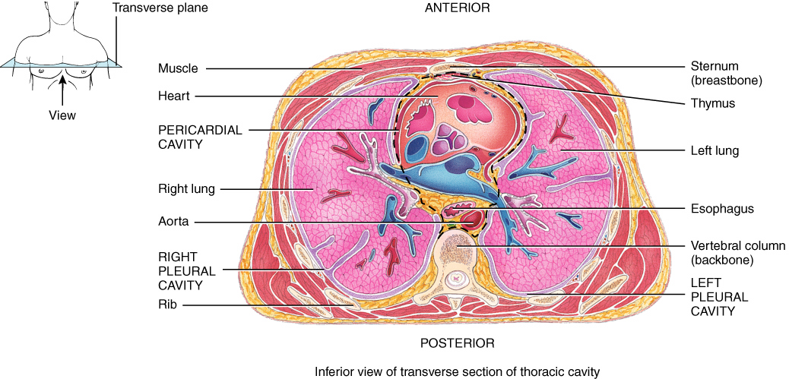
Transverse Plane (Cross Section)

Slide 84
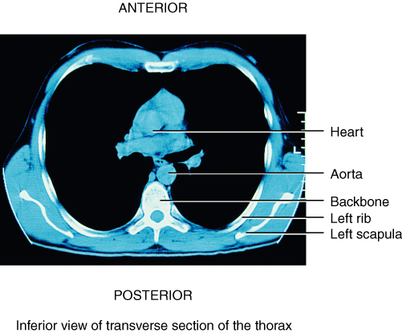
Chest CT Scan

Slide 85
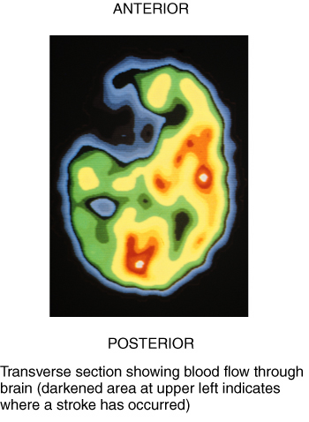
Brain MRI

Slide 86
Oblique (Diagonal) Plane
A diagonal plane slanting; deviating from the perpendicular, horizontal, sagittal, or coronal plane of the body.

Slide 87
Oblique Plane (Diagonal)

Slide 88
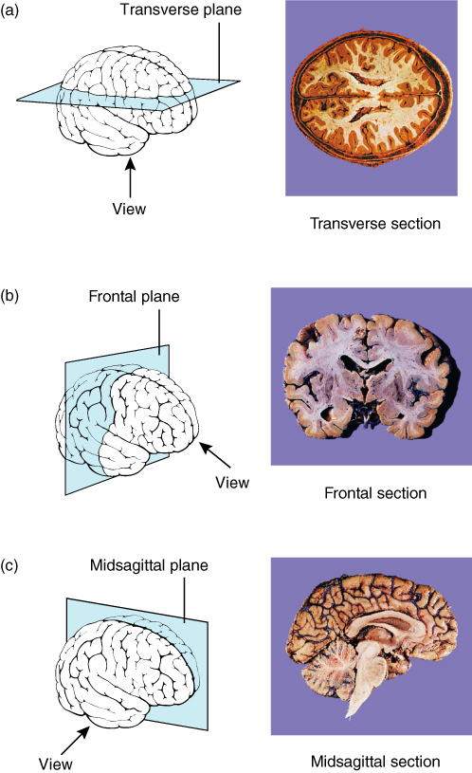
Planes - Overview

Slide 89
Body Position
Anatomical position is standing, with feet flat on floor and palms (anterior) surfaces facing forward.

Slide 90
Position Descriptors
Superior (Cranial)
Inferior (Caudal)
Anterior (Ventral)
Posterior (Dorsal)
Medial
Lateral
Intermediate
Proximal
Distal
Superficial (External)
Deep (Internal)
Supine
Prone

Slide 91
Directional Terms
It is easiest to learn these terms as the opposite pairs (as in the chart in your notes)
Questions about the practice? There can be more than one correct answer.

Slide 92
Orientation and Directional Terms
Table 1.1

Slide 93
Orientation and Directional Terms
Table 1.1 (cont)

Slide 94
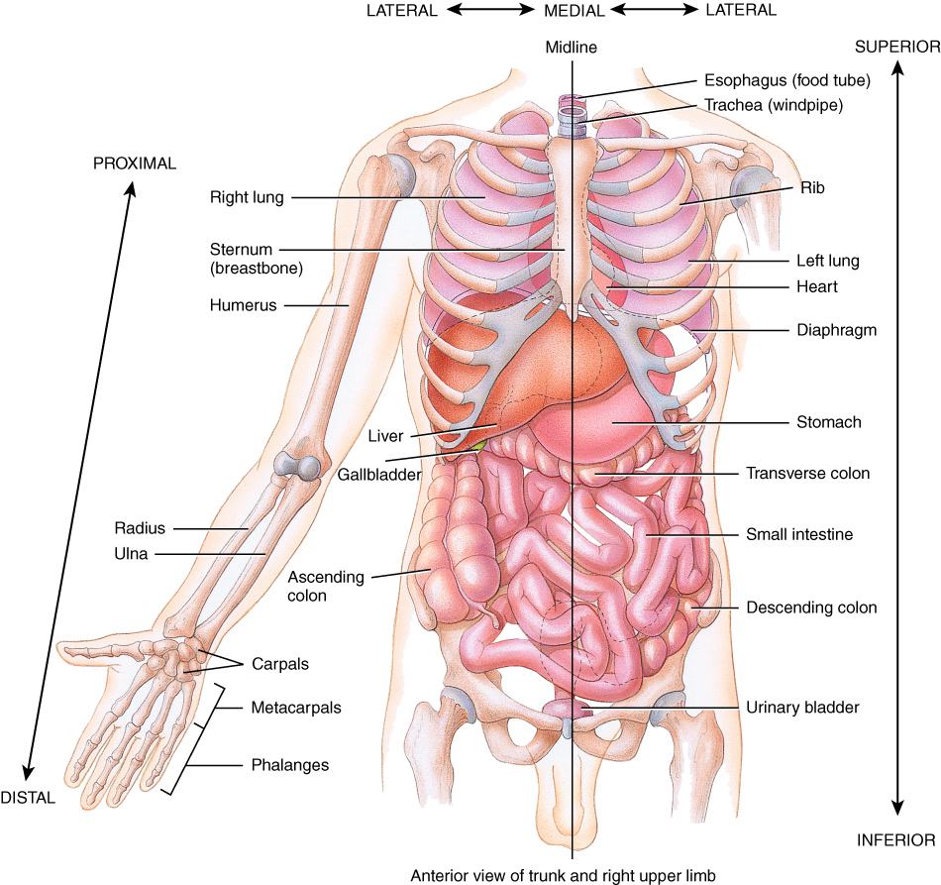
Position Descriptors

Slide 95
Abdominopelvic Quadrants & Regions
Divides lg abdominopelvic cavity into smaller areas (4 quadrants or 9 regions)

Slide 96
Abdominopelvic Quadrants
Figure 1.8a

Slide 97
Abdominopelvic Quadrants
The abdominopelvic cavity can be functionally divided into quadrants.
Used by clinical personnel to describe the location of abdominopelvic pain, tumors, and other abnormalities.

Slide 98
Abdominopelvic Quadrants
Used mostly in the medical and clinical disciplines.
Functionally divides the abdominopelvic cavity into four quadrants
RUQ - Right Upper Quadrant
LUQ - Left Upper Quadrant
RLQ - Right Lower Quadrant
LLQ - Left Lower Quadrant

Slide 99
Quadrants and Organs
RUQ – liver, gallbladder, right kidney
LUQ – stomach, spleen, pancreas, left kidney
RLQ – appendix, right ovary
LLQ – left ovary

Slide 100
Abdominopelvic Regions
Figure 1.8b

Slide 101
Abdominopelvic Major Organs
Figure 1.8c

Slide 102
Body Regions
p. 12 in text- Will also be covered in lab

Slide 103
Body Landmarks
Anterior
Figure 1.5a

Slide 104
Body Landmarks
Posterior
Figure 1.5b

Slide 105
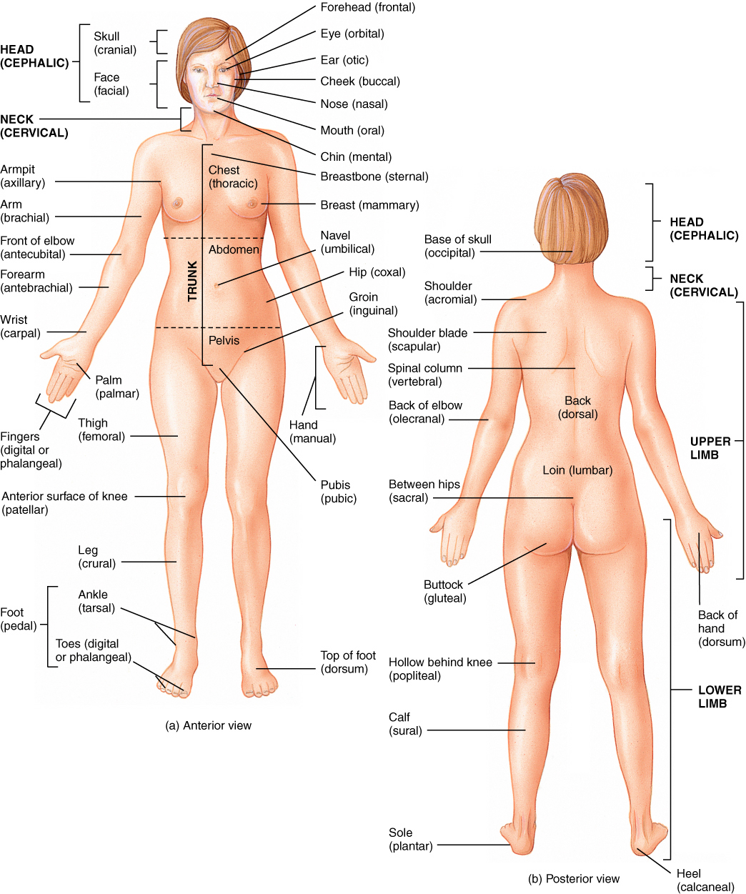
Anatomical Terms

