Slide 1
The Reflex Arc
Ch 11

Slide 2
The Reflex Arc
Reflex – rapid, predictable, and involuntary responses to stimuli
Reflex arc – direct route from a sensory neuron, to an interneuron, to an effector
Figure 7.11a
Copyright © 2003 Pearson Education, Inc. publishing as Benjamin Cummings
Slide 7.23

Slide 3
Reflex Arc
All reflex arcs have 4 elements:
1. sensory receptor- reacts to stimulus
2. afferent (sensory) neuron- goes to spinal cord
3. efferent (motor) neuron- leaves spinal cord
4. effector organ- muscle/gland that is stimulated

Slide 4
Knee-jerk Example
1. sensory receptor- receptors in muscle stretched in knee.
2. afferent (sensory) neuron- impulse travels from leg to spinal cord
3. efferent (motor) neuron- impulse leaves spinal cord and travels to muscle of leg.
4. effector organ- muscle of leg moves

Slide 5
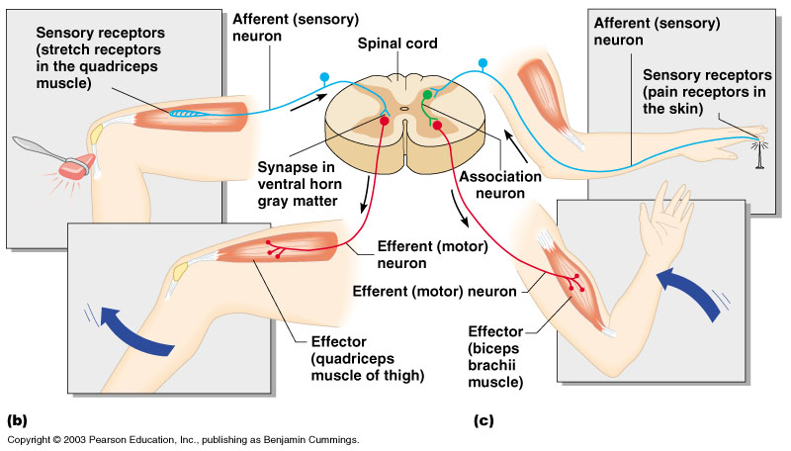
Simple Reflex Arc
Figure 7.11b, c
Copyright © 2003 Pearson Education, Inc. publishing as Benjamin Cummings
Slide 7.24

Slide 6
Types of Reflexes and Regulation
Autonomic reflexes
Smooth muscle regulation
Heart and blood pressure regulation
Regulation of glands
Digestive system regulation
Somatic reflexes
Activation of skeletal muscles
Copyright © 2003 Pearson Education, Inc. publishing as Benjamin Cummings
Slide 7.25

Slide 7
The Central Nervous System
Ch 12

Slide 8
Central Nervous System (CNS)
CNS develops from the embryonic neural tube
The neural tube becomes the brain and spinal cord
The opening of the neural tube becomes the ventricles
Four chambers within the brain
Filled with cerebrospinal fluid
Copyright © 2003 Pearson Education, Inc. publishing as Benjamin Cummings
Slide 7.26

Slide 9
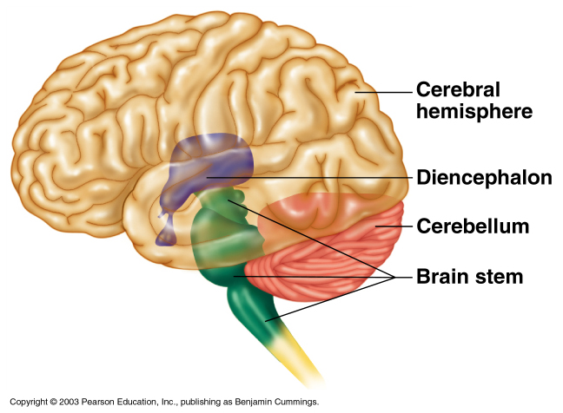
Regions of the Brain
Cerebral hemispheres
Diencephalon
Brain stem (midbrain, pons, medulla)
Cerebellum
Figure 7.12
Copyright © 2003 Pearson Education, Inc. publishing as Benjamin Cummings
Slide 7.27

Slide 10
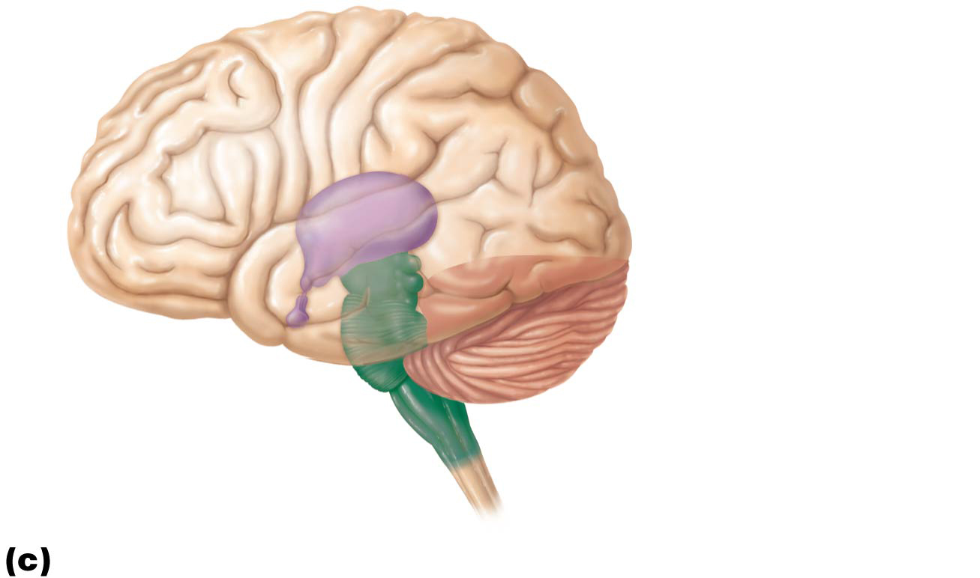
Cerebral
hemisphere
Diencephalon
Cerebellum
Brain stem
• Midbrain
• Pons
• Medulla oblongata
Birth: Shows adult pattern of structures and convolutions.

Slide 11
Brain Regions and Organization (cont.)
Gray matter: short, nonmyelinated neurons and cell bodies
White matter: myelinated and nonmyelinated axons
Basic pattern found in CNS: central cavity surrounded by gray matter, with white matter external to gray matter
Features and changes of pattern:
Spinal cord exhibits this basic pattern; however, pattern changes with ascent into brain stem

Slide 12
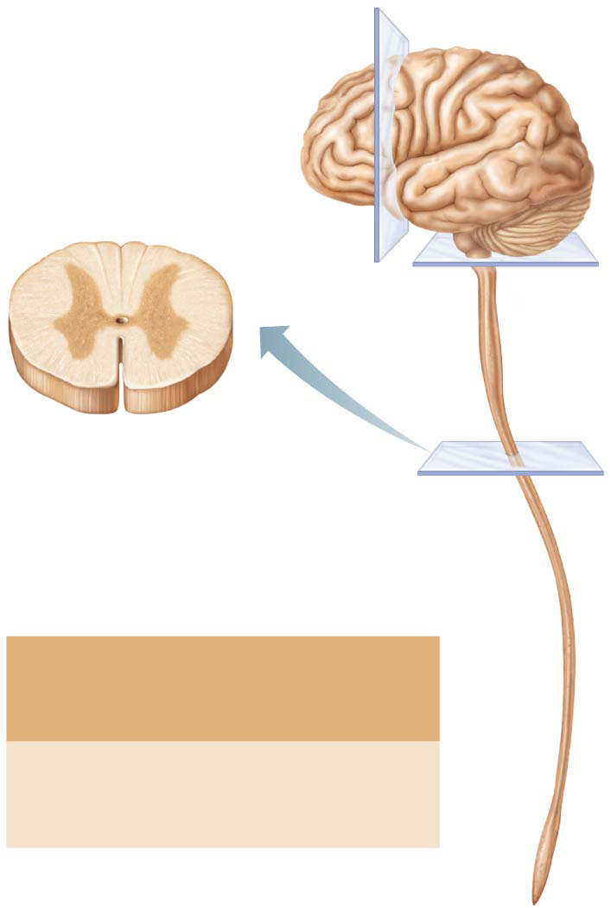
Figure 12.3-1 Pattern of distribution of gray and white matter in the CNS.
Central cavity
(spinal canal)
Inner gray
matter
Outer white
matter
1
The spinal cord exhibits
the basic pattern: a central
cavity surrounded by gray
matter, with outer white matter.
Gray matter:
• Neuron cell bodies
• Short nonmyelinated neurons
White matter:
• Mostly myelinated axons (with
some nonmyelinated axons)

Slide 13
Brain Regions and Organization (cont.)
Brain stem has additional gray matter nuclei scattered within white matter
Cerebral hemispheres (cerebrum) and cerebellum contain outer layer of gray matter called the cortex
Cerebrum and cerebellum also have scattered areas of gray matter nuclei amid white matter

Slide 14
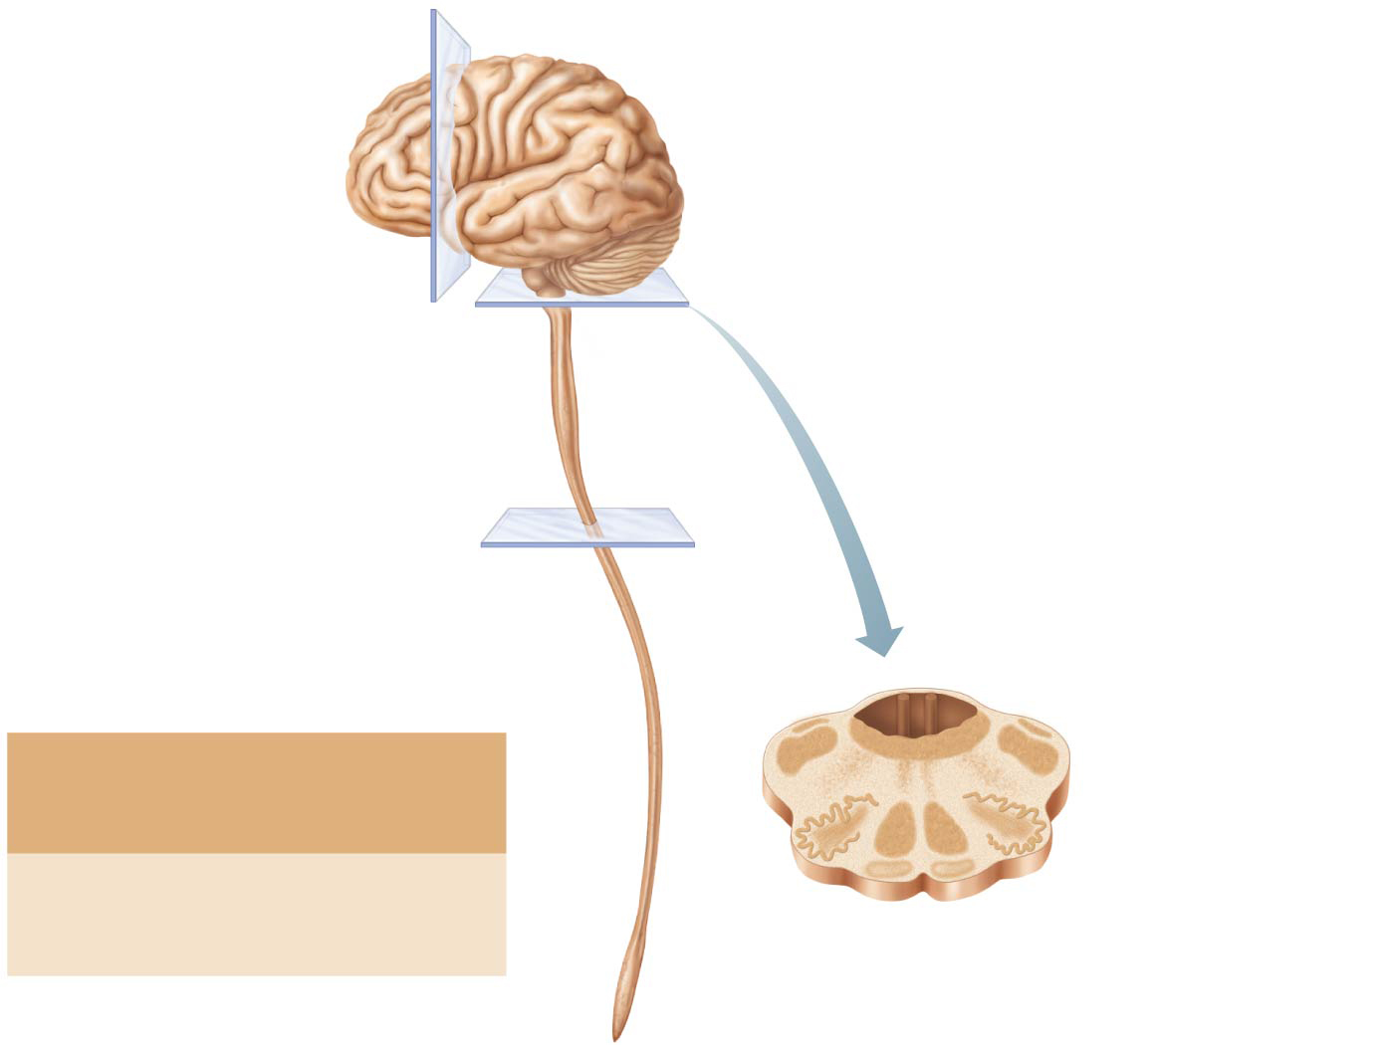
Figure 12.3-2 Pattern of distribution of gray and white matter in the CNS.
Central cavity
(4th ventricle)
Gray matter:
Inner gray matter
• Neuron cell bodies
• Short nonmyelinated neurons
Outer white matter
White matter:
• Mostly myelinated axons (with
some nonmyelinated axons)
2
The brain stem has additional
regions of gray matter (brain nuclei)
buried within the white matter.

Slide 15
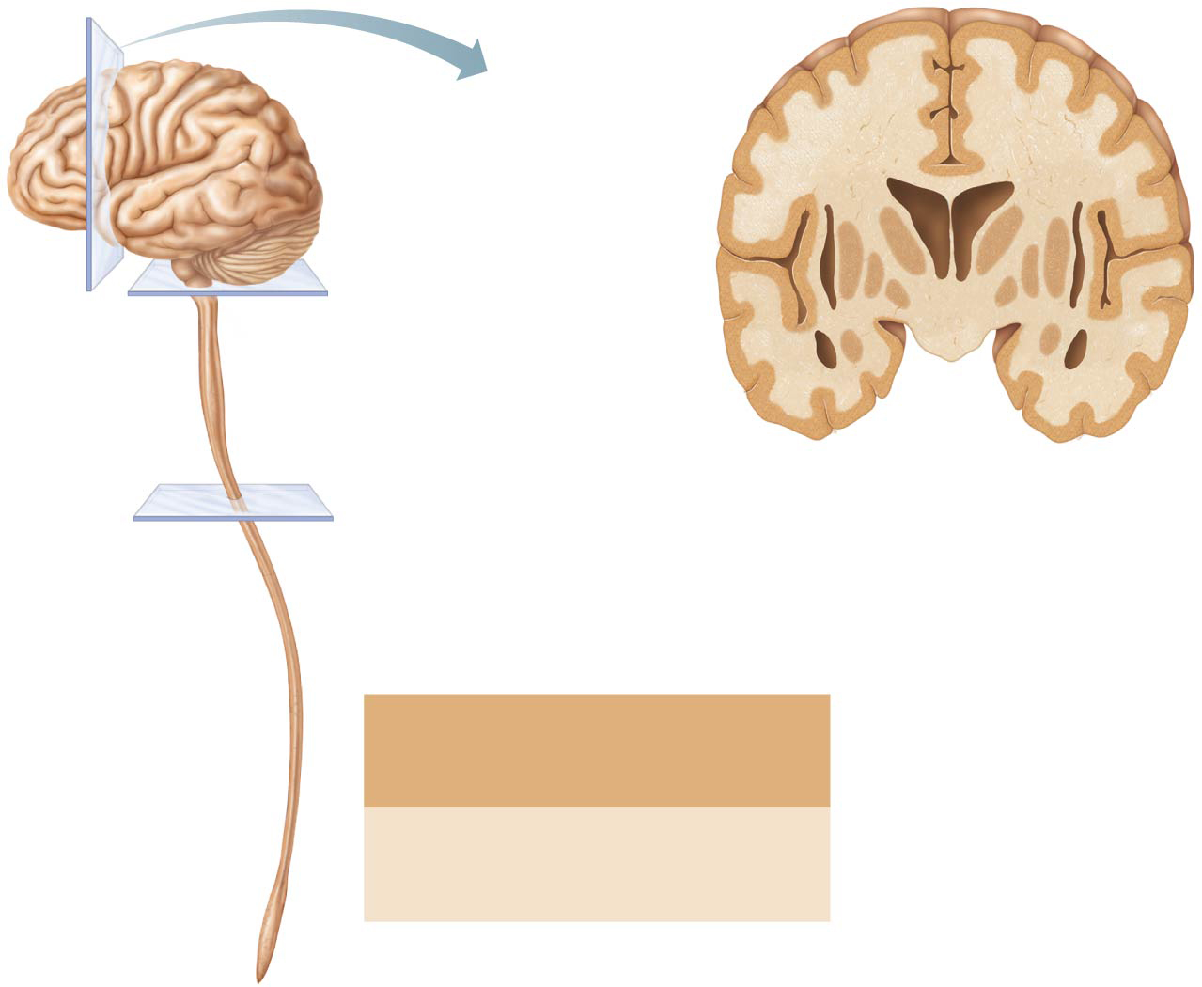
Figure 12.3-3 Pattern of distribution of gray and white matter in the CNS.
Central cavity
(lateral ventricle)
White matter
Gray matter
(brain nuclei)
Cortex of
gray matter
3
The cerebrum (shown here) and
cerebellum have islands of gray
matter (nuclei) within white matter, as
well as an outer cortex of gray matter.
Gray matter:
• Neuron cell bodies
• Short nonmyelinated neurons
White matter:
• Mostly myelinated axons (with
some nonmyelinated axons)

Slide 16
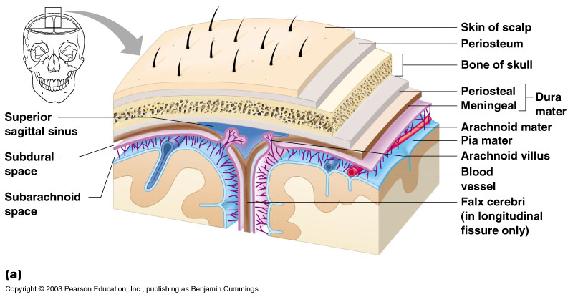
Protection of the Central Nervous System
Scalp and skin
Skull and vertebral column
Meninges
Figure 7.16a
Copyright © 2003 Pearson Education, Inc. publishing as Benjamin Cummings
Slide 7.44a

Slide 17
Protection of the Central Nervous System
Cerebrospinal fluid
Blood brain barrier
Figure 7.16a
Copyright © 2003 Pearson Education, Inc. publishing as Benjamin Cummings
Slide 7.44b

Slide 18
Meninges
Dura mater
Double-layered external covering
Periosteum – attached to surface of the skull
Meningeal layer – outer covering of the brain
Folds inward in several areas
Copyright © 2003 Pearson Education, Inc. publishing as Benjamin Cummings
Slide 7.45a

Slide 19
Meninges
Arachnoid layer
Middle layer
Web-like
Pia mater
Internal layer
Clings to the surface of the brain
Copyright © 2003 Pearson Education, Inc. publishing as Benjamin Cummings
Slide 7.45b

Slide 20
Cerebrospinal Fluid CSF

Slide 21
Cerebrospinal Fluid
Similar to blood plasma composition
125 mL in CNS
Formed by the choroid plexus
Forms a watery cushion to protect the brain
Circulated in arachnoid space, ventricles, and central canal of the spinal cord
Copyright © 2003 Pearson Education, Inc. publishing as Benjamin Cummings
Slide 7.46

Slide 22
Ventricles
Fluid-filled chambers that are continuous to one another and to central canal of spinal cord
Filled with cerebrospinal fluid (CSF)
Lined by ependymal cells (neuroglial cells)
Paired lateral ventricles are large, C-shaped chambers located deep in each hemisphere
Pair is separated by membranous septum pellucidum

Slide 23
Ventricles (cont.)
Each lateral ventricle is connected to the third ventricle via interventricular foramen
Third ventricle lies in diencephalon
Third ventricle is connected to the fourth ventricle via cerebral aqueduct
Fourth ventricle lies in hindbrain
Continuous with central canal of spinal cord
Three openings connect fourth ventricle to subarachnoid space that surrounds brain:
Paired lateral apertures in side walls
Median aperture in roof

Slide 24
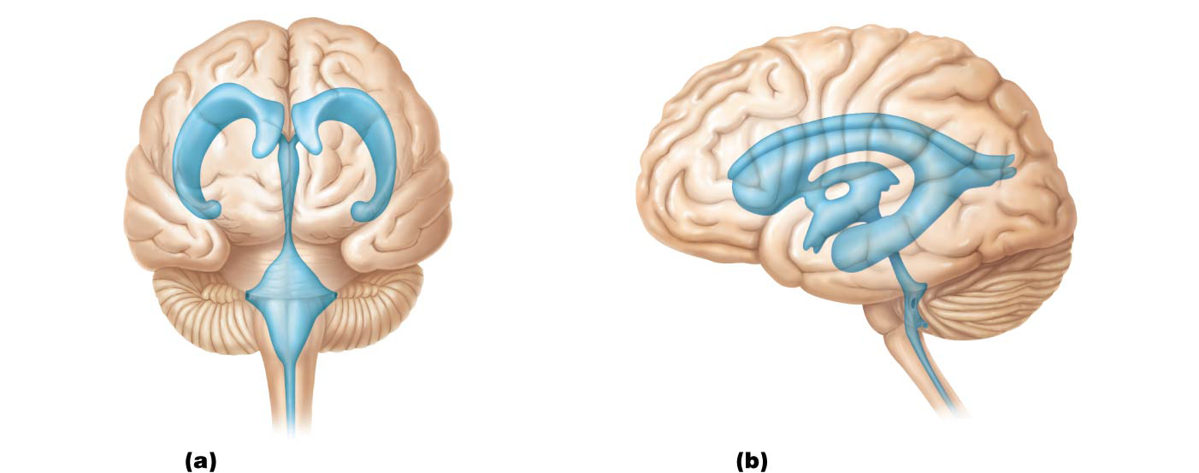
Figure 12.4 Ventricles of the brain.
Lateral ventricle
Anterior horn
Posterior
horn
Septum
pellucidum
Interventricular
foramen
Inferior
horn
Inferior
horn
Third ventricle
Lateral
aperture
Cerebral aqueduct
Lateral
aperture
Fourth ventricle
Median
aperture
Central canal
Anterior view
Left lateral view

Slide 25
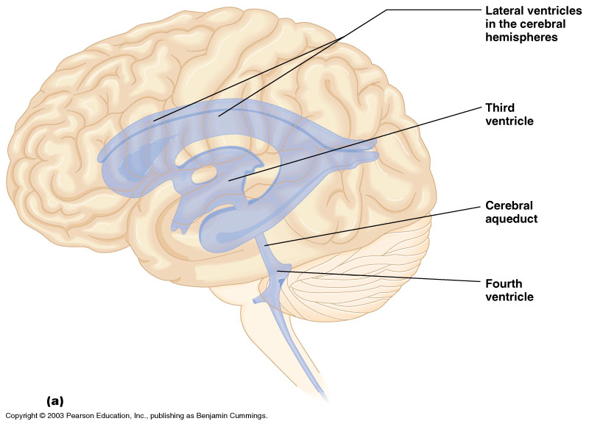
Ventricles and Location of the Cerebrospinal Fluid
Figure 7.17a
Copyright © 2003 Pearson Education, Inc. publishing as Benjamin Cummings
Slide 7.47a

Slide 26
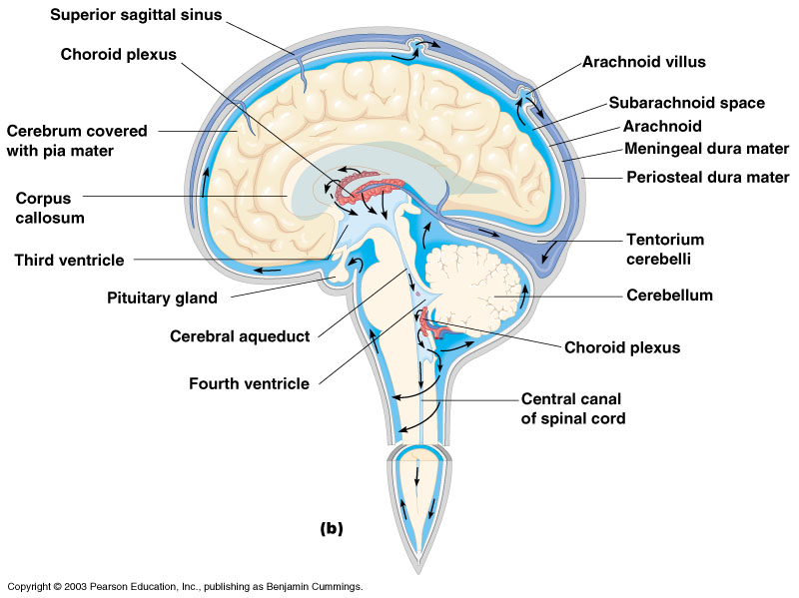
Ventricles and Location of the Cerebrospinal Fluid
Figure 7.17b
Copyright © 2003 Pearson Education, Inc. publishing as Benjamin Cummings
Slide 7.47b

Slide 27
Circulation of CSF
Path of CSF:
1. Secreted by 1st and 2nd lateral ventricles
2. Flows to 3rd ventricle (in middle)
3. Through Aqueduct of Sylvius
4. Through 4th ventricle (joins spinal cord as central canal)
5. Through subarachnoid space around brain
6. Passes back into venous blood through arachnoid granulations (villi)

Slide 28
CSF
CSF is secreted by the lateral ventricles and reabsorbed by the blood in the subarachnoid space.
Hydrocephalus is a blockage in the 4th ventricles so that CSF stays around the brain.

Slide 29
Blood Brain Barrier
Includes the least permeable capillaries of the body
Excludes many potentially harmful substances
Useless against some substances
Fats and fat soluble molecules
Respiratory gases
Alcohol
Nicotine
Anesthesia
Copyright © 2003 Pearson Education, Inc. publishing as Benjamin Cummings
Slide 7.48

