Slide 1
Cell Diagrams
You will need to be able to label a cell diagram. This is the example from your text. You will have a similar diagram on your exam (NOT the same one).

Slide 2
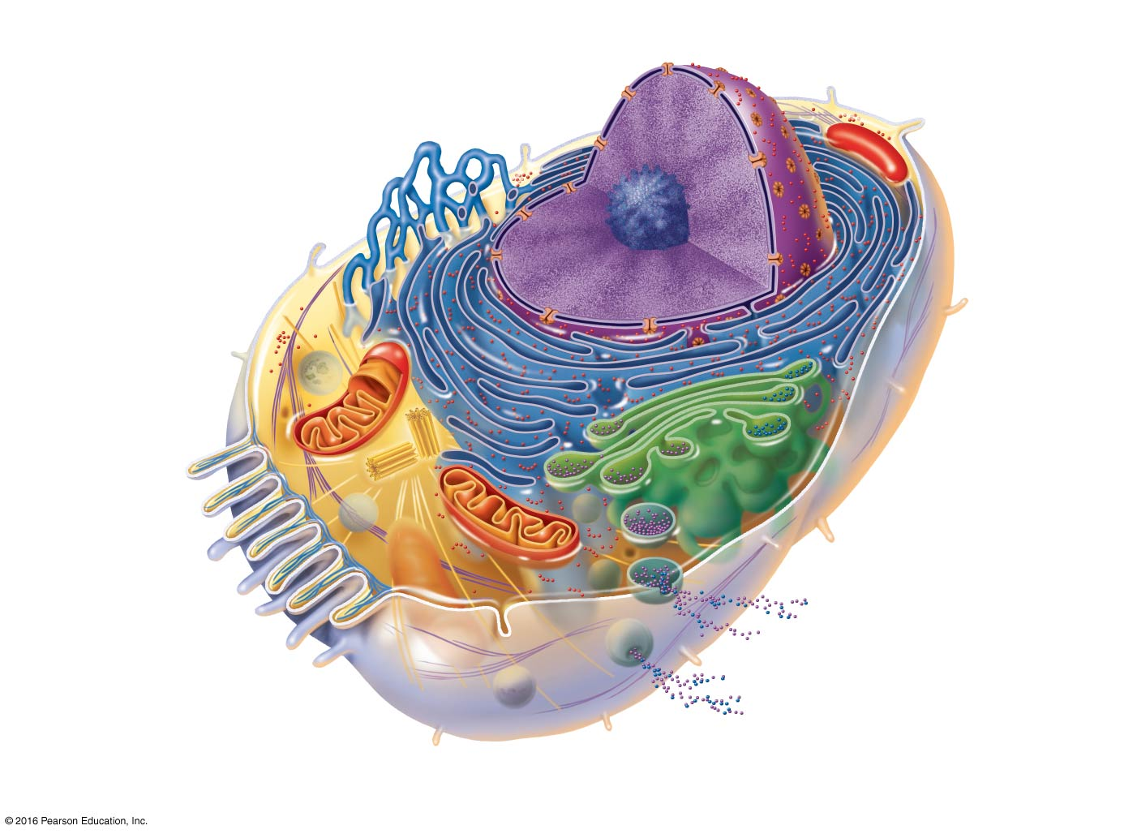
Cell diagram w/labels.
Nucleus
Nuclear envelope
Chromatin
Nucleolus
Nuclear pore
Smooth endoplasmic
reticulum
Plasma
membrane
Cytosol
Mitochondrion
Lysosome
Centrioles
Rough
endoplasmic
reticulum
Centrosome
matrix
Ribosomes
Golgi apparatus
Microvilli
Secretion being released
from cell by exocytosis
Microfilament
Microtubule
Cytoskeletal
elements
Intermediate
filaments
Peroxisome

Slide 3
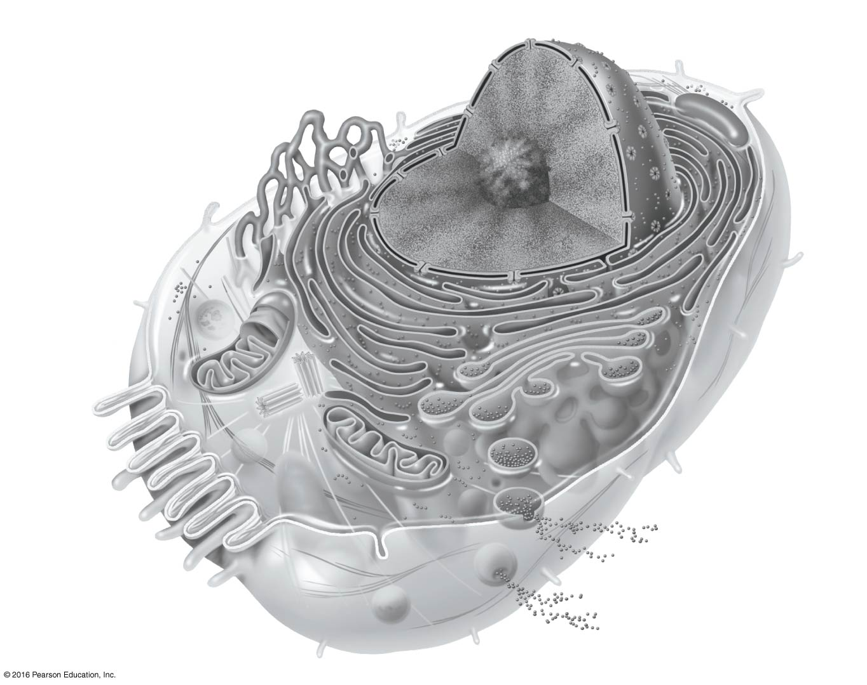
For practice:

Slide 4
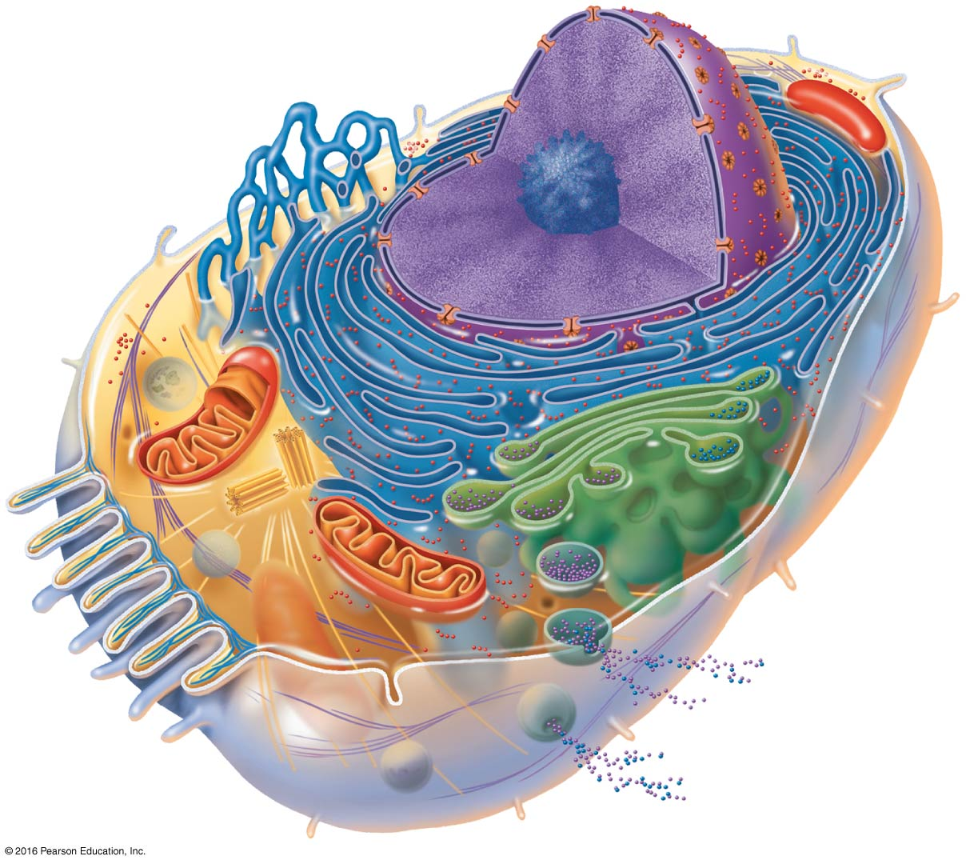
For Practice:

