Slide 1
The Brain

Slide 2
4 Major Regions of the Brain
The brain is composed of 4 regions:
1. Brainstem- connects brain to spinal cord
2. Diencephalon- the interbrain (inner part)
3. Cerebrum- “cerebral hemispheres”; makes up 3/4 of the brain
4. Cerebellum- “small brain”; 2nd largest area of brain

Slide 3
Brain Stem
Midbrain
Pons
Medulla oblongata

Slide 4
Brain Stem
Consists of three regions: midbrain, pons, medulla oblongata
Similar in structure to spinal cord but contains nuclei embedded in white matter
Controls automatic behaviors necessary for survival
Contains fiber tracts connecting higher and lower neural centers
Nuclei are associated with 10 of the 12 pairs of cranial nerves

Slide 5
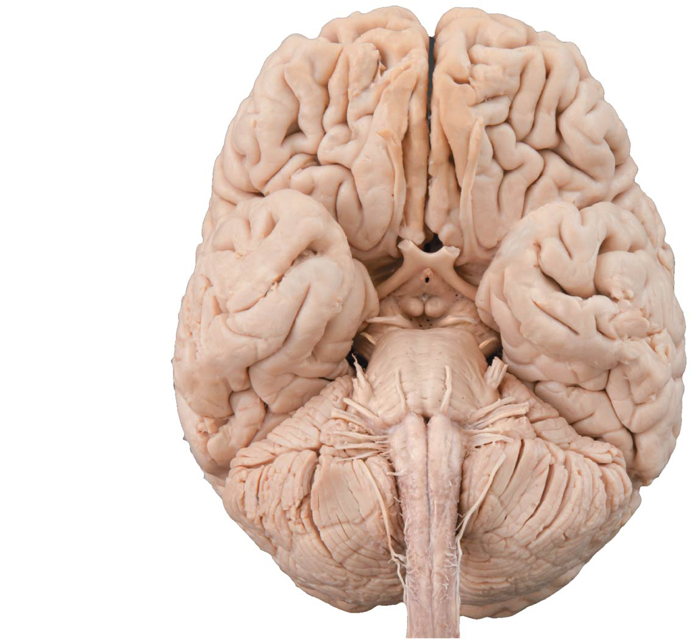
Figure 12.14 Inferior view of the brain, showing the three parts of the brain stem: midbrain, pons, and medulla oblongata.
Frontal lobe
Olfactory bulb
(synapse point of
cranial nerve I)
Optic chiasma
Optic nerve (II)
Optic tract
Mammillary body
Midbrain
Pons
Temporal
lobe
Medulla
oblongata
Cerebellum
Spinal cord

Slide 6
Brain Stem
Brain stem- gray matter surrounded by white (like spinal cord)
About 1inch long
Most cranial nerves arise from this area (all except 2)

Slide 7
Medulla Oblongata
Medulla- responsible for vital functions such as
a. Heart rate
b. Blood vessel diameter
c. Breathing
d. Reflex center (vomiting, coughing, sneezing, swallowing)
* Cranial nerves- IX, X, XI, XII
*some sources have cranial nerve VIII originating here

Slide 8
Medulla Oblongata
Also known as medulla
Blends into spinal cord at foramen magnum
Contains fourth ventricle
Continuation of central canal of spinal cord
Medulla and pons form ventral wall
Contains choroid plexus: capillary-rich membrane that forms cerebral spinal fluid

Slide 9
Pons
Pons- “bridge”; less than 1 inch long
contains ascending/ descending nerve tracts
relay center between cerebrum and cerebellum
Some nuclei play role in reticular formation, and some help maintain normal rhythm of breathing
Cranial nerves V, VI, VII, VIII
*some sources do not have cranial nerve VIII originating here

Slide 10
Midbrain
Located between diencephalon and pons
Cerebral peduncles: two ventral bulges that contain pyramidal motor tracts
Form pillars that hold up cerebrum
Cerebral aqueduct: channel running through midbrain that connects third and fourth ventricles

Slide 11
Midbrain
Midbrain- highest part of brain stem
responsible for:
a. Movement of head to respond to light/ sound
b. Change shape of lens in eye
Cranial nerves III, IV
Reticular Formation- extends through central core of pons, medulla, and midbrain
responsible for keeping brain alert by sending continuous stream of impulses to cerebral cortex

Slide 12
Diencephalon (Interbrain)
Interbrain composed of primarily gray matter
Source of only 2 cranial nerves

Slide 13
The Diencephalon
Consists of three paired gray-matter structures:
Thalamus
Hypothalamus
Epithalamus
All three enclose third ventricle

Slide 14
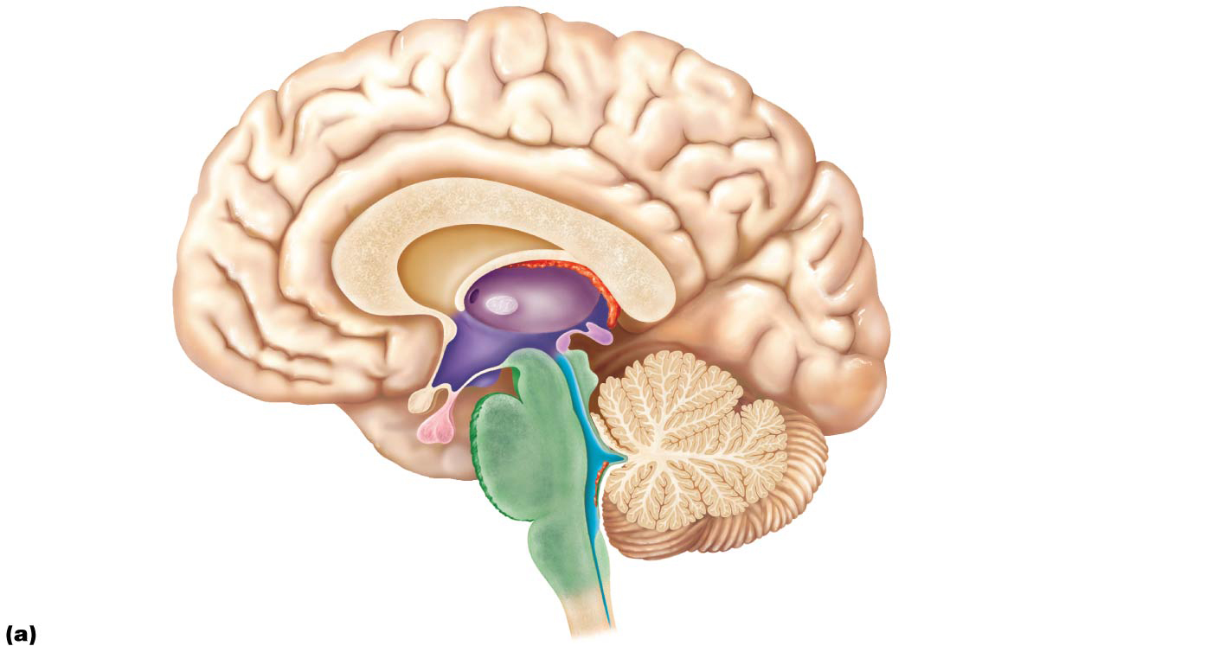
Figure 12.11a Midsagittal section of the brain.
Cerebral hemisphere
Septum pellucidum
Interthalamic
adhesion
(intermediate
mass of thalamus)
Corpus callosum
Fornix
Choroid plexus
Thalamus
(encloses third ventricle)
Interventricular
foramen
Posterior
commissure
Epithalamus
Anterior
commissure
Pineal gland
Hypothalamus
Corpora
quadrigemina
Optic chiasma
Cerebral
aqueduct
Midbrain
Pituitary gland
Arbor vitae (of cerebellum)
Mammillary body
Fourth ventricle
Pons
Choroid plexus
Medulla oblongata
Cerebellum
Spinal cord

Slide 15
Thalamus
Thalamus- largest, 80% of diencephalon; held together by “intermediate mass”; called “gateway to cerebral cortex”(all impulses go through here)
a. Influences mood
b. Registers pain
c. Relay center to cerebrum
d. Memory processing/ learning
Cranial nerves I and II

Slide 16
Hypothalamus
Hypothalamus-- small
contains Pituitary gland connected by a stalk (infundibulum)
maintain “homeostasis”
part of limbic system
main visceral (organs) control center of body.

Slide 17
Hypothalamus
The hypothalamus is the main visceral control and regulating center that is vital to homeostasis
Chief homeostasis controls:
Controls autonomic nervous system
Examples: blood pressure, rate and force of heartbeat, digestive tract motility, pupil size
Initiates physical responses to emotions
Part of limbic system: perceives pleasure, fear, rage, biological rhythms, and drives (sex drive)

Slide 18
Hypothalamus
The hypothalamus also:
Regulates body temperature: sweating or shivering
Regulates hunger and satiety in response to nutrient blood levels or hormones
Regulates water balance and thirst
Regulates sleep-wake cycles
Suprachiasmatic nucleus of thalamus sets our biological clock

Slide 19
Hypothalamus
Controls endocrine system functions such as:
Secretions of anterior pituitary gland
Production of posterior pituitary hormones

Slide 20
Hypothalamus is responsible for:
1. Temperature
2. Hunger
3. Thirst
4. Pleasure/ displeasure
5. growth
6. Secrete and control hormones
7. Odor (mamillary body)
8. Appetite
9. Rage/ anger

Slide 21
Epithalamus
Epithalamus-
forms the roof of the 3rd ventricle;
contains pineal body (endocrine gland responsible for sexual maturity)
as well as the choroid plexus (forms CSF)
secretes melatonin that helps regulate sleep-wake cycle

Slide 22
Figure 12.11a Midsagittal section of the brain.
Cerebral hemisphere
Septum pellucidum
Interthalamic
adhesion
(intermediate
mass of thalamus)
Corpus callosum
Fornix
Choroid plexus
Thalamus
(encloses third ventricle)
Interventricular
foramen
Posterior
commissure
Epithalamus
Anterior
commissure
Pineal gland
Hypothalamus
Corpora
quadrigemina
Optic chiasma
Cerebral
aqueduct
Midbrain
Pituitary gland
Arbor vitae (of cerebellum)
Mammillary body
Fourth ventricle
Pons
Choroid plexus
Medulla oblongata
Cerebellum
Spinal cord

Slide 23
Cerebrum
Cerebrum- 3/4 of brain; “cerebral hemispheres”; gray matter outside, white matter inside
1. Motor function
2. Sensory function
3. Association (integrate information)

Slide 24
Cerebral Hemispheres
Cerebral hemispheres form superior part of brain
Account for 83% of brain mass
Surface markings:
Gyri: ridges
Sulci: shallow grooves
Fissures: deep grooves
Longitudinal fissure
Separates two hemispheres
Transverse cerebral fissure
Separates cerebrum and cerebellum

Slide 25
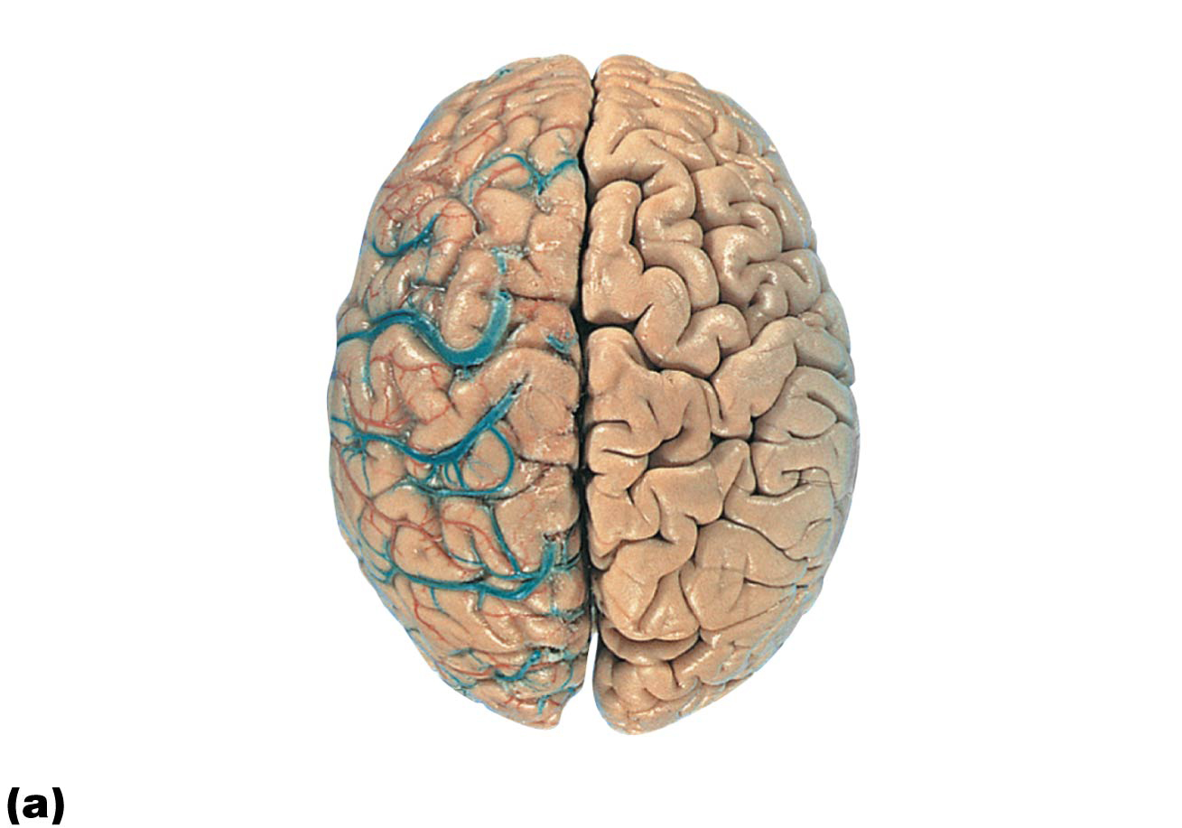
Figure 12.5a Lobes, sulci, and fissures of the cerebral hemispheres.
Anterior
Longitudinal
fissure
Frontal lobe
Cerebral veins
and arteries
covered by
arachnoid
mater
Parietal lobe
Left cerebral
hemisphere
Right cerebral
hemisphere
Occipital
lobe
Posterior
Superior view

Slide 26
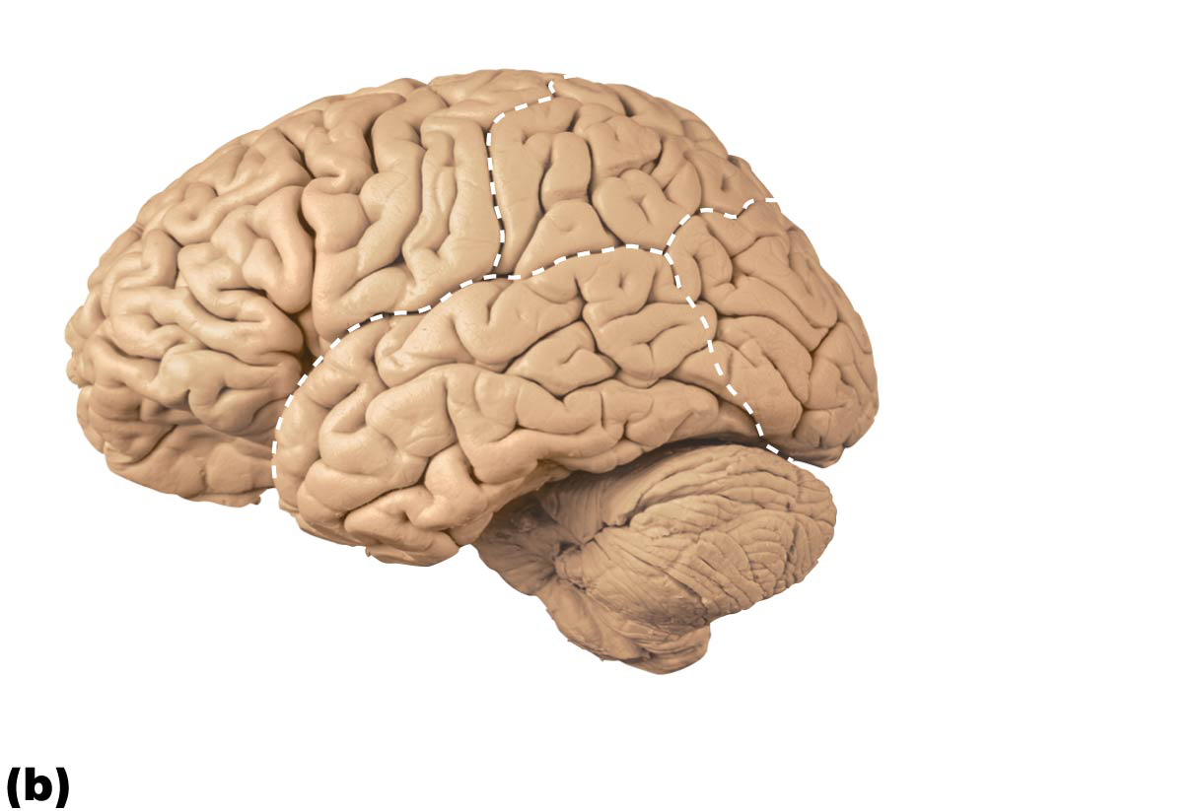
Figure 12.5b Lobes, sulci, and fissures of the cerebral hemispheres.
Frontal
lobe
Parietal
lobe
Occipital
lobe
Transverse
cerebral
fissure
Temporal
lobe
Brain stem
Cerebellum
Left lateral view

Slide 27
Cerebral Hemispheres
Several sulci divide each hemisphere into five lobes
Frontal
Parietal
Temporal
Occipital
Insula

Slide 28
Cerebral Hemispheres
First four are named after overlying skull bones
Insular lobe is buried under portions of temporal, parietal, and frontal lobes

Slide 29
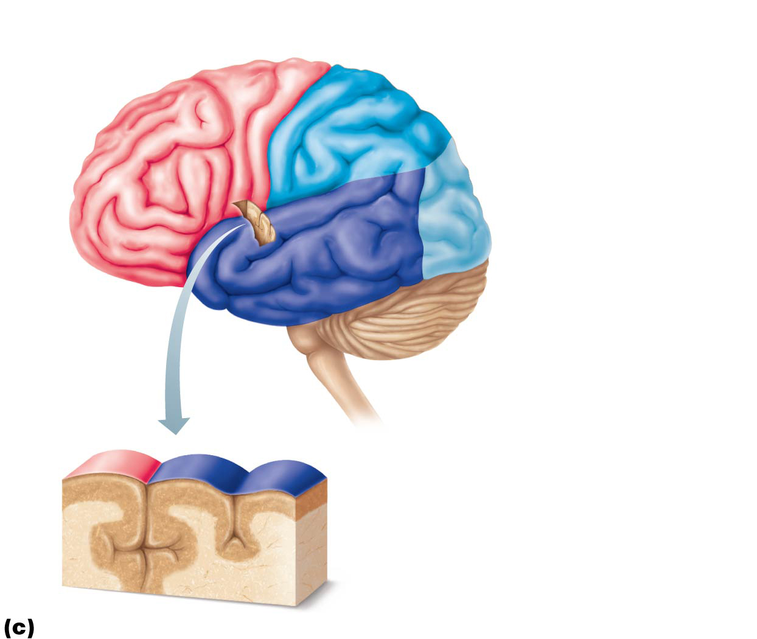
Figure 12.5c Lobes, sulci, and fissures of the cerebral hemispheres.
Precentral
gyrus
Central
sulcus
Postcentral
gyrus
Frontal lobe
Parietal lobe
Parieto-occipital sulcus
(on medial surface
of hemisphere)
Lateral sulcus
Occipital lobe
Temporal lobe
Transverse
cerebral fissure
Cerebellum
Fissure
(a deep
sulcus)
Gyrus
Cortex (gray matter)
Sulcus
White matter
Lobes and sulci of the cerebrum

Slide 30
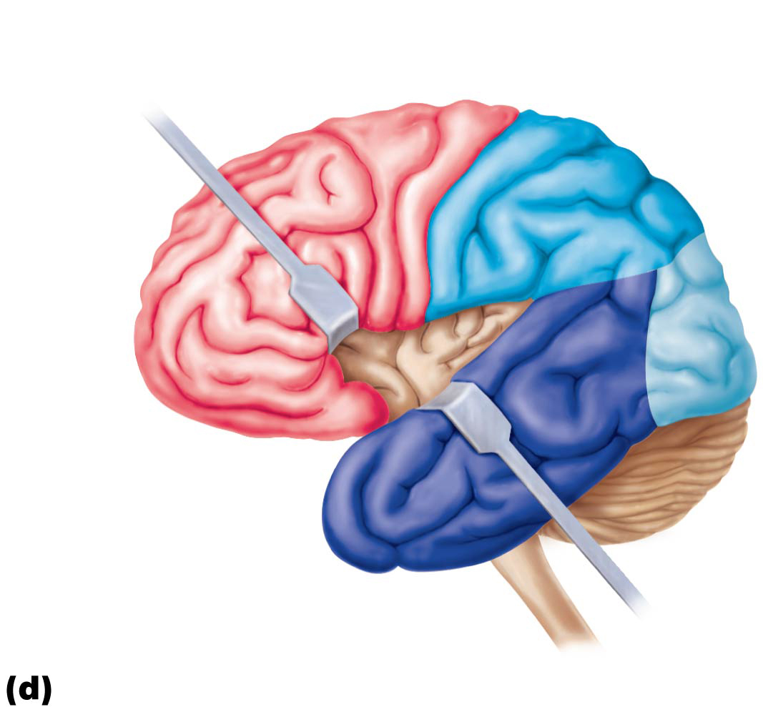
Figure 12.5d Lobes, sulci, and fissures of the cerebral hemispheres.
Central
sulcus
Frontal lobe
Gyri of insula
Temporal lobe
(pulled down)
Location of the insula (or insular lobe)

Slide 31
Cerebral Hemispheres
Major sulci that divide lobes:
Central sulcus separates precentral gyrus of frontal lobe and postcentral gyrus of parietal lobe
Parieto-occipital sulcus separates occipital and parietal lobes
Lateral sulcus outlines temporal lobes
Each hemisphere has three basic regions:
Cerebral cortex of gray matter superficially
White matter internally
Basal nuclei deep within white matter

Slide 32
Figure 12.5c Lobes, sulci, and fissures of the cerebral hemispheres.
Precentral
gyrus
Central
sulcus
Postcentral
gyrus
Frontal lobe
Parietal lobe
Parieto-occipital sulcus
(on medial surface
of hemisphere)
Lateral sulcus
Occipital lobe
Temporal lobe
Transverse
cerebral fissure
Cerebellum
Fissure
(a deep
sulcus)
Gyrus
Cortex (gray matter)
Sulcus
White matter
Lobes and sulci of the cerebrum

Slide 33
Cerebral Cortex
Cerebral cortex is “executive suite” of brain
Site of conscious mind: awareness, sensory perception, voluntary motor initiation, communication, memory storage, understanding
Thin (2–4 mm) superficial layer of gray matter
Composed of neuron cell bodies, dendrites, glial cells, and blood vessels, but no axons
40% of mass of brain

Slide 34
Cerebral Cortex
Functional imaging (PET and MRI) of brain show specific motor and sensory functions are located in discrete cortical areas called domains
Higher functions are spread over many areas

Slide 35
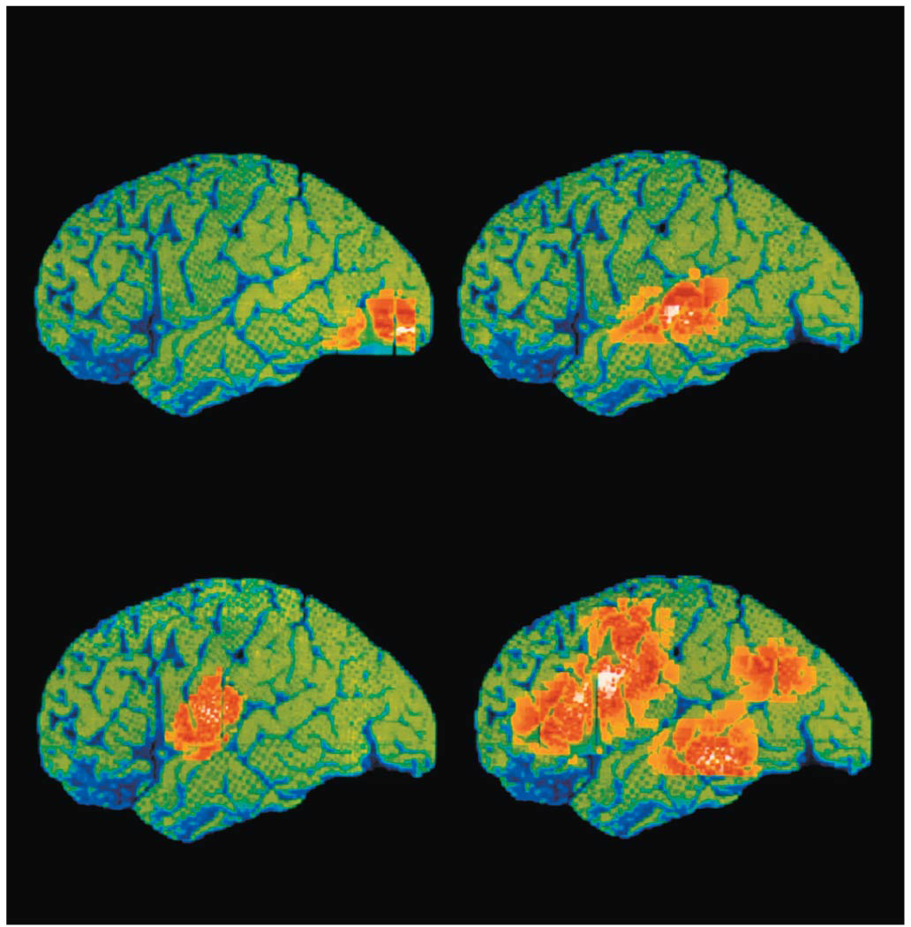
Figure 12.6 Functional neuroimaging (fMRI) of the cerebral cortex.
Seeing
Hearing
Speaking
Thinking

Slide 36
Cerebral Cortex
Four general considerations of cerebral cortex:
Contains three types of functional areas:
Motor areas: control voluntary movement
Sensory areas: conscious awareness of sensation
Association areas: integrate diverse information
Each hemisphere is concerned with contralateral (opposite) side of body
Lateralization (specialization) of cortical function can occur in only one hemisphere
Conscious behavior involves entire cortex in one way or another

Slide 37
Cerebral Cortex
Motor areas
Located in frontal lobe, motor areas act to control voluntary movement
Primary motor cortex in precentral gyrus
Premotor cortex anterior to precentral gyrus
Broca’s area anterior to inferior premotor area
Frontal eye field within and anterior to premotor cortex; superior to Broca’s area

Slide 38
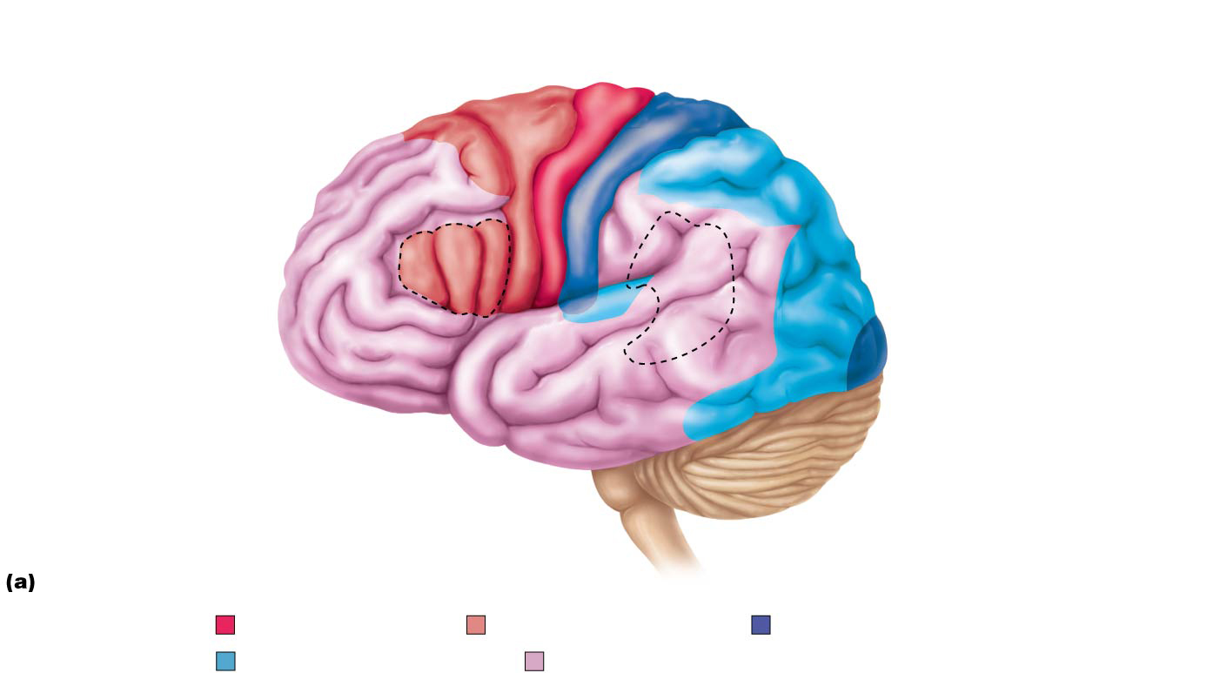
Figure 12.7a Functional and structural areas of the cerebral cortex.
Sensory areas and related
association areas
Motor areas
Central sulcus
Primary motor cortex
Primary somatosensory
cortex
Premotor cortex
Somatic
sensation
Frontal eye field
Somatosensory
association cortex
Broca’s area
(outlined by dashes)
Gustatory cortex
(in insula)
Taste
Anterior association area
(prefrontal cortex)
Wernicke’s area
(outlined by dashes
within the posterior
association area)
Working memory for
spatial tasks
Executive area for task
management
Primary visual
cortex
Solving complex,
multitask problems
Vision
Visual
association area
Working memory for
object-recall tasks
Auditory
association area
Primary
auditory cortex
Hearing
Lateral view, left cerebral hemisphere
Primary motor cortex
Motor association cortex
Primary sensory cortex
Sensory association cortex
Multimodal association cortex

Slide 39
Cerebral Cortex (cont.)
Primary (somatic) motor cortex
Located in precentral gyrus of frontal lobe
Pyramidal cells: large neurons that allow conscious control of precise, skilled, skeletal muscle movements
Pyramidal (corticospinal) tracts: formed from long axons that project down spinal cord
Somatotopy: all muscles of body can be mapped to area on primary motor cortex
Motor homunculi: upside-down caricatures represent contralateral motor innervation of body regions

Slide 40
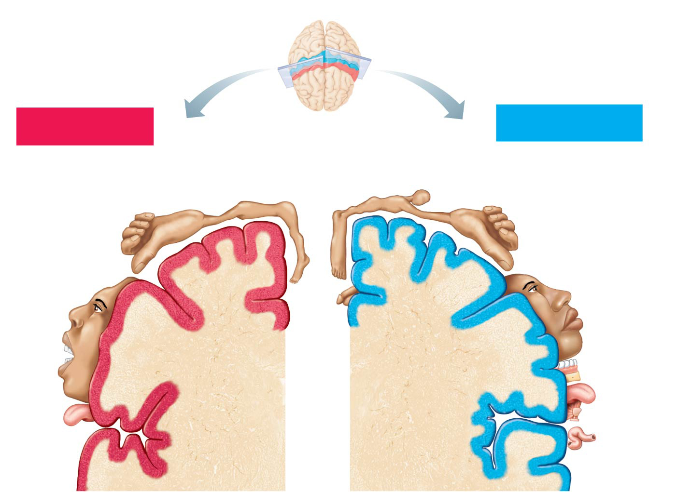
Figure 12.8 Body maps in the primary motor cortex and somatosensory cortex of the cerebrum.
Posterior
Motor map in
precentral gyrus
Motor
Sensory
Sensory map in
postcentral gyrus
Anterior
Shoulder
Trunk
Head
Trunk
Leg
Hip
Neck
Arm
Forearm
Arm
Hip
Elbow
Elbow
Hand
Wrist
Knee
Hand
Fingers
Fingers
Knee
Thumb
Thumb
Neck
Foot
Eye
Brow
Nose
Eye
Toes
Face
Genitals
Lips
Face
Lips
Teeth
Gums
Jaw
Jaw
Tongue
Tongue
Primary motor
cortex
(precentral gyrus)
Primary somato-
sensory cortex
(postcentral gyrus)
Pharynx
Swallowing
Intra-
abdominal

Slide 41
Cerebral Cortex (cont.)
Premotor cortex
Helps plan movements
Staging area for skilled motor activities
Controls learned, repetitious, or patterned motor skills
Coordinates simultaneous or sequential actions
Controls voluntary actions that depend on sensory feedback

Slide 42
Cerebral Cortex (cont.)
Broca’s area
Present in one hemisphere (usually the left)
Motor speech area that directs muscles of speech production
Active in planning speech and voluntary motor activities
Frontal eye field
Controls voluntary eye movements

Slide 43
Clinical – Homeostatic Imbalance 12.1
Damage to areas of primary motor cortex, as seen in a stroke, paralyzes muscles controlled by those areas
Paralysis occurs on opposite side of body from damage

Slide 44
Clinical – Homeostatic Imbalance 12.1
Muscle strength or ability to perform discrete individual movements is not impaired; only control over movements is lost
Example: damage to premotor area controlling movement of fingers would still allow fingers to move, but voluntary control needed to type would be lost
Other premotor neurons can be reprogrammed to take over skill of damaged neurons
Would require practice, just as the initial learning process did

Slide 45
Cerebral Cortex
Sensory areas
Areas of cortex concerned with conscious awareness of sensation
Occur in parietal, insular, temporal, and occipital lobes
Eight main areas include primary somatosensory cortex, somatosensory association cortex, visual areas, auditory areas, vestibular cortex, olfactory cortex, gustatory cortex, and visceral sensory area

Slide 46
Cerebral Cortex
Primary somatosensory cortex
Located in postcentral gyri of parietal lobe
Receives general sensory information from skin and proprioceptors of skeletal muscle, joints, and tendons
Capable of spatial discrimination: identification of body region being stimulated
Somatosensory homunculus: upside-down caricatures represent contralateral sensory input from body regions

Slide 47
Figure 12.8 Body maps in the primary motor cortex and somatosensory cortex of the cerebrum.
Posterior
Motor map in
precentral gyrus
Motor
Sensory
Sensory map in
postcentral gyrus
Anterior
Shoulder
Trunk
Head
Trunk
Leg
Hip
Neck
Arm
Forearm
Arm
Hip
Elbow
Elbow
Hand
Wrist
Knee
Hand
Fingers
Fingers
Knee
Thumb
Thumb
Neck
Foot
Eye
Brow
Nose
Eye
Toes
Face
Genitals
Lips
Face
Lips
Teeth
Gums
Jaw
Jaw
Tongue
Tongue
Primary motor
cortex
(precentral gyrus)
Primary somato-
sensory cortex
(postcentral gyrus)
Pharynx
Swallowing
Intra-
abdominal

Slide 48
Cerebral Cortex
Somatosensory association cortex
Posterior to primary somatosensory cortex
Integrates sensory input from primary somatosensory cortex for understanding of object
Determines size, texture, and relationship of parts of objects being felt

Slide 49
Cerebral Cortex
Visual areas
Primary visual (striate) cortex located on extreme posterior tip of occipital lobe
Most buried in calcarine sulcus
Receives visual information from retinas
Visual association area surrounds primary visual cortex
Uses past visual experiences to interpret visual stimuli (color, form, or movement)
Example: ability to recognize faces
Complex processing involves entire posterior half of cerebral hemispheres

Slide 50
Cerebral Cortex
Auditory areas
Primary auditory cortex
Superior margin of temporal lobes
Interprets information from inner ear as pitch, loudness, and location
Auditory association area
Located posterior to primary auditory cortex
Stores memories of sounds and permits perception of sound stimulus

Slide 51
Cerebral Cortex
Vestibular cortex
Posterior part of insula and adjacent parietal cortex
Responsible for conscious awareness of balance (position of head in space)

Slide 52
Cerebral Cortex
OIfactory cortex
Primary olfactory (smell) cortex
Medial aspect of temporal lobes (in piriform lobes)
Part of primitive rhinencephalon, along with olfactory bulbs and tracts
Remainder of rhinencephalon in humans becomes part of limbic system
Involved in conscious awareness of odors

Slide 53
Cerebral Cortex
Gustatory cortex
In insula just deep to temporal lobe
Involved in perception of taste
Visceral sensory area
Posterior to gustatory cortex
Conscious perception of visceral sensations, such as upset stomach or full bladder

Slide 54
Figure 12.7a Functional and structural areas of the cerebral cortex.
Sensory areas and related
association areas
Motor areas
Central sulcus
Primary motor cortex
Primary somatosensory
cortex
Premotor cortex
Somatic
sensation
Frontal eye field
Somatosensory
association cortex
Broca’s area
(outlined by dashes)
Gustatory cortex
(in insula)
Taste
Anterior association area
(prefrontal cortex)
Wernicke’s area
(outlined by dashes
within the posterior
association area)
Working memory for
spatial tasks
Executive area for task
management
Primary visual
cortex
Solving complex,
multitask problems
Vision
Visual
association area
Working memory for
object-recall tasks
Auditory
association area
Primary
auditory cortex
Hearing
Lateral view, left cerebral hemisphere
Primary motor cortex
Motor association cortex
Primary sensory cortex
Sensory association cortex
Multimodal association cortex

Slide 55
Clinical – Homeostatic Imbalance 12.2
Damage to the primary visual cortex results in functional blindness
By contrast, individuals with a damaged visual association area can see, but they do not comprehend what they are looking at

Slide 56
Cerebral Cortex
Multimodal association areas
Receive inputs from multiple sensory areas
Send outputs to multiple areas
Allows us to give meaning to information received, store in memory, tie to previous experience, and decide on actions
Sensations, thoughts, emotions become conscious: makes us who we are
Broadly divided into three parts: anterior association area, posterior association area, and limbic association area

Slide 57
Cerebral Cortex
Anterior association area
Also called prefrontal cortex
Most complicated cortical region
Involved with intellect, cognition, recall, and personality
Contains working memory needed for abstract ideas, judgment, reasoning, persistence, and planning
Development depends on feedback from social environment

Slide 58
Cerebral Cortex
Posterior association area
Large region in temporal, parietal, and occipital lobes
Plays role in recognizing patterns and faces and localizing us in space
Involved in understanding written and spoken language (Wernicke’s area)

Slide 59
Cerebral Cortex
Limbic association area
Part of limbic system
Involves cingulate gyrus, parahippocampal gyrus, and hippocampus
Provides emotional impact that makes a scene important to us and helps establish memories

Slide 60
Clinical – Homeostatic Imbalance 12.3
Tumors or other lesions of the anterior association area may cause mental and personality disorders, including loss of judgment, attentiveness, and inhibitions
Affected individual may be oblivious to social restraints, perhaps becoming careless about personal appearance, or take risks

Slide 61
Clinical – Homeostatic Imbalance 12.3
Different problems arise for individuals with lesions in the part of the posterior association area that provides awareness of self in space
Individual may refuse to wash or dress the side of the body opposite to lesion because “that doesn’t belong to me”

Slide 62
Cerebral Cortex
Lateralization of cortical functioning
Lateralization: division of labor between hemispheres
Hemispheres are not identical
Cerebral dominance: refers to hemisphere that is dominant for language
90% of humans have left-sided dominance
Usually results in right-handedness
In other 10%, roles of hemispheres are reversed

Slide 63
Cerebral Cortex
Lateralization of cortical functioning (cont.)
Left hemisphere
Controls language, math, and logic
Right hemisphere
Visual-spatial skills, intuition, emotion, and artistic and musical skills
Hemispheres communicate almost instantaneously via fiber tracts and functional integration

Slide 64
Cerebellum
11% of brain mass
Located dorsal to pons and medulla
Processes input from cortex, brain stem, and sensory receptors to provide precise, coordinated movements of skeletal muscles
Also plays a major role in balance

Slide 65
Cerebellum
Cerebellum- “small brain”; 2nd largest part; gray matter outside; white inside; contains arbor vitae (“white tree”)
1. Coordination
2. Tone
3. balance

Slide 66
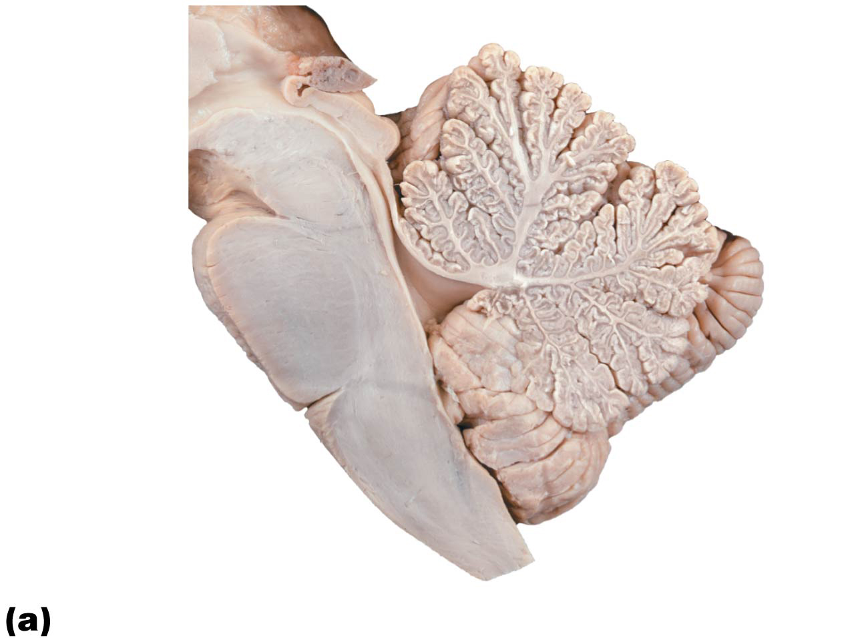
Figure 12.16a Cerebellum.
Anterior lobe
Arbor vitae
Cerebellar
cortex
Folia
Pons
Fourth ventricle
Posterior
lobe
Choroid plexus
Medulla oblongata

