Slide 1
Bone Development, Growth, and Repair

Slide 2
6.5 Bone Development
Ossification (osteogenesis) is the process of bone tissue formation
Formation of bony skeleton begins in month 2 of development
Postnatal bone growth occurs until early adulthood
Bone remodeling and repair are lifelong

Slide 3
Formation of the Bony Skeleton
Up to about week 8, fibrous membranes and hyaline cartilage of fetal skeleton are replaced with bone tissue
Endochondral ossification
Bone forms by replacing hyaline cartilage
Bones are called cartilage (endochondral) bones
Form most of skeleton
Intramembranous ossification
Bone develops from fibrous membrane
Bones are called membrane bones

Slide 4
Formation of the Bony Skeleton (cont.)
Endochondral ossification
Forms essentially all bones inferior to base of skull, except clavicles
Begins late in month 2 of development
Uses previously formed hyaline cartilage models
Requires breakdown of hyaline cartilage prior to ossification
Begins at primary ossification center in center of shaft
Blood vessels infiltrate perichondrium, converting it to periosteum
Mesenchymal cells specialize into osteoblasts

Slide 5
Formation of the Bony Skeleton (cont.)
Five main steps in the process of ossification:
Bone collar forms around diaphysis of cartilage model
Central cartilage in diaphysis calcifies, then develops cavities
Periosteal bud invades cavities, leading to formation of spongy bone
Bud is made up of blood vessels, nerves, red marrow, osteogenic cells, and osteoclasts

Slide 6
Formation of the Bony Skeleton (cont.)
Five main steps in the process of ossification (cont.):
Diaphysis elongates, and medullary cavity forms
Secondary ossification centers appear in epiphyses
Epiphyses ossify
Hyaline cartilage remains only in epiphyseal plates and articular cartilages

Slide 7
Figure 6.8 Endochondral ossification in a long bone.
Slide 2
Week 9
Hyaline
cartilage
Bone
collar
Primary
ossification
center
1
1
Bone collar forms around the diaphysis of the hyaline cartilage model.

Slide 8
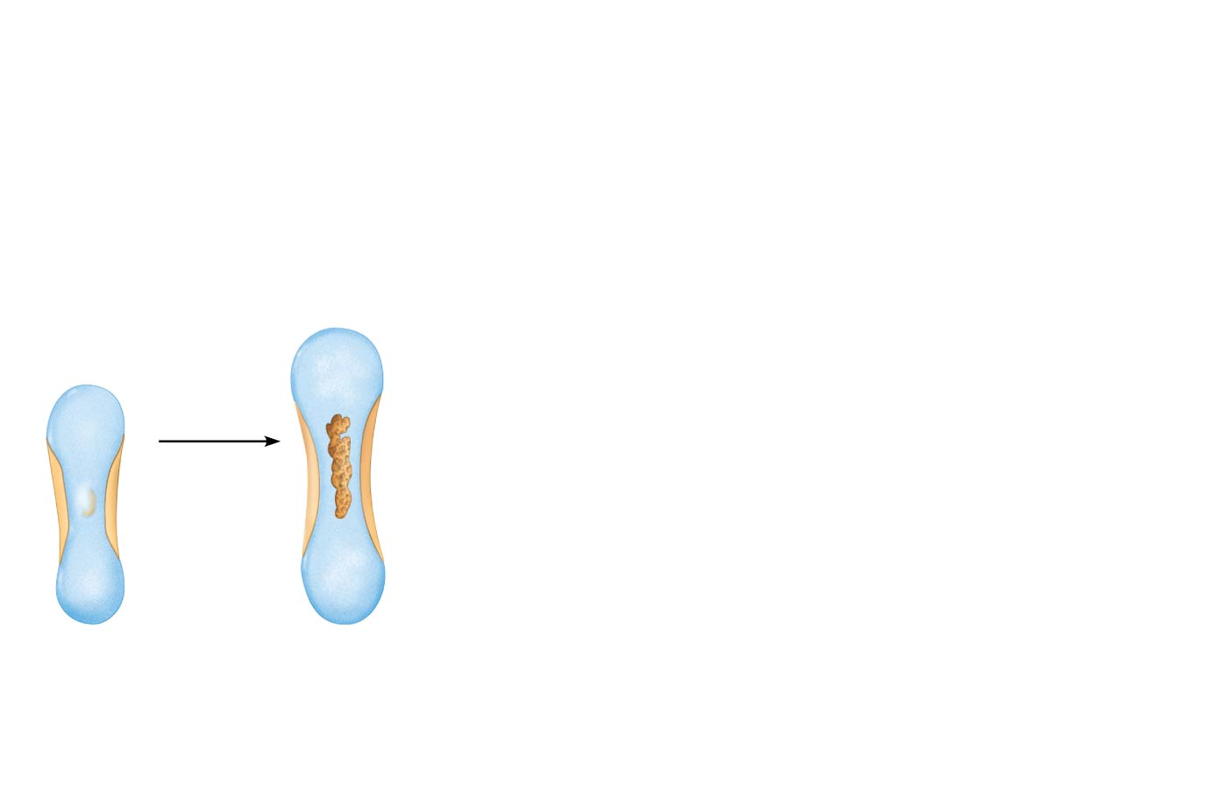
Figure 6.8 Endochondral ossification in a long bone.
Slide 3
Week 9
Area of
deteriorating
cartilage matrix
Hyaline
cartilage
Bone
collar
Primary
ossification
center
1
2
1
Cartilage in the center of the diaphysis calcifies and then develops cavities.
Bone collar forms around the diaphysis of the hyaline cartilage model.

Slide 9
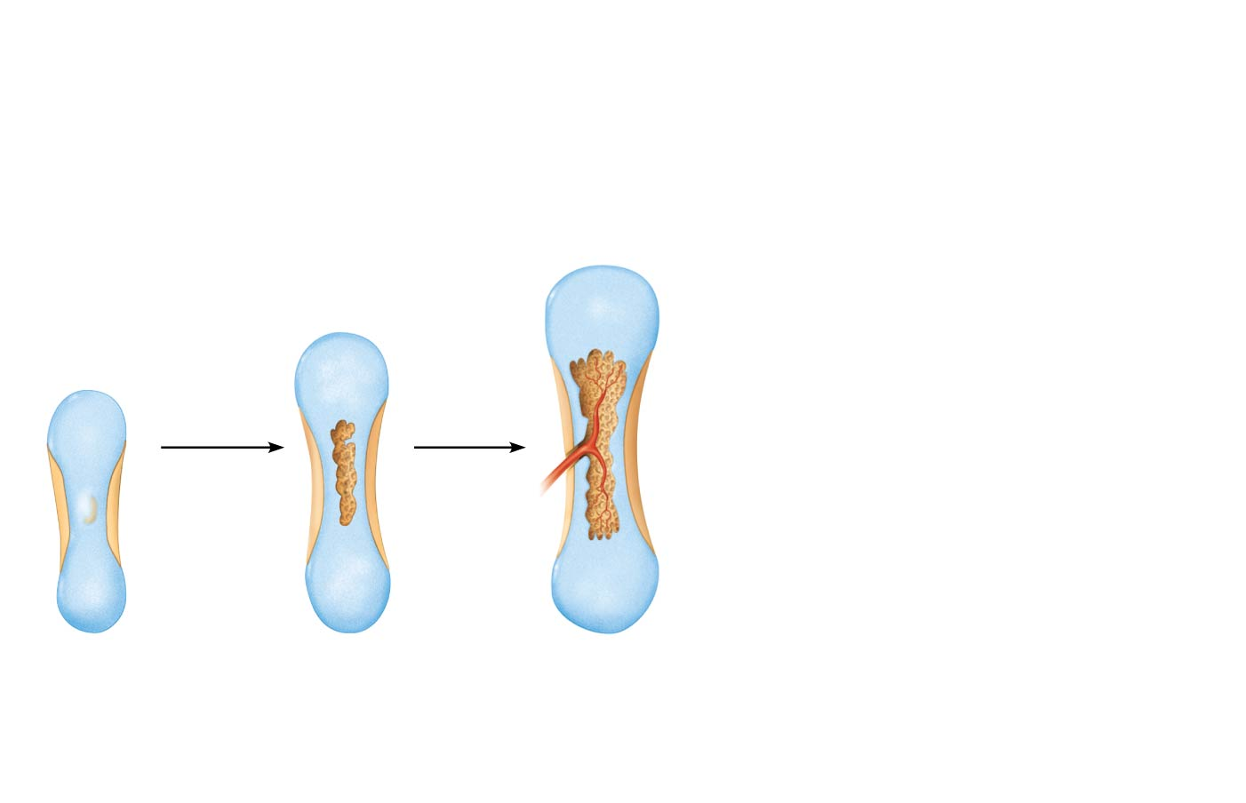
Figure 6.8 Endochondral ossification in a long bone.
Slide 4
Week 9
Month 3
Area of
deteriorating
cartilage matrix
Hyaline
cartilage
Spongy
bone
formation
Bone
collar
Blood
vessel of
periosteal
bud
Primary
ossification
center
1
2
3
1
Cartilage in the center of the diaphysis calcifies and then develops cavities.
The periosteal bud invades the internal cavities and spongy bone forms.
Bone collar forms around the diaphysis of the hyaline cartilage model.

Slide 10
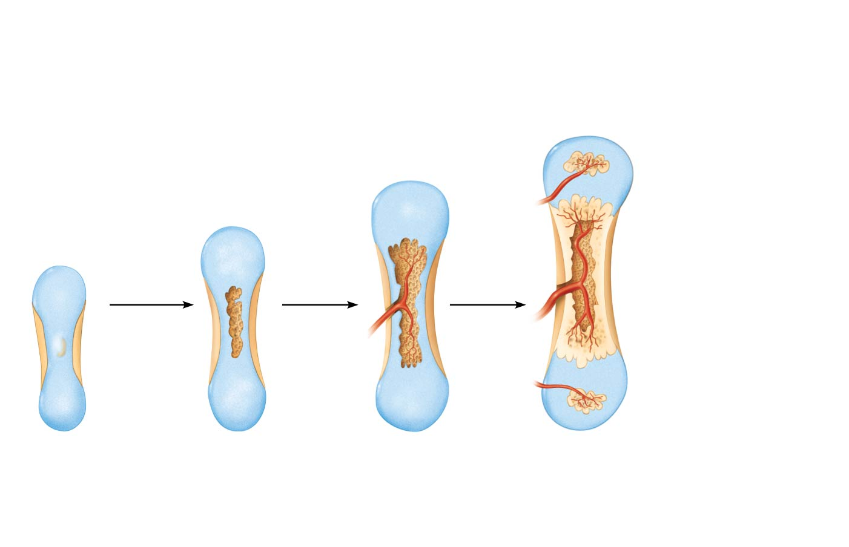
Figure 6.8 Endochondral ossification in a long bone.
Slide 5
Week 9
Month 3
Birth
Secondary
ossification
center
Epiphyseal
blood vessel
Area of
deteriorating
cartilage matrix
Hyaline
cartilage
Spongy
bone
formation
Medullary
cavity
Bone
collar
Blood
vessel of
periosteal
bud
Primary
ossification
center
1
2
3
4
1
Cartilage in the center of the diaphysis calcifies and then develops cavities.
The periosteal bud invades the internal cavities and spongy bone forms.
Bone collar forms around the diaphysis of the hyaline cartilage model.
The diaphysis elongates and a medullary cavity forms. Secondary ossification centers appear in the epiphyses.

Slide 11
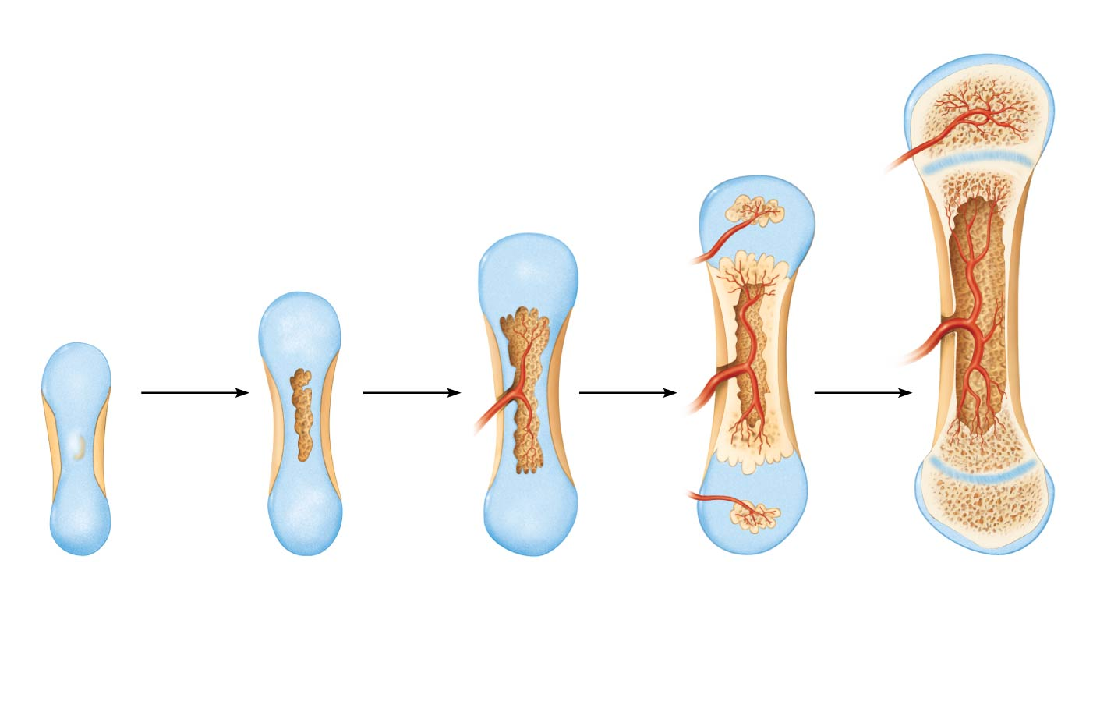
Figure 6.8 Endochondral ossification in a long bone.
Slide 6
Week 9
Month 3
Birth
Childhood to adolescence
Articular
cartilage
Secondary
ossification
center
Spongy
bone
Epiphyseal
blood vessel
Area of
deteriorating
cartilage matrix
Epiphyseal
plate
cartilage
Hyaline
cartilage
Spongy
bone
formation
Medullary
cavity
Bone
collar
Blood
vessel of
periosteal
bud
Primary
ossification
center
1
2
3
4
5
1
Cartilage in the center of the diaphysis calcifies and then develops cavities.
The periosteal bud invades the internal cavities and spongy bone forms.
The epiphyses ossify. When completed, hyaline cartilage remains only in the epiphyseal plates and articular cartilages.
Bone collar forms around the diaphysis of the hyaline cartilage model.
The diaphysis elongates and a medullary cavity forms. Secondary ossification centers appear in the epiphyses.

Slide 12
Formation of the Bony Skeleton (cont.)
Intramembranous ossification: begins within fibrous connective tissue membranes formed by mesenchymal cells
Forms frontal, parietal, occipital, temporal, and clavicle bones

Slide 13
Formation of the Bony Skeleton (cont.)
Four major steps are involved:
Ossification centers are formed when mesenchymal cells cluster and become osteoblasts
Osteoid is secreted, then calcified
Woven bone is formed when osteoid is laid down around blood vessels, resulting in trabeculae
Outer layer of woven bone forms periosteum
Lamellar bone replaces woven bone, and red marrow appears

Slide 14
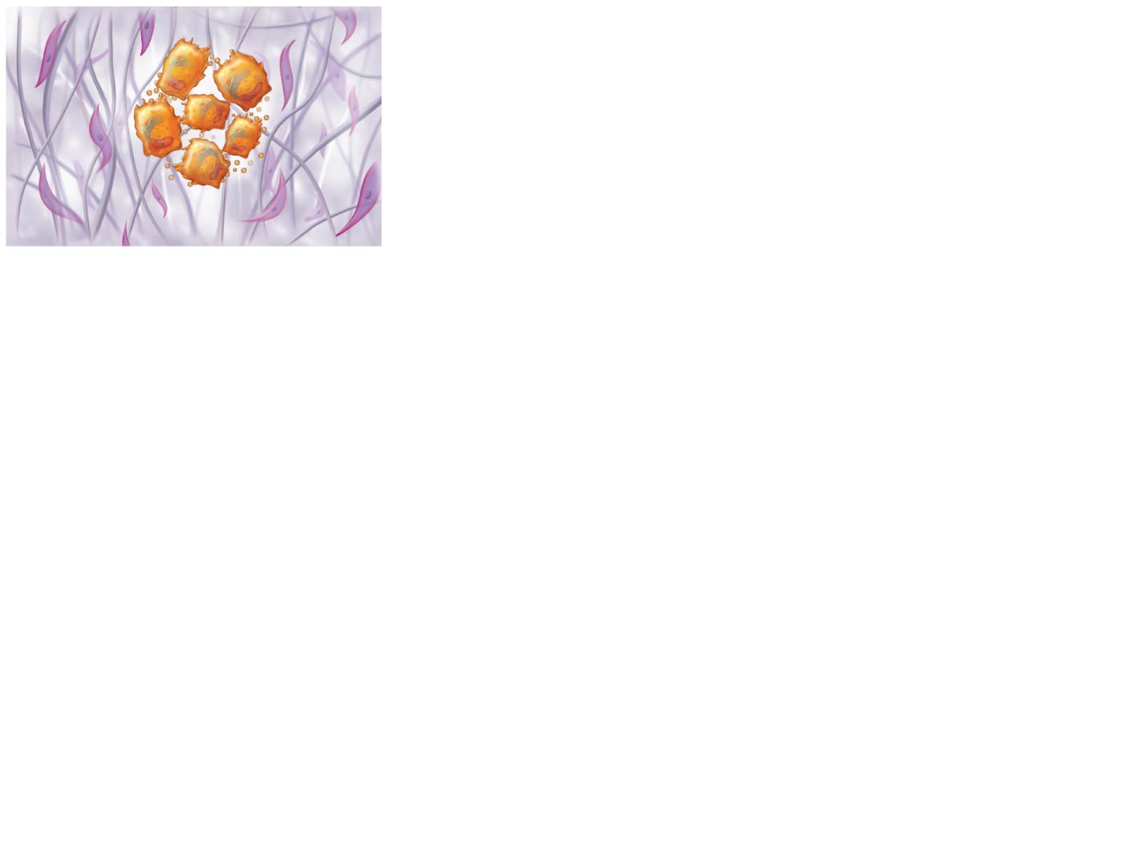
Figure 6.9 Intramembranous ossification.
Slide 2
Mesenchymal
cell
Collagen
fiber
Ossification
center
Osteoid
Osteoblast
1
Ossification centers appear in the fibrous connective tissue membrane.
• Selected centrally located mesenchymal cells cluster and differentiate into osteoblasts, forming an ossification center that produces the first trabeculae of spongy bone.

Slide 15
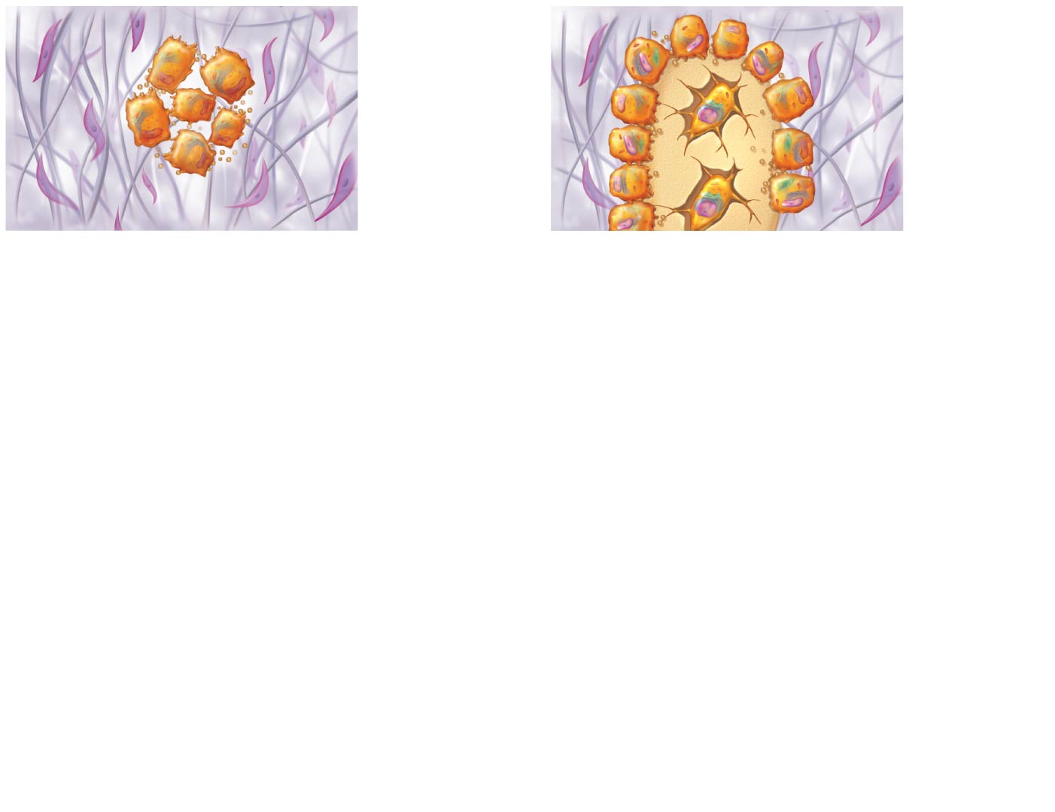
Figure 6.9 Intramembranous ossification.
Slide 3
Mesenchymal
cell
Osteoblast
Collagen
fiber
Osteoid
Ossification
center
Osteocyte
Newly calcified
bone matrix
Osteoid
Osteoblast
1
2
Ossification centers appear in the fibrous connective tissue membrane.
Osteoid is secreted within the fibrous membrane and calcifies.
• Selected centrally located mesenchymal cells cluster and differentiate into osteoblasts, forming an ossification center that produces the first trabeculae of spongy bone.
• Osteoblasts continue to secrete osteoid, which calcifies in a few days.
• Trapped osteoblasts become osteocytes.

Slide 16
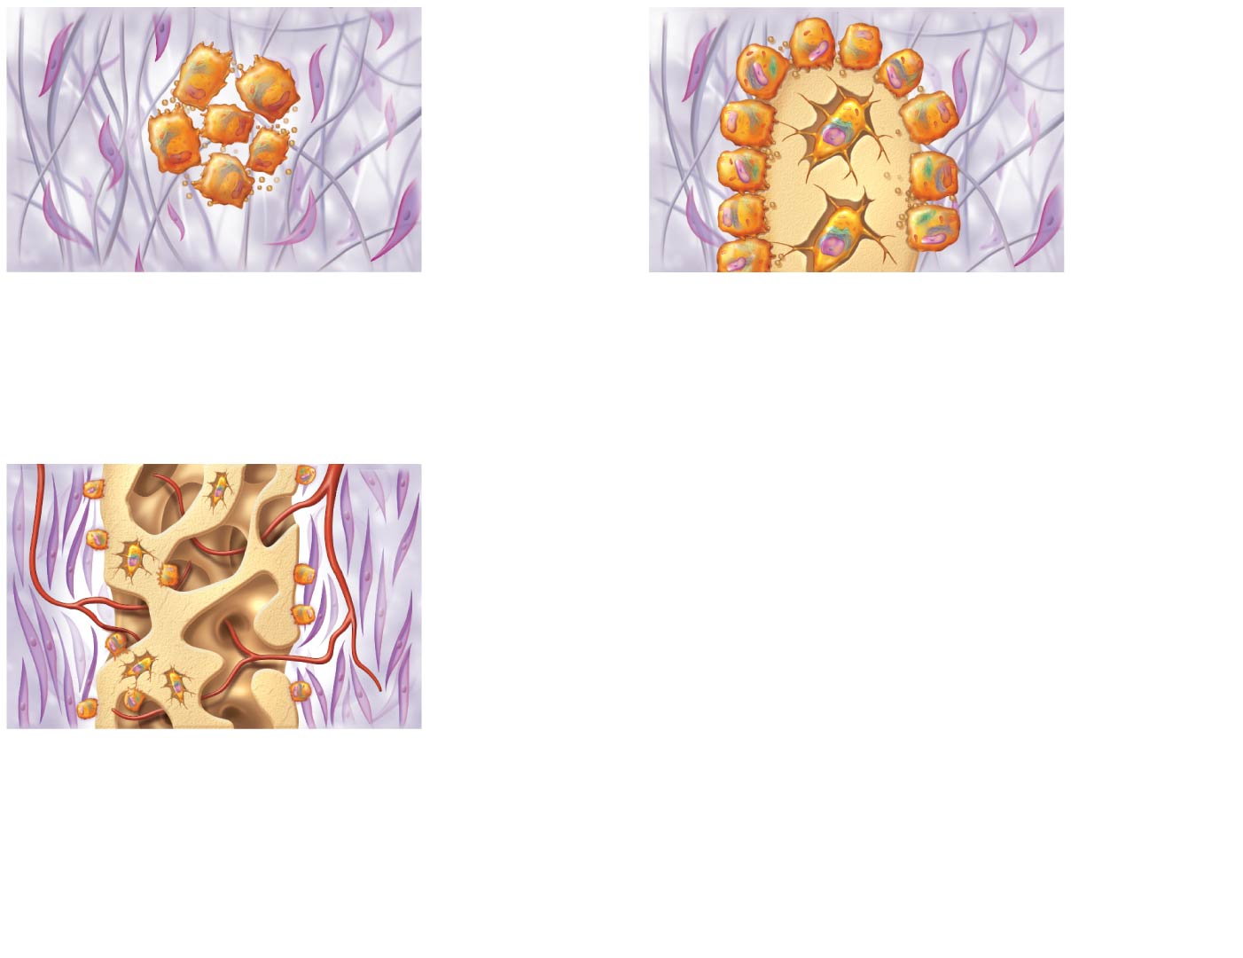
Figure 6.9 Intramembranous ossification.
Slide 4
Mesenchymal
cell
Osteoblast
Collagen
fiber
Osteoid
Ossification
center
Osteocyte
Newly calcified
bone matrix
Osteoid
Osteoblast
1
2
Ossification centers appear in the fibrous connective tissue membrane.
Osteoid is secreted within the fibrous membrane and calcifies.
• Selected centrally located mesenchymal cells cluster and differentiate into osteoblasts, forming an ossification center that produces the first trabeculae of spongy bone.
• Osteoblasts continue to secrete osteoid, which calcifies in a few days.
• Trapped osteoblasts become osteocytes.
Mesenchyme
condensing
to form the
periosteum
Trabeculae of
woven bone
Blood vessel
3
Woven bone and periosteum form.
• Accumulating osteoid is laid down between embryonic blood vessels in a manner that results in a network (instead of concentric lamellae) of trabeculae called woven bone.
• Vascularized mesenchyme condenses on the external face of the woven bone and becomes the periosteum.

Slide 17
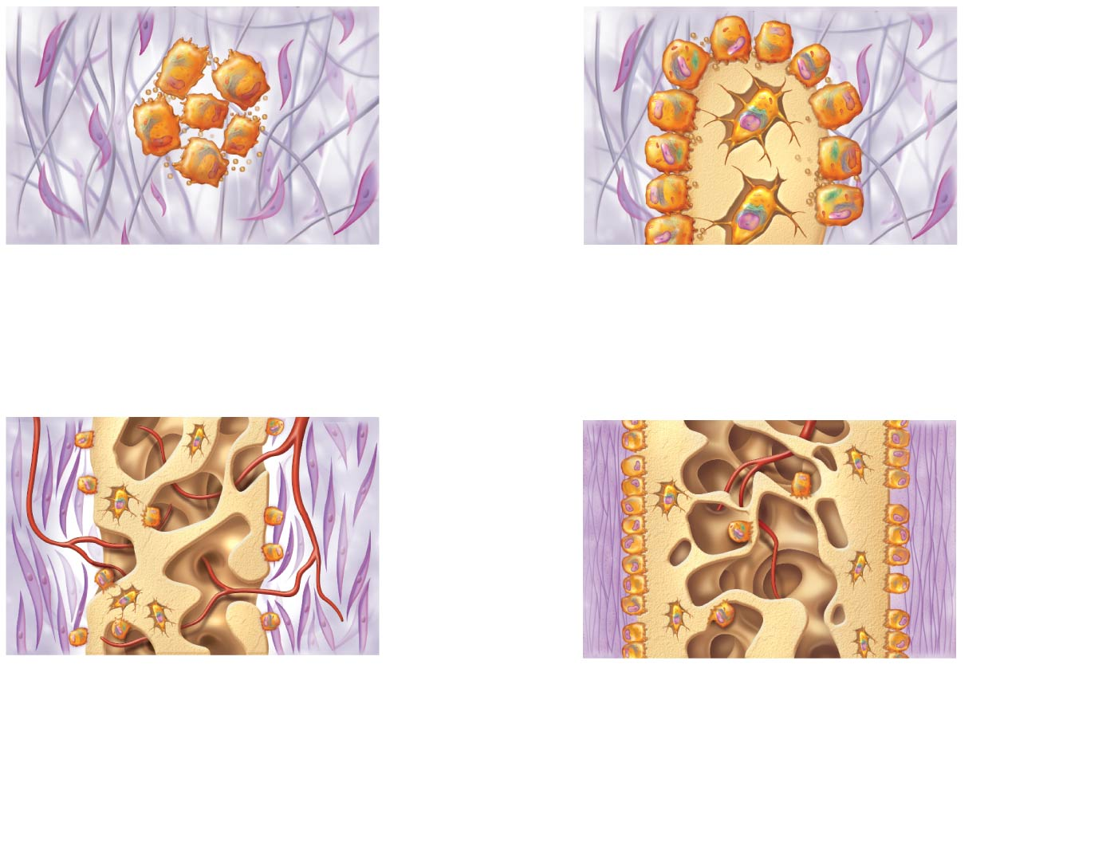
Figure 6.9 Intramembranous ossification.
Slide 5
Mesenchymal
cell
Osteoblast
Collagen
fiber
Osteoid
Ossification
center
Osteocyte
Newly calcified
bone matrix
Osteoid
Osteoblast
1
2
Ossification centers appear in the fibrous connective tissue membrane.
Osteoid is secreted within the fibrous membrane and calcifies.
• Selected centrally located mesenchymal cells cluster and differentiate into osteoblasts, forming an ossification center that produces the first trabeculae of spongy bone.
• Osteoblasts continue to secrete osteoid, which calcifies in a few days.
• Trapped osteoblasts become osteocytes.
Mesenchyme
condensing
to form the
periosteum
Fibrous
periosteum
Osteoblast
Trabeculae of
woven bone
Plate of
compact bone
Blood vessel
Diploë (spongy
bone) cavities
contain red
marrow
3
4
Woven bone and periosteum form.
Lamellar bone replaces woven bone, just deep to the periosteum. Red marrow appears.
• Accumulating osteoid is laid down between embryonic blood vessels in a manner that results in a network (instead of concentric lamellae) of trabeculae called woven bone.
• Vascularized mesenchyme condenses on the external face of the woven bone and becomes the periosteum.
• Trabeculae just deep to the periosteum thicken. Mature
lamellar bone replaces them, forming compact bone plates.
• Spongy bone (diploë), consisting of distinct trabeculae, persists internally and its vascular tissue becomes red marrow.

Slide 18
Postnatal Bone Growth
Long bones grow lengthwise by interstitial (longitudinal) growth of epiphyseal plate
Bones increase thickness through appositional growth
Bones stop growing during adolescence
Some facial bones continue to grow slowly through life

Slide 19
Growth in Length of Long Bones
Interstitial growth requires presence of epiphyseal cartilage in the epiphyseal plate
Epiphyseal plate maintains constant thickness
Rate of cartilage growth on one side balanced by bone replacement on other
Epiphyseal plate consists of five zones:
Resting (quiescent) zone
Proliferation (growth) zone
Hypertrophic zone
Calcification zone
Ossification (osteogenic) zone

Slide 20
Growth in Length of Long Bones (cont.)
Resting (quiescent) zone
Area of cartilage on epiphyseal side of epiphyseal plate that is relatively inactive
Proliferation (growth) zone
Area of cartilage on diaphysis side of epiphyseal plate that is rapidly dividing
New cells formed move upward, pushing epiphysis away from diaphysis, causing lengthening

Slide 21
Growth in Length of Long Bones (cont.)
Hypertrophic zone
Area with older chondrocytes closer to diaphysis
Cartilage lacunae enlarge and erode, forming interconnecting spaces
Calcification zone
Surrounding cartilage matrix calcifies; chondrocytes die and deteriorate

Slide 22
Growth in Length of Long Bones (cont.)
Ossification zone
Chondrocyte deterioration leaves long spicules of calcified cartilage at epiphysis-diaphysis junction
Spicules are then eroded by osteoclasts and are covered with new bone by osteoblasts
Ultimately replaced with spongy bone
Medullary cavity enlarges as spicules are eroded

Slide 23
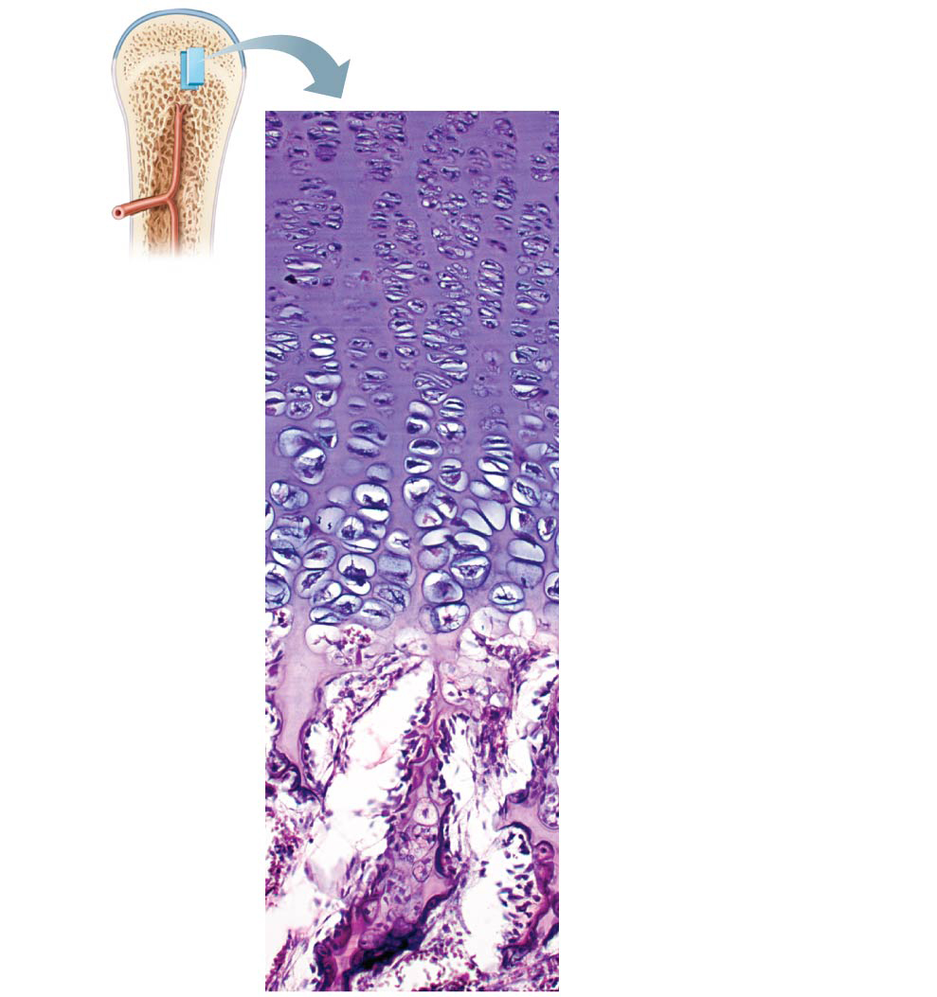
Figure 6.10 Growth in length of a long bone occurs at the epiphyseal plate.
Resting zone
1
Proliferation zone
Cartilage cells undergo
mitosis.
2
Hypertrophic zone
Older cartilage cells
enlarge.
3
Calcification zone
Calcified
cartilage spicule
Matrix calcifies; cartilage
cells die; matrix begins
deteriorating; blood
vessels invade cavity.
Osteoblast
depositing
bone matrix
4
Ossification zone
Osseous tissue
(bone) covering
cartilage spicules
New bone forms.

Slide 24
Growth in Length of Long Bones (cont.)
Near end of adolescence, chondroblasts divide less often
Epiphyseal plate thins, then is replaced by bone
Epiphyseal plate closure occurs when epiphysis and diaphysis fuse
Bone lengthening ceases
Females: occurs around 18 years of age
Males: occurs around 21 years of age

Slide 25
Growth in Width (Thickness)
Growing bones widen as they lengthen through appositional growth
Can occur throughout life
Bones thicken in response to increased stress from muscle activity or added weight
Osteoblasts beneath periosteum secrete bone matrix on external bone
Osteoclasts remove bone on endosteal surface
Usually more building up than breaking down which leads to thicker, stronger bone that is not too heavy

Slide 26
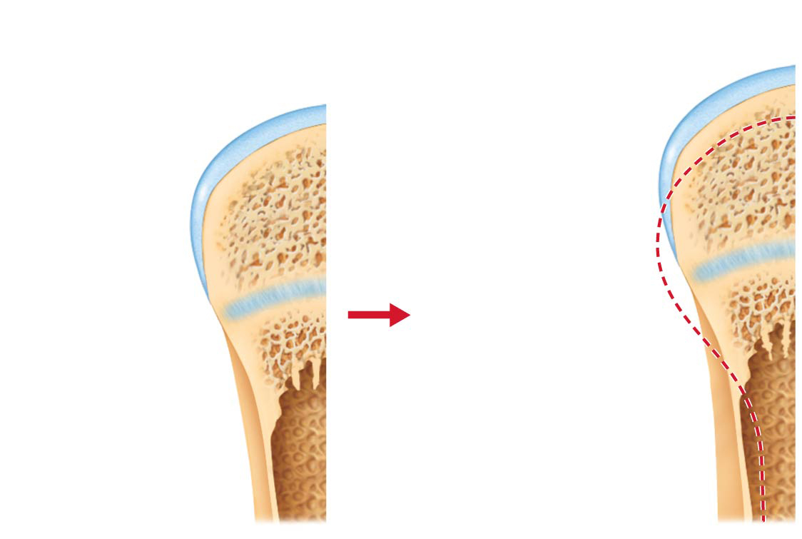
Figure 6.11 Long bone growth and remodeling during youth.
Bone growth
Bone remodeling
Articular cartilage
Cartilage
grows here.
Bone
replaces
cartilage
here.
Epiphyseal plate
Bone that was
here has been
resorbed.
Cartilage
grows here.
Appositional
growth adds
bone here.
Bone replaces
cartilage here.
Bone that was
here has been
resorbed.

Slide 27
Hormonal Regulation of Bone Growth
Growth hormone: most important hormone in stimulating epiphyseal plate activity in infancy and childhood
Thyroid hormone: modulates activity of growth hormone, ensuring proper proportions
Testosterone (males) and estrogens (females) at puberty: promote adolescent growth spurts
End growth by inducing epiphyseal plate closure
Excesses or deficits of any hormones cause abnormal skeletal growth

Slide 28
6.6 Bone Remodeling
About 5–7% of bone mass is recycled each week
Spongy bone replaced ~ every 3-4 years
Compact bone replaced ~ every 10 years
Bone remodeling consists of both bone deposit and bone resorption
Occurs at surfaces of both periosteum and endosteum
Remodeling units: packets of adjacent osteoblasts and osteoclasts coordinate remodeling process

Slide 29
Bone Deposit
New bone matrix is deposited by osteoblasts
Osteoid seam: band of unmineralized bone matrix that marks area of new matrix
Calcification front: abrupt transition zone between osteoid seam and older mineralized bone

Slide 30
Bone Deposit (cont.)
Trigger for deposit not confirmed but may include:
Mechanical signals
Increased concentrations of calcium and phosphate ions for hydroxyapatite formation
Matrix proteins that bind and concentrate calcium
Appropriate amount of enzyme alkaline phosphatase for mineralization

Slide 31
Bone Resorption
Resorption is function of osteoclasts
Dig depressions or grooves as they break down matrix
Secrete lysosomal enzymes and protons (H⁺) that digest matrix
Acidity converts calcium salts to soluble forms

Slide 32
Bone Resorption (cont.)
Osteoclasts also phagocytize demineralized matrix and dead osteocytes
Digested products are transcytosed across cell and released into interstitial fluid and then into blood
Once resorption is complete, osteoclasts undergo apoptosis
Osteoclast activation involves PTH (parathyroid hormone) and immune T cell proteins

Slide 33
Control of Remodeling
Remodeling occurs continuously but is regulated by genetic factors and two control loops
Hormonal controls
Negative feedback loop that controls blood Ca²⁺ levels
Calcium functions in many processes, such as nerve transmission, muscle contraction, blood coagulation, gland and nerve secretions, as well as cell division
99% of 1200–1400 gms of calcium are found in bone
Intestinal absorption of Ca²⁺ requires vitamin D
Response to mechanical stress

Slide 34
Control of Remodeling
Hormonal controls
Parathyroid hormone (PTH): produced by parathyroid glands in response to low blood calcium levels
Stimulates osteoclasts to resorb bone
Calcium is released into blood, raising levels
PTH secretion stops when homeostatic calcium levels are reached
Calcitonin: produced by parafollicular cells of thyroid gland in response to high levels of blood calcium levels
Effects are negligible, but at high pharmacological doses it can lower blood calcium levels temporarily

Slide 35
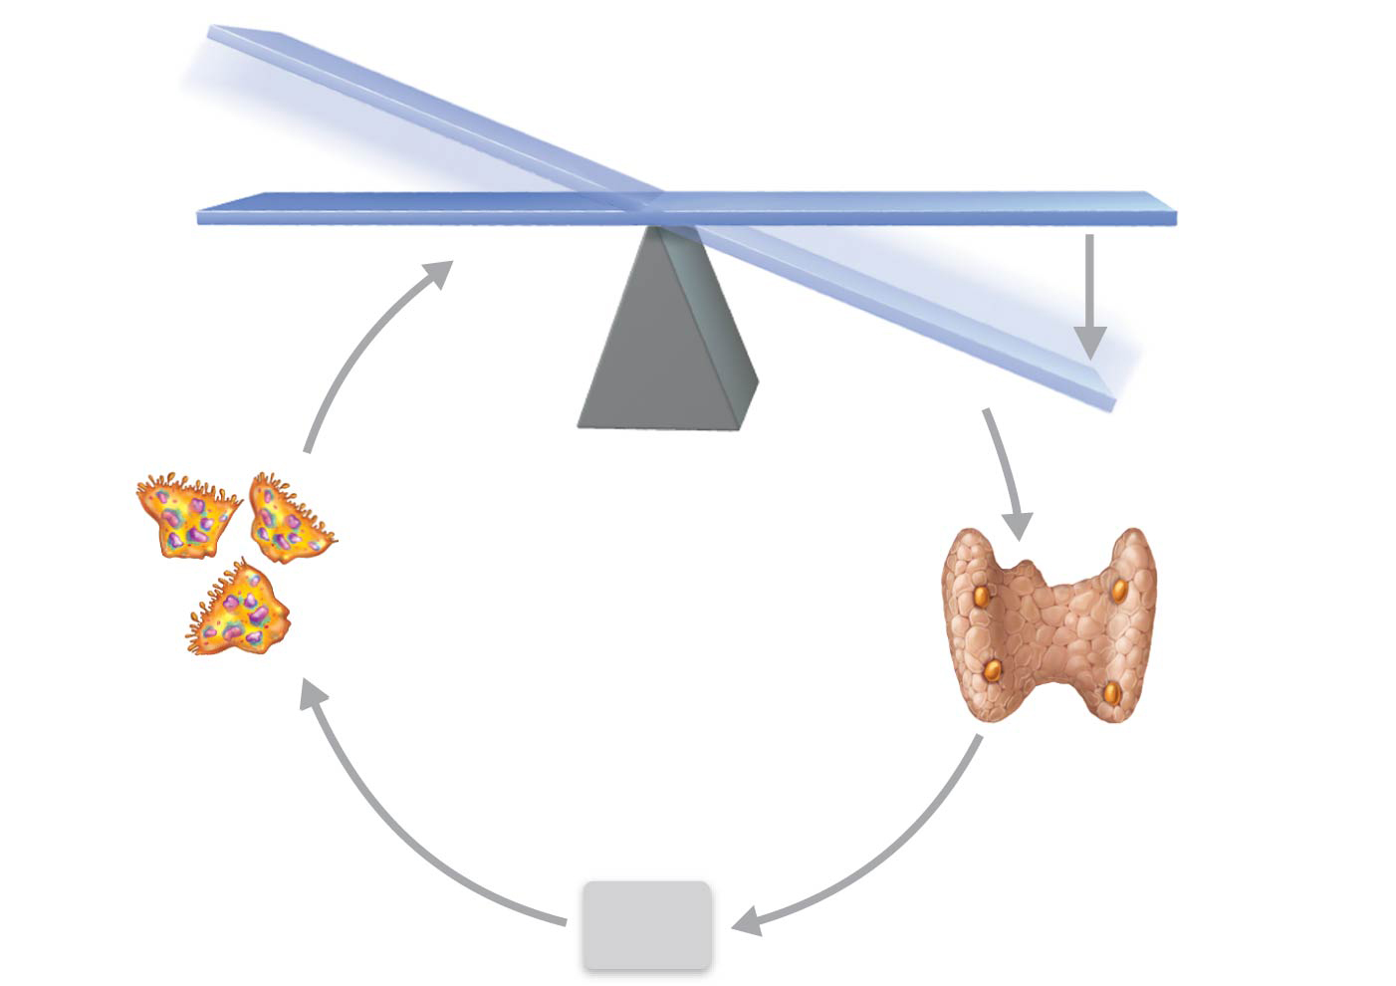
Figure 6.12 Parathyroid hormone (PTH) control of blood calcium levels.
IMBALANCE
Calcium homeostasis of blood: 9–11 mg/100 ml
BALANCE
BALANCE
Stimulus
Falling blood
Ca²⁺ levels
IMBALANCE
Thyroid
gland
Osteoclasts
degrade bone matrix and release
Ca²⁺ into blood.
Parathyroid
glands
Parathyroid
glands release parathyroid hormone (PTH).
PTH

Slide 36
Clinical – Homeostatic Imbalance 6.1
Even minute changes in blood calcium levels can cause severe neuromuscular problems
Hypocalcemia: low levels of calcium cause hyperexcitablility
Hypercalcemia: high levels of calcium cause nonresponsiveness
Sustained high blood calcium levels can lead to deposits of calcium salts in blood vessels or kidneys and formation of kidney stones

Slide 37
Control of Remodeling (cont.)
Hormonal controls (cont.)
Other hormones play a role in bone density and turnover
Leptin
Hormone released by adipose tissue
May play role in bone density regulation by inhibiting osteoblasts
Serotonin
Neurotransmitter regulates mood and sleep; also interferes with osteoblast activity
Most serotonin made in gut
Secreted into blood after a meal
May inhibit bone turnover after a meal, so bone calcium is locked in when new calcium is flooding into bloodstream

Slide 38
Control of Remodeling (cont.)
Response to mechanical stress
Bones reflect stresses they encounter
Bones are stressed when weight bears on them or muscles pull on them
Wolf’s law states that bones grow or remodel in response to demands placed on them
Stress is usually off center, so bones tend to bend
Bending compresses one side, stretches other side
Diaphysis is thickest where bending stresses are greatest
Bone can be hollow because compression and tension cancel each other out in center of bone

Slide 39
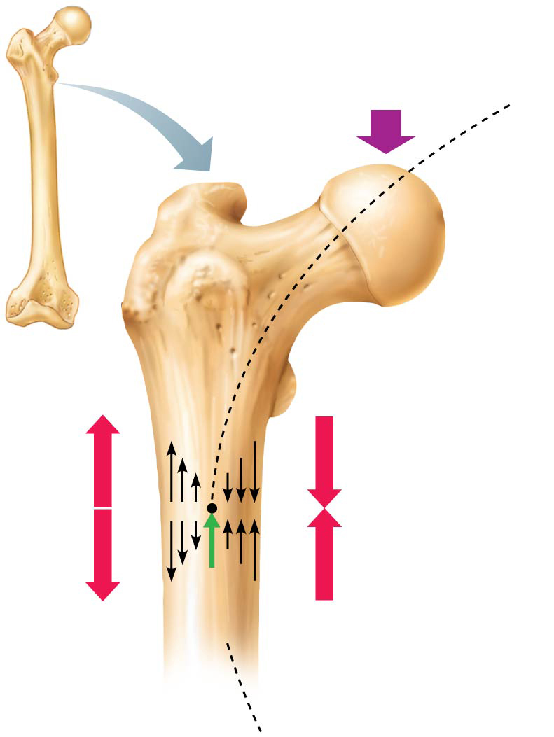
Figure 6.13 Bone anatomy and bending stress.
Load here
(body weight)
Head of
femur
Tension
here
Compression
here
Point
of no
stress

Slide 40
Control of Remodeling (cont.)
Wolf’s law also explains:
Handedness (right- or left-handed) results in thicker and stronger bone of the corresponding upper limb
Curved bones are thickest where most likely to buckle
Trabeculae form trusses along lines of stress
Large, bony projections occur where heavy, active muscles attach
Weight lifters have enormous thickenings at muscle attachment sites of most used muscles
Bones of fetus and bedridden people are featureless because of lack of stress on bones

Slide 41
Control of Remodeling (cont.)
Mechanical stress causes remodeling by producing electrical signals when bone is deformed
Compressed and stretched regions are oppositely charged
Compression/tension changes fluid flows within canaliculi, which may also stimulate remodeling
Hormonal controls determine whether and when remodeling occurs in response to changing blood calcium levels, but mechanical stress determines where it occurs

Slide 42
6.7 Bone Repair
Fractures are breaks
During youth, most fractures result from trauma
In old age, most result from weakness of bone due to bone thinning

Slide 43
Fracture Classification
Three “either/or” fracture classifications
Position of bone ends after fracture
Nondisplaced: ends retain normal position
Displaced: ends are out of normal alignment
Completeness of break
Complete: broken all the way through
Incomplete: not broken all the way through
Whether skin is penetrated
Open (compound): skin is penetrated
Closed (simple): skin is not penetrated
Can also be described by location of fracture, external appearance, and nature of break

Slide 44
Table 6.2-1 Common Types of Fractures

Slide 45
Table 6.2-2 Common Types of Fractures (continued)

Slide 46
Table 6.2-3 Common Types of Fractures (continued)

Slide 47
Fracture Treatment and Repair
Treatment involves reduction, the realignment of broken bone ends
Closed reduction: physician manipulates to correct position
Open reduction: surgical pins or wires secure ends
Immobilization of bone by cast or traction is needed for healing
Time needed for repair depends on break severity, bone broken, and age of patient

Slide 48
Fracture Treatment and Repair (cont.)
Repair involves four major stages:
Hematoma formation
Fibrocartilaginous callus formation
Bony callus formation
Bone remodeling

Slide 49
Fracture Treatment and Repair (cont.)
Hematoma formation
Torn blood vessels hemorrhage, forming mass of clotted blood called a hematoma
Site is swollen, painful, and inflamed

Slide 50
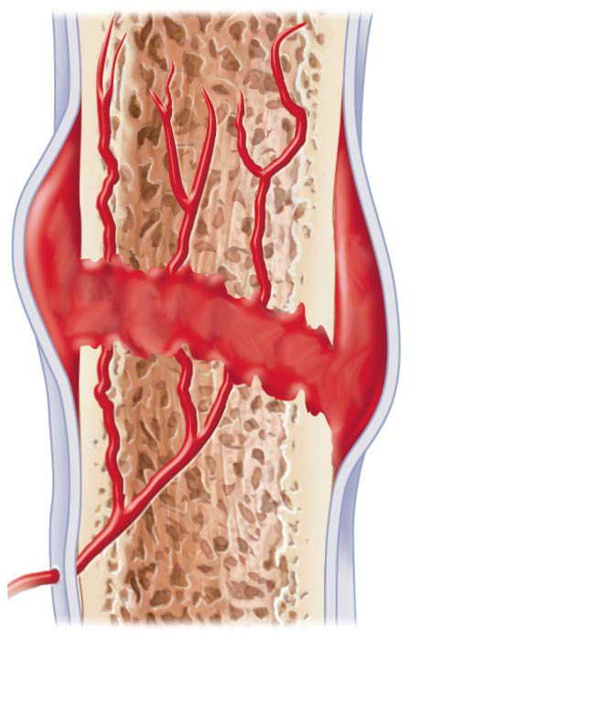
Figure 6.14-1 Stages in the healing of a bone fracture.
Hematoma
1
A hematoma forms.

Slide 51
Fracture Treatment and Repair (cont.)
Fibrocartilaginous callus formation
Capillaries grow into hematoma
Phagocytic cells clear debris
Fibroblasts secrete collagen fibers to span break and connect broken ends
Fibroblasts, cartilage, and osteogenic cells begin reconstruction of bone
Create cartilage matrix of repair tissue
Osteoblasts form spongy bone within matrix
This mass of repair tissue is called fibrocartilaginous callus

Slide 52
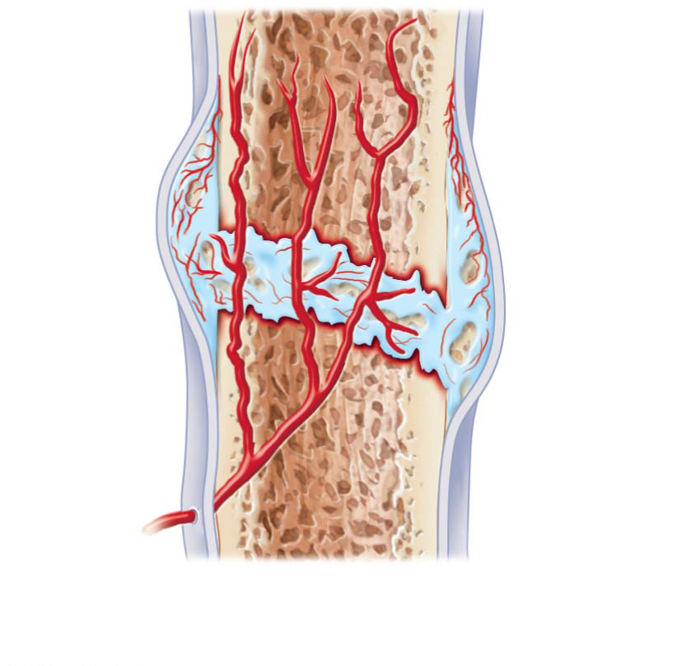
Figure 6.14-2 Stages in the healing of a bone fracture.
External
callus
Internal
callus
(fibrous
tissue and
cartilage)
New
blood
vessels
Spongy
bone
trabecula
2
Fibrocartilaginous callus forms.

Slide 53
Fracture Treatment and Repair (cont.)
Bony callus formation
Within one week, new trabeculae appear in fibrocartilaginous callus
Callus is converted to bony (hard) callus of spongy bone
Bony callus formation continues for about 2 months until firm union forms

Slide 54
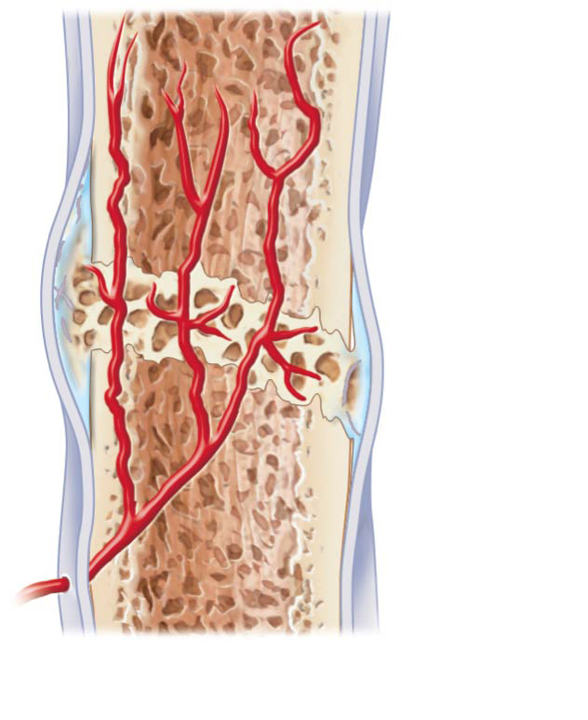
Figure 6.14-3 Stages in the healing of a bone fracture.
Bony
callus of
spongy
bone
3
Bony callus forms.

Slide 55
Fracture Treatment and Repair (cont.)
Bone remodeling
Begins during bony callus formation and continues for several months
Excess material on diaphysis exterior and within medullary cavity is removed
Compact bone is laid down to reconstruct shaft walls
Final structure resembles original structure
Responds to same mechanical stressors

Slide 56
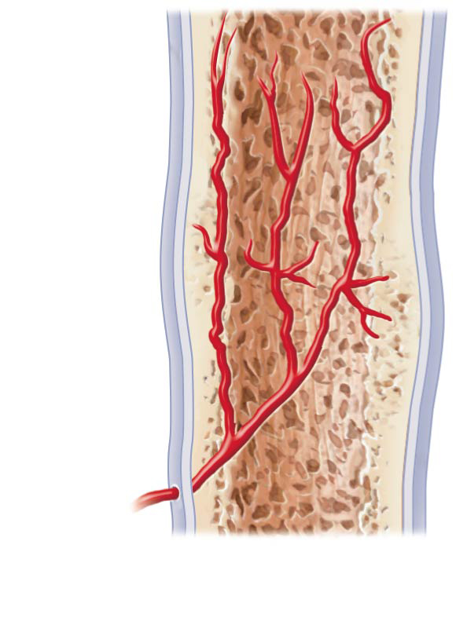
Figure 6.14-4 Stages in the healing of a bone fracture.
Healed
fracture
4
Bone remodeling occurs.

Slide 57
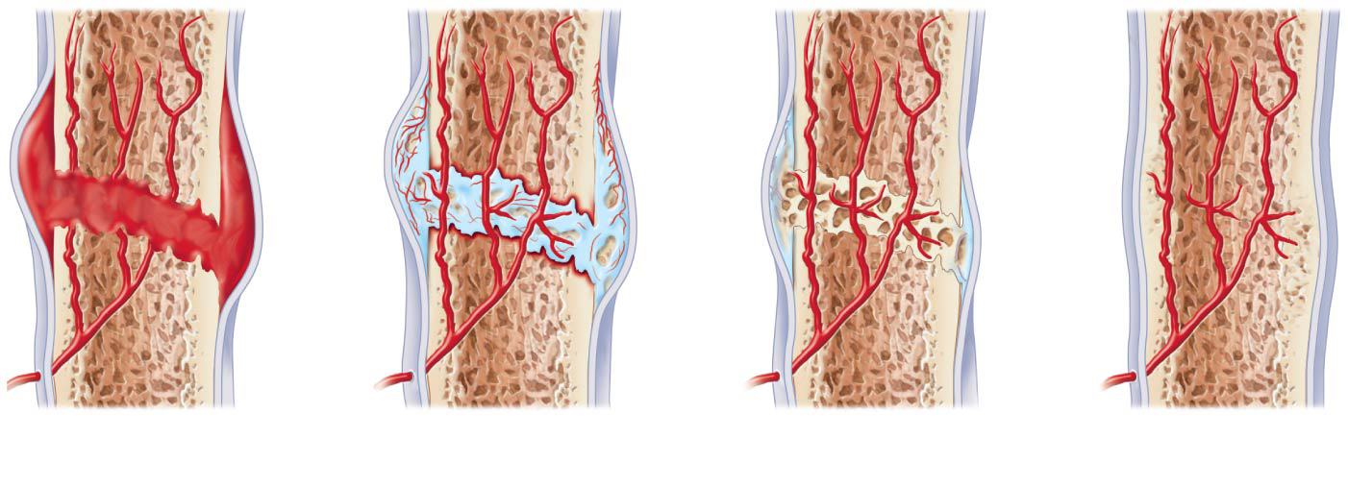
Figure 6.14 Stages in the healing of a bone fracture.
Hematoma
External
callus
Bony
callus of
spongy
bone
Internal
callus
(fibrous
tissue and
cartilage)
New
blood
vessels
Healed
fracture
Spongy
bone
trabecula
1
A hematoma forms.
2
3
Bony callus forms.
4
Fibrocartilaginous callus forms.
Bone remodeling occurs.

Slide 58
6.8 Bone Disorders
Imbalances between bone deposit and bone resorption underlie nearly every disease that affects the human skeleton.
Three major bone diseases:
Osteomalacia and rickets
Osteoporosis
Paget’s disease

Slide 59
Osteomalacia and Rickets
Osteomalacia
Bones are poorly mineralized
Osteoid is produced, but calcium salts not adequately deposited
Results in soft, weak bones
Pain upon bearing weight
Rickets (osteomalacia of children)
Results in bowed legs and other bone deformities because bones ends are enlarged and abnormally long
Cause: vitamin D deficiency or insufficient dietary calcium

Slide 60
Osteoporosis
Osteoporosis is a group of diseases in which bone resorption exceeds deposit
Matrix remains normal, but bone mass declines
Spongy bone of spine and neck of femur most susceptible
Vertebral and hip fractures common

Slide 61
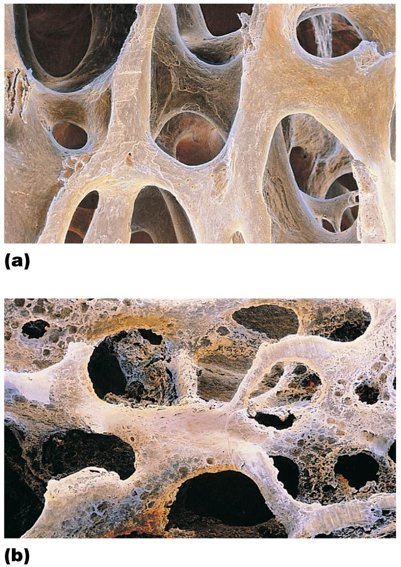
Figure 6.15 The contrasting architecture of normal versus osteoporotic bone.
Normal bone
Osteoporotic bone

Slide 62
Osteoporosis (cont.)
Risk factors for osteoporosis
Most often aged, postmenopausal women
Affects 30% of women aged 60–70 years and 70% by age 80
30% of Caucasian women will fracture bone because of osteoporosis
Estrogen plays a role in bone density, so when levels drop at menopause, women run higher risk
Men are less prone due to protection by the effects of testosterone

Slide 63
Osteoporosis (cont.)
Additional risk factors for osteoporosis:
Petite body form
Insufficient exercise to stress bones
Diet poor in calcium and protein
Smoking
Hormone-related conditions
Hyperthyroidism
Low blood levels of thyroid-stimulating hormone
Diabetes mellitus
Immobility
Males with prostate cancer taking androgen-suppressing drugs

Slide 64
Osteoporosis (cont.)
Treating osteoporosis
Traditional treatments
Calcium
Vitamin D supplements
Weight-bearing exercise
Hormone replacement therapy
Slows bone loss but does not reverse it
Controversial because of increased risk of heart attack, stroke, and breast cancer

Slide 65
Osteoporosis (cont.)
Other drugs for osteoporosis:
Bisphosphonates: decrease osteoclast activity and number
Partially reverse osteoporosis in spine
Selective estrogen receptor modulators: mimic estrogen without targeting breast and uterus
Denosumab
Monoclonal antibody shown to reduce fractures in men with prostate cancer
Improves bone density in elderly

Slide 66
Osteoporosis (cont.)
Preventing osteoporosis
Plenty of calcium in diet in early adulthood
Reduce consumption of carbonated beverages and alcohol
Leach minerals from bone, so decrease bone density
Plenty of weight-bearing exercise
Increases bone mass above normal for buffer against age-related bone loss

Slide 67
Paget’s Disease
Excessive and haphazard bone deposit and resorption cause bone to be made fast and poorly
Called Pagetic bone
Very high ratio of spongy to compact bone and reduced mineralization
Usually occurs in spine, pelvis, femur, and skull
Rarely occurs before age 40
Cause unknown: possibly viral
Treatment includes calcitonin and bisphosphonates

Slide 68
Developmental Aspects of Bone
Embryonic skeleton ossifies predictably, so fetal age is easily determined from X rays or sonograms
Most long bones begin ossifying by 8 weeks, with primary ossification centers developed by week 12

Slide 69
Developmental Aspects of Bone
Birth to Young Adulthood
At birth, most long bones ossified, except at epiphyses
Epiphyseal plates persist through childhood and adolescence
At ~ age 25, all bones are completely ossified, and skeletal growth ceases

Slide 70
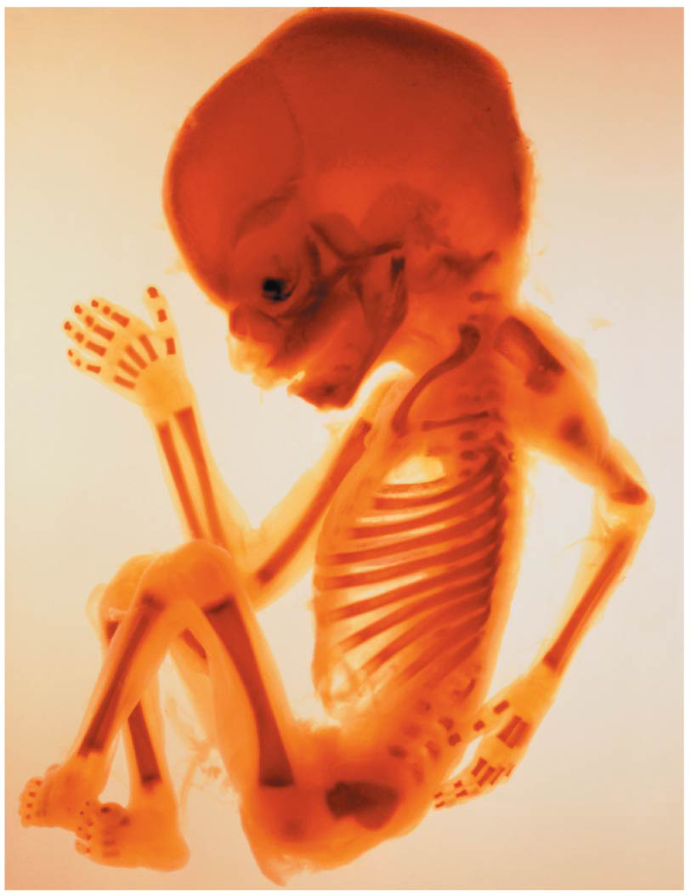
Figure 6.17 Fetal primary ossification centers at 12 weeks.
Parietal
bone
Frontal
bone
of skull
Occipital
bone
Mandible
Clavicle
Scapula
Radius
Ulna
Humerus
Femur
Tibia
Ribs
Vertebra
Ilium

Slide 71
Age-Related Changes in Bone
In children and adolescents, bone formation exceeds resorption
Males tend to have greater mass than females
In young adults, both are balanced
In adults, bone resorption exceeds formation

Slide 72
Age-Related Changes in Bone (cont.)
Bone density changes over lifetime are largely determined by genetics
Gene for vitamin D’s cellular docking determines mass early in life and osteoporosis risk at old age
Bone mass, mineralization, and healing ability decrease with age beginning in fourth decade
Except bones of skull
Bone loss is greater in whites and in females

